Slide 1
Computer Architecture and Organization Machine Instructions
Abdullah Al Shiam Lecturer, Dept. of CSE, Sheikh Hasina University, Netrokona email: shiam.cse@shu.edu.bd

Slide 2
Machine instruction
Instruction Codes
A program is a set of instructions that specify the operations, operand, and the sequence
An instruction is a binary code that specifies a sequence of micro-operations
Codes and data are stored in memory
The computer reads each instruction from memory and places it in a control register.
The control then interprets the binary code and proceeds to execute it

Slide 3
Machine instruction
Instruction Code:
A group of bits that instruct the computer to perform a specific operation
It is usually divided into parts
Operation Code:
The most basic part of an instruction code
A group of bits that define such operations as add, subtract, multiply, shift, and complement

Slide 4
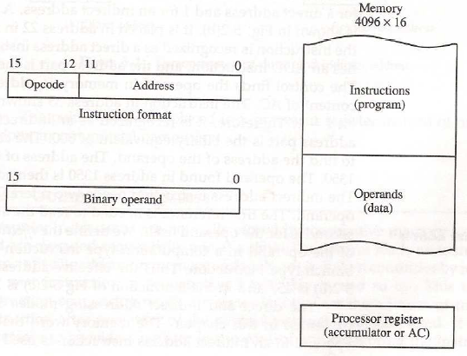
Machine instruction

Slide 5
Machine instruction
Stored Program Organization
Instruction code format with two parts: Op. Code + Address
Op. Code: specify 16 possible operations (4 bit)
Address: specify the address of an operand (12 bit)
Unused part is used for other purpose
Memory: 12 bit = 4096 word (Instruction and Data are stored)
Store each instruction code (program) and operand (data) in 16-bit memory word

Slide 6
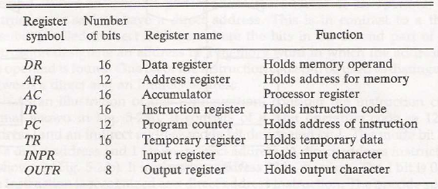
Machine instructions
List of registers in basic computer

Slide 7
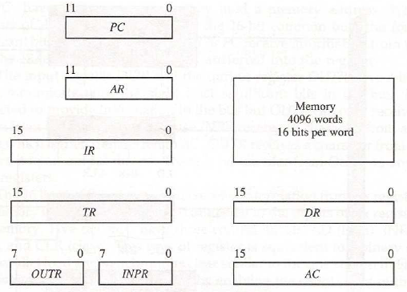
Machine instructions
Registers and memory of basic computer:

Slide 8
Machine instruction
Functions of basic registers:
Data Register (DR): hold the operand (data) read from memory
Accumulator Register (AC): general purpose processing register
Instruction Register (IR): hold the instruction read from memory
Temporary Register (TR): hold a temporary data during processing
Address Register (AR): hold a memory address, 12 bit width
Input Register (INPR): receive an 8-bit character from an input device
Output Register (OUTR): hold an 8-bit character for an output device

Slide 9
Machine instructions
Program Counter (PC):
Hold the address of the next instruction to be read from memory after the current instruction is executed.
A branch instruction calls for a transfer to a non-consecutive instruction in the program.
The address part of a branch instruction is transferred to PC to become the address of the next instruction.
To read instruction, memory read cycle is initiated, and PC is incremented by one.

Slide 10
Machine instructions
Timing and Control:
A master clock generator controls the timing for all registers in the basic computer.
The clock pulses are applied to all F/Fs and registers in system.
The clock pulses do not change the state of a register unless the register is enabled by a control signal.
The control signals are generated in the control unit.
It provides controls for the mux in the common bus, registers etc.

Slide 11
Machine instructions
Hardwired Control
The control logic is implemented with gates, F/Fs, decoders, and other digital circuits.
For any change, need to change hardware.
Fast operation.
Microprogrammed Control
The control information is stored in a programmed control memory.
Any required change can be done by updating the microprogram in control memory,
Slow operation.

Slide 12
Machine instructions
Instruction Cycle:
1) Instruction Fetch from Memory – read instruction from memory through the data bus
2) Instruction Decode – the control unit determine the type of instruction that was just read from memory
3) Fetch the operand – accumulate the operands to make operation; read from memory in case of indirect addressing mode (operands are residing data in memory)
4) Instruction Execution – perform the operation based on decoded Opcode.
5) Go to step 1): Next Instruction [PC+1]

Slide 13
Machine instructions
Instruction Formats:
1) Operation Code Field: the operation code field of an instruction is a group of bits that specifies various operations such as add, subtract, complement and shift.
2) Address Field: specifies the memory address or a processor register.
3) Mode Field: defines a variety of alternatives for choosing the operands from the given address.

Slide 14
Machine instructions
The address field depends on the arrangement of registers
Most computers fall into one of three types of CPU organizations:
1) Single Accumulator Organization: ADD X
2) General Register Organization: ADD R1, R2, R3
3) Stack Organization: PUSH X

Slide 15
Machine instructions
Instructions with different address fields
1) Three-Address Instruction
ADD R1, A, B R1←M[A]+M[B]
MUL X, R1, R2 M[X] ←R1*R2
Each address fields specify either a processor register or a memory operand
Short program
Require too many bit to specify 3 address
2) Two-Address Instruction
MOV R1, A R1 ←M[A]
MUL R1, R2 R1 ←R1*R2
MOV X, R1 M[X] ←R1
The most common in commercial computers
Each address field specifies either a processor register or a memory operand

Slide 16
Machine instructions
Instructions with different address fields
3) One-Address instruction
LOAD A AC ←M[A]
ADD B AC ←AC+M[B]
All operations are done between the AC register and memory operand
3) Zero-Address instruction
PUSH A TOS ←A (TOS=top of stack)
PUSH B TOS ←B
ADD TOS ←A+B
Stack-organized computer does not use an address field for the instructions ADD, and MUL
PUSH, and POP instructions need an address field to specify the operand
Zero-Address: absence of address ( ADD, MUL )

Slide 17
Machine instructions
Addressing Mode
It specifies a rule for interpreting the address field operands
The term addressing modes refers to the way in which the operand of an instruction is specified.
Implied Mode: Operands are specified implicitly in definition of the instruction.
Examples
COM: Complement Accumulator
Operand in AC is implied in the definition of the instruction
PUSH: Stack push
Operand is implied to be on top of the stack

Slide 18
Machine instructions
Addressing Mode
Immediate Mode
Operand field contains the actual operand. It is useful for initializing registers to a constant value.
Example: LD #NBR -> #NBR= constant value
Register Mode
Operands are in registers. Register is selected from a register field in the instruction
Example: LD R1 AC ←R1

Slide 19
Machine instructions
Addressing Mode
Register Indirect Mode
Selected register contains the address of the operand rather than the operand itself.
Example: LD (R1) AC ←M[R1]
Auto-increment or Auto-decrement Mode
Similar to the register indirect mode except that
the register is incremented after its value is used to access memory
the register is decrement before its value is used to access memory
Example (Auto-increment): LD (R1)+ AC ←M[R1], R1 ←R1+1

Slide 20
Machine instructions
Addressing Mode
Direct Addressing Mode
Effective address is equal to the address field of the instruction (Operand)
Example: LD ADR AC ←M[ADR]
Indirect Addressing Mode
Address field of instruction gives the address where the effective address is stored in memory
Example: LD @ADR AC ←M[M[ADR]]

Slide 21
Machine instructions
Addressing Mode
Relative Addressing Mode
PC is added to the address part of the instruction to obtain the effective address
Example: LD $ADR AC ←M[PC+ADR]
Indexed Addressing Mode
XR (Index register) is added to the address part of the instruction to obtain the effective address
Example: LD ADR(XR) AC ←M[ADR+XR]

Slide 22
Machine instructions
Addressing Mode
Base Register Addressing Mode
the content of a base register is added to the address part of the instruction to obtain the effective address
base register (BR) : LD ADR(BR) AC ←M[BR+ADR]
base register hold a base address

Slide 23
Machine instructions
Input-Output Configuration
The communication with I/O is performed through two registers: Input Register (INPR), Output Register (OUTR)
The registers communicate with I/O serially and with the AC in parallel
Each quantity of information has eight bits of an alphanumeric code
The serial data from the keyboard is shifted into the input register INPR.
The serial information for the printer is stored in the output register OUPR.

Slide 24
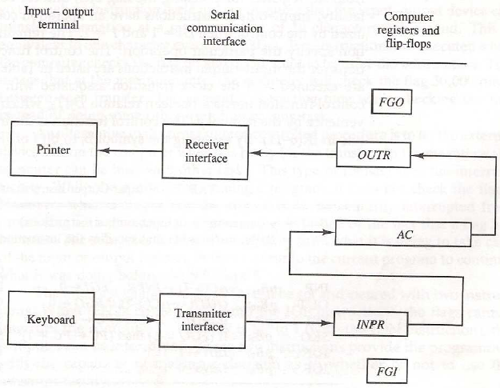
Machine instructions

Slide 25
Machine instructions
I/O Instruction
INP and OUT are the common instructions for I/O processing.
Input/Output (I/O) instructions are used to input data from peripherals, output data to peripherals, or read/write input/output controls
INP – AC(0-7) ←INPR, FGI ←0; Input character, FGI is the input flag
OUT – OUTR ←AC(0-7), FGO ←0; Output character, FGO is the output flag

Slide 26
Machine instructions
Program control with Status bits
The status of 4-bits status register is used to control the program.
The bits are set or cleared as a result of an operation performed in the ALU.
Bit C (carry) : set to 1 if the end carry C8 is 1
Bit S (sign) : set to 1 if F7 of the output (F7-F0) is 1
Bit Z (zero) : set to 1 if the output of the ALU contains all 0’s
Bit V (overflow) : set to 1 if the XOR of the last two carries (C8 and C7) is equal to 1

Slide 27
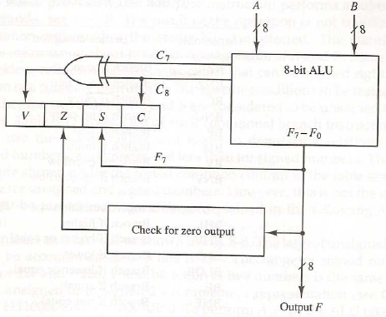
Machine instructions
Program control with Status bits

Slide 28
Machine instructions
Data transfer and manipulation:
Most computer instructions can be classified into three categories:
1) Data transfer
2) Data manipulation
3) Program control instructions

Slide 29
Machine instructions
Data Transfer Instruction: Transfer of data from one location to another without changing content.
Typical Data Transfer Instruction:
Load→ transfer from memory to a processor register, usually an AC (memory read)
Store→ transfer from a processor register into memory (memory write)
Move→ transfer from one register to another register
Exchange→ swap information between two registers or a register and a memory word
Input/Output→ transfer data among processor registers and input/output device
Push/Pop→ transfer data between processor registers and a memory stack

Slide 30
Machine instructions
Data manipulation instruction: Perform operations on data and provide the computational capabilities for the computer.
Arithmetic Instructions: Performs basic arithmetic operations on the specified operands. Examples: INC, DEC, ADD, SUB, MUL, DIV
Logical and Bit Manipulation Instructions: Logical instructions perform binary operations on the strings of bits stored in registers. Example: CLR, OR, AND, COM
Shift Instructions: Shits are operations in which the bits of a word are moved to the left or right. Example: SHR, ROR, SHL

Slide 31
Machine instructions
Program control instructions:
Program control instruction is used to make the flow of program controlled to be altered.
It specifies conditions for altering the content of the program counter breaking the sequence of instruction execution.
Example: BR, JMP, CALL.

Slide 32
Machine instructions
Interrupt Handling:
Interrupt is an event that changes the sequence in which the processor executes instructions.
Transfer program control from a currently running program to another service program
Control returns to the original program after the service program is executed

Slide 33
Machine instructions
Interrupt Handling:
Steps of Interrupt Service
An interrupt is initiated by an internal or external signal
The address of the interrupt service routine (ISR) is determined by the hardware
An interrupt procedure stores all the information necessary to define the state of the CPU
Execute the ISR
Restore the original state (control comes to the original program)

Slide 34
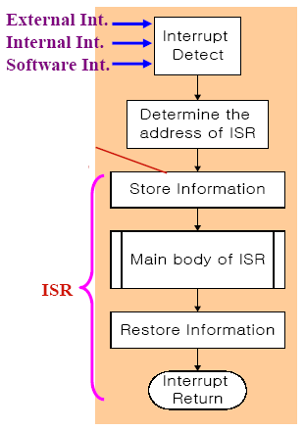
Machine instructions
Interrupt Handling:

Slide 35
Machine instructions
Types of Interrupts:
External Interrupts - come from I/O device, from a timing device, from a circuit monitoring the power supply, or from any other external source
Internal Interrupts - caused by register overflow, attempt to divide by zero, an invalid operation code, stack overflow, and protection violation
Software Interrupts - initiated by executing an instruction used by the programmer to initiate an interrupt procedure at any desired point in the program

