Slide 1
Computer Architecture and Organization Processing Unit
Abdullah Al Shiam Lecturer, Dept. of CSE, Sheikh Hasina University, Netrokona email: shiam.cse@shu.edu.bd

Slide 2
Processing Unit
The central processing unit (CPU) of a computer is the main unit that dictates the rest of the computer organization
Register set: Stores intermediate data during the execution of instructions;
Arithmetic logic unit (ALU): Performs the required micro-operations for executing the instructions;
Control unit: supervises the transfer of information among the registers and instructs the ALU as to which operation to perform by generating control signals.

Slide 3
Processing Unit
Functions of CPU
Central Processing Unit = “brain of computer”
Executes programs by:
Fetching and decoding the next instruction from memory
Execute it
Consists of:
Control Unit
Arithmetic Logic Unit (ALU)
Registers (high-speed memory)
Program Counter (PC)
Instruction Register (IR)

Slide 4
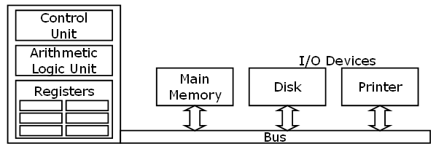
Processing Unit
Functions of CPU
BUS connection with CPU

Slide 5
Processing Unit
General register organization
CPU must have some working space (fast access and close to CPU)
This space is efficiently used to store intermediate values
The most convenient way to communicate registers is through common bus system

Slide 6
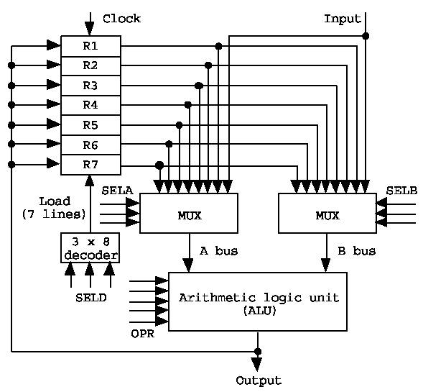
Processing Unit
Register organization

Slide 7
Processing Unit
Selection of operation
An operation is selected by the ALU operation selector (OPR).
The result of a micro-operation is directed to a destination register selected by a decoder (SELD).
Control word: The 14 binary selection inputs (3 bits for SELA, 3 for SELB, 3 for SELD, and 5 for OPR)

Slide 8

Processing Unit
Format of the control word:
Example: R1←R2+R3
1) MUX A selector (SELA): to place the content of R2 into BUS A
2) MUX B selector (SELB): to place the content of R3 into BUS B
3) ALU operation selector (OPR): to provide the arithmetic addition R2 + R3
4) Decoder selector (SELD): to transfer the content of the output bus into R1

Slide 9
Processing Unit
Pipelining
Decomposing a sequential process into suboperations.
Each subprocess is executed in a special dedicated segment concurrently
Pipelining is an implementation technique where multiple instructions are overlapped in execution. The computer pipeline is divided in stages. Each stage completes a part of an instruction in parallel.
Example:
Multiply and Add Operation: A_{i}*B_{i}+C_{i} ( for i = 1, 2, …, 7 )
3 Suboperation Segment
1): R1 ← Ai, R2 ← Bi; Input Ai and Bi
2): R3 ← R1*R2, R4 ← Ci; Multiply and input Ci
3): R5 ← R3+R4; Add Ci

Slide 10
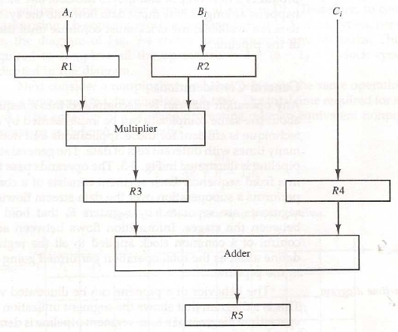
Processing Unit
Pipelining

Slide 11
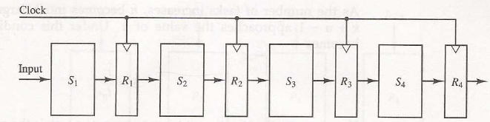
Processing Unit
General consideration of pipelining
Operation is decomposed into a number of suboperations
The technique is efficient when the same task is repeated for different data sets
The general structure of four-segment pipelining is shown in following figure:

Slide 12
Processing Unit
General consideration of pipelining
Each operation pass through all of four segments
Section Si performs the suboperation and Ri holds the temporary results
Common clock is used to transfer the data from Ri

Slide 13
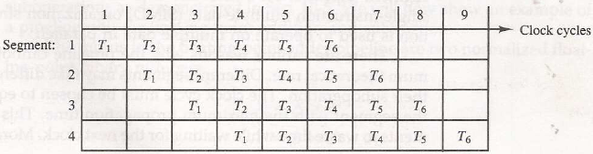
Processing Unit
Space-time representation
Pipeline can be represented as space-time diagram
Shows the segment utilization as a function of time
The space-time representation of a four-segment pipelining system:

Slide 14
Performance of a pipelined processor
Consider a ‘k’ segment pipeline with clock cycle time as ‘Tp’. Let there be ‘n’ tasks to be completed in the pipelined processor. Now, the first instruction is going to take ‘k’ cycles to come out of the pipeline but the other ‘n – 1’ instructions will take only ‘1’ cycle each, i.e, a total of ‘n – 1’ cycles. So, time taken to execute ‘n’ instructions in a pipelined processor:
In the same case, for a non-pipelined processor, the execution time of ‘n’ instructions will be:
ETpipeline = k + n – 1 cycles
= (k + n – 1) Tp
ETnon-pipeline = n * k * Tp

Slide 15
Performance of a pipelined processor
So, speedup (S) of the pipelined processor over the non-pipelined processor, when ‘n’ tasks are executed on the same processor is:
S = Performance of Non-pipelined processor /
Performance of pipelined processor
As the performance of a processor is inversely proportional to the execution time, we have,
S = ETnon-pipeline / ETpipeline
=> S = [n * k * Tp] / [(k + n – 1) * Tp]
S = [n * k] / [k + n – 1]

Slide 16
Performance of a pipelined processor
When the number of tasks ‘n’ is significantly larger than k, that is, n >> k
S = n * k / n
S = k
where ‘k’ are the number of stages in the pipeline.

Slide 17
Efficiency = Given speed up / Max speed up
=S/S_{max} =S/K
Throughput = Number of instructions / Total time to complete the instructions
= n / (k + n – 1) * Tp

Slide 18
Processing Unit
N=no. of process
K=segment
Total clock cycle for pipeline=k+(N-1)=4+(6-1)=9
Total clock cycle for pipeline=K*N=4*6=24
To complete first instruction it needs k clock cycle.
Rest of the instruction (N-1) need one clock cycle to complete
Speedup Ratio= 24/9=2.67

Slide 19
Processing Unit
The diagram shows six tasks T1 through T6 executed in four segments
The speedup of pipeline system over nonpipeline is defined as –
where
n : task number (6)
_{Tp} : clock cycle time
k : segment number (4)
hence, S = [6*4]/[4+6-1] = 24 / 9 = 2.67
S = [n * k * Tp] / [(k + n – 1) * Tp]
S = [n * k] / [k + n – 1]

Slide 20
Processing Unit
Instruction Pipeline
The computer needs to process each instruction with the following sequence of steps:
1) Fetch the instruction from memory
2) Decode the instruction
3) Calculate the effective address
4) Fetch the operands from memory
5) Execute the instruction
6) Store the result in the proper place

