Slide 1
Computer Architecture and Organization I/O Organization
Abdullah Al Shiam Lecturer, Dept. of CSE, Sheikh Hasina University, Netrokona email: shiam.cse@shu.edu.bd

Slide 2
I/O Organization
Peripheral devices
The input or output devices attached to the computer are also called peripherals.
Among the most common peripherals are keyboards, display units and printers
The peripherals that provide auxiliary storage for the system are magnetic disks and tapes.
The devices that are under the direct control of computer are said to be connected online.

Slide 3
I/O Organization
I/O Interface
Provides the method for transferring information between internal computing unit and external I/O devices.
Interface
I/O interface requires the following things:
Special hardware components between the CPU and peripherals.
Supervise and synchronize all input and output transfers.

Slide 4
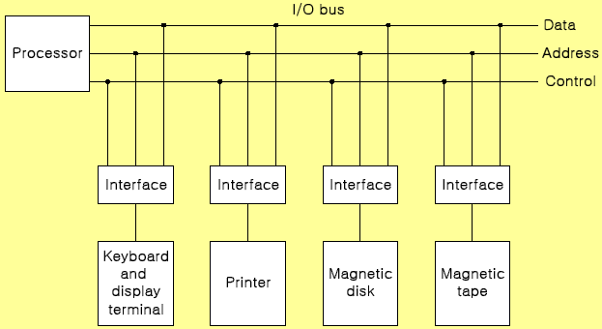
I/O Organization
I/O Bus and Interface Modules
The interface of I/O with CPU is performed by different I/O bus lines → Data lines, Address lines, Control lines:

Slide 5
I/O Organization
Interface Modules:
SCSI (Small Computer System Interface)
IDE (Integrated Device Electronics)
RS-232
USB (Universal Serial Bus)

Slide 6
I/O Organization
I/O versus Memory Bus
Computer buses are used to communicate with memory and I/O.
Three ways to make such communication:
Use two separate buses, one for memory and the other for I/O
Use one common bus for both memory and I/O but have separate control lines for each
Use one common bus for memory and I/O with common control lines

Slide 7
I/O Organization
Synchronous Data Transfer:
All data transfers occur simultaneously during the occurrence of a clock pulse
Registers in the interface share a common clock with CPU registers
Asynchronous Data Transfer:
Internal timing in each unit (CPU and Interface) is independent
Each unit uses its own private clock for internal registers

Slide 8
Problem faced in asynchronous input output
It is not sure that the data on the data bus is fresh or not as their no time slot for sending or receiving data.
This problem is solved by following mechanism:
Strobe
Handshaking

Slide 9
I/O Organization: Strobe Mechanism
Strobe : Control signal to indicate the time at which data is being transmitted.
Source-initiated strobe
Destination-initiated strobe
Source initiated Strobe:
When source initiates the process of data transfer. Strobe is just a signal.
(i) First, source puts data on the data bus and ON the strobe signal.
(ii) Destination on seeing the ON signal of strobe, read data from the data bus.
(iii) After reading data from the data bus by destination, strobe gets OFF.

Slide 10
I/O Organization: Strobe Mechanism
Destination initiated signal:
(i) First, the destination ON the strobe signal to ensure the source to put the fresh data on the data bus. (ii) Source on seeing the ON signal puts fresh data on the data bus. (iii) Destination reads the data from the data bus and strobe gets OFF signal.

Slide 11
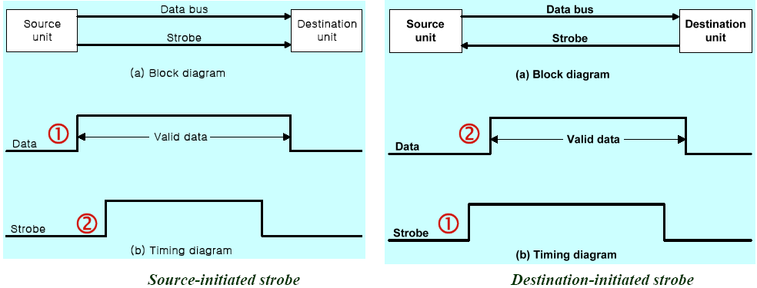
I/O Organization: Strobe Mechanism

Slide 12
Problems faced in Strobe based asynchronous input output –
In Source initiated Strobe, it is assumed that destination has read the data from the data bus but their is no surety.
In Destination initiated Strobe, it is assumed that source has put the data on the data bus but their is no surety.
This problem is overcome by Handshaking.

Slide 13
I/O Organization: Handshake Mechanism
1. Source initiated Handshaking
2. Destination initiated
Source initiated Handshaking:
When source initiates the data transfer process. It consists of signals: DATA VALID: if ON tells data on the data bus is valid otherwise invalid. DATA ACCEPTED: if ON tells data is accepted otherwise not accepted.

Slide 14
Source initiated Handshaking:
(i) Source places data on the data bus and enable Data valid signal.
(ii) Destination accepts data from the data bus and enable Data accepted signal.
(iii) After this, disable Data valid signal means data on data bus is invalid now.
(iv) Disable Data accepted signal and the process ends.
Now there is surety that destination has read the data from the data bus through data accepted signal.

Slide 15
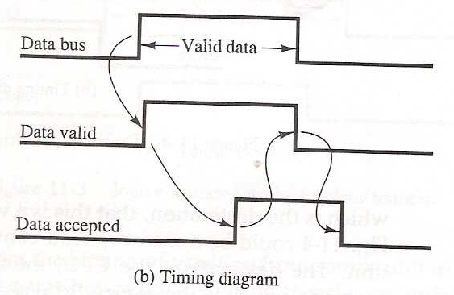
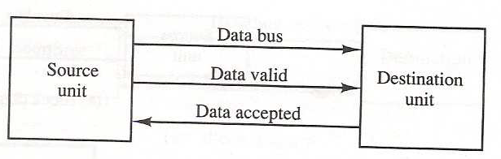


I/O Organization: Handshake Mechanism
Handshake: Agreement between two units
Source-initiated
It shows that first data is put on the data bus then data valid signal gets active and then data accepted signal gets active. After accepting the data, first data valid signal gets off then data accepted signal gets off.

Slide 16
I/O Organization: Handshake Mechanism
Destination initiated Handshaking:
When destination initiates the process of data transfer. REQUEST FOR DATA: if ON requests for putting data on the data bus. DATA VALID: if ON tells data is valid on the data bus otherwise invalid data.
(i) When destination is ready to receive data, Request for Data signal gets activated.
(ii) source in response puts data on the data bus and enabled Data valid signal.
(iii) Destination then accepts data from the data bus and after accepting data, disabled Request for Data signal.
(iv) At last, Data valid signal gets disabled means data on the data bus is no more valid data.
Now there is surety that source has put the data on the data bus through data valid signal.

Slide 17
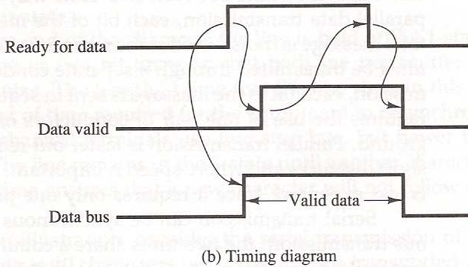
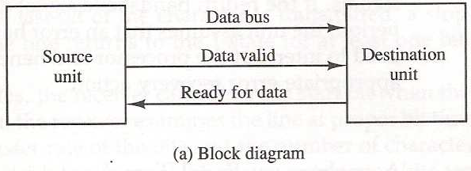
I/O Organization
Destination initiated handshake:
It shows that first Request for Data signal gets active then data is put on data bus then Data valid signal gets active. After reading data, first Request for Data signal gets off then Data valid signal.

Slide 18
I/O Organization
Asynchronous Data Transfer:
Special bits are inserted at both ends of the character code
Each character consists of three parts :
start bit : always “0”, indicate the beginning of a character
character bits : data
stop bit : always “1”

Slide 19
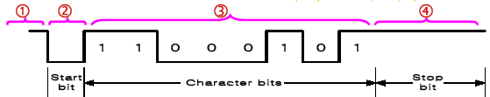
I/O Organization
Asynchronous transmission rules
(1) When a character is not being sent, the line is kept in the 1-state
(2) The initiation is detected from the start bit, which is always “0”
(3) The character always follow the start bit
(4) A stop bit is detected when the line returns to the 1-state for at least one bit time
UART (Universal Asynchronous Receiver): 8250

Slide 20
I/O Organization
Modes of Transfer
Data transfer to and from peripherals
1) Programmed I/O
2) Interrupt-initiated I/O
3) Direct Memory Access (DMA)
4) I/O Processor (IOP)

Slide 21
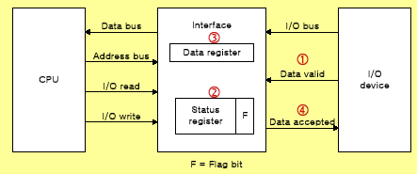
I/O Organization
Example of Programmed I/O
Programmed I/O refers to data transfers initiated by a CPU under driver software control to access registers or memory on a device.

Slide 22
I/O Organization
Interrupt-initiated I/O:
1) Non-vectored : fixed branch address
2) Vectored : interrupt source supplies the branch address
Priority Interrupt:
Identify the source of the interrupts from simultaneous several sources
Determine which one is to be serviced first from simultaneous multiple requests

Slide 23
I/O Organization
Software Polling:
Identify the highest-priority source by software means
Polls the interrupt sources in sequence
The highest-priority source is tested first

Slide 24
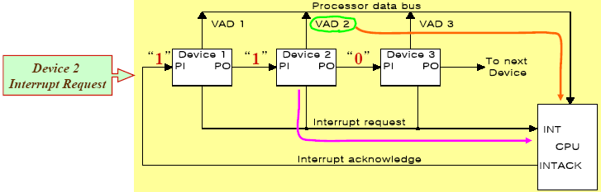
I/O Organization
Hardware priority interrupt:
Daisy-Chaining, parallel priority
Daisy –chaining
The hardware priority function can be established by either a serial or a parallel connection of interrupt lines. The serial connection is called daisy chaining method.
In daisy chaining method all the devices are connected in serial. The device with the highest priority is placed in the first position, followed by lower priority devices.
the daisy chain arrangement gives the highest priority to the device that receives the interrupt acknowledge signal from the CPU.
This signal is received by device 1 at its PI(priority in) input. The acknowledge signal passes on the next device.
It blocks the acknowledgement signal from the next device by placing a 0 in the PO output, if device I has a pending interrupt. It then proceeds to insert its own interrupt vector address (VAD) into the data bus for the CPU to use, during the interrupt cycle.

Slide 25
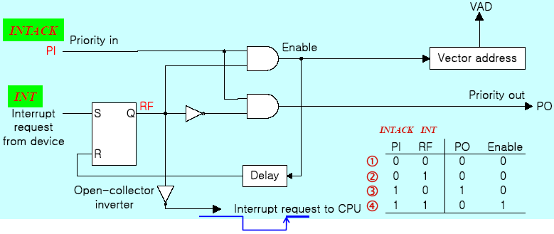
I/O Organization
(1) No interrupt request
(2) Invalid : interrupt request, but no ack (3) No interrupt request: Pass to other device
(4) Interrupt request
One step of DC

Slide 26
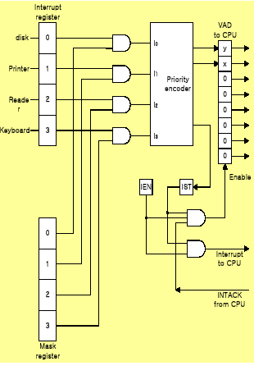
I/O Organization
Parallel Priority
Priority Encoder
Parallel Priority :
Interrupt Enable F/F (IEN): set or cleared by program. If any
Interrupt get the IST will set.
Interrupt Status F/F (IST): set or cleared by output. If any
Interrupt get the IST will set.
INTACK: CPU acknowledge

Slide 27
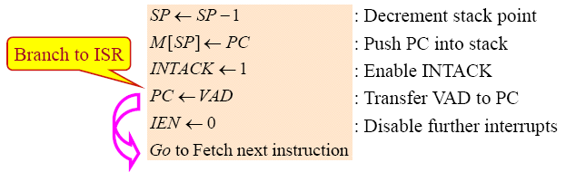
I/O Organization
Interrupt Cycle
At the end of each instruction cycle, CPU
checks IEN and IST
if both IEN and IST equal to “1”
CPU goes to an Interrupt Cycle
Sequence of microoperation during Interrupt cycle

Slide 28
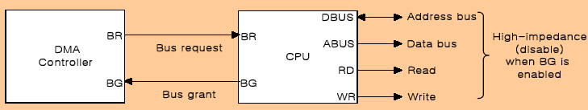
I/O Organization
Direct Memory Access (DMA):
DMA controller takes over the buses to manage the transfer directly between the I/O device and memory
Transfer Modes
Burst transfer : Block
Cycle stealing transfer : Byte
Direct memory access (DMA) is a method that allows an input/output (I/O) device to send or receive data directly to or from the main memory, bypassing the CPU to speed up memory operations. The process is managed by a chip known as a DMA controller (DMAC).

Slide 29
I/O Organization
DMA Controller (Intel 8237 DMAC) Initialization Process
1) Set Address register: memory address for read/write
2) Set Word count register: the number of words to transfer
3) Set transfer mode :
read/write,
burst/cycle stealing,
I/O to I/O,
I/O to Memory,
Memory to Memory
Memory search
I/O search
4) DMA transfer start : next section
5) EOT (End of Transfer): Interrupt

Slide 30
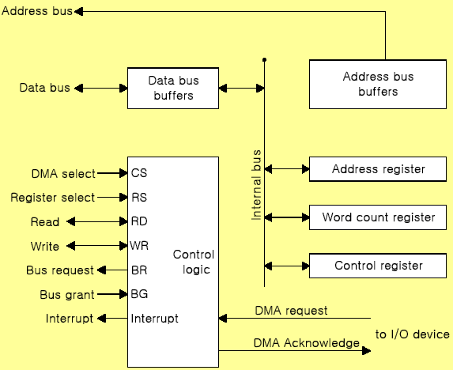
I/O Organization

Slide 31
I/O Organization
DMA Transfer (I/O to Memory)
1) I/O Device sends a DMA request
2) DMAC activates the BR line
3) CPU responds with BG line
4) DMAC sends a DMA acknowledge to the I/O device
5) I/O device puts a word in data bus (memory write)
6) DMAC write a data to the address specified by AR
7) Decrement Word count register
8) Word count register = 0 (EOT interrupt)
9) Word count register ≠ 0 (DMAC checks the DMA request from I/O device)

Slide 32
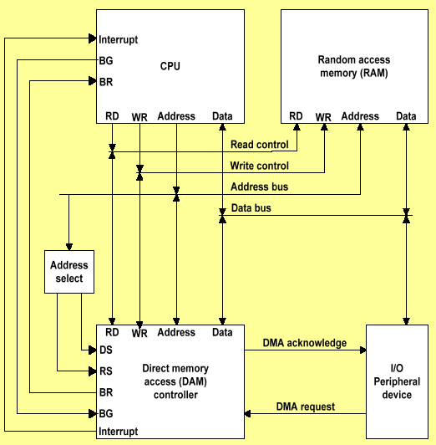
I/O Organization

Slide 33
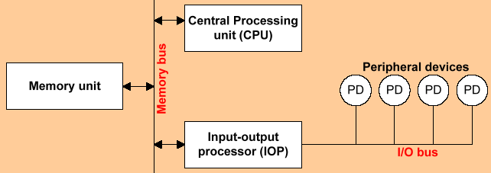
I/O Organization
Input-Output Processor (IOP)
Communicate directly with all I/O devices
Fetch and execute its own instruction
IOP instructions are designed for I/O transfer
DMAC must be set up entirely by the CPU
Designed to handle the details of I/O processing
The IOP attaches to the system I/O bus and one or more input/output adapters (IOAs). The IOP processes instructions from the system and works with the IOAs to control the I/Odevices. There are many different kinds of IOPs. Some IOPs can only support one type of I/O device.

Slide 34
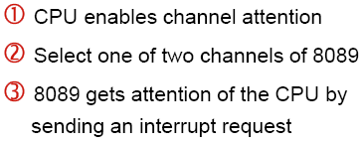
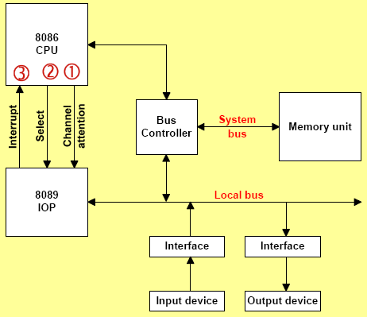
I/O Organization
Intel 8089 IOP

