Slide 1
Computer Architecture and Organization Memory Organization
Abdullah Al Shiam Lecturer, Dept. of CSE, Sheikh Hasina University, Netrokona email: shiam.cse@shu.edu.bd

Slide 2
Memory Organization
Memory Hierarchy
Arrangement of different types of memories based on accessibility in computer system.
Main Memory: memory unit that communicates directly with the CPU (RAM).
Auxiliary Memory: device that provide backup storage (Disk Drives).
Cache Memory: special very-high-speed memory to increase the processing speed.

Slide 3
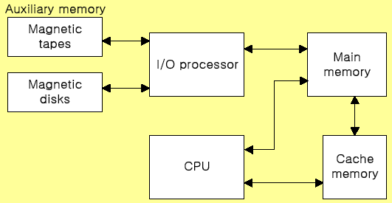
Memory Organization
Memory Hierarchy
Order according to speed: Cache>Main Memory>Auxiliary memory
Order according to size: Cache<Main memory<Auxiliary memory

Slide 4
Memory Organization
Main Memory
Main memory is the only one directly accessible to the CPU.
The CPU continuously reads instructions stored there and executes them as required.
Any data actively operated on is also stored there in uniform manner.
RAM (Random access memory) and ROM (Read only memory) are treated as main memory.

Slide 5
Memory Organization
RAM
Its purpose is to temporarily hold programs and data for processing.
Described as being volatile (all data are lost when power off)
It is direct access as it can be both written to or read from in any order
RAM is a very much essential memory. During the execution of a program, there is a close interaction in between RAM and processor. In the execution of program, processor takes data and instruction from RAM. After processing, RAM stores information.

Slide 6
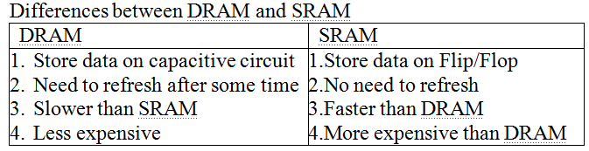
Memory Organization
Types of RAM
Dynamic RAM (DRAM)
The RAM which requires the stored information to be periodically re-written, or refreshed, otherwise it would vanish.
Static RAM (SRAM)
The RAM which never needs to be refreshed as long as power is applied. (It loses its content if power is removed).

Slide 7
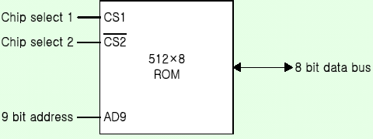
Memory Organization
ROM
Stores a program that helps start up the computer
ROM is non-volatile (holds programs and data even after power off)
ROM is also direct access but only read
The contents of ROM are fixed at the time of manufacture (a typical ROM chip)
ROM is a primary memory used to store some embedded data and instruction for Input-Output operation and other important operations. Unlike RAM, in a ROM data can only be read but not write. Although in programmable ROM data can write but it is a complex operation. Processor can direct access in ROM and executes its internal instructions.

Slide 8
Memory Organization
Bootstrap Loader
A Bootstrap Loader (BSL) is a small program that reside in ROM which can be activated immediately after a microcontroller has been powered up, in order to load and execute another program in a well defined manner. It is automatically executed by the processor when turning on the computer.
How does it work?
When the computer is turned on or restarted, the bootstrap loader first performs the power-on self-test, also known as POST. If the POST is successful and no issues are found, the bootstrap loader reads the hard drives boot sector to loads the operating system for the computer into memory. The computer can then access, load, and run the operating system.

Slide 9
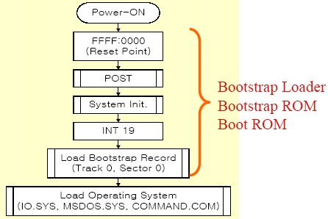
Bootstrap Loader
POST=Power on self test
Track 0, Sector 0=Memory location
INT 19=a low-level system command normally used just after POST to boot the operating system .

Slide 10
Types of ROM
PROM: This stands for Programmable Read Only Memory. It is a semiconductor memory which can only have data written to it once - the data written to it is permanent. These memories are bought in a blank format and they are programmed using a special PROM programmer. Typically a PROM will consist of an array of fuseable links some of which are "blown" during the programming process to provide the required data pattern.

Slide 11
EPROM: This is an Erasable Programmable Read Only Memory. This form of semiconductor memory can be programmed and then erased at a later time. This is normally achieved by exposing the silicon to ultraviolet light. To enable this to happen there is a circular window in the package of the EPROM to enable the light to reach the silicon of the chip. When the PROM is in use, this window is normally covered by a label, especially when the data may need to be preserved for an extended period.

Slide 12
EEPROM: This is an Electrically Erasable Programmable Read Only Memory. Data can be written to it and it can be erased using an electrical voltage. This is typically applied to an erase pin on the chip. Like other types of PROM, EEPROM retains the contents of the memory even when the power is turned off. Also like other types of ROM, EEPROM is not as fast as RAM. Read more about EEPROM.

Slide 13
Flash memory: Flash memory may be considered as a development of EEPROM technology. Data can be written to it and it can be erased, although only in blocks, but data can be read on an individual cell basis. To erase and re-programme areas of the chip, programming voltages at levels that are available within electronic equipment are used. It is also non-volatile, and this makes it particularly useful. As a result Flash memory is widely used in many applications including memory cards for digital cameras, mobile phones, computer memory sticks and many other applications. Read more about Flash memory.

Slide 14
Memory Organization
Memory address map
Memory Address Map is a representation of assigned address space for each chip
Assume that a computer system needs 512 bytes of RAM and 512 bytes of ROM
The RAM have 128 byte and need seven address lines, where the ROM have 512 bytes and need 9 address lines

Slide 15
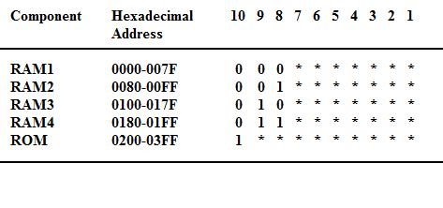
Memory Organization
Memory address map

Slide 16
Memory Organization
Memory Connection with CPU
The hexadecimal address assigns a range of hexadecimal equivalent address for each chip
Line 8 and 9 represent four distinct binary combination to specify which RAM we chose
When line 10 is 0, CPU selects a RAM. And when it’s 1, it selects the ROM

Slide 17
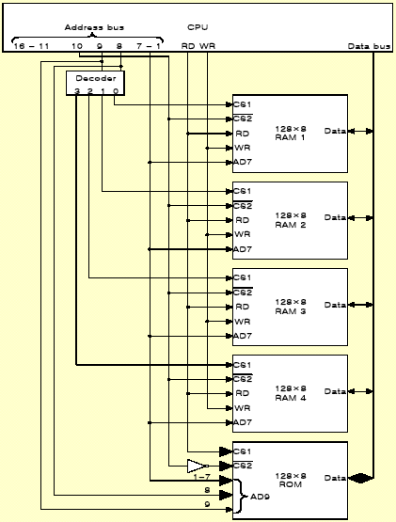
Memory Organization
Memory Connection with CPU

Slide 18
Memory Organization
Cache memory
Small amount of faster memory (SRAM) to speed up computer
Level 1 cache is built within the CPU (internal)
Level 2 cache may be on chip or nearby (external)
Faster for CPU to access than main memory
A cache memory is a physical memory like RAM. It is smaller in capacity but faster in operation than RAM. It is positioned in between processor and RAM.
There are two types of cache memory, such as L1 type cache memory and L2 type cache memory. L1 type cache memory is built-in into the processor and L2 type cache memory is built-in outside the processor but inside the motherboard.

Slide 19
Memory Organization
Cache performance
Defined as hit ratio
When the CPU refers to memory and finds the word in cache, it is called hit;
If the word is not found in cache it counts miss.
The hit ratio is defined as: hit ratio=hit/(hit+miss).

Slide 20
Memory Organization
Cache performance
For example, if you have 51 cache hits and three misses over a period of time, then that would mean you would divide 51 by 54. The result would be a hit ratio of 0.944.

Slide 21
Memory Organization
Factors of Cache performance
Cache size
The cache is smaller in size. Memory ranges from 2KB to a few MB generally. The higher the size the performance will be improved.
Mapping method: Cache mapping refers to a technique using which the content present in the main memory is brought into the memory of the cache. Three distinct types of mapping are used for cache memory mapping. Ex: associative, direct, set-associative

Slide 22
Factors of Cache performance
Replace algorithm:
Cache replacement algorithms specifies different ways to remove an item from the cache when it is full. There are different types of cache replacement are LRU(Least Recently Used), LFU(least frequently used), FIFO(First In First Out)
Write policy: A cache’s write policy is the behavior of a cache while performing a write operation. A cache’s write policy plays a central part in all the variety of different characteristics exposed by the cache. There are three policies write-through, write-back, write-around.

Slide 23
Memory Organization
Secondary Storage
Secondary storage (auxiliary storage) is not directly accessible by the CPU.
The computer usually uses its I/O channels to access secondary storage
Transfers the desired data using intermediate area in primary storage.
Secondary storage does not lose data when the device is powered off - non-volatile.

Slide 24
Memory Organization
Virtual Memory
An imaginary memory area supported by some operating systems in conjunction with the hardware. You can think of virtual memory as an alternate set of memory addresses. Programs use these virtual addresses rather than real addresses to store instructions and data. When the program is actually executed, the virtual addresses are converted into real memory addresses. The purpose of virtual memory is to enlarge the address space, the set of addresses a program can utilize. For example, virtual memory might contain twice as many addresses as main memory.
Uses backing storage e.g. hard disk as a temporary location for programs and data where insufficient RAM available
Swaps programs and data between the hard-disk and RAM as the CPU requires them for processing
A cheap method of running large or many programs on a computer system
Cost is speed: the CPU can access RAM in nanoseconds but hard-disk in milliseconds
Virtual memory is much slower than RAM

Slide 25
Memory Organization
Memory Management:
A collection hardware and software for managing the various programs residing in memory.
The basic components of a memory management unit are:
A facility for dynamic storage relocation that maps logical memory references into physical memory addresses
A provision for sharing common programs stored in memory by different users
Protection of information against unauthorized access between users and preventing users from changing operating systems functions.

