Slide 1
Computer Architecture and Organization Composite Architectures
Abdullah Al Shiam Lecturer, Dept. of CSE, Sheikh Hasina University, Netrokona email: shiam.cse@shu.edu.bd

Slide 2
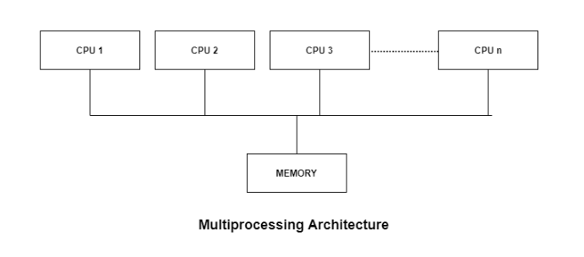
Composite Architecture
Multiprocessors:
The Computer system having two or more processing units
A multiprocessor system is simply a computer that has more than one CPU on its motherboard.
Share main memory and peripherals

Slide 3
Reasons of using multiprocessors
Multiple users:
Multiprocessor computer can give access to multiple user to work with simultaneously.
Multiple applications:
It helps to execute multiple application simultaneously.
Reduced Cost:
As more work is completed by the CPU’s so these systems are economically good as well.
Increased Reliability:
In a multiprocessor system, even if one processor fails, the system will not halt. This ability to continue working despite hardware failure is known as graceful degradation. For example: If there are 5 processors in a multiprocessor system and one of them fails, then also 4 processors are still working. So the system only becomes slower and does not ground to a halt.
Increased Throughput:
If multiple processors are working in having two things arranged one in front of the other., then the throughput of the system increases i.e. number of processes getting executed per unit of time increase.

Slide 4
Two types of multiprocessor systems:
Message Passing, Shared memory

Slide 5
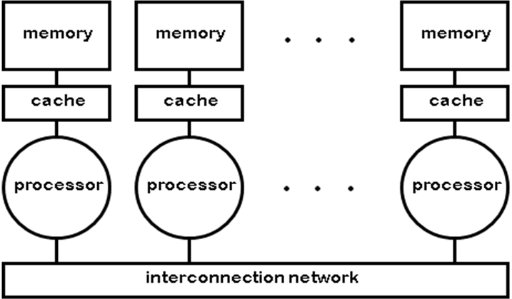
Composite Architecture
Message Passing
Separate address space for each processor
Processors communicate via message passing
Processors have private memories

Slide 6
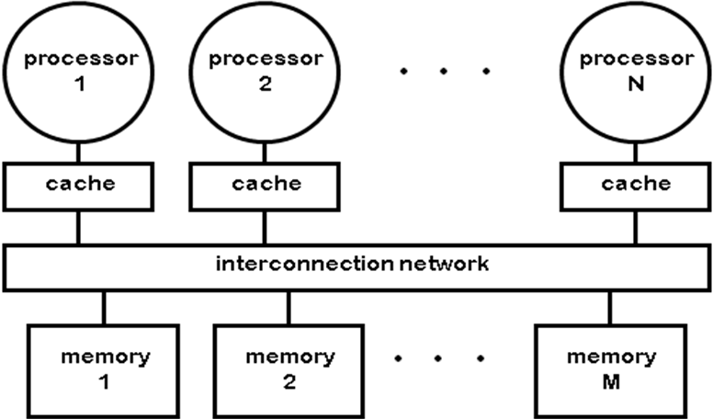
Composite Architecture
Shared Memory
Processors communicate with shared address space
Processors communicate by memory read/write
Easy on small-scale machines
Lower latency

Slide 7
Composite Architecture
Multicomputers:
A multicomputer system is a computer system with multiple processors that are connected together to solve a problem. Each processor has its own memory and it is accessible by that particular processor and those processors can communicate with each other via an interconnection network.
As the multicomputer is capable of messages passing between the processors, it is possible to divide the task between the processors to complete the task. Hence, a multicomputer can be used for distributed computing. It is cost effective and easier to build a multicomputer than a multiprocessor.

Slide 8
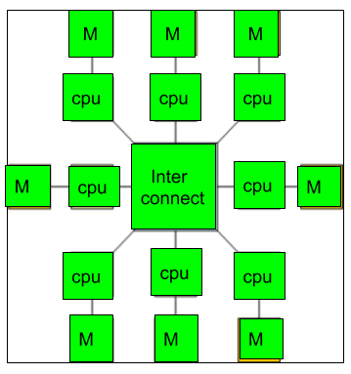
Composite Architecture
Multicomputer Consist of
Processing nodes – CPU, memory and network interface (NIC)
I/O nodes – device controller and NIC
Interconnection network

Slide 9
Difference between multiprocessor and Multicomputer:
Multiprocessor is a system with two or more central processing units (CPUs) that is capable of performing multiple tasks where as a multicomputer is a system with multiple processors that are attached via an interconnection network to perform a computation task.
A multiprocessor system is a single computer that operates with multiple CPUs where as a multicomputer system is a cluster of computers that operate as a singular computer.
Construction of multicomputer is easier and cost effective than a multiprocessor.
In multiprocessor system, program tends to be easier where as in multicomputer system, program tends to be more difficult.
Multiprocessor supports parallel computing, Multicomputer supports distributed computing.

Slide 10
Composite Architecture
CISC –The PDP-11, 80x86 and Motorola 68K.
Complex instruction set computer (CISC)
Several CISC characteristics:
It stands for Complex Instruction Set Computer. These processors offer the users, hundreds of instructions of variable sizes. CISC architecture includes a complete set of special purpose circuits that carry out these instructions at a very high speed. These instructions interact with memory by using complex addressing modes. CISC processors reduce the program size and hence lesser number of memory cycles are required to execute the programs. This increases the overall speed of execution.
Examples: Intel architecture, AMD
Properties of CISC instructions:
A 2-operand format, where instructions have a source and a destination.
Variable length instructions
Instructions which require multiple clock cycles to execute.

Slide 11
Composite Architecture
RISC –IBM 801, Stanford MIPS, and Berkeley RISC 1
Reduced Instruction Set Computer (RISC):
It stands for Reduced Instruction Set Computer. It is a type of microprocessor architecture that uses a small set of instructions of uniform length. These are simple instructions which are generally executed in one clock cycle. RISC chips are relatively simple to design and inexpensive. The setback of this design is that the computer has to repeatedly perform simple operations to execute a larger program having a large number of processing operations.
Examples: SPARC, POWER PC etc.
Supports Pipelining
Large number of registers: the RISC design philosophy generally incorporates a larger number of registers to prevent in large amounts of interactions with memory

Slide 12
Example – Suppose we have to add two 8-bit number:
CISC approach: There will be a single command or instruction for this like ADD which will perform the task.
RISC approach: Here programmer will write first load command to load data in registers then it will use suitable operator and then it will store result in desired location.

Slide 13
Composite Architecture
Comparison of CISC and RISC processors
CISC Complex instruction | RISC A small, highly-optimized set of instructions
Emphasis on hardware | Emphasis on software
Includes multi-clock complex instructions | Single-clock, reduced instruction only
Small code sizes, high cycles per second | Low cycles per second, large code sizes
Limited number of registers | Large number of registers

Slide 14
Composite Architecture
Parallel Processing
Parallel processing – executing more than one instruction at the same time.
It is possible to achieve parallelism with a uniprocessor system.
The CPU must include a vectored arithmetic unit.

Slide 15
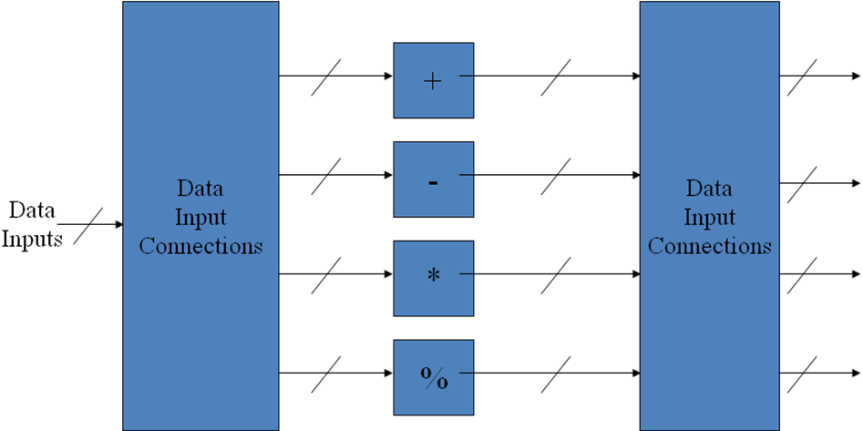
Composite Architecture
A vector arithmetic unit contains
It has Multiple functional
The control unit routes input values to the different functional units
To add two numbers, the control unit routes these values to an adder unit. For the operations A <-B + C, and D <- E - F the CPU would route B and C to an adder and send E and F to a subtracter, this allows the CPU to execute both instructions simultaneously.

Slide 16
Composite Architecture
Parallelism in multiprocessors
Parallel processing systems achieve parallelism by having more than one processor performing tasks simultaneously.
Since multiprocessor systems are more complicated than uniprocessor systems, there are many different ways to organize the processors and memory based on instruction stream and data stream.

Slide 17
What is Instruction Stream and Data Stream?
Instruction Stream:
The instruction stream is defined as the sequence of instructions performed by the processing unit.
Data Stream:
The data stream is defined as the data traffic exchanged between the memory and the processing unit.

Slide 18
Composite Architecture
The Flyinn’s classification of parallel processing is as follows:
SISD: Single instruction with single data – conventional computers
SIMD: Single instruction with multiple data – vector computing machines
MISD: Multiple instruction with single data – pipelining system
MIMD: Multiple instruction with multiple data – general purpose machine

Slide 19
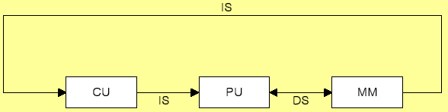
Composite Architecture
IS=Instruction Stream
DS= Data Stream
SISD
An SISD computing system is a uniprocessor machine which is capable of executing a single instruction, operating on a single data stream. In SISD, machine instructions are processed in a sequential manner and computers adopting this model are popularly called sequential computers. Most conventional computers have SISD architecture. All the instructions and data to be processed have to be stored in primary memory.

Slide 20
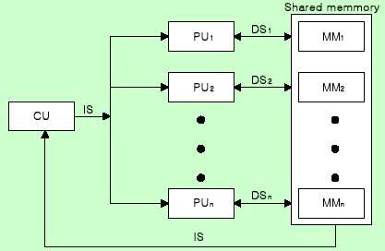
Composite Architecture
SIMD
Vector or array operations
one vector operation includes many operations on a data stream

Slide 21
SIMD
SIMD stands for 'Single Instruction and Multiple Data Stream'. It represents an organization that includes many processing units under the supervision of a common control unit.
All processors receive the same instruction from the control unit but operate on different items of data.
The shared memory unit must contain multiple modules so that it can communicate with all the processors simultaneously.

Slide 22
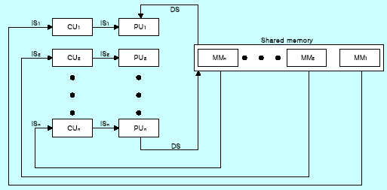
Composite Architecture
MISD
Data Stream bottle neck

Slide 23
MISD
Example Z = sin(x)+cos(x)+tan(x)
The system performs different operations on the same data set. Machines built using the MISD model are not useful in most of the application, a few machines are built, but none of them are available commercially.

Slide 24
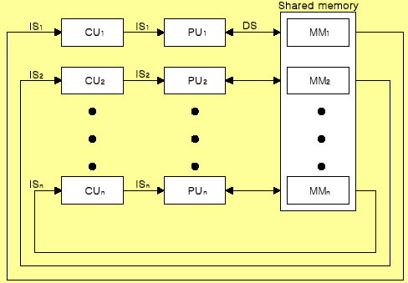
Composite Architecture
MIMD
Multiprocessor System
Shared memory or Message passing

Slide 25
MIMD
An MIMD system is a multiprocessor machine which is capable of executing multiple instructions on multiple data sets. Each PE in the MIMD model has separate instruction and data streams; therefore machines built using this model are capable to any kind of application. Unlike SIMD and MISD machines, PEs in MIMD machines work asynchronously.

Slide 26
Difference between SIMD and MIMD
MIMD:
Multiprocessor System
Shared memory or Message passing
The MIMD architecture performs multiple different actions simultaneously on multiple data pieces.
MIMD is capable of more complex operations
An example is the performance of various mathematical calculations such as addition and multiplication simultaneously. take less time SIMD:
Vector or array operations
The SIMD architecture performs an identical action simultaneously on multiple data pieces.
An example is retrieving a lot of different files at the same time. SIMD processors tend to be simpler, smaller, cheaper and faster than MIMD processors
take more time

