Slide 1
Lecture-3
CSE-3101
Computer Networking
Mala Rani Barman
Assistant Professor, Department of Computer Science and Engineering
Sheikh Hasina University

Slide 2
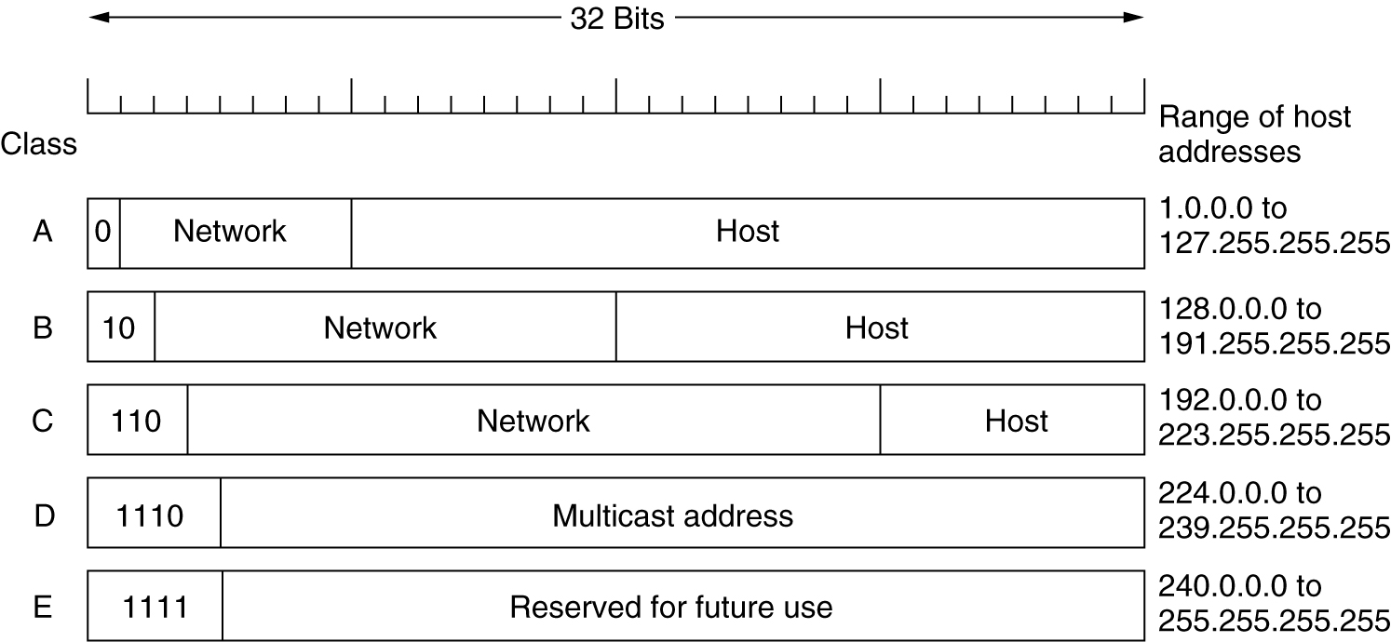
IP Addresses
IP address formats.

Slide 3
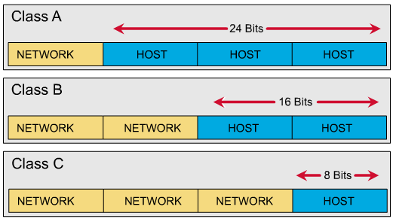
Class A (24 bits for hosts) 2²⁴ - 2* = 16,777,214 maximum hosts
Class B (16 bits for hosts) 2¹⁶ - 2* = 65,534 maximum hosts
Class C (8 bits for hosts) 2⁸ - 2* = 254 maximum hosts
* Subtracting the network and broadcast reserved address

Slide 4
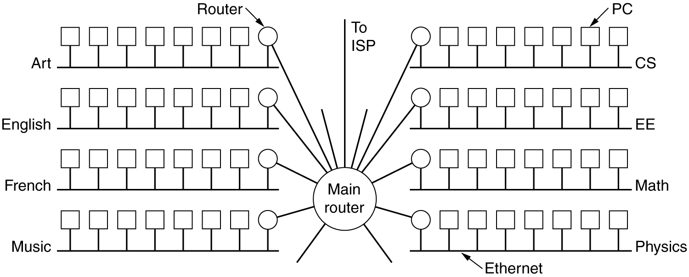
Subnets
A big network usually spitted into several small parts for internal use but still act like a single network to the outside world.
A typical campus network might look like fig below, with a main router connected to an ISP or regional network and numerous Ethernets spread around campus in different departments. Each of the Ethernets has its own router connected to the main router (via backbone LAN). In the internet literature, the part of the network (in this case, Ethermets) are called subnets.
A campus network consisting of LANs for various departments.

Slide 5
Subnets (2)
An IP address has two components, the network address and the host address. A subnet mask separates the IP address into the network and host addresses (<network> <host>). Subnetting further divides the host part of an IP address into a subnet and host address (<network> <subnet> <host>).

Slide 6
A Subnet mask is a 32-bit number that masks an IP address, and divides the IP address into network address and host address. Subnet Mask is made by setting network bits to all "1"s and setting host bits to all "0"s.
Within a given network, two host addresses are reserved for special purpose. The "0" address is assigned a network address and "255" is assigned to a broadcast address, and they cannot be assigned to a host.
It is called a subnet mask because it is used to identify network address of an IP address by performing bitwise AND operation on the subnet mask.

Slide 7
The default subnet mask used for class A, B, C and D are:
Class A: 11111111.00000000. 00000000. 00000000
255.0.0.0
Class B: 11111111. 11111111. 00000000. 00000000
255.255.0.0
Class C: 11111111. 11111111. 11111111. 00000000
255.255.255.0
For example we have a class C IP address of a host: 192.168.23.4
Anding the IP address with default subnet mask 255.255.255.0 give the result of 192.168.23.0 which is the net ID part of the IP address.

Slide 8
The possible hosts will be:
192.168.23.1
192.168.23.2
192.168.23.3
192.168.23.4
…………….
192.168.23.254
192.168.23.0 and 192.168.23.255 are excluded as mentioned before. Therefore the number of hosts is 2⁸-2 = 254

Slide 9
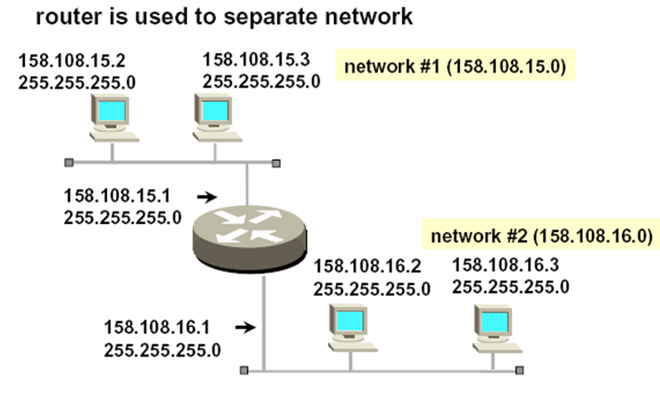
Example-1
192
192
192.
192
192.
192.
192.
192

Slide 10
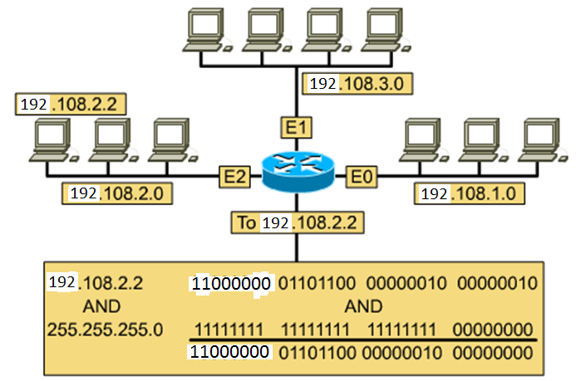
Performing the AND Function
Example-2: A host wants to send packet to a host 192.108.2.2. First the sender has to find the net ID of the receiver.
in decimal 192.108.2.0

Slide 11
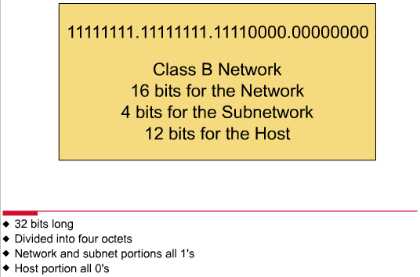
Subnet Mask
Follow these steps to determine the subnet mask:
  Replace the network and subnet portion of the address with all 1s.
  Replace the host portion of the address with all 0s.
  Convert the binary expression back to dotted-decimal notation.

Slide 12
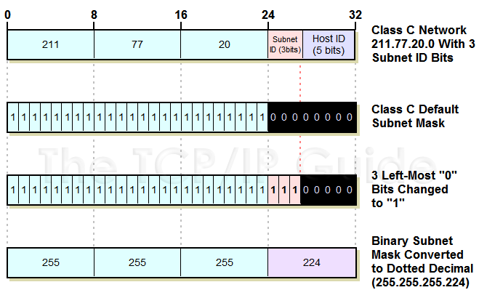
Default Subnet mask
255.255.255.0
Customed Subnet mask

Slide 13
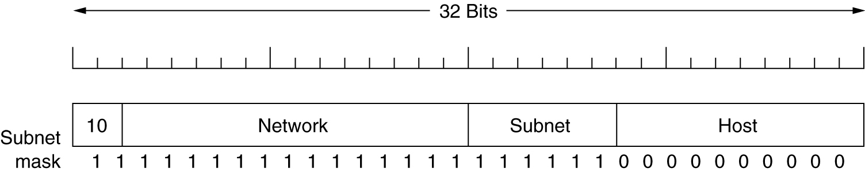
The example of a customed subnet mask for class B is like:
A class B network subnetted into 64 subnets.
Example: Determine the number of subnet and host per subnet
Ans. The number of subnet = 2⁶ = 64
The number of hosts/subnet = 2¹⁰-2= 1022

Slide 14
Examples

Slide 15


Example-1: Put default class C IP address to each node
192.168.2.1
192.168.4.2
192.168.4.1
192.168.5.2
Net-C
192.168.4.0
192.168.2.2
192.168.3.1
192.168.4.5
HUB
192.168.3.2
192.168.4.6
192.168.5.1
192.168.2.4
Net-B
192.168.3.0
192.168.5.3
192.168.2.3
Net-D
192.168.5.0
Net-A
192.168.2.0
192.168.4.3
192.168.5.4
192.168.4.4
The drawback of the network is that it needs 4 IP address from ISP for 4 networks.

Slide 16
Example-2 Design the network with proper subnetting using class B IP.
Subnet-D
HUB
Router-2
Router-3
Router-1
Subnet-A
Subnet-B
Subnet-C
We have four subnets.
a)The subnet–A has four hosts (3 PCs and 1 router interface)
b) subnet-B has 6 hosts (4 PCs and 2 router interfaces)
c) subnet-C has 4 hosts (3 PCs and 1 router interface)
d) the network has another two hosts correspond to subnet-D i.e between router-1 and router-2 which are directly connected. Here we have 4 subnets.

Slide 17
Subnet-D
HUB
Router-2
Router-3
Router-1
Subnet-A
Subnet-B
Subnet-C
If we keep 3 bits for the subnet ID (we can also take 2 bits for subnet for above network) of then we have 2³ = 8 subnets which is greater than 4 subnets of above figure. We can also use 2 bits for 4 subnets. Considering class B IP address. Our custom subnet mask will be ,
11111111
11111111
11100000
00000000
255
255
224
0

Slide 18
Let we have class B IP address 191.1.0.0 where net ID is 191.1 then possible 8 subnets will be:
191
1
00100000
00000000
191.1.32.0
191
1
01000000
00000000
191.1.64.0
191
1
01100000
00000000
191.1.96.0
191
1
10000000
00000000
191.1.128.0
191
1
10100000
00000000
191.1.160.0
191
1
11000000
00000000
191.1.192.0

Slide 19
191
1
00000000
00000000
191.1.0.0
191
1
11100000
00000000
191.1.224.0

Slide 20
191.1.64.1
191.1.64.2
191.1.96.1
191.1.32.1
191.1.32.4
191.1.128.2
191.1.64.1
191.1.96.4
191.1.32.2
191.1.128.1
191.1.64.5
Router-2
Router-3
Router-1
191.1.96.2
191.1.64.3
191.1.64.4
191.1.32.3
Subnet-A
191.1.96.3
Subnet-B
Subnet-C
The advantage of the network is that it needs only one IP address from ISP.

Slide 21
The possible hosts for the subnet 191.1.32.0 ( we may chose for the subnet-A of previous figure) will be,
191
1
001xxxxx
xxxxxxxx
Binary
Decimal
10111111.00000001.00100000.00000001
10111111.00000001. 00100000.00000010
10111111.00000001. 00100000.00000011
…………………………………………..
…………………………………………..
10111111.00000001. 00111111.11111110
191.1.32.1
191.1.32.2
191.1.32.3
………….
………….
191.1.63.254
Total number of hosts will be 2¹³-2

Slide 22
The possible hosts for the subnet 191.1.64.0 ( we may chose for the subnet-B of previous figure) will be,
191
1
010xxxxx
xxxxxxxx
Binary
Decimal
191.1.64.1
191.1.64.2
191.1.64.3
………….
………….
191.1.95.254
10111111.00000001.01000000.00000001
10111111.00000001.01000000.00000010
10111111.00000001.01000000.00000011
…………………………………………..
…………………………………………..
10111111.00000001.01011111.11111110
Total number of hosts will be 2¹³-2

Slide 23
The possible hosts for the subnet 191.1.96.0 ( we may chose for the subnet-C of previous figure) will be,
191
1
011xxxxx
xxxxxxxx
191.1.96.1
191.1.96.2
191.1.96.3
………….
………….
191.1.127.254
10111111.00000001.01100000.00000001
10111111.00000001.01100000.00000010
10111111.00000001.01100000.00000011
…………………………………………..
…………………………………………..
10111111.00000001.01111111.11111110
Total number of hosts will be 2¹³-2

Slide 24
The possible hosts for the subnet 191.1.128.0 ( we may chose for the for the point to point link of Router-1 and Router-2 of previous figure) will be,
191
1
100xxxxx
xxxxxxxx
191.1.128.1
191.1.128.2
191.1.128.3
………….
………….
191.1.159.254
10111111.00000001.10000000.00000001
10111111.00000001. 10000000.00000010
10111111.00000001. 10000000.00000011
…………………………………………..
…………………………………………..
10111111.00000001. 10011111.11111110
Total number of hosts will be 2¹³-2

Slide 25
The possible hosts for the subnet 191.1.160.0 ( we may chose for the for the point to point link of Router-1 and Router-2 of previous figure) will be,
191
1
101xxxxx
xxxxxxxx
191.1.160.1
191.1.160.2
191.1.160.3
………….
………….
191.1.191.254
10111111.00000001.10100000.00000001
10111111.00000001.10100000.00000010
10111111.00000001.10100000.00000011
…………………………………………..
…………………………………………..
10111111.00000001.10111111.11111110
Total number of hosts will be 2¹³-2

Slide 26
The possible hosts for the subnet 191.1.192.0 ( we may chose for the for the point to point link of Router-1 and Router-2 of previous figure) will be,
191
1
110xxxxx
xxxxxxxx
191.1.192.1
191.1.192.2
191.1.192.3
………….
………….
191.1.223.254
10111111.00000001.11000000.00000001
10111111.00000001.11000000.00000010
10111111.00000001.11000000.00000011
…………………………………………..
…………………………………………..
10111111.00000001.11011111.11111110
Total number of hosts will be 2¹³-2

Slide 27
The subnets and possible host IDs are shown below.
Subnet | 1st host ID | Last host ID
191.1.32.0 | 191.1.32.1 | 191.1.63.254
191.1.64.0 | 191.1.64.1 | 191.1.95.254
191.1.96.0 | 191.1.96.1 | 191.1.127.254
191.1.128.0 | 191.1.128.1 | 191.1.159.254
191.1.260.0 | 191.1.160.1 | 191.1.191.254
191.1.192.0 | 191.1.192.1 | 191.1.223.254
From above table we get two formulas:
The 1st host ID = subnet ID + 1
The last host ID of a range = next subnet ID - 2

Slide 28
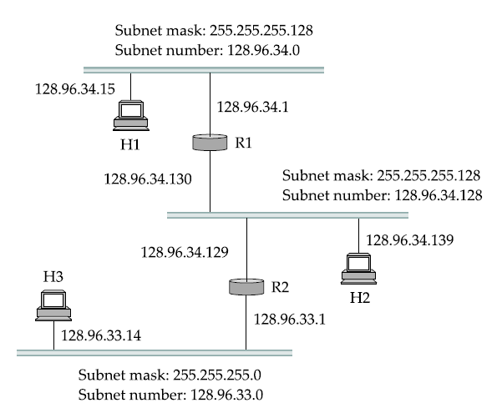
Example-3
Host H1 in Figure below is configured with an address of 128.96.34.15 and a subnet mask of 255.255.255.128. The bitwise AND of these two numbers defines the subnet number of the host and of all other hosts on the same subnet. In this case, 128.96.34.15 AND 255.255.255.128 equals 128.96.34.0, so this is the subnet number for the topmost subnet in the figure.

Slide 29
For example, if H1 is sending to H2, then H1 ANDs its subnet mask (255.255.255.128) with the address for H2 (128.96.34.139) and the result is found as: 128.96.34.128. This does not match the subnet number for H1 (128.96.34.0) so H1 knows that H2 is on a different subnet. Since H1 cannot deliver the packet to H2 directly over the subnet, it sends the packet to its default router R1.

Slide 30
R1 would AND H2’s address (128.96.34.139) with the subnet mask of the first entry (255.255.255.128) and compare the result (128.96.34.128) with the network number for that entry (128.96.34.0). Since this is not a match, it proceeds to the next entry. This time a match does occur, so R1 delivers the datagram to H2 using interface 1, which is the interface connected to the same network as H2.

Slide 31
Example-4
A class B IP address is 150.100.14.163 and the corresponding subnet mask is 255.255.255.128 Determine the maximum number of hosts per subnet.
Ans. The subnet mask in both binary and decimal is like:
11111111. 11111111. 11111111. 10000000
255.255.255.128
Here 9 bits are for subnets and 7 bits for hosts.
Therefore the number of hosts per subnet 2⁷-2 = 126
The number of subnets = 2⁹ = 512

Slide 32
Example-5
A router is connected to network has two subnets 190.155.16.0 and 190.155.15.0 where the net_ID is 190.155.0.0 i.e. class B IP. Assume 8 bits for subnet ID. How the router will deal with a datagram destined to 190.155.16.16.
Subnet ID
190.155.16.0
Subnet ID
190.155.15.0
Router-1
Subnet-1
Subnet-2
Ans. Since 8 bits for subnet ID and 16 bits for net ID (class B address) therefore the custom subnet mask will be 255.255.255.0 for both the subnets. Now making ‘and’ operation of 190.155.16.16 and 255.255.255.0 gives 190.155.16.0. Therefore the router will route the datagram to its subnet 190.155.16.0.

Slide 33
Example-6
If the subnet mask 255.255.240.0 is used for a class B IP address then find the number of subnets and number of hosts/subnet.
Binary: 11111111 . 11111111 . 11110000 . 00000000
Decimal: 255.255.240.0
The number of hosts/subnet = 2¹² – 2 = 4094
The number of subnets = 2⁴ = 16
Example-7
If the subnet mask 255.255.255.192 is used for a class C IP address then fined the number of subnets and number of hosts/subnet.
The number of hosts/subnet = 2⁶ – 2 = 62
The number of subnets = 2³ = 8

Slide 34
Exercise-1
Using class C subnet mask 255.255.255.0 for a class B IP, you can divide class B network 172.16.0.0 into 256 possible subnets. Justify with numerical example.

Slide 35
We can now describe the datagram forwarding algorithm in the following way:
D = destination IP address
for each forwarding table entry SubnetNumber, SubnetMask, NextHop
D1 = SubnetMask & D
if D1 = SubnetNumber
if NextHop is an interface
deliver datagram directly to destination
else
deliver datagram to NextHop (a router)

Slide 36
IP Routing Table
Typically a routing table contains pair (N, R) where N is the net ID of the destination network and R is the IP address of the next router along the path to network N.
Fig below will help to explain routing tables. Let us concentrate on router R which is directly connected to network 20.0.0.0 and 30.0.0.0 (class A net_ID) can use direct delivery to send to host on either of these networks.
A datagram destined for a host on network 40.0.0.0, R routes it to address of router S, 30.0.0.7. R can reach on 30.0.0.7 directly and S can reach on network 40.0.0.0 directly.
Network
Network
20.0.0.0
Q
10.0.0.0
20.0.0.5
10.0.0.5
20.0.0.6
R
Network
30.0.0.6
30.0.0.0
40.0.0.0
S
30.0.0.7
Network
40.0.0.7

Slide 37
Example-4 Show the routing table of router R
20.0.0.0
Q
10.0.0.0
20.0.0.5
10.0.0.5
20.0.0.6
R
30.0.0.6
30.0.0.0
40.0.0.0
S
30.0.0.7
40.0.0.7
Routing table of R
To Reach Hosts on Network | Route to this address
20.0.0.0 | Deliver Directly
30.0.0.0 | Deliver Directly
10.0.0.0 | 20.0.0.5
40.0.0.0 | 30.0.0.7

Slide 38


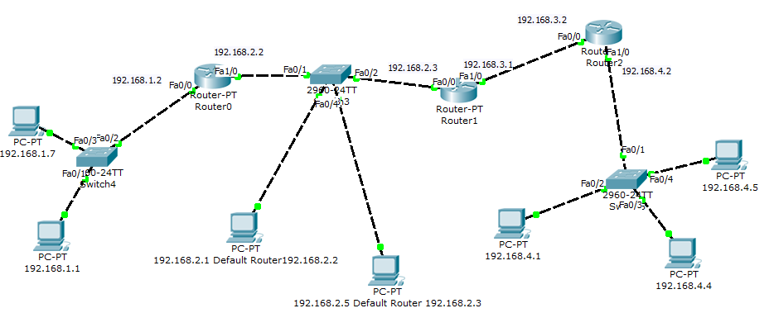


Slide 39
Classless Interdomain Routing (CIDR)
or Supernetting
Classless interdomain routing (CIDR, pronounced “cider”) is a technique that addresses two scaling concerns in the Internet:
the growth of backbone routing tables as more and more network numbers need to be stored in them
the potential for the 32-bit IP address space to be exhausted well before the 4 billionth host is attached to the Internet.

Slide 40
Supernetting, also called Classless Inter-Domain Routing (CIDR), is a way to aggregate multiple Internet addresses of the same class. Supernetting is the idea of combining two or more blocks of IP addresses that together compose a continuous range of addresses (no missing addresses in the middle). You create a supernet when you have a need to place more hosts on a single network than currently will work in a classful configuration.
The original Internet Protocol (IP) defines IP addresses in four major classes of address structure, Classes A through D. Each class allocates one portion of the 32-bit Internet address format to a network address and the remaining portion to the specific host machines within the network.

Slide 41
Using supernetting, the network address 192.168.2.0/24 and an adjacent address 192.168.3.0/24 can be merged into 192.168.2.0/23. The "23" at the end of the address says that the first 23 bits are the network part of the address, leaving the remaining nine bits for specific host addresses.
Supernetting is most often used to combine Class C network addresses and is the basis for most routing protocols currently used on the Internet.
The Border Gateway Protocol (BGP), the prevailing exterior (interdomain) gateway protocol and the Open Shortest Path First (OSPF) router protocol both support supernetting, but the older exterior or interdomain protocols, the Exterior Gateway Protocol (EGP) and the Routing Information Protocol (RIP) do not support it.

Slide 42
For any class C IP address 192.168.1.0 and default subnet mask 255.255.255.0 we have 2⁸-2 = 254 hosts. Let us now see how class C address an produce more than 254 hosts.
The basic principle is to take one or more bits from the net ID part as the host ID part. For example if we use subnet mask of 23 bits instead of 24 bits of default subnet mask then we get 9 bits for host ID the the number of hosts will be 2⁹-2.
In this case net ID does not fall in any category hence called classless IP. Such mask is called CIDR mask.

Slide 43
Let the available IP addresses are 192.168.20.0 through 192.168.31.0 i.e. 12 continuous class C addresses. Listing the third byte in binary value provides the flowing results. The four leftmost bites of third byte are the same. Thus we can implement a 20-bits subnet mask which allows 12 bits for the host addresses. The total number of hosts will be 2¹²-2 = 4094.
Decimal | Binary of third byte
192.168.20.0 192.168.21.0 192.168.22.0 192.168.23.0 192.168.24.0 192.168.25.0 192.168.26.0 192.168.27.0 192.168.28.0 192.168.29.0 192.168.30.0 192.168.31.0 | 00010100 00010101 00010110 00010111 00011000 00011001 00011010 00011011 00011100 00011101 00011110 00011111
The entire IP addresses acts as a single IP hence reduce the size of table of a router.

Slide 44
Example-8
For the CIDR address of 192.168.10.0/20 determine the range of class C IP address.
Ans.
Decimal | Binary of third byte
192.168.10.0 192.168.11.0 192.168.12.0 192.168.13.0 192.168.14.0 192.168.15.0 | 00001010 00001011 00001100 00001101 00001110 00001111
The range of class C IP address is 192.168.10.0 to 192.168.15.0

Slide 45
Example-9
Suppose you got three consecutive IP addresses: 203.100.200.0, 203.100.201.0 and 203.100.202.0 of class C.
IP address
203.100.200.0 | 11001011 | 01100100 | 11001 000 | 00000000
203.100.201.0 | 11001011 | 01100100 | 11001 001 | 00000000
203.100.202.0 | 11001011 | 01100100 | 11001 010 | 00000000
Default subnet mask | 11111111 | 11111111 | 11111111 | 00000000
Supernet mask | 11111111 | 11111111 | 11111 000 | 00000000
Therefore 8 subnet can be converted to a supernet using supernet mask of 255.255.248.0.

Slide 46
IPv6
IPv6 uses 128 bit and expressed in 32 hexadecimal numbers like:
EFAC: BA89: 7529:AFDC: 92AF:8654:1293 :29A2
After every 4 digits a colon ‘:’ is used therefore 32 digits + 7 colons = 39 characters hence called addressing system of 39 characters.
In some addresses huge number of zeros exits like:
DFAC: 0000: 0000:0000: 0009:03AC1:5923 :FEA2
can be expressed as:
DFAC: 0: 0:0: 9:3AC1:5923 :FEA2
or
DFAC: : 9:3AC1:5923 :FEA2
Double colon can be used only once in a IPv6 address.

Slide 47
How many subscriber is possible in IPv6?
Ans. 2¹²⁸

Slide 48
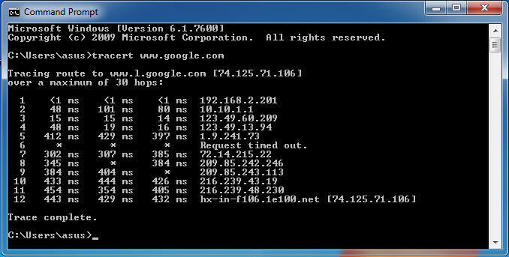
Try Running

Slide 49
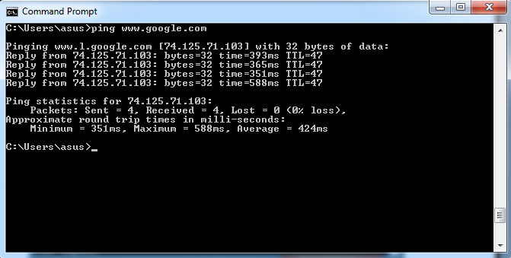

Slide 50
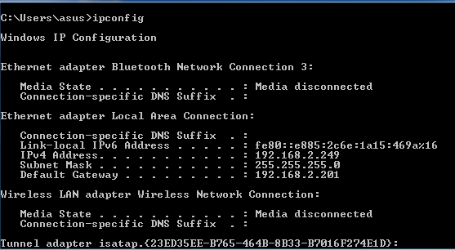
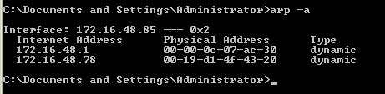

Slide 51
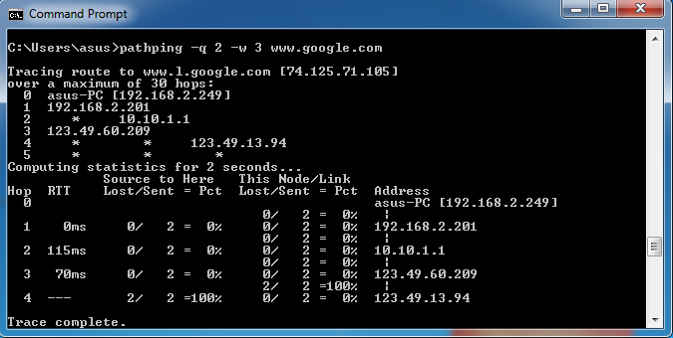
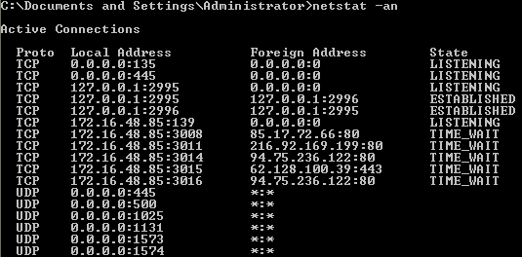
Displays protocol statistics and current TCP/IP network connections.

Slide 52
