Slide 1
Chapter 2. Network Models
Layered Tasks
The OSI Model
Layers in the OSI Model
TCP/IP Protocol Suite
Addressing
Data Communications, GUB
2-1

Slide 2
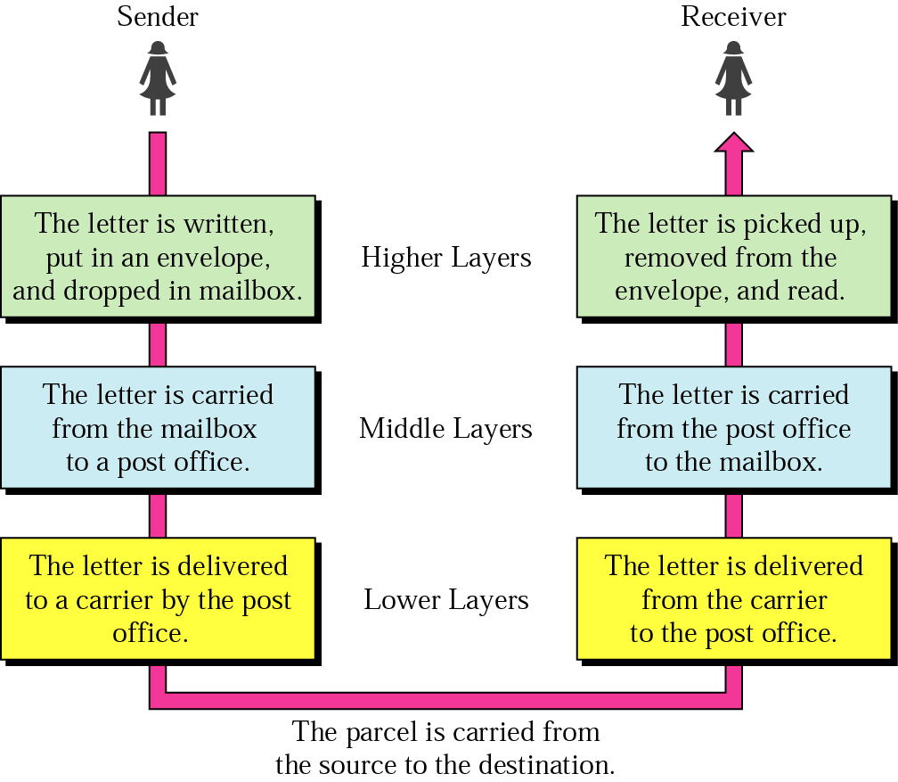
Layered Model: Sending a Letter
Data Communications, GUB
2-<number>

Slide 3

OSI Model
ISO is the organization. OSI is the model
Data Communications, GUB
2-<number>

Slide 4

Interaction between layers in the OSI model
Layer and interface
Data Communications, GUB
2-<number>

Slide 5

An exchange using the OSI model
Encapsulation with header and possibly trailer
Data Communications, GUB
2-<number>

Slide 6

Physical Layer
The physical layer is responsible for movements of individual bits from one hop (node) to the next
Mechanical and electrical specification, the procedures and functions
Data Communications, GUB
2-<number>

Slide 7
Physical Layer: Duties
Physical characteristics of interfaces and media
Representation of bits
Data rate
Synchronization of bits
Line configuration
Physical topology
Transmission mode
Data Communications, GUB
2-<number>

Slide 8

Data Link Layer
The data link layer is responsible for moving frames from one hop (node) to the next
Transform the physical layer to a reliable (error-free) link
Data Communications, GUB
2-<number>

Slide 9
Data Link Layer: Duties
Framing
Physical addressing
Flow control
Error control
Access control
Data Communications, GUB
2-<number>

Slide 10

Hop-to-Hop Delivery
Data Communications, GUB
2-<number>

Slide 11

Network Layer
The network layer is responsible for the delivery of packets from the source host to the destination host
Data Communications, GUB
2-<number>

Slide 12

Network Layer: Duties
Logical addressing and routing
Data Communications, GUB
2-<number>

Slide 13

Transport Layer
The transport layer is responsible for delivery of a message from one process to another
Data Communications, GUB
2-<number>

Slide 14
Transport Layer: Duties
Service-point (port) addressing
Segmentation and reassembly
Connection control
Flow control
Error control
Data Communications, GUB
2-<number>

Slide 15

Reliable Process-to-Process Delivery of a Message
Data Communications, GUB
2-<number>

Slide 16

Session Layer
Session layer is responsible for dialog control and synchronization
Data Communications, GUB
2-<number>

Slide 17

Presentation Layer
Presentation layer is responsible for translation, compression, and encryption
Data Communications, GUB
2-<number>

Slide 18

Application Layer
Application layer is responsible for providing services to the user
Data Communications, GUB
2-<number>

Slide 19
Application Layer: Services
Network virtual terminal
Mail services
File transfer, access, and management
Directory services
Data Communications, GUB
2-<number>

Slide 20

Summary of Layers
Data Communications, GUB
2-<number>

Slide 21

TCP/IP and OSI Model
Data Communications, GUB
2-<number>

Slide 22
TCP/IP Protocol Suite
Host-to-network : Physical and data link layer
  No specific protocol
Network layer
  IP(Internet Protocl), ARP(Address Resolution Protocol), RARP(Reverse ARP), ICMP(Internet Control Message Protocol), IGMO(Internet Group Message Protocol)
Transport layer
  TCP(Transmission Control Protocol), UDP(User Datagram Protocl), SCTP(Stream Control Transmission Protocol),
Application Layer
  Combined session, presentation, and application layers
Data Communications, GUB
2-<number>

Slide 23

Addressing
Four levels of addresses in TCP/IP protocols
Physical (link), logical (IP, network), port, and specific addresses
Data Communications, GUB
2-<number>

Slide 24

Relationship of Layers and Addresses
Data Communications, GUB
2-<number>

Slide 25

Physical Address
A node with physical address 10 sends a frame to a node with physical address 87. The two nodes are connected by a link (bus topology LAN). As the figure shows, the computer with physical address 10 is the sender, and the computer with physical address 87 is the receiver.
07:01:02:01:2C:4B
A 6-byte (12 hexadecimal digits) physical address.
Data Communications, GUB
2-<number>

Slide 26

Logical (IP) Address
The physical addresses will change from hop to hop, but the logical addresses usually remain the same
Data Communications, GUB
2-<number>

Slide 27

Port Address
The physical addresses change from hop to hop, but the logical and port addresses usually remain the same
Data Communications, GUB
2-<number>

Slide 28
Specific Address
Some application have user-friendly addresses that are designed for that specific address
Example 1: e-mail address: kchung@kw.ac.kr
  Defines the recipient of an e-mail
Example 2: URL (Universal Resource Locator) : www.kbs.co.kr
  Used to find a document on the WWW
Data Communications, GUB
2-<number>

