Slide 1
Lecture-4
CSE-3101
Computer Networking
Mala Rani Barman
Assistant Professor, Department of Computer Science and Engineering
Sheikh Hasina University

Slide 2
Network Layer Design Issues
Store-and-Forward Packet Switching
Services Provided to the Transport Layer
Implementation of Connectionless Service
Implementation of Connection-Oriented Service
Comparison of Virtual-Circuit and Datagram Subnets

Slide 3

Store-and-Forward Packet Switching
The major components of the system are the carrier’s equipment (router connected by transmission lines), shown inside the shaded oval, and the customers equipment shown outside the oval.
fig 5-1
The environment of the network layer protocols.
A host with a packet to send, transmits it to the nearest router, either on its LAN or over a point-to-point like to the carrier. The packet is stored there until it has fully arrived so the checksum can be verified. Then it is forwarded to the next router along the path until it reaches the destination host, where it is delivered. This mechanism is store-and-forward packet switching.

Slide 4
Implementation of Connectionless Service
If connectionless service is offered, packets are injected onto the subnet individually and routed independently of each other. No advanced setup is needed. In this context, the packet are frequently called datagram's (in analogy with telegram) and the subnet is called a datagram subnet.
If connection oriented service is used, a path from the source to destination router must be established before any data packets can be sent. This connection is called a VC (virtual circuit), in analogy with the physical circuits set up by the telephone system, and the subnet is called a virtual circuit subnet.

Slide 5

Suppose that the process P1 in fig. has a long message for P2. It hand the message to the transport layer with instructions to deliver it to process P2 on host H2. The transport layer code runs on H1, typically within the operating system. It prepends a transport header to the front of the message and hands the result to the network layer, probably just another procedure within the operating system.
Routing within a diagram subnet.
The message is four times longer than the maximum packet size, so the network layer has to break the it into four packets 1, 2, 3 and 4 and sends each of them in turn to router A using some point-to-point protocol.

Slide 6
Implementation of Connection-Oriented Service
A fixed route is used for all traffic flowing over the connection, exactly the same way that the telephone system works. When the connection is released, the virtual circuit is also terminated. With connection-oriented service, each packet carries an identifier telling which virtual circuit it belongs to.

Slide 7

Routing within a virtual-circuit subnet.
Let us consider the connection between : (i) host H1 to H2 (ii) Host H3 to H2

Slide 8

Comparison of Virtual-Circuit and Datagram Subnets
5-4

Slide 9
Routing Algorithms
The Optimality Principle
Shortest Path Routing
Flooding
Distance Vector Routing
Link State Routing
Hierarchical Routing
Broadcast Routing
Multicast Routing
Routing for Mobile Hosts
Routing in Ad Hoc Networks

Slide 10
The routing algorithm is that part of the network layer software responsible for deciding which output line an incoming packet should be transmitted on. Certain properties are desirable in a routing algorithm: correctness, simplicity, robustness, stability, fairness and optimality.
*Non-adaptive algorithms
*Adaptive algorithm

Slide 11
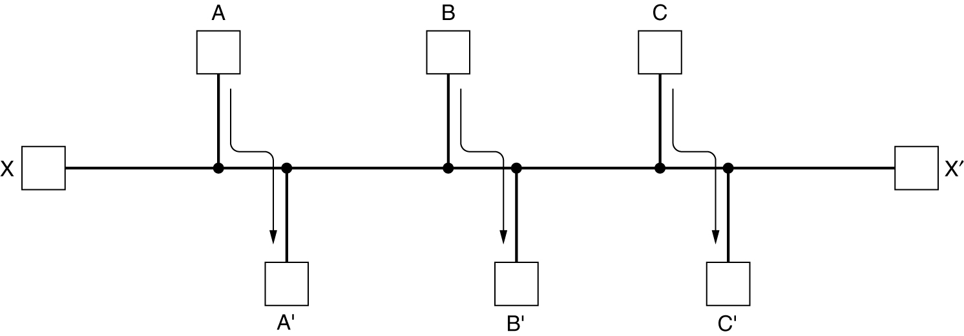
Fairness and optimally may sound obvious-surely no reasonable person would oppose them-but as it turns out, they often contradictory goals. Suppose that there is enough traffic between A and A', between B and B', and between C and C' to saturate the horizontal links. To maximize the total flow, the X and X' traffic should be shut off altogether. Unfortunately X and X' nay not see it that way. Evidently some compromise between global efficiency and fairness to individual connections is needed.
Conflict between fairness and optimality.
In context of fairness and optimality, we actually need to reduce delay of packet. The routing algorithm attempt to minimize the number of hops to reduce delay and increase the throughput.

Slide 12
The Optimality Principle
It states that if router J is on the optimal path from router I to router K, then the optimal path from J to K also falls along the same route. To see this, call the part of the route from I to J is r₁ and the rest of the route r₂. If a route better than r₂ existed from J to K, it could be concatenated with r₁ to improve the route from I to K, contradicting our statement that r₁r₂ is optimal.
r1
I
K
J
r2

Slide 13
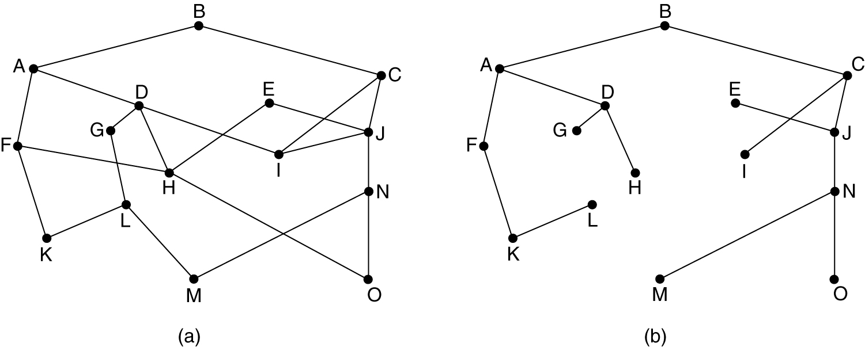
A subnet is represented by a graph, G = (V, E), where routers are the vertices and links are the edges. A tree is a connected undirected graph with no simple circuits
Consider a terminal of a network as the destination and the rest of the node are sources. Draw the optimal path from each source to the destination node. You will get a routed tree where the destination node will be the root of the tree. Such tree is called sink tree. The sink tree of the network is not unique.
(a) A subnet. (b) A sink tree for router B
What is the drawback of such algorithm?

Slide 14
Exercise
Draw the sink tree taking A as the root/destination.
A
5
4
8
5
7
2
1
9
4
3
4
15
12
14
5
9
3
9
7
6
9
2
11
15

Slide 15
Let G be a simple graph. A spanning tree of G is a subgraph of G that is a tree containing every vertex of G.
A minimum spanning tree in a connected weighted graph is a spanning tree that has the smallest possible sum of weights of its edges.
Prim’s Algorithm of minimum spanning tree
procedure Prim(G: weighted connected undirected graph with n vertices)
T := a minimum-weight edge
for i := 1 to n − 2
e := an edge of minimum weight incident to a vertex in T and not forming a
simple circuit in T if added to T
T := T with e added
return T {T is a minimum spanning tree of G}

Slide 16
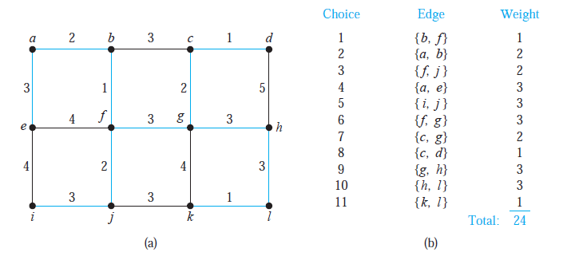
Ex.
Use Prim’s algorithm to find a minimum spanning tree in the graph shown in Figure 3.

Slide 17
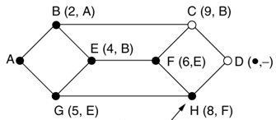
Shortest Path Routing
The concept of shortest path deserves some explanation. One way of measuring path length is the number of hops. Using this metric, path ABC = path ABE.
Another metric is the geographic distance in Km, in this case path ABC > path ABE.
Usually path distance is function of: distance related to propagation delay, BW/ link capacity in bps, average traffic load on the link, communication cost (in case of leased line), mean queue length of routers along the path ( related to delay) etc. The combinations of above criteria the algorithm measures the shortest path.

Slide 18
Each link is weighted using above criteria (weighted graph). Each node is labeled (in parentheses) with its distance from the source node. Initially, no paths are known, so all nodes are labeled with infinity. As the algorithm proceeds and path are found, the labels may change, reflecting better paths.

Slide 19
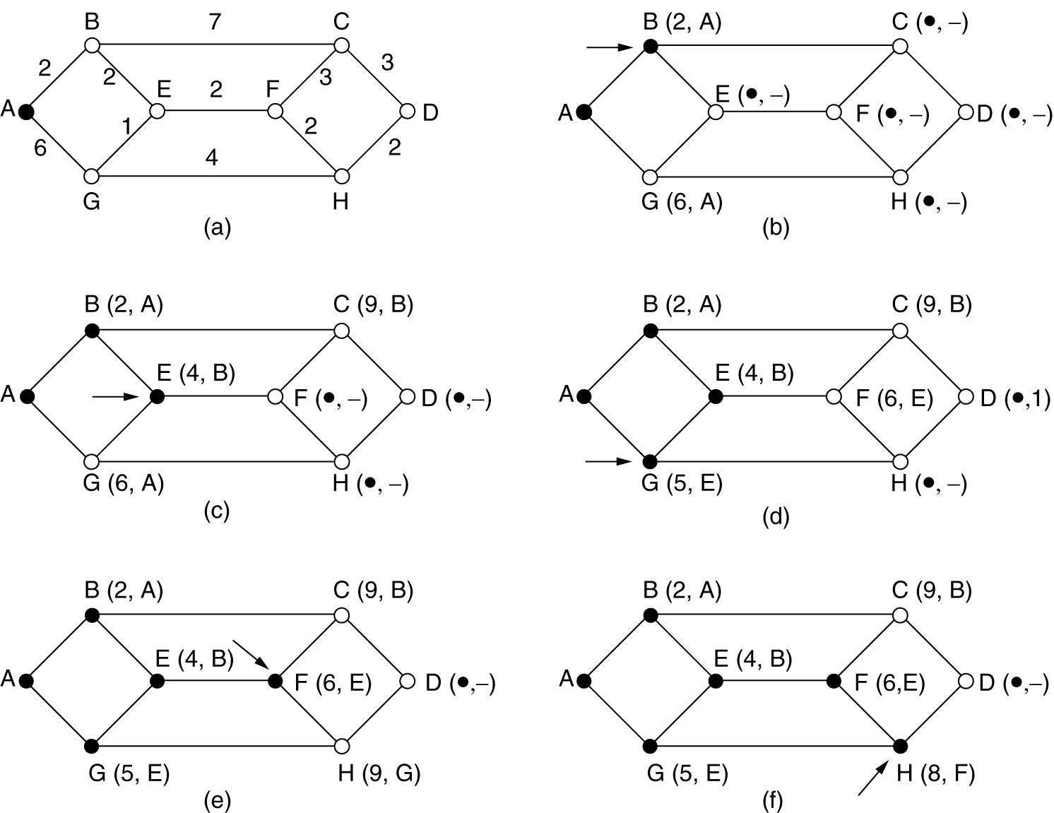
Shortest Path Routing Example

Slide 20
Flooding
Flooding is a static algorithm in which every incoming packet is sent out on every outgoing line except the one it arrived on. Flooding obviously generates vast numbers of duplicating packets. Several remedial measures are taken against huge duplications of packets:
Using hop counter in the header of each packet.
An alternative technique for damming the flood is to keep track of which packets have been flooded, to avoid sending them out a second time.
Using selective flooding algorithm where the routers do not send every incoming packet out on every line, only on those lines that are going approximately in the right direction.

Slide 21
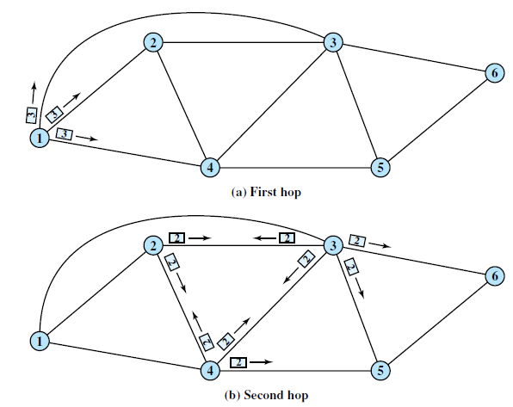
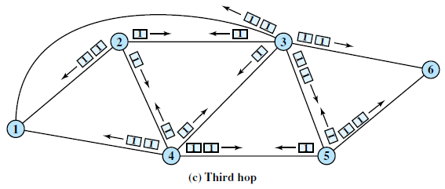
Flooding Example: hop count = 3

Slide 22
Flooding is not practical in most applications, but it does have some uses. For example, in military applications, where a large number of routers may be blown at any instant, the tremendous robustness of flooding is highly desirable.
In wireless networks, all messages are transmitted by a station can be received by all other stations within its radio range (because of unguided communications) which is in fact flooding.

Slide 23
Distance Vector Routing
Two dynamic algorithms: distance vector routing and link state routing are most popular. Distance vector routing algorithms operate by having each router maintain a table (vector) giving the best known distance to each destination and which line to use to get there. These tables are updated by exchanging information with the neighbors.
The entry of the table contains two parts: the preferred outgoing line to use for that destination and an estimate of the time or distance to that destination. The metric used might be the number of hops, time delay in ms, total number of packets queued along the path, or some thing similar.

Slide 24
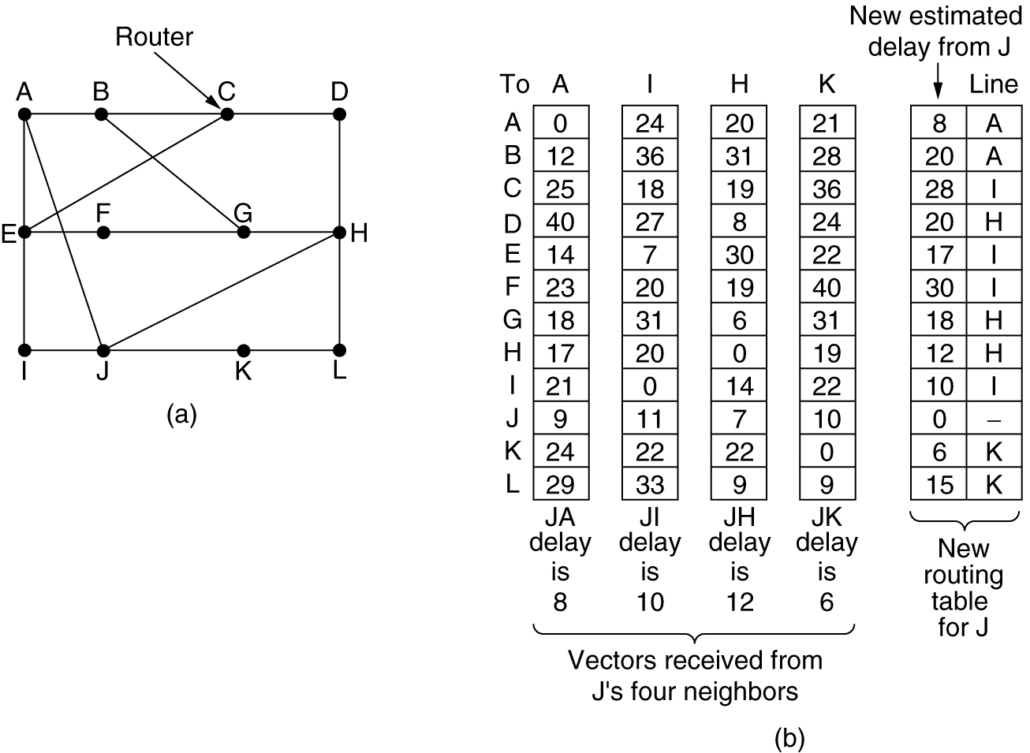
Assume that delay is used as a metric and that router knows the delay to each of its neighbors. Once every T ms each router sends to each neighbor a list of its estimated delays to each destination. It also receives a similar lists from each neighbor. Let the delay from router X to J is r ms and the delay from I to X is p ms. Now the delay from I to J will be r+p ms. In this way each router updates its table. The routers can find its delay with neighbors sending echo packets.

Slide 25
The updating process is illustrated in fig. below considering a subnet. Router J has four neighbors A, I, H, and K. The first four columns of fig.(b) shows the delay vectors received from the neighbors of router J.
(a) A subnet. (b) Input from A, I, H, K, and the new routing table for J.

Slide 26
Now assume that some delays are changed shown below the table. Now the new routing table of J will be:
Delay from J to G via A, JA+AG = 8 + 18 = 26ms
Delay from J to G via I, JI+IG = 10 + 31 = 41ms
Delay from J to G via H, JH+HG = 12 + 6 = 18ms
Delay from J to G via K, JK+KG = 6 + 31 = 37ms

Slide 27
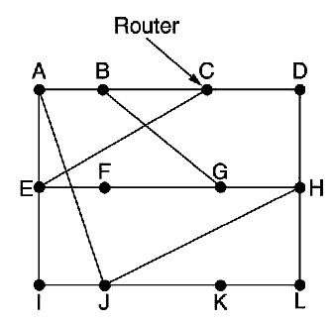
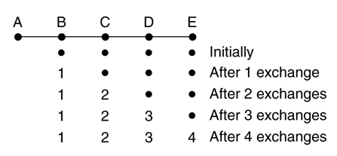
The count-to-infinity problem
The distance vector routing react rapidly to good news, but leisure to bad news. To see how fast good news propagates, consider the five-node (linear) subnet of fig. below, where the delay metric is the number of hops. Suppose A is down initially and all the other routers know this. In other words, they have all recorded the delay to A as infinity.
Good news

Slide 28
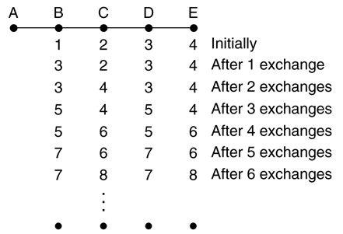
Now let us consider the situation of fig. below in which all the lines and routers are initially up. Routers B, C, D, and E have distances to A of 1, 2, 3, and 4, respectively. Suddenly A goes down, or alternatively, the line between A and B is cut, which is effectively the same thing from B's point of view.
Bad News

