Slide 1
Lecture-5
CSE-3101
Computer Networking
Mala Rani Barman
Assistant Professor, Department of Computer Science and Engineering
Sheikh Hasina University

Slide 2
Transport Layer

Slide 3
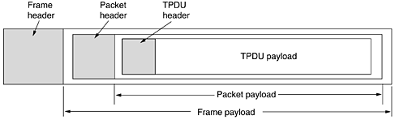
The task of transport layer is to provide reliable, cost-effective data transport from the source machine to the destination machine, independently of the physical network.
The hardware and/or software within the transport layer that does the work is called the transport entity. For lack of a better term, we will reluctantly use the somewhat ungainly acronym TPDU (Transport Protocol Data Unit) for messages sent from transport entity to transport entity.

Slide 4
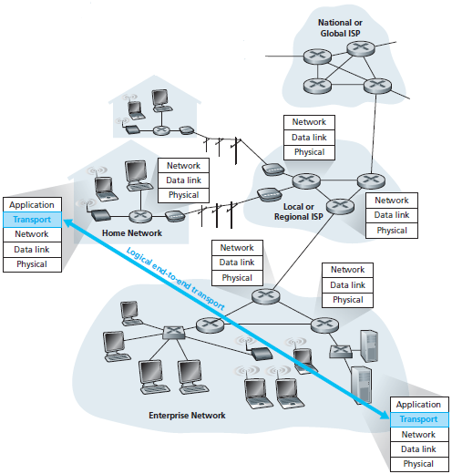
A transport-layer protocol provides logical communication between processes running on different hosts, a network-layer protocol provides logical communication between hosts. This distinction is subtle but important. Let’s examine this distinction with the aid of a household analogy.
The transport layer provides logical rather than physical communication between application processes.

Slide 5
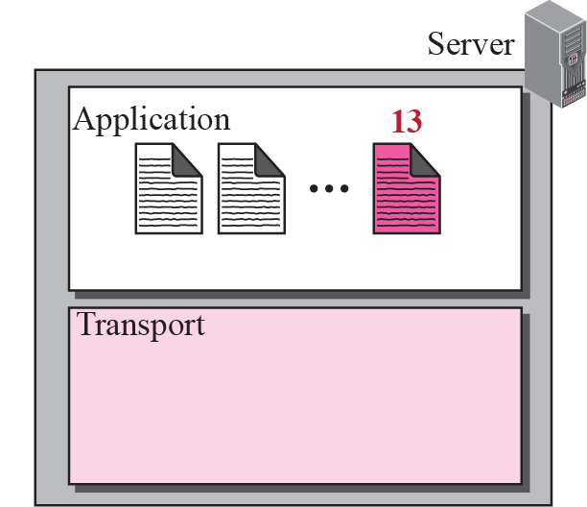
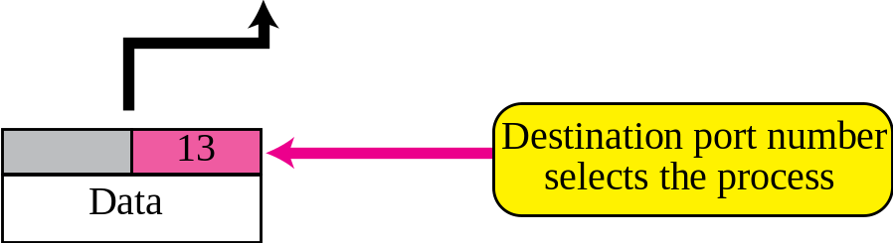
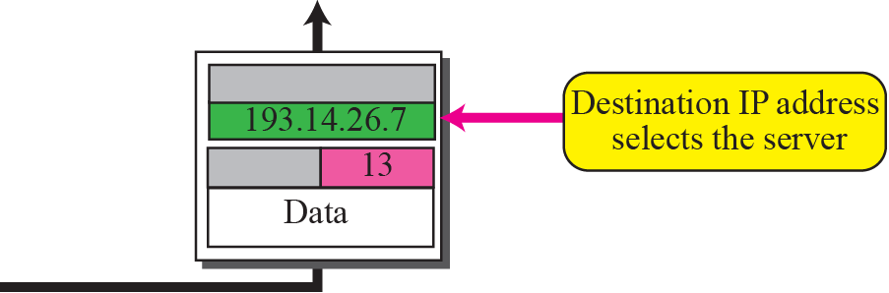
Port Number in Transport Packet

Slide 6
Household Analogy
Consider two houses, one on the Dhaka and the other on the Khulna, with each house being home to a dozen kids. The kids in the Dhaka household are cousins of the kids in the Khulna household. The kids in the two households love to write to each other—each kid writes each cousin every week, with each letter delivered by the traditional postal service in a separate envelope. Thus, each household sends 144 letters to the other household every week.
In each of the households there is one kid—Roshid in the Khulna house and Hasan in the Dhaka house—responsible for mail collection and mail distribution. Each week Roshid visits all her brothers and sisters, collects the mail, and gives the mail to a postal-service mail carrier, who makes daily visits to the house. When letters arrive at the Khulna house, Roshid also has the job of distributing the mail to her brothers and sisters. Hasan has a similar job on the Dhaka.

Slide 7
In this example, the postal service provides logical communication between the two houses—the postal service moves mail from house to house, not from person to person. On the other hand, Roshid and Hasan provide logical communication among the cousins — Roshid and Hasan pick up mail from, and deliver mail to, their brothers and sisters.
application messages = letters in envelopes
processes = cousins
hosts (also called end systems) = houses
transport-layer protocol = Roshid and Hasan
network-layer protocol = postal service (including mail carriers)

Slide 8
On the sending side, the transport layer converts the application-layer messages it receives from a sending application process into transport-layer packets, known as transport-layer segments in Internet terminology.
This is done by (possibly) breaking the application messages into smaller chunks and adding a transport-layer header to each chunk to create the transport-layer segment.
The Internet has two main protocols in the transport layer, a connectionless protocol and a connection-oriented one. In the following sections we will study both of them. The connectionless protocol is UDP (User Datagram Protocol). The connection-oriented protocol is TCP (Transmission Control Protocol ).

Slide 9
Transport-layer multiplexing and demultiplexing
The most fundamental responsibility of UDP and TCP is to extend IP’s delivery service between two end systems to a delivery service between two processes running on the end systems. Extending host-to-host delivery to process-to-process delivery is called transport-layer multiplexing and demultiplexing.
Suppose you are sitting in front of your computer, and you are downloading Web pages while running one FTP session and two Telnet sessions. You therefore have four network application processes running—two Telnet processes, one FTP process, and one HTTP process. When the transport layer in your computer receives data from the network layer below, it needs to direct the received data to one of these four processes.

Slide 10
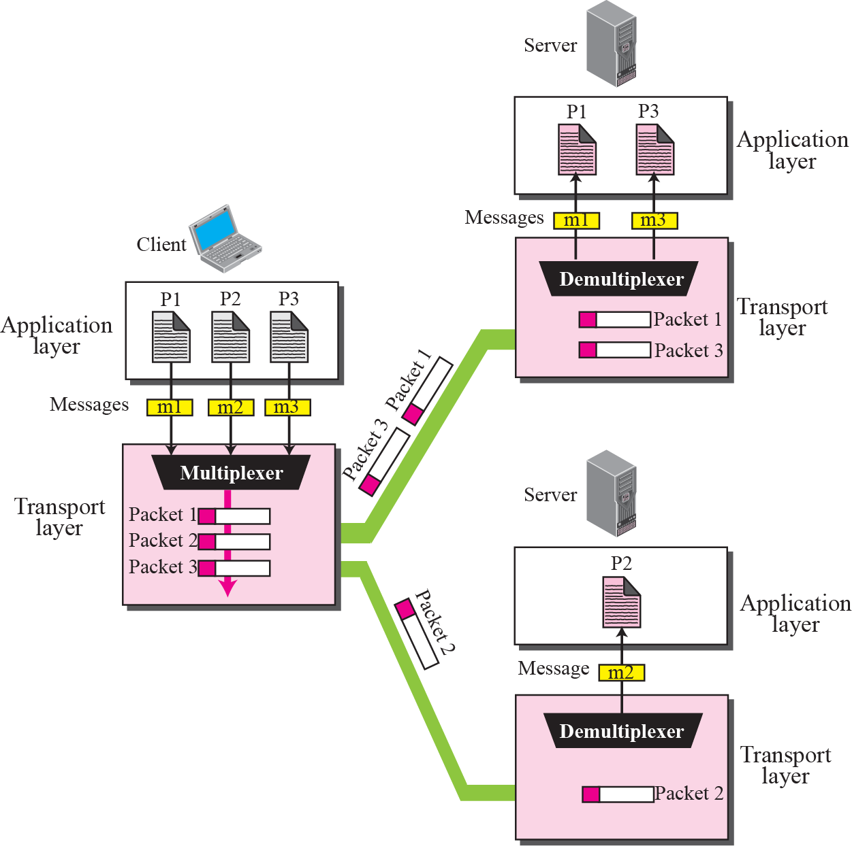
Multiplexing and De-multiplexing

Slide 11
Connection Establishment
Establishing a connection sounds easy, but it is actually surprisingly tricky. At first glance, it would seem sufficient for one transport entity to just send a CONNECTION REQUEST TPDU to the destination and wait for a CONNECTION ACCEPTED reply. The problem occurs when the network can lose, store, and duplicate packets. This behavior causes serious complications.

Slide 12
The worst possible nightmare is as follows. A user establishes a connection with a bank, sends messages telling the bank to transfer a large amount of money to the account of a not-entirely-trustworthy person, and then releases the connection.
Unfortunately, each packet in the scenario is duplicated and stored in the subnet. After the connection has been released, all the packets pop out of the subnet and arrive at the destination in order, asking the bank to establish a new connection, transfer money (again), and release the connection.
The bank has no way of telling that these are duplicates. It must assume that this is a second, independent transaction, and transfers the money again.

Slide 13
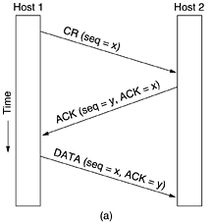
Tomlinson (1975) introduced the three-way handshake. The normal setup procedure when host 1 initiates is shown in fig. below. Host 1 chooses a sequence number, x, and sends a CONNECTION REQUEST TPDU containing it to host 2.
Host 2 replies with an ACK TPDU acknowledging x and announcing its own initial sequence number, y. Finally, host 1 acknowledges host 2's choice of an initial sequence number in the first data TPDU that it sends.

Slide 14
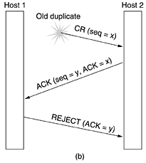
Now let us see how the three-way handshake works in the presence of delayed duplicate control TPDUs.
In Fig. below, the first TPDU is a delayed duplicate CONNECTION REQUEST from an old connection. This TPDU arrives at host 2 without host 1's knowledge. Host 2 reacts to this TPDU by sending host 1 an ACK TPDU, in effect asking for verification that host 1 was indeed trying to set up a new connection. When host 1 rejects host 2's attempt to establish a connection, host 2 realizes that it was tricked by a delayed duplicate and abandons the connection. In this way, a delayed duplicate does no damage.

Slide 15
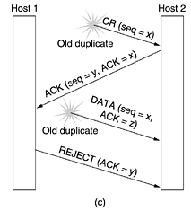
The worst case is when both a delayed CONNECTION REQUEST and an ACK are floating around in the subnet. This case is shown in Fig. below.
As in the previous example, host 2 gets a delayed CONNECTION REQUEST and replies to it. At this point it is crucial to realize that host 2 has proposed using y as the initial sequence number for host 2 to host 1 traffic, knowing full well that no TPDUs containing sequence number y or acknowledgements to y are still in existence.
When the second delayed TPDU arrives at host 2, the fact that z has been acknowledged rather than y tells host 2 that this, too, is an old duplicate. The important thing to realize here is that there is no combination of old TPDUs that can cause the protocol to fail and have a connection set up by accident when no one wants it.

Slide 16
Connection Release
Releasing a connection is easier than establishing one. Nevertheless, there are more pitfalls than one might expect. As we mentioned earlier, there are two styles of terminating a connection: asymmetric release and symmetric release.
Asymmetric release is the way the telephone system works: when one party hangs up, the connection is broken. Symmetric release treats the connection as two separate unidirectional connections and requires each one to be released separately.

Slide 17
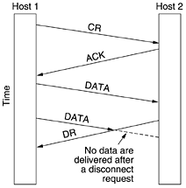
Asymmetric release is abrupt and may result in data loss. Consider the scenario of Fig. below. After the connection is established, host 1 sends a TPDU that arrives properly at host 2. Then host 1 sends another TPDU. Unfortunately, host 2 issues a DISCONNECT before the second TPDU arrives. The result is that the connection is released and data are lost.
Clearly, a more sophisticated release protocol is needed to avoid data loss.

Slide 18
Clearly, a more sophisticated release protocol is needed to avoid data loss. One way is to use symmetric release, in which each direction is released independently of the other one. Here, a host can continue to receive data even after it has sent a DISCONNECT TPDU.
Symmetric release does the job when each process has a fixed amount of data to send and clearly knows when it has sent it.

Slide 19
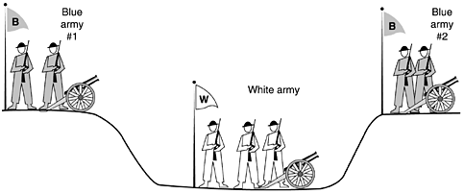
One can envision a protocol in which host 1 says: I am done. Are you done too? If host 2 responds: I am done too. Goodbye, the connection can be safely released. Unfortunately, this protocol does not always work. There is a famous problem that illustrates this issue. It is called the two-army problem.

Slide 20
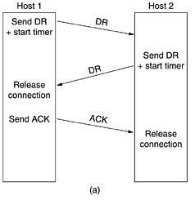
We will next consider using a three-way handshake for four scenarios of releasing connection.
In Fig. (a), we see the normal case in which one of the users sends a DR (DISCONNECTION REQUEST) TPDU to initiate the connection release. When it arrives, the recipient sends back a DR TPDU, too, and starts a timer, just in case its DR is lost. When this DR arrives, the original sender sends back an ACK TPDU and releases the connection. Finally, when the ACK TPDU arrives, the receiver also releases the connection.

Slide 21
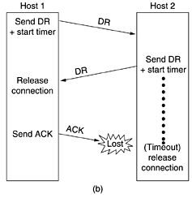
If the final ACK TPDU is lost, as shown in Fig. 6-14(b), the situation is saved by the timer. When the timer expires, the connection is released anyway.

Slide 22
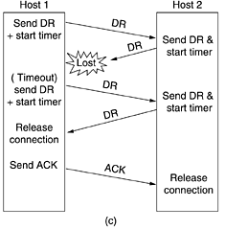
Now consider the case of the second DR being lost. The user initiating the disconnection will not receive the expected response, will time out, and will start all over again. In Fig. (c) we see how this works, assuming that the second time no TPDUs are lost and all TPDUs are delivered correctly and on time.

Slide 23
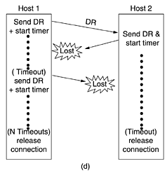
Our last scenario, Fig. (d), is the same as Fig. (c) except that now we assume all the repeated attempts to retransmit the DR also fail due to lost TPDUs. After N retries, the sender just gives up and releases the connection. Meanwhile, the receiver times out and also exits.

Slide 24
The TCP Segment Header

Slide 25
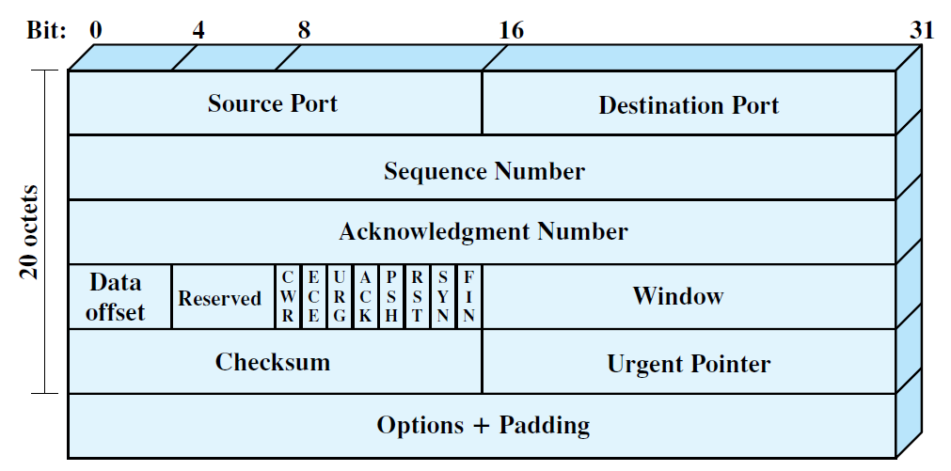
TCP Header

Slide 26
Source Port (16 bits): Source TCP user. Example values are Telnet 23;A complete list is maintained at http://www.iana.org/
assignments/port-numbers.
Destination Port (16 bits): Destination TCP user.
Sequence Number (32 bits): Sequence number of the first data octet in this segment except when the SYN flag is set. If SYN is set, this field contains the initial sequence number (ISN) and the first data octet in this segment has sequence number ISN + 1.

Slide 27
Acknowledgment Number (32 bits): Contains the sequence number of the
next data octet that the TCP entity expects to receive.
Data Offset (4 bits): Number of 32-bit words in the header.
Reserved (4 bits): Reserved for future use.
Flags (6 bits): For each flag, if set to 1, the meaning is
CWR: congestion window reduced.
ECE: ECN-Echo; the CWR and ECE bits, defined in RFC 3168, are used for the explicit congestion notification function; a discussion of this function is beyond our scope.
URG: urgent pointer field significant.
ACK: acknowledgment field significant.
PSH: push function.
RST: reset the connection.
SYN: synchronize the sequence numbers.
FIN: no more data from sender.

Slide 28
The Sequence Number and Acknowledgment Number are bound to octets rather than to entire segments. For example, if a segment contains sequence number 1001 and includes 600 octets of data, the sequence number refers to the first octet in the data field; the next segment in logical order will have sequence number 1601.

Slide 29

UDP transmits segments consisting of an 8-byte header followed by the payload. The header is shown in Fig. 6-23. The two ports serve to identify the end points within the source and destination machines. When a UDP packet arrives, its payload is handed to the process attached to the destination port.

Slide 30
TCP Congestion Control

Slide 31
TCP Congestion Control
When the load offered to any network is more than it can handle, congestion builds up.
The Internet is no exception. Before discussing how TCP reacts to congestion, let us first describe what it does to try to prevent congestion from occurring in the first place.
When a connection is established, a suitable window size has to be chosen. The receiver can specify a window based on its buffer size. If the sender sticks to this window size, problems will not occur due to buffer overflow at the receiving end, but they may still occur due to internal congestion within the network.

Slide 32
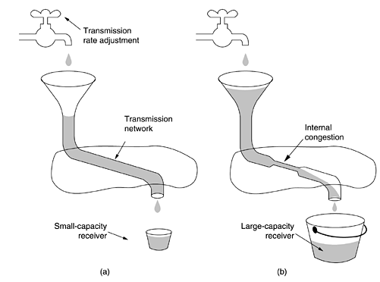
In Fig.(a)-(b), we see this problem illustrated hydraulically. In Fig. (a), we see a thick pipe leading to a small-capacity receiver. As long as the sender does not send more water than the bucket can contain, no water will be lost. In Fig. (b) the limiting factor is not the bucket capacity, but the internal carrying capacity of the network. If too much water comes in too fast, it will back up and some will be lost (in this case by overflowing the funnel).
Figure (a) A fast network feeding a low-capacity receiver. (b) A slow network feeding a high-capacity receiver.

Slide 33
The Internet solution is to realize that two potential problems exist: network capacity and receiver capacity and to deal with each of them separately. To do so, each sender maintains two windows: the window the receiver has granted and a second window, the congestion window.
Congestion Window
TCP maintains a new state variable for each connection, called Congestion Window, which is used by the source to limit how much data it is allowed to have in transit at a given time. The unit of Congestion Window is packets

Slide 34
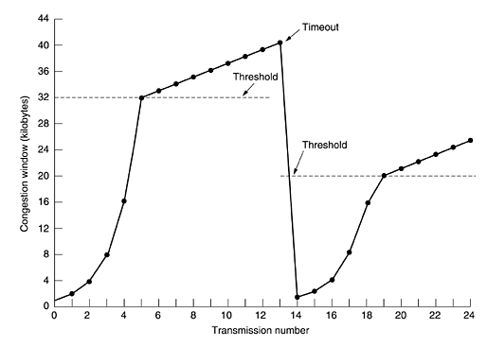
Internet congestion control algorithm
As an illustration of how the congestion algorithm works, see Fig. below. The maximum segment size (the size of a packet is called maximum segment size in TCP terminology) here is 1024 bytes or 1KB. Congestion Window is not allowed to fall below the size of a single packet.
After timeout the algorithm starts with size of the congestion window = size of a packet = 1KB.

Slide 35
The threshold value of congestion window is the maximum allowed value of the congestion window till which the window grows exponentially. The exponential growth means congestion window W, is increased by 1/W each time a regular ACK is received
Initially, the congestion window was 64 KB, but a timeout occurred, so the threshold is set to 32 KB and the congestion window to 1 KB for transmission 0 here. The congestion window then grows exponentially until it hits the threshold (32 KB). Starting then, it grows linearly.
Figure An example of the Internet congestion algorithm.

Slide 36
If no more timeouts occur, the congestion window will continue to grow up to the size of the receiver's window. At that point, it will stop growing and remain constant as long as there are no more timeouts and the receiver's window does not change size.
If the loss is detected by the triple dup ACKs, cwnd = cwnd / 2, and remain in congestion avoidance phase i.e. linear rise in cwnd.
Triple duplicate ACK
  Packet n is lost, but packets n+1, n+2, etc. arrive
  Receiver sends duplicate acknowledgments and the sender retransmits packet n quickly
  Do a multiplicative decrease and keep going

Slide 37
Slow Start in Action
Double CWND per round-trip time
1
2
4
8
Src
D
A
D
D
A
A
D
D
D
D
A
A
A
A
Dest
Two packets generated per acknowledgement
The window doubles on every round trip time – until loss occurs
Rapidly finds the correct window size for the path

Slide 38
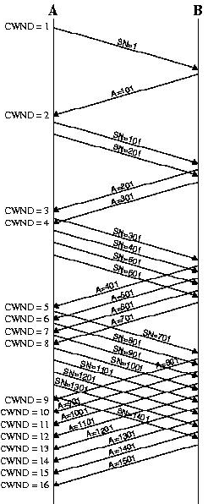
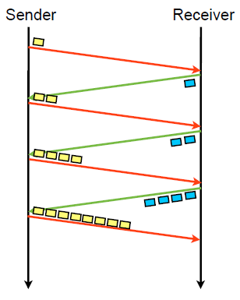
The terms slow start is a bit of misnomer, because cwnd actually grows exponentially.
Fig. Slow start

Slide 39
TCP Mechanisms
Congestion Avoidance (CA) and Slow-Start (SS)
Slow-start phase at beginning of a session
Sawtooth-like window evolution during CA
W
Receiver window
Updated Slow start
threshold
Slow start
threshold
Congestion
Avoidance
CA
halved
Slow Start
SS
Time
Loss detected via Timeout
Loss detected via duplicate ACKs
Fast retransmit+Fast recovery
Notes:
During file transfers TCP moves between several states:
TCP starts with with a slow-start phase. The goal of SS is to quickly probe for available bandwidth, and thus the window is increased exponentially fast
After hiiting the SS threshold TCP moves to congestion avoidance phase, in which the window is adapted using the AIMD described previously
The increase in the window continues till the maximum receiver side is reached or till a loss occurs.
The last interval demonstrates that the AIMD mechansim results in a sawtooth like window evolution

Slide 40
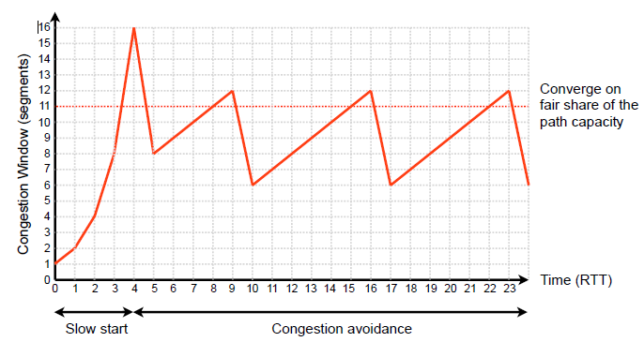
Typical evolution of TCP window, assuming Winit = 1

Slide 41
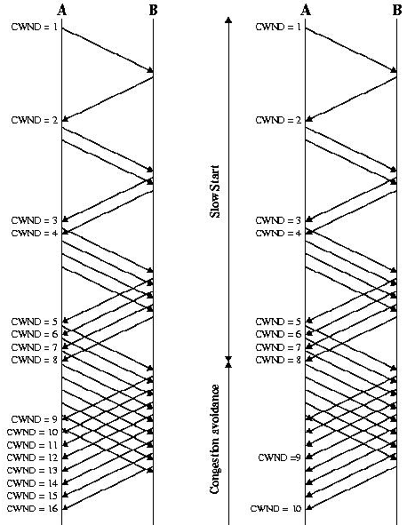
Slow starts, ending with a timeout
Slow starts, followed by congestion avoidance

Slide 42
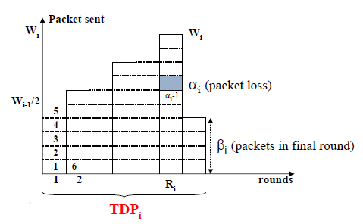
TD period (Triple-Duplicate ACKs Period, TDP) is a period between two consecutive TD loss. Let us concentrate on the i-th TDP when α_{i}th packet is lost,
Y_{i} : # packets sent in the period
A_{i} : the duration of the period
W_{i}: the window size at the end of the period
A total of Y_{i} = α_{i}+ (W_{i}) – 1; considering average position of α_{i}th packet in the middle of last window.

Slide 43
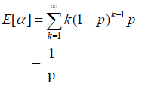
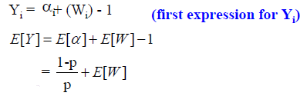
We assume packets losses occur in a round independently with probability p.
The probability that k-1 packets are sent before a packet is lost is,
P[α = k] = (1− p)^{k−1} p
The expected number of packets that are lost is
The expected number of packets transmitted is

Slide 44
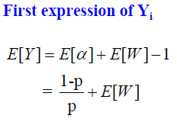
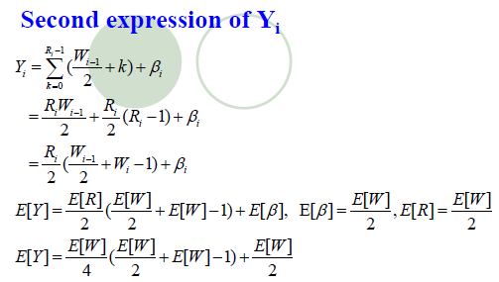
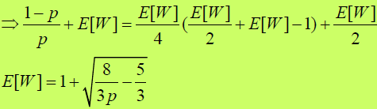

Slide 45
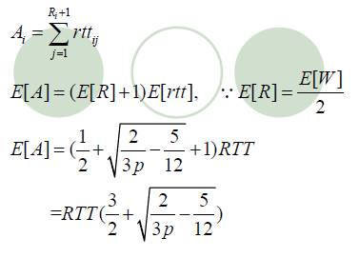
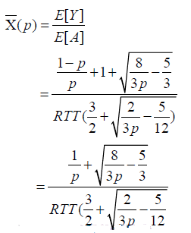
Expected duration of the period Ai
;Where RTT is the duration of a round
Average sending rate

