Slide 1
Lecture-7
CSE-3101
Computer Networking
Mala Rani Barman
Assistant Professor, Department of Computer Science and Engineering
Sheikh Hasina University

Slide 2
Computer networks are typically a shared resource used by many applications representing different interests. The Internet is particularly widely shared, being used by competing businesses, mutually antagonistic governments, and opportunistic criminals. Unless security measures are taken, a network conversation or a distributed application may be compromised by an adversary.
The main tools for securing networked systems are cryptography and firewalls.

Slide 3
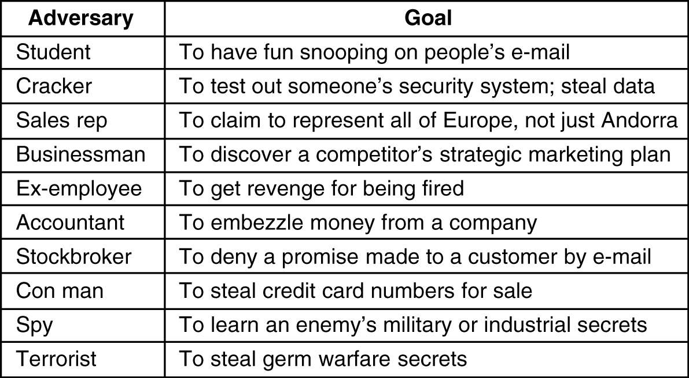
Need for Security
Some people who cause security problems and why.

Slide 4
An Introduction to Cryptography
Cryptography comes from the Greek words for ‘secret writing.’ It has a long and colorful history going back thousands of years.
Professionals make a distinction between cipher and codes. A cipher is a character-for-character or bit-for-bit transformation, without regard to the linguistic structure of the messages. In contrast, a code replace one word with another word or symbol.
Historically four groups of people have used and contributed to the art of cryptography: the military, the diplomatic corps, diarists and lovers.

Slide 5
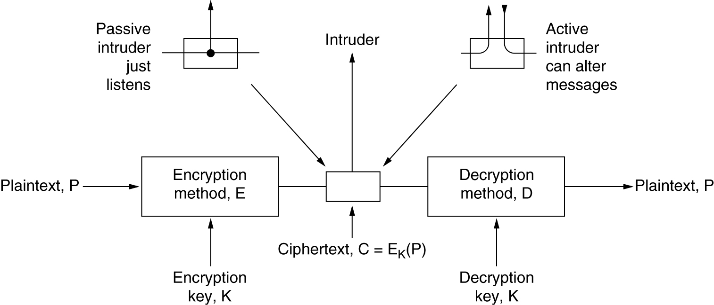
The messages to be encrypted, known as plaintext, are transformed by a function that parameterized by a key. The output of the encryption process, known as the ciphertext, is then transmitted, often by messenger or radio. We assume that the enemy or intruder, hears and accurately copies down the complete ciphertext.
The encryption model (for a symmetric-key cipher)

Slide 6
Sometimes the intruder can only listen to the communication channel (passive intruder) but can also record messages and play them back later, inject his own messages or modify legitimate messages before they get to the receiver (active intruder).
The art of breaking ciphers, called cryptanalysis and the art devising them (cryptography) is collectively known as cryptology.

Slide 7
It will often be useful to have a notation for relating plaintext, ciphertext and keys. We will use C = E_{K}(P) to mean that the encryption of the plaintext P using key K gives the ciphertext C. Similarly, P = D_{K}(C) represents the decryption of C to get the plaintext again. Therefore, D_{K}(E_{K}(P)) = P.

Slide 8
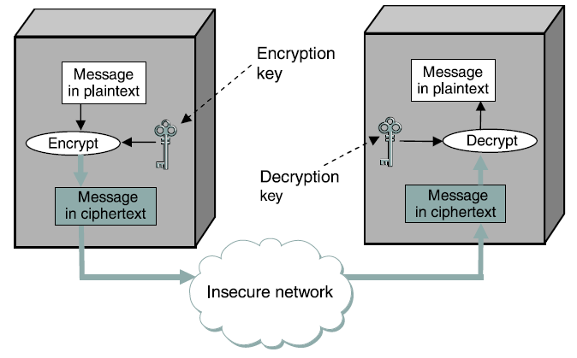
The sender applies an encryption function to the original plaintext message, resulting in a ciphertext message that is sent over the network, as in fig. below. In a symmetric-key cipher, both participants in a communication share the same key. In other words, if a message is encrypted using a particular key, the same key is required for decrypting the message.
Symmetric-key encryption and decryption

Slide 9
Encryption methods have historically been divided into two categories: substitution ciphers and transposition ciphers.
Substitution Ciphers
In substitution cipher each letter or group of letters is replaced by another letter or group of letters to disguise it.
One of the oldest ciphers is the Caesar cipher, attributed to Julius Caesar. In this method a becomes D, b becomes E, c becomes F, …….., z becomes C. For example attack becomes DWWDFN.
A slight generalization of the Caesar cipher allows the ciphertext alphabet to be shifted by k letters, instead of always 3. In this case k becomes a key to the general method of circularly shifted alphabets.

Slide 10
The next improvement is to have the symbols in the plaintext, say, the 26 letters for simplicity map onto some other letters. For example:
Plaintext: a b c d e f g h i j k l m n o p q r s t u v w x y z
Ciphertext: Q W E R T Y U I O P A S D F G H J K L Z X C V B N M
The general system of symbol-for-symbol substitution is called momoalphabetic substitution, with the key being 26-letter string corresponding to the full alphabet. Now attach become QZZQEA.
At first this might appeared to be safe because it requires 26! Keys and take 10¹⁰ years if each trial needs 1nsec.
Statistical distribution of letters will be changed.

Slide 11
In English, e is the most common letter, followed by t, o, a, n, i etc.
Digrams: th, in, er, re and an.
Trigrams: the, ing, and and ion.
From the most frequent letter, T = e.
tXe will be the i.e. X= h
thYt will be that i.e. Y=a

Slide 12
Example-1: Ciphetext from an accounting firm should contains financial
CTBMN BYCTC BTJDS QXBNS GSTJC BTSWX CTQTZ CQVUJ
QJSGS TJQZT MNQJS VLNSX VSZJU JDSSTS JQUUS JUBXJ
DSKSU JSNTK BGAQJ ZBGYQ TLCTZ BLCTZ BNYBN QJSW
Using our knowledge that financial has a repeated letter (i), with four other letters between their occurrences. We look for repeated letters in the ciphertext at this spacing. We find 12 hits at positions 6, 15, 27, 31, 42, 48, 56,66, 70, 71, 76 and 82. However, only two of these, 31 and 42, have the next letter( corresponding to n in the plaintext) repeated in the popper place. Of these two only 31 also has the a correctly positioned, so we know that financial begins at position 30.

Slide 13
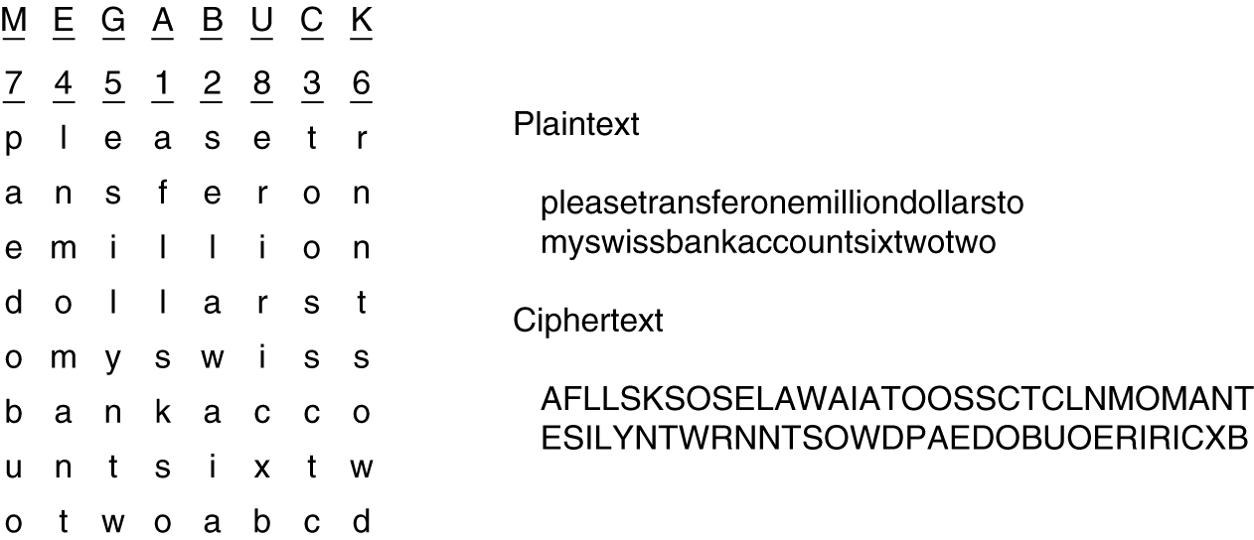
Transposition Ciphers
Transpositional ciphers in contrast reorder the letters but do not disguise them. Therefore statistical distribution of letters will remain same. The cipher is keyed by a word or phrase not containing any repeated letters. In this example, MEGABUCK is the key. If the intruder assume that the plain text contains milliondollar then he can try to beak it
Fig.2 A transposition cipher.

Slide 14
The cryptanalyst must first aware he is dealing with transposition cipher (from the statistical distribution of letters).
For example, suppose that our cryptanalyst suspects that the plaintext phrase milliondollars occurs somewhere in the message. Observe that digrams MO, IL, LL, LA, IR and OS occur in the ciphertext as a result of this phrase wrapping around.

Slide 15
The ciphertext letter O follows the ciphertext letter M (they are vertically adjacent in column 4) because they are separated in the probable phrase by a distance equal to the key length. If a key length seven had been used, the digrams: MD, IO, LL, LL, IA , OR and NS would have occurred instead.
By hunting for various possibilities, the cryptanalyst can easily find the key length.
The ramaining step is to order the columns. If the key length is k then k(K-1) column pair can be examined to see if its digram frequencies match those for English plaintext.

Slide 16
Public-Key Algorithms
Key had to be protected from theft, but they also had to be distributed.
In 1976, two researcher at Stanford University, Diffie and Hellman (1976) proposed a radically new kind of cryptosystem, one in which the encryption and decryption key were different, and the decryption key could not feasibly be derived from the encryption key. In their proposal, the (keyed) encryption algorithm, E, and the (keyed) decryption algorithm, D, had to meet three requirements:
D(E(P)) = P
It is exceedingly difficult to deduce D from E.
E can not be broken by a chosen plaintext attack.

Slide 17
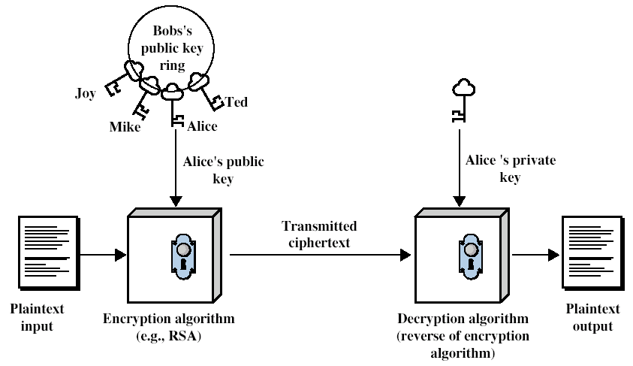
Public-key cryptography requires each user to have two key: a public key, used by the entire world for encrypting messages to be sent to that user and a private key, which the user needs for decrypting message.

Slide 18
RSA
One good method was discovered by a group at M.I.T. , 1978 known as RSA( Rivest, Shamir, Adleman). The RSA method is based on some principles from number theory.
1. Select two large primes: p = 17, q = 11 (typically 1024 bits)
2. Compute n = pq = 17×11 = 187 and z = (p–1)(q-1) = 16×10 = 160
3. Select d: gcd (d, 160) = 1 and d < 160. Actually d is a number
relatively prime to z. (for example d = 7)
4. choose e such that de = 1 mod z (We will divide de = 7e by z =160 and the remainder will be 1 for example you can get e = 23)

Slide 19
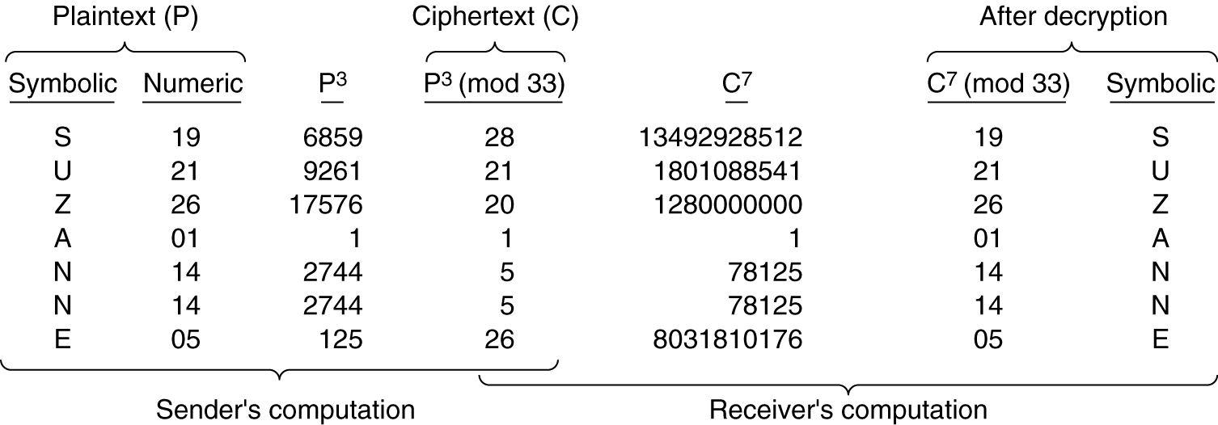
To encrypt a message, P, compute C = P^{e}(mod n). To decrypt C, compute P = C^{d} (mod n).
Let, p = 3, q = 11
n = pq = 33, z = (p-1)(q-1) = 20
d = 7, since 20 and 7 does not have common factor
Now 7e = 1 mod 20 which provides e = 3
C = P³ (mod 33) which provides encoded value C
Fig. An example of the RSA algorithm.

Slide 20
RSA In Image Encryption and Decryption
e = 3;
n = 33;
d = 7;
N=256;
I=imread('17.jpg');
I=rgb2gray(I);
I=imresize(I,[N, N]);
subplot(2,2,1)
imshow(I)
title('Original Image')
R=mod(I,16);
R=double(R);
I=double(I);
for i=1:N
for j=1:N
Q(i,j)=round(deconv(I(i,j),16)-0.5);
% quisont of the image
end
end

Slide 21
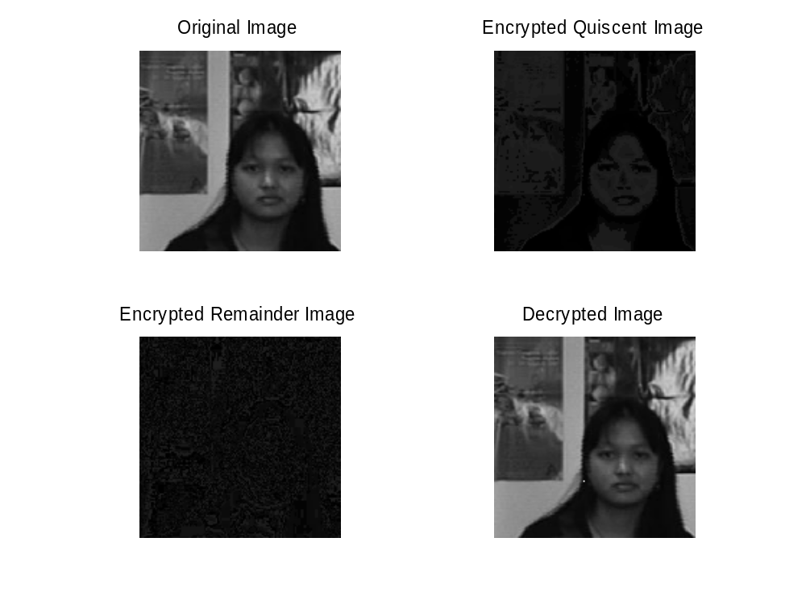
for i =1:N
for j = 1:N
Qe(i, j)=mod(Q(i,j)^e, n);
Re(i, j)=mod(R(i,j)^e, n);
%Decryption of image
Qd(i, j)=mod(Qe(i,j)^d, n);
Rd(i, j)=mod(Re(i,j)^d, n);
end
End
Rec=Qd*16+Rd;
subplot(2,2,2)
imshow(uint8(Qe))
title('Encrypted Quiscent Image')
subplot(2,2,3)
imshow(uint8(Re))
title('Encrypted Remainder Image')
subplot(2,2,4)
imshow(uint8(Rec))
title('Decrypted Image')

Slide 22
Digital Signatures
The authority of many legal, financial and other documents is determined by the presence or absence of an authorized handwritten signature.
Basically, what is needed is a system by which one party can send a signed message to another party in such a way that the following conditions holds:
The receiver can verify the claimed identity of the sender.
The sender cannot later repudiate (deny) the contents of the message.
The receiver cannot possibly have concocted the message himself.

Slide 23
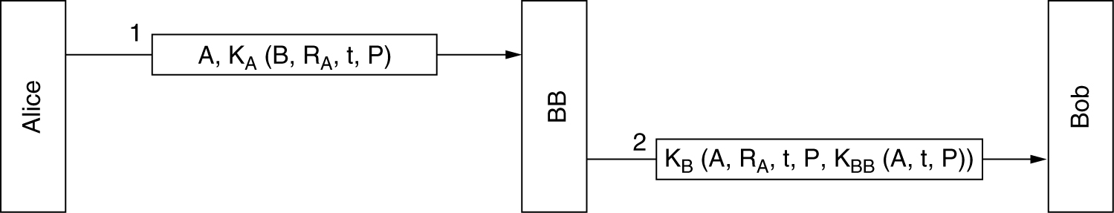
Symmetric-Key Signatures
One approach to digital signature is to have a central authority that knows everything and whom everyone trusts, say big brother (BB). Each user then chooses a secret key and carries it by hand to BB’s office. Thus only Alice and BB know Alice’s secret key K_{A} and so on.
Digital signatures with Big Brother

Slide 24
When Alice wants to send a signed plaintext message P, to her banker, Bob, she generates K_{A}(B, R_{A}, t, P), where B is Bob’s identity, R_{A} is a random number chosen by Alice, t is a timestamp to ensure freshness, and K_{A}(B, R_{A}, t, P) is the message encrypted with her K_{A}. Then she send it as depicted in fig, below. BB sees that the message is from Alice , decrypts it and sends a message to Bob as shown. The message to Bob contains the plain text of Alice’s message and also the signed message K_{BB}(A, t, P). Bob now carries out Alice’s request.
Digital signatures with Big Brother

Slide 25
Public-Key Signatures
The structural problem with using symmetric-key cryptography for digital signature is that everyone has to agree to trust Big Brother. Furthermore Big Brother gets to read all signed messages. The most logical candidates for running the Big Brother server are the government, the banks, the accountants and the lawyers. Unfortunately none of these organizations inspire total confidence in all citizens. Hence it would be nice if signing documents did not require a trusted authority.

Slide 26
Fortunately public-key cryptography can make an important contribution in this area. Let us assume that the public-key encryption and decryption algorithms have the property that E(D(P)) = P, in addition of course, to the usual property that D(E(P)) = P (RSA has this property, so the assumption is not unreasonable). Here D is private key encryption and E is public key encryption algorithm.
Assuming that this is the case, Alice can send a signed plaintext message, P to Bob by transmitting E_{B}(D_{A}(P)). Note carefully that Alice knows her own (private) key, D_{A}, as well as Bob’s public key, E_{B,} so constructing this message is something Alice can do.

Slide 27
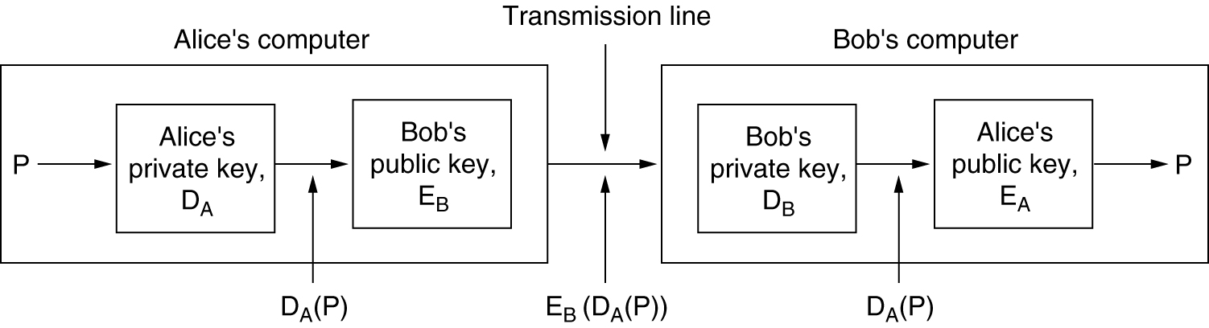
When Bob receives the message, he transform it using his private key, as usual, yielding D_{A}(P) shown below. He stores this text in a safe place and then applies E_{A} to get the original plaintext.
Digital signatures using public-key cryptography

Slide 28
To see how the signature properly works, suppose that Alice subsequently denies having sent the message P to Bob. When the case comes up in the court, Bob can produce both P and D_{A}(P).
The judge can easily verify that Bob indeed has a valid message encrypted by D_{A} by simply applying E_{A} to it. Sine Bob does not know what Alice’s private key is, the only way Bob could have acquired a message encrypted by it is if Alice did indeed send it.

Slide 29
Problems:
Bob can prove that a message was sent by Alice only as long as D_{A} remains secret. If Alice discloses her secret key, the argument no longer holds, because anyone could have sent the message including Bob himself.
An other problem with signature scheme is what happens if Alice decides to change her key. Doing so is clearly legal, and it is probably a good idea to do so periodically. If a court case later arises, as described above, the judge will apply the current E_{A} to D_{A}(P) and discover that it does not produce P. Bob will look pretty stupid at this point.

Slide 30
Message Digests
This scheme is based on the idea of a one way hash function that takes an arbitrary long piece of plaintext and from it computes a fixed length bit string. This hash function, MD often called a message digest, has four important properties:
Given P, it is easy to compute MD(P).
Given MD(P), it is effectively impossible to find P.
Given P no one can find Ṕ such that MD(Ṕ ) = MD(P).
A change to the input of even 1 bit produces a very different output.

Slide 31
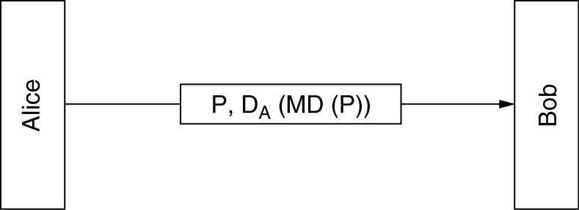
Computing a message digest from a piece of plaintext is much faster than encrypting that plaintext with a public-key algorithm, so message digests can be used to speed up digital signature algorithms. To see how this works, consider the signature protocol of fig. below again. Instead of signing P with K_{BB} (A, t, P), BB now computes the message digest by applying MD to P, yielding MD(P). BB then encloses K_{BB}(A, t, MD(P)), as the fifth item in the list encrypted with K_{B} that is sent to Bob, instead of K_{BB}(A, t, P).
Digital signatures with Big Brother
Digital signature using message digest

Slide 32
If a dispute arises, Bob can produce both P and K_{BB}(A, t, MD(P)). After Big brother has decrypted it for the judge, Bob has MD(P), which is guaranteed to be genuine, and the alleged P. However since it is effectively impossible for Bob to find any other message that gives this hash, the judge will easily be convinced that Bob is telling the truth. Using message digest in this way saves both encryption time and message transport cost.

Slide 33
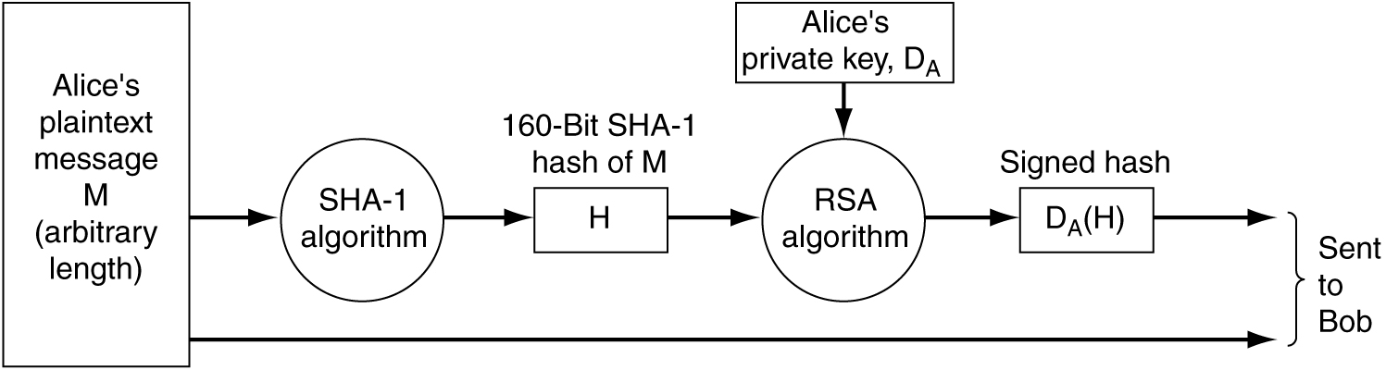
SHA-1
The other major message digest function is SHA-1 (Secure Hash Algorithm-1). A typical way for Alice to send a nonsecret but signed message to Bob is illustrated in fig. below. Here her plaintext message is fed into the SHA-1 algorithm to get a 160-bit SHA-1 hash. Alice then signs the hash with her RSA privte key and sends both the plaintext massage and the signed hash to Bob.
Use of SHA-1 and RSA for signing nonsecret messages

Slide 34
After receiving the message, Bob computes the SHA-1 hash himself and also applies, Alice’s public key to the signed hash to get the original hash, H. If the two agree, the message is considered valid. Since there is no way for intruder to modify the message (plaintext) while it is in transit and produce a new one that hashes to H, Bob can easily detect any change.

Slide 35
IP Security (IPsec)
One of the weaknesses of the original Internet Protocol is that it lacks any sort of general purpose mechanism for ensuring the authenticity and privacy of data as it is passed over the internetwork. Since IP datagrams must usually be routed between two devices over unknown networks, any information in them is subject to being intercepted and even possibly changed. With the increased use of the Internet for critical applications, security enhancements were needed for IP. To this end, a set of protocols called IP Security or IPSec was developed.
Internet Protocol Security (IPsec) is a technology protocol suite for securing Internet Protocol (IP) communications by authenticating and encrypting each IP packet of a communication session.
It can be used in protecting data flows between a pair of hosts (host-to-host), between a pair of security gateways (network-to-network), or between a security gateway and a host (network-to-host)

Slide 36
IP Security (IPsec)
IPsec provides three degrees of freedom.
First, it is highly modular, allowing users to select from a variety of cryptographic algorithms and specialized security protocols.
Second, IPsec allows users to select from a large menu of security properties, including access control, integrity, authentication, originality, and confidentiality.
Third, IPsec can be used to protect narrow streams (e.g., packets belonging to a particular TCP connection being sent between a pair of hosts) or wide streams (e.g., all packets flowing between a pair of gateways).

Slide 37
Basic Concepts:
Authentication Verifies that each datagram was originated by the claimed sender that the sender is not impersonated by third party. (data origin authentication).
Integrity Verifies that the contents of a datagram were not changed in transit, either deliberately or due to random errors.
Confidentiality With certain security mechanism (so-called encryption/decryption), data is protected during transmission from third party 's knowing the content. (Conceals the content of a message, typically by using encryption.)
Security Association (SA) An agreement between two communication parties on knowing and using certain combination of security mechanisms for data transmission between them. It's based on destination address and a certain index, called Security Parameters Index (SPI).

Slide 38
Transport and Tunnel Modes
IPsec can be used in either of two modes. In transport mode, the IPsec header is inserted just after the IP header. In tunnel mode, the entire IP packet, header and all, is encapsulated in the body of a new IP packet with completely new IP header.
Transport mode is used to encrypt & optionally authenticate
IP data
    * data protected but header left in clear
    * can do traffic analysis but is efficient
    * good for ESP host to host traffic
    Tunnel mode encrypts entire IP packet
    * add new header for next hop
    * good for VPNs, gateway to gateway security

Slide 39
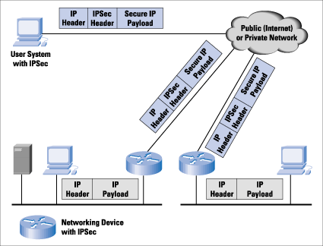
An IP Security Scenario

Slide 40
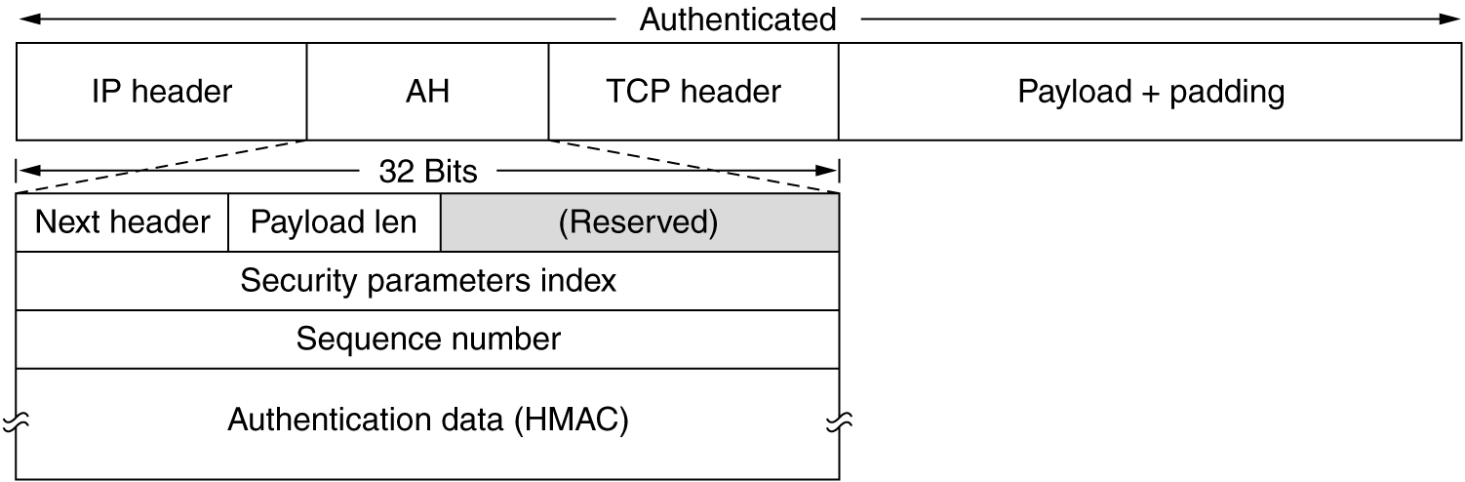
The IPsec authentication header in transport mode for IPv4.

Slide 41
Next Header:The Next Header is an 8-bit field that identifies the type of the next payload after the Authentication Header. The value of this field is chosen from the set of IP Protocol Numbers defined on the web page of Internet Assigned Numbers Authority (IANA). For example, a value of 4 indicates IPv4, a value of 41 indicates IPv6, and a value of 6 indicates TCP.
Payload Length: This 8-bit field specifies the length of AH in 32-bit words (4-byte units), minus "2". For IPv6, the total length of the header must be a multiple of 8-octet units. (Note that although IPv6 characterizes AH as an extension header, its length is measured in 32-bit words, not the 64-bit words used by other IPv6 extension headers.) .
Reserved: This 16-bit field is reserved for future use. It MUST be set to "zero" by the sender, and it SHOULD be ignored by the recipient.

Slide 42
Security Parameters Index: The Security Parameters Index is the connection identifier tag. It is inserted by the sender to indicate a particular record in the receiver’s database. The record contains the shared key used on this connection and other information about the connection.
Sequence Number
This unsigned 32-bit field contains a counter value that increases by one for each packet sent, i.e., a per-SA packet sequence number.

Slide 43
Authentication Data: It is a variable-length field contains the payload’s digital signature. Normally public-key-cryptography is not used here because packets must be processed extremely rapidly and all known public key algorithms are too slow. One simple way is to compute the hash over the packet plus the shared key. The shared key is not transmitted, of course. A scheme like this is called an HMAC (Hashed Message Authentication Code)

Slide 44
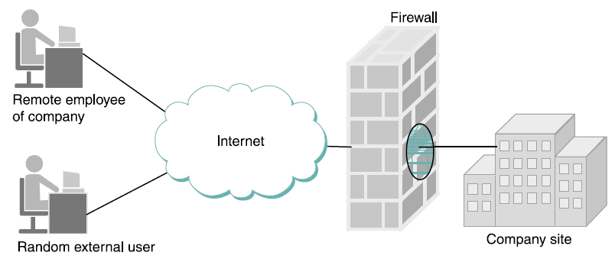
Firewall
A firewall is a system that is the sole point of connectivity between the site it protects and the rest of the network, as illustrated in Figure 8.20. It is usually implemented as part of a router, although a personal firewall may be implemented on an end-user machine.
A firewall filters packets flowing between a site and the rest of the Internet

Slide 45
In terms of walls, a firewall is like the only door (connection) through a wall (the absence of any other connection). A firewall provides access control by restricting which messages it will relay between the site and the rest of the network; it forwards messages that are allowed, and filters out messages that are disallowed. For example, it might filter out all incoming messages addressed to a particular IP address or to a particular TCP port number.

Slide 46
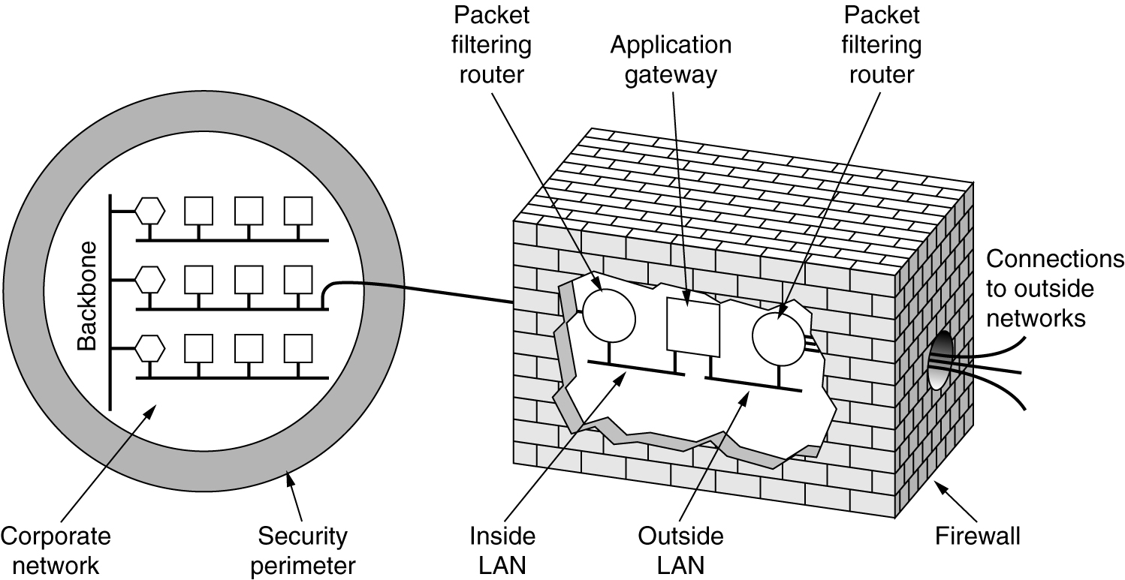
The firewall shown in fig. below has two components: two routers that do packet filtering and an application gateway. Each packet filter is a standard router equipped with some extra functionality.
A firewall consisting of two packet filter and an application gateway

Slide 47
Firewalls packet filtering (two packet filters inside the firewall) is based on IP, TCP, and UDP information, among other things. They are configured with a table of addresses that characterize the packets they will, and will not, forward. By addresses, we mean more than just the destination’s IP address, although that is one possibility. Generally, each entry in the table is a 4-tuple: It gives the IP address and TCP (or UDP) port number for both the source and destination. For example, a firewall might be configured to filter out (not forward) all packets that match the following description:
<192.12.13.14, 1234, 128.7.6.5, 80>
This pattern says to discard all packets from port 1234 on host 192.12.13.14 addressed to port 80 on host 128.7.6.5. (Port 80 is the well-known TCP port for HTTP.)

Slide 48
Of course it’s often not practical to name every source host whose packets you want to filter, so the patterns can include wildcards. For example,
<*, *, 128.7.6.5, 80>
says to filter out all packets addressed to port 80 on 128.7.6.5, regardless of what source host or port sent the packet.

Slide 49
Modern firewalls also understand and filter based on many specific application level protocols such as HTTP, Telnet, or FTP. They use information specific to that protocol, such as URLs in the case of HTTP, to decide whether to discard a message.
The second half of the firewall is the application gateway. Rather than just looking at raw packets, the gateway operates at the application level. A mail gateway for example, can be set up to examine each message going in or coming out. For each one the gateway decides whether to transmit or discard the message based on header fields, message size, or even the content (i.e. at a military installation, the presence of words like ‘nuclear’ or ‘bomb’ might cause some special action to be taken.

Slide 50
Even if the firewall is perfectly configured, plenty of security problems still exits. For example, if a firewall is configured to allow in packets from only specific networks ( i.e. company’s other plants), an intruder outside the firewall can put in false source address to bypass this check.
If an insider wants to ship out secret documents , he can encrypt them or even convert the message in jpeg image which bypasses any word filter.

