Slide 1
Digital Image Processing
Image Representation
Abdullah Al Shiam
Assistant Professor
Dept. of Computer Science and Engineering
Netrokona University
shiam.cse@shu.edu.bd

Slide 2
Sampling, Quantisation And Resolution
  Image sensing and representation
  Sampling and quantisation
  Resolution

Slide 3
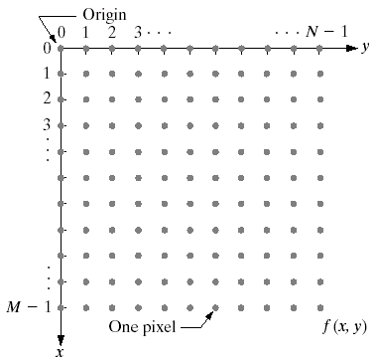
Image Representation
Before we discuss image acquisition recall that a digital image is composed of M rows and N columns of pixels
each storing a value
Pixel values are most
often gray levels in the
range 0-255(black-white)
We will see later on
that images can easily
be represented as
matrices
col
f (row, col)
row

Slide 4


Image Acquisition
Images are typically generated by illuminating a scene and absorbing the energy reflected by the objects in that scene
  Typical notions of illumination and scene can be way off:
    X-rays of a skeleton
    Ultrasound of an
    unborn baby
    Electro-microscopic
    images of molecules

Slide 5
• Illumination source reflected from a scene
element
• Imaging system collects the incoming energy and focus it onto an image plane (sensor array)
• Response of each sensor proportional to the integral of the light energy projected
• Sensor output: analog signal → digitized

Slide 6
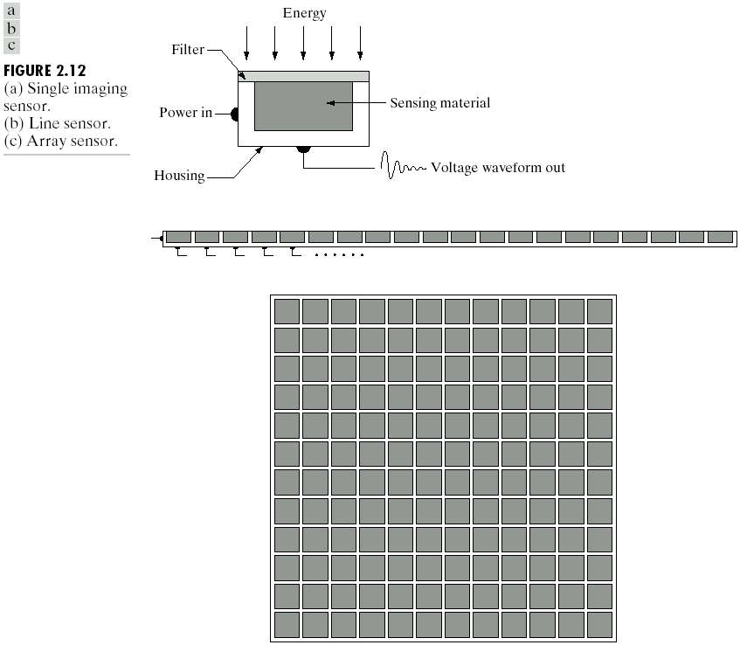
Image Sensing
Incoming energy lands on a sensor material responsive to that type of energy and this generates a voltage
Collections of sensors are arranged to capture images
Imaging Sensor
Line of Image Sensors
Array of Image Sensors

Slide 7

Image Sampling And Quantisation
A digital sensor can only measure a limited number of samples at a discrete set of energy levels
Quantisation is the process of converting a continuous analogue signal into a digital representation of this signal
Notes:
Analogue Vs digital
Think of the volume knob on your stereo
Records Vs CDs Vs Mp3s
Nyquist theory etc talks about how much sampling we need to do

Slide 8
Image Sampling And Quantisation
Notes:
Analogue Vs digital
Think of the volume knob on your stereo
Records Vs CDs Vs Mp3s
Nyquist theory etc talks about how much sampling we need to do

Slide 9
Image Sampling And Quantisation
Notes:
Analogue Vs digital
Think of the volume knob on your stereo
Records Vs CDs Vs Mp3s
Nyquist theory etc talks about how much sampling we need to do

Slide 10

Image Sampling And Quantisation (cont…)
Remember that a digital image is always only an approximation of a real world scene

Slide 11
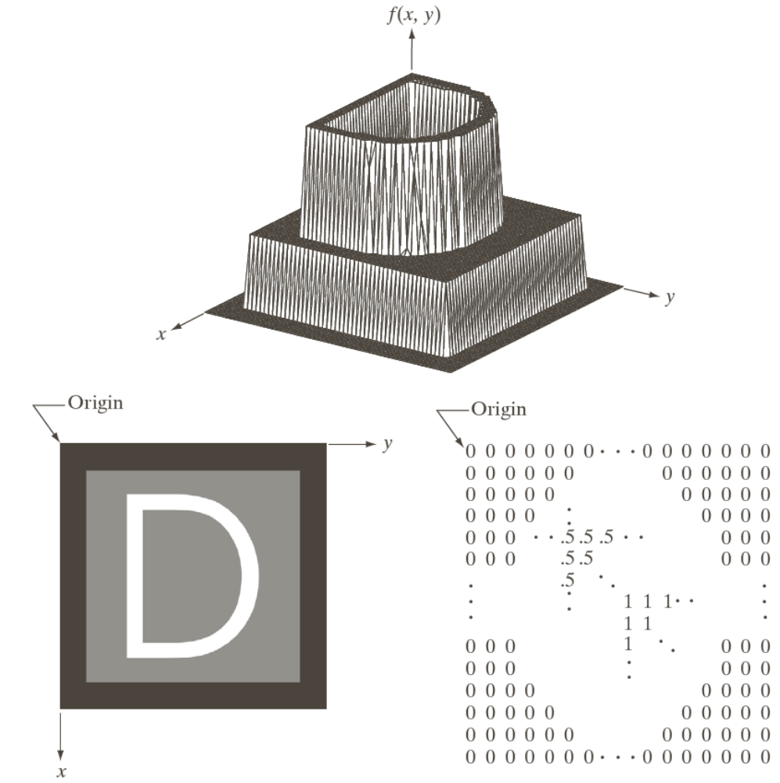
Image Representation

Slide 12
Image Representation

Slide 13
Image Representation

Slide 14
Image Representation

Slide 15
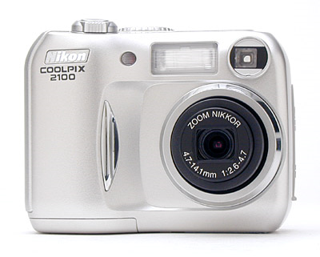
Spatial Resolution
The spatial resolution of an image is determined by how sampling was carried out
Spatial resolution simply refers to the smallest discernable detail in an image
  Vision specialists will
  often talk about pixel
  size
  Graphic designers will
  talk about dots per
  inch (DPI)
5.1 Megapixels

Slide 16
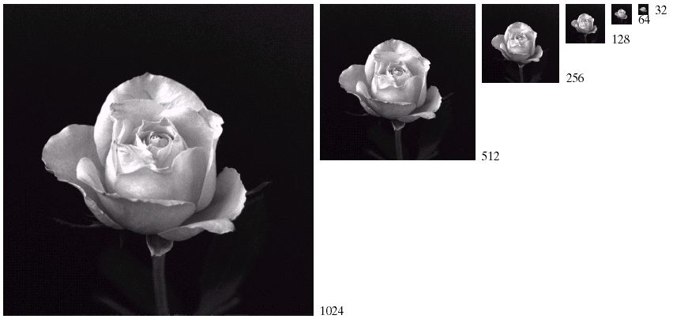
Spatial Resolution (cont…)

Slide 17
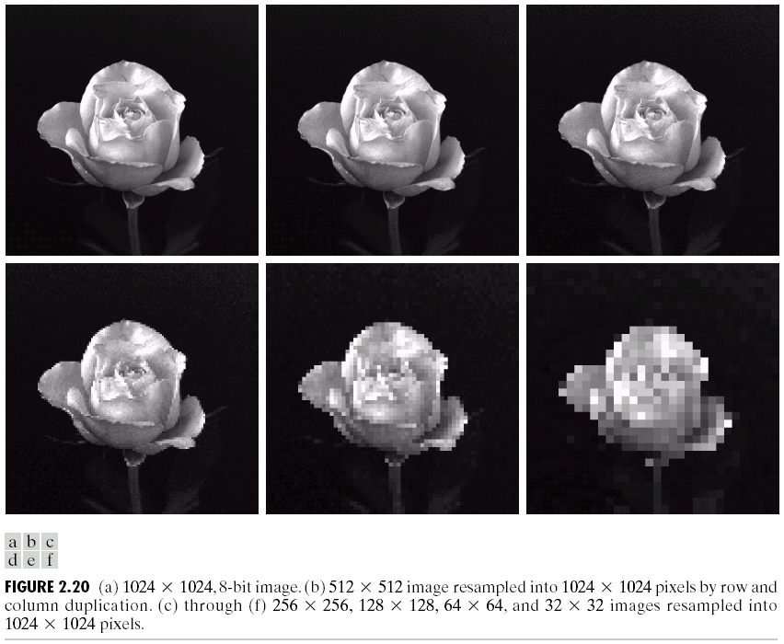
Spatial Resolution (cont…)

Slide 18
Spatial Resolution (cont…)

Slide 19
Spatial Resolution (cont…)

Slide 20
Spatial Resolution (cont…)

Slide 21
Spatial Resolution (cont…)

Slide 22
Spatial Resolution (cont…)

Slide 23
Intensity Level Resolution
Intensity level resolution refers to the number of intensity levels used to represent the image
  The more intensity levels used, the finer the level of detail discernable in an image
  Intensity level resolution is usually given in terms of the number of bits used to store each intensity level
Number of Bits
Number of Intensity Levels
Examples
1
2
0, 1
2
4
00, 01, 10, 11
4
16
0000, 0101, 1111
8
256
00110011, 01010101
16
65,536
1010101010101010

Slide 24


Intensity Level Resolution (cont…)
256 grey levels (8 bits per pixel)
128 grey levels (7 bpp)
64 grey levels (6 bpp)
32 grey levels (5 bpp)
16 grey levels (4 bpp)
8 grey levels (3 bpp)
4 grey levels (2 bpp)
2 grey levels (1 bpp)

Slide 25
Intensity Level Resolution (cont…)

Slide 26
Intensity Level Resolution (cont…)

Slide 27
Intensity Level Resolution (cont…)

Slide 28
Intensity Level Resolution (cont…)

Slide 29
Intensity Level Resolution (cont…)

Slide 30
Intensity Level Resolution (cont…)

Slide 31
Intensity Level Resolution (cont…)

Slide 32
Intensity Level Resolution (cont…)

Slide 33
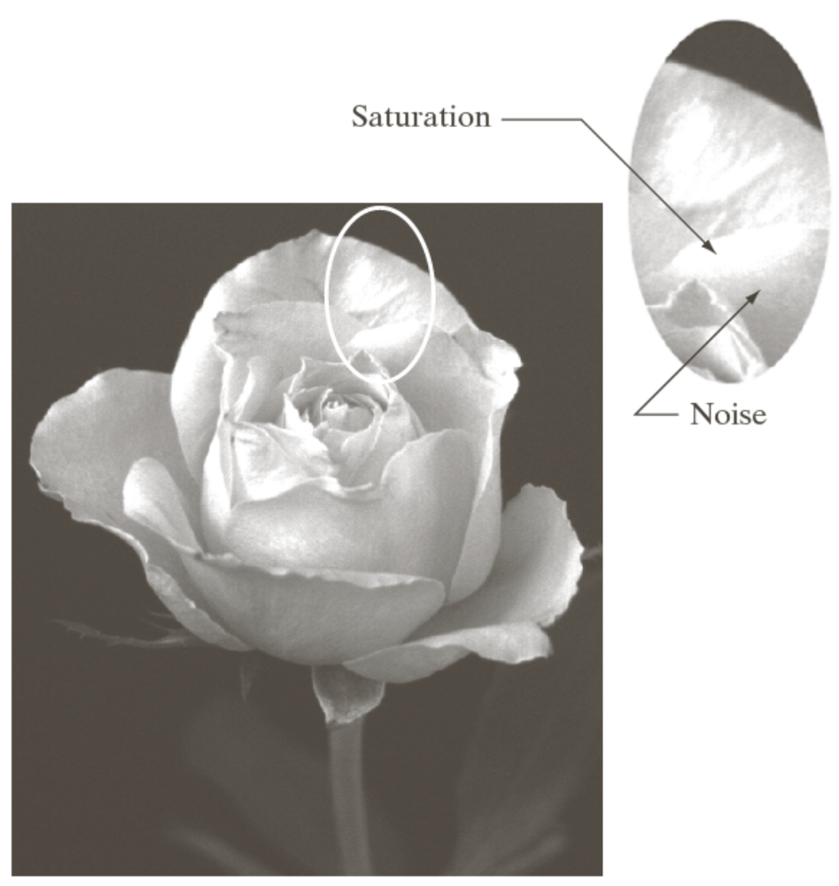
Saturation & Noise

Slide 34
Resolution: How Much Is Enough?
The big question with resolution is always how much is enough?
  This all depends on what is in the image and what you would like to do with it
  Key questions include
    Does the image look aesthetically pleasing?
    Can you see what you need to see within the image?

Slide 35
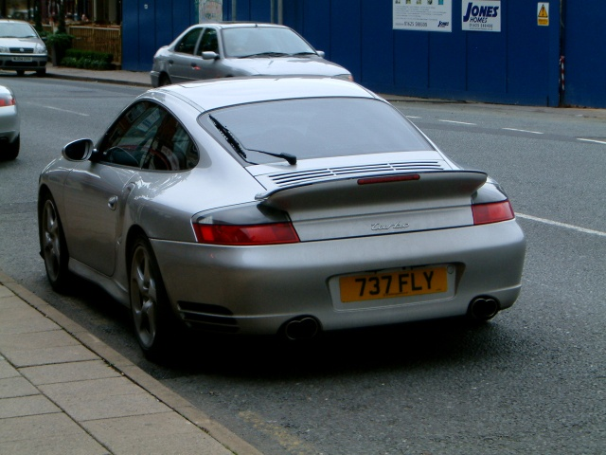

Resolution: How Much Is Enough? (cont…)
The picture on the right is fine for counting the number of cars, but not for reading the number plate

Slide 36
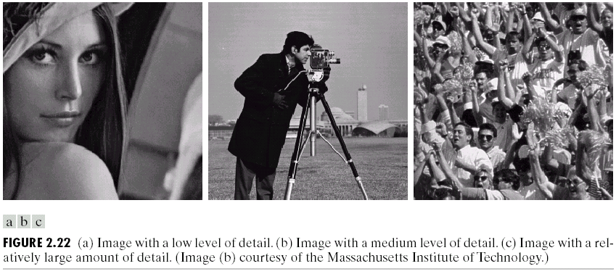
Intensity Level Resolution (cont…)
Low Detail
Medium Detail
High Detail

Slide 37
Intensity Level Resolution (cont…)

Slide 38
Intensity Level Resolution (cont…)

Slide 39
Intensity Level Resolution (cont…)

Slide 40
Summary
We have looked at:
  Image representation
  Image sensing and acquisition
  Sampling, quantisation and resolution
Next time we start to look at techniques for image enhancement

