Slide 1
Digital Image Processing
Image Enhancement
(Point Processing)
Abdullah Al Shiam
Assistant Professor
Dept. of Computer Science and Engineering
Netrokona University
shiam.cse@neu.ac.bd

Slide 2
Contents
In this lecture we will look at image enhancement point processing techniques:
  What is point processing?
  Negative images
  Thresholding
  Logarithmic transformation
  Power law transforms
  Grey level slicing
  Bit plane slicing

Slide 3
Basic Spatial Domain Image Enhancement
Most spatial domain enhancement operations can be reduced to the form
g (x, y) = T[ f (x, y)]
where f (x, y) is the
input image, g (x, y) is
the processed image
and T is some
operator defined over
some neighbourhood
of (x, y)
Origin
x
(x, y)
y
Image f (x, y)

Slide 4
Point Processing
The simplest spatial domain operations occur when the neighbourhood is simply the pixel itself
In this case T is referred to as a grey level transformation function or a point processing operation
Point processing operations take the form
s = T ( r )
where s refers to the processed image pixel value and r refers to the original image pixel value

Slide 5
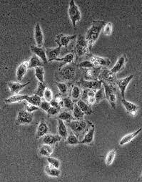
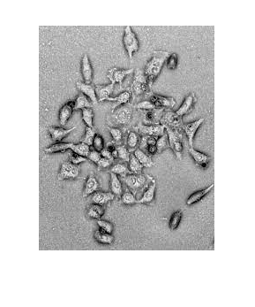
Point Processing Example:
Negative Images
Negative images are useful for enhancing white or grey detail attached in dark regions of an image
  Note how much clearer the tissue is in the negative image of the mammogram below
Original Image
s = 1.0 - r
Negative Image

Slide 6
Point Processing Example:
Negative Images (cont…)
Original Image
x
Enhanced Image
x
y
Image f (x, y)
y
Image f (x, y)
s = intensity_{max} - r

Slide 7
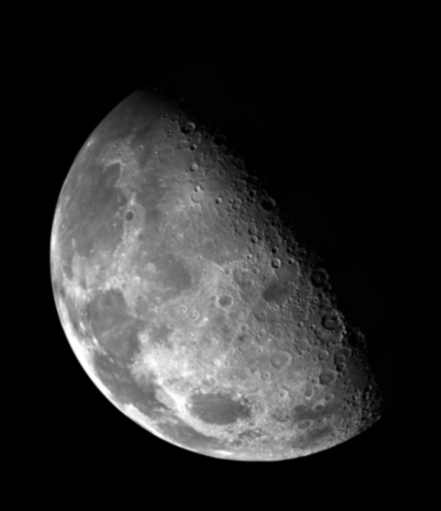

Point Processing Example:
Thresholding
Thresholding transformations are particularly useful for segmentation in which we want to isolate an object of interest from a background
1.0
r > threshold
s =
0.0
r <= threshold

Slide 8
Point Processing Example:
Thresholding (cont…)
Original Image
x
Enhanced Image
x
y
Image f (x, y)
y
Image f (x, y)
1.0 r > threshold
s =
0.0 r <= threshold

Slide 9
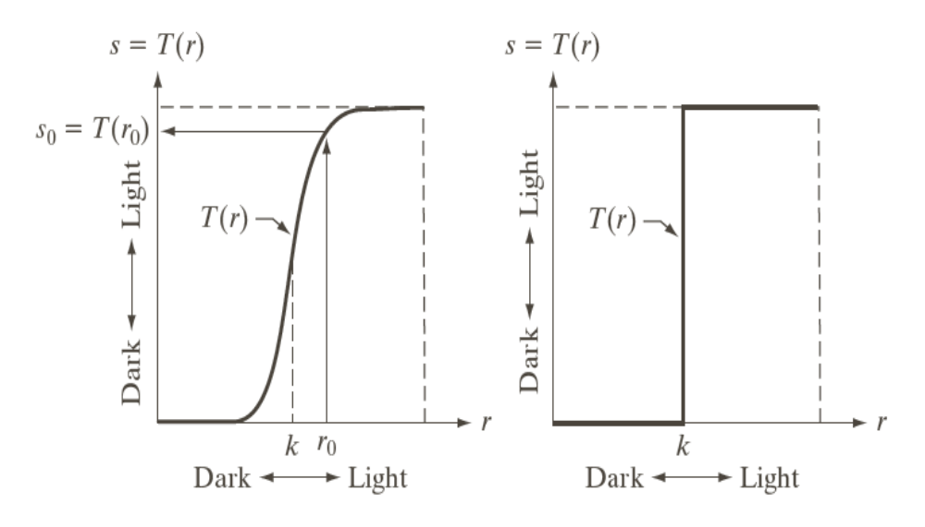
Intensity Transformations

Slide 10
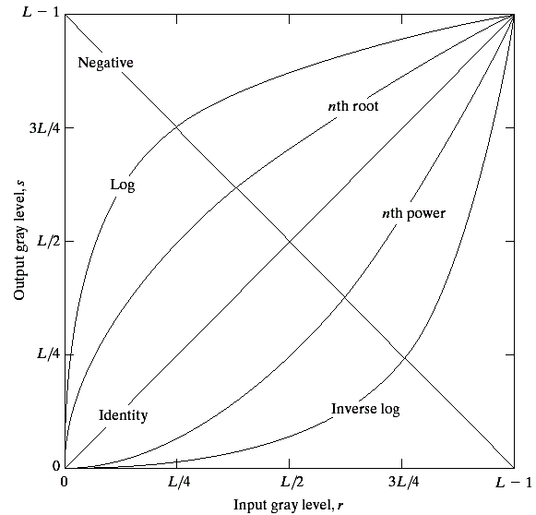
Basic Grey Level Transformations
There are many different kinds of grey level transformations
Three of the most
common are shown
here
  Linear
    Negative/Identity
  Logarithmic
    Log/Inverse log
  Power law
    n^{th} power/n^{th} root

Slide 11
Logarithmic Transformations
The general form of the log transformation is
s = c * log(1 + r)
The log transformation maps a narrow range of low input grey level values into a wider range of output values
The inverse log transformation performs the opposite transformation

Slide 12
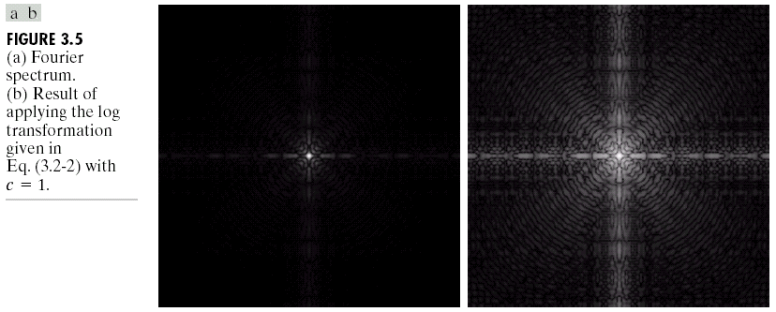
Logarithmic Transformations (cont…)
Log functions are particularly useful when the input grey level values may have an extremely large range of values
In the following example the Fourier transform of an image is put through a log transform to reveal more detail
s = log(1 + r)

Slide 13
Logarithmic Transformations (cont…)
Original Image
x
Enhanced Image
x
y
Image f (x, y)
y
Image f (x, y)
s = log(1 + r)
We usually set c to 1
Grey levels must be in the range [0.0, 1.0]

Slide 14
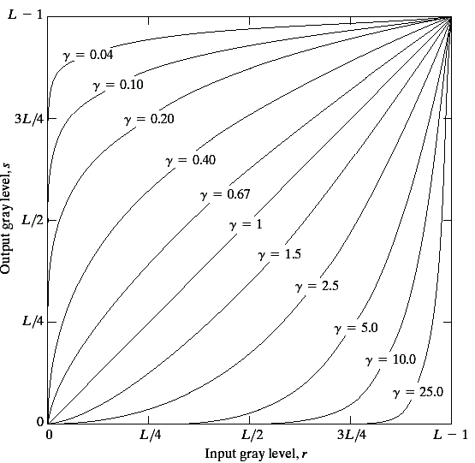
Power Law Transformations
Power law transformations have the following form
s = c * r ^{γ}
Map a narrow range
of dark input values
into a wider range of
output values or vice
versa
Varying γ gives a whole
family of curves

Slide 15
Power Law Transformations (cont…)
Original Image
x
Enhanced Image
x
y
Image f (x, y)
y
Image f (x, y)
s = r ^{γ}
We usually set c to 1
Grey levels must be in the range [0.0, 1.0]

Slide 16
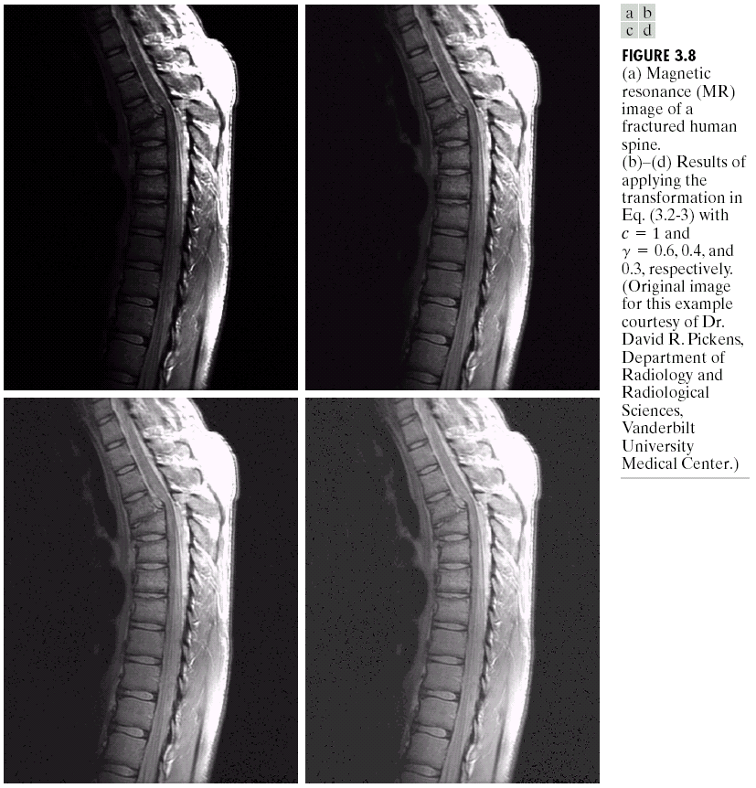
Power Law Example

Slide 17
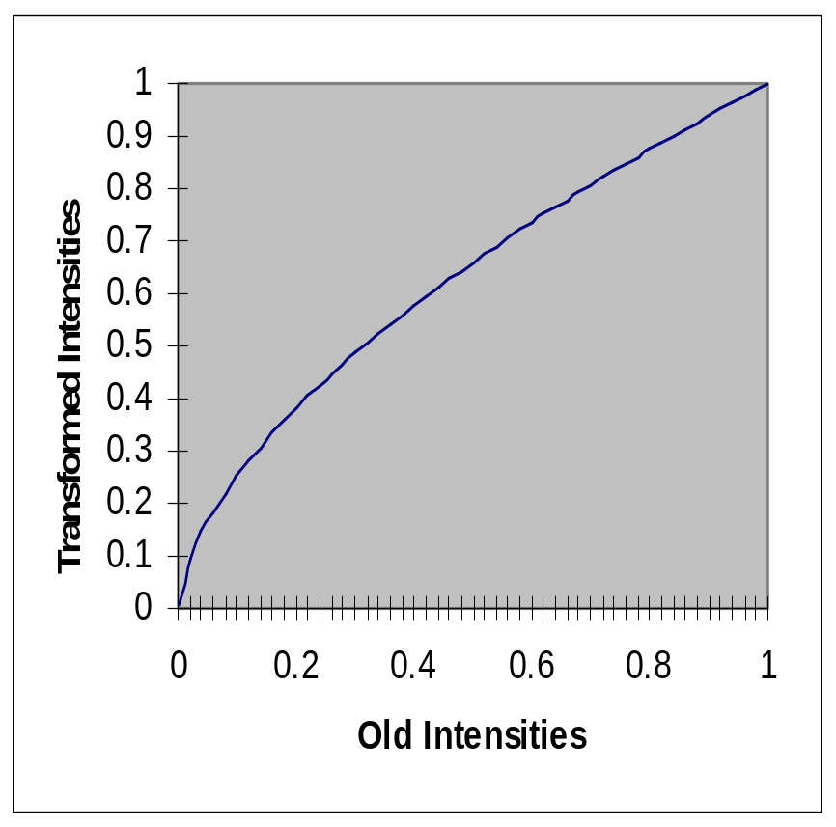
Power Law Example (cont…)
γ = 0.6

Slide 18
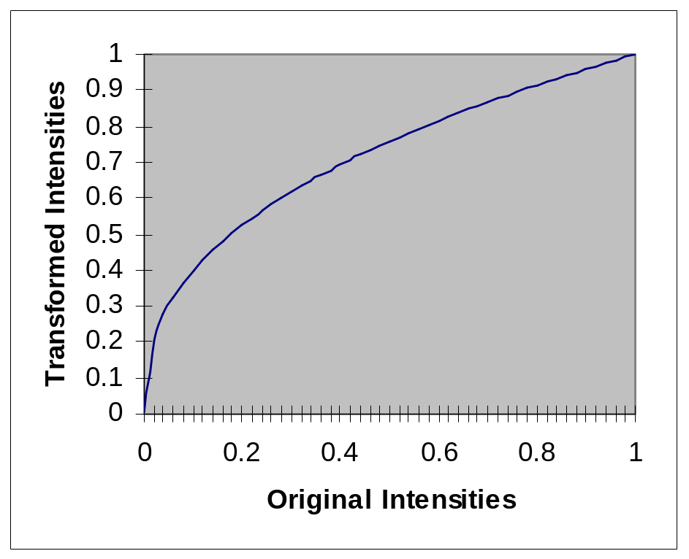
Power Law Example (cont…)
γ = 0.4

Slide 19
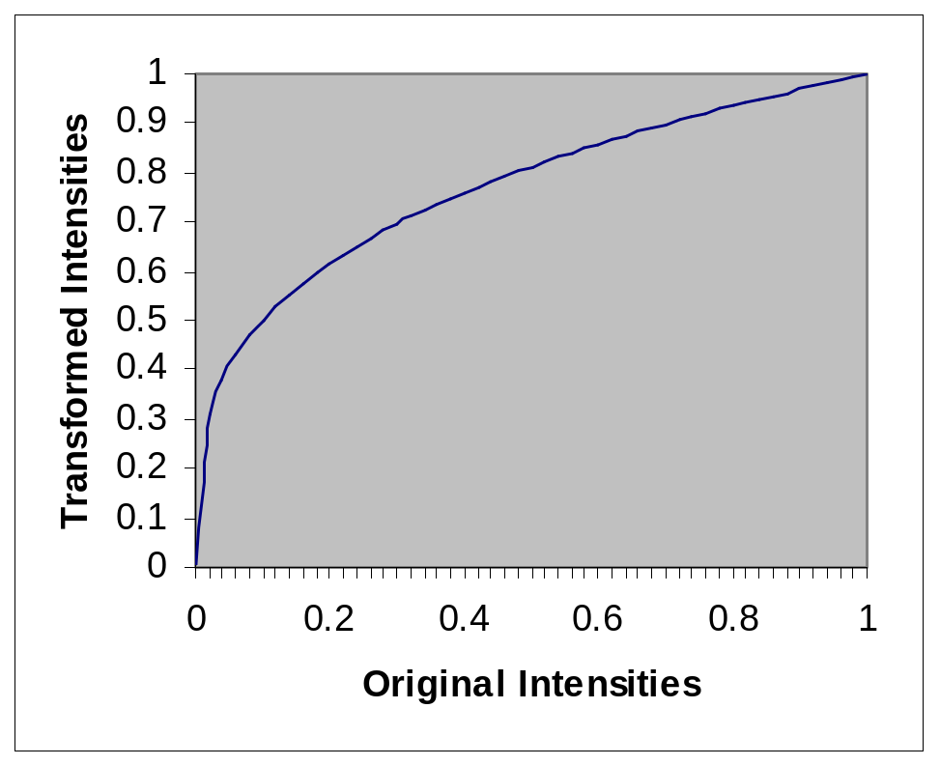
Power Law Example (cont…)
γ = 0.3

Slide 20
Power Law Example (cont…)
The images to the
right show a
magnetic resonance
(MR) image of a
fractured human
spine
Different curves
highlight different
detail
s = r ^{0.6}
s = r ^{0.3}
s = r ^{0.4}
Notes:
The third transform is a step too far

Slide 21
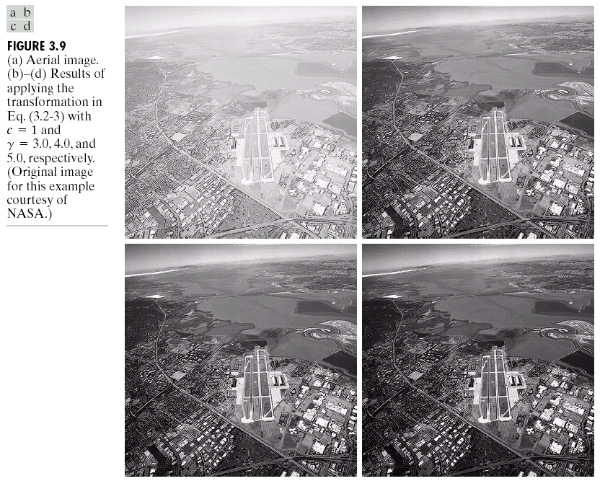
Power Law Example

Slide 22
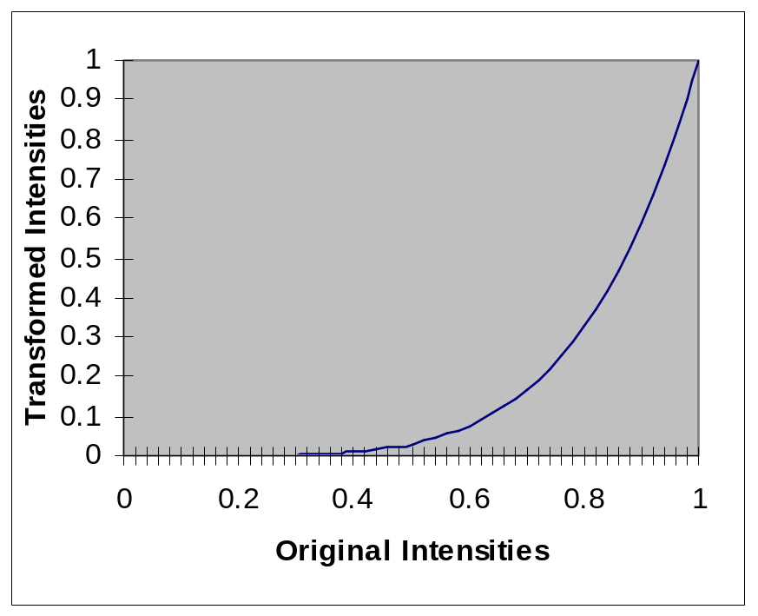
Power Law Example (cont…)
γ = 5.0

Slide 23
Power Law Transformations (cont…)
An aerial photo
of a runway is
shown
This time
power law
transforms are
used to darken
the image
Different curves
highlight
different detail
s = r ^{3.0}
s = r ^{4.0}
s = r ^{5.0}

Slide 24
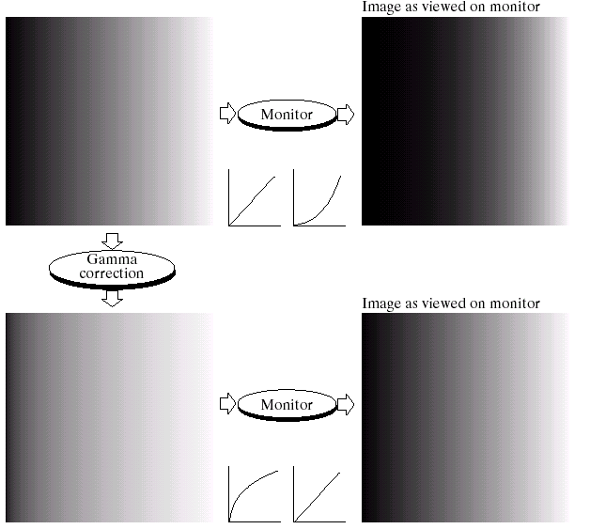
Gamma Correction
Many of you might be familiar with gamma correction of computer monitors
Problem is that
display devices do
not respond linearly
to different
intensities
Can be corrected
using a log
transform

Slide 25
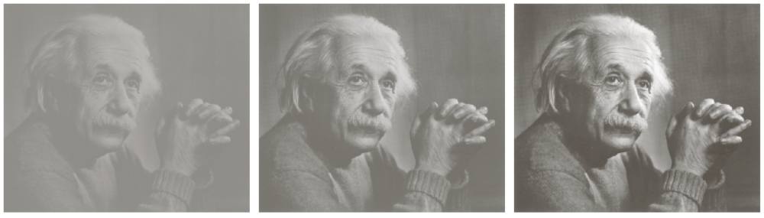
More Contrast Issues

Slide 26

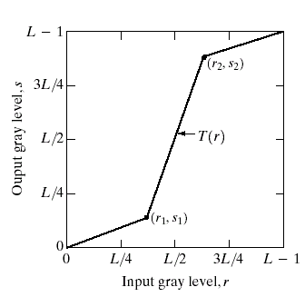
Piecewise Linear Transformation Functions
Rather than using a well defined mathematical function we can use arbitrary user-defined transforms
The images below show a contrast stretching linear transform to add contrast to a poor quality image

Slide 27
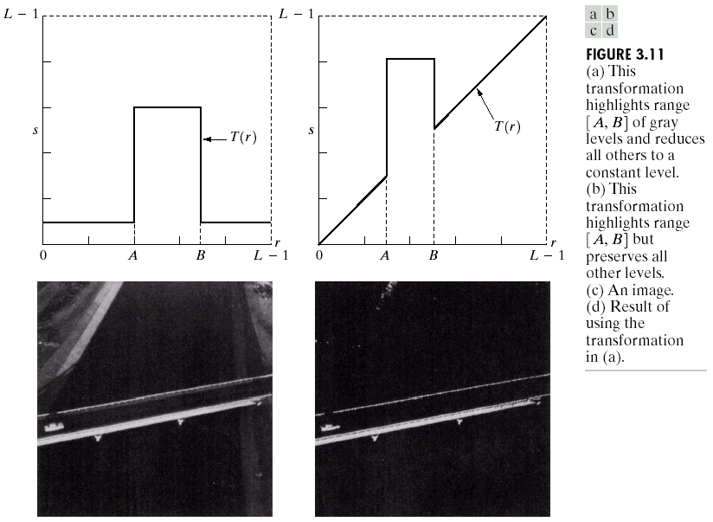
Gray Level Slicing
Highlights a specific range of grey levels
  Similar to thresholding
  Other levels can be
  suppressed or maintained
  Useful for highlighting features
  in an image

Slide 28
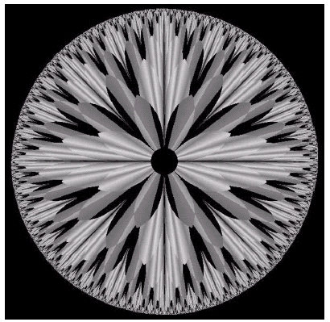
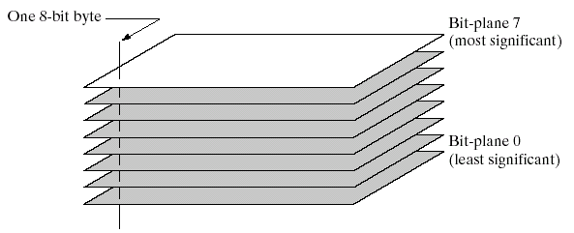
Bit Plane Slicing
Often by isolating particular bits of the pixel values in an image we can highlight interesting aspects of that image
  Higher-order bits usually contain most of the significant visual information
  Lower-order bits contain
  subtle details

Slide 29
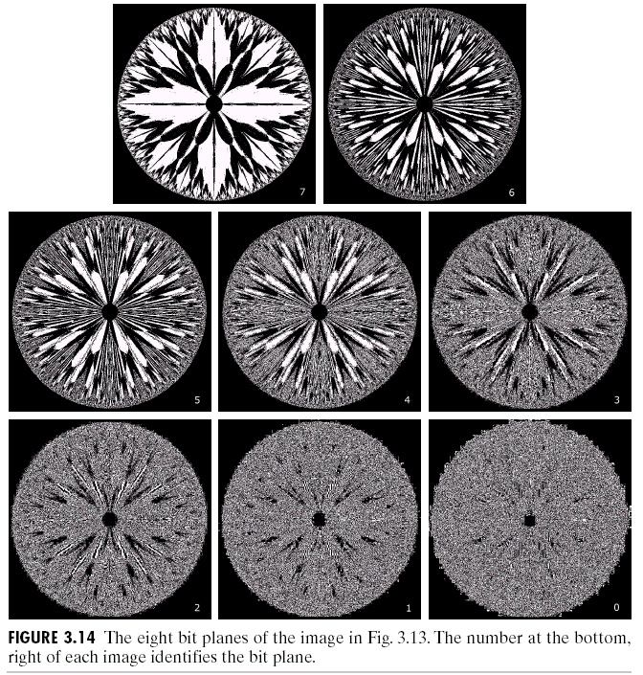
Bit Plane Slicing (cont…)
[10000000]
[01000000]
[00100000]
[00001000]
[00000100]
[00000001]

Slide 30
Bit Plane Slicing (cont…)
[10000000]
[01000000]
[00100000]
[00001000]
[00000100]
[00000001]

Slide 31
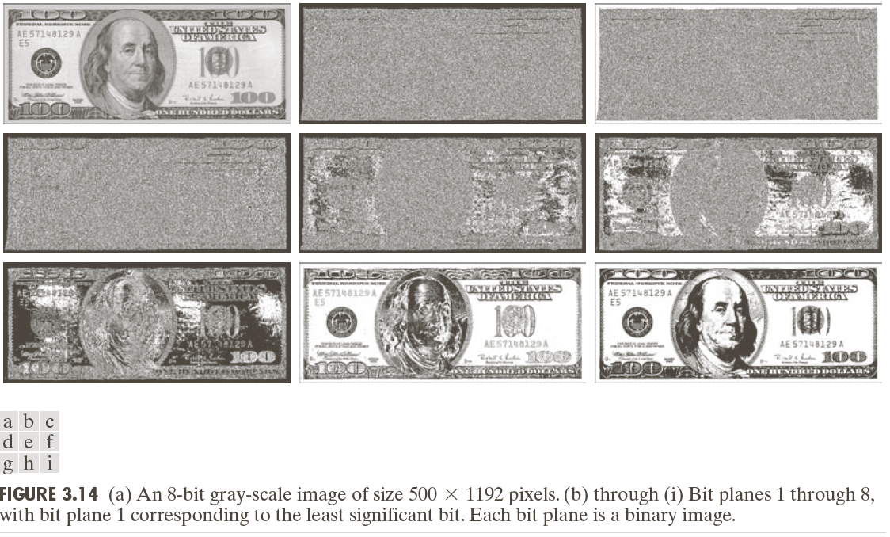
Bit Plane Slicing (cont…)

Slide 32
Bit Plane Slicing (cont…)

Slide 33
Bit Plane Slicing (cont…)

Slide 34
Bit Plane Slicing (cont…)

Slide 35
Bit Plane Slicing (cont…)

Slide 36
Bit Plane Slicing (cont…)

Slide 37
Bit Plane Slicing (cont…)

Slide 38
Bit Plane Slicing (cont…)

Slide 39
Bit Plane Slicing (cont…)

Slide 40
Bit Plane Slicing (cont…)

Slide 41
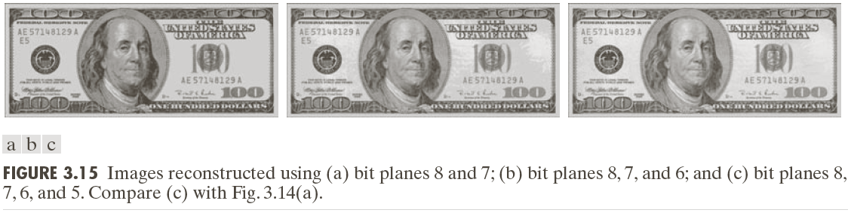
Bit Plane Slicing (cont…)
Reconstructed image using only bit planes 8 and 7
Reconstructed image using only bit planes 8, 7 and 6
Reconstructed image using only bit planes 7, 6 and 5

Slide 42
Summary
We have looked at different kinds of point processing image enhancement
Next time we will start to look at neighbourhood operations – in particular filtering and convolution

