Slide 1
Digital Image Processing
Image Enhancement (Spatial Filtering 1)
Abdullah Al Shiam Assistant Professor
Computer Science and Engineering Netrokona University shiam.cse@neu.ac.bd
Notes:
1

Slide 2
Contents
In this lecture we will look at spatial filtering techniques:
Neighbourhood operations
What is spatial filtering?
Smoothing operations
What happens at the edges?
Correlation and convolution
Notes:
2

Slide 3
Neighbourhood Operations
Neighbourhood operations simply operate on a larger neighbourhood of pixels than point operations
Neighbourhoods are mostly a rectangle around a central pixel
Any size rectangle and any shape filter are possible
Origin
x
(x, y)
Neighbourhood
y
Image f (x, y)
Notes:
3

Slide 4
Simple Neighbourhood Operations
Some simple neighbourhood operations include:
Min: Set the pixel value to the minimum in the neighbourhood
Max: Set the pixel value to the maximum in the neighbourhood
Median: The median value of a set of numbers is the midpoint value in that set (e.g. from the set [1, 7, 15, 18, 24] 15 is the median). Sometimes the median works better than the average
Notes:
4

Slide 5
Simple Neighbourhood Operations Example
Original Image
x
Enhanced Image
x
123
127
128
119
115
130
140
145
148
153
167
172
133
154
183
192
194
191
194
199
207
210
198
195
164
170
175
162
173
151
y
y
Notes:
5

Slide 6
The Spatial Filtering Process
Origin
x
a
b
c
r
s
t
d
e
f
*
u
v
w
g
h
i
x
y
z
Original Image Pixels
Filter
Simple 3*3 Neighbourhood
e
3*3 Filter
e_{processed} = v*e + r*a + s*b + t*c + u*d + w*f + x*g + y*h + z*i
y
Image f (x, y)
The above is repeated for every pixel in the original image to generate the filtered image
Notes:
6

Slide 7
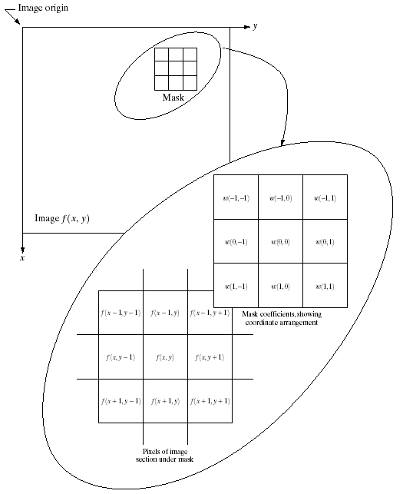
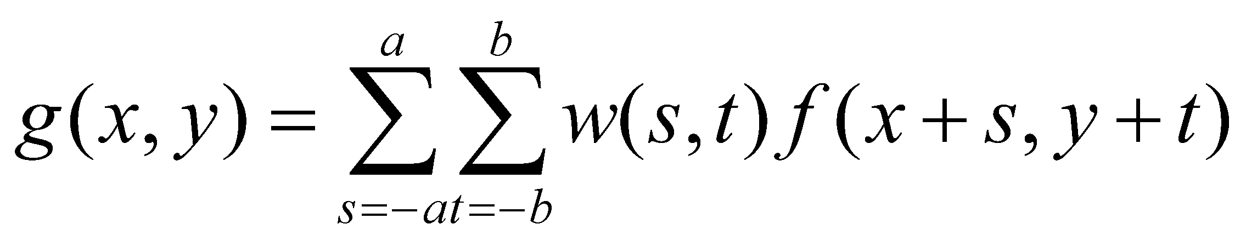
Spatial Filtering: Equation Form
Filtering can be given in equation form as shown above
Notations are based on the image shown to the left
Notes:
7

Slide 8
Smoothing Spatial Filters
One of the simplest spatial filtering operations we can perform is a smoothing operation
Simply average all of the pixels in a neighbourhood around a central value
Especially useful in removing noise from images
Also useful for highlighting gross detail
¹/₉ | ¹/₉ | ¹/₉
¹/₉ | ¹/₉ | ¹/₉
¹/₉ | ¹/₉ | ¹/₉
Simple averaging filter
Notes:
8

Slide 9
Smoothing Spatial Filtering
Origin
x
104
100
108
¹/₉
¹/₉
¹/₉
*
¹/₉
¹/₉
¹/₉
99
106
98
95
90
85
¹/₉
¹/₉
¹/₉
Original Image Pixels
Filter
¹/₉
¹/₉
¹/₉
Simple 3*3 Neighbourhood
104
100
108
3*3 Smoothing Filter
¹/₉
¹/₉
¹/₉
99
106
98
¹/₉
¹/₉
¹/₉
95
90
85
e = ¹/₉*106 + ¹/₉*104 + ¹/₉*100 + ¹/₉*108 + ¹/₉*99 + ¹/₉*98 + ¹/₉*95 + ¹/₉*90 + ¹/₉*85
= 98.3333
y
Image f (x, y)
The above is repeated for every pixel in the original image to generate the smoothed image
Notes:
9

Slide 10
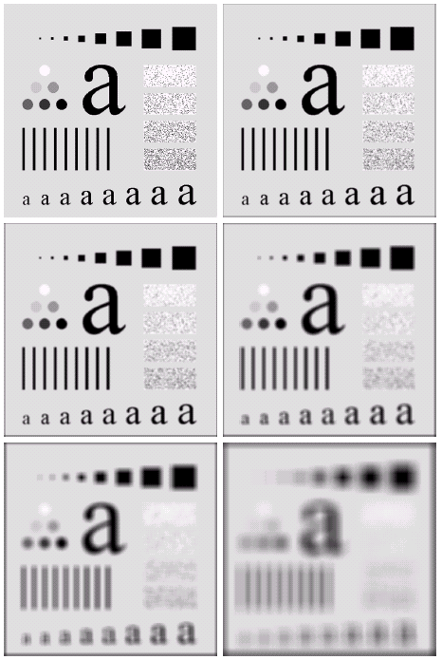
Image Smoothing Example
The image at the top left is an original image of size 500*500 pixels
The subsequent images show the image after filtering with an averaging filter of increasing sizes
3, 5, 9, 15 and 35
Notice how detail begins to disappear
Notes:
10

Slide 11
Image Smoothing Example
Notes:
11

Slide 12
Image Smoothing Example
Notes:
12

Slide 13
Image Smoothing Example
Notes:
13

Slide 14
Image Smoothing Example
Notes:
14

Slide 15
Image Smoothing Example
Notes:
15

Slide 16
Image Smoothing Example
Notes:
16

Slide 17
Weighted Smoothing Filters
More effective smoothing filters can be generated by allowing different pixels in the neighbourhood different weights in the averaging function
Pixels closer to the central pixel are more important
Often referred to as a weighted averaging
¹/₉ | ²/₉ | ¹/₉
²/₉ | ⁴/₉ | ²/₉
¹/₉ | ²/₉ | ¹/₉
Weighted averaging filter
Notes:
17

Slide 18
Weighted Smoothing Filters
Origin
x
104
100
108
¹
²
¹
99
106
98
*
²
⁴
²
95
90
85
¹
²
¹
Original Image Pixels
Filter
¹/₉
¹/₉
¹/₉
Simple 3*3 Neighbourhood
104
100
108
3*3 Smoothing Filter
¹/₉
¹/₉
¹/₉
99
106
98
¹/₉
¹/₉
¹/₉
95
90
85
e = (⁴*106 + ¹*104 + ²*100 + ¹*108 + ²*99 + ²*98 + ¹*95 + ²*90 + ¹*85)/9
=
y
Image f (x, y)
The above is repeated for every pixel in the original image to generate the smoothed image
Notes:
18

Slide 19
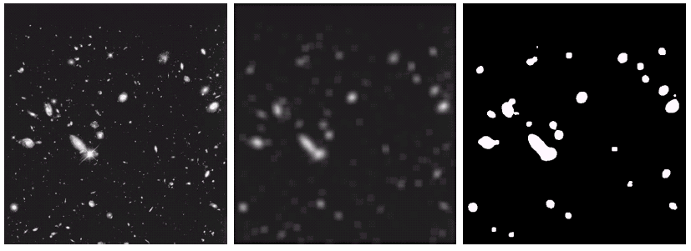
Another Smoothing Example
By smoothing the original image we get rid of lots of the finer detail which leaves only the gross features for thresholding
Original Image
Smoothed Image
Thresholded Image
Notes:
19

Slide 20
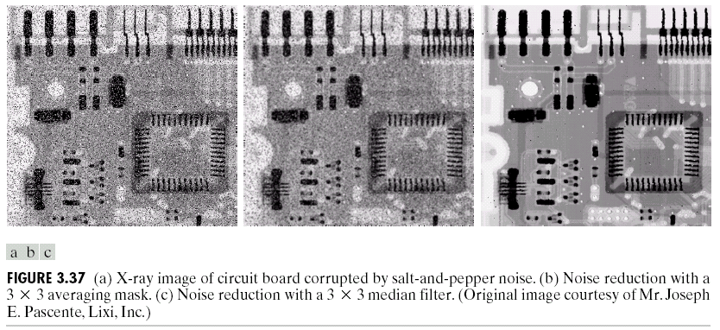
Averaging Filter Vs. Median Filter Example
Original Image With Noise
Image After Averaging Filter
Image After Median Filter
Filtering is often used to remove noise from images
Sometimes a median filter works better than an averaging filter
Notes:
20

Slide 21
Averaging Filter Vs. Median Filter Example
Notes:
21

Slide 22
Averaging Filter Vs. Median Filter Example
Notes:
22

Slide 23
Averaging Filter Vs. Median Filter Example
Notes:
23

Slide 24
Simple Neighbourhood Operations Example
x
123
127
128
119
115
130
140
145
148
153
167
172
133
154
183
192
194
191
194
199
207
210
198
195
164
170
175
162
173
151
y
Notes:
24

Slide 25
Strange Things Happen At The Edges!
At the edges of an image we are missing pixels to form a neighbourhood
Origin
x
e
e
e
e
e
e
e
y
Image f (x, y)
Notes:
25

Slide 26
Strange Things Happen At The Edges! (cont…)
There are a few approaches to dealing with missing edge pixels:
Omit missing pixels
Only works with some filters
Can add extra code and slow down processing
Pad the image
Typically with either all white or all black pixels
Replicate border pixels
Allow pixels wrap around the image
Can cause some strange image artefacts
Notes:
26

Slide 27
Simple Neighbourhood Operations Example
x
123
127
128
119
115
130
140
145
148
153
167
172
133
154
183
192
194
191
194
199
207
210
198
195
164
170
175
162
173
151
y
Notes:
27

Slide 28
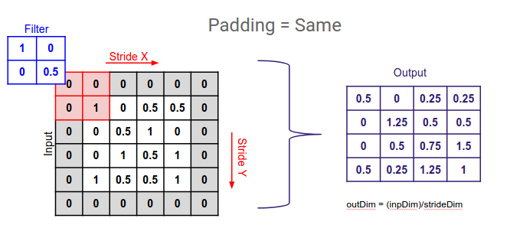
Strange Things Happen At The Edges! (cont…)
Padding
Notes:
28

Slide 29
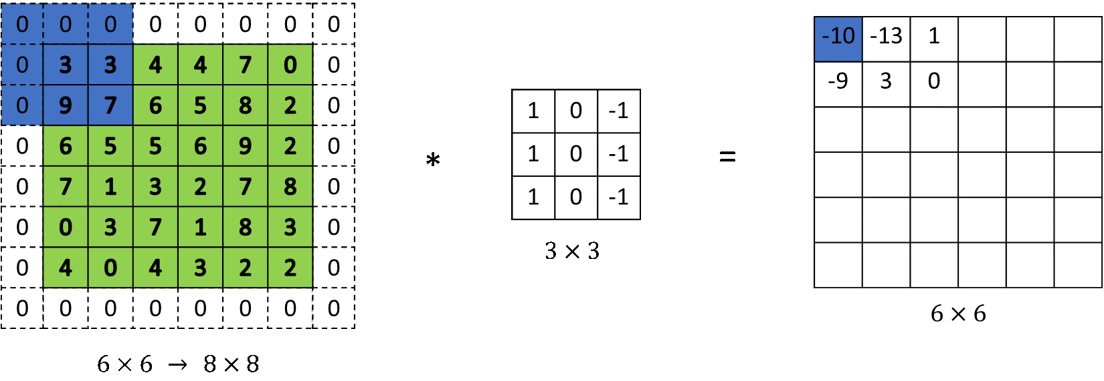
Strange Things Happen At The Edges! (cont…)
Padding
Mask
Original Image
Notes:
29

Slide 30
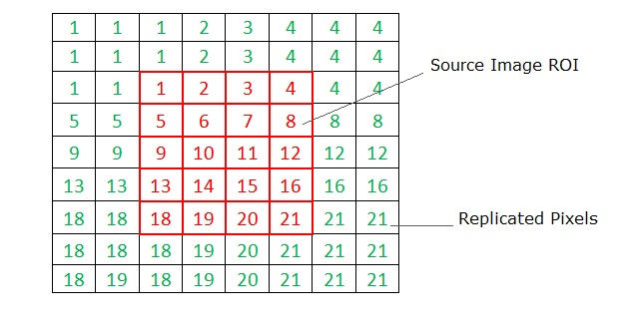
Strange Things Happen At The Edges! (cont…)
Replicate Border Pixel
Notes:
30

Slide 31
Strange Things Happen At The Edges! (cont…)
Allow pixels wrap around the image
198
199
207
210
198
199
145
148
153
167
167
145
148
153
167
145
154
183
192
194
194
154
183
192
194
154
199
207
210
198
198
199
207
210
198
199
Original Image
167
145
148
153
167
145
Padded Image
Notes:
31

Slide 32
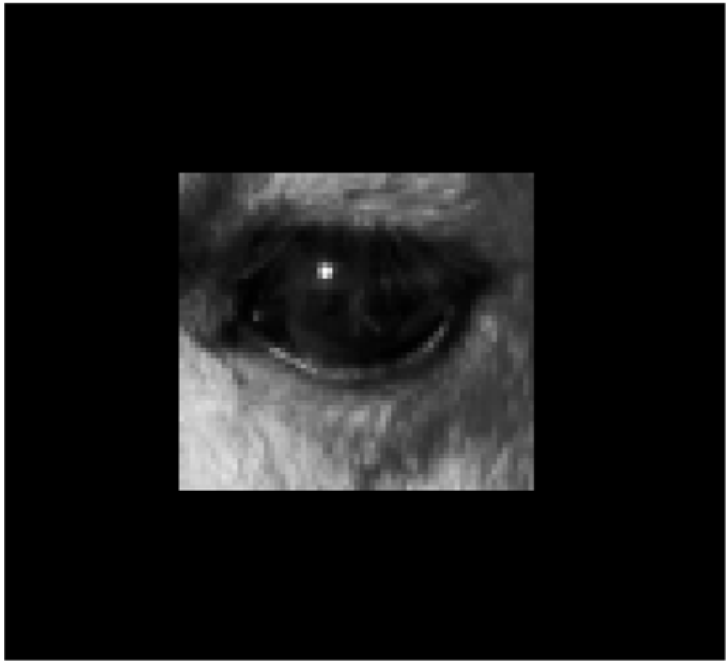
What to do at image boundaries?
Pad
Notes:
32

Slide 33
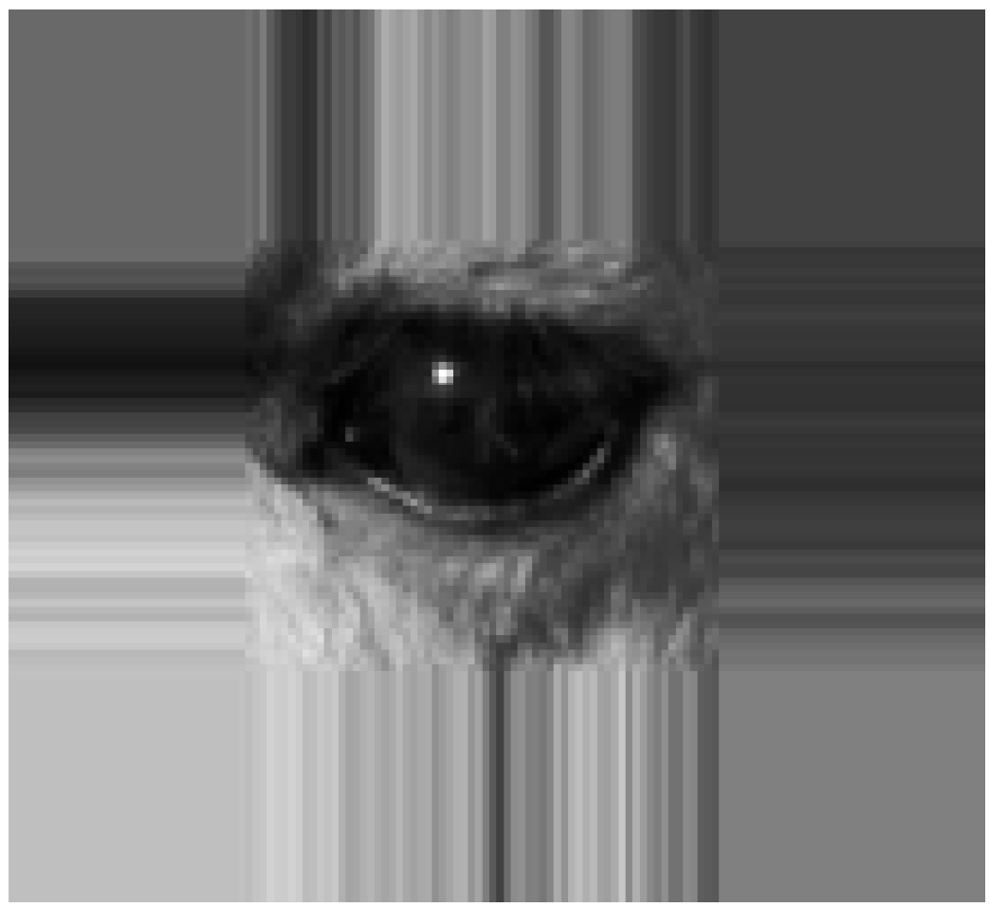
What to do at image boundaries?
Replicate border pixels
Notes:
33

Slide 34
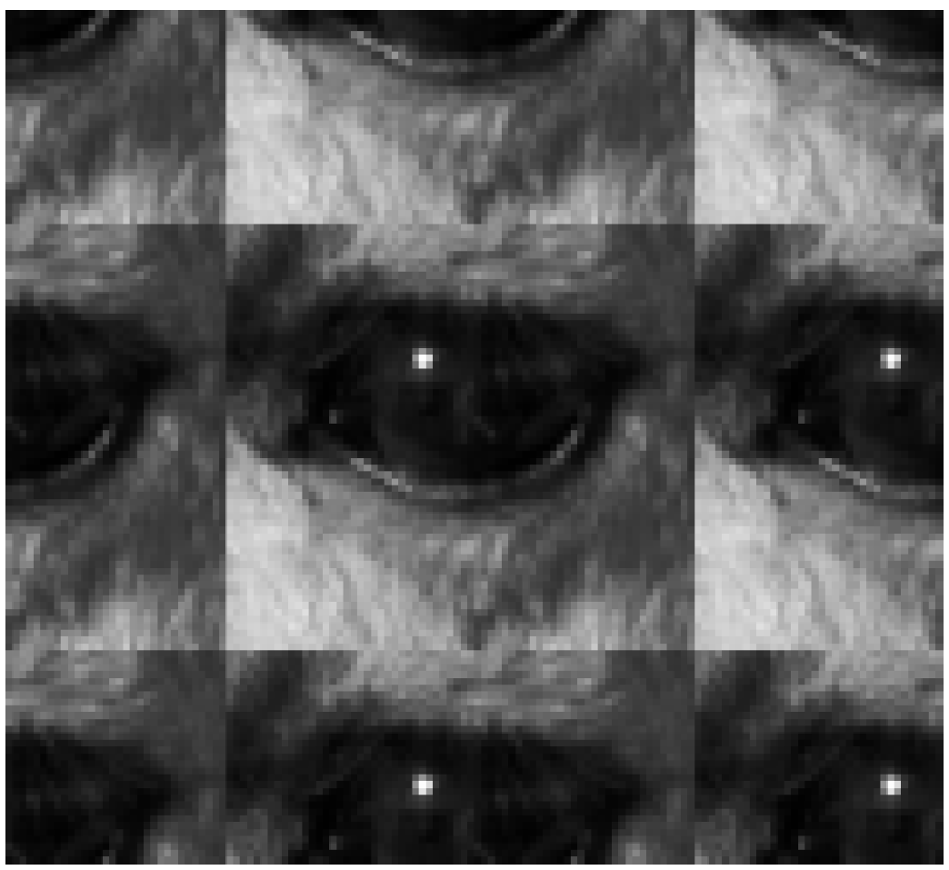
What to do at image boundaries?
Wrap
Notes:
34

Slide 35
Correlation & Convolution
The filtering we have been talking about so far is referred to as correlation with the filter itself referred to as the correlation kernel
Convolution is a similar operation, with just one minimal difference
For symmetric filters it makes no difference
a
b
c
r
s
t
e_{processed} = v*e + z*a + y*b + x*c + w*d + u*e + t*f + s*g + r*h
d
e
e
*
u
v
w
f
g
h
x
y
z
Original Image Pixels
Filter
Notes:
35

Slide 36
Summary
In this lecture we have looked at the idea of spatial filtering and in particular:
Neighbourhood operations
The filtering process
Smoothing filters
Dealing with problems at image edges when using filtering
Correlation and convolution
Next time we will looking at sharpening filters and more on filtering and image enhancement
Notes:
36

