Slide 1
Digital Image Processing
Image Enhancement
(Spatial Filtering 2)
Abdullah Al Shiam
Assistant Professor
Computer Science and Engineering
Netrokona University
shiam.cse@neu.ac.bd

Slide 2
Contents
In this lecture we will look at more spatial filtering techniques
  Spatial filtering refresher
  Sharpening filters
    1st derivative filters
    2nd derivative filters
  Combining filtering techniques

Slide 3
Spatial Filtering Refresher
Origin
x
a
b
c
r
s
t
d
e
f
*
u
v
w
g
h
i
x
y
z
Original Image Pixels
Filter
Simple 3*3
Neighbourhood
e
3*3 Filter
e_{processed} = v*e +
r*a + s*b + t*c +
u*d + w*f +
x*g + y*h + z*i
y
Image f (x, y)
The above is repeated for every pixel in the original image to generate the smoothed image

Slide 4
Sharpening Spatial Filters
Previously we have looked at smoothing filters which remove fine detail
Sharpening spatial filters seek to highlight fine detail
  Remove blurring from images
  Highlight edges
Sharpening filters are based on spatial differentiation

Slide 5
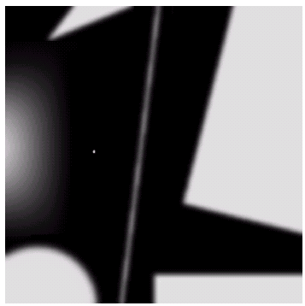
Spatial Differentiation
Differentiation measures the rate of change of a function
Let’s consider a simple 1 dimensional example

Slide 6
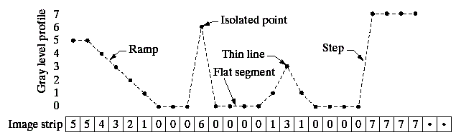
Spatial Differentiation
A
B

Slide 7
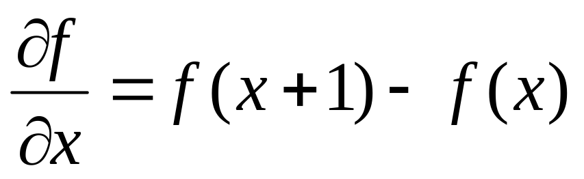
1st Derivative
The formula for the 1st derivative of a function is as follows:
It’s just the difference between subsequent values and measures the rate of change of the function

Slide 8
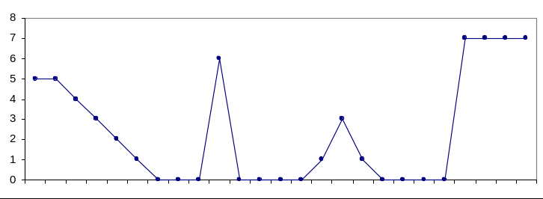
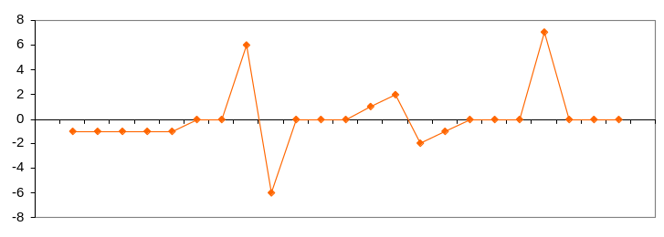
1st Derivative (cont…)
5 | 5 | 4 | 3 | 2 | 1 | 0 | 0 | 0 | 6 | 0 | 0 | 0 | 0 | 1 | 3 | 1 | 0 | 0 | 0 | 0 | 7 | 7 | 7 | 7
 | 0 | -1 | -1 | -1 | -1 | 0 | 0 | 6 | -6 | 0 | 0 | 0 | 1 | 2 | -2 | -1 | 0 | 0 | 0 | 7 | 0 | 0 | 0

Slide 9
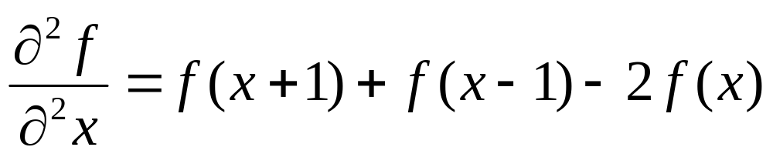
2nd Derivative
The formula for the 2nd derivative of a function is as follows:
Simply takes into account the values both before and after the current value

Slide 10
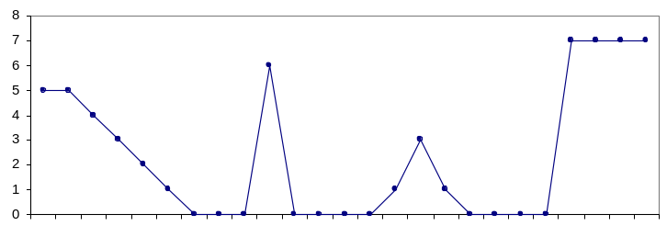
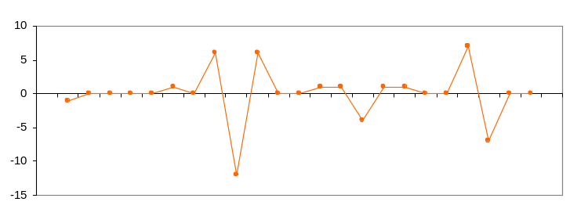
2nd Derivative (cont…)
5 | 5 | 4 | 3 | 2 | 1 | 0 | 0 | 0 | 6 | 0 | 0 | 0 | 0 | 1 | 3 | 1 | 0 | 0 | 0 | 0 | 7 | 7 | 7 | 7
 | -1 | 0 | 0 | 0 | 0 | 1 | 0 | 6 | -12 | 6 | 0 | 0 | 1 | 1 | -4 | 1 | 1 | 0 | 0 | 7 | -7 | 0 | 0

Slide 11
Using Second Derivatives For Image Enhancement
The 2nd derivative is more useful for image enhancement than the 1st derivative
  Stronger response to fine detail
  Simpler implementation
  We will come back to the 1st order derivative later on
The first sharpening filter we will look at is the Laplacian
  One of the simplest sharpening filters
  We will look at a digital implementation

Slide 12
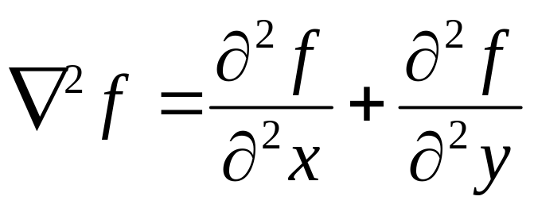
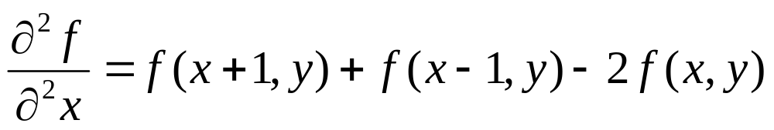
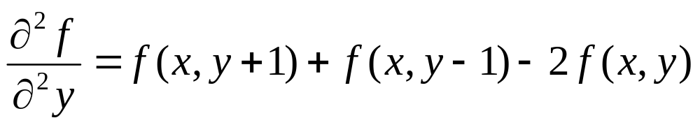
The Laplacian(2nd order Derivative)
The Laplacian is defined as follows:
where the partial 1st order derivative in the x direction is defined as follows:
and in the y direction as follows:

Slide 13
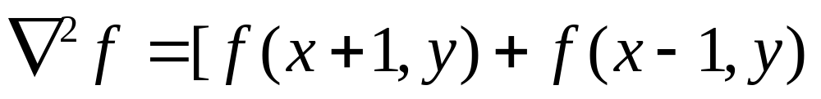
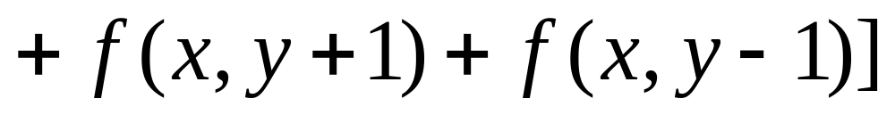
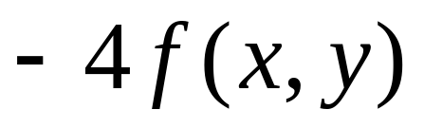
The Laplacian (cont…)
So, the Laplacian can be given as follows:
We can easily build a filter based on this
0
1
0
1
-4
1
0
1
0

Slide 14
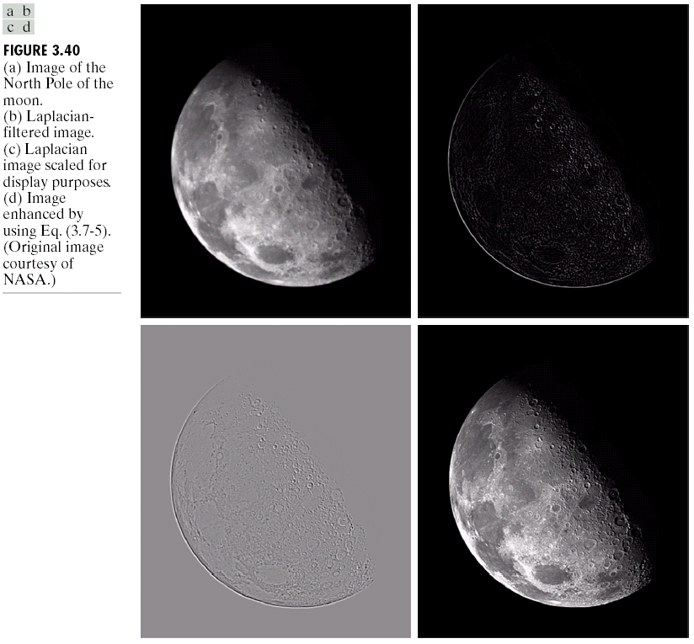
The Laplacian (cont…)
Applying the Laplacian to an image we get a new image that highlights edges and other discontinuities
Original
Image
Laplacian
Filtered Image
Laplacian
Filtered Image
Scaled for Display

Slide 15
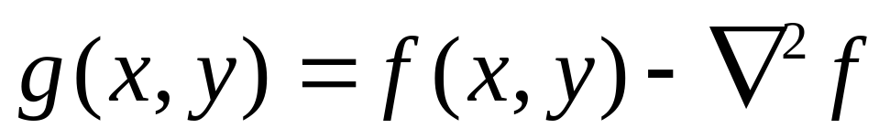
But That Is Not Very Enhanced!
The result of a Laplacian filtering is not an enhanced image
We have to do more work in order to get our final image
Subtract the Laplacian result from the original image to generate our final sharpened enhanced image
Laplacian
Filtered Image
Scaled for Display

Slide 16
Laplacian Image Enhancement
-
=
Original
Image
Laplacian
Filtered Image
Sharpened
Image
In the final sharpened image edges and fine detail are much more obvious

Slide 17
Laplacian Image Enhancement

Slide 18
Laplacian Operator
Laplacian Operator is also a derivative operator which is used to find edges in an image. Laplacian is a second order derivative mask. It can be further divided into positive laplacian and negative laplacian.
All these masks find edges. Some find horizontally and vertically, some find in one direction only and some find in all the directions. The next concept that comes after this is sharpening which can be done once the edges are extracted from the image
Let’s see that how Laplacian operator works.

Slide 19
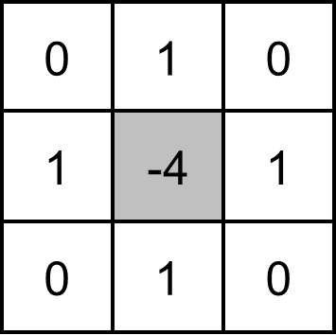
Positive Laplacian Operator
In Positive Laplacian we have standard mask in which center element of the mask should be negative and corner elements of mask should be zero.
Positive Laplacian Operator is use to take out outward edges in an image.

Slide 20
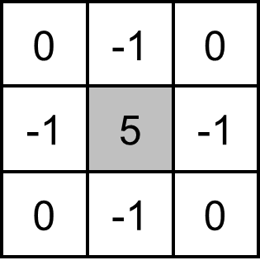
Negative Laplacian Operator
In negative Laplacian operator we also have a standard mask, in which center element should be positive. All the elements in the corner should be zero and rest of all the elements in the mask should be -1.
Negative Laplacian operator is use to take out inward edges in an image

Slide 21
How it works
Laplacian is a derivative operator; its uses highlight gray level discontinuities in an image and try to deemphasize regions with slowly varying gray levels. This operation in result produces such images which have grayish edge lines and other discontinuities on a dark background. This produces inward and outward edges in an image
The important thing is how to apply these filters onto image. Remember we can’t apply both the positive and negative Laplacian operator on the same image. we have to apply just one but the thing to remember is that if we apply positive Laplacian operator on the image then we subtract the resultant image from the original image to get the sharpened image.

Slide 22
Similarly if we apply negative Laplacian operator then we have to add the resultant image onto original image to get the sharpened image.
Laplacian in its original form is not used for edge detection because:
1. It is very sensitive to noise
2. It’s magnitude produces double edges
3. Unable to detect the direction of an edge.

Slide 23
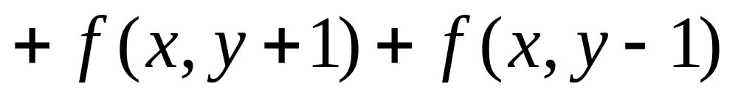
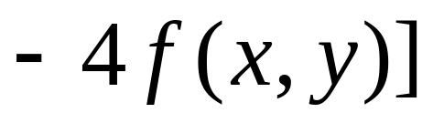
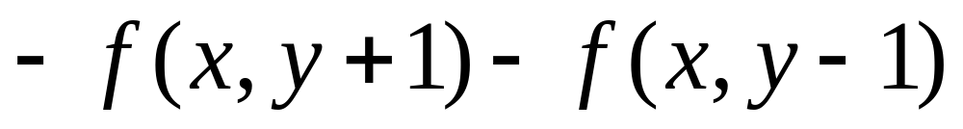
Simplified Image Enhancement
The entire enhancement can be combined into a single filtering operation

Slide 24
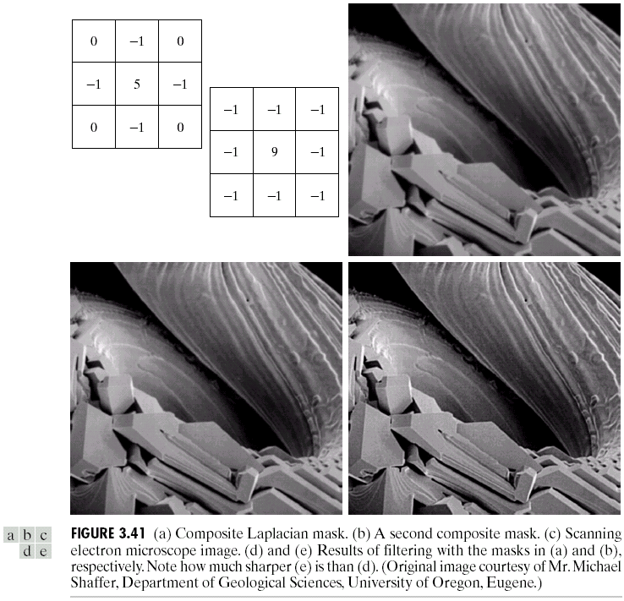
Simplified Image Enhancement (cont…)
This gives us a new filter which does the whole job for us in one step
0
-1
0
-1
5
-1
0
-1
0

Slide 25
Simplified Image Enhancement (cont…)

Slide 26
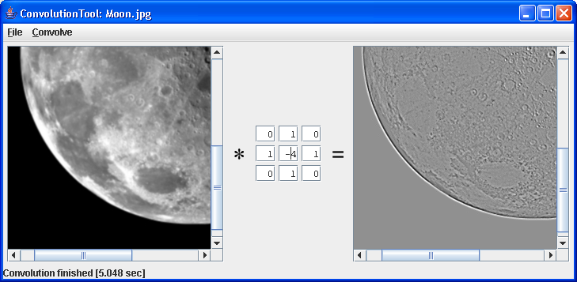
Simple Convolution Tool In Java
A great tool for testing out different filters
  From the book “Image Processing tools in Java”
  Available from webCT later on today
  To launch: java ConvolutionTool Moon.jpg

Slide 27
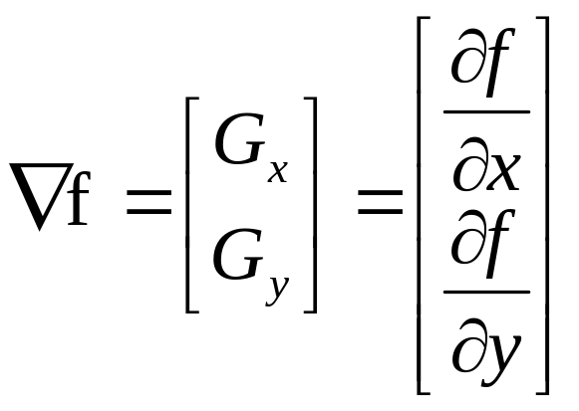
1st Derivative Filtering
Implementing 1st derivative filters is difficult in practice
For a function f(x, y) the gradient of f at coordinates (x, y) is given as the column vector:

Slide 28
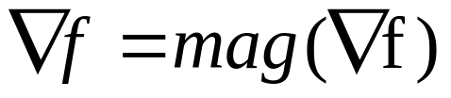
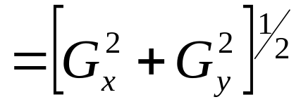
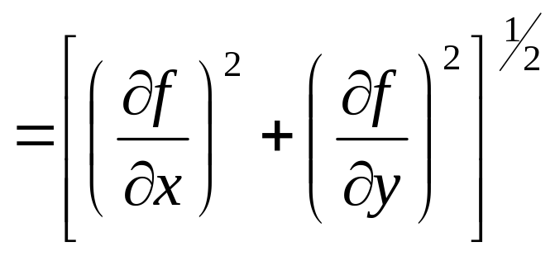
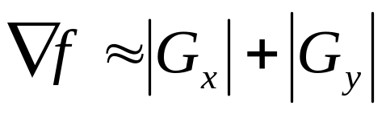
1st Derivative Filtering (cont…)
The magnitude of this vector is given by:
For practical reasons this can be simplified as:

Slide 29
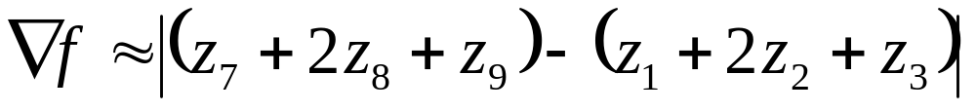
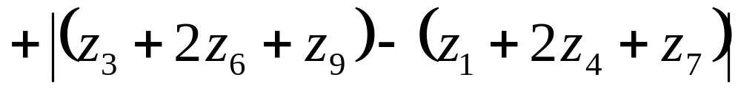
1st Derivative Filtering (cont…)
There is some debate as to how best to calculate these gradients but we will use:
which is based on these coordinates
z₁
z₂
z₃
z₄
z₅
z₆
z₇
z₈
z₉

Slide 30
1st & 2nd Derivatives
Comparing the 1st and 2nd derivatives we can conclude the following:
  1st order derivatives generally produce thicker edges
  2nd order derivatives have a stronger response to fine detail e.g. thin lines
  1st order derivatives have stronger response to grey level step
  2nd order derivatives produce a double response at step changes in grey level

Slide 31
Summary
In this lecture we looked at:
  Sharpening filters
    1st derivative filters
    2nd derivative filters
  Combining filtering techniques

Slide 32
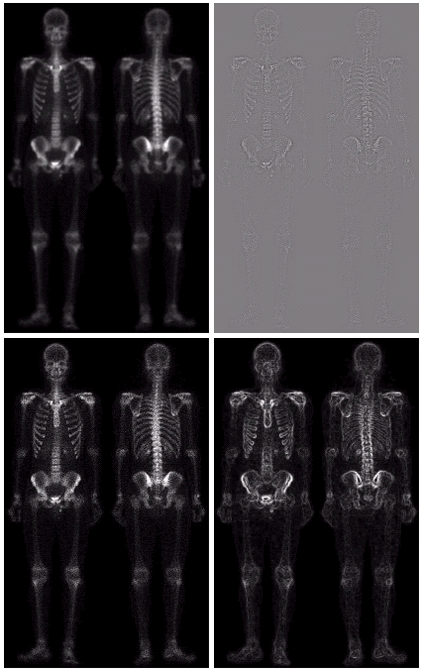
Combining Spatial Enhancement Methods
Successful image enhancement is typically not achieved using a single operation
Rather we combine a range of techniques in order to achieve a final result
This example will focus on enhancing the bone scan to the right

Slide 33
Combining Spatial Enhancement Methods (cont…)
(a)
Laplacian filter of bone scan (a)
(b)
Sharpened version of bone scan achieved by subtracting (a) and (b)
(c)
Sobel filter of bone scan (a)
(d)

Slide 34
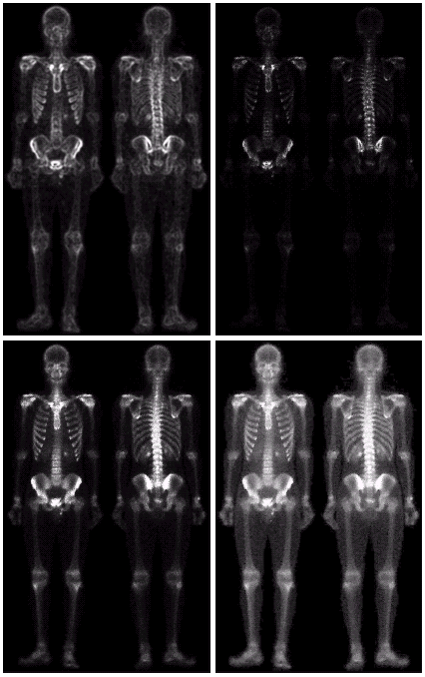
Combining Spatial Enhancement Methods (cont…)
Result of applying a power-law trans. to (g)
(h)
Sharpened image which is sum of (a) and (f)
(g)
The product of (c) and (e) which will be used as a mask
(f)
(e)
Image (d) smoothed with a 5*5 averaging filter

Slide 35
Combining Spatial Enhancement Methods (cont…)
Compare the original and final images

