Slide 1
School Mangement System
Presented By
Eyasir Ahamed
Roll :15
Department of CSE
SHEIKH HASINA UNIVERSITY
Topic : Normalization

Slide 2
NORMALIZATION
Why We Need Normalization in DBMS?
Eliminating Redundancy
Consistency
Storage Optimization
Logically Stored Data
CRUD Operation
It's a database design principle for organizing data in a organize and consistent way

Slide 3
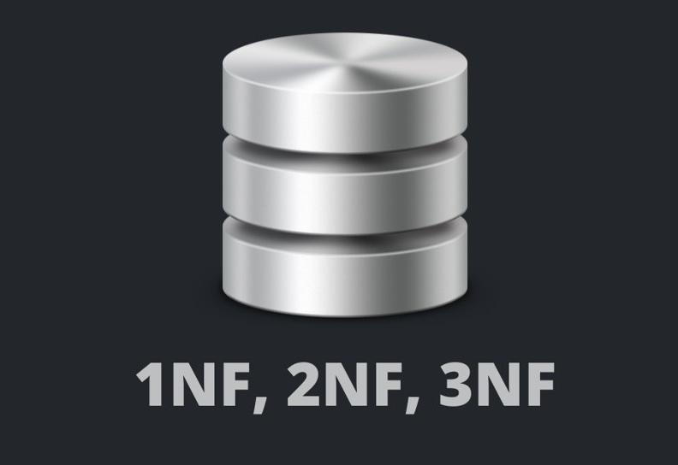
NORMALIZATION
First Normal Form
Second Normal Form
Third Normal Form

Slide 4

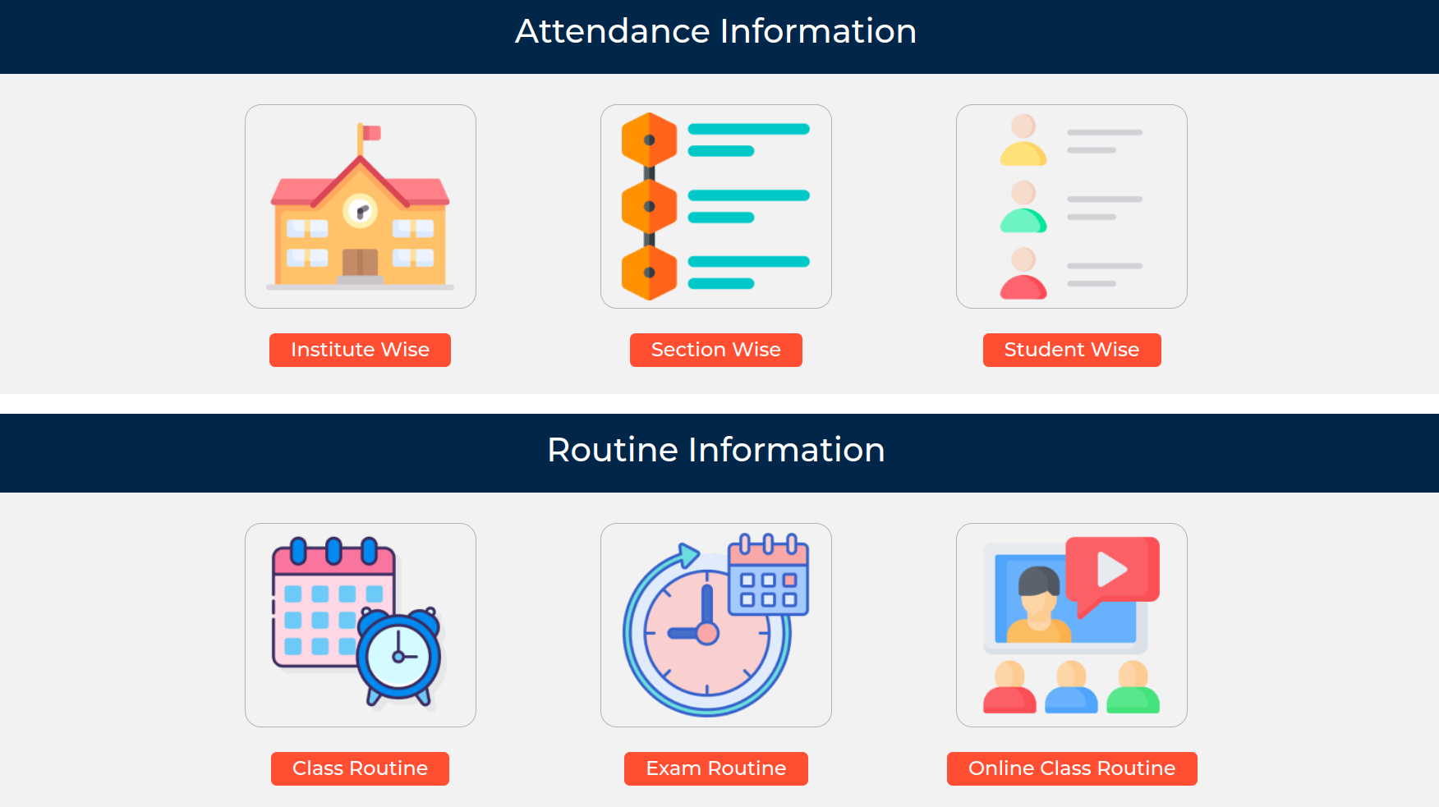
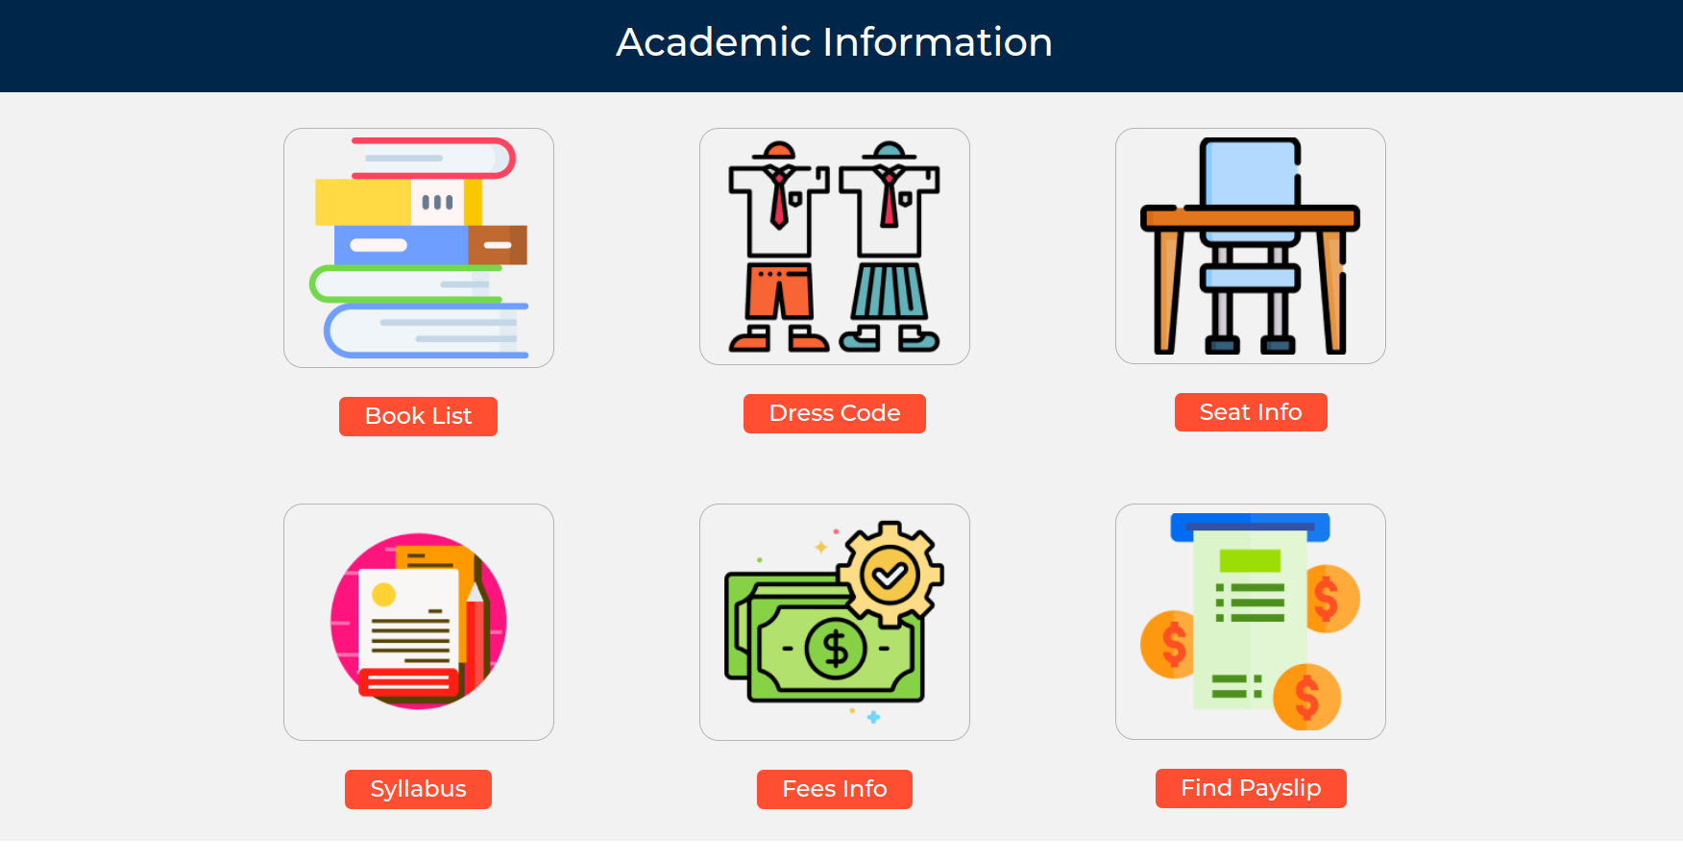
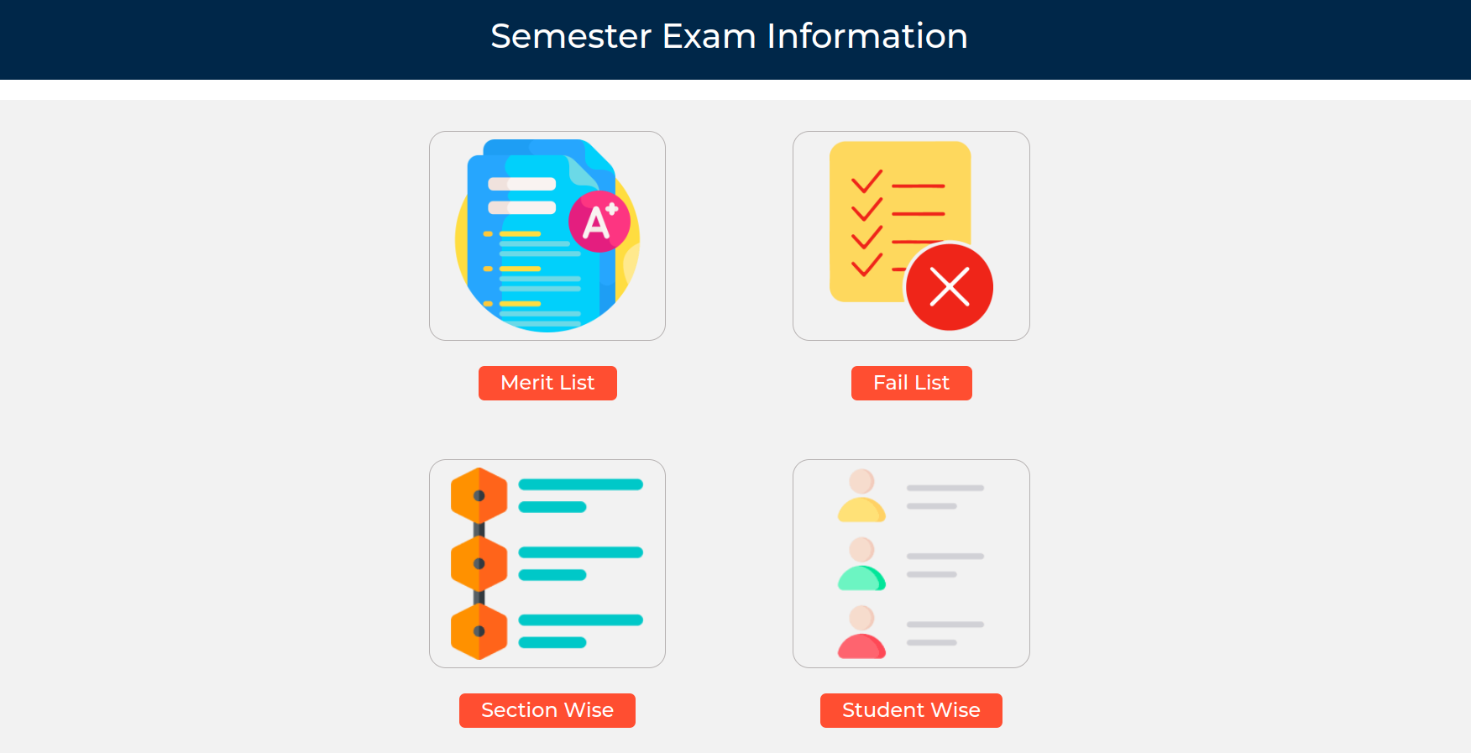
Features In School Website Project

Slide 5
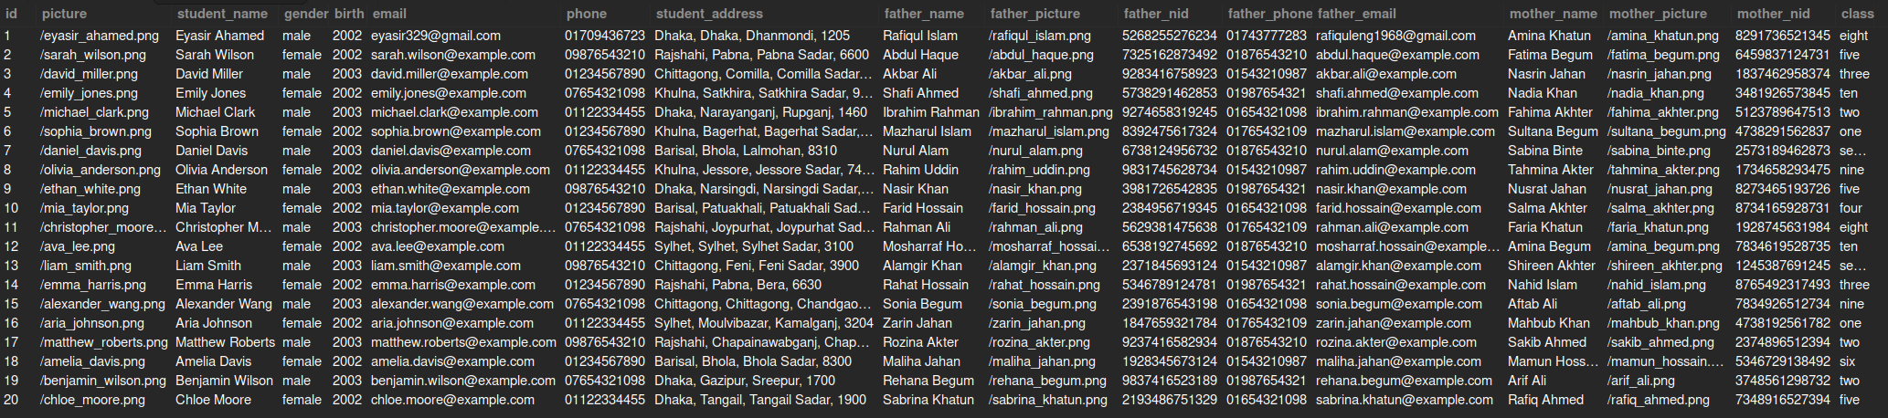






1NF
Single cell not hold more than one value.
There must be primary key.
Each record is unique
STUDENT SECTION

Slide 6
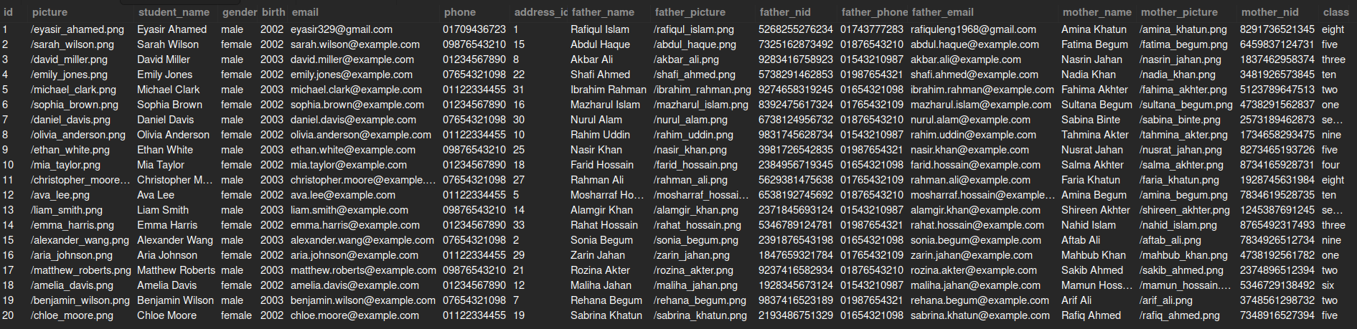
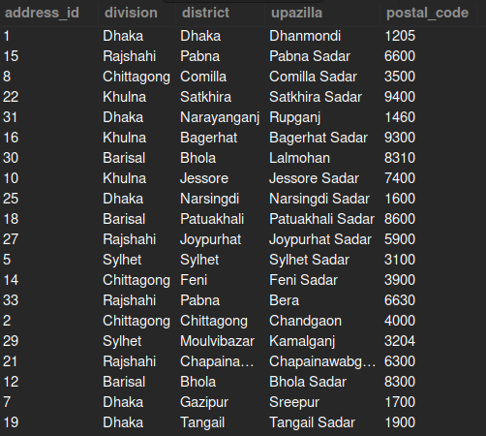
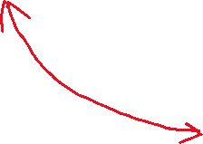
Now it's done for 1NF
But we have so many redundancy value.

Slide 7
All element from our table not following one primary key.
2NF
1NF eliminates repeating group not redundancy.
Must be in 1NF.
No partial dependancy.
(Means no key attributes are fully dependent on a primary key.)

Slide 8
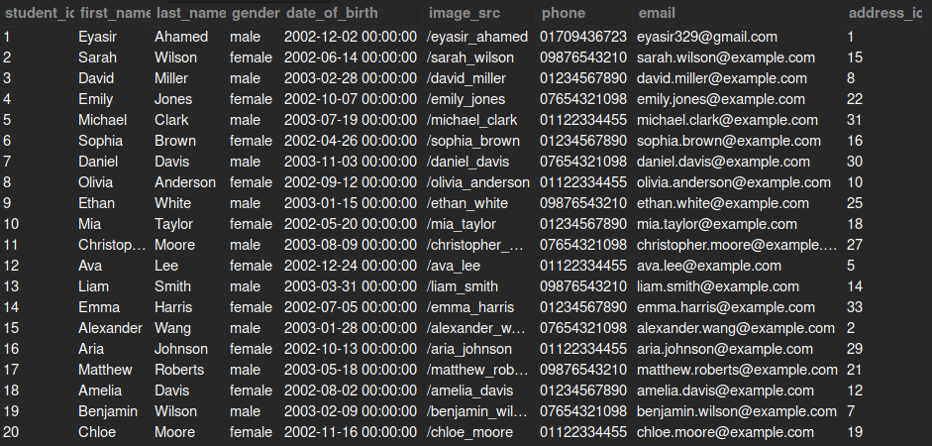
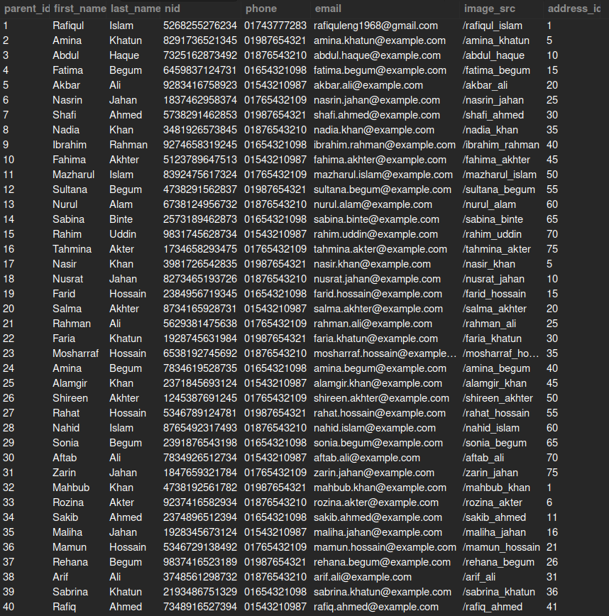
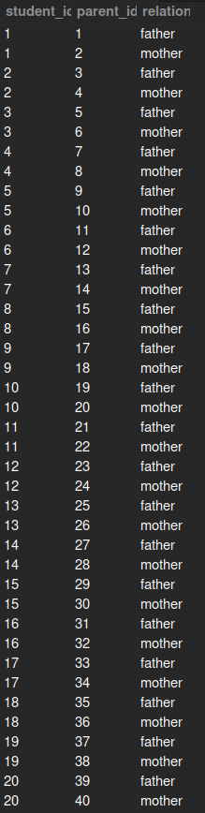
Now we are done using 1NF and 2NF

Slide 9

3NF
2NF is perfect but it does not eliminate transitive partial dependency. So we need another normalization
Must be in 2NF.
Have no transitive partial dependency.
(Means a non-prime attribute is NOT dependent on another non-prime attribute.)

Slide 10
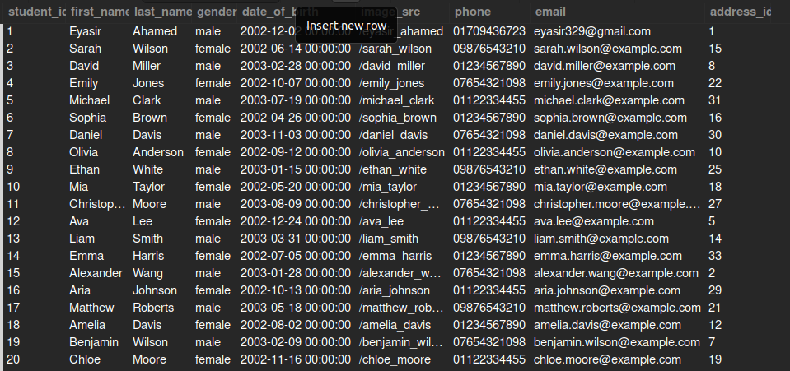
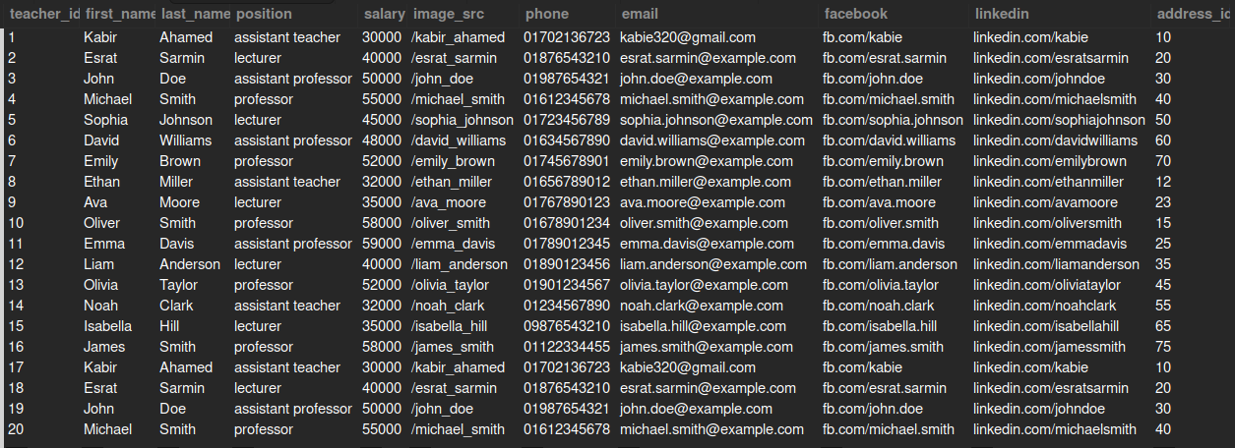
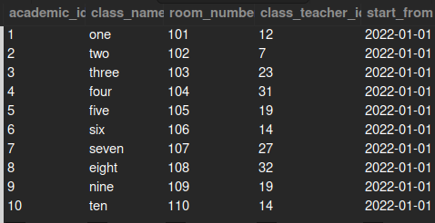
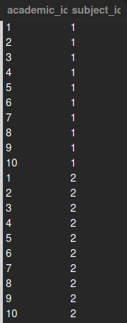
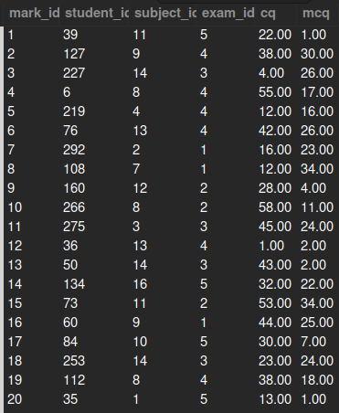
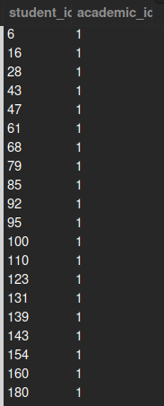
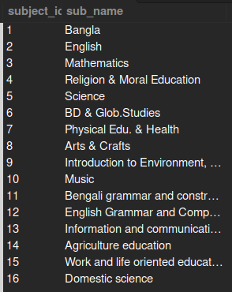
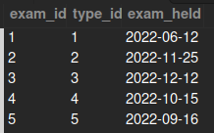
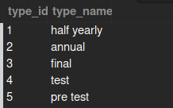






















Slide 11
Previous Process is Applied for all other table...

Slide 12
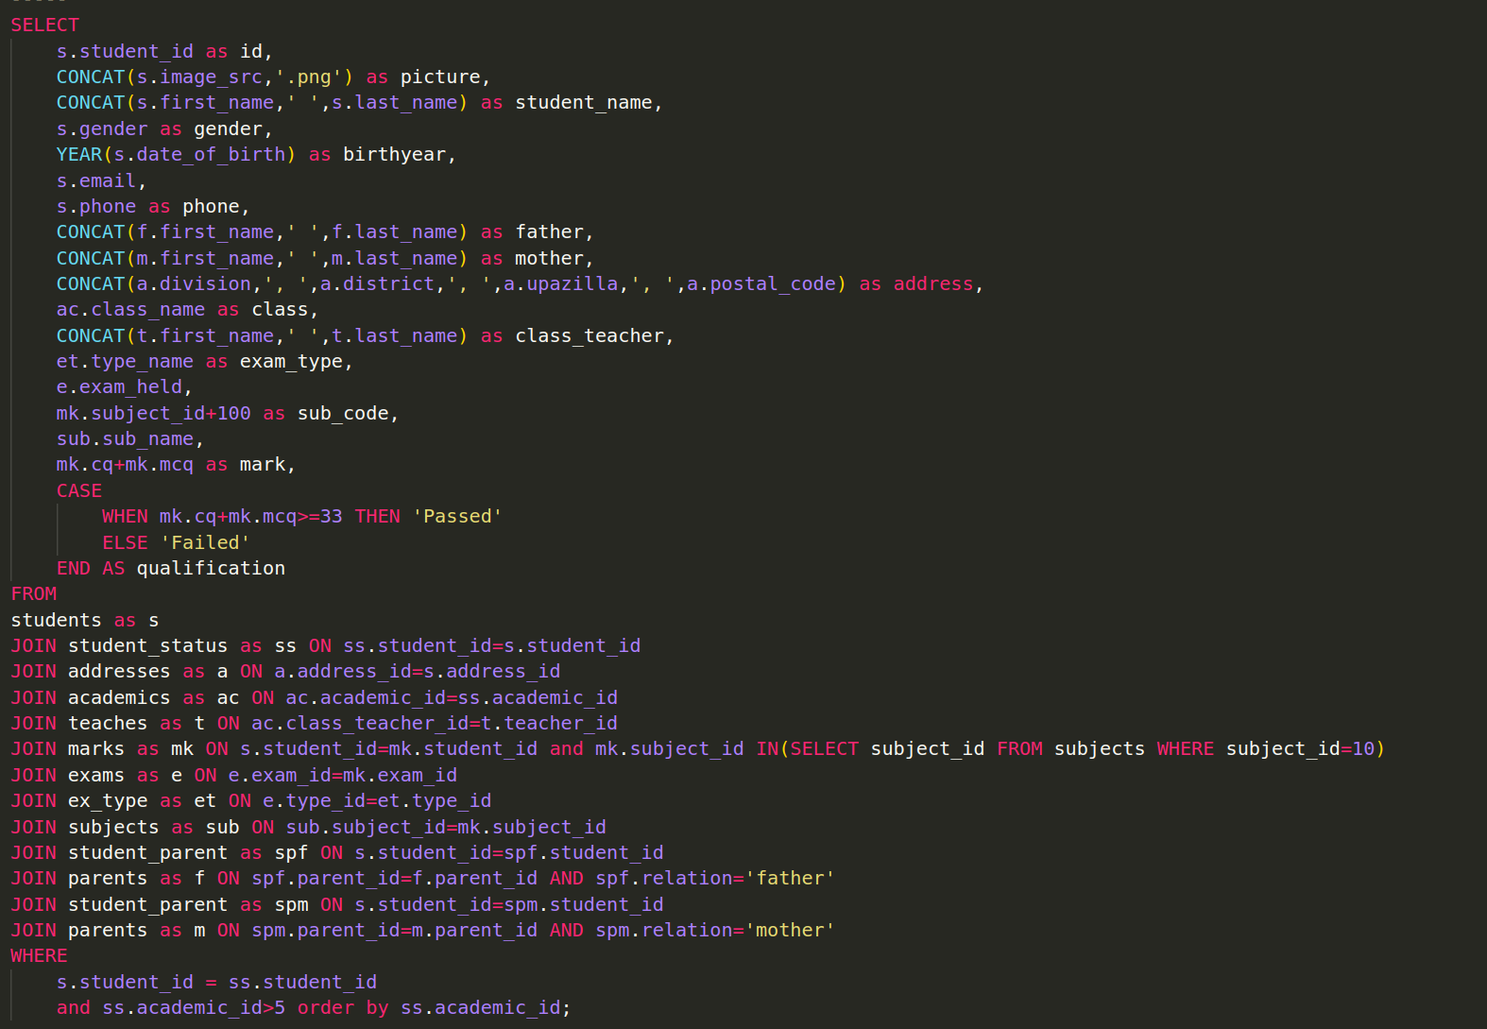

Slide 13
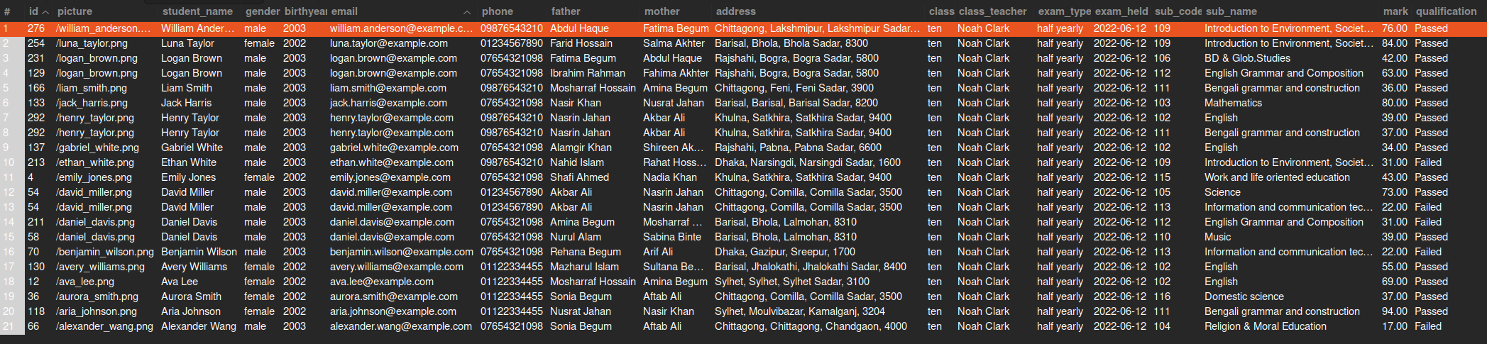

Slide 14
