Slide 1
Conway's Game of Life – project 3
Presented by Vib, EmmanuEl, Charlie

Slide 2
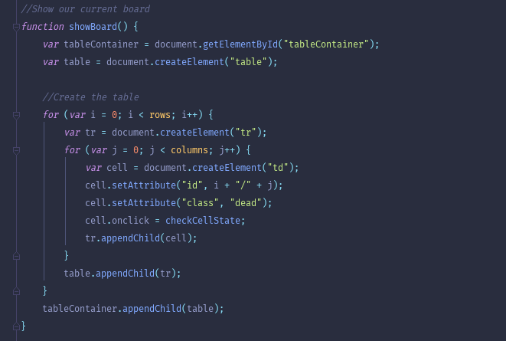
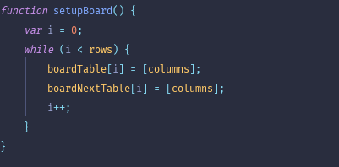
Make board
Board is a table.
Build the table and then set it up.

Slide 3

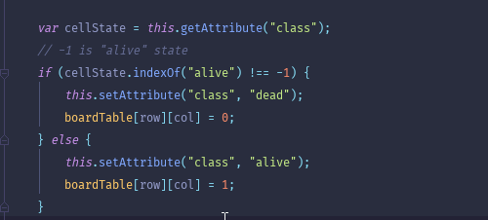
Make the board visible
Easiest way? Make it a table. So we used document.createElement to create the board. Set an attribute to each cell (td). Then use an onclick function on each cell, if clicked then change that cell state to alive.

Slide 4
Now comes the logic….

Slide 5
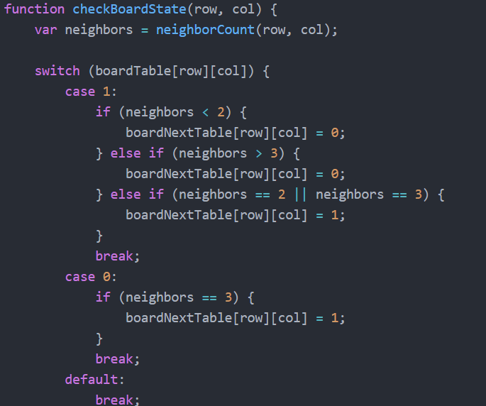
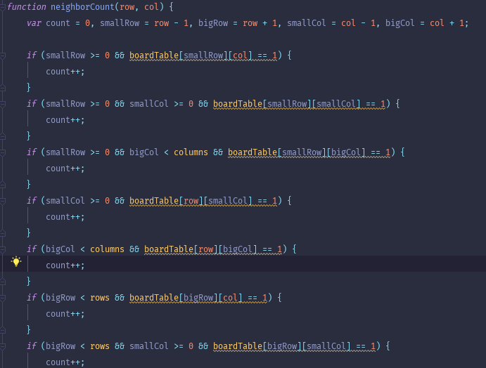
Check state of board

Slide 6
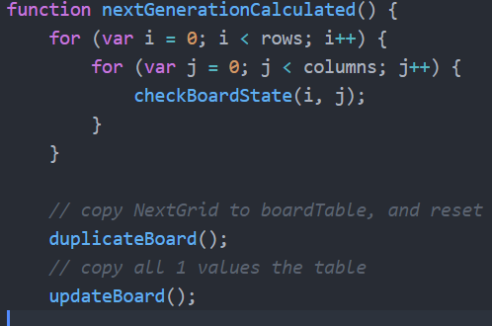
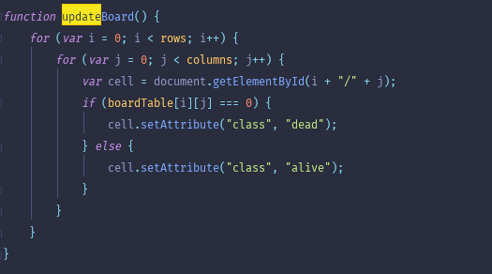
Go one generation
Single iteration of the game.

Slide 7
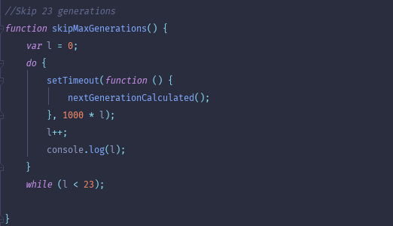
Go 23 Generations
Simple for loop going through each 23 generations

Slide 8
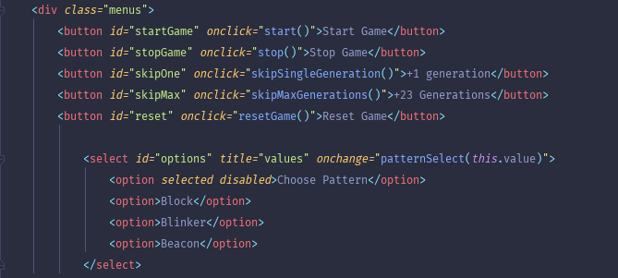
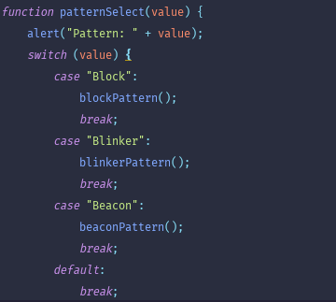
HTML

Slide 9
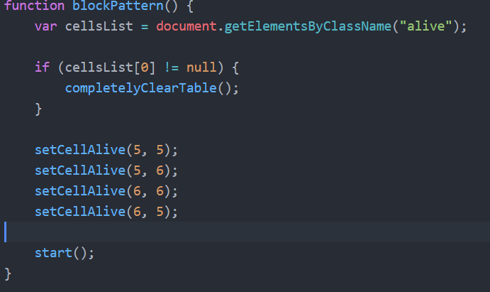
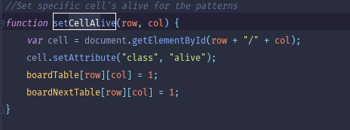
Patterns

Slide 10
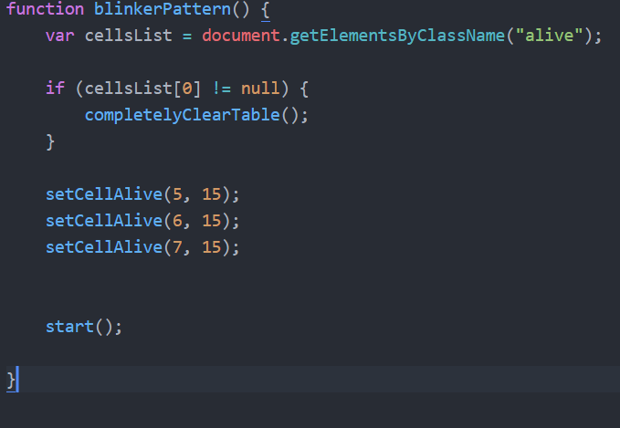
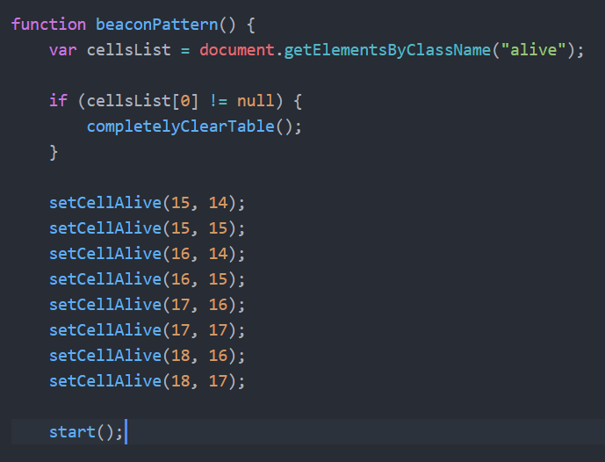
Patterns - 2

