Slide 1

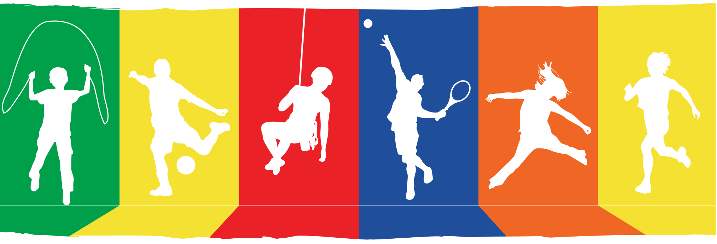





Fit to Study PE Teacher Training
Catherine Wheatley
& Nick Beale
July 2017
Funded by the Education and Neuroscience Programme. Grant Ref. 2681
Notes:
Key points:
- Thanks for coming and supporting Fit to Study
Housekeeping
ACKNOWLEDGE NATCEN
- This session takes about 90 mins
- This is an interactive session and we want you to participate in discussion
- You have been invited because your school has been randomised into the intervention arm of the trial
- This means we will be asking to to deliver a programme of PE that we believe could enhance academic attainment
So…what is it all about?

Slide 2

What is the Aim of Fit to Study?
Can a programme of vigorous physical activity during Year 8 PE improve brain function and raise academic attainment?
Notes:
Key points:
We want to test whether a programme of vigorous physical activity during Year 8 PE raise academic attainment, especially among disadvantaged children
This is perhaps largest UK study to measure PA in secondary schools over a whole school year – it is an ambitious project!
Your school is one of 50 state schools that have been selected at random to deliver a simple but - we think - effective intervention
The 50 control schools will deliver PE as usual
The intervention will last a whole school year, from September 2017 – July 2018
We will talk about the intervention in more detail later in the session
First the rationale for the study ….

Slide 3
The Physical Activity Background

Slide 4
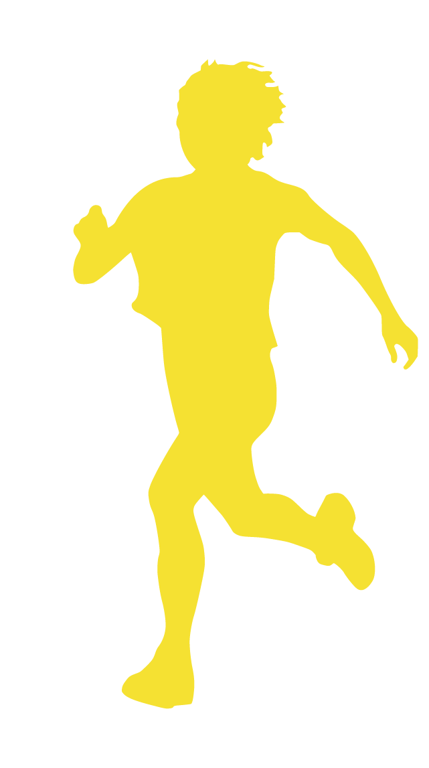
Defining Physical Activity
“Any body movement produced by skeletal muscles that results in a substantial increase over resting energy expenditure”
Moderate intensity: brisk walking (heart rate 60-70% of max)¹
Vigorous intensity: running (heart rate 71-85% of max)¹
:
Ekelund et al, 2001¹
Notes:
What do we mean by physical activity ?
These number are derived for adolescents
(Quick slide - PE staff know)

Slide 5
Declining Adolescent Physical Activity
Percentage of Young People in England Meeting Guidelines
%
Proportion of young people completing 60 minutes a day of moderate-to-vigorous physical activity every day falls sharply during adolescence
Targeting age 12-13 in Year 8
Notes:
We know that there is a dramatic decline in daily physical activity during adolescence. Heath guidelines suggest that young people do 60 minutes of MVPA - exercise that gets you warm, raises your heart and breathing rate – every day. This is the picture in England in 2014 – at age 11, just a quarter of boys and a fifth of girls achieve their 60 minutes. By 13 that’s fallen 23% and 14% and by 15 you can see that less than 1 in 10 of the girls are hitting this target. It’s a similar picture in the rest of the developed world.
Discussion point – is this something you see among your students?
This is a key reason why we are targeting year 8 – there is scope to make a difference
Evidence that sedentary adolescents tend to become sedentary adults so good to keep this age group active
This is an age where the brain is still very plastic – connections are still being made –
More practically, because they have settled into secondary school but not yet into GCSEs

Slide 6

Why Vigorous Activity?
Achieves similar health and fitness benefits to traditional aerobic training with shorter bouts of activity¹
Positive effects on:
Mental Health²
Sleep Quality³
Wellbeing³
More evidence needed for adolescents
Costigan et al., 2015¹; Kilpatrick, Jung & Little, 2014^{2;} Singh et al., 2005³
Notes:
We have just been talking about moderate-to-vigorous activity.
Our intervention asks whether a programme of vigorous activity can improve academic attainment?
Why? Because we understand the pressure on PE teachers to deliver the curriculum and we believe that – potentially – there are similar benefits to be had with shorter bouts of activity
We have designed the Fit to Study Intervention with this in mind
Mental health²
Sleep quality³
Wellbeing³
More evidence needed for adolescents!
Achieves similar health and fitness benefits to traditional aerobic training with shorter bouts of activity¹
Positive effects on:
Mental Health²
Sleep Quality³
Costigan S, Eather N, Plotnikoff R, Taaffe DR, Lubans DR. High-
intensity interval training for improving health-related fitness in adolescents: a systematic review and meta-analysis. Br J Sports Med. 2015;49(19):1253–61.
Kilpatrick MW, Jung ME, Little JP. High-intensity interval train- ing: a review of physiological and psychological responses. ACSMs Health Fit J. 2014;18(5):11–6.
Singh NA, Stavrinos TM, Scarbek Y, Galambos G, Liber C, Fiatarone Singh MA. A randomized controlled trial of high versus low intensity weight training versus general practitioner care for clinical depression in older adults. J Gerontol A Biol Sci Med Sci. 2005;60(6):768–76.

Slide 7
The Neuroscience Background
Notes:
Let’s start by thinking about the neuroscience background to this project

Slide 8
A Healthy Body and a Healthy Mind
We know physical activity is good for heart health, bone strength and weight management
But neuroscience research suggests that physical activity might also improve our brains and our mental abilities
Notes:
mens sana in corpore sano "a healthy mind in a healthy body“
anima sana in corpore sano “a healthy soul in a healthy body”

Slide 9
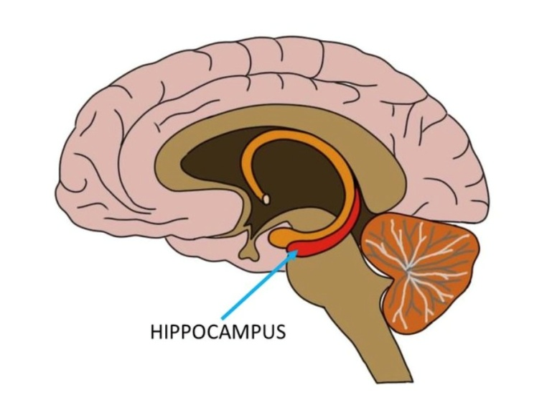
Physical Activity Boosts Our Brains
Brain cell development - neurogenesis
Brain capillary growth - angiogenesis
New connections between neurons - synaptogenesis
More proteins that help neurons survive – neurotrophins
Our MRI Study will look for evidence of increased hippocampal volume
Notes:
Growing evidence that exercise stimulates the release of chemicals in the brain that affect the health of brain cells, the growth of new blood vessels in the brain, and even the abundance and survival of new brain cells.
Effects both immediately and in the longer term
Studies have shown that a programme of MVPA can increase the volume of the hippocampus which is responsible for memory
Much of the research has involved looking at older adults and the effect of exercise on mild cognitive impairment
Now researchers are starting to look at the possible impact of physical activity on young people’s brains and their hippocampi
Also some evidence that exercise might impact parts of the prefrontal cortex responsible for controlling impulsivity and maintaining attention
Discussion point – has your school been selected for the MRI Sub Study?

Slide 10

Activity – Cognition - Attainment?
Activity can improve attention and memory
Over the longer term
Immediately after exercise ¹
Research links physical activity with attainment²
But we need more and better evidence in schools
eg Hotting et al 2016; Etnier et al., 2016 ¹
eg Donnelly et al., 2016; Lees & Hopkins, 2013²
Notes:
So there is enough evidence to suggest that physical activity in this age group might improve memory and attention
Not only over the longer term via changes to the brain
But also, possibly, immediately after exercise (so if maths is straight after PE…)
Several studies have linked physical activity in school with academic attainment
But the conclusions are not clear because it has been difficult to pin down the mechanisms between the two

Slide 11
The Neuroscience Pathway
Fit to Study is measuring:
Brain: Attention & Memory
Physical Activity
Academic Attainment
Fitness
Notes:
This is what the computer challenges have been assessing! Will we see an improvement in cognitive skills among pupils in intervention schools compared to those in control schools?
(About the cognitive tasks – yes they are complicated – but if they were easy an everyone could do them then we would not be able to detect improvements/differenecs between the groups)
Fitness is what the bleep test or cooper run comes in
This is the main part of the story, but not the whole story….

Slide 12
The Psychosocial Background

Slide 13
Activity Can Lift Mood & Maintain Mental Health
Better physical self-perception and self-esteem
Reduced depression
Increased feelings of wellbeing
Notes:
We know that – as well as delivering physical health benefits - physical activity can:
Improve your idea of your own physical strength, fitness, appearance and capabilities
Which can lead to general improvements in self esteem
Reduce feelings of depression (and in some cases anxiety)
Lift mood
And increase feelings of wellbeing

Slide 14

Activity - Health/Wellbeing - Attainment?
Mental health and wellbeing are linked to attainment¹ but the mechanisms are not clear:
Improved overall self-esteem?
Better behaviour?
Less absence?
More and better sleep?
We need more and better evidence in schools
Lees & Hopkins, 2013¹
Notes:
- These are some of the hypothesised links

Slide 15
The Psychosocial Pathway
Fit to Study is measuring:
Mental Health & wellbeing
Physical Activity
Brain: Attention & Memory
Fitness
Academic Attainment
Notes:
This is what the About You questionnaire has been assessing!
We will be looking for differences in mental health, wellbeing, daytime sleepiness and self esteem between intervention and control groups

Slide 16
The PE Context

Slide 17
Shaping our Childrens’ Futures…
“Events in early life affect health and wellbeing in later life. Whether this is through changes in genetic expression, how the brain is formed or emotional development…what happens in these years lays down the building blocks for the future. This is particularly the case at times of rapid brain growth in the early years and adolescence.”
Dame Sally Davies, Chief Medical Officer, Annual Report 2012
Notes:
For all these reasons physical activity has a very important role to play, not just in adolescents’ physical and mental health and cognition, but in driving academic attainment in secondary schools.
Similar, smaller trials in schools confirm that more physical activity certainly does not harm academic attainment…and might improve it
We think there is particular scope for improving attainment among disadvantaged children among who PA levels are often low
Why would we like our intervention to target activity during PE?
- PE is compulsory, PE is controlled
Physical activity is important, PE is important for delivering physical activity, and adolescence is an important time to get students active. We believe PE has fundamental importance in secondary school…

Slide 18
Physical Activity During PE
Proportion PE Lesson Spent in MVPA^{1,2}
%
32%
27%
Notes:
AfPE guidelines suggest that pupils spend 50% of a PE lesson is spent in MVPA – but for lots of reasons that does not always happen.
A recent review of PE lessons around the world put the figure at 42%
A review of British lessons by F&S put the figure at 27-47%
Our own early research, which used wrist mounted accelerometers and covered 42 lessons in a variety of sports over an 8 month period had the figure as low as 18%.
NB there are no specific guidelines on the amount of vigorous physical activity per day/week
In other words – there is room to squeeze in more activity
This is a breakdown of different lesson activities or teaching contexts during a typical lesson (measured in the Netherlands)
The percentage time spent in MVPA varies a great deal
Fitness Activity 60% MVPA
Skills practice 32% MVPA
Management 27% MVPA
Game Play 24% MVPA
General Knowledge 2% MVPA (rules, physiology, strategy etc)
We know

Slide 19
Exercise 1: Your Typical Lesson
Consider a typical one-hour lesson
For every five minute block, write down teaching context:
fitness activity
general knowledge
class management
skill practice
game play
Notes:
Ask teachers to think about the last lesson they taught
How many 5 minute blocks were spent in each activity?
Put the exercise on one side for later – we will come back to it

Slide 20
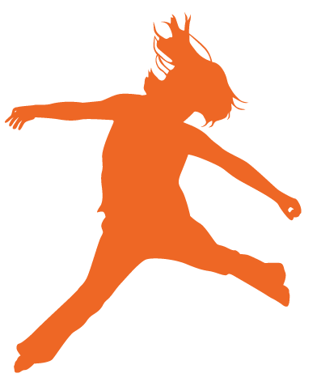
Key Stage 3 PE Curriculum Aims
To ensure that all pupils:
Develop competence to excel in a broad range of physical activities
Are physically active for sustained periods of time
Engage in competitive sports and activities
Lead healthy, active lives
DfE National Curriculum for England KS3 and KS4
Notes:
We recognise that PE teachers have to balance competing aims, working with a wide range of abilities
We understand things are likely to become even more difficult in September with funding cuts
So we wanted to design - and ask you to implement - a simple but effective intervention
The intervention we are about to introduce is the result of three years of consultation with Heads of PE, the Oxfordshire Sports Partnership and extensive piloting in local schools

Slide 21
The Fit to Study Intervention
Notes:
The moment you have been waiting for…..

Slide 22
Ten Minutes, Twice a Week, All Year
The Fit to Study intervention:
Active warm-up: 4 minutes’ vigorous
Fitness Infusion: 2 minutes’ vigorous
Fitness Infusion: 2 minutes’ vigorous
Fitness Infusion: 2 minutes’ vigorous
Simple
Short
Easy to Incorporate
Notes:
We are asking teachers to incorporate ten minutes of VPA into every singe lesson from September 2017 – July 2018
To help you do this, we have designed an active ten-minute warm up and three x two –minute fitness infusions

Slide 23
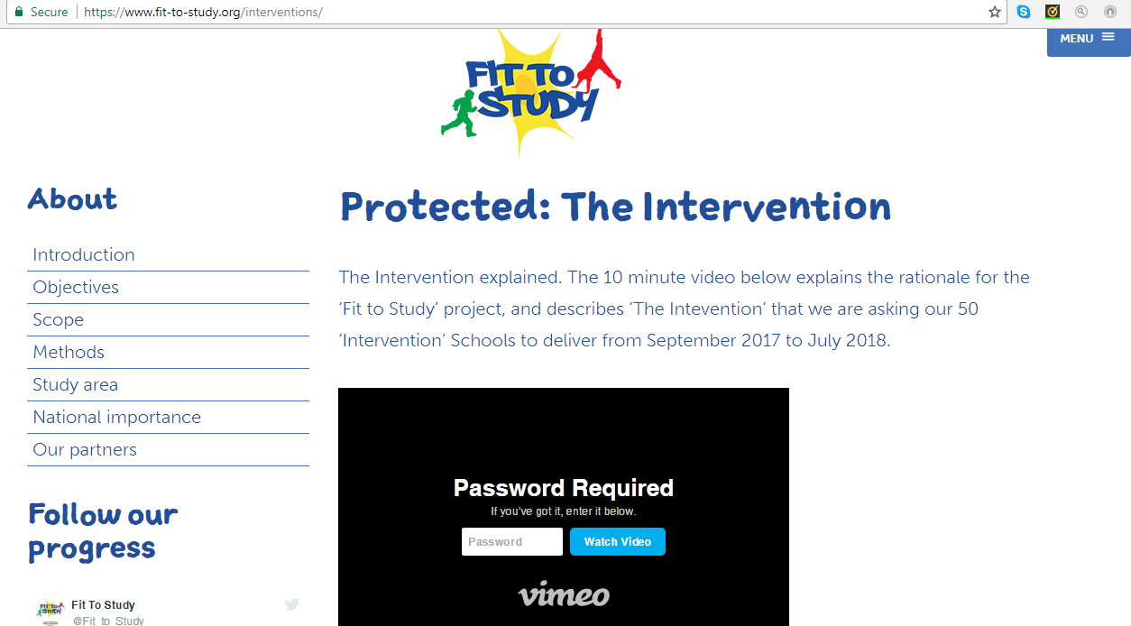

https://www.fit-to-study.org/interventions/
Call 01865 482752 for password

Slide 24
Active 10 Minute Warm Up
Start with 10-minute dynamic full-body warm-up
Include 4 minutes of vigorous activity
Maximise MVPA and minimise injury risk
Notes:
This warm-up was created by the NZ All Blacks rugby coach
It warms up all areas of the body
Starts with small movements of light intensity but the work rate increases
We have tested extensively with heart rate monitors and we know that if followed correctly the adolescent heart rate moves into the vigorous zone
It is an exemplar rather than something to be exactly followed
The overarching point is that it gears up to include 4 mins of vigorous activity – it is not a steady stage jog around the field
[link to clip here] starts 4.04 Ends 5.05
https://drive.google.com/file/d/0B0QboQ8ig_pKQWo5SkxLSDFCWGM/view

Slide 25

Infusion 1: Fast Arms (2 mins)
Fast arm rotations on the spot for a count of ten
Active recovery for a count of ten
Notes:
The point about vigorous intensity activity is that you can only sustain it for short bursts
This infusion likely to involve bursts of sprinting on the spot followed by a short recovery periods before starting again

Slide 26

Infusion 2: Dynamic Balance (2 mins)
Squats and lunges
Aerobic plus resistance component
Active recovery between sets

Slide 27

Infusion 3: Fast Feet
Sprinting on the spot for a count of ten
Active recovery for a count of ten

Slide 28
Exercise 2: PE Practical
Nominate a colleague to devise and lead an infusion
Put on your heart rate monitors
Two minutes VPA!
Notes:
The point of this exercise is for teachers to understand that this exercise can push HR into a vigorous zone
And to have some fun

Slide 29
Exercise 3: Your Typical Lesson Now
Go back to your lesson evaluation
Can you make time for the warm up?
Where might you fit in the infusions?

Slide 30
We Are Asking You to...
Share Fit to Study with other school staff
(But don’t share it with other schools)
Plan how to deliver the intervention next year
Tell your students about Fit to Study
Ten minutes, twice a week!

Slide 31
Monitoring Intervention Impact
Notes:
In other words – how will we measure how successfully intervention schools are delivering the intervention?

Slide 32
The Lesson Log
Please complete and retain the lesson log!
This covers all Year 8 PE lessons for the whole year
Notes:
We are relying on your honest appraisal of what you have delivered
If we see no improvements in fitness/cognition/academic attainment, we would like to know whether this might be because the intervention was not delivered.
Otherwise we might draw false conclusions.
Thank you!

Slide 33
Physical Activity Monitoring
Researchers will measure physical activity during PE in the autumn, spring and summer terms
Notes:
AX3s
At least half the year
That is what we having been doing this term

Slide 34
Academic Attainment
Maths test in Term 6 of Year 8
Independent evaluators NatCen to administer

Slide 35
In Summary…
Mental Health & Wellbeing
Physical Activity
Brain: Attention & Memory
Academic Attainment
Fitness
Accelerometer
& Lesson Log
Maths Test (NatCen)
Bleep Test
Online Tasks
Notes:
We will be looking for differences in mental health, wellbeing, daytime sleepiness and self esteem between intervention and control groups

Slide 36
Thank You for Participating!
Any Questions?
Funded by the Education and Neuroscience Programme. Grant Ref. 2681
Notes:
Key points:
- Thanks for coming and supporting Fit to Study
Housekeeping
ACKNOWLEDGE NATCEN
- This session takes about two hours
- This is an interactive session and we want you to participate in discussion
- You have been invited because your school has been randomised into the intervention arm of the trial
- This means we will be asking to to deliver a programme of PE that we believe could enhance academic attainment
So…what is it all about?

