Slide 1
Eyedeea Photos — UX Scenario
LG webOS TV · com.eyediatech.eyedeeaphotos · v1.0.3

Slide 2
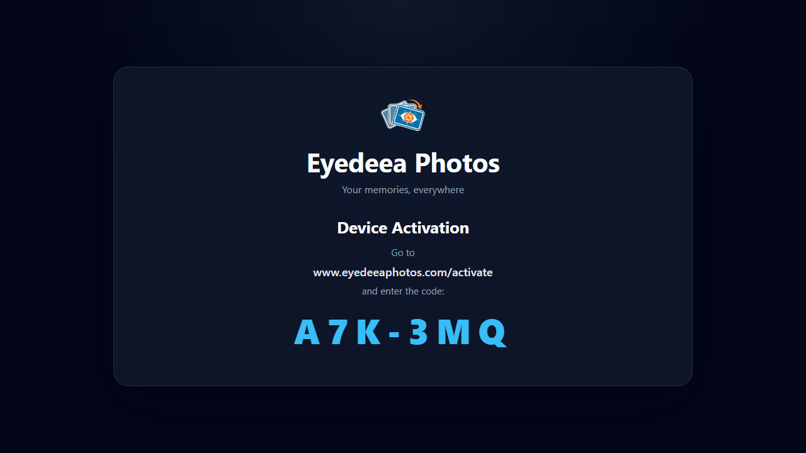
1. Launch / device code
App launches to Eyedeea Photos device code screen (not web home)
Large XXX-XXX code for web activation
Shows www.eyedeeaphotos.com/activate
Status shows Waiting for activation… while polling
Activation is completed on phone/desktop — not inside the TV app.

Slide 3
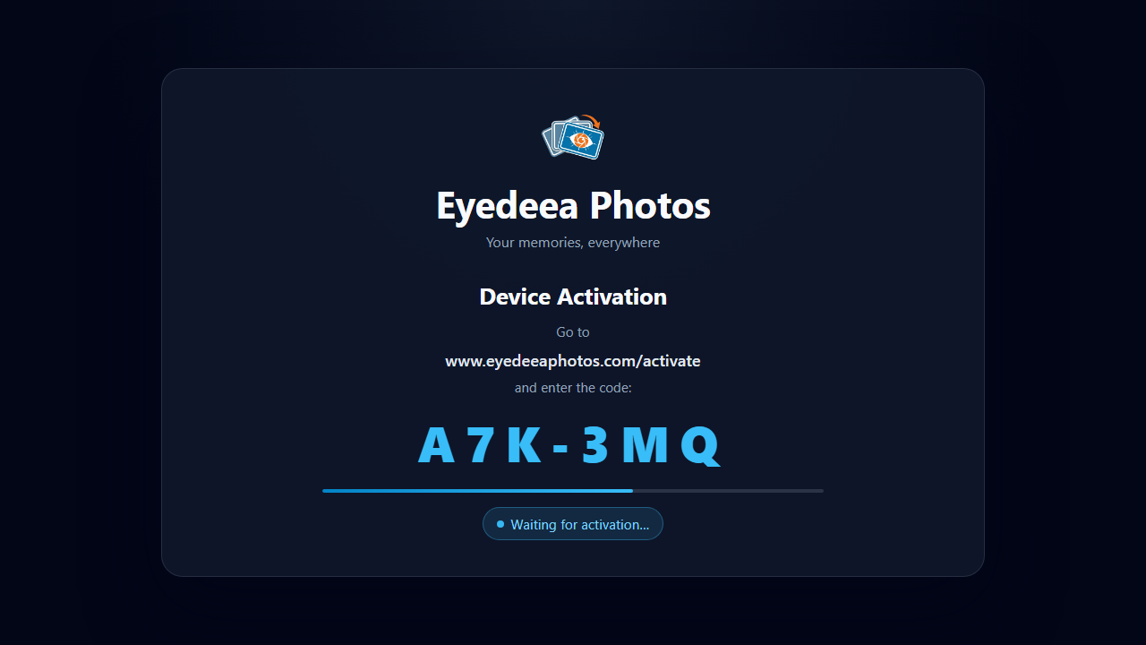
2. Waiting for activation
TV polls until the code is entered on the web
Progress bar shows remaining code lifetime
On success, TV switches to slideshow within ~10 seconds
QA must use a subscribed account with photos in the library.

Slide 4
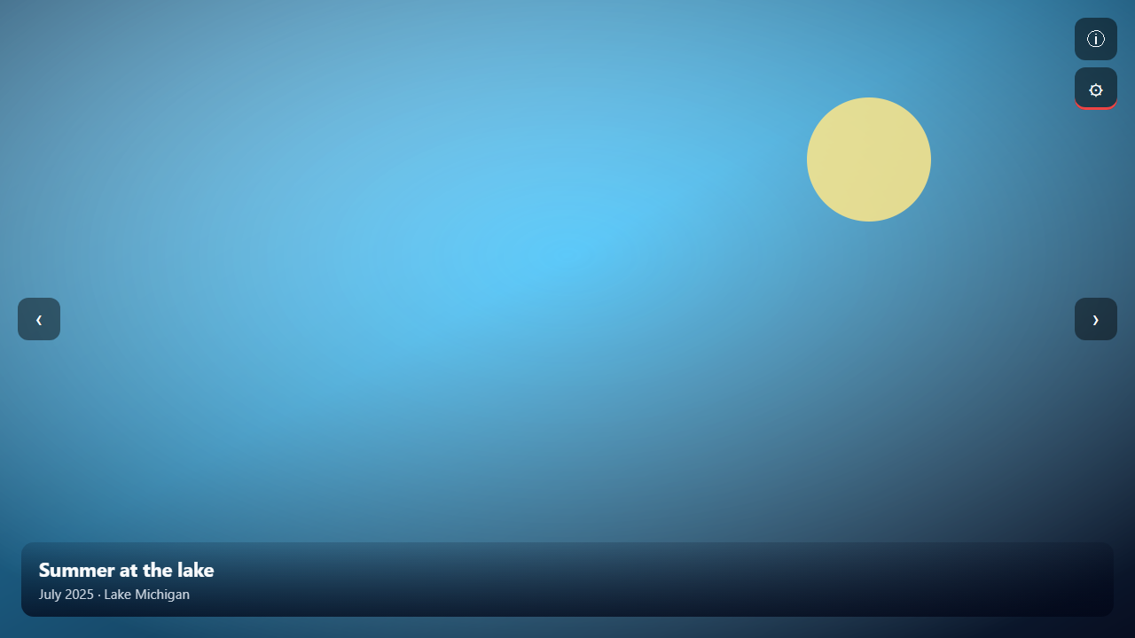
3. Slideshow view
Full-screen family photo slideshow
Metadata overlay: title, date, location
Left/Right: previous / next (chrome hidden)
Up/Down: show controls; OK activates focused control
Red remote button (or gear + OK): Settings
Back closes panels; from Settings returns to View.

Slide 5
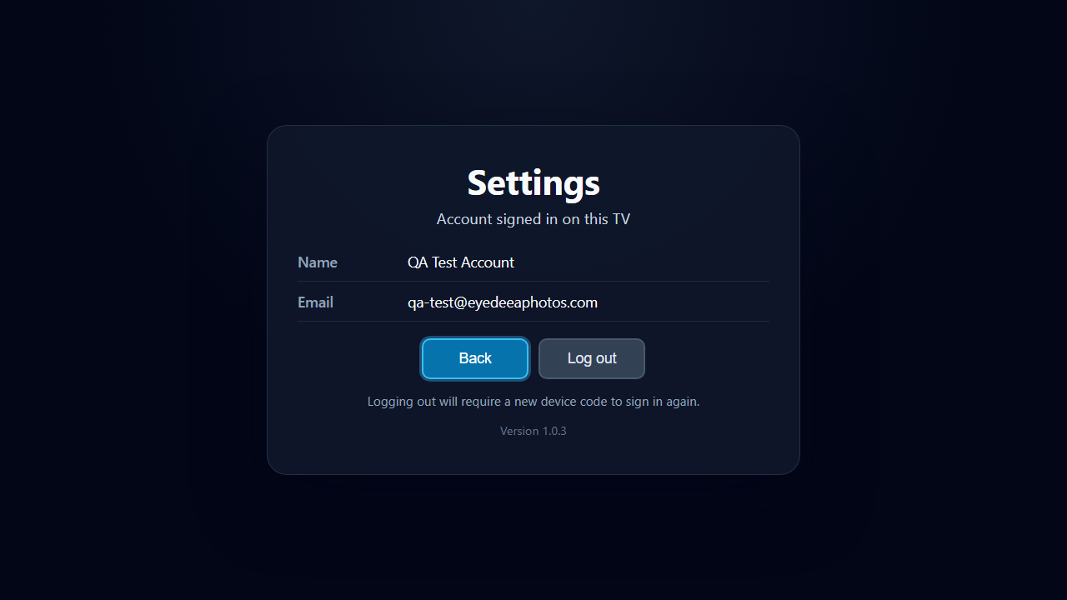
4. Settings
Shows signed-in name and email
Back returns to slideshow
Log out clears session
No in-app purchases or ads. Subscription is managed on the web.

Slide 6
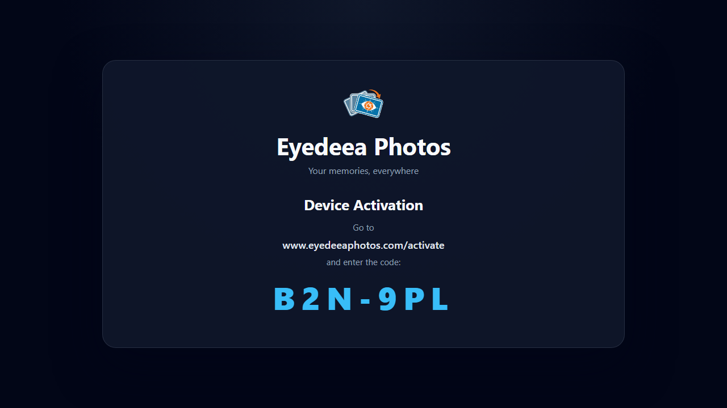
5. After logout
Fresh device code issued
Same /activate instructions shown
User must activate again to view photos
Remove any Seller Lounge template instruction slides before upload.

