Slide 1
Crash Stats
https://www.data.vic.gov.au/data/dataset/crash-stats-data-extract
Lia
Ivan

Slide 2
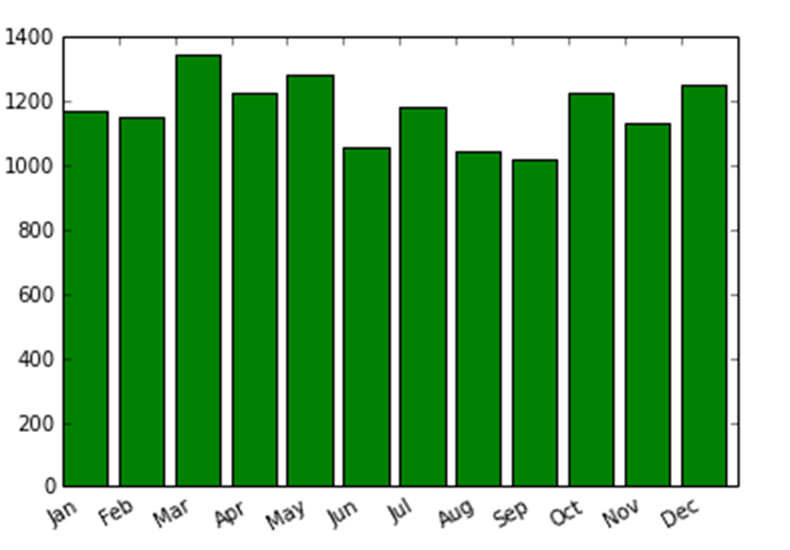
Have A Guess How Many Car Accidents Happen In A Month?

Slide 3


Liz Marks was driving her Mazda 3 along a road in St Michaels, Maryland, when she looked down at her phone to check a text message from her mother, Betty. Seconds later, she crashed into a tow truck

Slide 4
Type Of Car Accidents
Struct animal
Collision with vehicle
Struck Pedestrian
Collision with a fixed object
Fall from or in moving vehicle
Vechicle overturned
Collision with some other object
No collision and no object struck

Slide 5
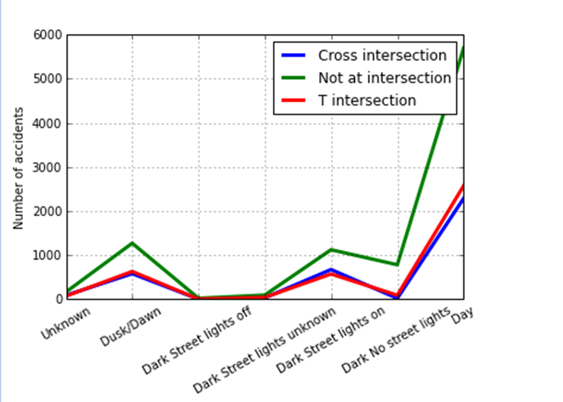
What Situation Car Accident Happens More Frequently?
In our guess, that could be dark street with no light or Cross intersection road

Slide 6
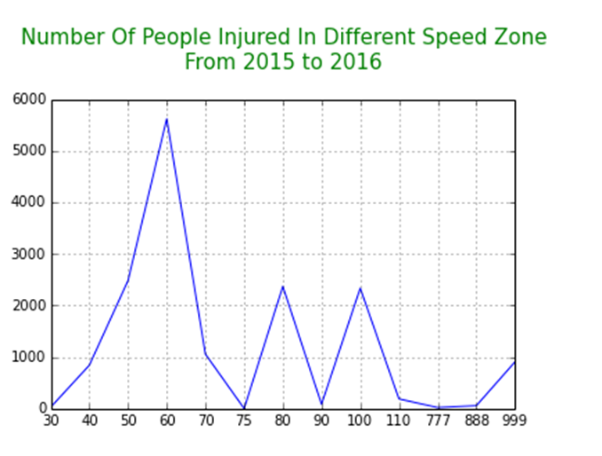
People Injured Or even Killed In Car Accident

Slide 7
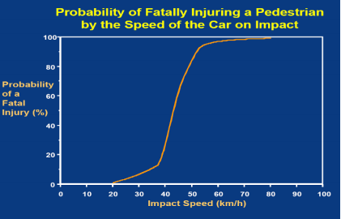
The Driving Speed Matters
As a vehicle’s speed increases, so does the distance travelled during the driver’s reaction time (reaction distance) and the distance needed to stop (braking distance). Also, the higher the speed, the greater the amount of kinetic (moving) energy that must be absorbed by the impact in a crash. Therefore, as well as being identified as a causal factor in around 40 per cent of fatal crashes, speed is an aggravating factor in the severity of all crashes

Slide 8
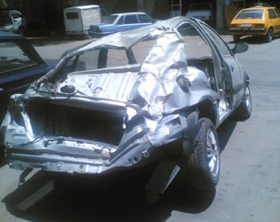
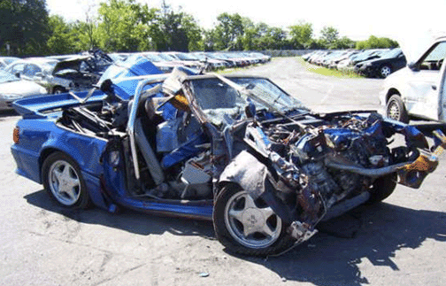
The crash OVEr 100/120

Slide 9
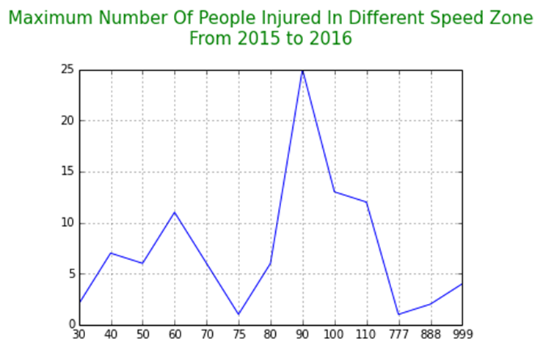
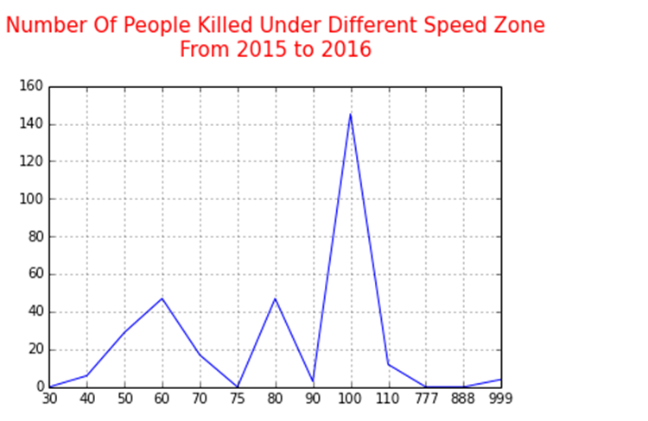

Slide 10
DATA PROCESSING STEPS
Extraction
Parsing data in its raw form
Munging
Transforming data into useful forms
Cleaning
Normalising the data for ease of use
Aggregation
Sampling the dataset
Visualisation
Pivoting

