Slide 1
Traffic Congestion and Efficiency in victoria
Why and where do traffic congestions and bottlenecks happen and how can we improve its efficiency?
COMP20008 Elements of Data Processing
Semester 1 2016 Project Phase 3
Ivan Ken Weng Chee
736901

Slide 2
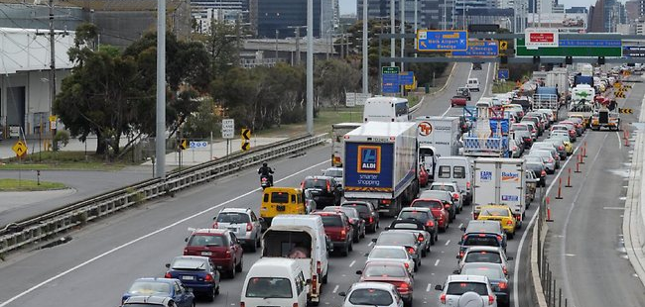
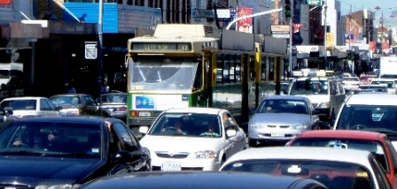
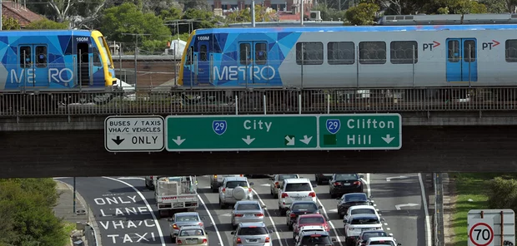
Why should we care ?
Getting on time
Cater for growth
Reduce Emissions
Improve travel times and determine bottlenecks
Amount of traffic in Melbourne rises each year
Vehicles continue to emit carbon monoxide while idle in traffic jams

Slide 3
Related Datasets
Road Width and Number of Lanes
Victorian Road Traffic Volumes
VicRoads Speed Data
VicRoads Open Data
Shows road and shoulder widths and number of traffic lanes on freeways and arterial roads
http://vicroadsopendata.vicroadsmaps.opendata.arcgis.com/datasets/24ccad5c745e4addabfcfb32c400ee83_0
AURIN
Contains road traffic volumes for freeways and arterial roads
http://data.aurin.org.au/dataset/vic-govt-vicroads-vicroads-evol-mar13-na
Victorian Government Open Data Repository
Records the latest typical hourly speed data in kilometres per hour
https://www.data.vic.gov.au/data/dataset/vicroads-speed-data-by-road-segment

Slide 4
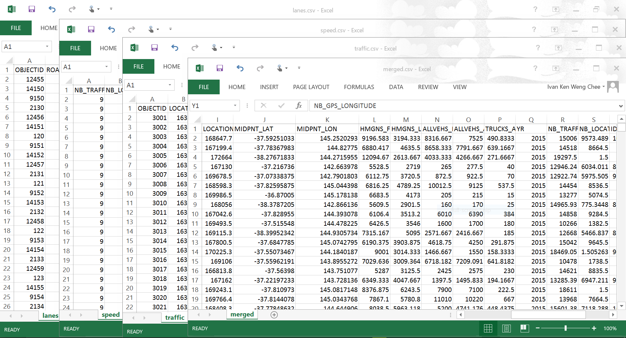
Data wrangling methodologies
Extracting
Munging
Cleaning
Aggregation
Visualisation
Depositng

Slide 5
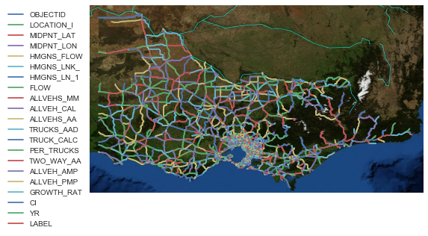
Current findings
Traffic Map of Victoria

Slide 6
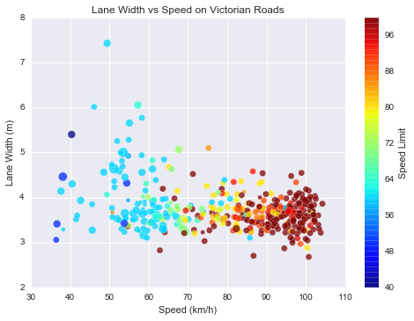
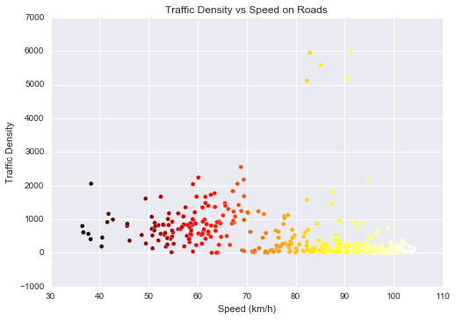
Scatterplots

Slide 7
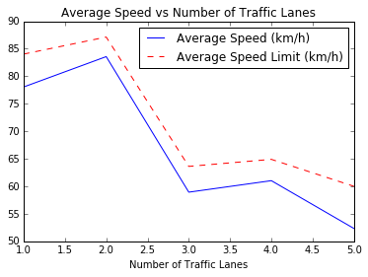
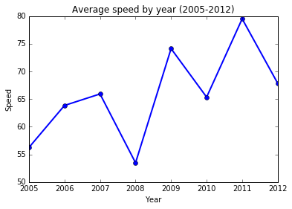
Line Plots

Slide 8
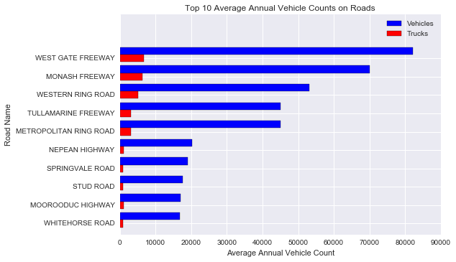
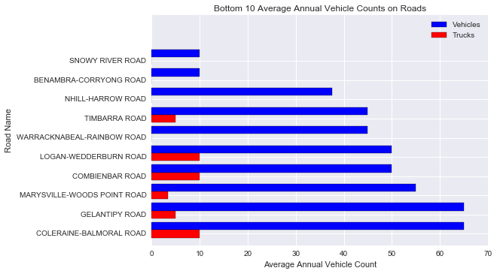
Bar charts

Slide 9
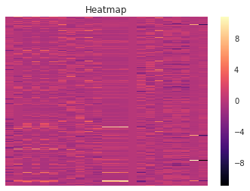
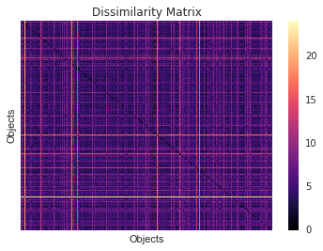
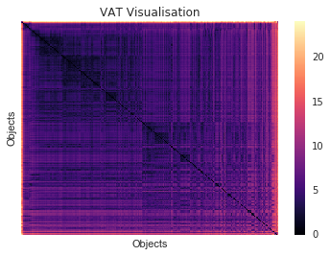
VARIANCE EXPLAINED BY DATA
heatmap
Dissimilarity matrix
Vat visualisation

Slide 10
Challenges faced
What would I do differently
Unconventional formatting of datasets
Volume of data to be processed
Different naming conventions in similar columns
Numerical methods to apply in merging
Determining non-relevant data to be left out
Choosing proper visualisation methods
Better naming conventions
Choosing more relevant datasets
Working with json instead of csv

