Slide 1
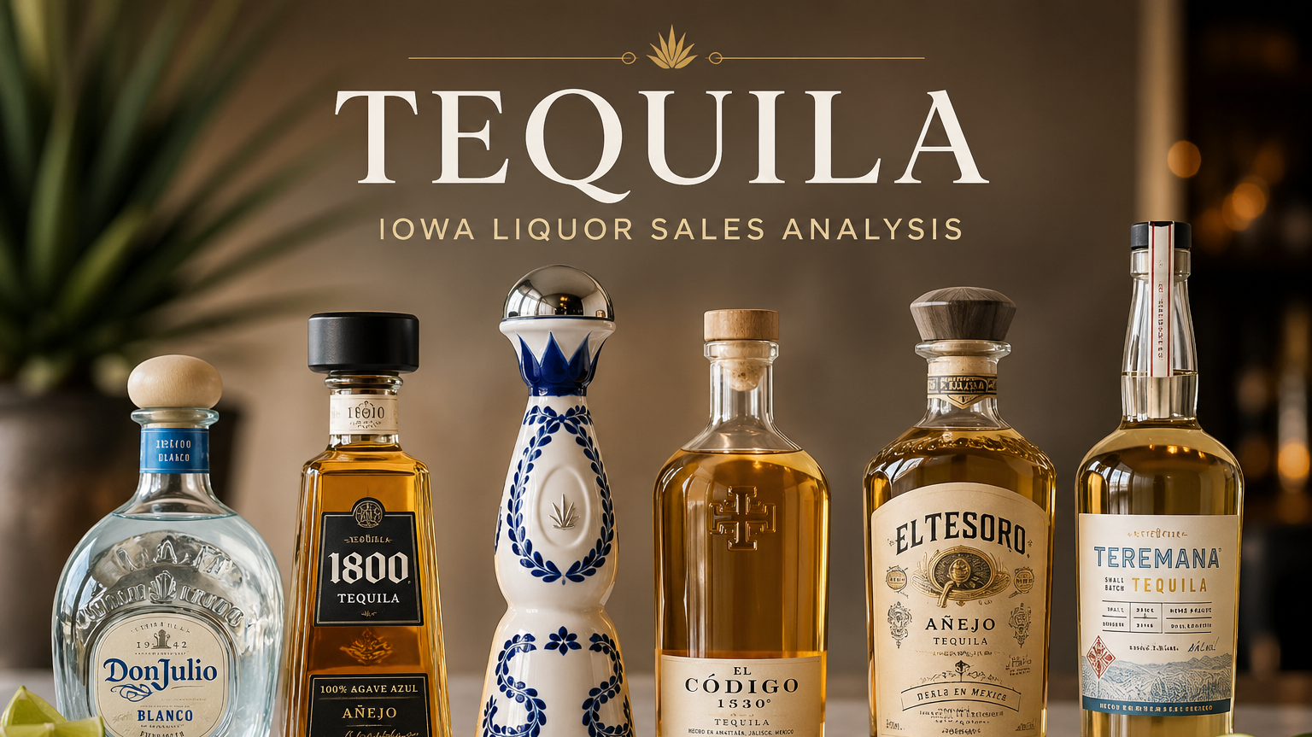
Eyerusalem Debero She/Her Data Analytics Capstone Dallas, TX 04/30/2026

Slide 2
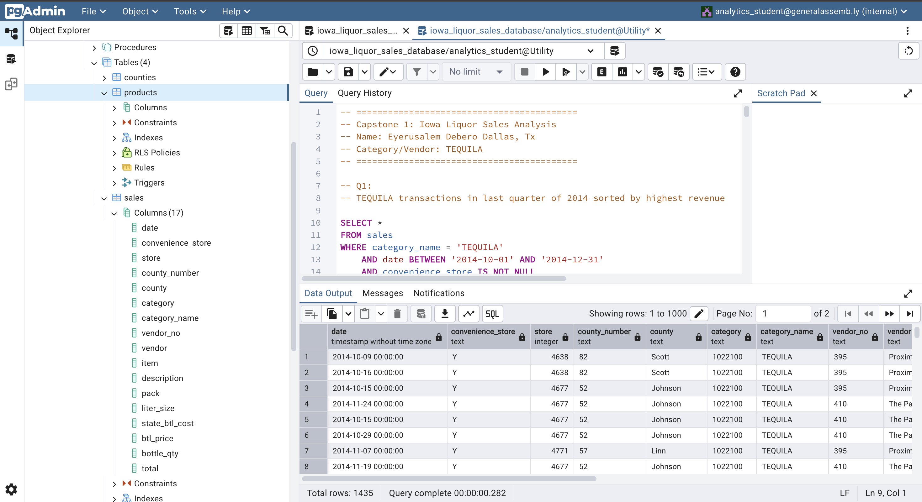
Business Scenario
- Dataset: Iowa Liquor Sales
- Focus: TEQUILA category
- Goal: Analyze sales trends, top products, and store performance

Slide 3
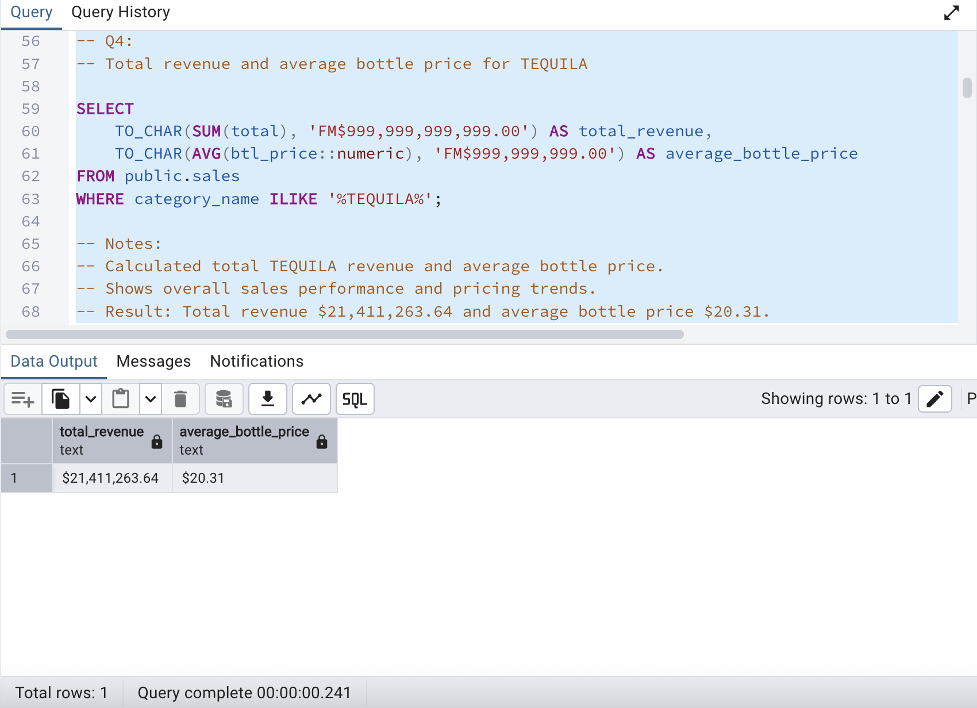
Key Summary Statistics
Total Revenue: $21.4 Million
Average Bottle Price: $20.31
Top Product: Jose Cuervo Especial Reposado

Slide 4
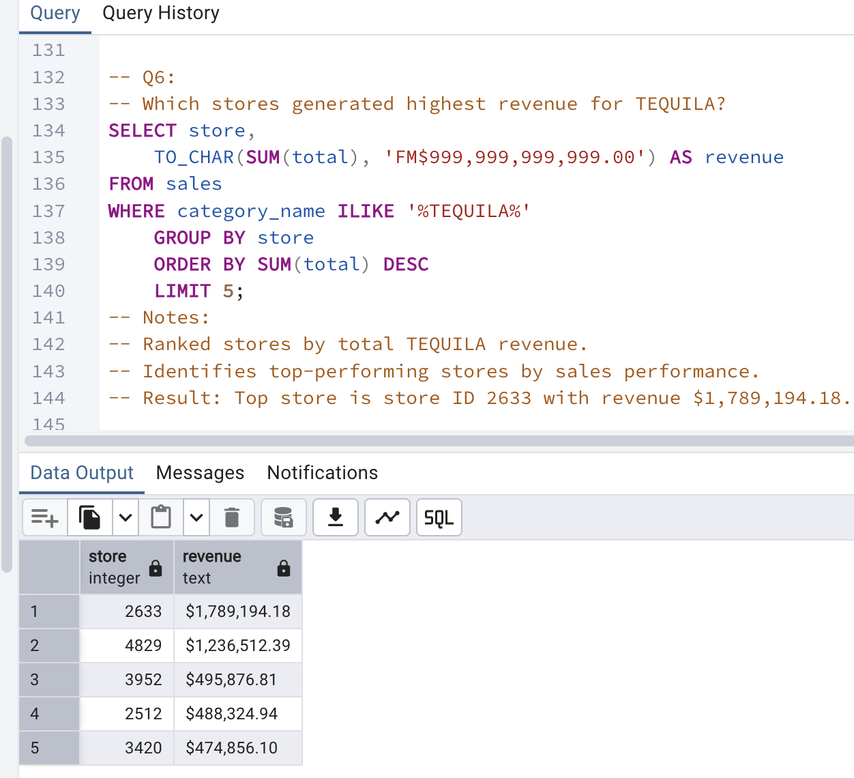
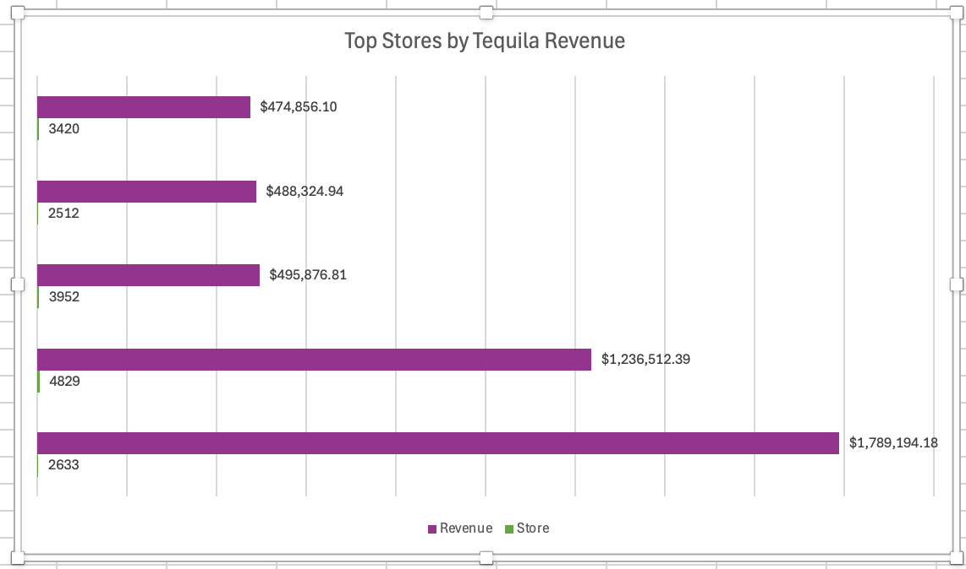
STRENGTHS (High-Performing Stores)
- High-performing stores generate most revenue
- Store 2633 is the top seller
- Strong demand for tequila products

Slide 5
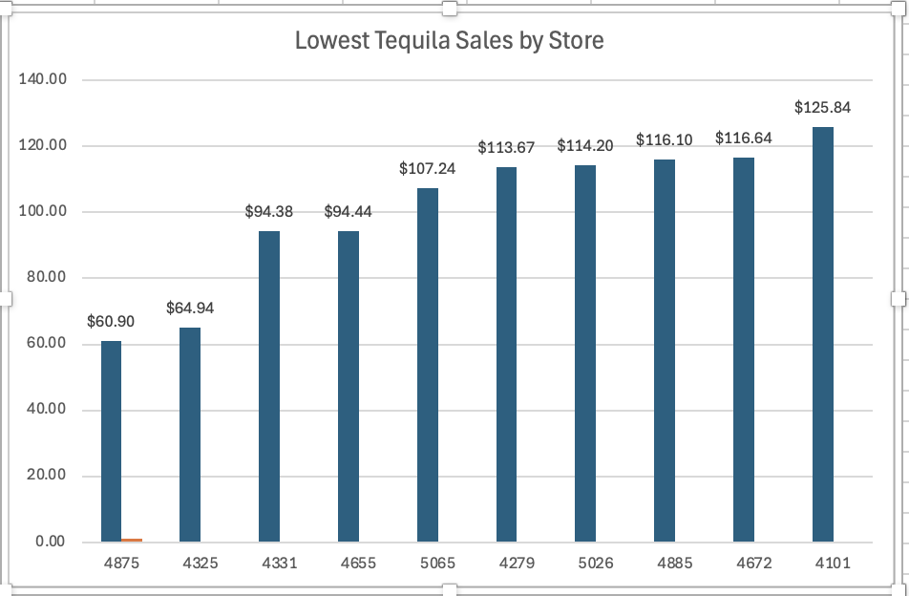
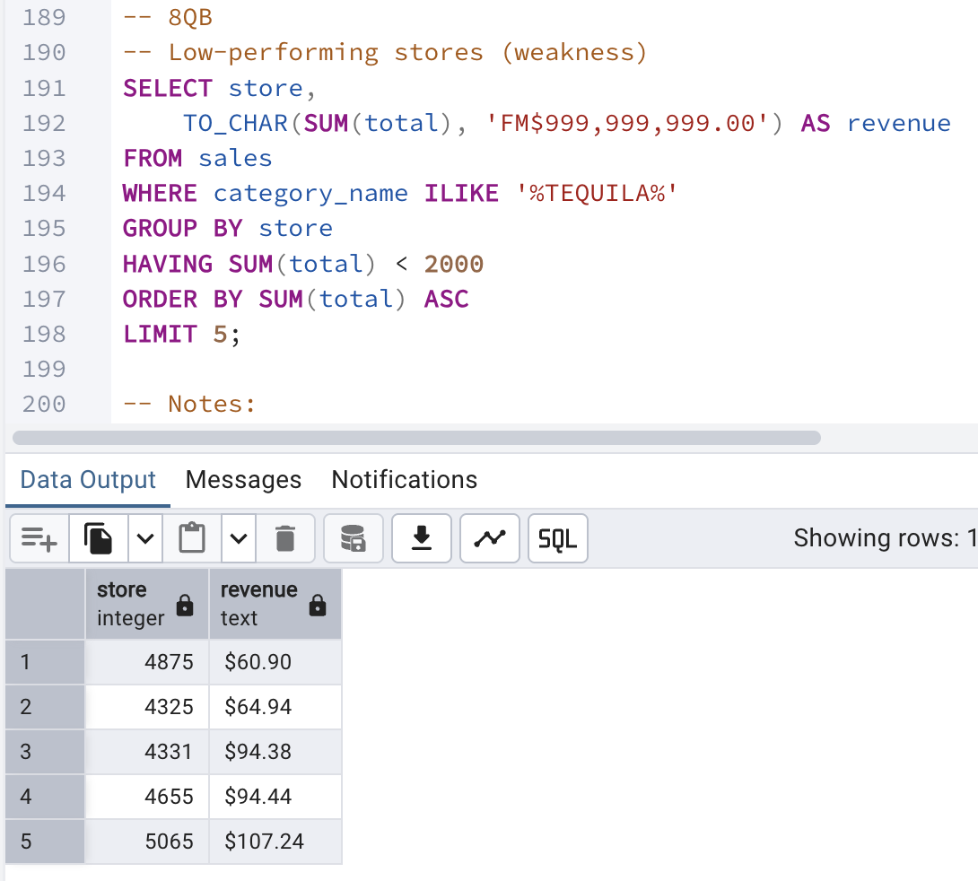
WEAKNESSES (LOW-PERFORMING STORES)
- Some stores generate extremely low tequila revenue
- Stores such as 4875 ($60.90) and 4325 ($64.94) perform far below others
- This shows uneven performance across store locations

Slide 6
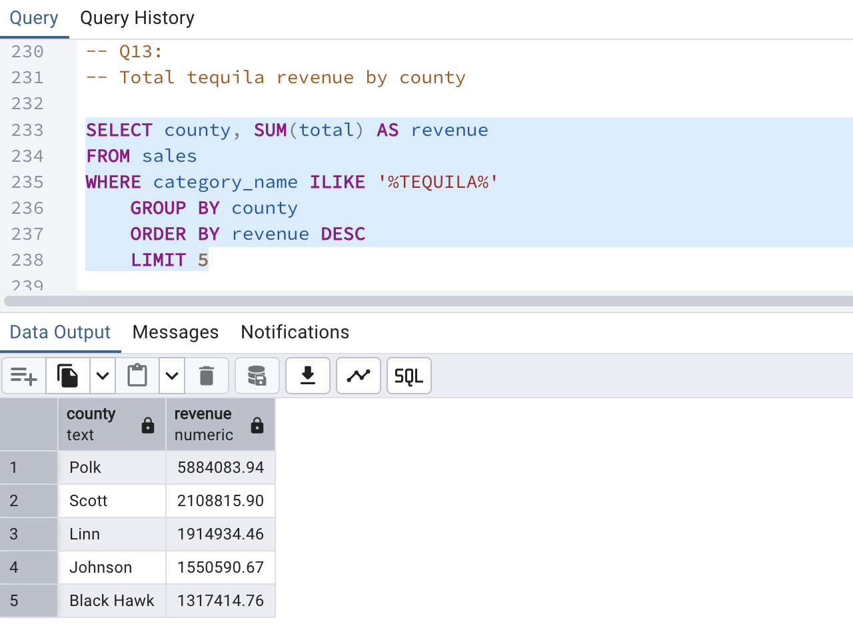
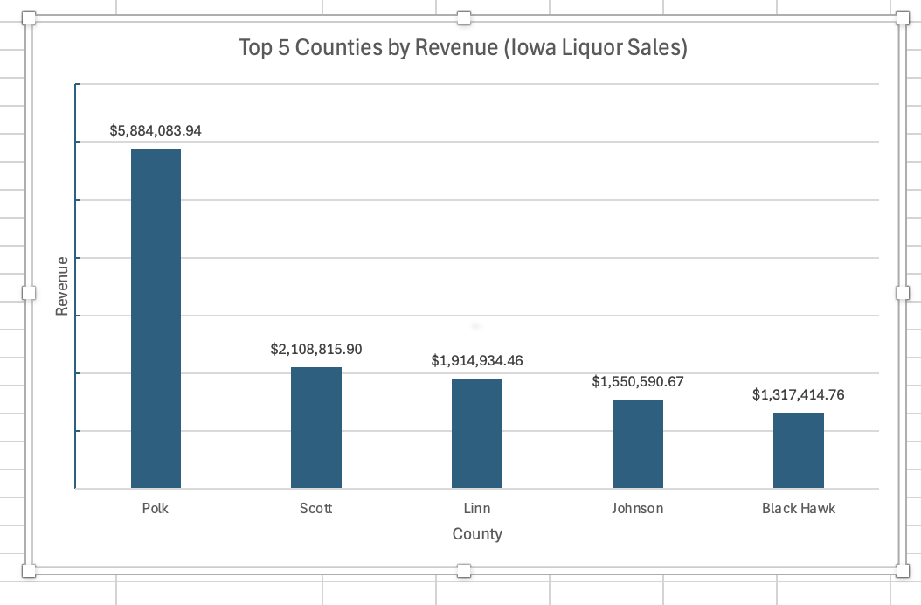
Opportunities: Growth by County
- Polk County generates the highest tequila revenue
- Some populated areas still have lower sales potential
- Weak-performing regions may have future growth opportunities

Slide 7
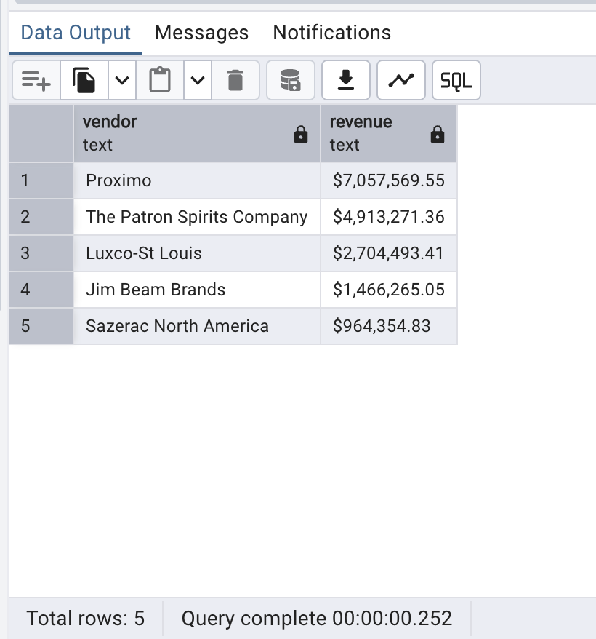
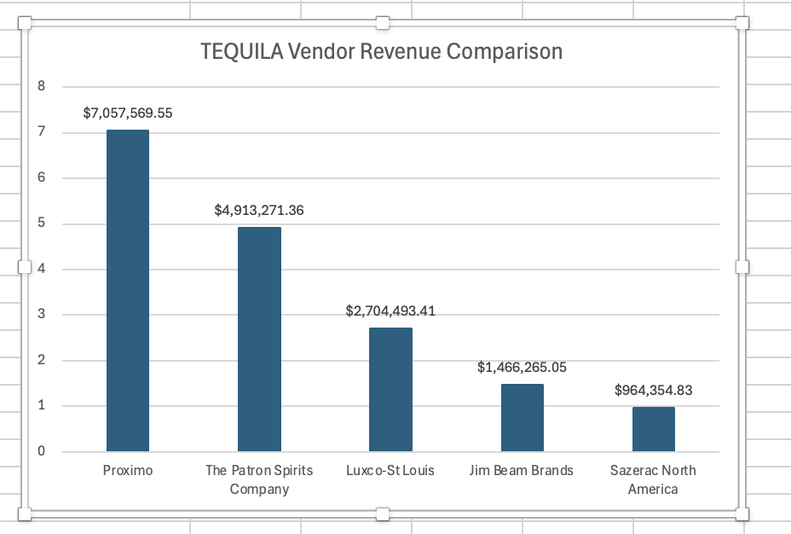
Threats: Vendor Competition
- Large vendors dominate tequila sales
- Market competition is very strong
- Smaller vendors may struggle to compete

Slide 8
SUMMARY
SQL helped transform raw sales data into business insights.
Key findings:
- Top-performing stores were identified
- Best-selling products were found
- Revenue patterns were analyzed

