Slide 1
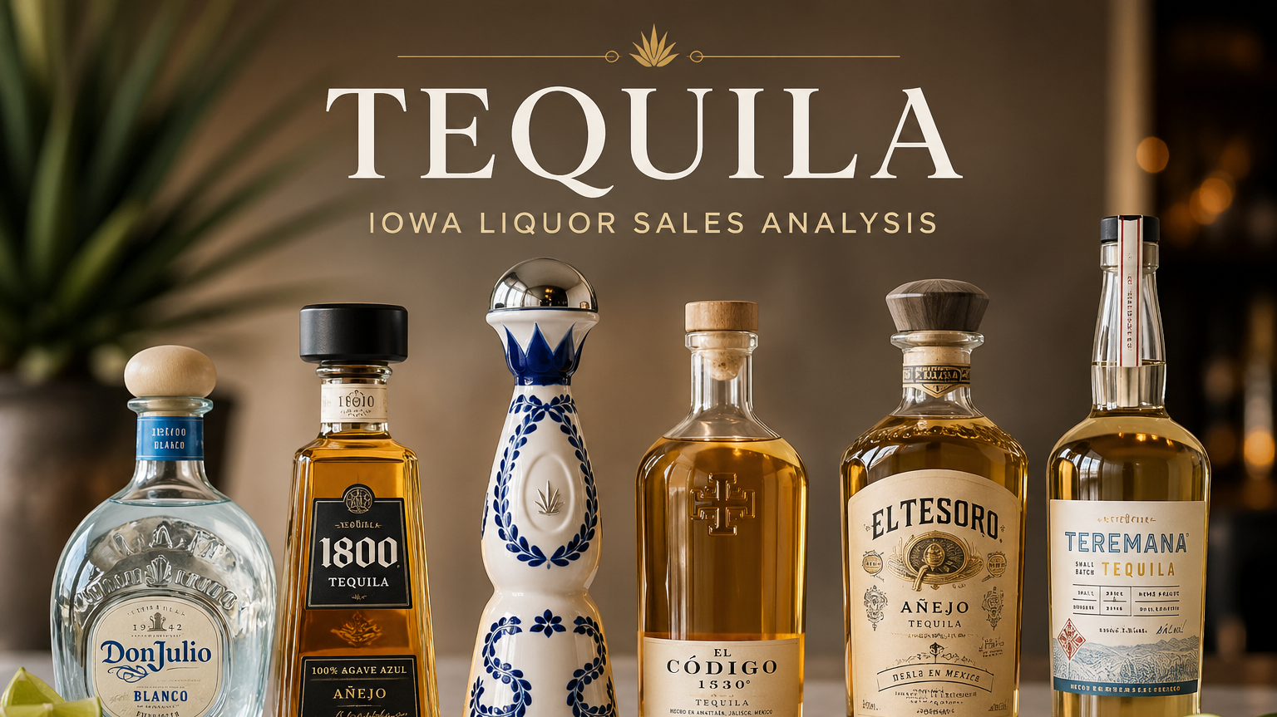
Eyerusalem Debero She/Her Data Analytics Capstone Dallas, TX 04/30/2026

Slide 2
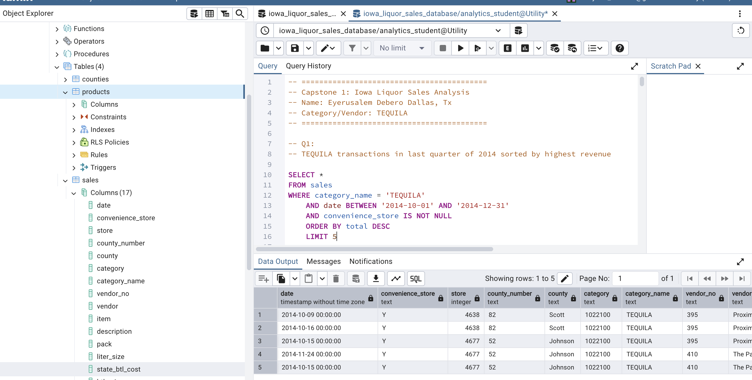
Business Scenario
- Dataset: Iowa Liquor Sales
- Focus: TEQUILA category
- Goal: Analyze sales trends, top products, and store performance
- The goal of this analysis is to identify performance differences across stores, counties, and vendors

Slide 3
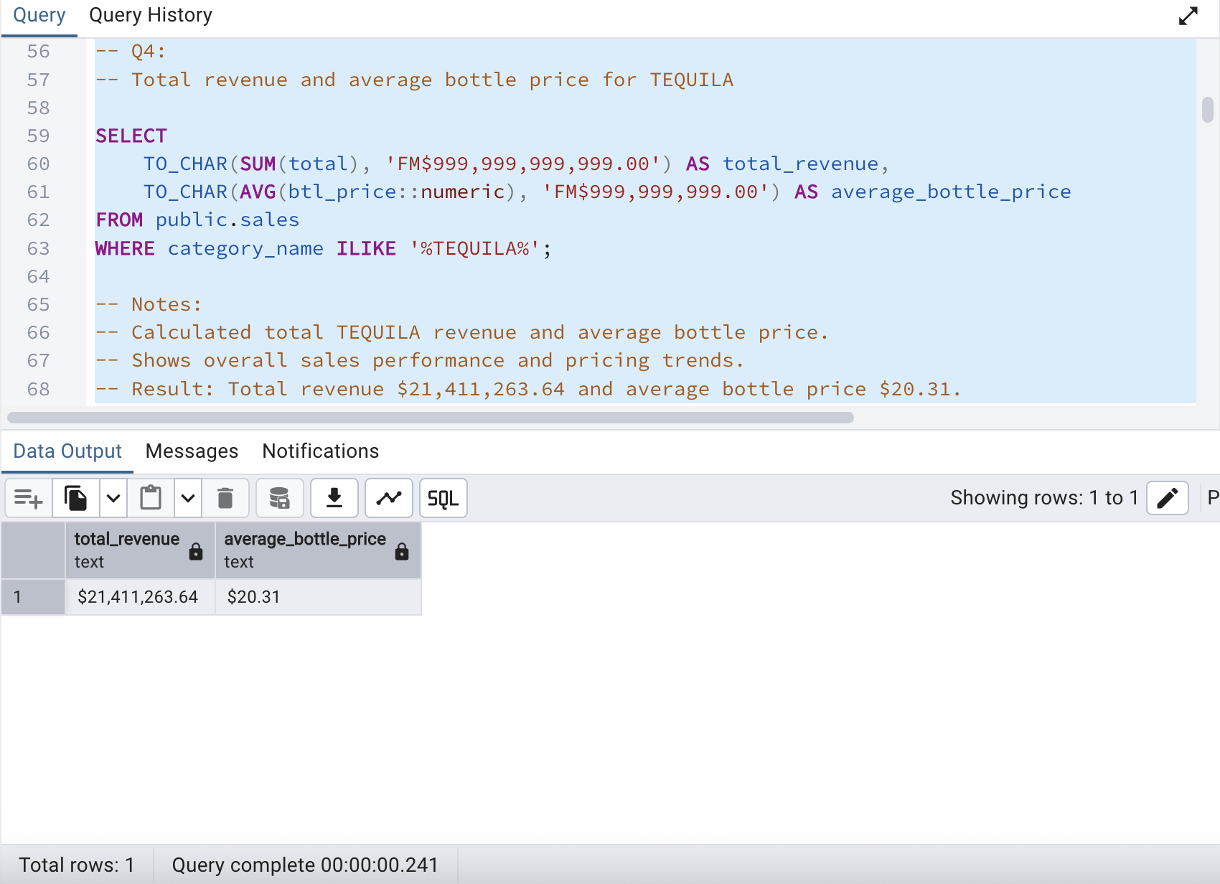
Key Summary Statistics
Total Revenue: $21.4 Million
Average Bottle Price: $20.31
Top Product: Jose Cuervo Especial Reposado
These totals help establish the overall scale of tequila sales before analyzing patterns in detail.

Slide 4
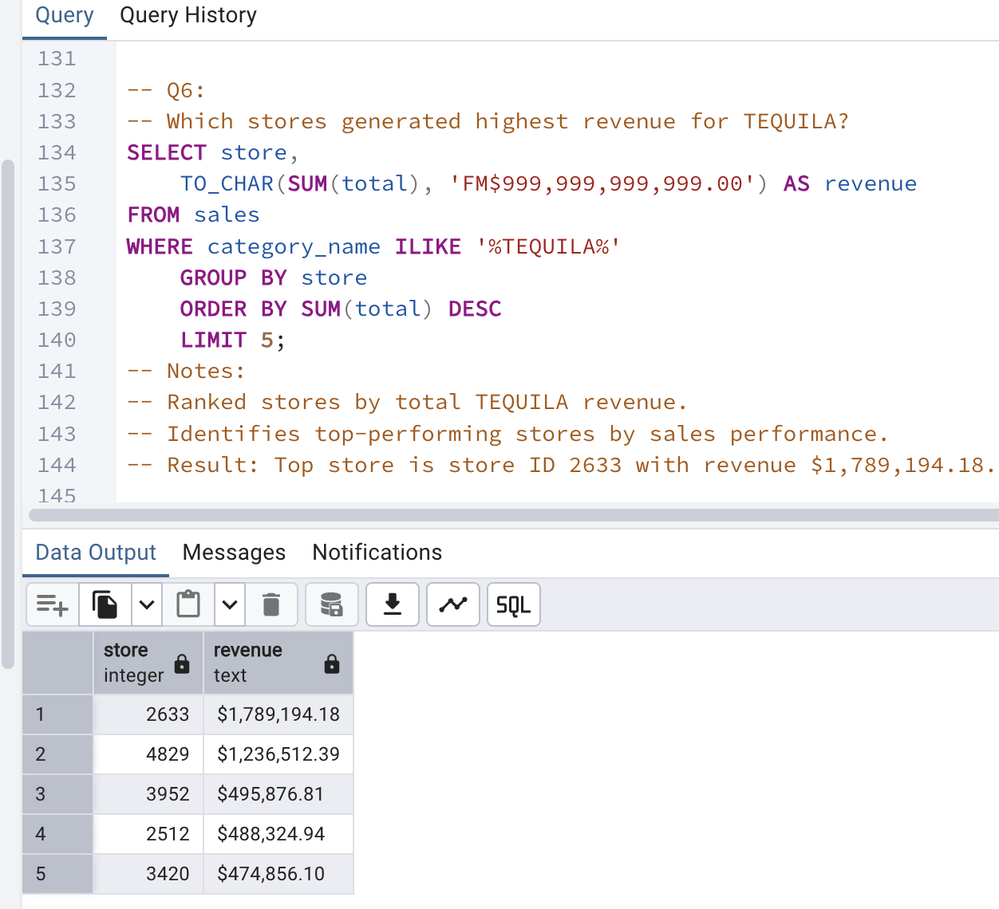
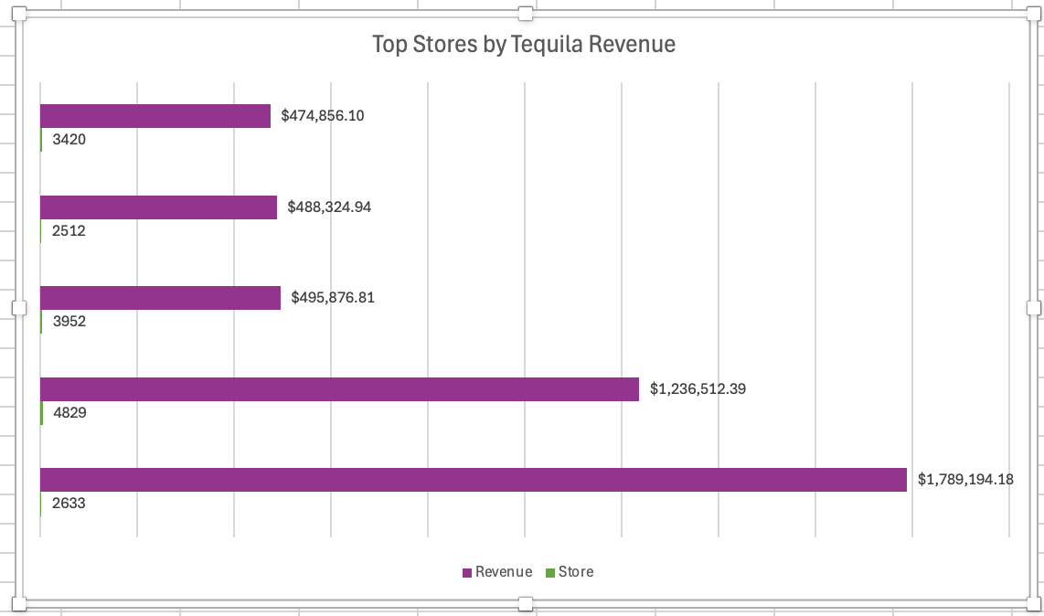
Strengths 1: Top Store Performance
- High-performing stores generate most revenue
- Store 2633 is the top seller
- Strong demand for tequila products

Slide 5
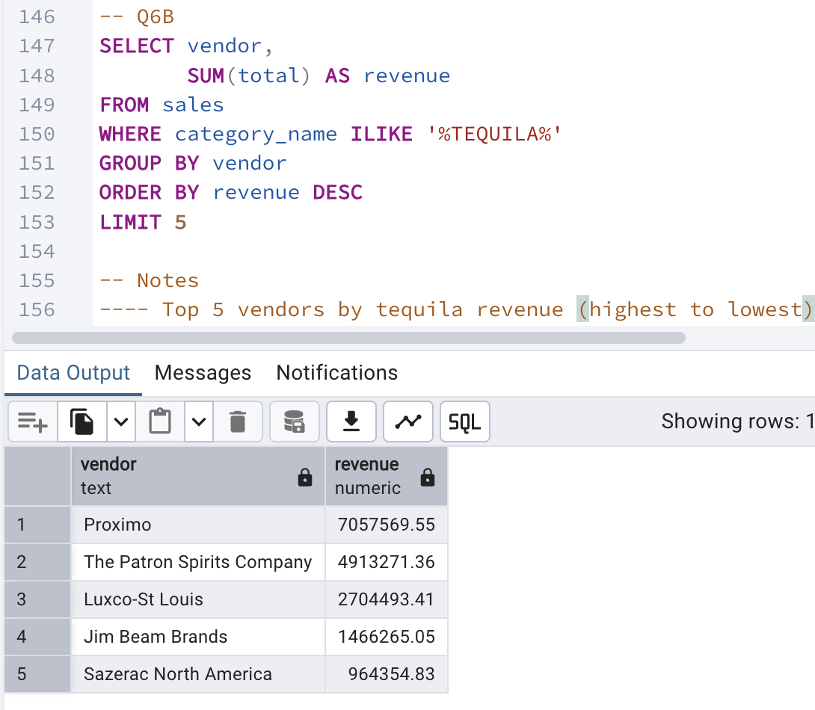
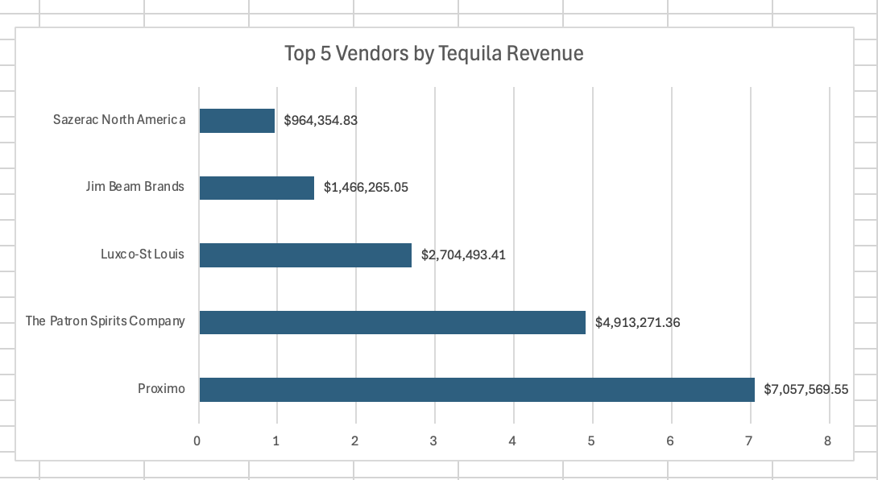
Strengths 2: Vendor Performance
A few vendors generate most tequila revenue
Sales are heavily concentrated among top suppliers
Vendor performance strongly impacts total revenue

Slide 6
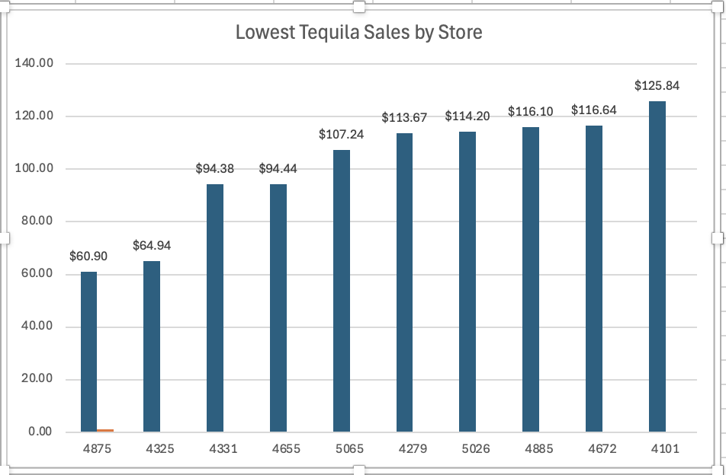
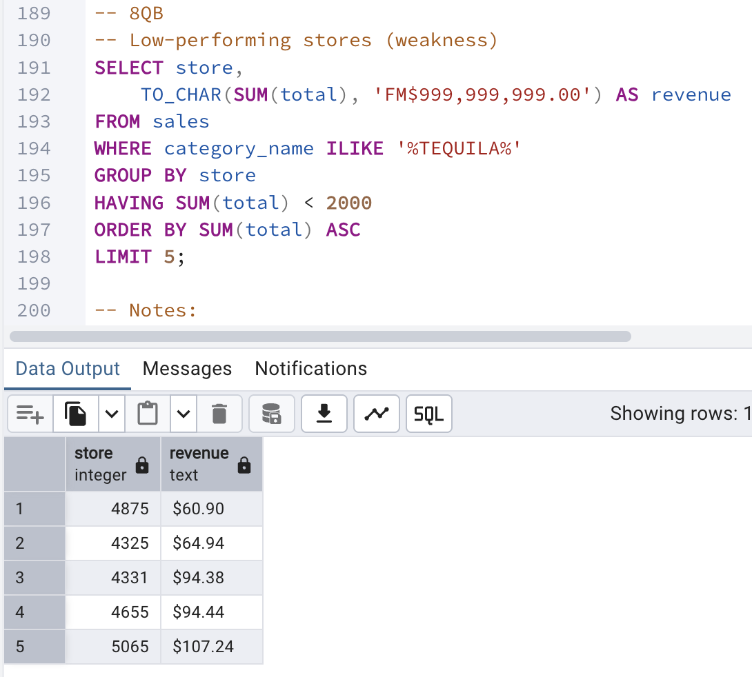
WEAKNESSES (LOW-PERFORMING STORES)
- Stores have very low tequila sales (below $100)
- Performance is not consistent across all stores

Slide 7
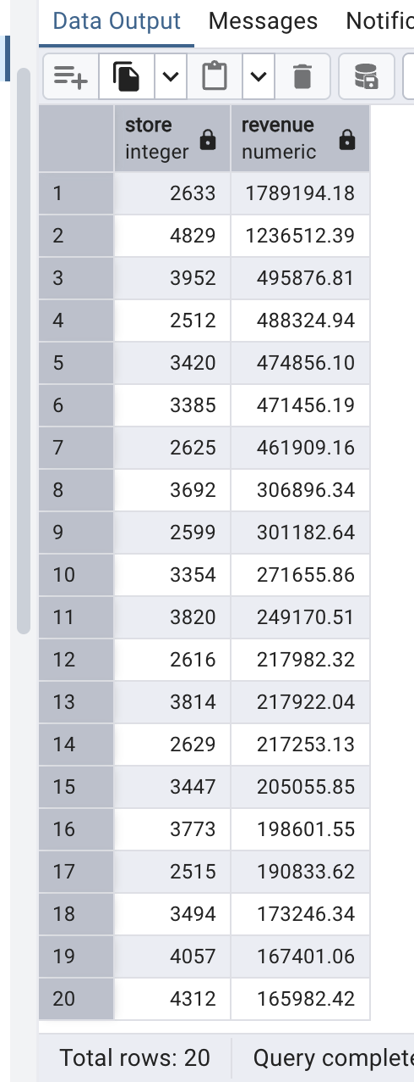
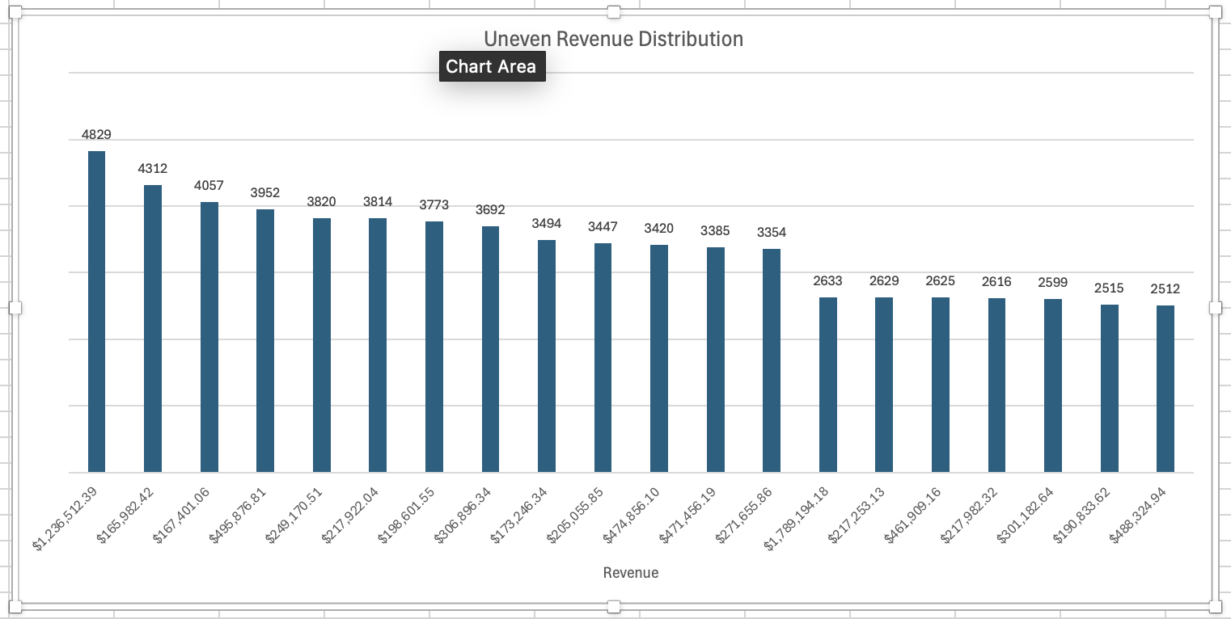
Weaknesses: Uneven Revenue Distribution
- Revenue is concentrated in a small number of stores
- Underperforming stores reduce overall balance
- Heavy dependence on top stores creates risk

Slide 8
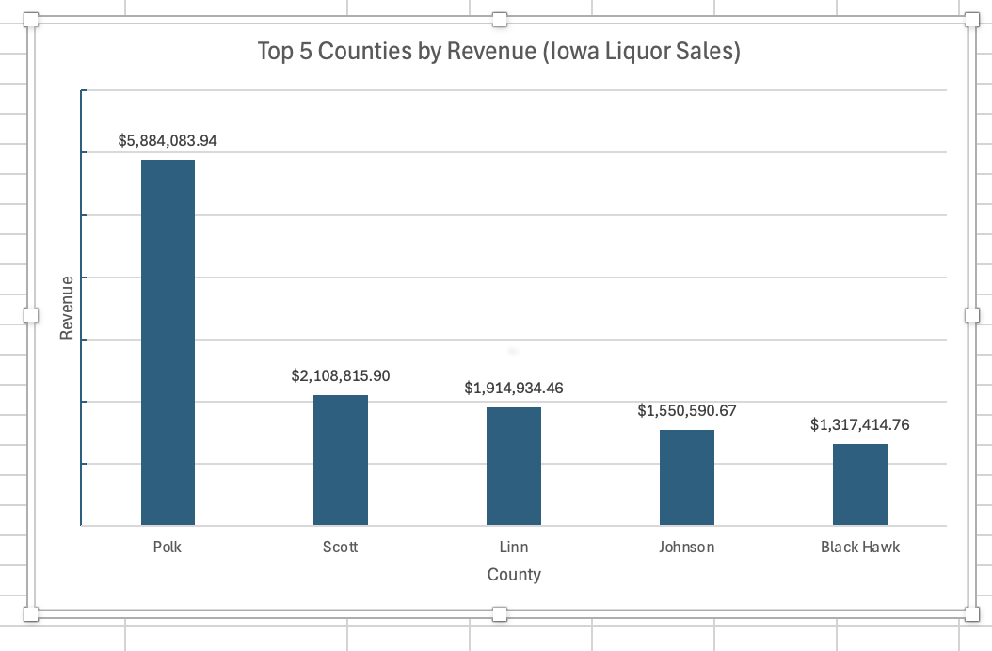
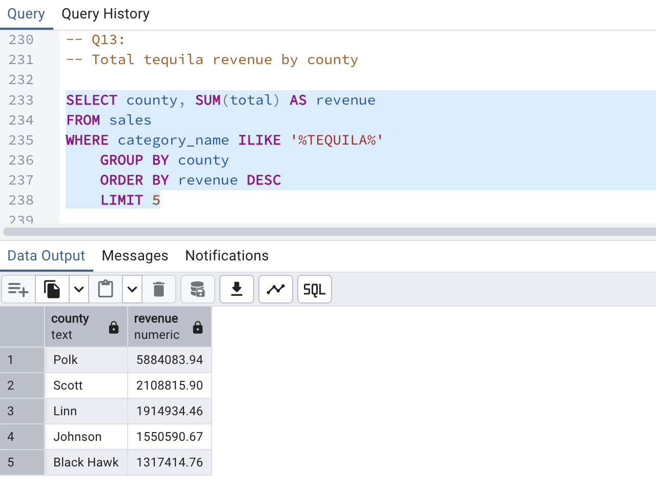
OPPORTUNITIES
- Polk County has the highest revenue
- Some high-population areas may be underused
- Growth opportunity in weak regions

Slide 9
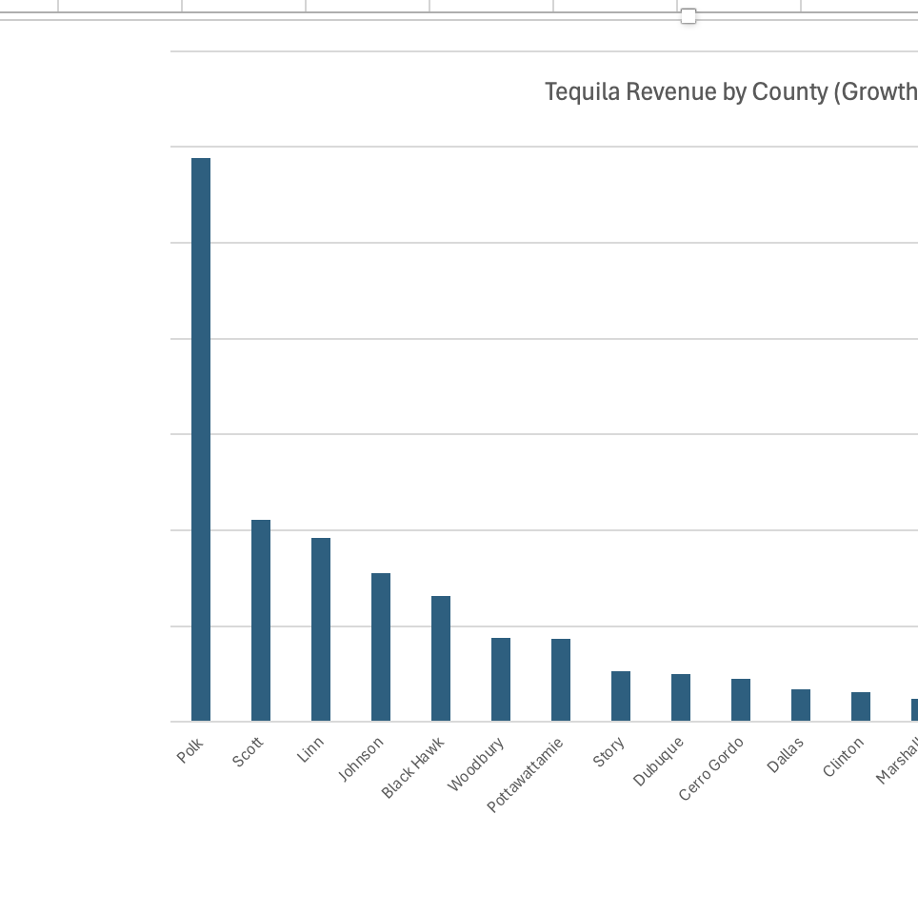
Opportunities: Market Expansion
- Lower-performing counties may improve through marketing
- Expanding inventory could increase tequila sales
- Businesses can target new customer groups

Slide 10
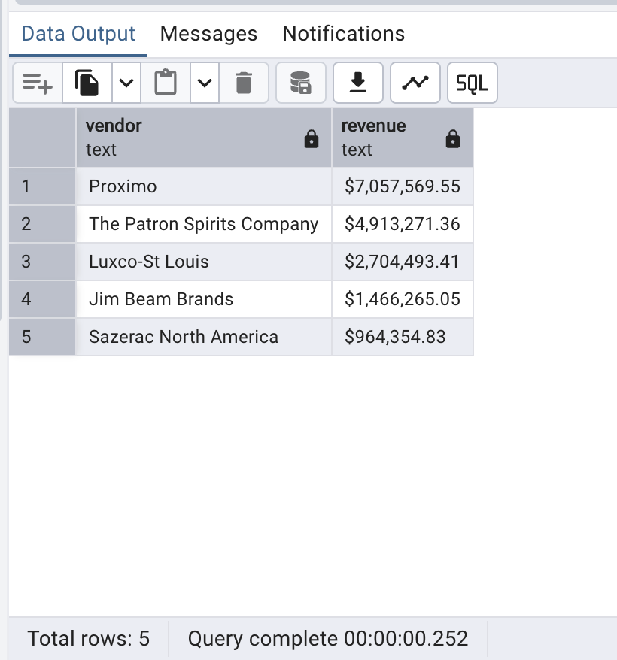
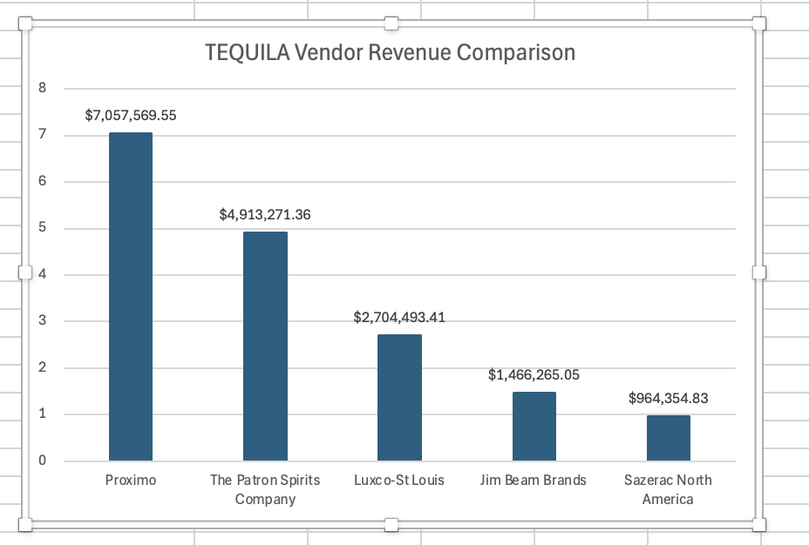
THREATS 1
- Strong competition between vendors
- Market dominated by top brands
- Need to focus on best-selling products

Slide 11
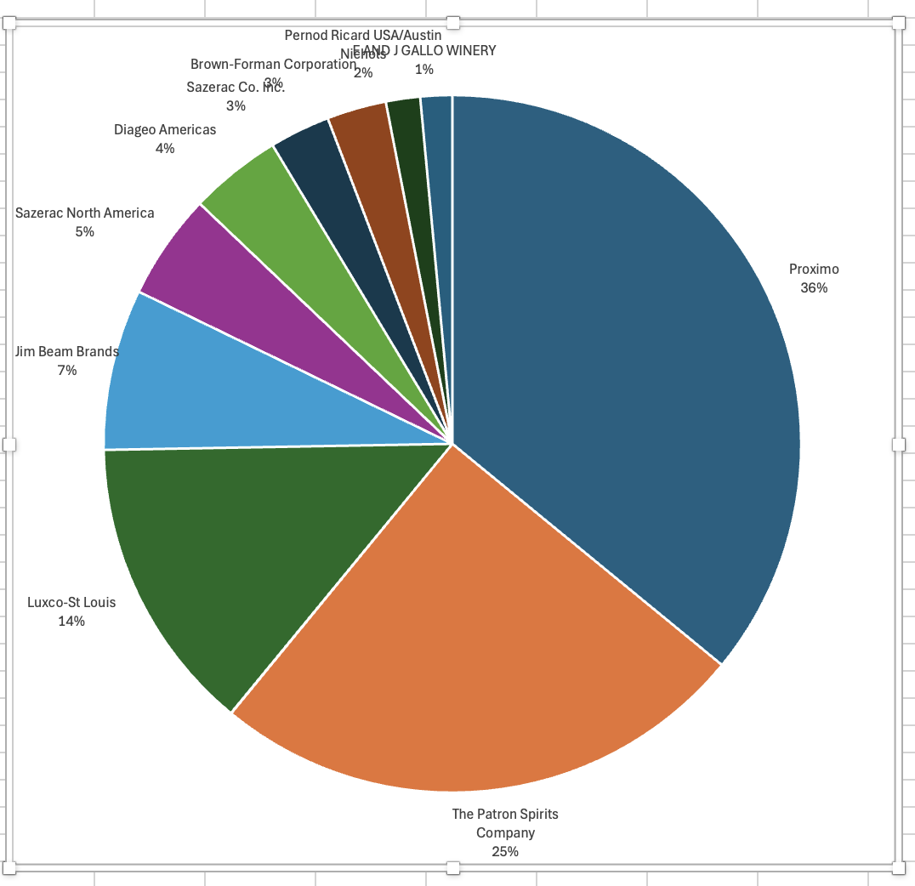
THREATS 2
- Large vendors control much of the tequila market
- Smaller vendors face strong competition
- Market concentration may reduce future growth opportunities

Slide 12
SUMMARY
SQL helped transform raw sales data into business insights Key findings:
- Top stores identified
- Best-selling products found
- Revenue patterns analyzed - Businesses should improve weaker stores and expand growth opportunities

