Slide 1
protein language models:
a case study with erbb2 and pertuzumab
isaac stier robson
unc @ chapel hill
3 dec 2019

Slide 2
outline
tl;dr
molecules
language models & attention
research goals
isaac stier robson
protein language models: a case study
3 dec 2019 2 / 17

Slide 3
tl;dr

Slide 4
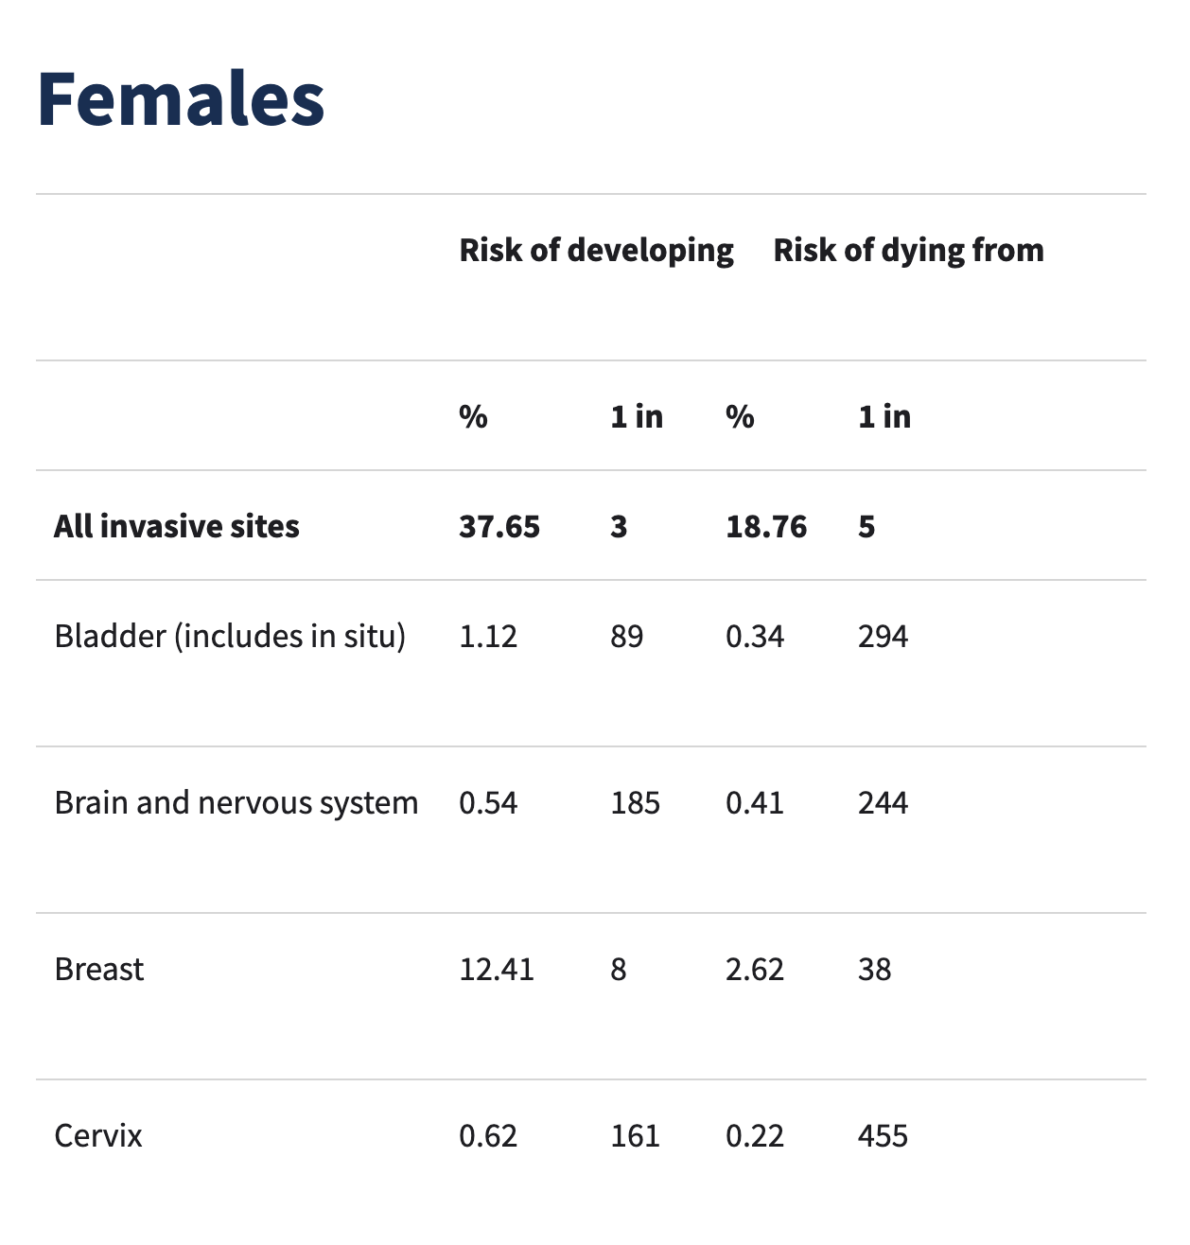
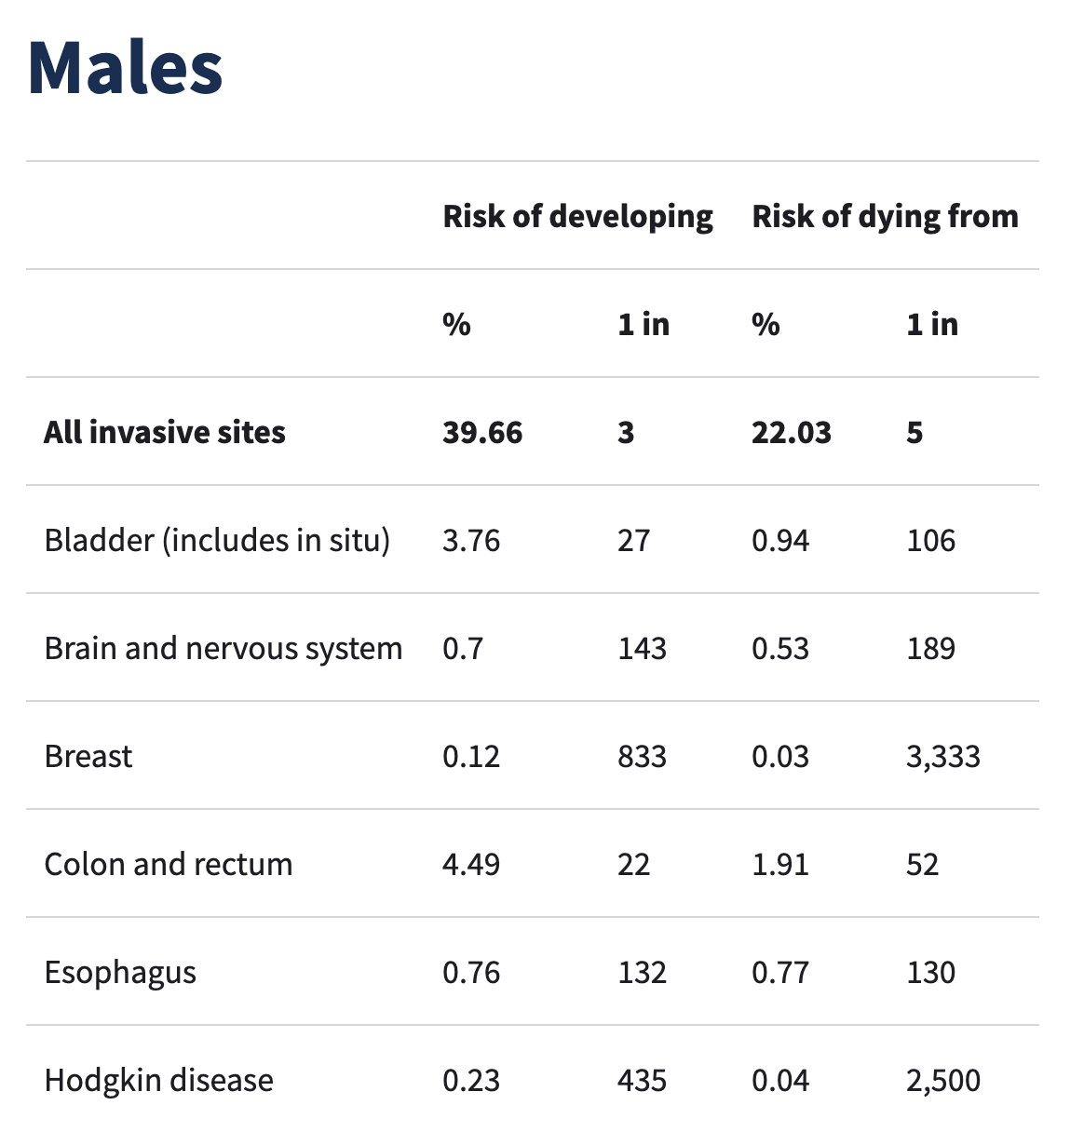
lifetime risk of cancer in xx and xy american cancer society
xx
xy
https://www.cancer.org/cancer/cancer-basics/lifetime-probability-of-developing-or-dying-from-cancer.html
isaac stier robson
protein language models: a case study
4 nov 2019 4 / 34

Slide 5
lifetime risk of cancer
“you could say aging is the major carcinogen”
- norman sharpless
nci director
isaac stier robson
darwin
4 nov 2019 5 / 34

Slide 6
molecules

Slide 7
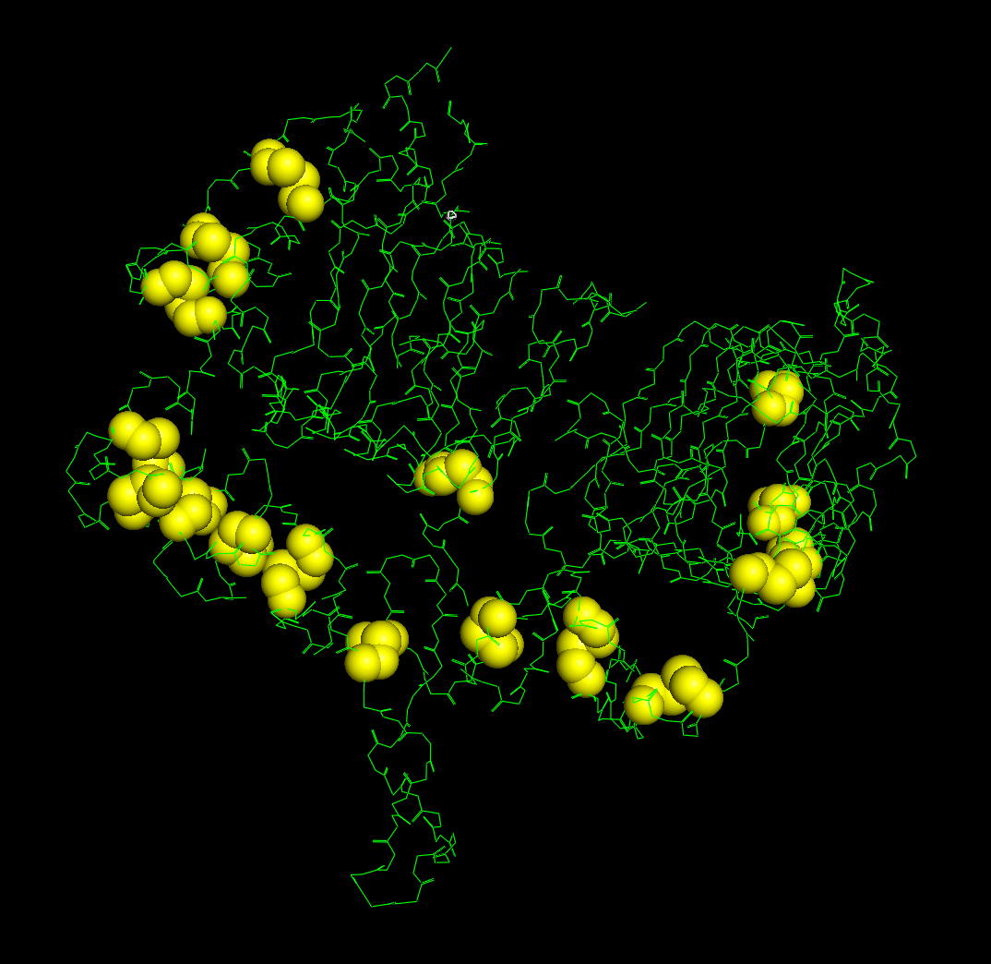
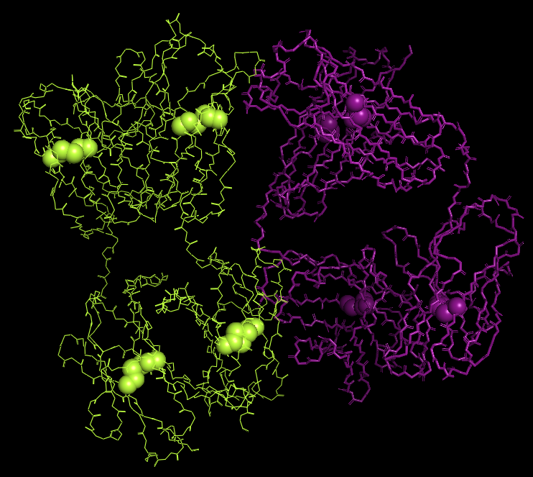
molecules erbb2 & pertuzumab
erbb2 ectodomain protein receptor kinase main amino chain disulfide bonds
2a91 – x-ray of residues 22-530 @ 2.50 å
pertuzumab monoclonal antibody antagonist mutated heavy chain light chain clambda
4llw – x-ray @ 1.95 å
isaac stier robson
protein language models: a case study
3 dec 2019 7 / 17

Slide 8
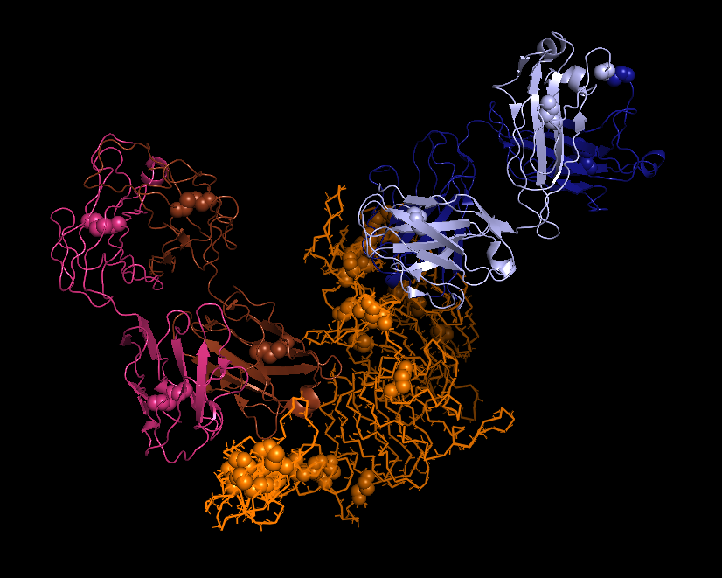
molecules erbb2 & pertuzumab
trastuzumab heavy chain light chain
pertuzumab heavy chain light chain
erbb2 ectodomain
6oge – x-ray of erbb2 trastuzumab pertuzumab complex @ 4.36 å
isaac stier robson
protein language models: a case study
3 dec 2019 8 / 17

Slide 9
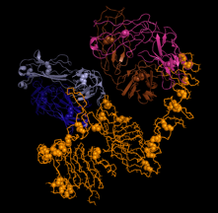
molecules erbb2 & pertuzumab
pertuzumab heavy chain light chain
why two?
cancer can also mutate biomolecules and change their structure
unless we can mutate solutions faster than cancer…
we have a problem!
trastuzumab heavy chain light chain
erbb2 ectodomain
6oge – x-ray of erbb2 trastuzumab pertuzumab complex @ 4.36 å
isaac stier robson
protein language models: a case study
3 dec 2019 9 / 17

Slide 10
language models

Slide 11
language models context
fill in the blanks!
the cat is out of the _______
o romeo, romeo, wherefore art _______ romeo?
how can we infer the blank?
via context
…and an ai algorithm can do the same!
bag
thou
smartphones!
isaac stier robson
protein language models: a case study
3 dec 2019 11 / 17

Slide 12
language models
1axc
human pcna
M
F
E
A
R
L
V
Q
G
language model
context vector
isaac stier robson
protein language models: a case study
3 dec 2019 12 / 17

Slide 13
language models …what do?
predict secondary structure (bepler & berger 2019)
optimize thermostability
context vector
increase functionality (alley et al. 2019)
protein family classification (bileschi et al. 2019)
physical interactions (…we’ll see :) )
full disclaimer:
the ai is bad and needs some help but it’s k
isaac stier robson
protein language models: a case study
3 dec 2019 13 / 17

Slide 14
research goals

Slide 15
research goals
context vectors
erbb2
language model
interaction model
?????
pertuzumab
isaac stier robson
protein language models: a case study
3 dec 2019 15 / 17

Slide 16
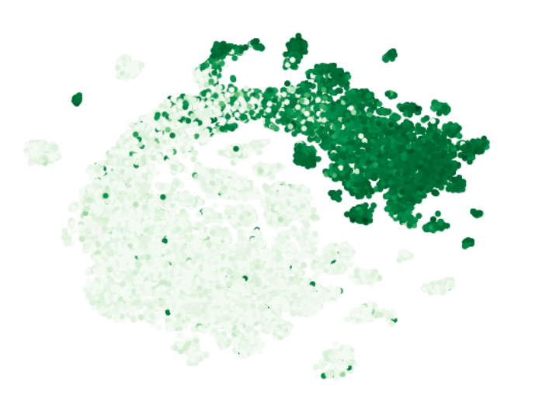
research goals something to actually see
gfp mutations on a manifold colored by log-fluorescence
(each dot <> mutated sequence)
rao, bhattacharya, and thomas et al. 2019
isaac stier robson
protein language models: a case study
3 dec 2019 16 / 17

Slide 17
</end>

