Slide 1
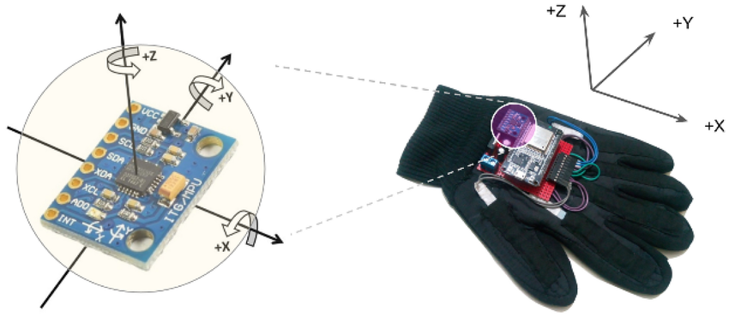
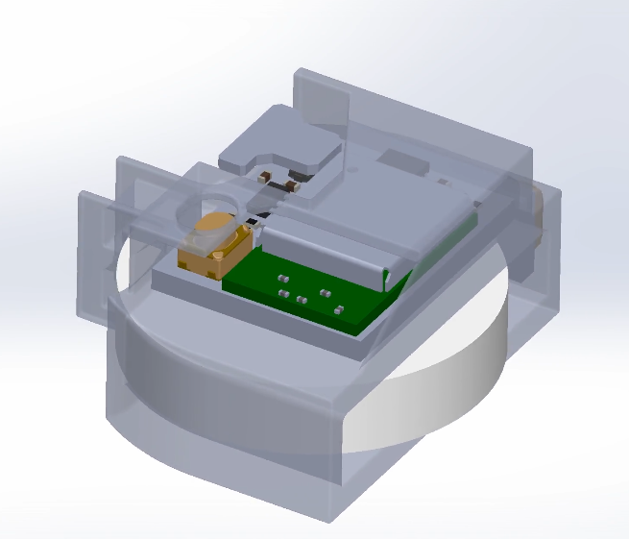
May 11, 2025
Motion Metrics
Dept. of EE
by
Eric Yu
Simon Wang

Slide 2
Task & Plan
Multi-class human motion activity recognition
Input: on-device IMU data (3-9 features sampled over time)
Output: 6 daily activities including walking, jogging, standing, sitting, going upstairs and downstairs
Model: Lightweight LSTM or transformer
Target: ≥ 90 % (baseline ≈ 85 %)
Cross-entropy loss
Utilize MotionSense Dataset for initial training
Prepare data with normalization and augmentation
Initial training using MotionSense dataset from Kaggle

Slide 3
The Data
MontionSense dataset:
24 participants, 15 trials, labeled with 6 daily activities
Collected on a iPhone 6s
Approximate 5 hrs of data with each well-labeled CSV
Use for initial training, validation, and testing
12 axis features
Planned to only select 3 to 9 axes for power reduction and model simplicity
Extended: in-house data
Collected via custom-build sensor with data with more axis
Testing performance of our model
Extended: other public HAR data
Further training and testing of the model

Slide 4
Impact, Feasibility & Next Steps
Impacts:
HAR data have potential for analyzing more detailed human activities for fitness, outdoor analytics, and safety warning service.
est. >$30 B market by 2030
Feasibility:
Open-source MotionSense data can be trained in <1h on single consumer-grade GPU.
Data are collected from different device placements, orientations, and variances from users and can be further augmented and normalized, guaranteeing good quality of dataset.
Future Work:
Future work can include more diverse dataset + activity labels.

