Slide 1
Modelling buildings and their heating systems

Slide 2
Motivation for this topic
part of heat transition is to renovate houses and use new technical building equipment
different paths to archieve climate-neutral houses
our task is to analyse some of them
goal: climate neutrality until 2045
residential buildings are responsible for 30% of greenhouse gas emissions
building energy act came into force on 1. january 2024 and ensures the switch to renewable energy for heating and hot water
2022: 19,5 million residential buildings, 13 million are single-familiy houses
Notes:
Facts from DENA Gebäudereport 2024

Slide 3
Building stock in Germany
Including GEG
3 typical buildings (ABC) from Dena Gebäudereport 2024

Slide 4
Building stock in Germany – evolution of energy standards
Information we can use or just that our group has the same knowledge and we can delete them later:
first Energy Saving Ordinance (EnEV) came into force on 1 January 2002
the thermal insultaiton ordinance (WSV) and the heating systems ordinance (HAV) were merged so that structural and heating requirements can be considered together
since then, the EnEV has been revised several timesthe building envelope and building technology are taken into account by using the variables primary energy demand and transmission heat losses/ U-value requirements but also summer heat insulation is includes
On 1 November 2020, EnEV was incorporated into the building energy act (GEG) and officially ceased to apply
the previous renewable energies heat act (EEWG) was also integrated into the GEG
EEWG was the national impelementation of the EU Renewable Energy Directive (RED)
the energy saving act (EnEG) could be repealed since it was now part of the GEG
the EnEG was enacted in 1973 after the first oil crisis in 1976

Slide 5
Building stock in Germany – overview buildings
roughly 25% of residential building was built before 1946 and 35% between 1946-1977
since the introductions of EnEV 2014 around 1 million = 5% of the residential buildings were built
nearly half of the housing stock are three- and four-room flats
from 2000 to 2022, the proportion of completed residential buildings with heat pumps as an energy source increased from almost 0% to 57%.
In 2022, the average flat size in new builds was around 154 m^2 for detached houses and 112 m^2 for semi-detached houses. There has been a trend towards an increase in the size of detached and semi-detached houses since 2000. This trend can also be applied to room sizes
In multi-family houses, on the other hand, the size decreases and, at around 76 m^2, is generally smaller than that of the other types of flat
Average per capita living space has risen almost steadily since 1990 (34.8 m^2) and was around 47.4 m^2 in 2022
Notes:
Source: DENA Gebäudereport

Slide 6
Building stock in Germany – overview heating
2022 heating based on renewable energy in 22% of the general housing stock
7,3 % were air-to-water heat pumps, brine-to.water heat pumps, water-to-water heat pumps and hot water heat pumps
proportion of residential units heated by heat pumpps has been rising steadily since 2003, reaching 3% in 2022
heat consumption per heated square metre decreases annually due to climate change
the largest areas of application for energy consumtion in residential buildings are space heating (66%) and hot water (16%)
Notes:
Source: DENA Gebäudereport

Slide 7
Building stock in Germany
Based on information before, we choose these 3 typical houses:
My suggestion:
25% before 1946 (Dena)→ Tabula data for 1919 - 1948
35% before 1977 (Dena)→ Tabula data for 1958 - 1968
and of course a modern one → Tabula data for 2016
The heating season in Germany is 200 days per year (https://s2.building-typology.eu/abpdf/DE_N_01_EPISCOPE_CaseStudy_TABULA_National.pdf)

Slide 8
How does a heat pump work?
AC v Heat pump
COP with some heat flow math

Slide 9
How does a heat pump work - principle
https://www.iea.org/reports/the-future-of-heat-pumps/how-a-heat-pump-works :
extracts heat from a source like surrounding air, geothermal energy stored in the ground, water, waste heat
then amplifies and transfers the heat to where it is needed
most of the heat is transferred rather than generated → heat pumps are more efficient than conventional heating technologies
output of energy in the form of heat in normally several times greater thatn that required to power the heat pump (coefficient of poerformanc for a typical household is aroud four → output is four times greater thatn electrical energy used to run it)
consist of a compressor, which moves a refrigerant through a refrigeration cylce
and a heat exchanger, which extracts heat from the source
heat is passed on to a heat sink through another heat exchanger
in buildings the heat is delivered using forced air or hydronic systems such as radiotrs or under-floor heating
One thing that always confuses people is how heat pumps can be „300% efficient“. It doesn‘t violate physical laws because the heat energy is only moved, not generated. And this also works when you would think there is no „heat“ cause it‘s cold outside. But heat is not the same thing as „warm“

Slide 10
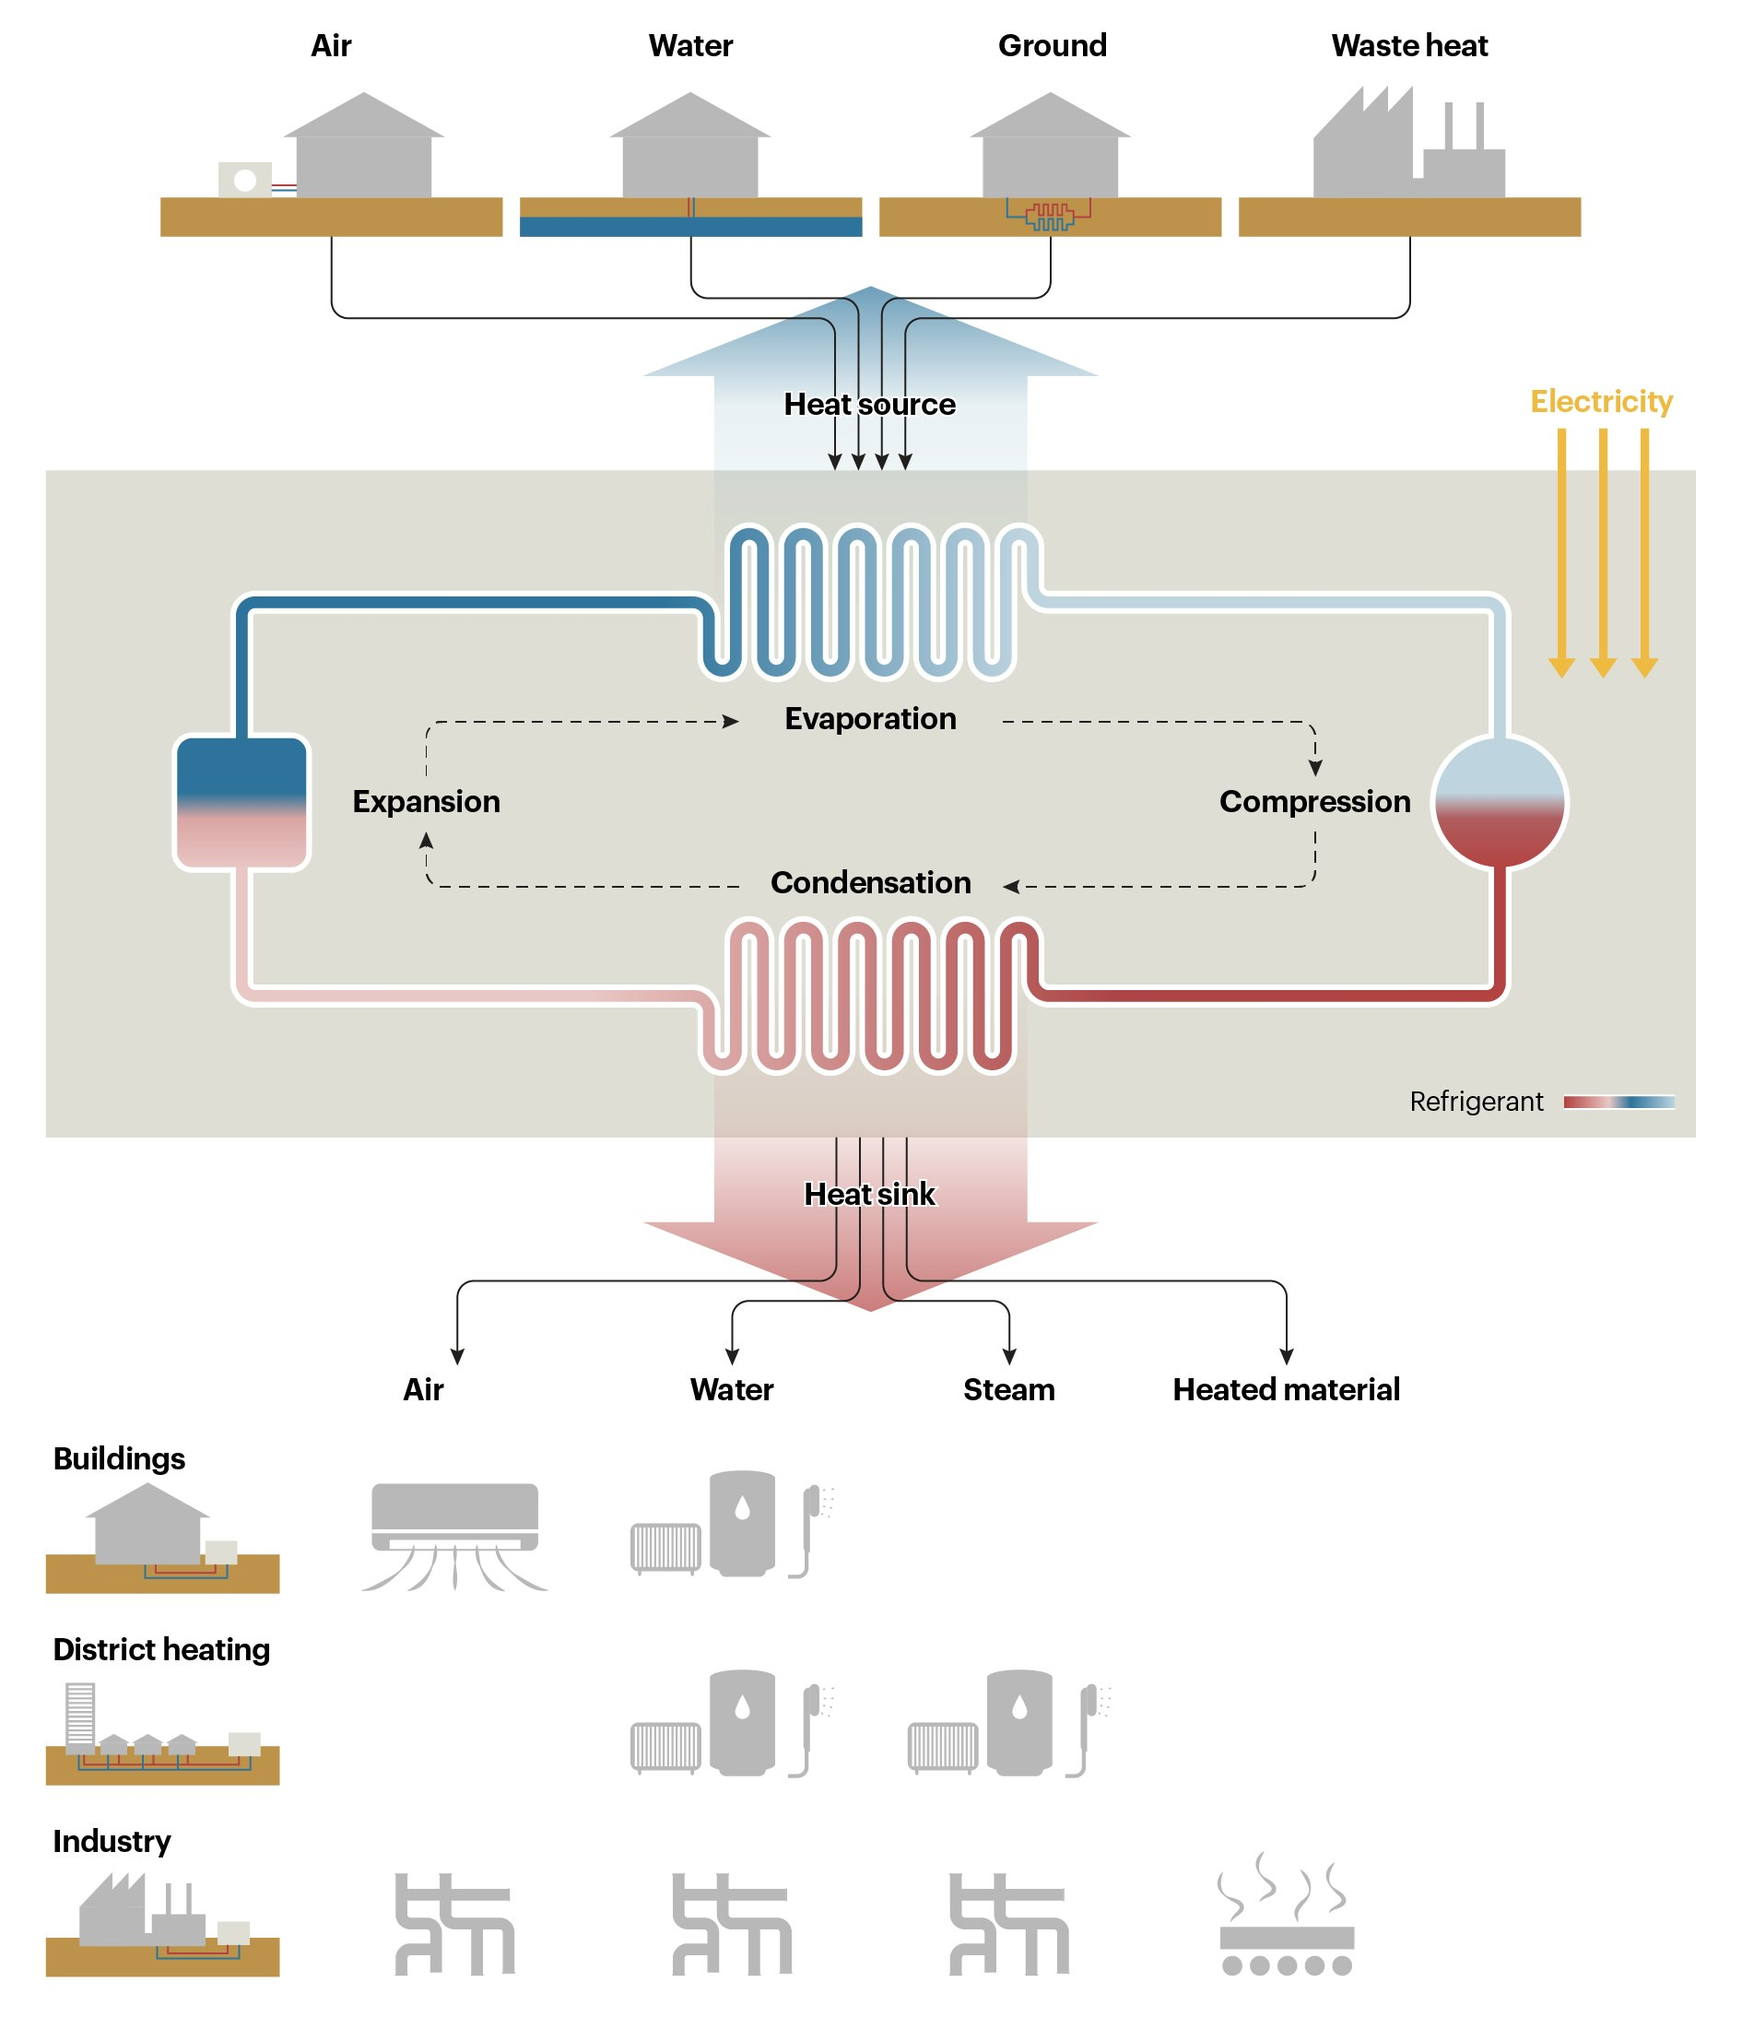
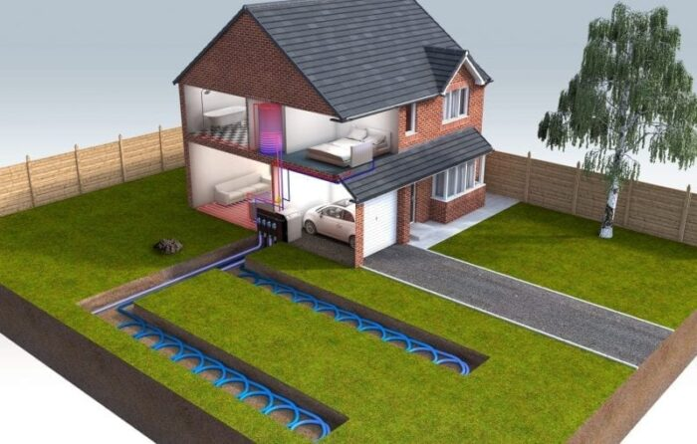
How does a heat pump work?

Slide 11
How do different heat pumps work? ASHP vs. GSHP
feature | ASHP | GSHP
heat source | air | ground
heat absorption | air that is blown over the heat exchanger by a fan → usually comprise a single, self-contained outdoor unit | by refrigerant running through a series of buried pipes → can be laid horizontally and buried in trenches just over a metre deep → can also be laid vertically in boreholes a single pipe loop might need around 600 m^2, larger buildings may require a second loop a single pipe loop might need around 600 m^2, larger buildings may require a second loop (/ open loop system that directly extracts heat from a pond or other source of water)
cost | not that expensive | expensive
temperature stability | varies with weather | relatively stable around the year
efficiency | lower in cold climates | generally higher, especially in winter
Notes:
Source: https://www.granddesignsmagazine.com/heating/air-source-heat-pumps-vs-ground-source-heat-pumps/

Slide 12
How does a heat pump work? -> COP and what influences it
What are the main parameters that influence the COP of heat pumps?
COP = generated heating energy (kWh) / electricity consumed to generate heat (kWh)
source temperature, sink temperature
system design like control devices, compressor, type of refrigerant, length and dimension of piping, sizing of heat exchangers
higher COPs are associated with longer cycle times required for more complete desorption and adsorption processes, resulting in a lower number of cycles per unit time and consequently in lower specific heating or cooling power
How do ASHP and GSHP differ in this context?
GSHP are more efficient, roughly: COP=6, ASHP COP=4
Notes:
https://gebwell.fi/en/news/how-is-the-cop-of-a-heat-pump-calculated-and-what-affects-it/ ;
Vítor A.F. Costa, João M.S. Dias, On the best coefficient of performance and specific heating or cooling power combination for adsorption refrigerators and heat pumps, International Journal of Refrigeration
2023

Slide 13
What‘s Modelica?
AixLib
This is what the environment looks like (small demo)

Slide 14
What‘s Modelica
What are the main principles?
object-oriented, equation based, declarative modeling language
designed to model complex physical systems involving multiple physical domains like mechanical, electrical, thermal, …
What are main differences to other modelling tools?
you use quations to describe relationships rather than commands
you can easily reuse components in different configurations
there are several pre-built components for physical modeling
has symbols to represent the physical model

Slide 15
What‘s Modelica - AixLib
is a library designed for modeling and simulating building energy systems
based on IBPSA library (International Building Performance Simulation Association)
proviedes models for
heating, cooling, ventilation systems
building envelope
control strategies
weather data handling

Slide 16
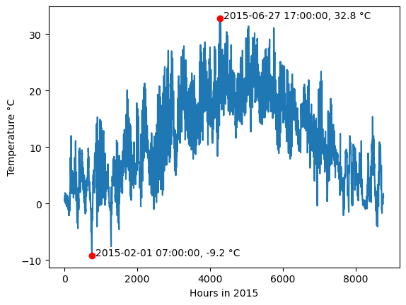
Weather data (2015)
TRY makes lots of data available
Maybe show the uploaded video animation of weather data in Germany

Slide 17
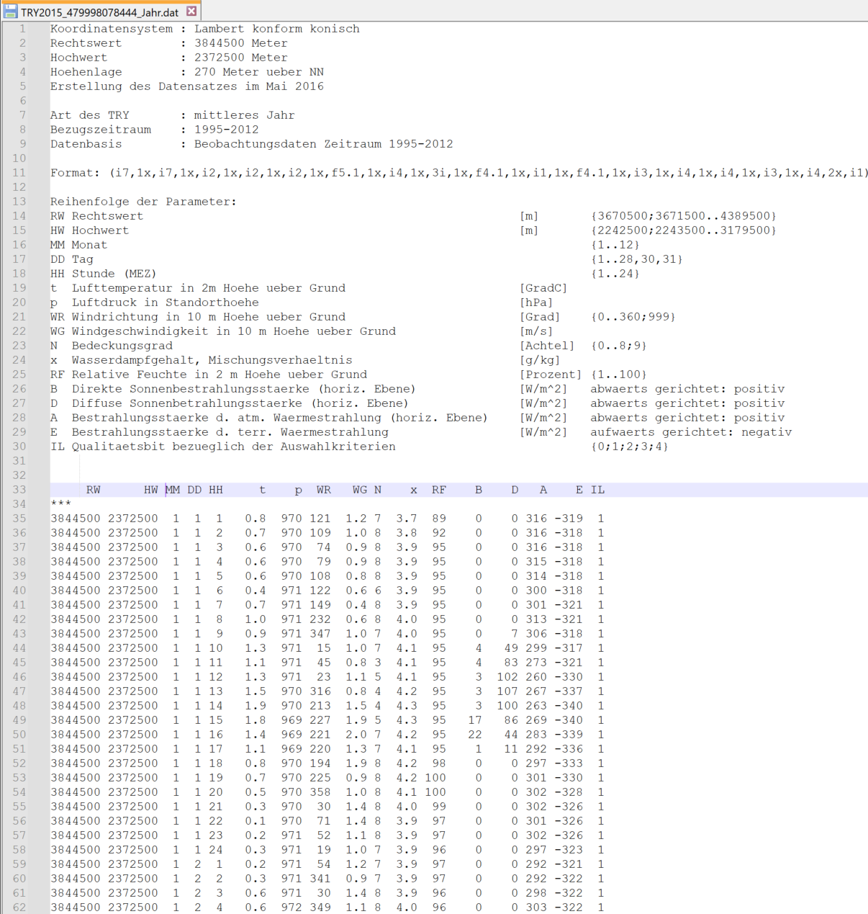
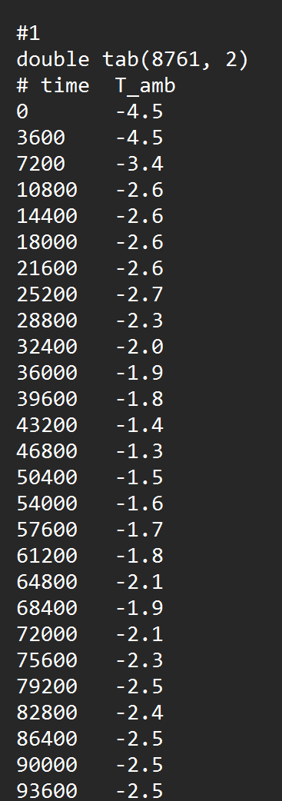

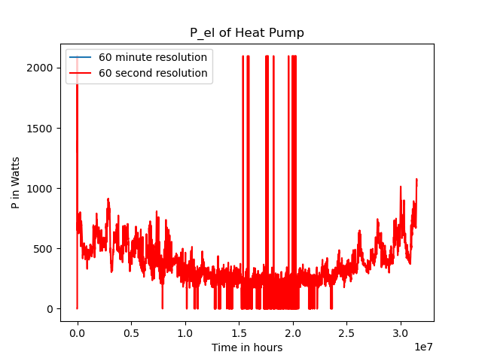
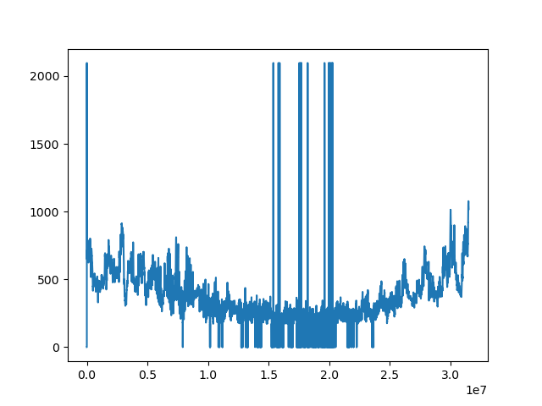
Preprocessing
Custom Python script to reformat temperature data
Write custom files with all building parameters
Before Simulation
Choose weather file
Choose building file
Modelica‘s “dassl“ integratior actually adapts the step size
It takes >10 minutes to run a full year

Slide 18

Modelica Simulation Run

Slide 19
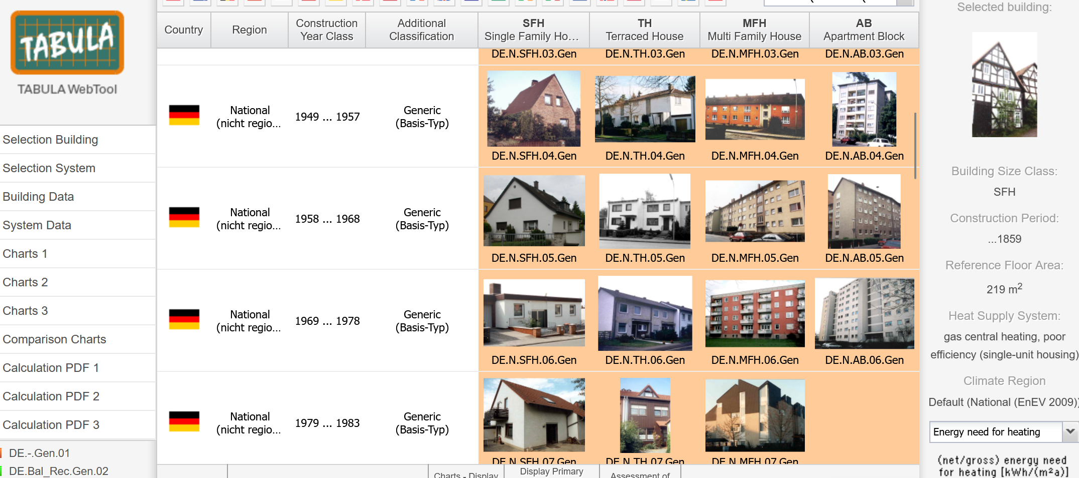
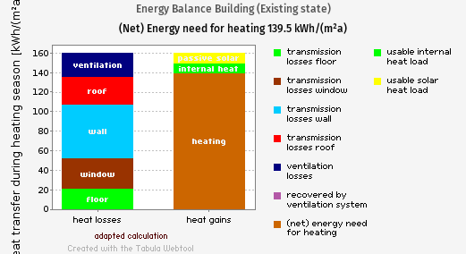
Parameters
Tabula website with building stock data across Europe
Validate the model by checking if results can be reproduced with real data
No ventilation, no internal heat source, no solar irradiance
https://webtool.building-typology.eu/?c=de#vares

Slide 20
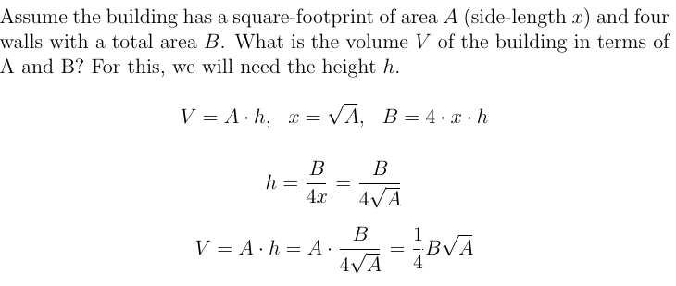
Tabula parameters
Tabula provides the surface area and thermal transmittance (U) of the components: floor, walls, windows, roof
For the model, we also need the volume of air inside

Slide 21
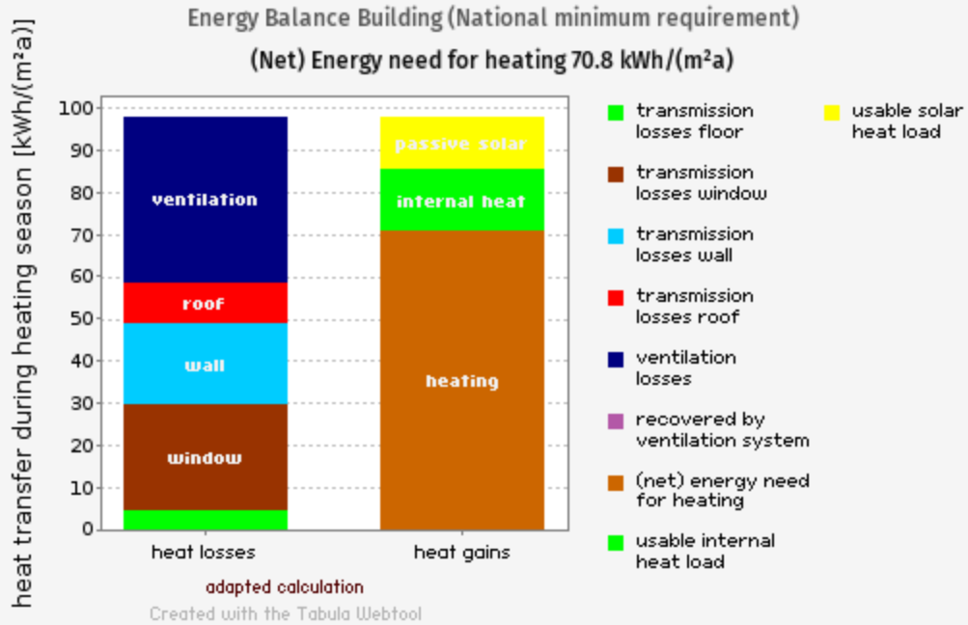
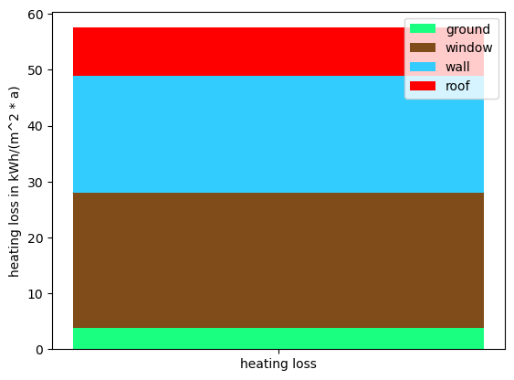
The model kinda works
Make the equations look nice, floor area not equal ground area
Heat gains and losses are equal, conservation of energy or som
→ 70.8 / COP = the electricity the heat pump consumed.
„Heating period“ Oct 1 to Apr 30 = 200 days.

Slide 22
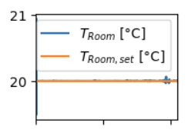
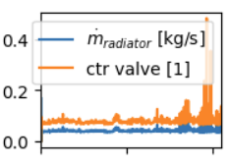
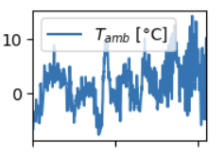
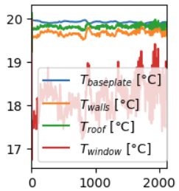
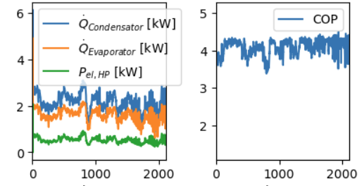
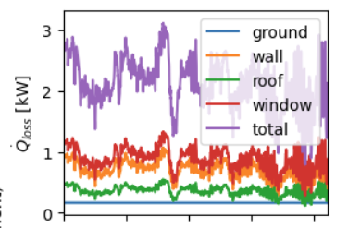
Comparisons (relevant plots)
Controller
Misc
Heat pump
Building

Slide 23
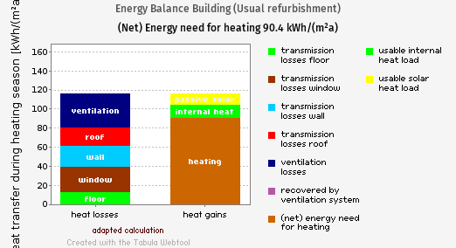
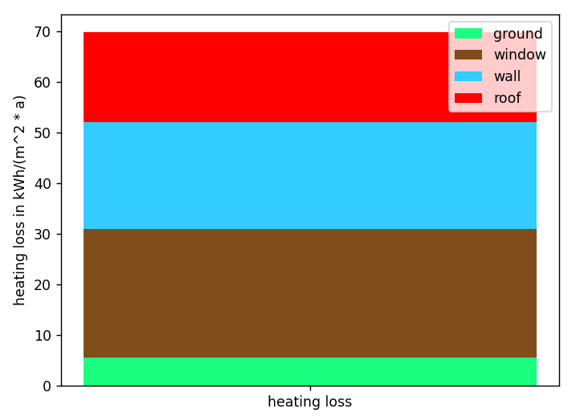
1978 building in whole 2015
Typical building, explain plots

Slide 24
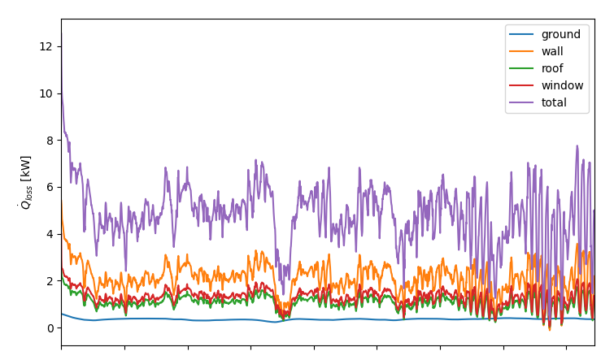
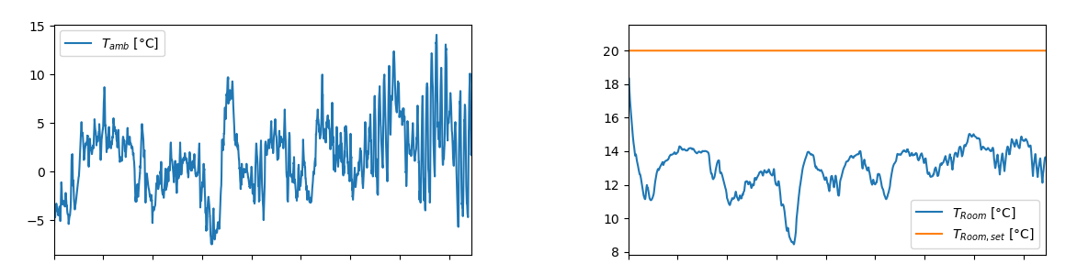
Not powerful enough to heat the building

Slide 25
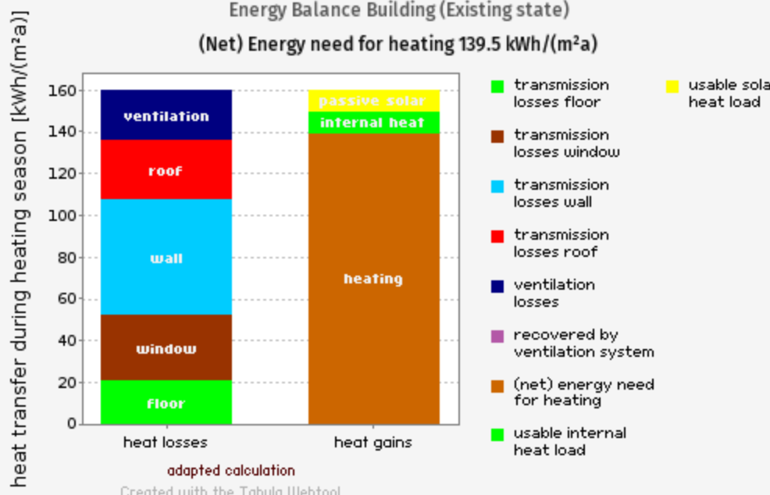
1978 building vs 2016 building in 2015
What‘s up with the window?
And the heat pump used 119 kWh/(m^2 *a) (from Jan to Mar)

Slide 26
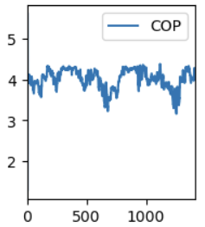
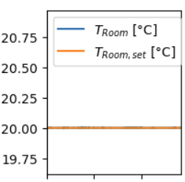
2016 building in cold vs normal winter (2015)

Slide 27
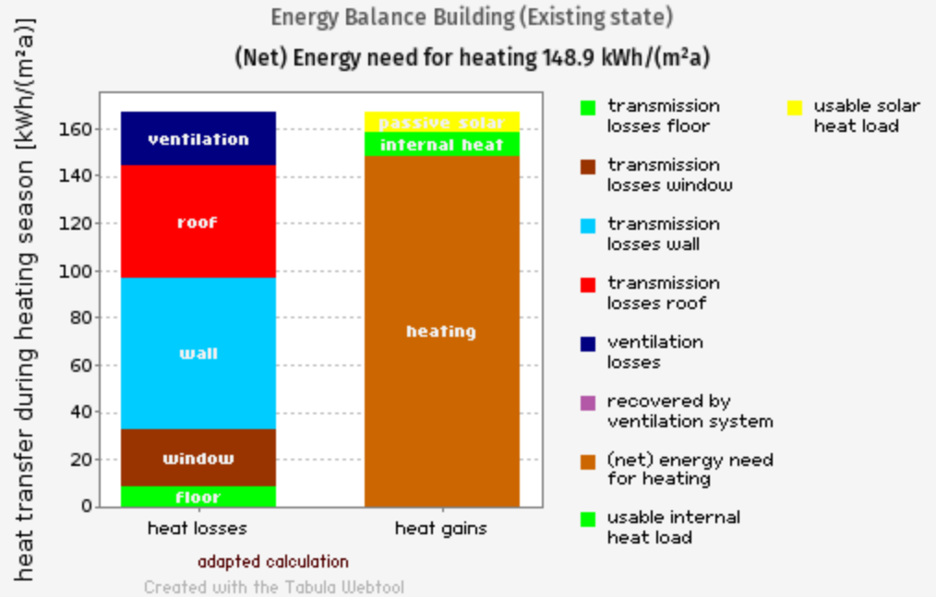
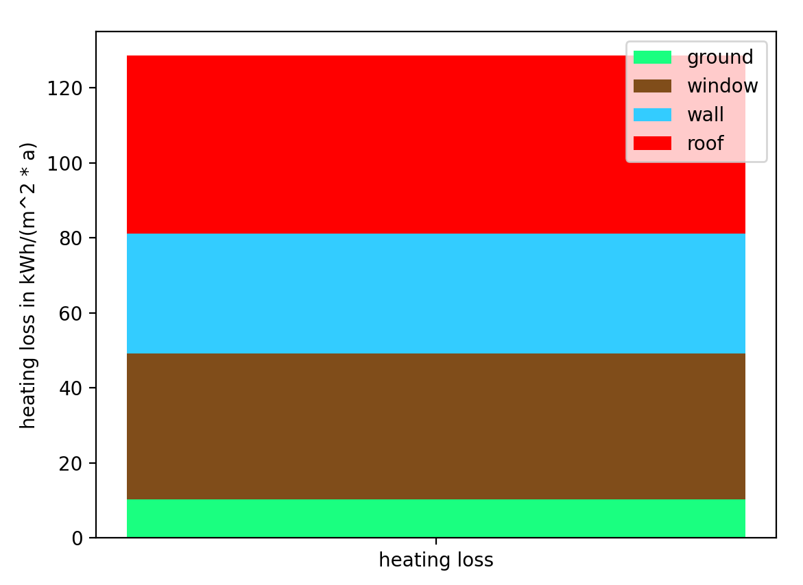
1948 building in 2015, refurbished (do advanced next)
T_HC_1_amb=273.15-20, T_HC_1_sup=273.15+70, T_HC_2_amb=273.15+20, T_HC_2_sup=273.15+20
But that needed HP=2 and
T_HC_1_amb=273.15-20, T_HC_1_sup=273.15+70, T_HC_2_amb=273.15+20, T_HC_2_sup=273.15+20

Slide 28
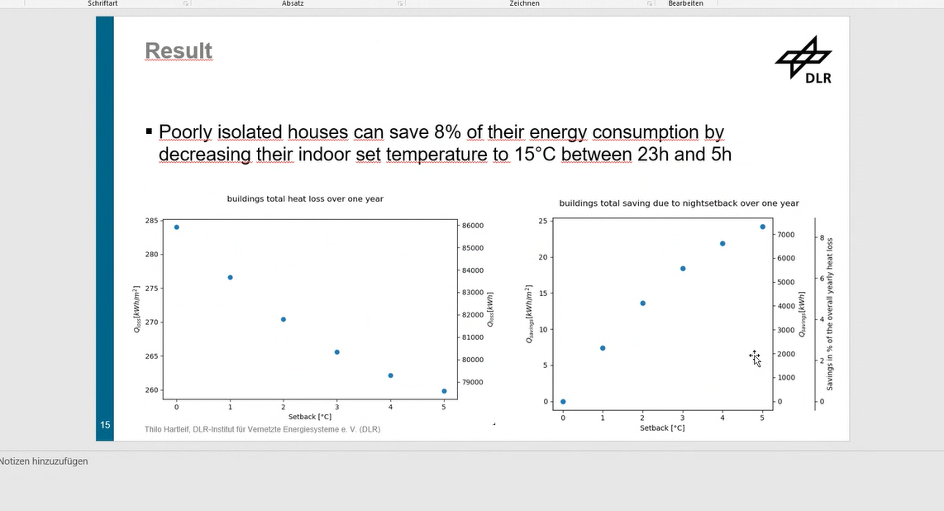
Night setback difference 2015 normal
„old“ building 1978
„new“ building 2016

Slide 29
Compare 2015 and 2045 T timeseries

Slide 30
2016 building in cold vs normal winter (2045?)
And the heat pump used 42.83 kWh/(m^2 *a) (from Jan to Mar)

Slide 32
Conclusions

Slide 33
Thanks for listening!

Slide 34
Sources
Krähenmann, S., Walter, A., Brienen, S., Imbery, F., Matzarakis, A.: Stündliche Raster der Lufttemperatur für Deutschland (Projekt TRY-Weiterentwicklung), Version V001, DWD Climate Data Center (CDC), DOI:10.5676/DWD_CDC/TRY_Basis_v001, 2016

Slide 35
3 questions, 4 answers each

Slide 36
Do you have any questions?

Slide 37
A0 Poster

