Slide 1
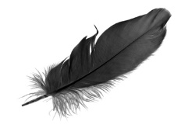
Anishnaabe Kwewag Gamig Inc. Organizational Chart
Board of Directors
Alderville First Nation
Chippewas of Georgina Island First Nation
Mississaugas of
Scugog First Nation
Rama First Nation
Moose Deer Point
First Nation
Algonquins of
Pikwakanagan
First Nation
Beausoleil First Nation
EXECUTIVE
COORDINATOR
PROGRAM
COORDINATOR
RESIDENTIAL
COUNSELLORS
CHILD AND YOUTH
WORKERS
MAINTENANCE
WORKER
Family Violence Prevention Worker

