Slide 1
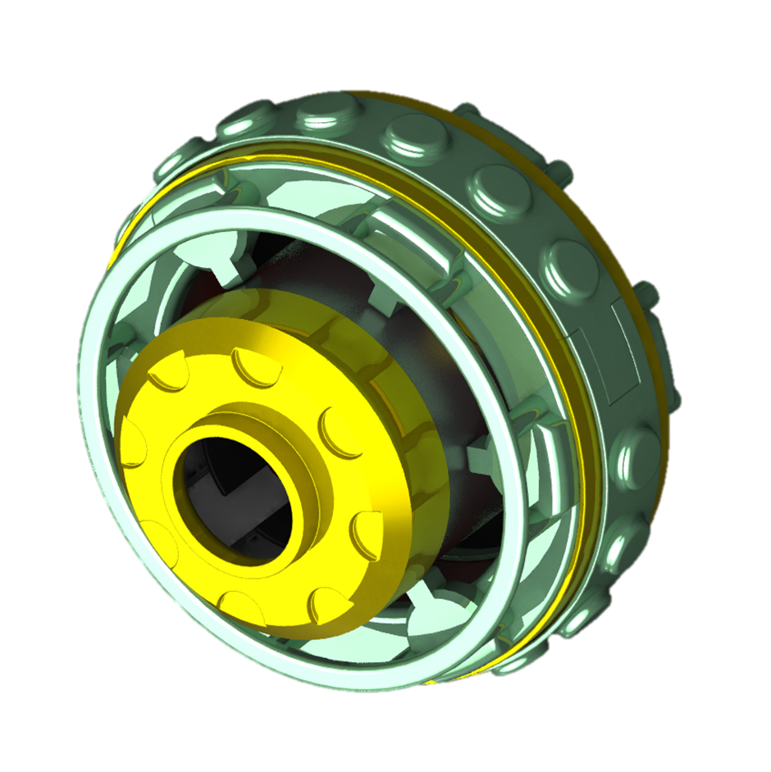
Sasha Star
“Bringing Earth’s comfort to the stars…”
Eylia Wahbeh (20374600)
Dang Nguyen (22093304)
Benjamin Driscoll (22066676)
Christian Santiago (22062115)
Claire McNally (22090806)
Adrian Marsano (22064315)
Notes:
• Slides summarise product, people, your design approach

Slide 2
Habitation: 24-Hour Cycle
Home Star ISS module
Adrian
Christian, Claire, Eylia
Christian, Claire, Eylia
Christian, Claire, Eylia
Ben
Dang
Dang
Dang
Ben
00 01 02 03 04 05 06 07 08 09 10 11 12 13 14 15 16 17 18 19 20 21 22 23 24
Sleeping
work
Eating
Work
Eating
Free time
Work
Free time
Eating
Sleeping

Slide 3
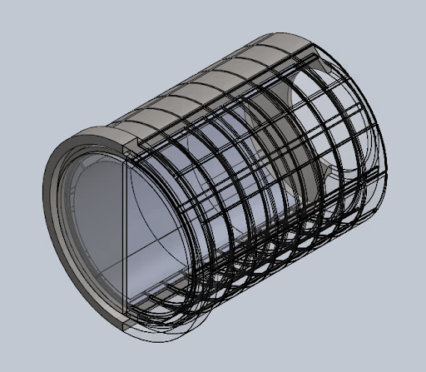
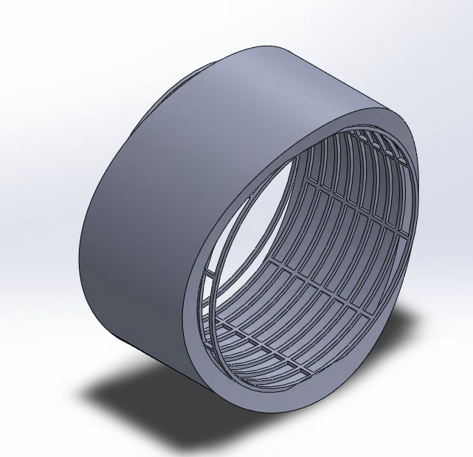
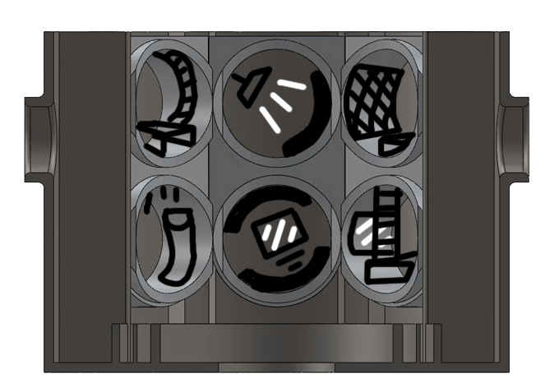
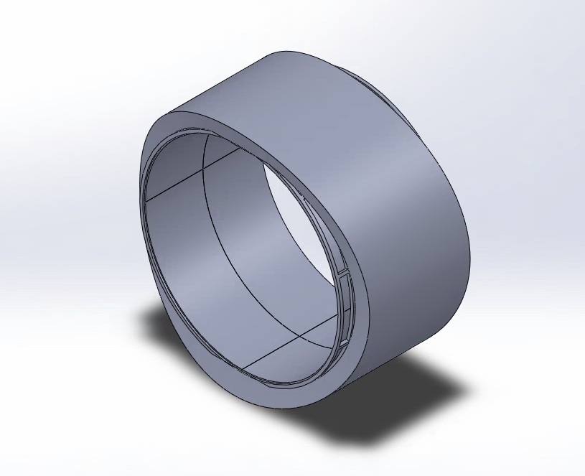
Sleeping Capsules
Variable Comfort Spaces
Focus: Sleep deprivation is a major psychological stressor on the ISS.
Goal: Improve comfort, rest quality, and mental health via evidence-based design
Psychological grounding: Based on circadian lighting, noise isolation, and spatial privacy.
Integrates into quiet zone of the interaction module.
Compact Community
With limited space on the ISS the design creates a compact set of sleep stations yet still provides the necessary space to relax
Rotation Modularity
The pods are small rotational based modular rooms which allows the users to rotate and move pieces of furniture across the surfaces as they wish
Human Integration Design Handbook Revisions
Notes:
• Convey new product features and intentions highlighting astronaut crew

Slide 4
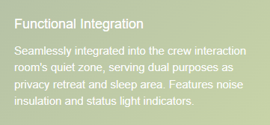
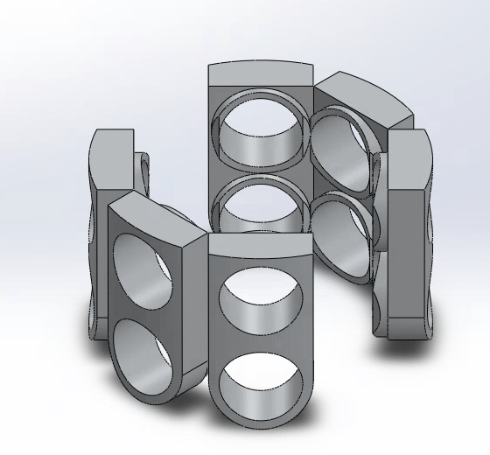
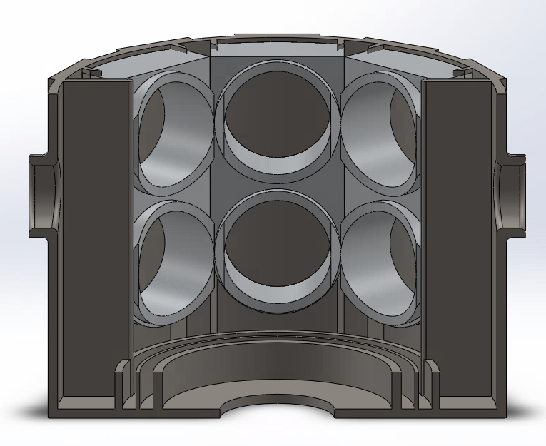
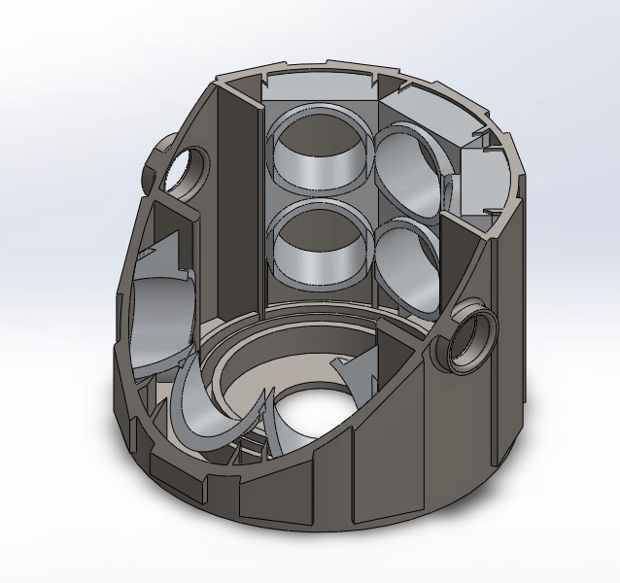
Sleeping Capsules
Pod Dimensions: 2.2m × 1.0m × 1.2m
Smart Environmental Systems
Airflow and lighting systems are linked to central environment, enabling coordinated adjustments to support shared sleep cycles.
Comfort Features
Memory foam padding integrated into wall panels
Antibacterial, hypoallergenic fabric covers
Optimized sleep quality with safety standards
Rotating Modular floor system allowing customisable living conditions
Notes:
• Minimum of two evidence-based references per team member (1 mark)

Slide 5
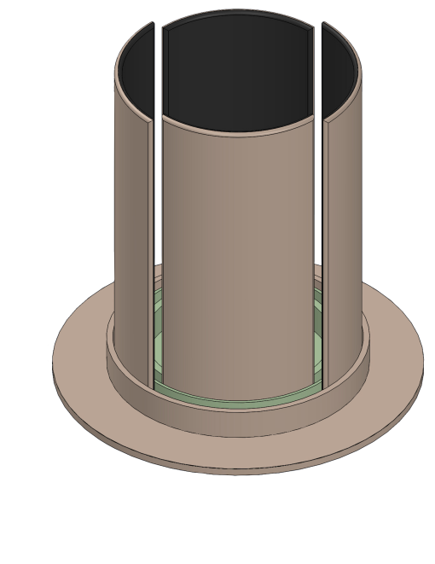
Community Room
Sasha Star’s communal area comprises four sliding touch screen panels which travel along magnetic guide rails — forming the ‘Community Room’.
The panels run along parallel rails, allowing them to collapse; providing easy access to the sleeping capsules and/or exit
A curved linear motion system powers the panels’ movement, which can be controlled by various means (gestures, wearable technologies, etc)
Direct integration with Earthlight ; our multisensory virtual reality experience
Also integrates with Ouroboros, The Hive, and external systems aboard the ISS

Slide 6
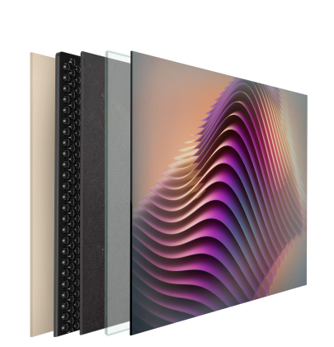
Community Room
Panel Features
Functional Integration
It was important to consider how these panels transformed the shared and private spaces in our concept. As such, particular emphasis was placed on noise minimisation because of the proximity between the shared and private areas in our proposal
Backing Panel
Faces towards the sleeping capsules
Viscoelastic Damping Sheet
Reduces vibration and noise
Mass-loaded Vinyl
Blocks sound from passing through
Laminated Acoustic Glass
Minimises sound transmission
Capacitive LED Touch Screen
A touch screen which allows astronauts to experience Earthlight, interact with The Hive, and other cross-functional features
24-Hour Cycle
Colour temperature of the touch screen adjusts based on 24-hour cycle to promote high quality, restful sleep
Backing Panel
Viscoelastic Damping Sheet
Mass-loaded Vinyl
Laminated Acoustic Glass
Capacitive LED Touch Screen

Slide 7
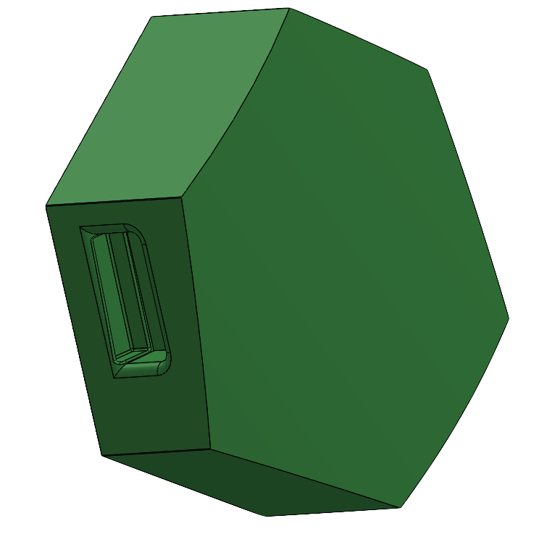
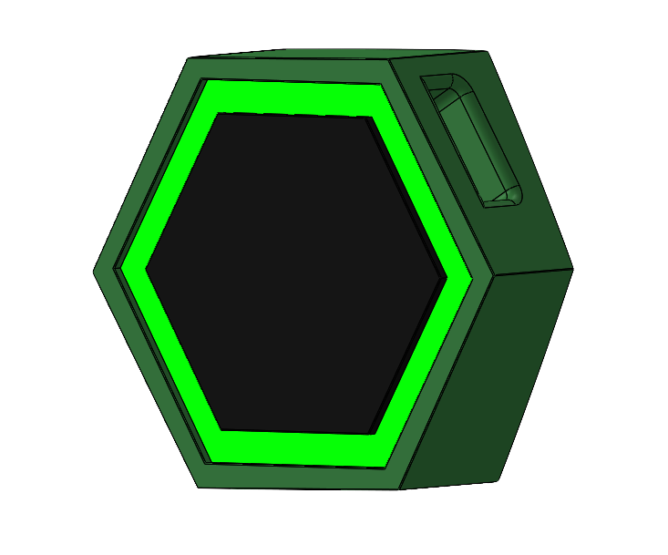
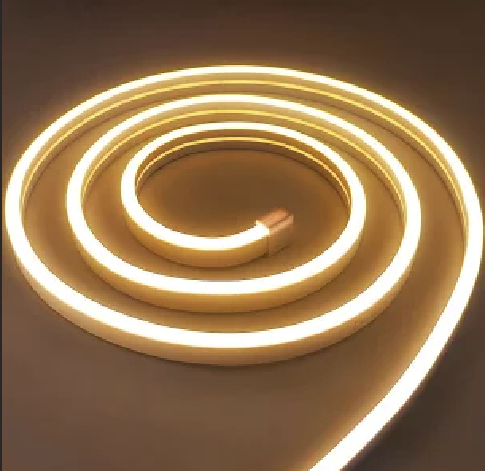
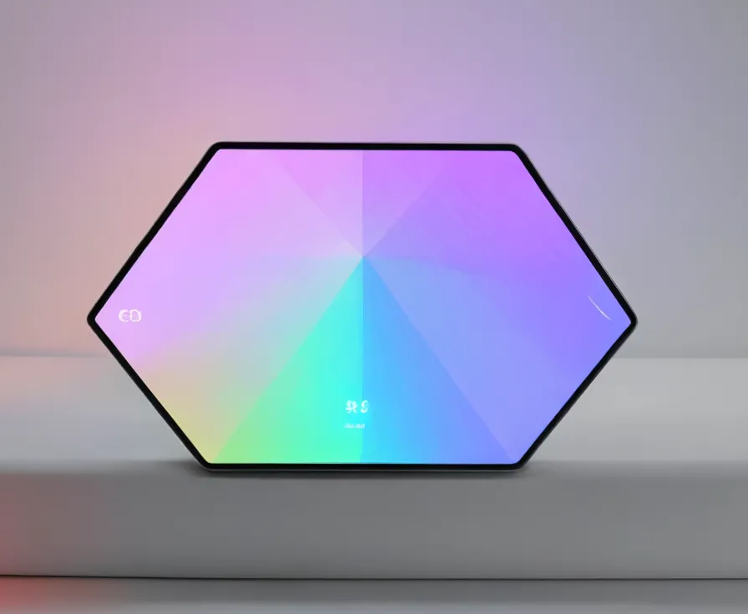
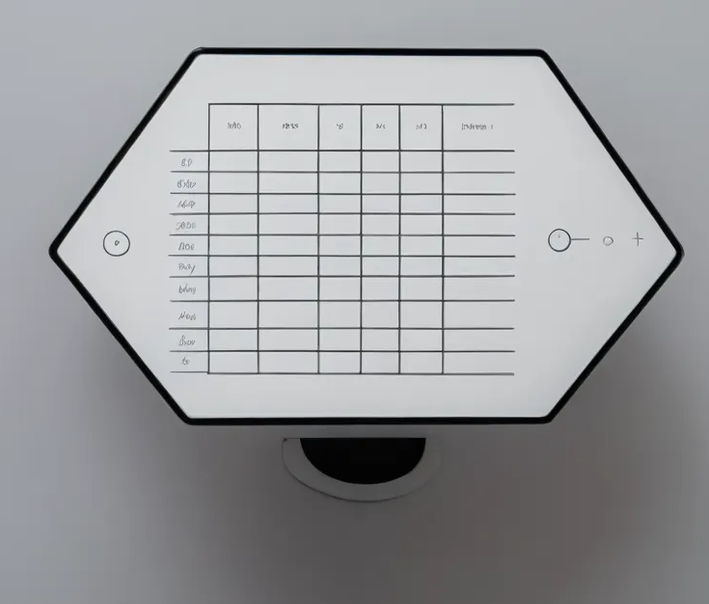
The Hive
The mood tracker is integrated with the crew interaction 24 hours system. Having a centralised data network ensures consistent and real-time monitoring of crew wellbeing. The mood tracker system provides data visualisation and feedback to the crew and mission control to ensure a more efficient and one management approach to the mental health of the ISS. This interconnection design with environment and other data devices allow seamless support and interaction enhancing crews situational awareness as a collective.
Intenrals
Audio speakers,
Data trackers and battery source
Handle
Strong hold handle on either side to provide stabability of user interaction
Data collected
Emotions, diary journal and feedback loop from earth controls
LED Lights
Indicator of the emotion of the crew
Aesthetic is earth tones reminder of home
Touch screen tablet
Intuitive User interface
Connect to wearable device
control/connect to earthlight
Notes:
• Convey new product features and intentions highlighting astronaut crew

Slide 8
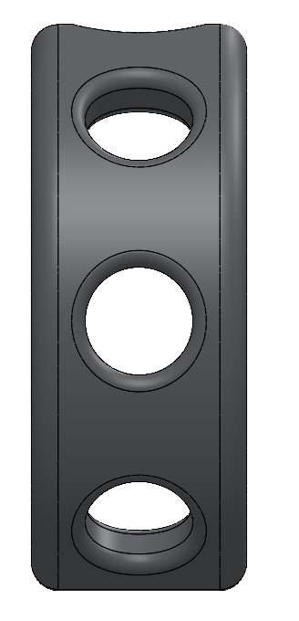
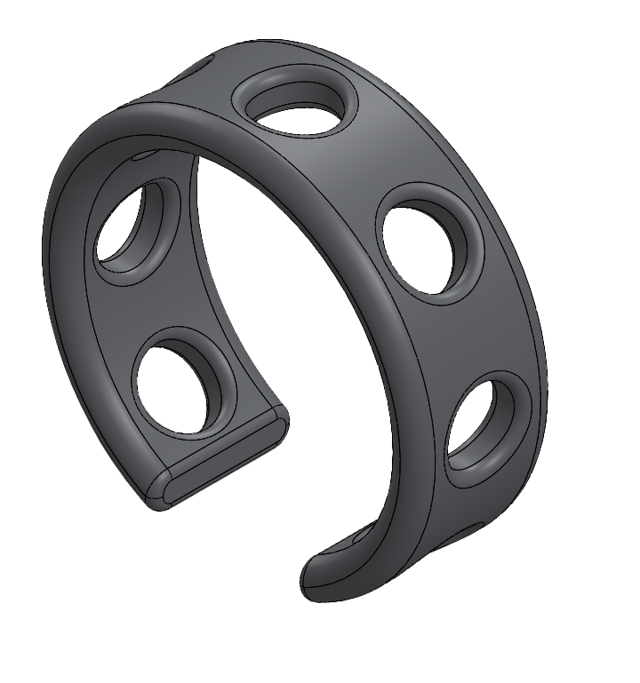
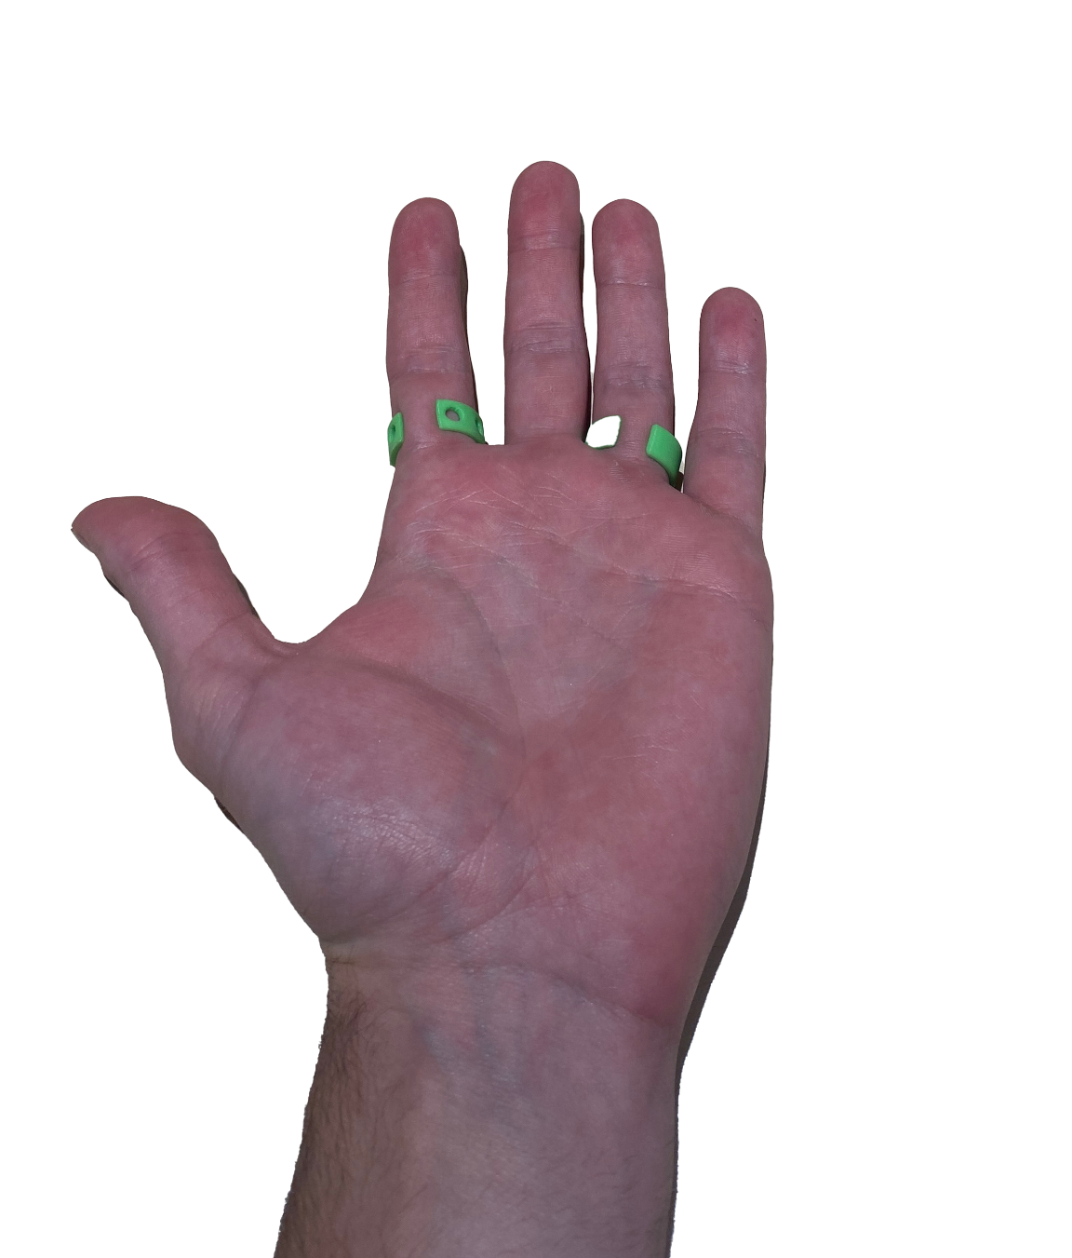
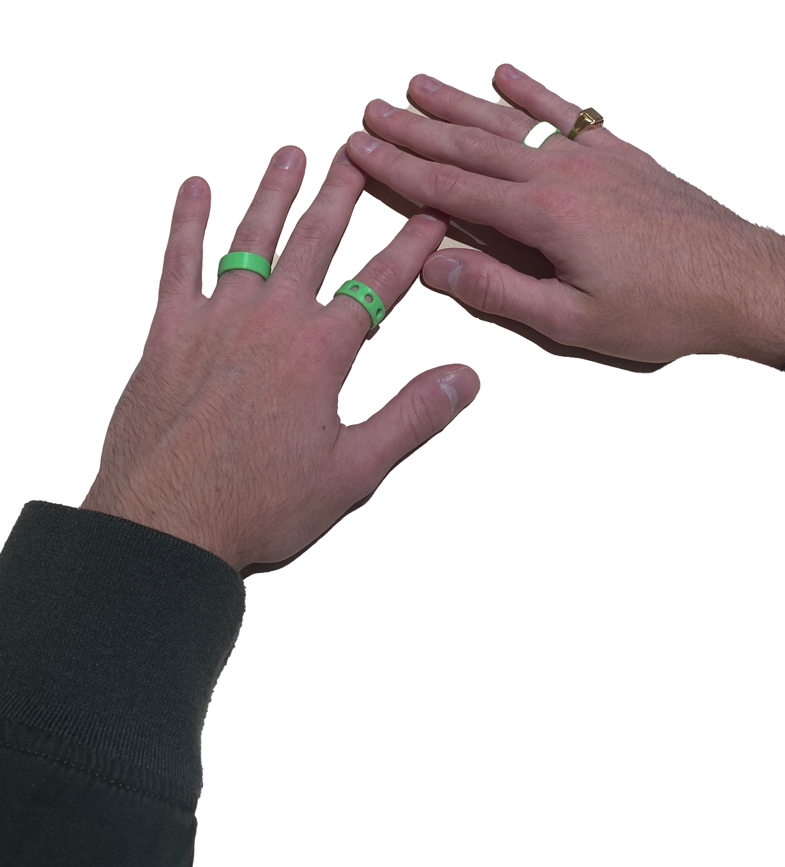
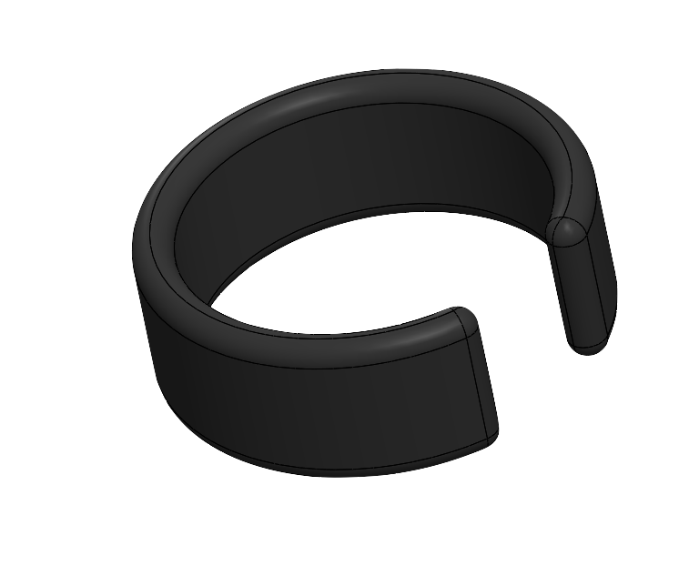
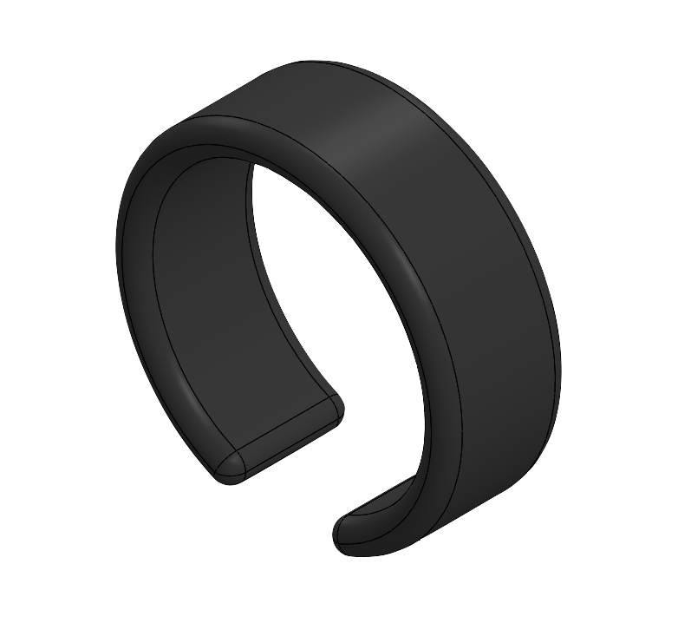
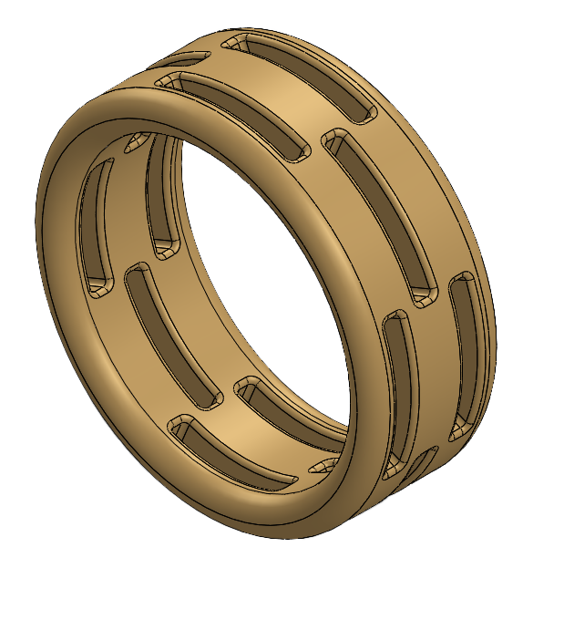
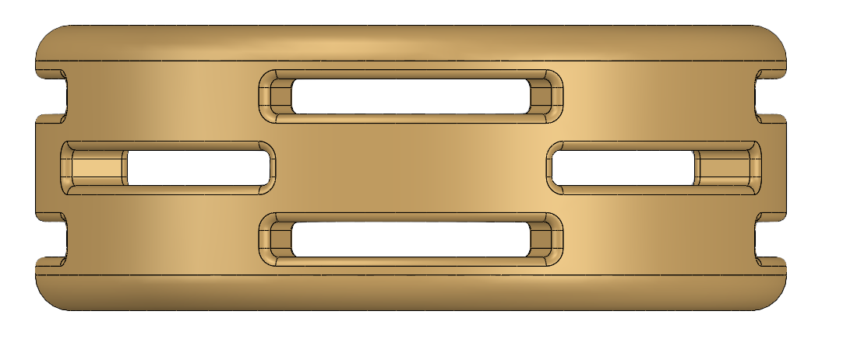
Wearable Fitness Tech
24/7 Health Monitoring
🕛 Night (Sleep Monitoring: 10 PM – 6 AM)
🌅 Morning (Wake-Up & Start of Day: 6 AM – 9 AM)
☀️ Daytime (Work, Activity, Exercise: 9 AM – 6 PM)
🌇 Evening (Wind-down Time: 6 PM – 10 PM)
🔁 Continuous (24/7 Passive Monitoring)
v
User Experience
Variations of Wearable
Material (Ergonomic Feature)
Medical-Grade Silicone:
Soft & Flexible: Adapts to different finger sizes and can be worn comfortably 24/7.
Non-toxic & Hypoallergenic: Safe for all skin types.
Waterproof & Sweat-resistant: Perfect for continuous wear, including during workouts and sleep.
Sanitizable: Can be washed with soap, alcohol, or even boiled (briefly) for disinfection between users.
Affordable & Replaceable: Easily produced in bulk, making shared use simpler.
Notes:
• Convey new product features and intentions highlighting astronaut crew

Slide 9
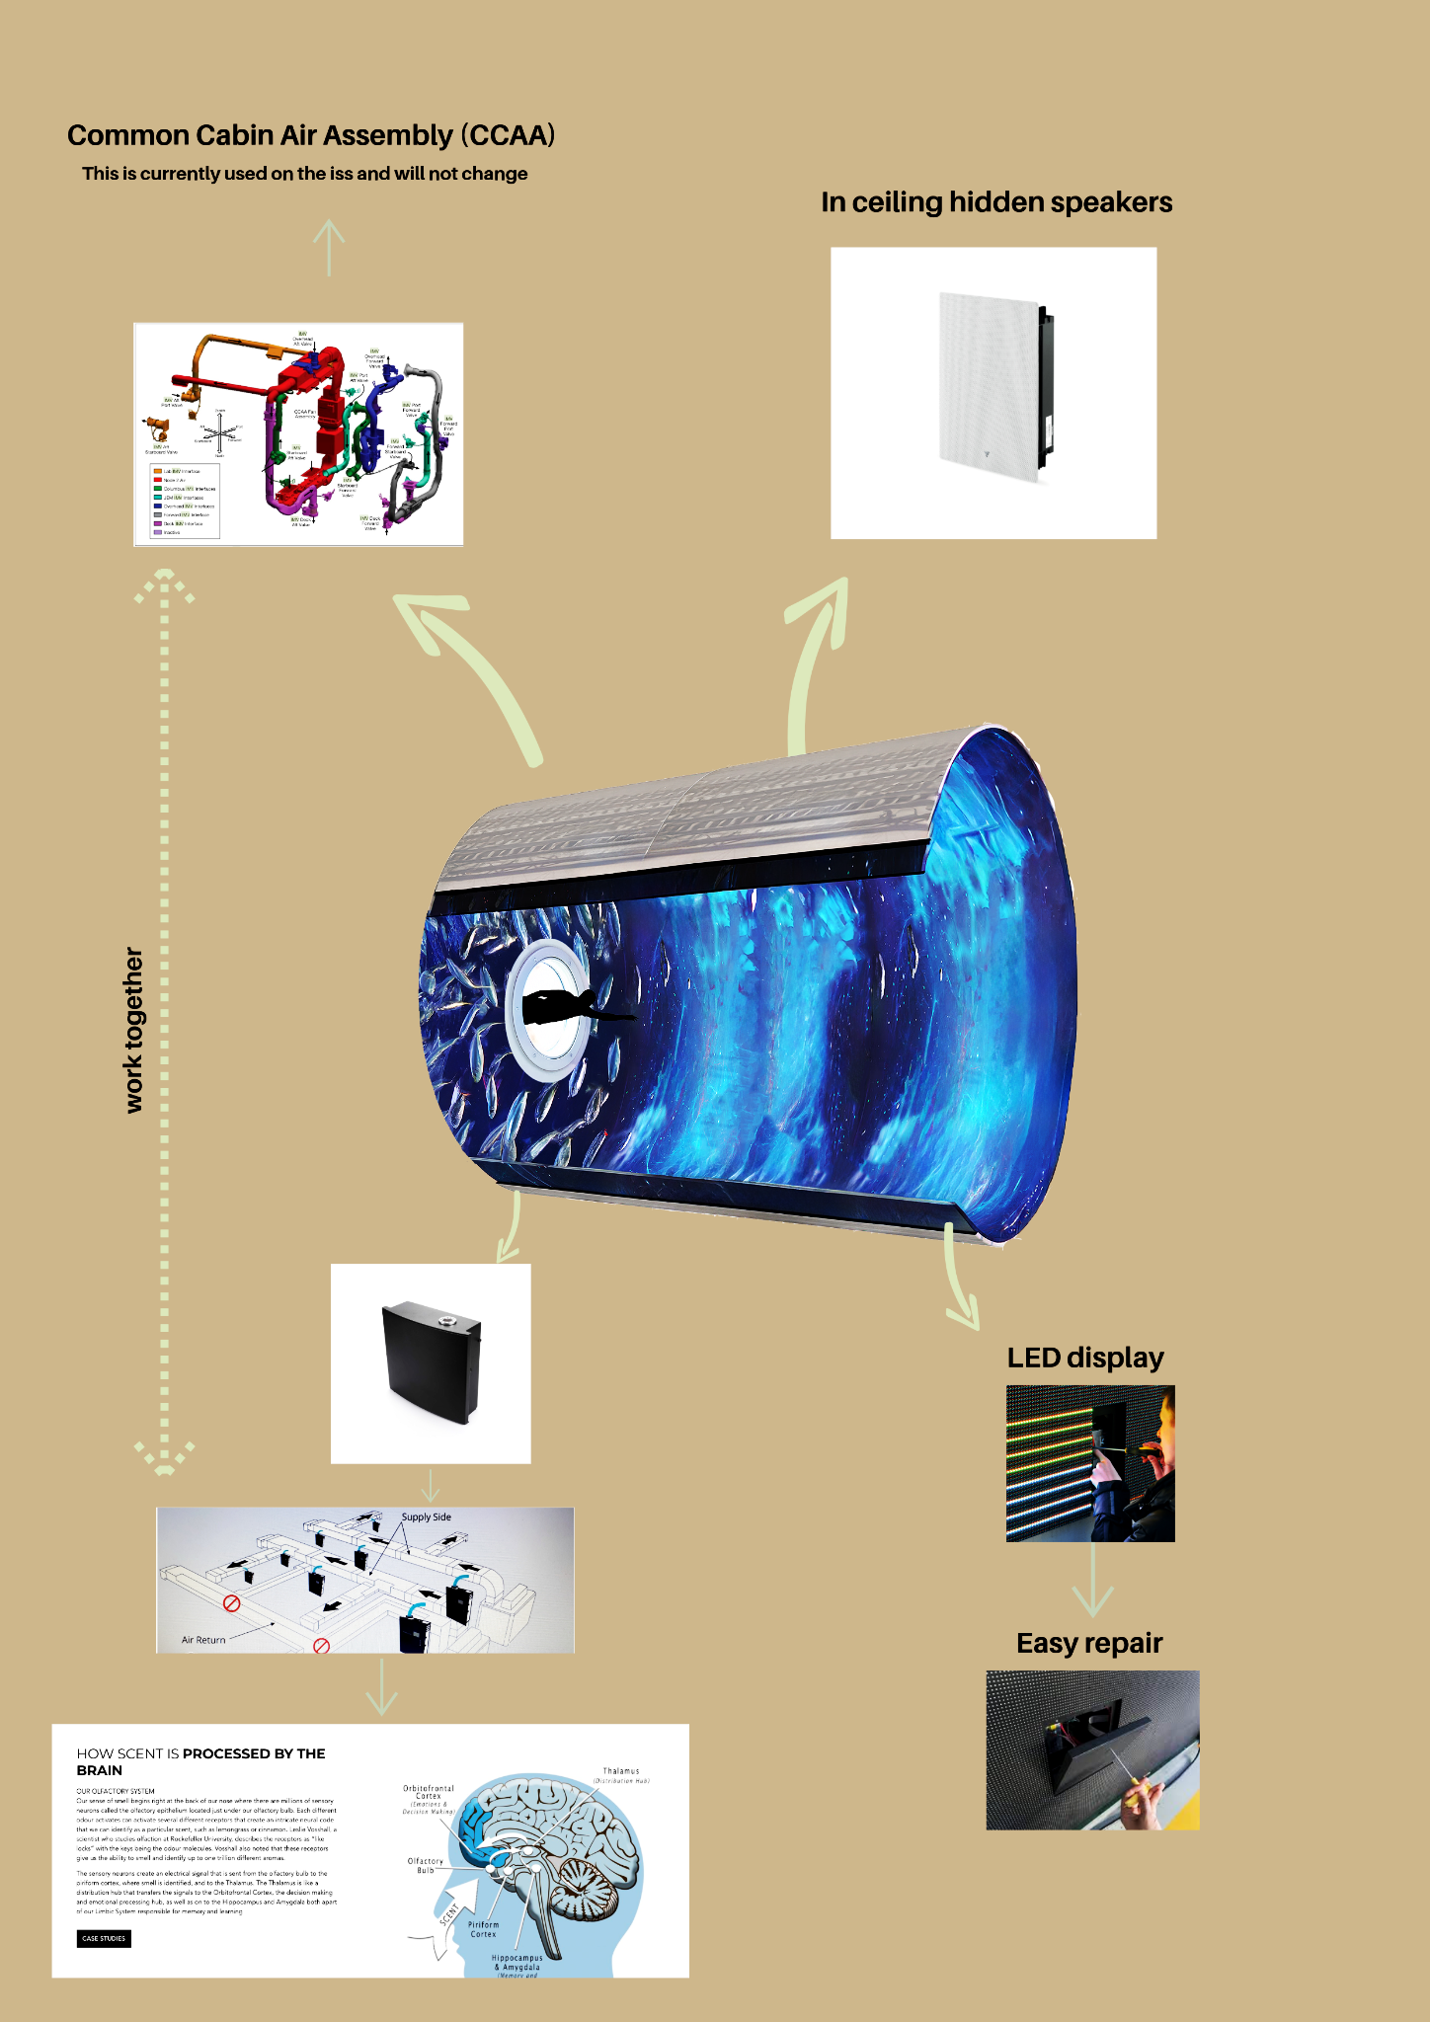
Earthlight
Earthlight is a modular virtual reality environment integrated into the ISS galley. aims to enhance astronauts mental well-being
Objective
Reduce the home sickness and emptiness felt by astronauts on a space mission
Approach
Simulating Earth-like experiences during mealtime and personal breaks through immersive visuals, ambient sounds, scent diffusers and climate control system.
Earthlight is a virtual reality environment which aims to enhance astronauts mental well-being through simulating Earth-like experiences.
Objective
Reduce the home sickness and emptiness felt by astronauts on a space mission
Approach
Simulating Earth-like experiences during mealtime and personal breaks through immersive visuals, ambient sounds, scent diffusers and climate control system.
Notes:
• Reinforce overall findings (1 mark)

Slide 10
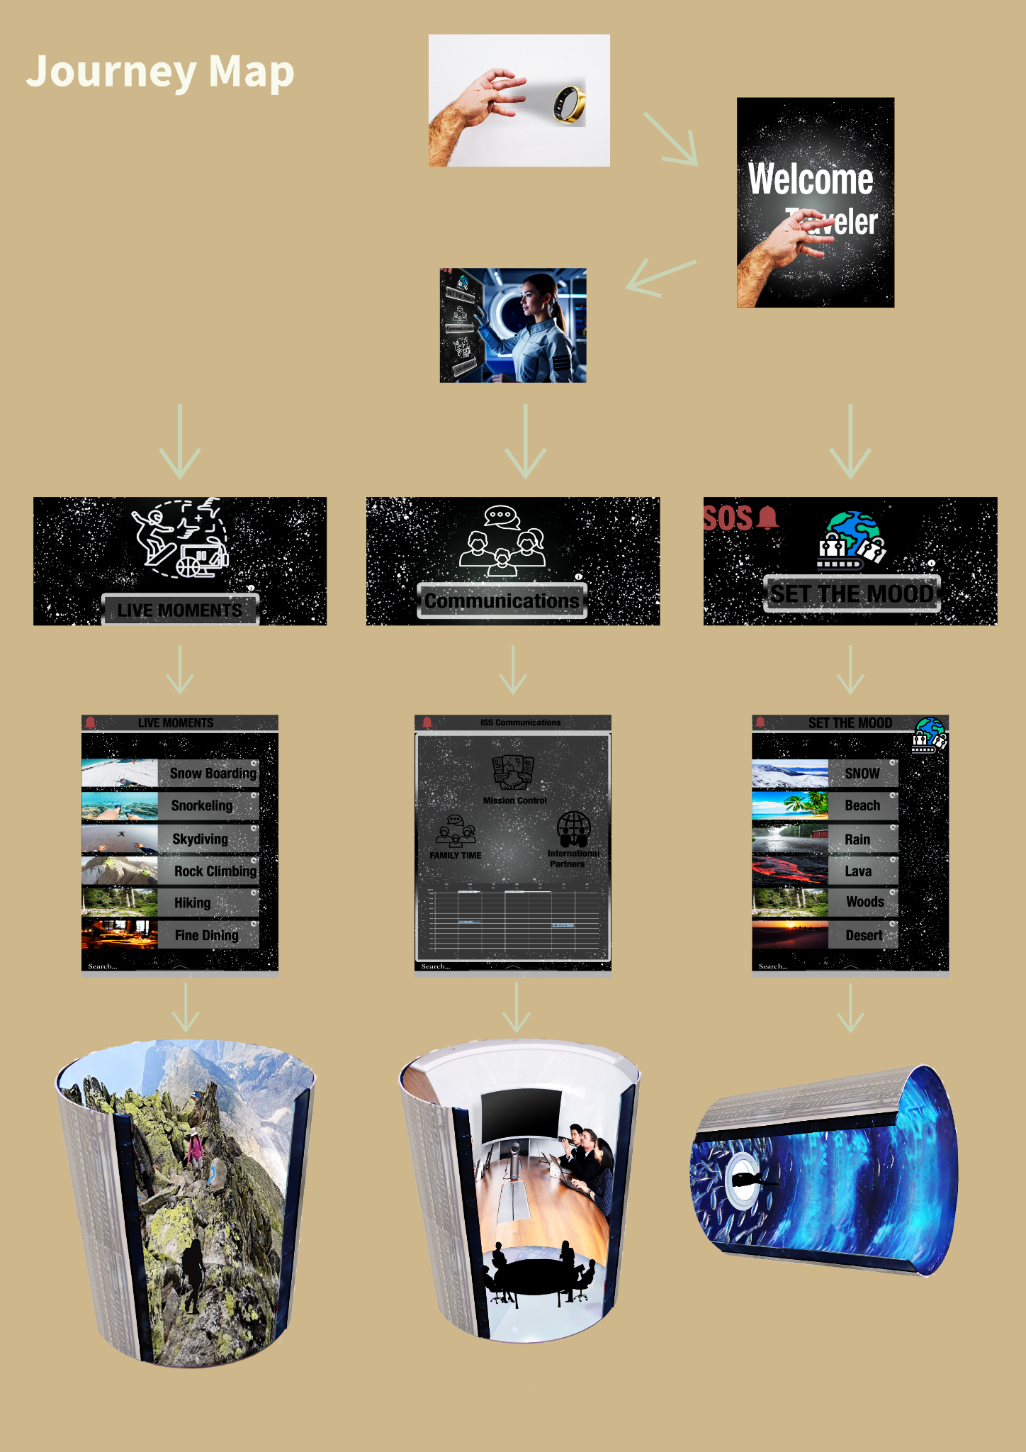
Personalised central management system
Description:
A personalised management system that lets astronauts easily customize and control their settings and experiences, creating a more comfortable and engaging environment.
Activation: (user specific personalised options )
Through the contact of smart ring with the screens on the iss
Live Moments – Step into immersive Earth-like adventures for relaxation and joy
Communications – Facilitates seamless connection with mission control, crew members, and loved ones
Set the Mood – Change the environment to match their feelings or boost their mood
Description:
A personalised management system that lets astronauts easily customize and control their settings and experiences, creating a more comfortable and engaging environment.
Activation: (user specific personalised options )
Through the contact of smart ring with the screens on the iss
Live Moments – Step into immersive Earth-like adventures for relaxation and joy
Communications – Facilitates seamless connection with mission control, crew members, and loved ones
Set the Mood – Change the environment to match their feelings or boost their mood
Notes:
• Reinforce overall findings (1 mark)

Slide 11

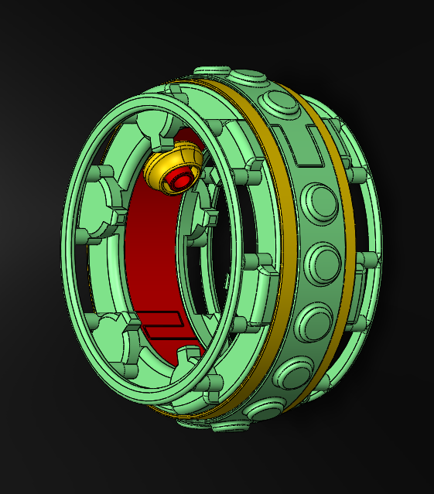
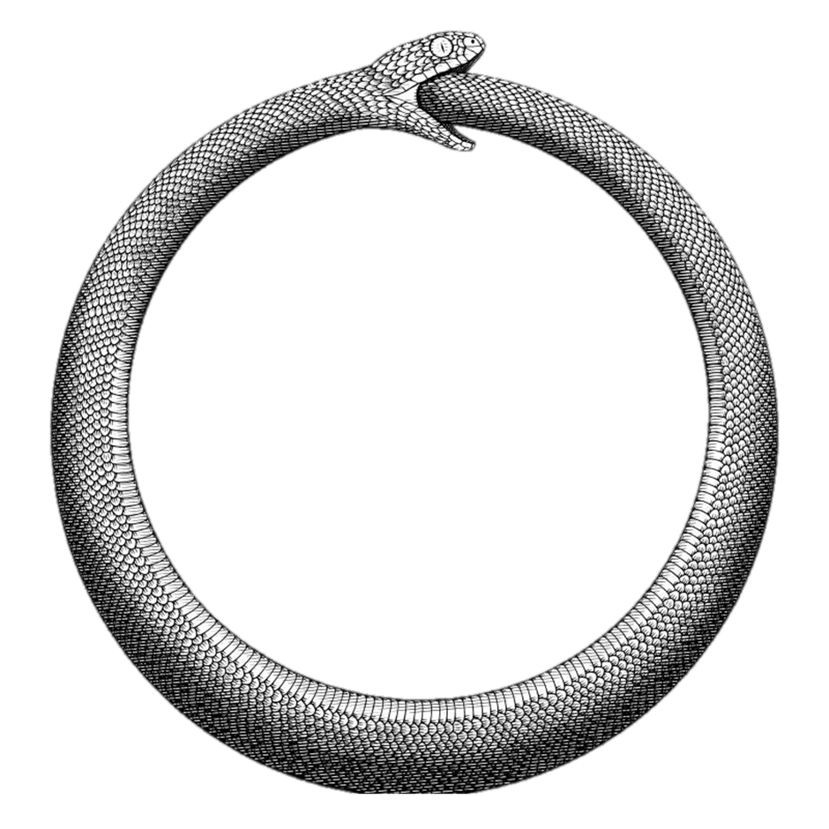
Ouroboros
Self
Sustain Horticulture
Chamber

Slide 12
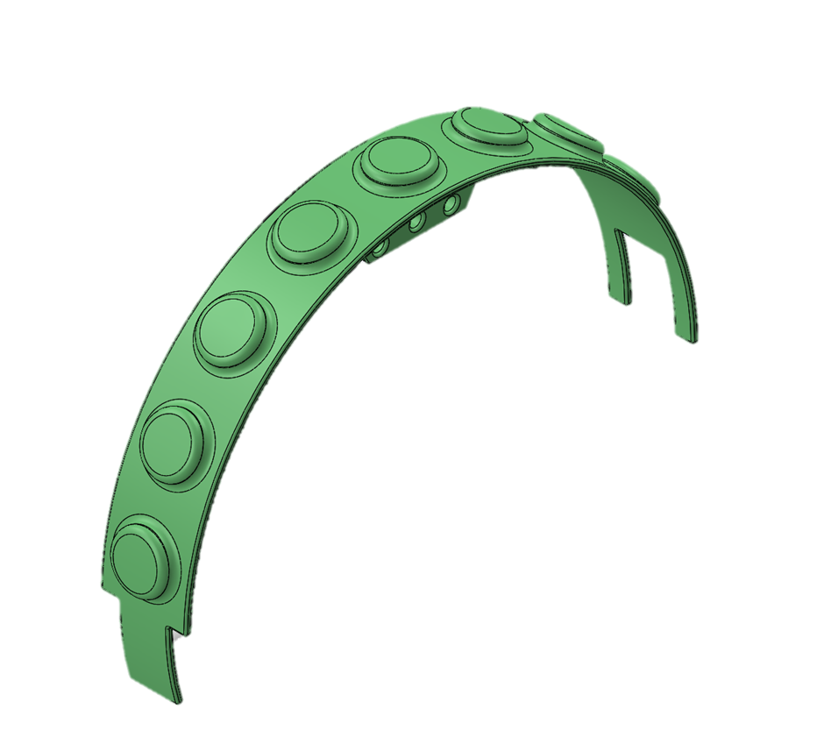
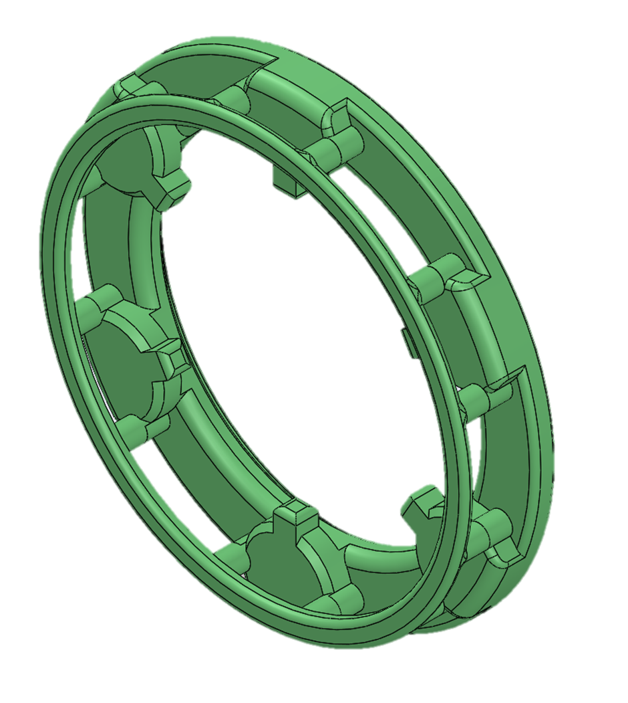
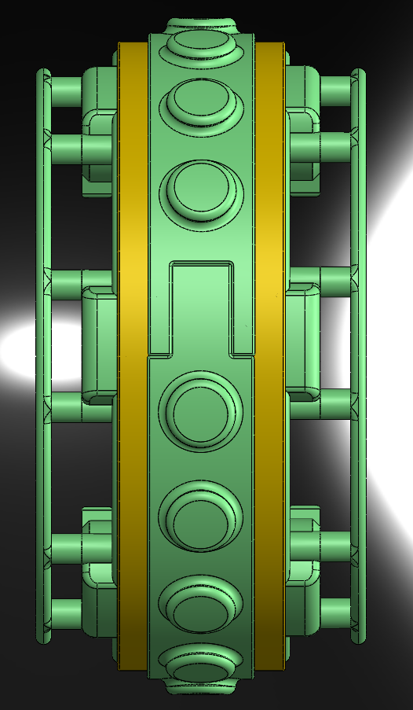
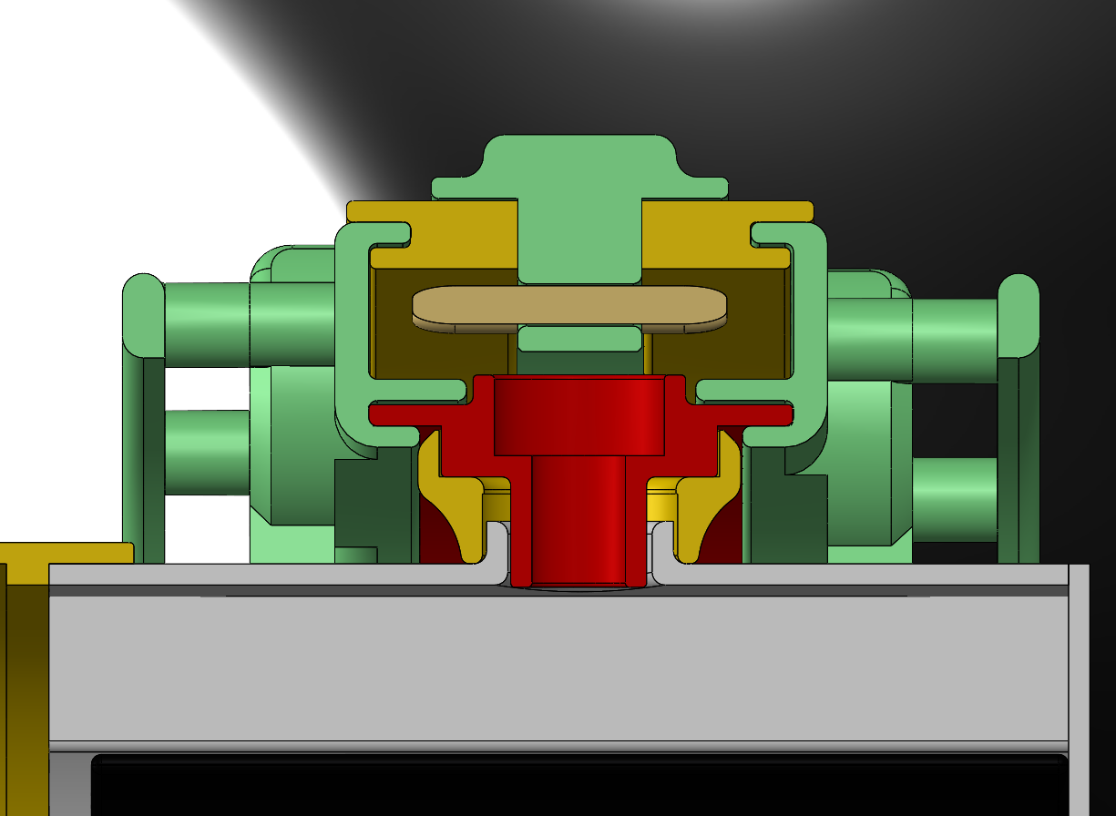
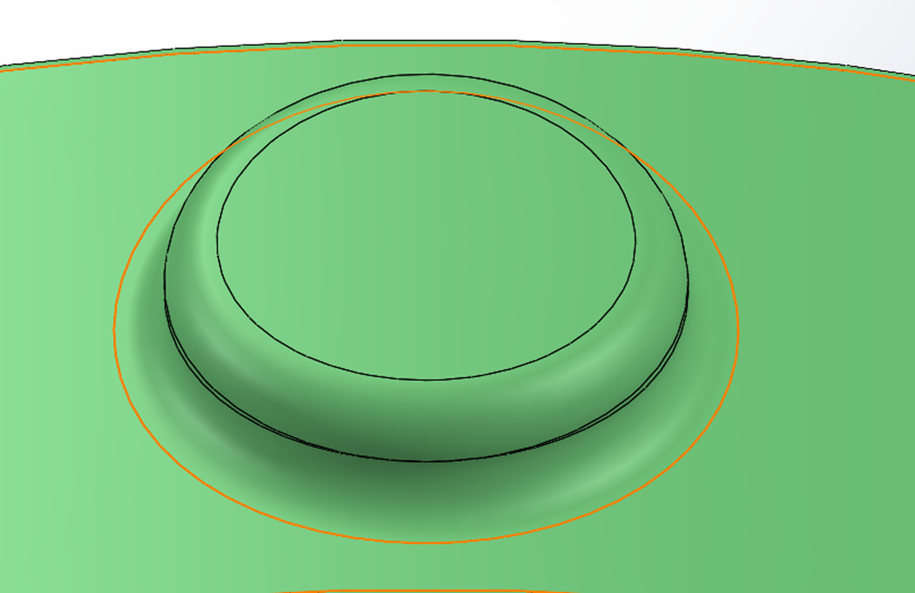
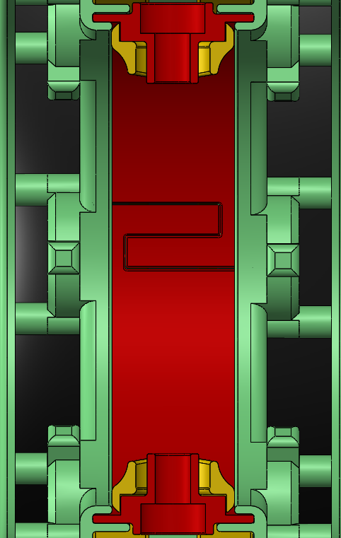
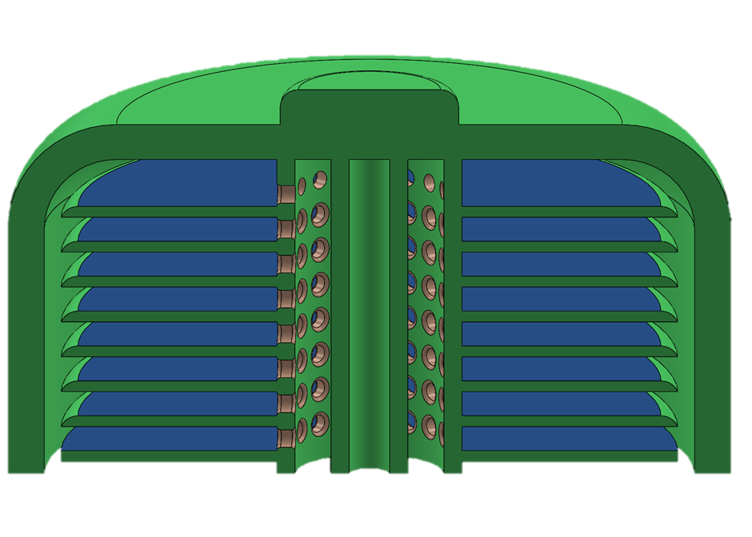
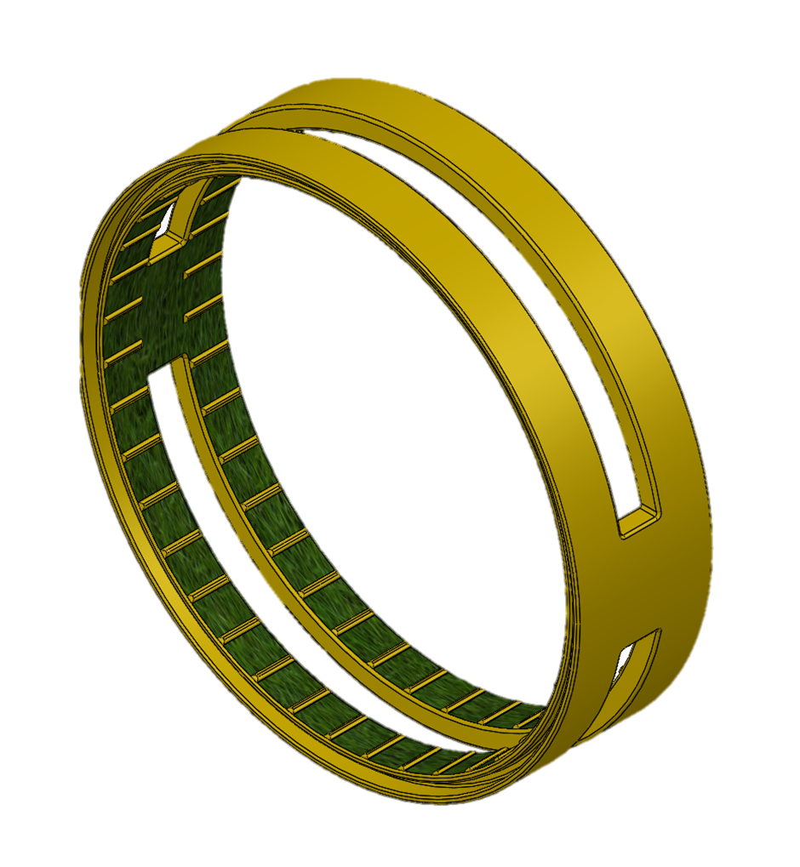
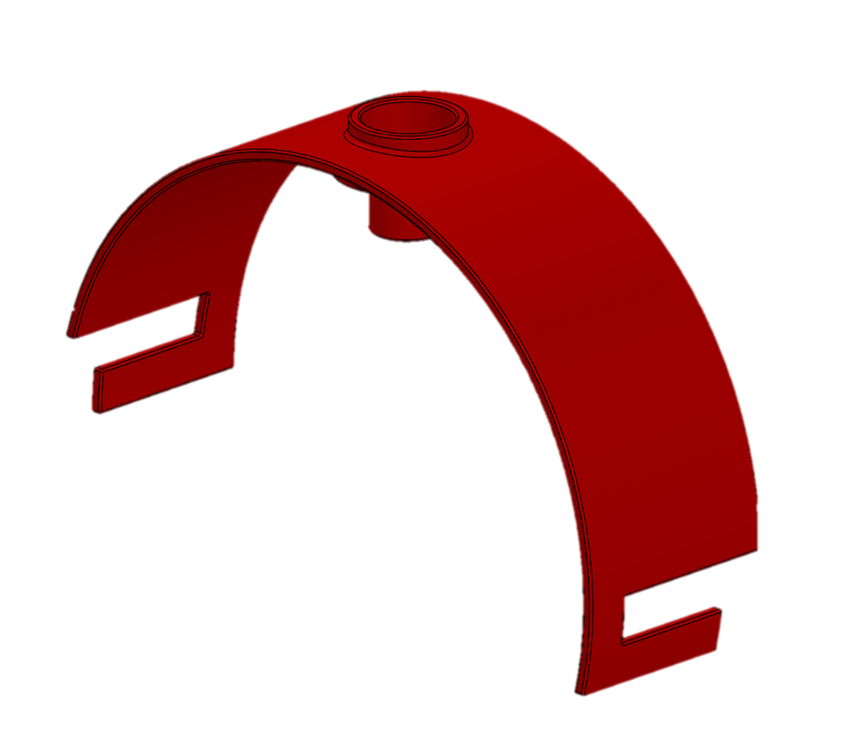
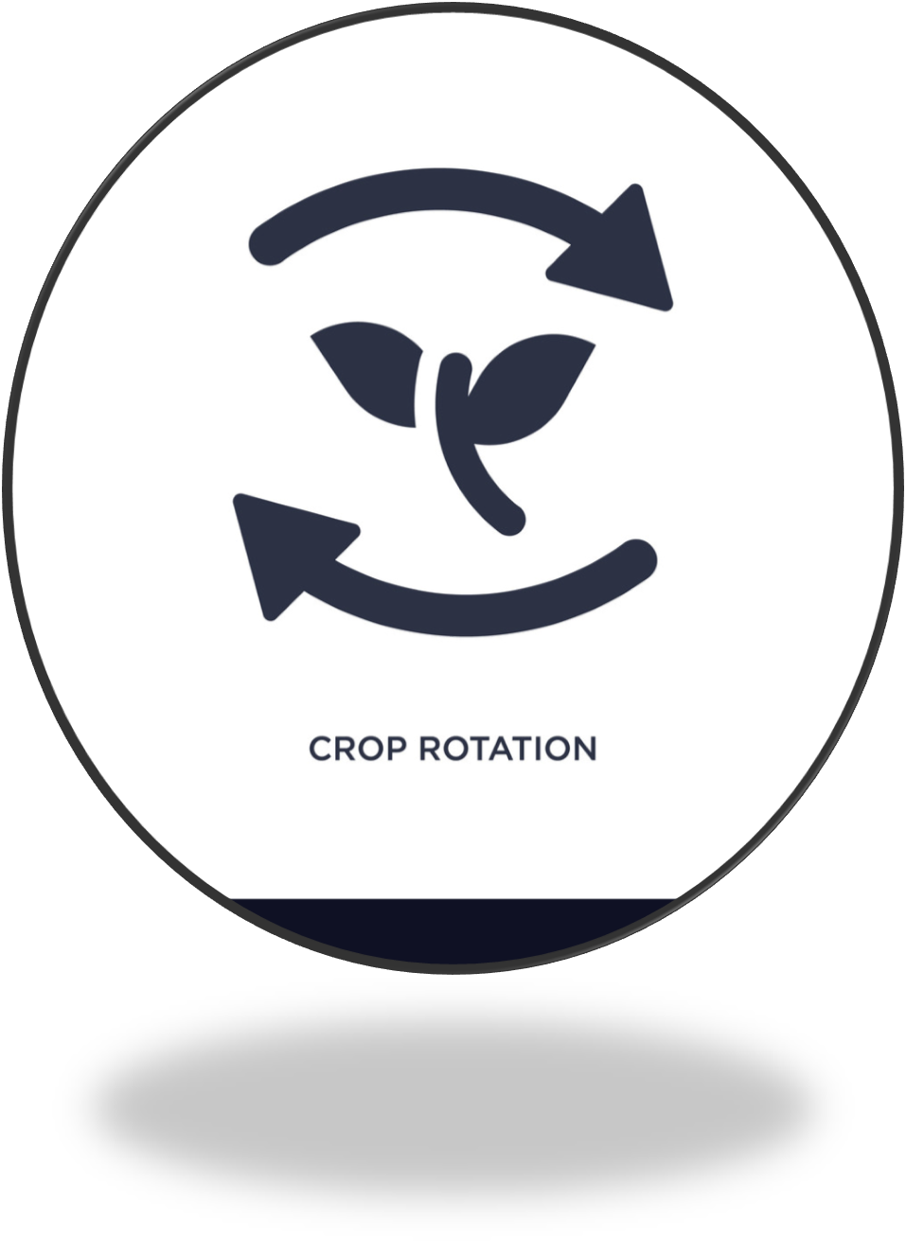


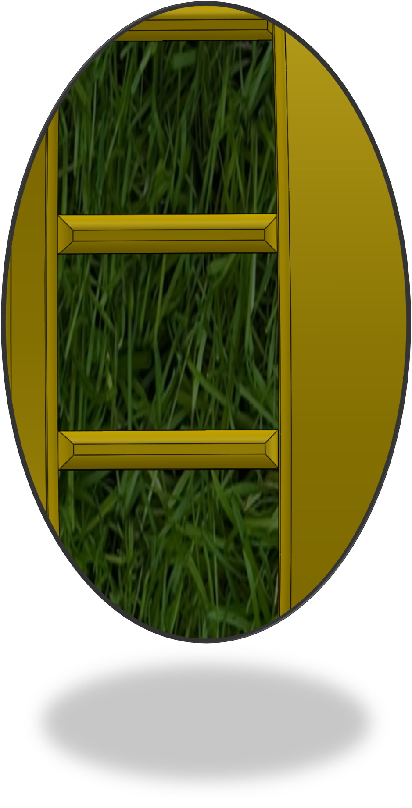
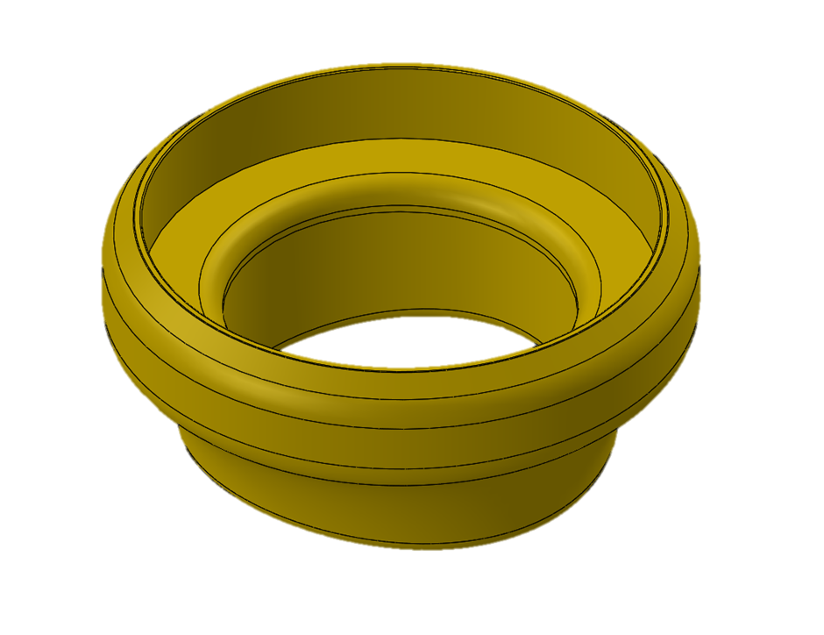



Slide 13
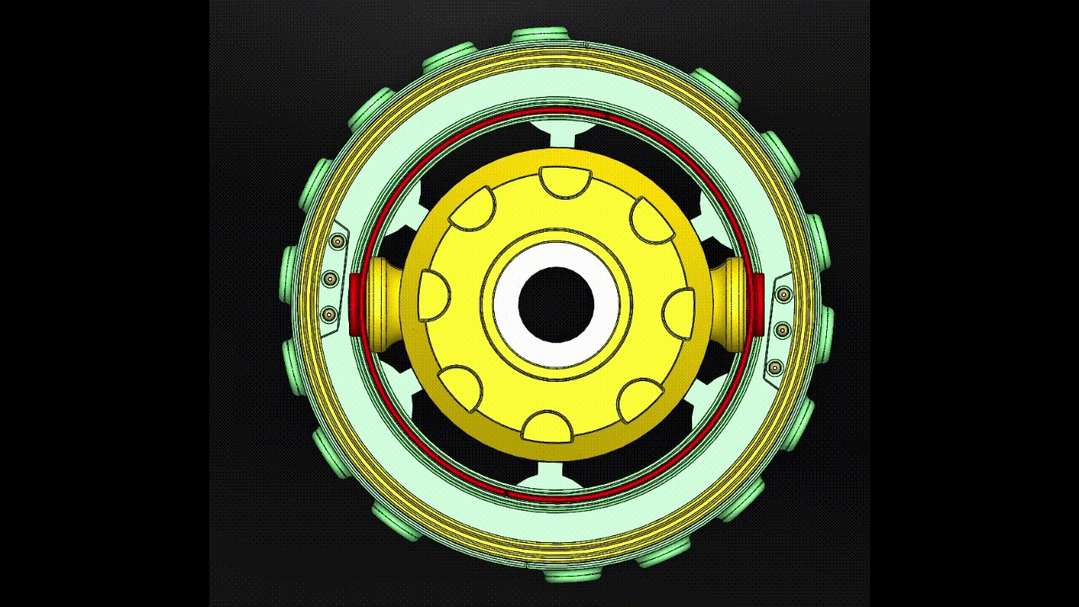
Notes:
• Image and annotations impact (1 mark)

Slide 14
