Slide 1
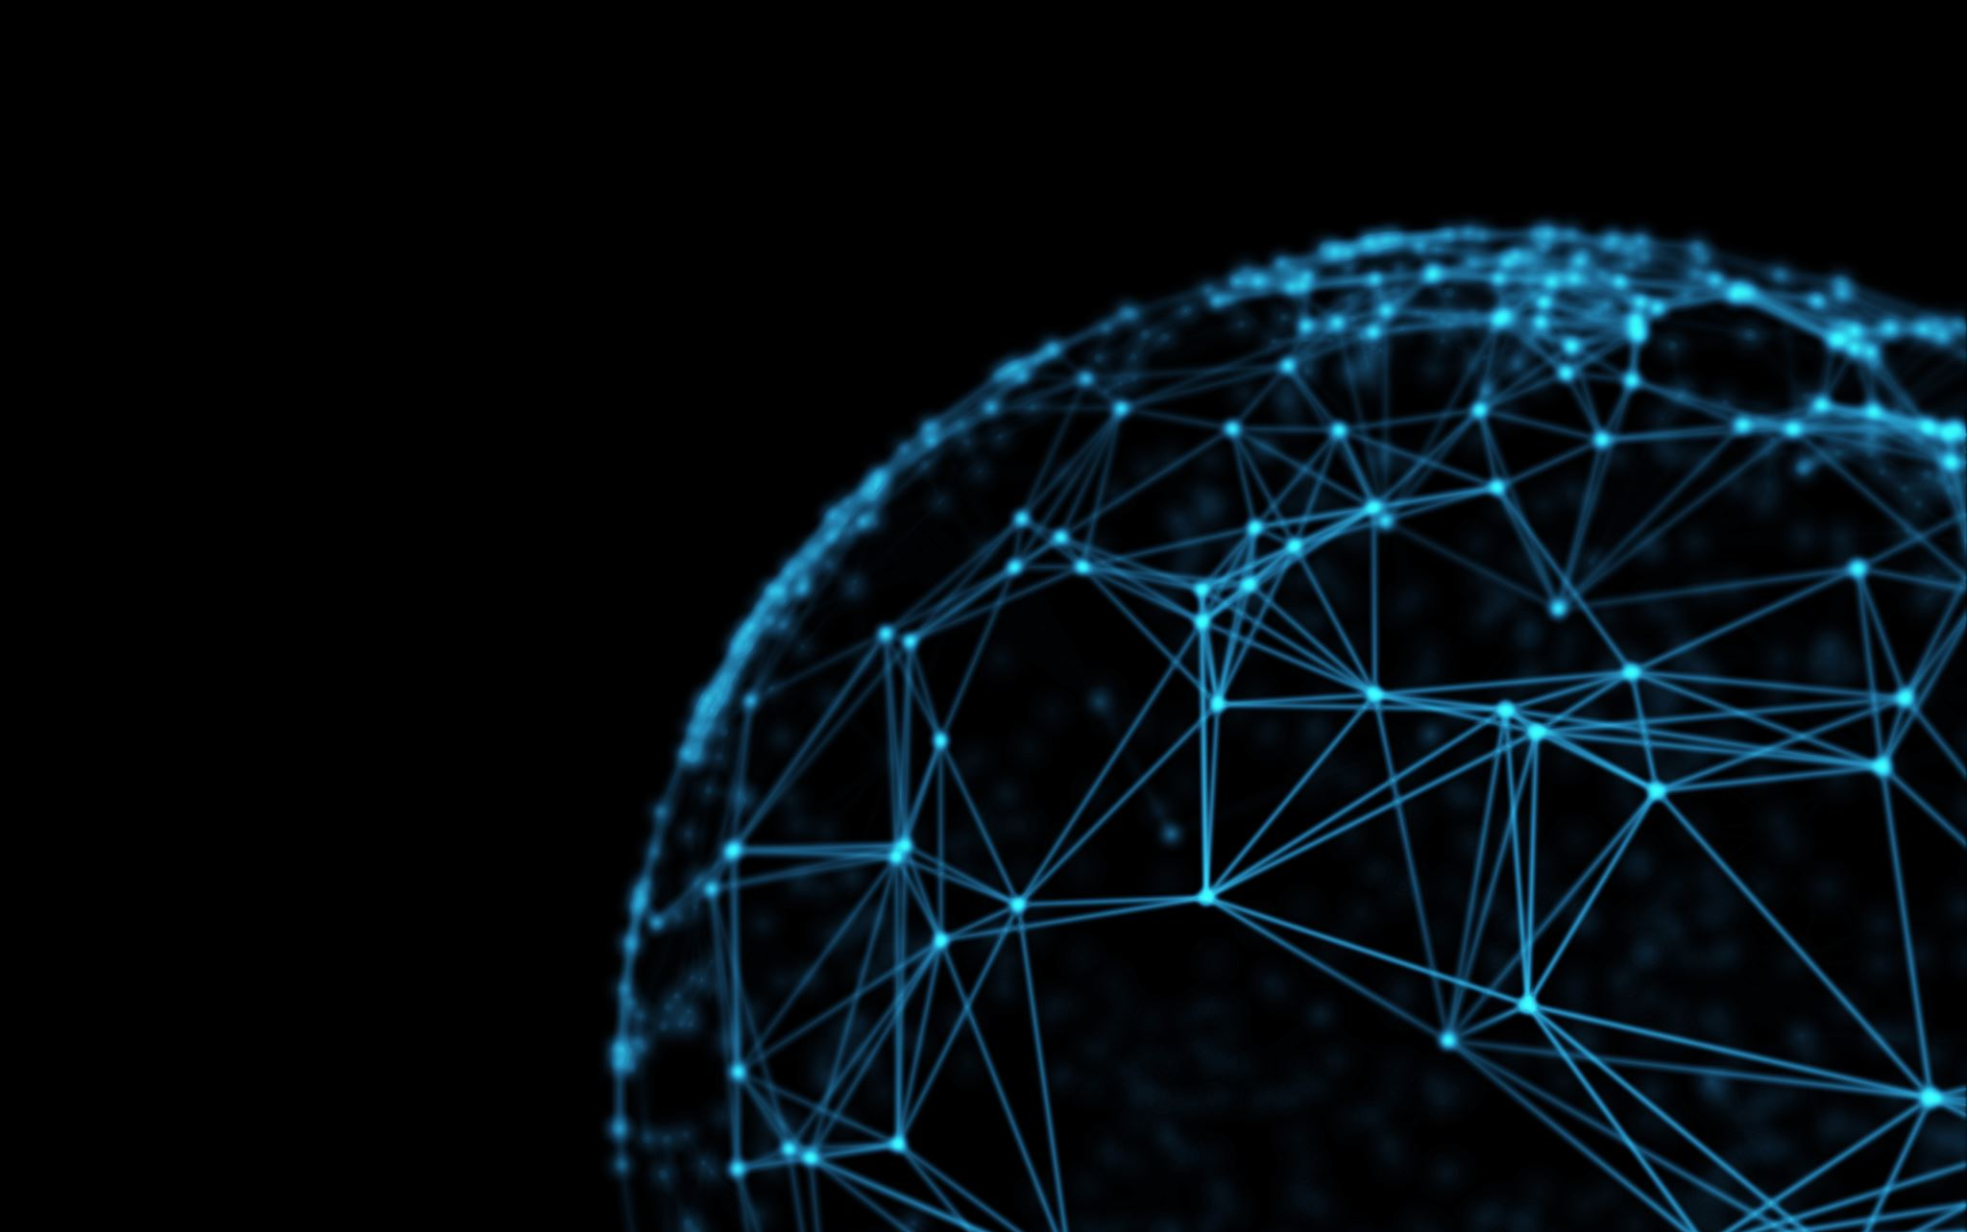
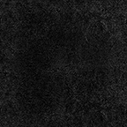
Continuous-Layered Dense Artificial Neural Networks
Eylon Caplan and Dr. Stephen Scott
Collaboration with Dr. M. Foss and Dr. P. Radu

Slide 2
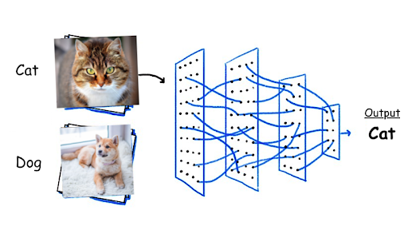
Introduction
Neural networks and machine learning
Powerful in medicine, email filtering, speech recognition, and computer vision

Slide 3
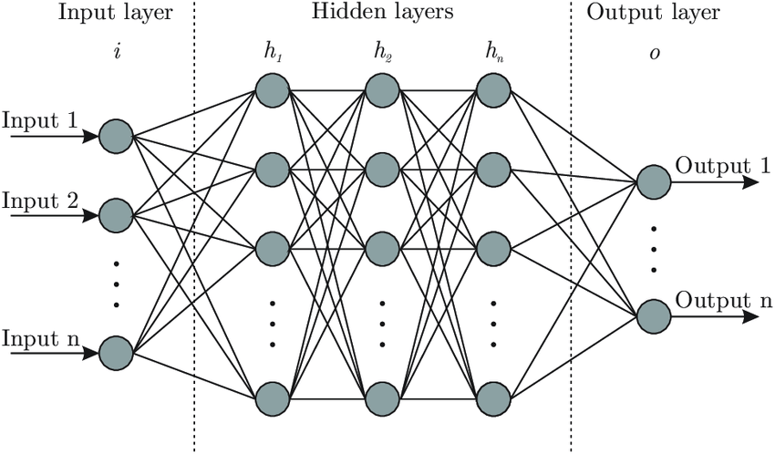
Conventional Neural Network
Each node or ‘neuron’ connect to the previous layer’s nodes
Error from target output is used to adjust parameters

Slide 4
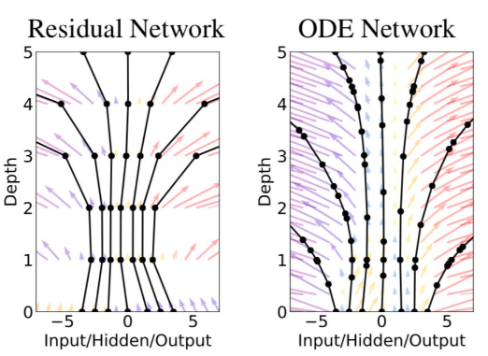
ODE Neural Network
(R. Chen et al.) in 2018
Ordinary differential equations
Discrete vs. continuous
Memory efficiency, scalability

Slide 5
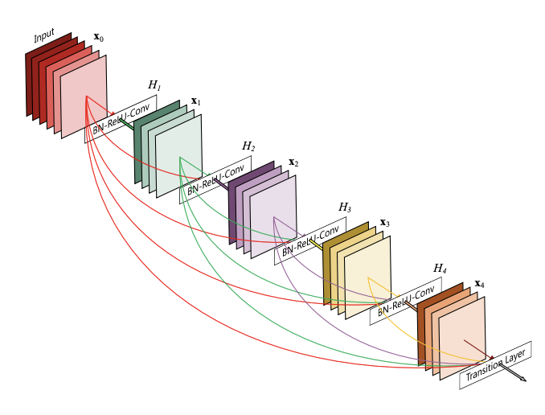
DenseNet
(G. Huang et al.) in 2016
Fewer parameters with similar accuracy
Promotes sharing of data between layers
Allows for neat implementation of integral equation

Slide 6
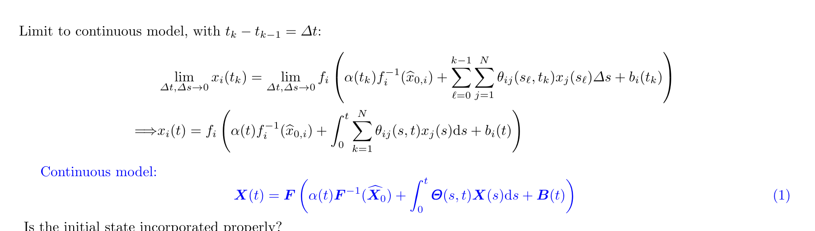
Dense, IE Architecture
Drs. Foss and Radu’s formulation
Preliminary implementation
Using TensorFlow and tensors

Slide 7
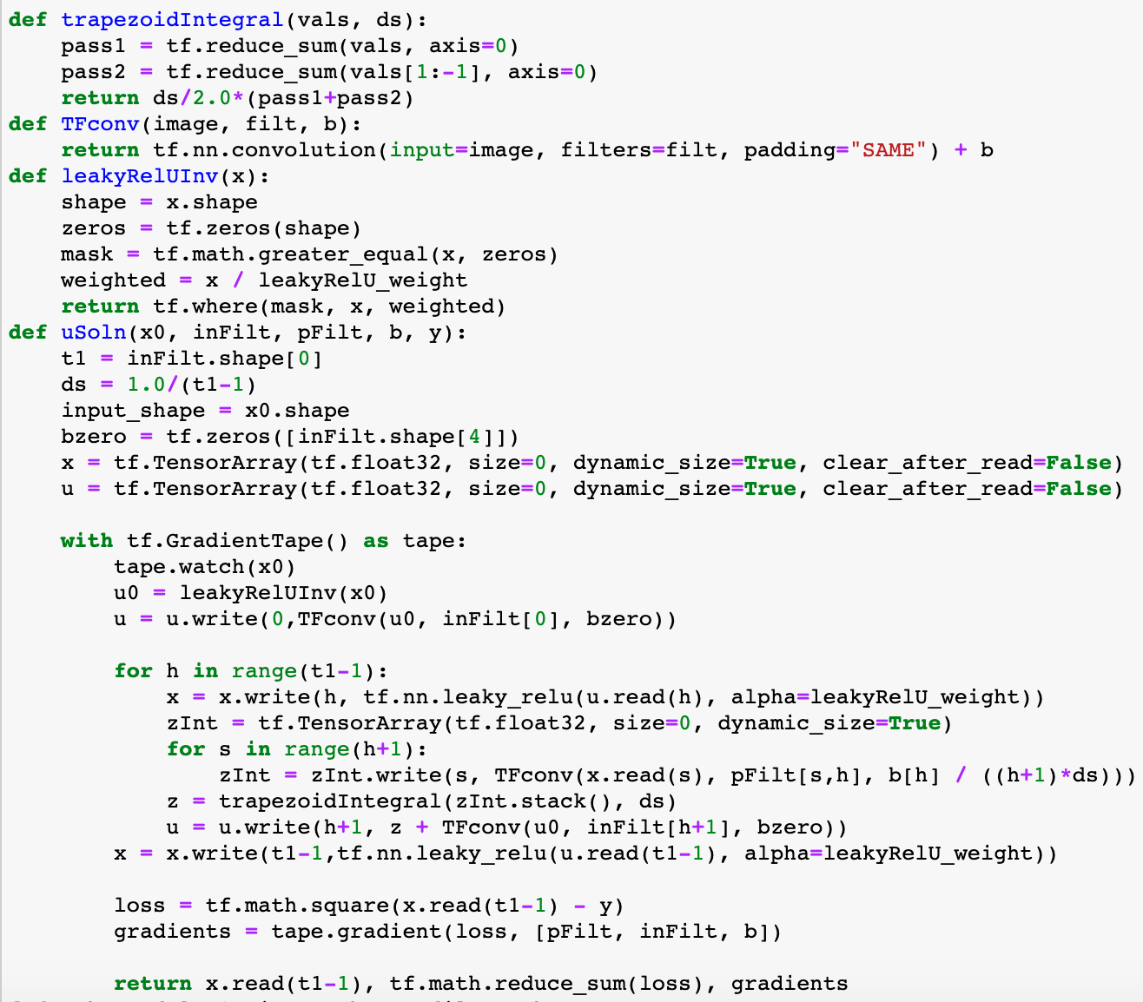
TensorFlow Implementation
About 40 lines of code
Automatic differentiation and gradient descent
Integral computed using trapezoidal rule
GPU capable

Slide 8
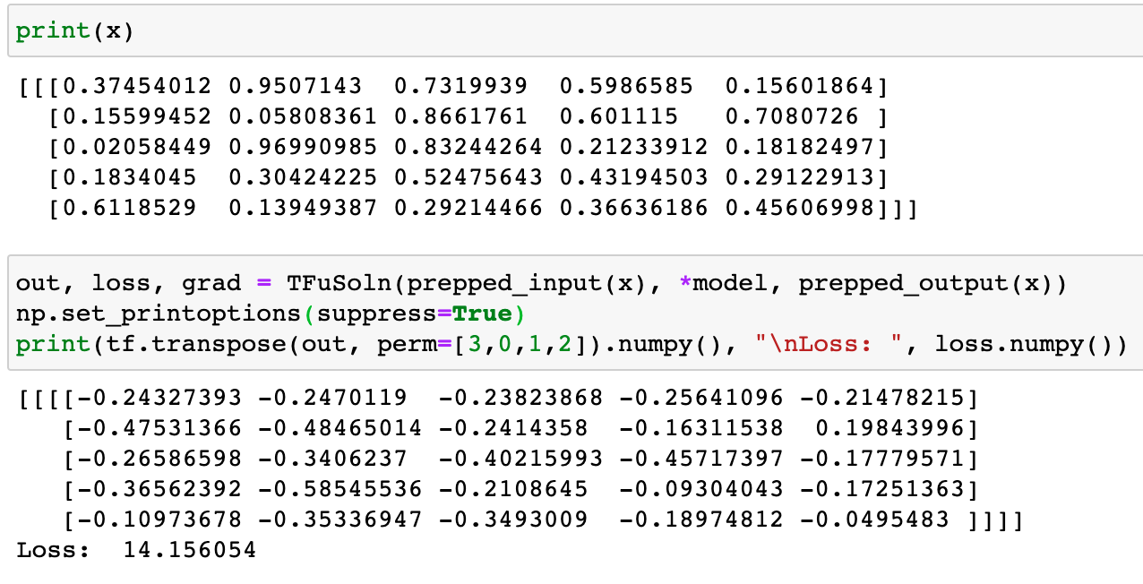
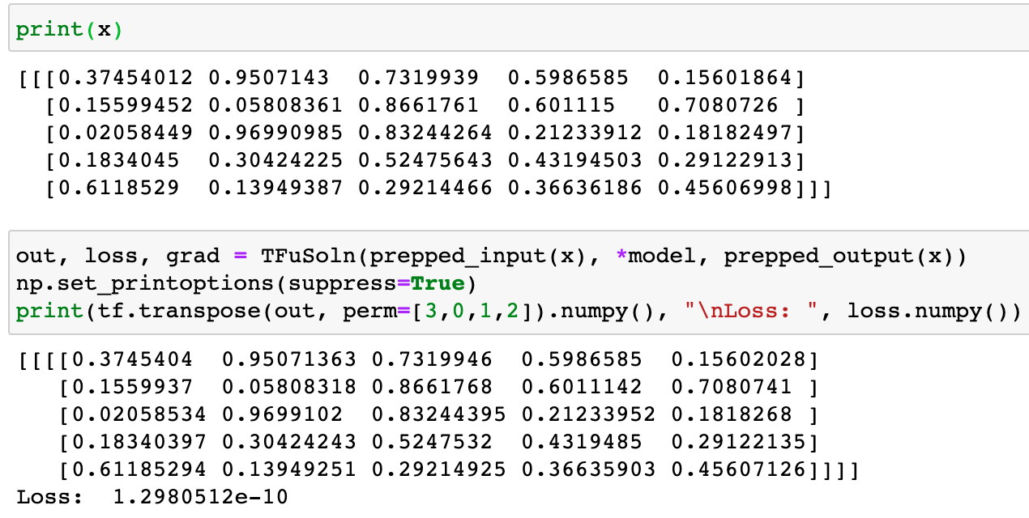
Example: Train to output the input
First feed forward through network: input and output are very different
Feed forward after 1000 training iterations: input and output are very similar

Slide 9
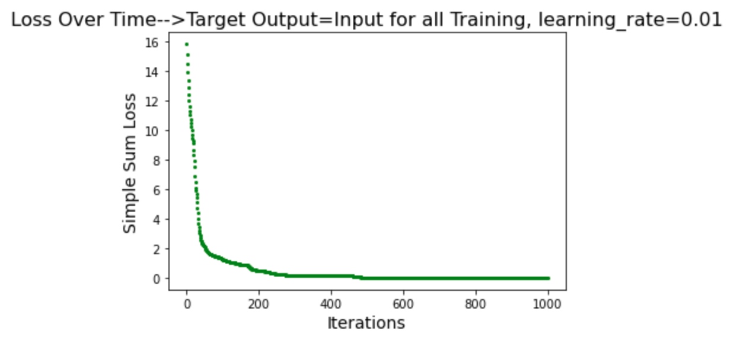
Example cont.

Slide 10
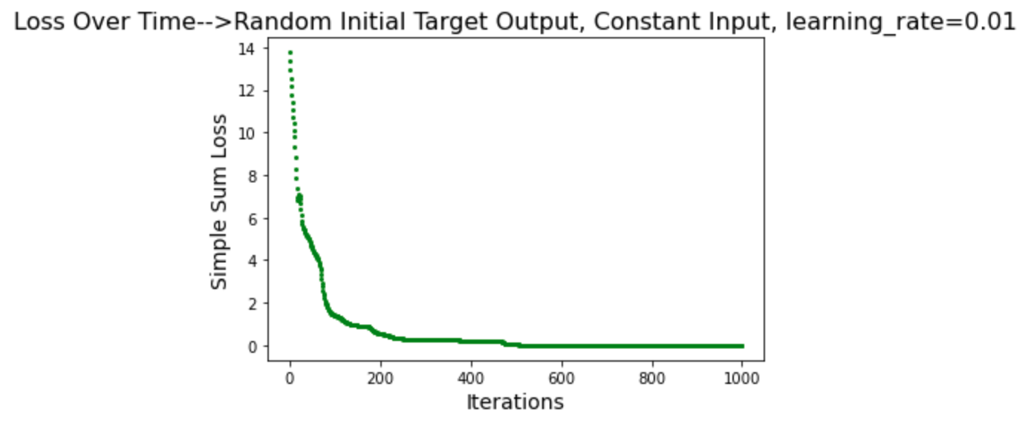
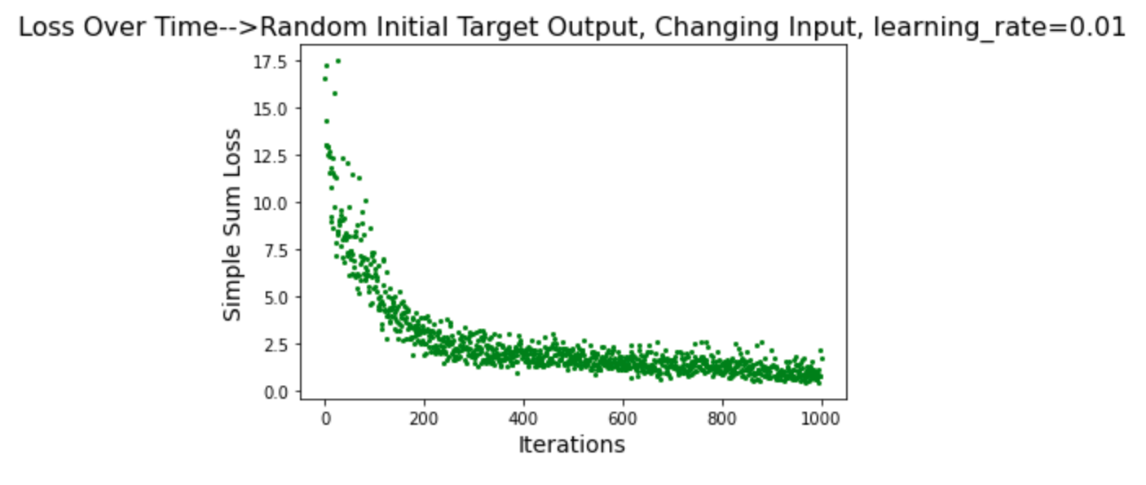
Other examples
Random initial target output with random initial input that is constant over iterations
Random initial target output with new random input each iteration

Slide 11
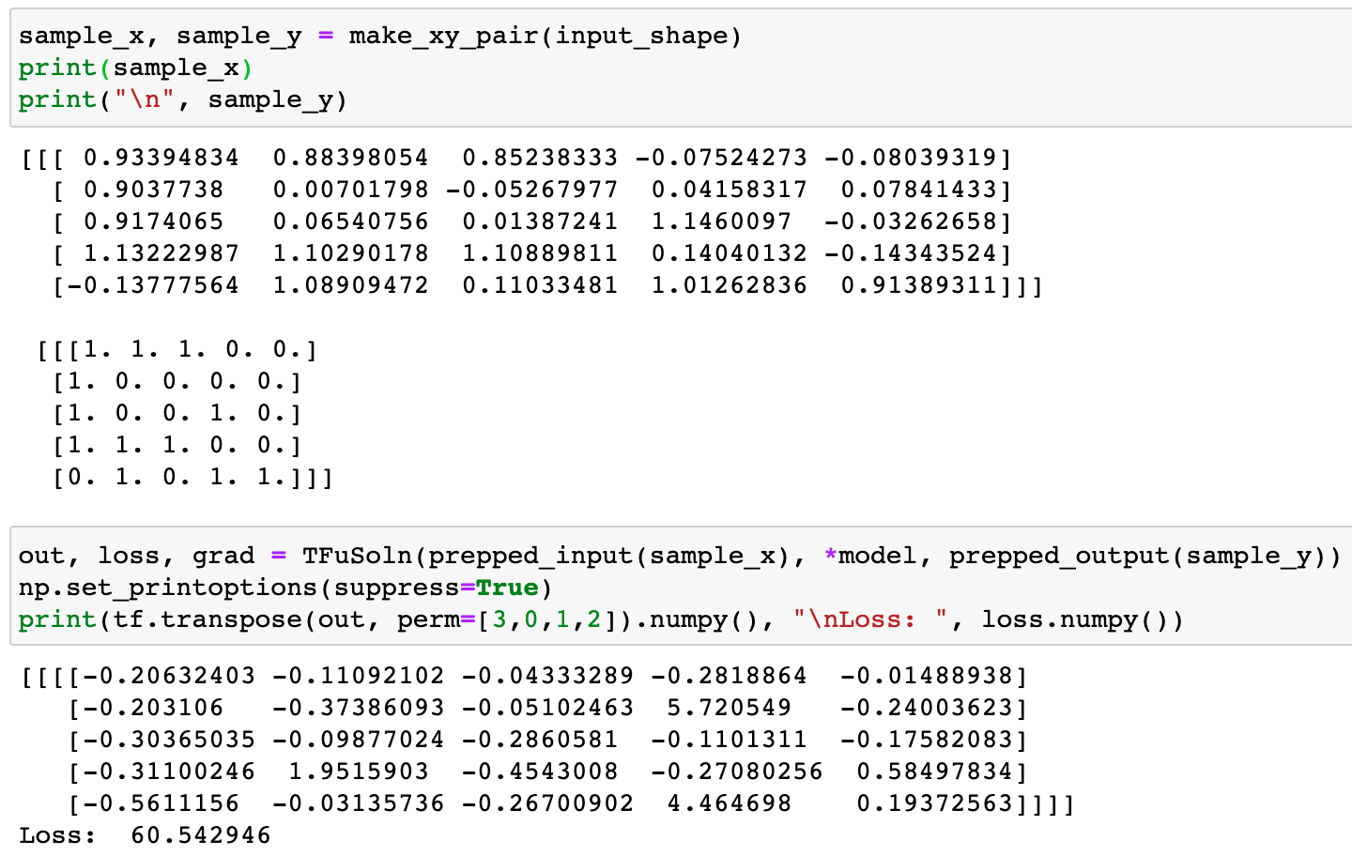
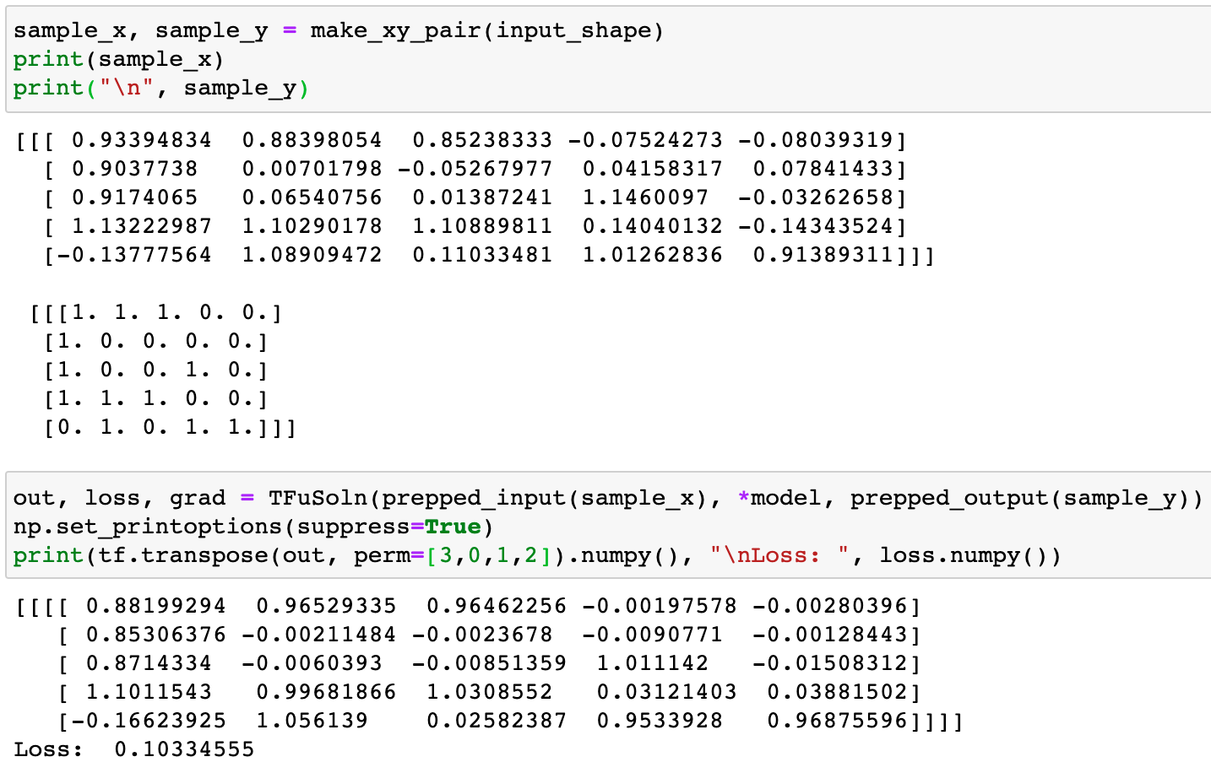
Noise Correction
noisy input
target output
First feed forward through network: output is noisier than the input
Feed forward after 10,000 iterations: output is closer to 1’s and 0’s than input

Slide 12
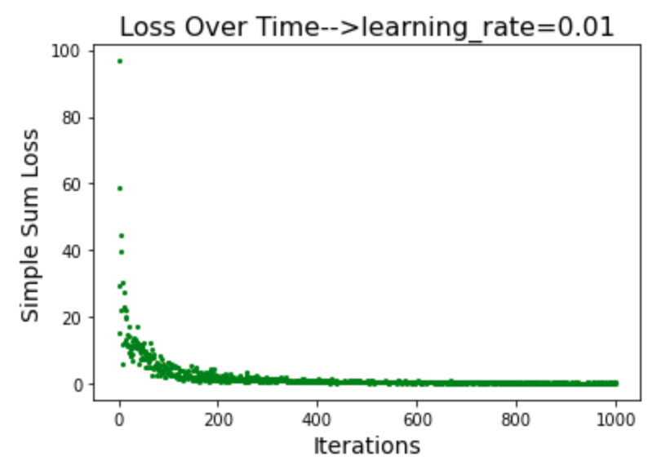
Noise Correction cont.
Noise correction loss after each iteration with ‘depth’ set to 5

Slide 13
Conclusion and Future Directions
Small implementation shows promise
Loss is reduced, gradient is backpropagating, simple problems can be solved
Use in TensorFlow allows for GPU use
Much work to be done to determine strengths/weaknesses, parameter size, depth, scalability, and hyperparameter tuning
Benchmark testing
Comparison on sets such as MNIST with current neural networks
Implementation of other integral solvers

Slide 14
Acknowledgements
Dr. Stephen Scott
Dr. Mikil Foss, Dr. Petronela Radu
UCARE Undergraduate Research

Slide 15
References
https://github.com/eyloncaplan/ucare-summer2021
http://www.aidemands.com/which-is-better-for-image-classification-supervised-or-unsupervised-classification/
https://arxiv.org/pdf/1806.07366.pdf
https://arxiv.org/pdf/1608.06993.pdf

