Slide 1


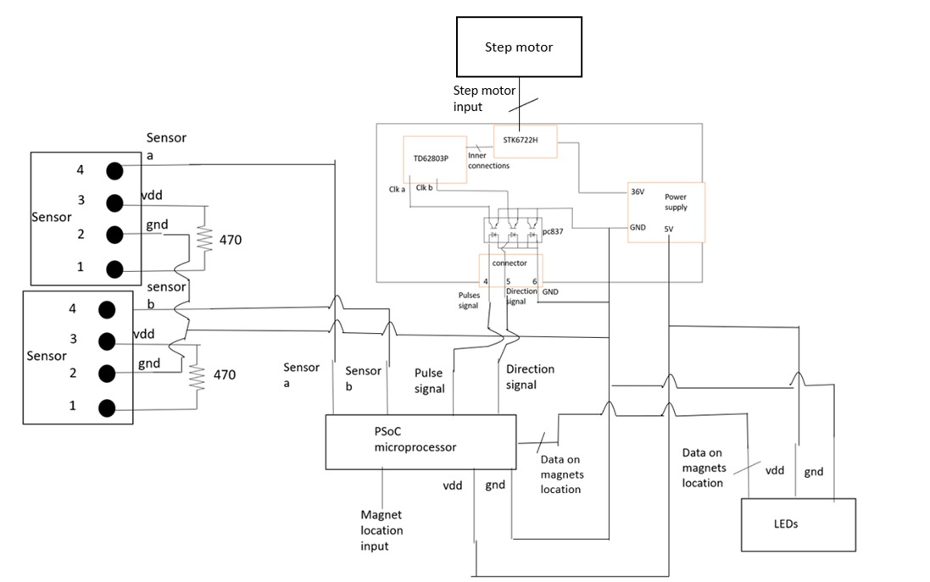
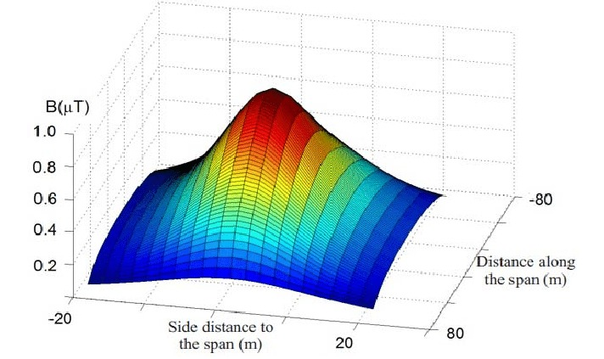
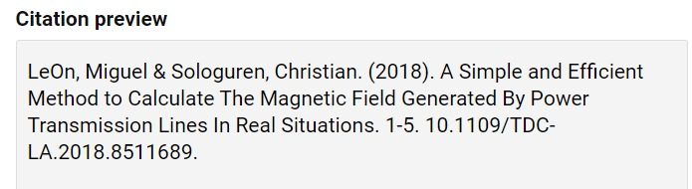
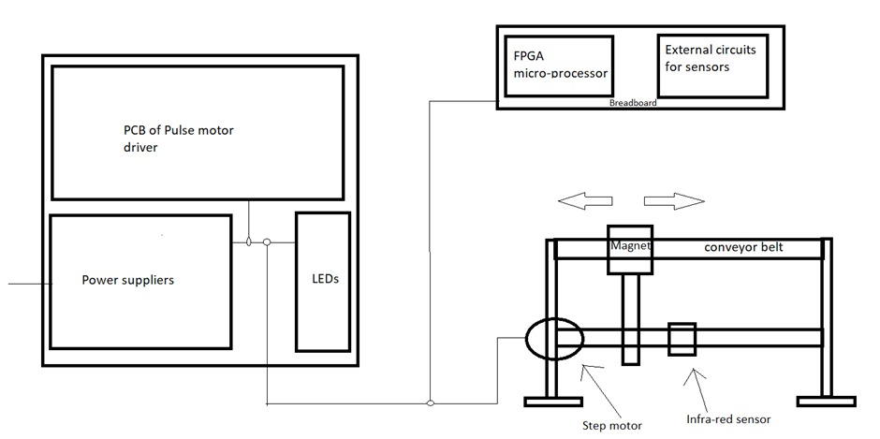
p-2022-048
Faculty of Engineering Sciences
Department of Electrical & Computer Engineering
Computerized drive for permanent magnets in a spectroscopic setup
Raam Kavod, Eylon Kapel
Advisor: Dr. Ilan Shalish
Introduction
Design of an ARM microcontroller-based system for moving permanent magnets in a spectroscopic measurement setup. The design will include driving step motors, reading position sensors, providing local control from controller box with a local display and indicators as remote control from a computer using a LabView program.
Goal
Classic approaches
Conclusions
Problem/Motivation
difficulties

