Slide 1

Computerized drive for permanent
magnets in a spectroscopic setup
Project number: p-2022-048 Students' names: Raam Kavod, Eylon Kapel Advisor: Dr Ilan Shalish

Slide 2
Introduction
In the future, we may not be able to solve any problem with Silicon, therefore, there is motivation to research alternative materials, it requires using a set-up that allows control over several independent variables, including an on-off control over a magnetic field.
The purpose of this project is to enable computerized control of such measurement conditions.

Slide 3
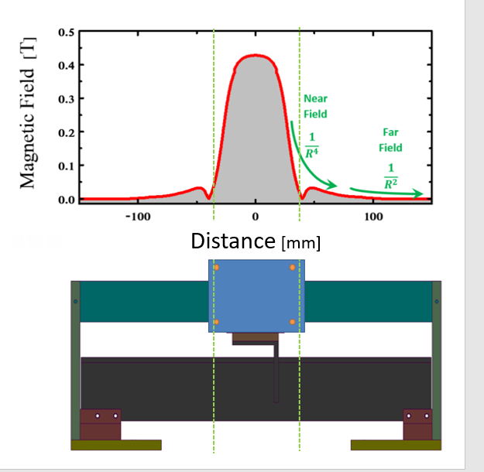
Technical objectives
Moving a magnet between two locations over a conveyor belt which affects the magnetic field’s strength:
Several modes to control the movement
Controlled by a remote software
Controlled by the user moving a switch
Design and implement a robust system

Slide 4
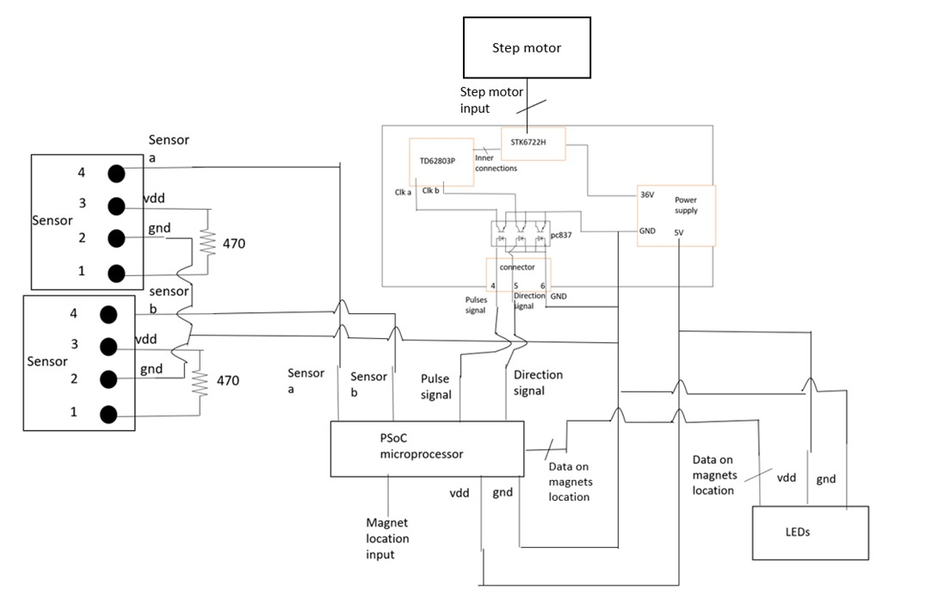
The system
Logical System
A system which is built from multiple electrical components
Stepper Motor – A device which converts electrical signals to mechanical movements.
PSoC (Programmable system on a chip) – A microcontroller that is programmed with schematic design & C code according to a PSoC Creator software, and as a result converts basic input signals to information that can be processed by the system’s electrical components.
Motor driver - A PCB that converts signals from the microcontroller to the Stepper Motor.
Sensors – Optical sensors which indicates the position of the magnet on the conveyor belt as input to the microcontroller.
LEDs – Indicates the position of the magnet as output feedback for the user.
1
1
2
3
4
3
4
PSoC microcontroller
2
5
5

Slide 5
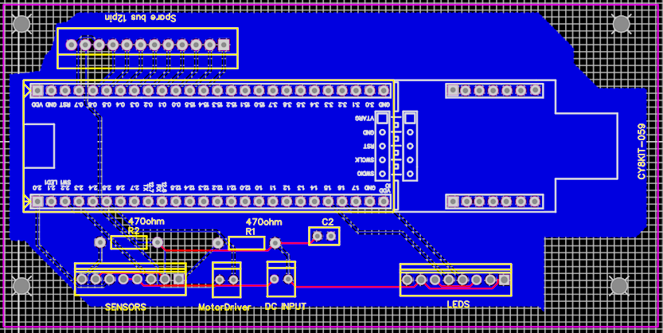
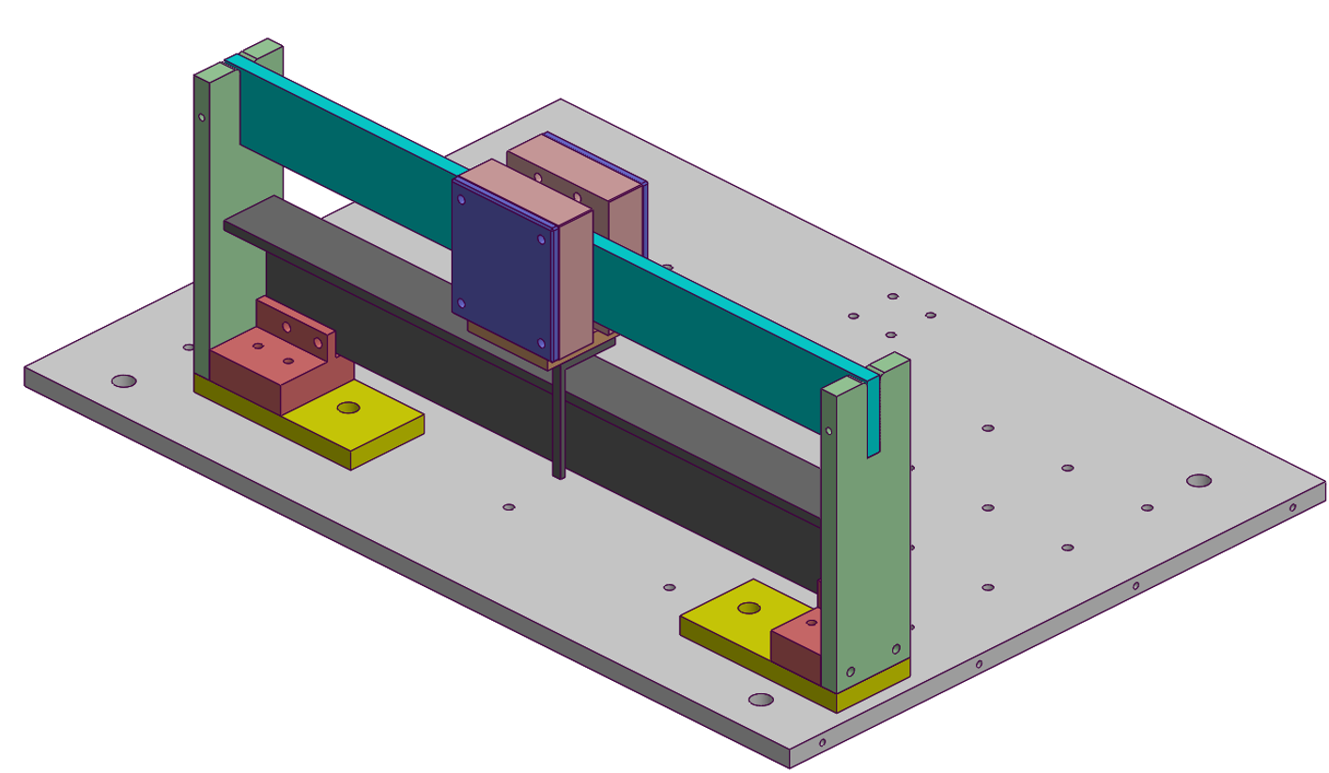
The system cont.
Printed Circuit Board
An electrical board which integrates the microcontroller and its peripheral circuit that contains DC power supply, Motor Driver, LEDs, Optical sensors and passive components.
Mechanical System
A magnet that is connected to a conveyor belt. The system is nailed to its surface to reduce physical disturbances and movements.

Slide 6
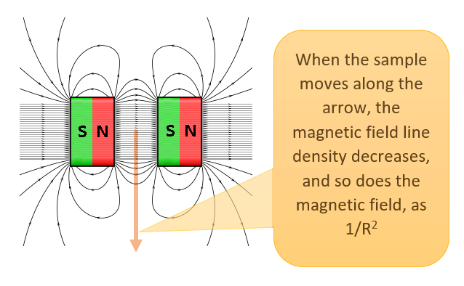
Main measurement
Magnetic field measurement
The experiment included measurements of the magnetic field by a Magnometer. We measured over the length of the conveyor belt in each step of the Stepper Motor.
Afterwards, we converted the motor steps to distance in millimeters.
The results agrees with our expectations, the magnetic field decreases at such a rate that at the edge of the conveyor belt the magnetic field’s strength is negligible.

Slide 7
Difficulties and solutions
Dual supplier input problem
There are two ways to supply voltage to the microcontroller, through USB connection to a PC and through an external source, but not together, this is to prevent short circuit between two suppliers.
The external source is the preferred way to supply power to the microcontroller in order to avoid the need to keep the USB always connected, but we need the USB to program the microcontroller. This is a problem since the PCB we designed does not connect between the microcontroller DC input and the external source.
There is a chip that transfers DC supply from the USB (PC) through a diode (D1). In order to prevent short circuit and solve the design problem, we disconnected the diode and soldered VDD and GND underneath the PCB between the DC input of the board to the DC input of the microcontroller, so the microcontroller will only receive voltage from the external power supply even while programming the microcontroller through USB.

Slide 8
Difficulties and solutions cont.
Override switch and spare bus.
In the initial design of the PCB, we created a spare bus connection to the microcontroller GPIOs* and DC input in case of possible changes.
After we designed and printed the PCB, we decided that another component is needed, a switch that can override the software and move the magnet on-off the sample. We used the spare bus GPIOs to integrate the override switch to the system.
GPIO* = General purpose input output

Slide 9

Summary
Currently we achieved the following
A system that fulfills the base conditions (moving the magnet on-off the sample)
The system is robust – designed and printed a PCB and suitable connectors
Added peripheral parts such as LEDs and a switch
In comparison to the original plans
We didn’t integrate the system with Labview – still can’t control the magnet’s position by software in real time
We added a component that initially wasn’t planned – an override switch for multiple modes of moving the magnet

