Slide 1
Computerized drive for permanent magnets in a spectroscopic setup
Project number: p-2022-048 Students names: Raam Kavod, Eylon Kapel Advisor: Dr Ilan Shalish

Slide 2
PUT A VIDEO HERE

Slide 3
Intruduction:
In the future, we may not be able to solve any problem with Silicon, therefore there is motivation to research alternative materials, it requires using a set-up that allows control over several independent variables, including an on-off control over a magnetic field.
Goal:
The purpose of this project is to enable computerized control of such measurement conditions.

Slide 4
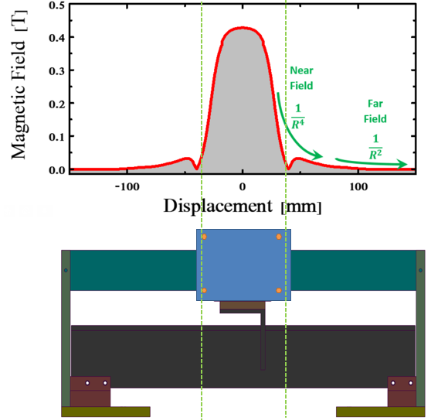
Techincal objectives:
Moving a magnet between two locations over a conveyor belt which affects the magnetic field’s strength:
Several modes to control the movement
Controlled by a remote software
Controlled by the user moving a switch
Design and implement a robust system

Slide 5
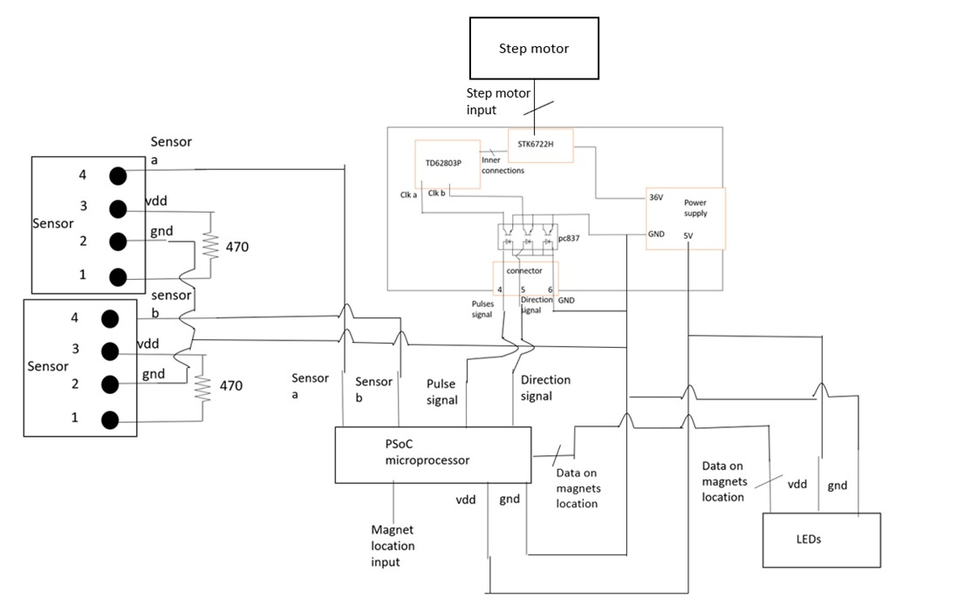
The system
1
Logical System
A system which is built from multiple electrical components
Stepper Motor – A device which converts electrical signals to mechanical movements.
PSoC (Programmable system on a chip) – A microcontroller that is programmed with schematic design & C code according to a PSoC Creator software and as a result converts basic input signals to information that can be processed by the system’s electrical components.
Motor driver - A PCB that converts signals from the microcontroller to the Stepper Motor.
Sensors – Optical sensors which indicates the position of the magnet on the conveyor belt as input to the microcontroller.
LEDs – Indicates the position of the magnet as output feedback for the user.
3
1
4
2
PSoC microcontroller
2
3
4
5
5

Slide 6
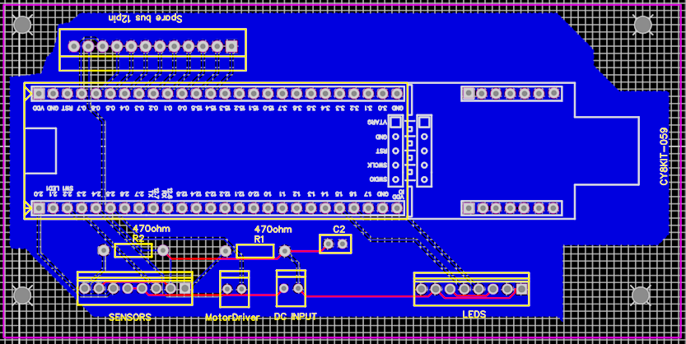
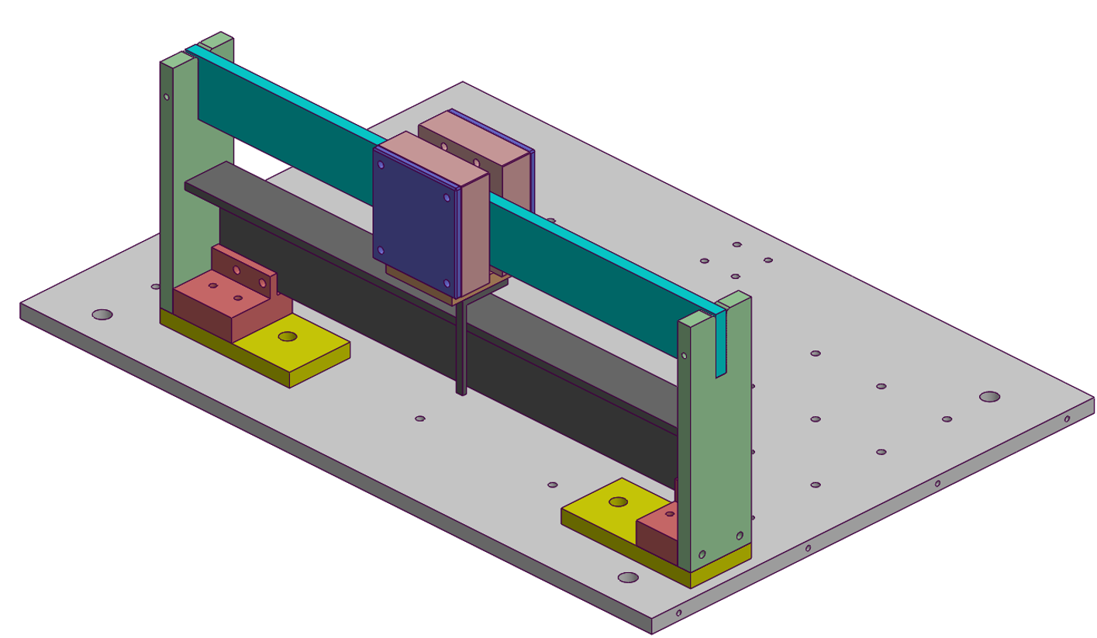
The system cont.
Printed Circuit Board
An electrical board which integrates the microcontroller and its peripheral circuit that contains DC, Motor Driver, LEDs, Optical sensors and passive components.
Mechanical System
A magnet that is connected to a conveyor belt, this system is nailed to its surface to reduce physical disturbances and movements of the system.

Slide 7
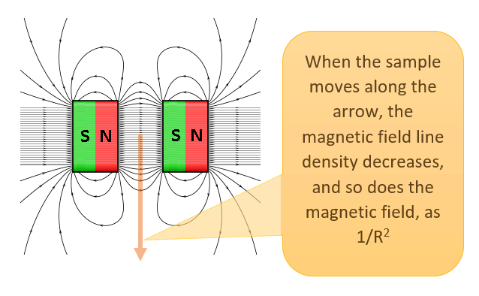
Main measurement
Magnetic field measurement
The experiment included measurements of the magnetic field by a Magnometer in each step of the Stepper Motor for the length of the conveyor belt and conversion of the motor steps to distance in millimeters.

