Slide 1


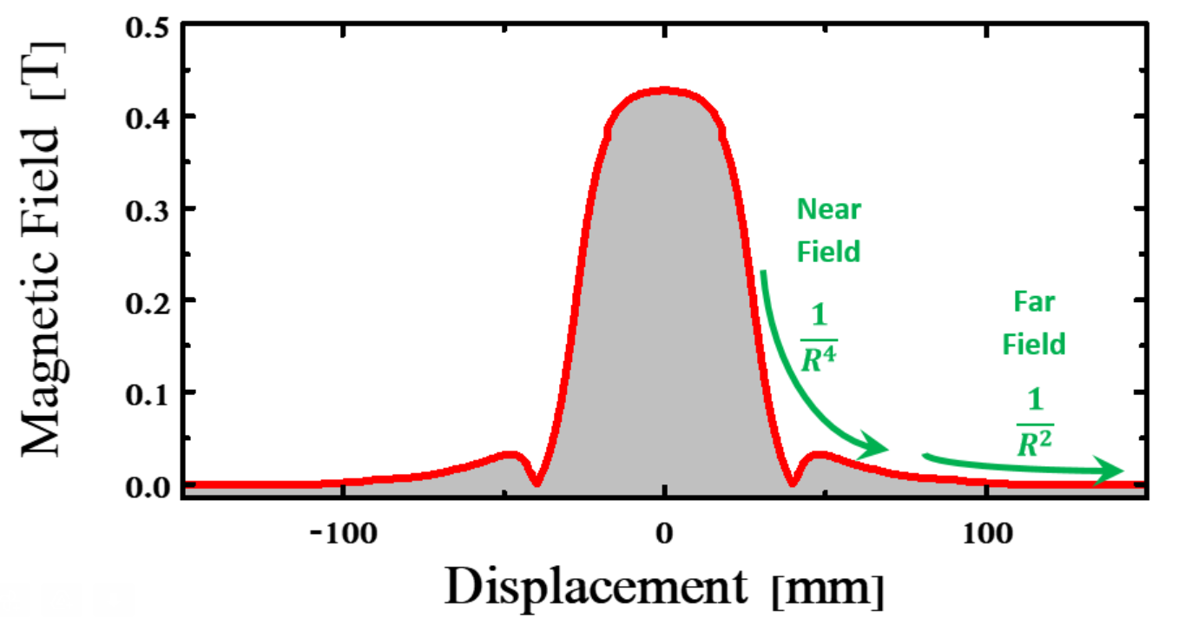
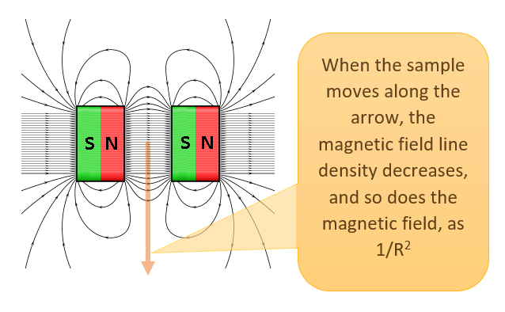

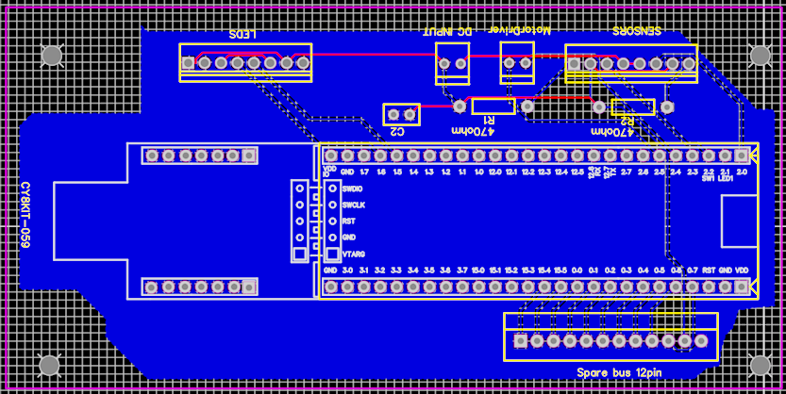
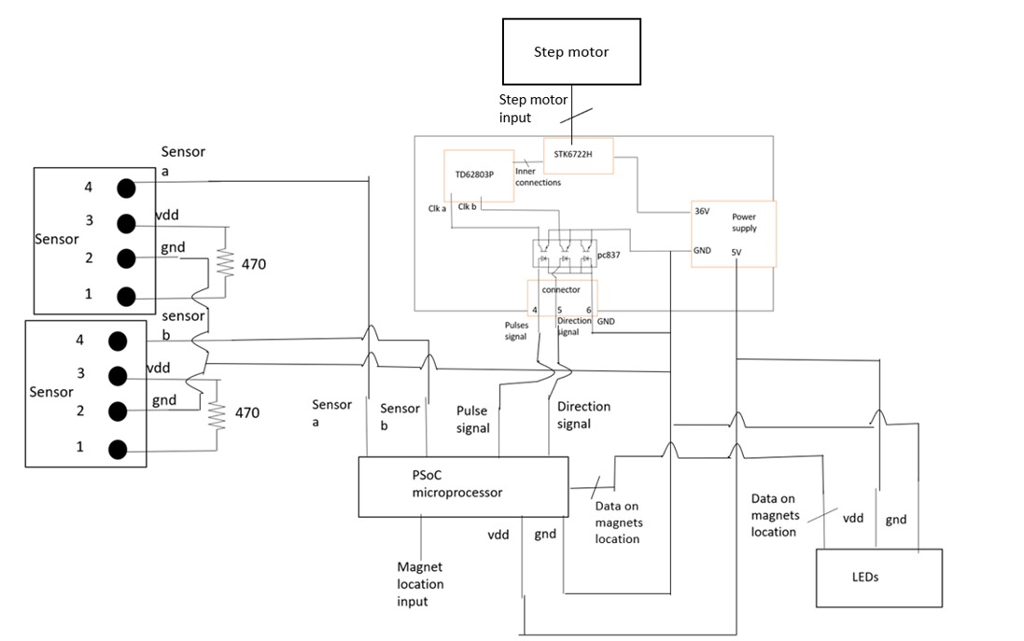
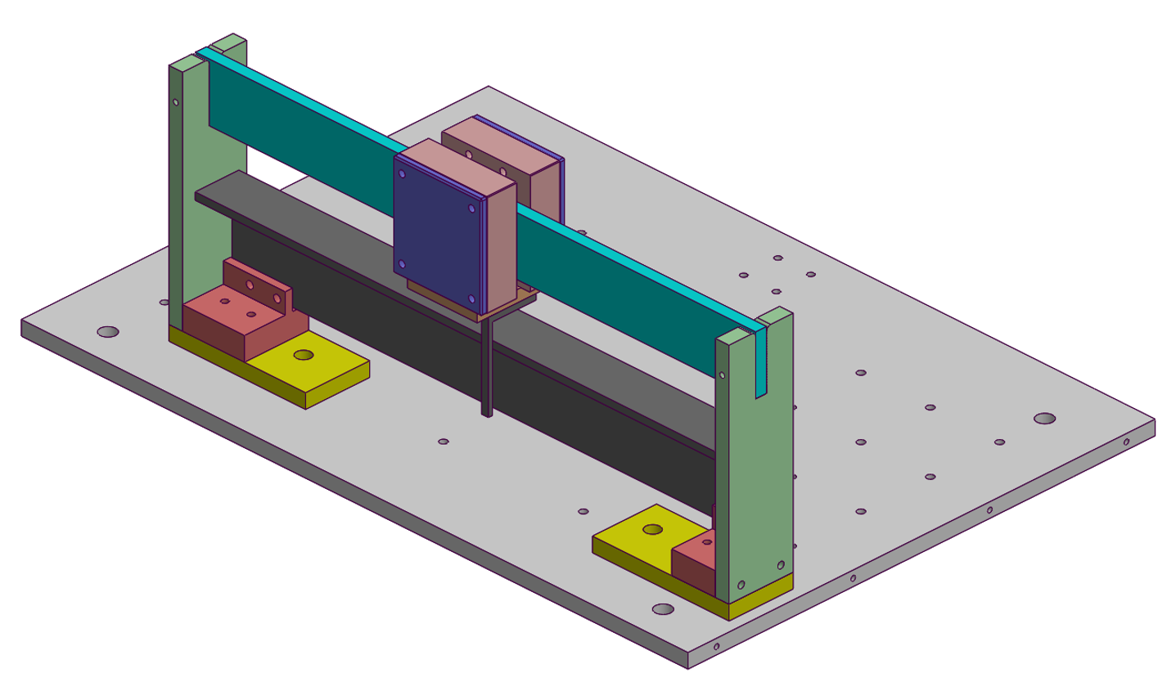
P-2022-048
Faculty of Engineering Sciences
Department of Electrical & Computer Engineering
יש למקם כאן את הברקוד
Computerized drive for permanent magnets
Kavod Raam, Kapel Eylon
Advisors: Dr. Ilan Shalish
Introduction
Design of an ARM microcontroller-based system for moving permanent magnets in a spectroscopic measurement setup. The design includes driving step motors, reading position sensors, providing local control from a controller box having a local display and panel indicators and an alternative remote control from a computer using a LabView program.
2. The Classic Approach
Use of an electromagnet - A type of magnet in which the magnetic field is produced by an electric current.
Since an electromagnet heats up due to the power it dissipates, it requires a cooling system that can satisfy those demands, which increases its complexity, in addition to its typically large size, rendering this solution expensive.
3. Goal
Build a remote-controlled system that can change a magnetic field while taking measurements inside an isolated faraday cage box without exposure to light.
4. Motivation
The motivation arises from need to research a variety of materials using a set-up that allows control over several independent variables, (in our case) including an on-off control over a magnetic field.
5. Magnetic Field as a function
of distance from source
For the first 43 mm, the probe is still between the magnet plates, therefore because it is in the
“Near field”, the magnetic field decreases like 1/R^4, better than we anticipated.
When It reaches the edges of the plates, the magnets’ magnetic fields cancel each others in a specific
area because of edge effects. Beyond that point, the field decreases like 1/R^2, perfectly suited
to our necessities.
6. Design
Printed Circuit Board
Logical
schematic
Mechanical
schematic

