Slide 1
Computerized drive for permanent magnets in a spectroscopic setup
Project number: p-2022-048 Students' names: Raam Kavod, Eylon Kapel Advisor: Dr Ilan Shalish

Slide 2
PUT A VIDEO HERE

Slide 3
Introduction:
In the future, we may not be able to solve any problem with Silicon, therefore there is motivation to research alternative materials, it requires using a set-up that allows control over several independent variables, including an on-off control over a magnetic field.
Goal:
The purpose of this project is to enable computerized control of such measurement conditions.

Slide 4
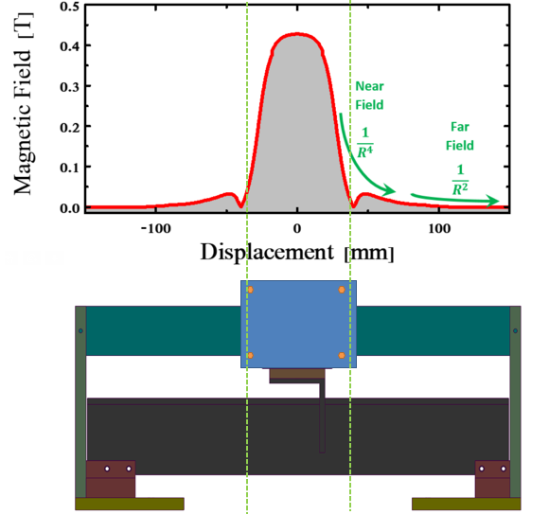
Technical objectives:
Moving a magnet between two locations over a conveyor belt which affects the magnetic field’s strength:
Several modes to control the movement
Controlled by a remote software
Controlled by the user moving a switch
Design and implement a robust system

Slide 5
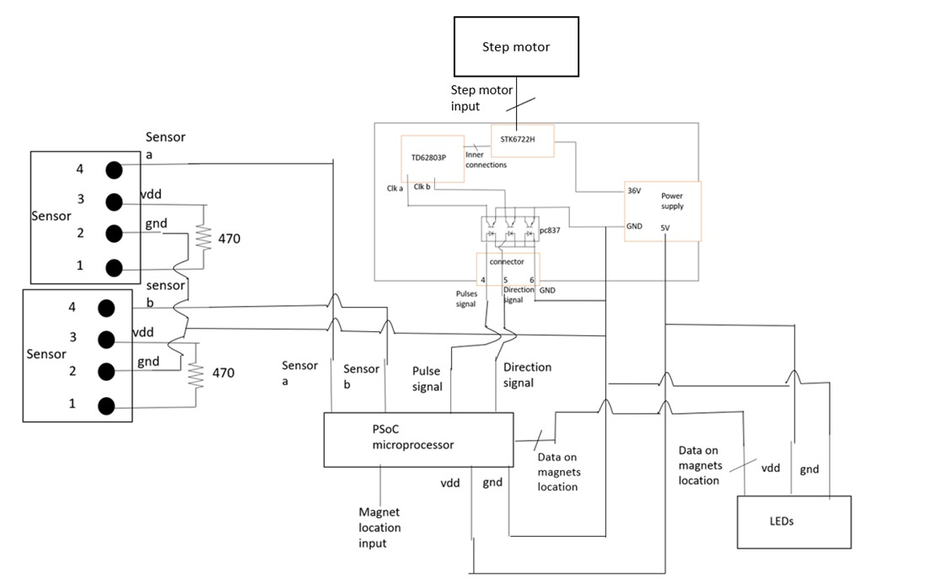
The system
1
Logical System
A system which is built from multiple electrical components
Stepper Motor – A device which converts electrical signals to mechanical movements.
PSoC (Programmable system on a chip) – A microcontroller that is programmed with schematic design & C code according to a PSoC Creator software and as a result converts basic input signals to information that can be processed by the system’s electrical components.
Motor driver - A PCB that converts signals from the microcontroller to the Stepper Motor.
Sensors – Optical sensors which indicates the position of the magnet on the conveyor belt as input to the microcontroller.
LEDs – Indicates the position of the magnet as output feedback for the user.
3
1
4
2
PSoC microcontroller
2
3
4
5
5

Slide 6
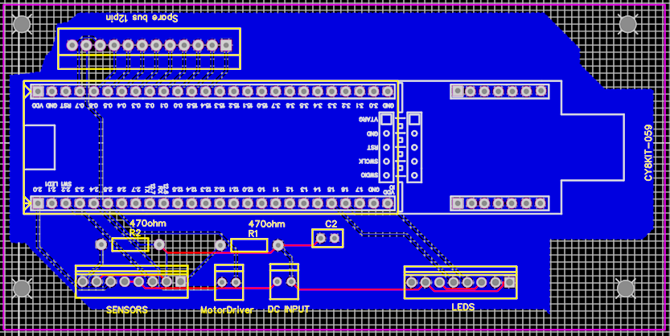
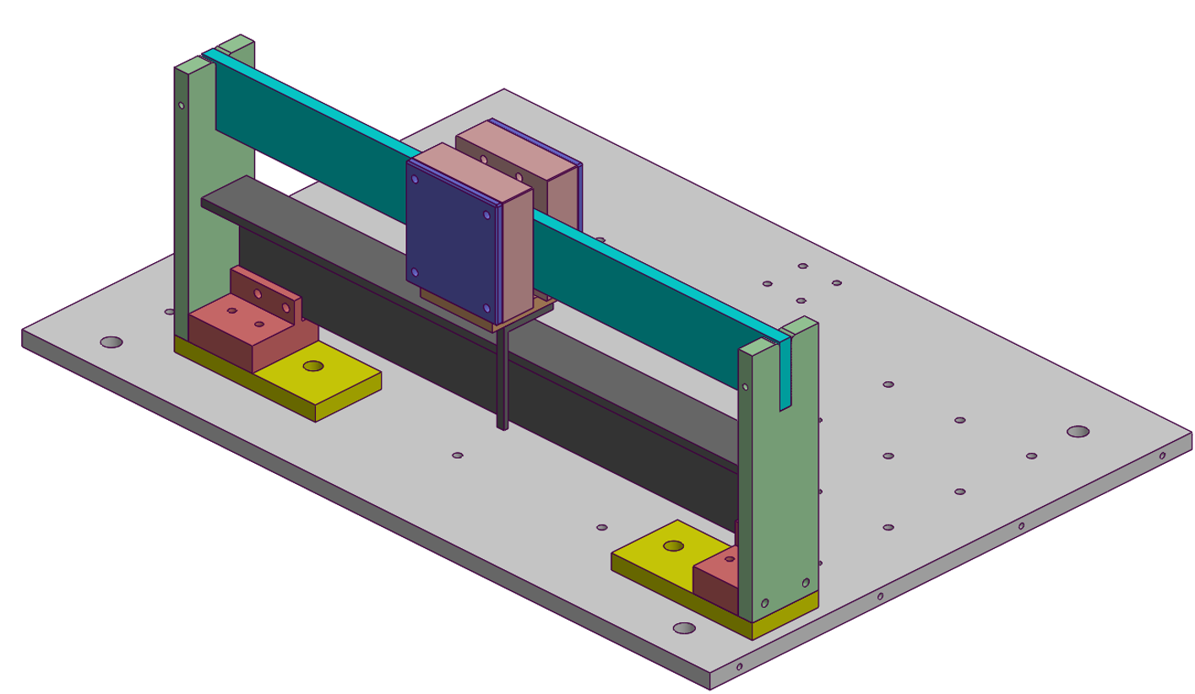
The system cont.
Printed Circuit Board
An electrical board which integrates the microcontroller and its peripheral circuit that contains DC, Motor Driver, LEDs, Optical sensors and passive components.
Mechanical System
A magnet that is connected to a conveyor belt, this system is nailed to its surface to reduce physical disturbances and movements of the system.

Slide 7
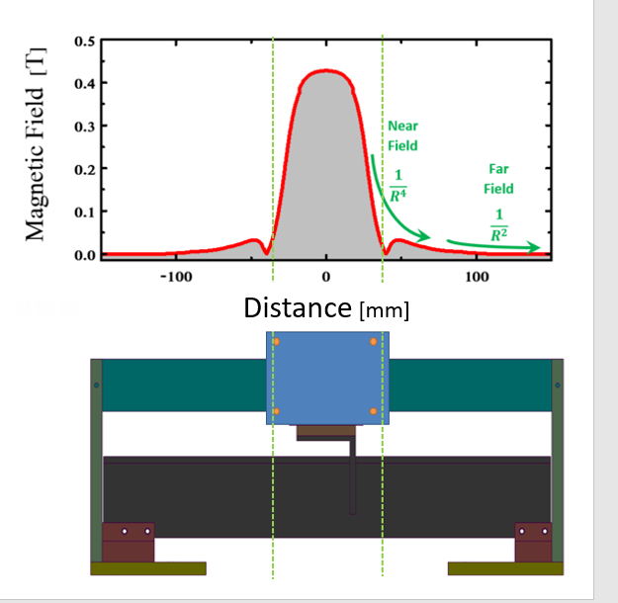
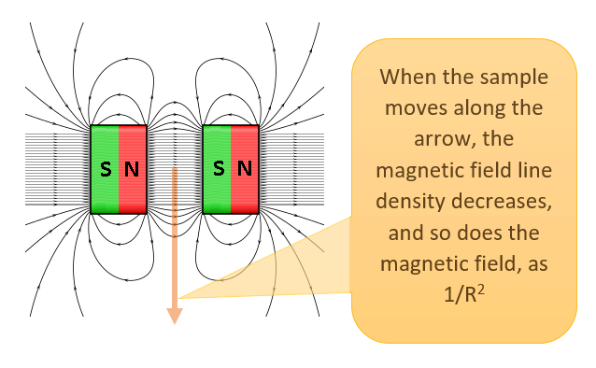
Main measurement
Magnetic field measurement
The experiment included measurements of the magnetic field by a Magnometer in each step of the Stepper Motor for the length of the conveyor belt and conversion of the motor steps to distance in millimeters.
The results agrees with our expectations, the magnetic field decreases at such a rate that at the edge of the conveyor belt the magnetic field’s strength is negligible.

Slide 8
Difficulties and solutions
Dual supplier input problem
Introduction: There are two ways to supply voltage to the microcontroller, through USB connection to a PC and through an external source.
We designed the PCB to support the voltage supply through the USB connection to a PC. We mustn’t supply through USB connection to a PC and through and external source together, because we don’t want to cause short circuit between two suppliers. We want to supply the microcontroller through an external source and not the USB connection although we need the USB to program the microcontroller.
There is diode YURY so we disconnected the diode and soldered VDD and GND underneath the PCB between the DC input of the board to the DC input of the microcontroller, so the microcontroller will only receive voltage from the external power supply even while programming the microcontroller through USB.
Override switch and spare bus.
In the initial design of the PCB, we created a spare bus connection to the microcontroller GPIOs and DC input in case of possible changes.
After we designed and printed the PCB, we decided that another component is needed, a switch that can override the software and move the magnet on/off the sample. We used the spare bus GPIO to integrate the override switch to the system.

