Slide 1

MY SPOTIFY JOURNEY through seasons
Eylül Yurtsever 30695

Slide 2
Starting with the outlines of my project
Motivation:
The motivation for this project is a personal interest in understanding my music listening habits across different seasons and musical taste shift. It could also be driven by a desire to explore patterns in music preferences and how they vary over time.
Data Source:
The data for this project is sourced from my Spotify. It comprises JSON files, specifically 'StreamingHistory' files and 'playlist.json.' and ‘Book 1 .xlsx’ The data likely includes information about the songs I played, artists, play durations, and timestamps and genres. The collection method involves accessing Spotify's API and directly retrieving personal data from a own Spotify account.
Data Analysis: Techniques used
Using Python, pandas
"I employed statistical analysis and data visualization techniques to uncover patterns and insights in the Spotify data."

Slide 3
My Hypothesis
Academic seasons (Winter and Spring), with my school-related responsibilities, are expected to coincide with longer music listening sessions, featuring predominantly pop artists. Conversely, during non-academic seasons (Fall and Summer), characterized by leisure, a reduction in the duration of played songs is anticipated, with a shift towards more frequent listening to artists from the rap genre.

Slide 4
My expected outcome: Longer durations of played songs will be observed during academic seasons, while shorter durations will be observed during non-academic seasons, reflecting the impact of academic schedules on music listening habits.

Slide 5
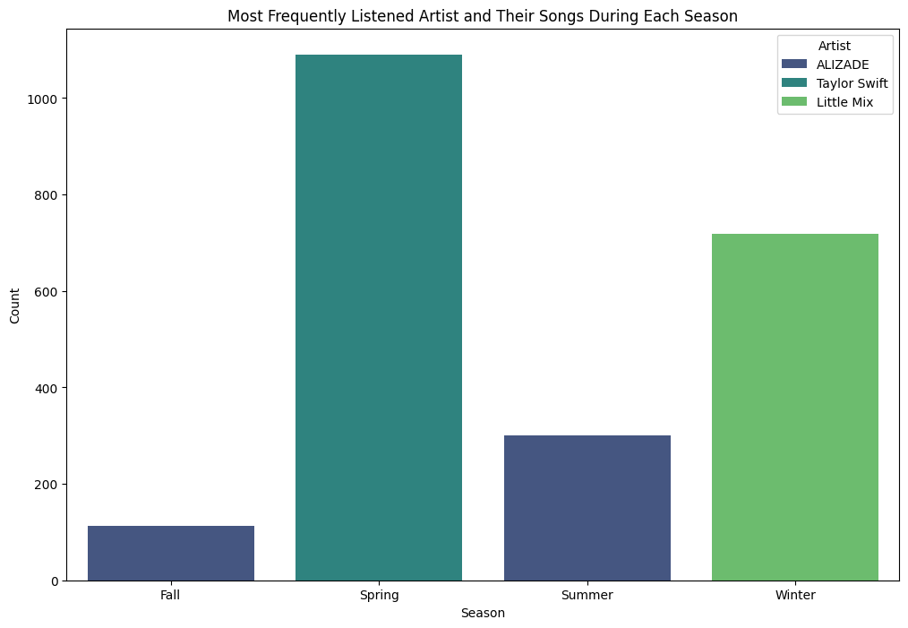
Starting with the most played artist by season

Slide 6
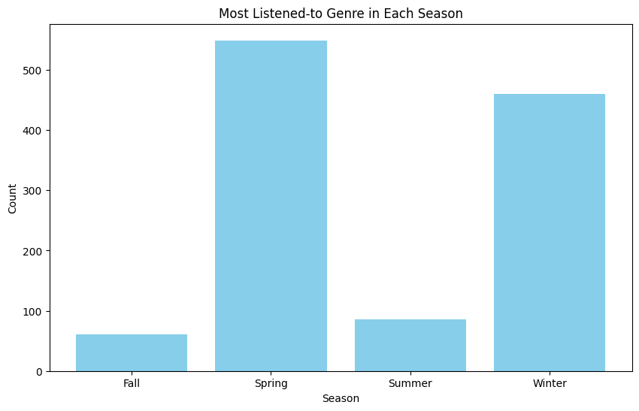
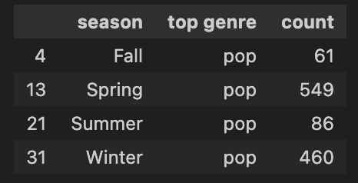
Let's see the genres I played in seasons

Slide 7
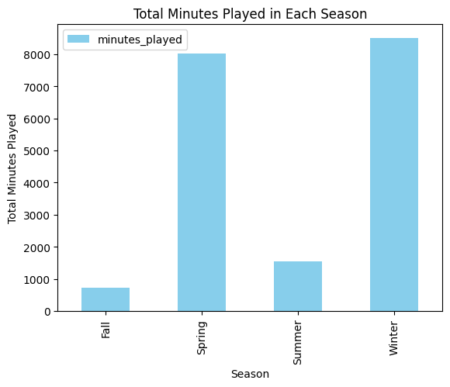
The minute distribution in seasons

Slide 8
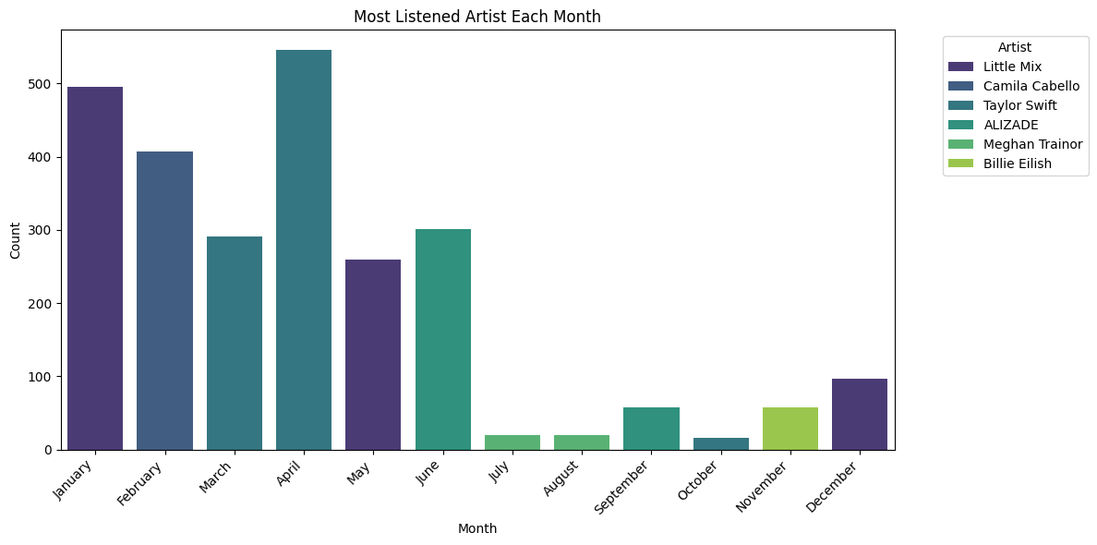
To, understand my shift in taste
Little Mix- pop
Camila Cabello- pop
Taylor Swift- pop
Alizade- rap
Meghan Trainer-pop
Billie Eilish -pop

Slide 9
Findings and Future Plans
Identify patterns in seasonal preferences for artists.
Understand how my music taste may vary throughout the year.
Gain insights into the genres and songs that dominate specific seasons.
Explore advanced analytics, such as machine learning models for predicting future listening habits.

