Slide 1

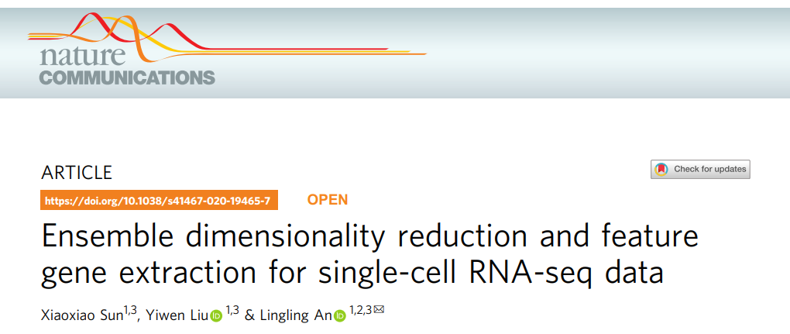

Slide 2
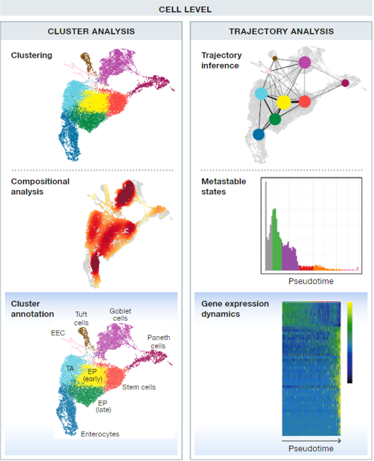
背景
多细胞生物由不同的细胞类型组成，具有不同的细胞类型，但细胞类型的概念始终没有一个标准的定义
传统bulk sequencing技术通过分析包含大量细胞的组织结构，得到的基因表达信息实质上是一整个细胞群的表达水平。许多细胞类型未被识别
单细胞测序技术从单个细胞层面进行转录组分析，能够更好的反映细胞间的异质性，发现细胞亚群
通过聚类识别细胞亚群：
基于基因表达水平的相似度（距离度量）来划分簇，如欧氏距离、cosine相似度、spearman距离等
簇内部的距离尽可能小

Slide 3
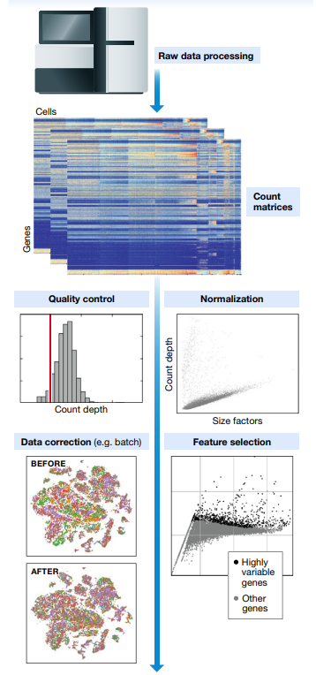
基因表达数据高稀疏性、高维度、高噪声、细胞数目多，直接在原始数据上聚类性能较差
由于技术偏差，某些基因的表达水平不能准确测量，产生dropout
基因表达水平之间的相关性
基因选择：筛选出细胞类型特异性基因子集，即标记基因，能够提高聚类结果的准确性和可解释性。

Slide 4
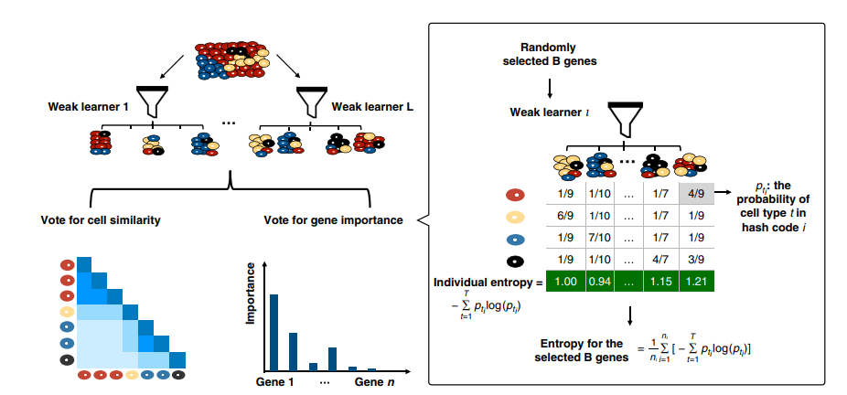
Notes:
常见的降维算法有PCA、UMAP、t-sne

Slide 5
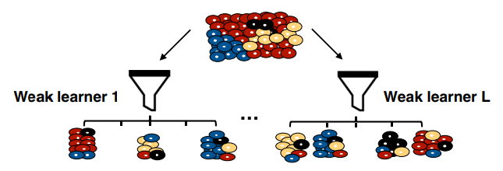
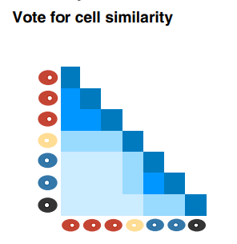

Similarity search
在所有基因中随机选择B个基因
在所有基因表达值中随机选择一个阈值
对于每一个细胞，计算一个二值向量V∈{0，1}，每个元素对应于选择的基因，如果表达值大于阈值，则对应值为1，否则为0
cell
……
B Selected genes
随机产生一个权重向量W，计算V点乘W作为一个哈希映射值。对于任意两个细胞，如果他们的哈希值相等，则它们之间的相似度为1，否则为0
最终得到一个细胞相似度矩阵，重复L次，平均得到最终的相似度矩阵S

Slide 6
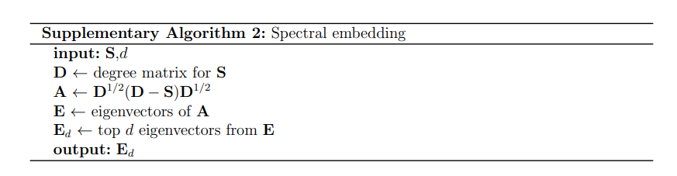
Spectral embedding
construction of a k-nearest neighbor (k-NNG) graph with the weighted adjacency matrix S

Slide 7
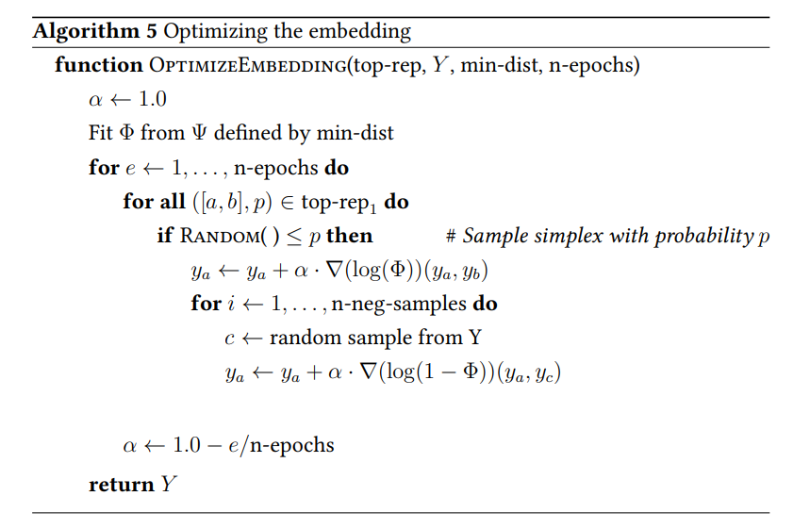


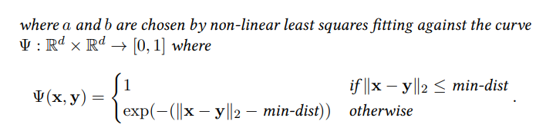
e⋅ is the eigenvector of the cell ⋅ in Ed

Slide 8
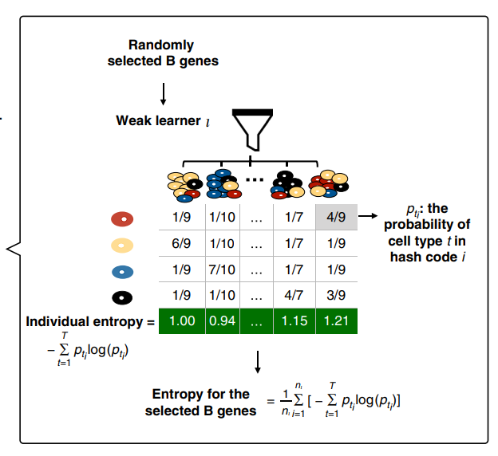

feature gene selection
1、apply a shared nearest neighbor modularity optimization-based clustering algorithm to the optimized embedding matrix
2、predicted labels of cells
3、select feature genes based on the measure of information entropy.
4、Let μ and σ be the mean and standard deviation of the averaged entropy values over L weak learners
5、choose μ − 1.5 × σ as the cutoff value to select top feature genes

Slide 9
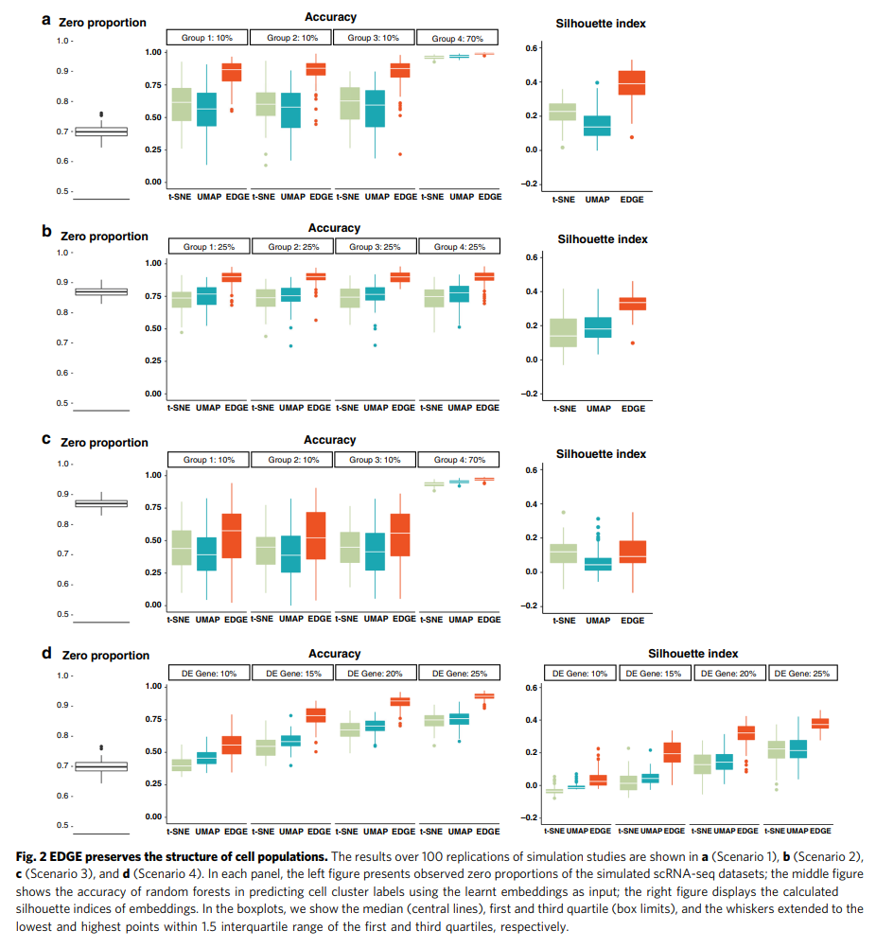
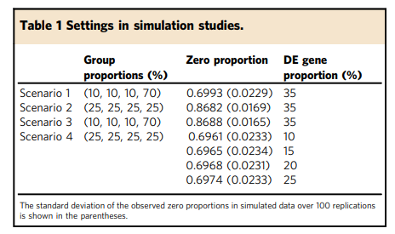
Simulated experiment
1000 cells and 1500 genes
The range of the silhouette index is from −1 to +1, and the positive one represents well-separated clustering

Slide 10
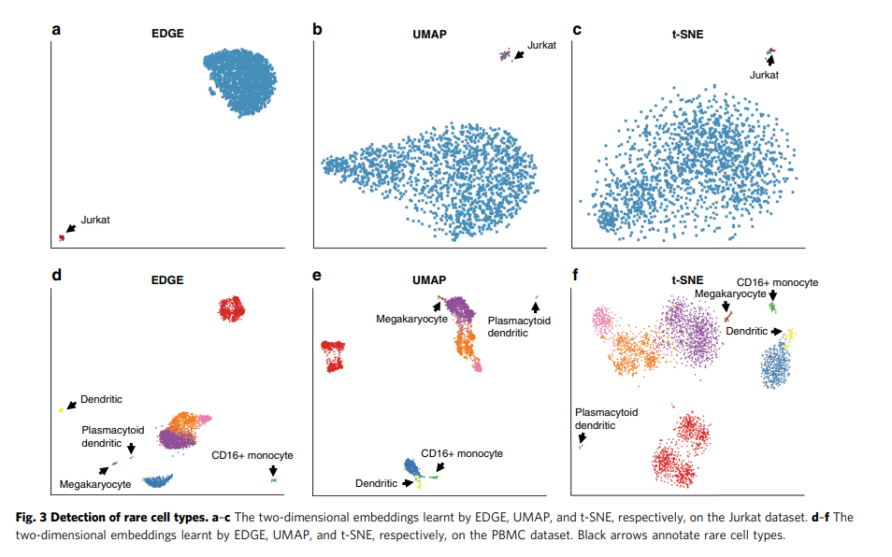
Jurkat dataset: two cell types ——293T and Jurkat（rare)
PBMC dataset：nine cell types——four are rare
For every dataset, project cell into two-dimensional space
The mean (standard deviation) of the silhouette indices
EDGE | UMAP | t-SNE
0.851(0.045) | 0.801(0.012) | 0.838(0.008)

Slide 11
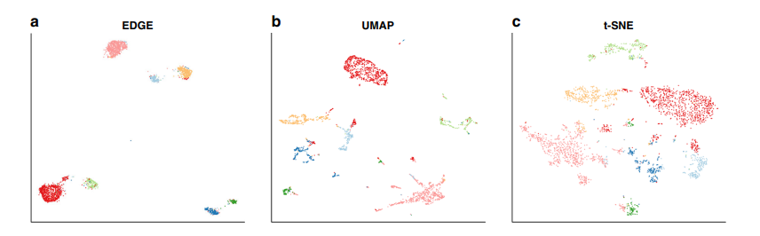
Mouse brain dataset: 3005 cells
project cell into 2-dimensional space using UMAP、t-SNE、EDGE
seven types of cells identified in the original study were mapped to seven compact regions in the EDGE
EDGE | UMAP | t-SNE
0.621(0.085) | 0.597(0.025) | 0.501(0.017)
The mean (standard deviation) of the silhouette indices

Slide 12
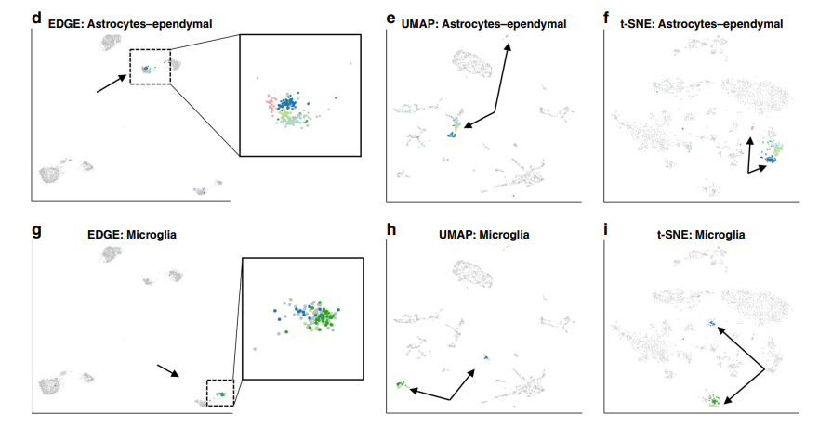
EDGE showed promising results in maintaining hierarchical structures of cell
five subtypes of astrocytes-ependymal cells
four subtypes of microglia cells

Slide 13
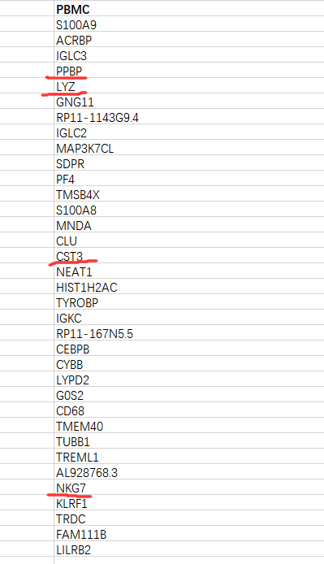
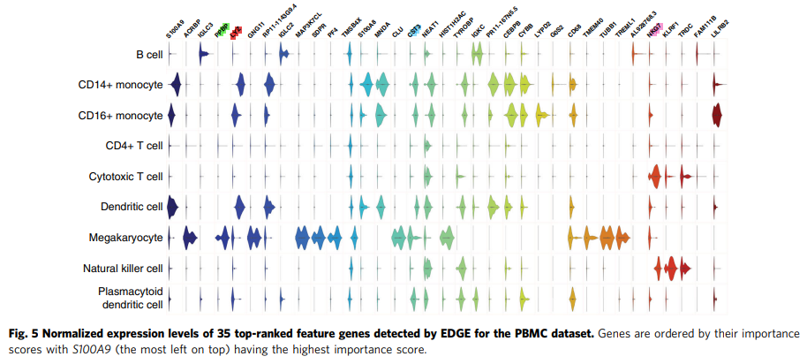
EDGE is capable of detecting feature genes that are responsible for the separation of different cell populations
PPBP, LYZ, CST3, and NKG7 were the marker genes for platelet, CD14+ monocyte, dendritic cells, and natural killer cells, respectively

