Slide 1

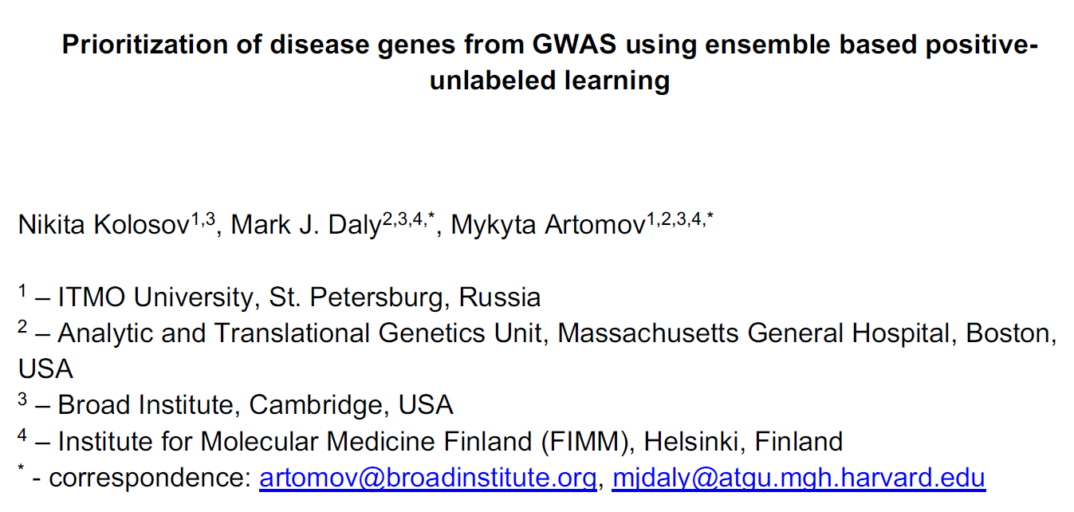


Slide 2
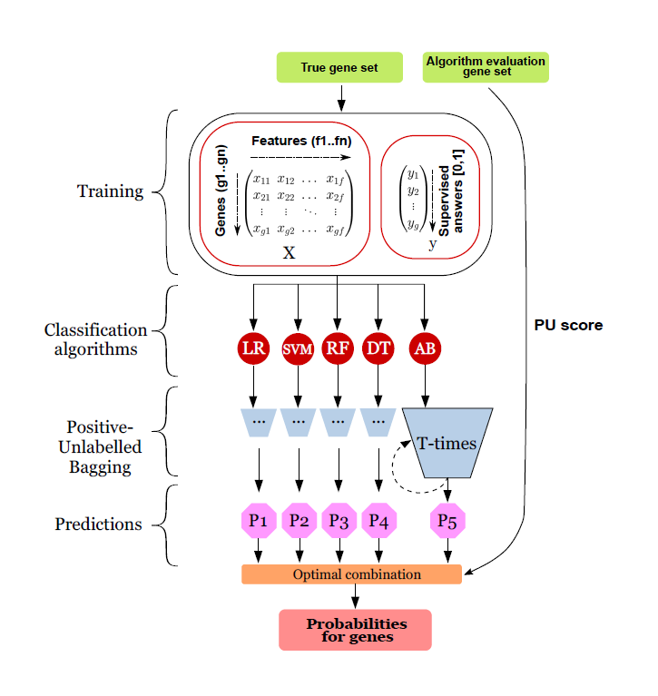
GPrior ensemble positive-unlabeled learning framework
Figure 1.GPrior ensemble positive-unlabeled learning framework
Matrix of gene features along with vector of supervised answers is used to train 5 models using PU-bagging approach. Two independent gene sets are used for training – true set of genes for individual classification algorithms training and algorithm evaluation set of true genes for selecting the optimal combination of the predictions. Predictions are generated using positive-unlabeled bagging and further an optimal combination returning the largest PU-score is returned.
知行合一、经世致用
Central South University
Notes:
每个基分类器重复T次取平均值，在5个分类器中选择最好的结果。

Slide 3
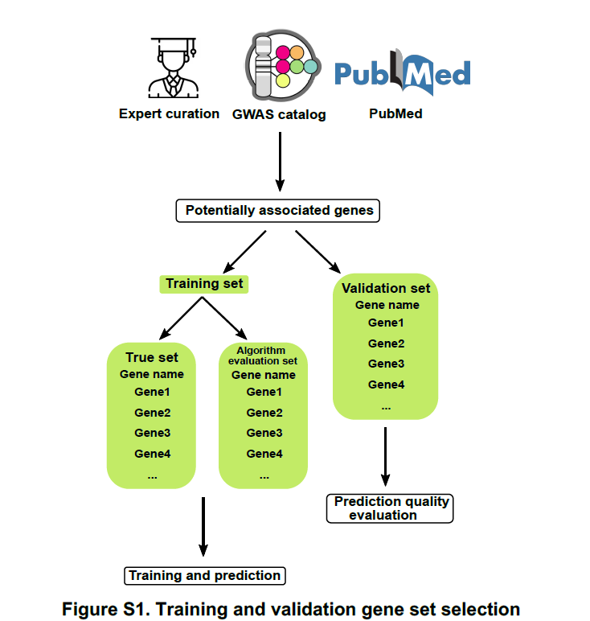
Training and validation gene sets
Train gene set should be divided into two parts:
True gene set(TS)
Algorithm evaluation set(AES)
Validation gene set(VS): only used for independent performance evaluation of the final set of predictions from all prioritization algorithms tested.
1
知行合一、经世致用
Central South University
Notes:
TS用于模型训练，AES用于对5个基分类器调参，选出最后预测时的优化组合。

Slide 4
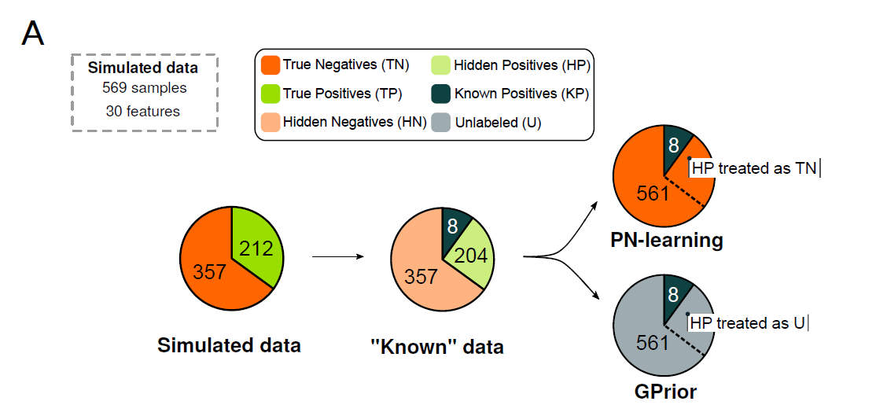
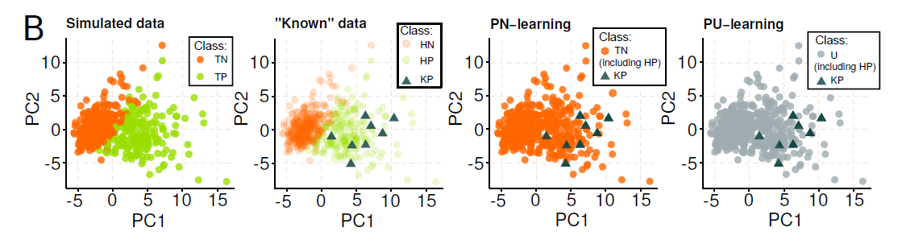
Inputs and Features
Dataset breakdown. Known data represents scenario when only a part of the true positive instances were discovered to date.
PCA of the simulated data with highlighted true instance classes
Notes:
Gprior使用agglomerative feature clustering来降低维度，以此提取合适数量的特征，来提升性能。

Slide 5
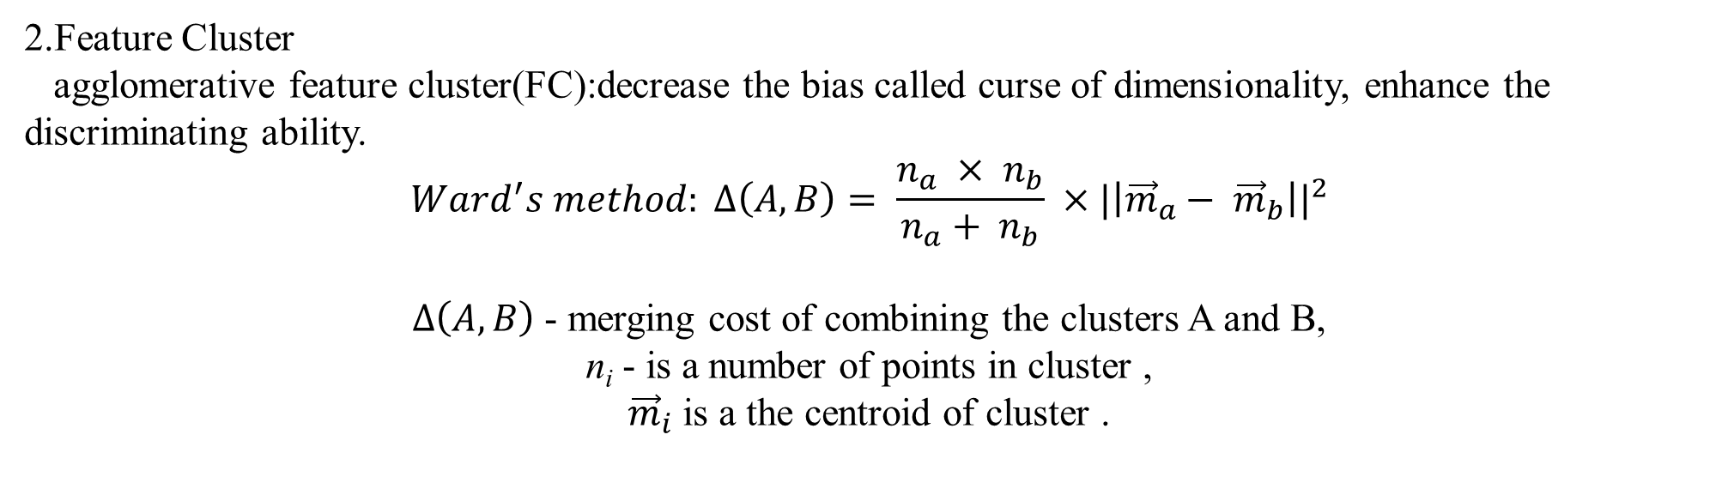
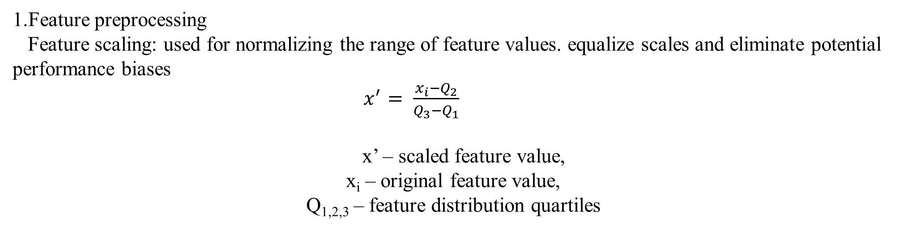
Input and Features
1.Feature preprocessing
Feature scaling: used for normalizing the range of feature values. equalize scales and eliminate potential performance biases
$x^{′}= \frac{x_{i}−Q_{2}}{Q_{3}−Q_{1}}$
x’ – scaled feature value,
x_{i} – original feature value,
Q_{1,2,3} – feature distribution quartiles
2.Feature Cluster
agglomerative feature cluster(FC):decrease the bias called curse of dimensionality, enhance the discriminating ability.
$$Ward^{′}s method: ∆\left(A, B\right)= \frac{n_{a} × n_{b}}{n_{a}+ n_{b}} ×{|\left|{\vec{m}}_{a}− {\vec{m}}_{b}\right||}^{2}$$
$∆\left(A, B\right)$ - merging cost of combining the clusters A and B,
n_{i} - is a number of points in cluster ,
${\vec{m}}_{i}$ is a the centroid of cluster .
Notes:
POSTGAP预处理GWAS数据，得到特征。特征进行聚类：1.消除维度诅咒偏差；2.初始数据集通常包含一些相关或不相关的特征。Ward’s method采用欧氏距离进行聚类

Slide 6
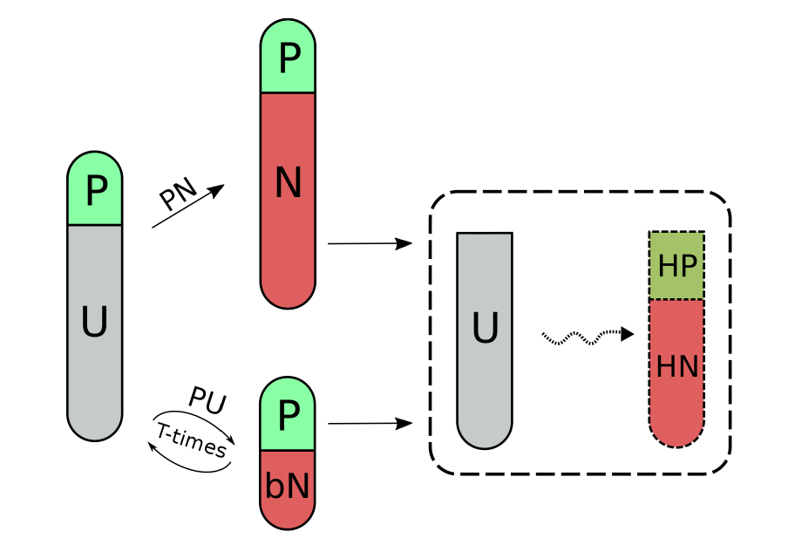
GPrior Algorithm
Training and individual ML predictions generation
P – positive training instances
U – unlabeled instances
bN – bootstrap negative instances,
N – negative instances in PN-learning
HP – hidden positive instances
HN – hidden negative instances
Positive-Unlabeled bagging procedure and Positive-Negative learning difference. Positive-unlabeled data in case of PN-learning is treated as positive and negative classes. For PU-bagging procedure, only a small part of unlabeled instances are treated as negatives, leading to significant decrease in false negative rate. Finally, both approaches attempt to identify hidden positives and hidden negatives in the unlabeled set.

Slide 7
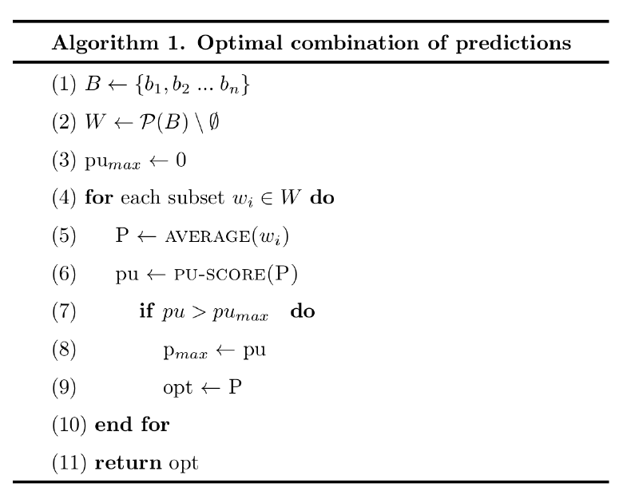
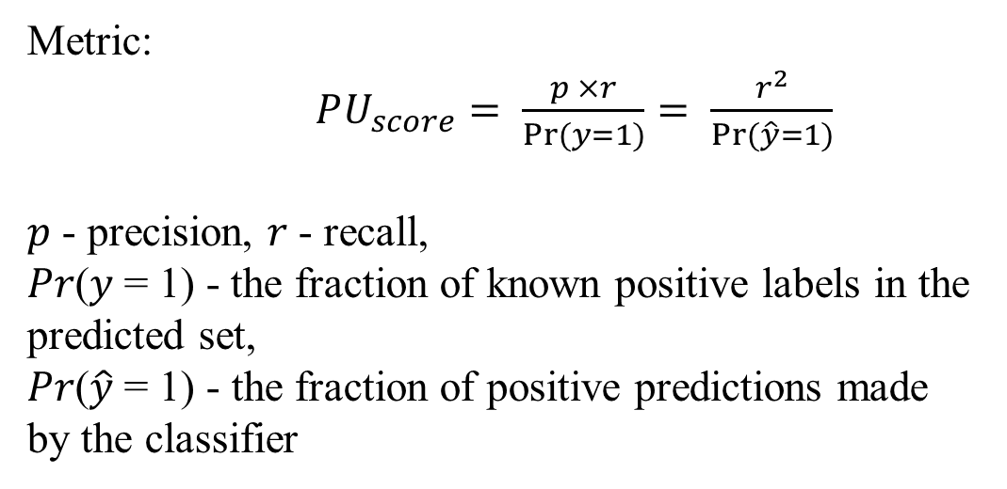
GPrior Algorithm
Combining results from multiple ML algorithms
Algorithm 1.
Metric:
$PU_{score}= \frac{p ×r}{Pr⁡(y=1)}= \frac{r^{2}}{Pr⁡(\hat{y}=1)}$
𝑝 - precision, 𝑟 - recall,
𝑃𝑟(𝑦 = 1) - the fraction of known positive labels in the predicted set,
𝑃𝑟($\hat{y}$ = 1) - the fraction of positive predictions made by the classifier
b_{i} is a final prediction of i-th classifier and n is the total number of used PU bagging classifiers. W = P(B) \ ∅， size of N, that stores all possible subsets of B, excluding empty set ∅.

Slide 8
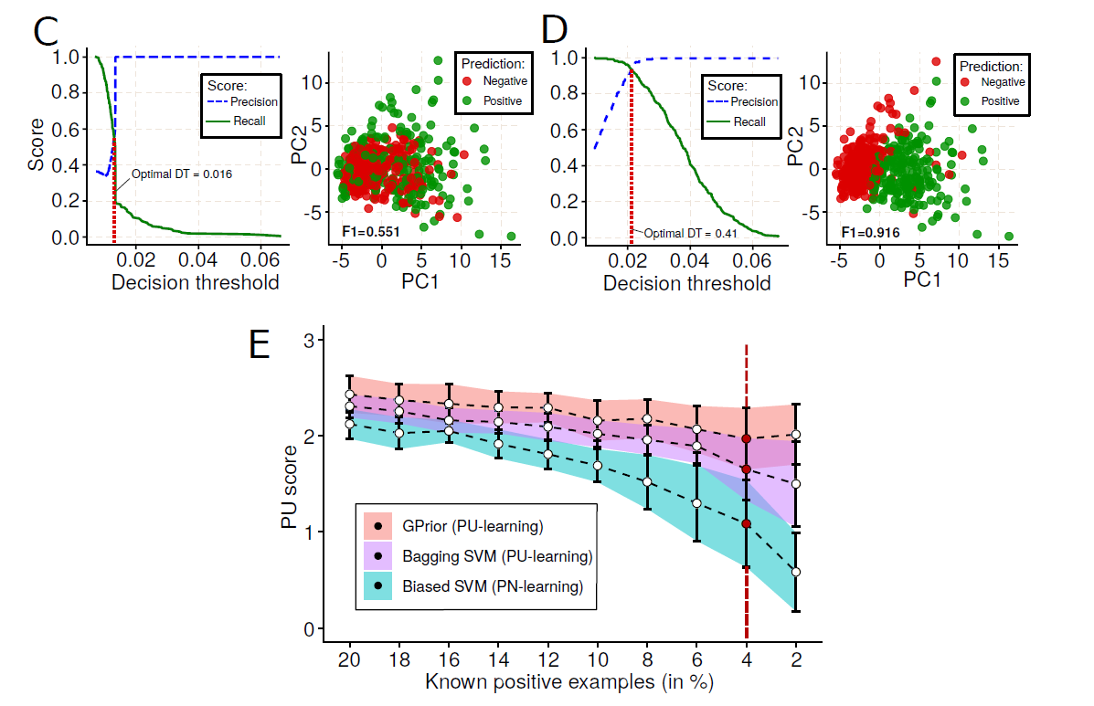
Results
(C) Prediction results for PN-learning (biased SVM) approach; (D) Prediction results for GPrior; (E) Performance of PU and PN learning approaches with respect to a fraction of known positive data points.

Slide 9
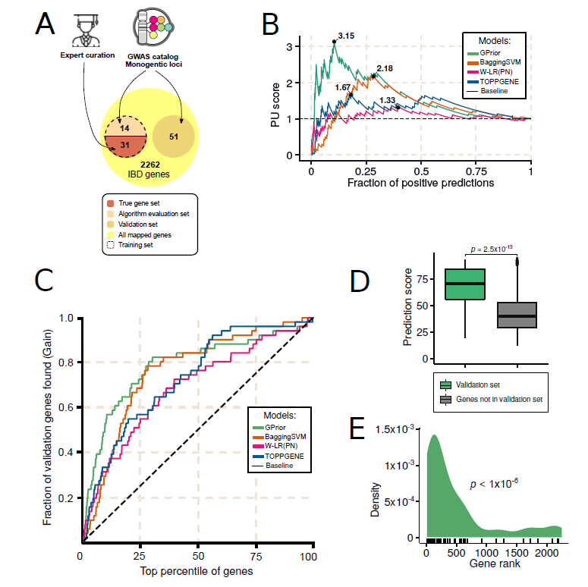
Gene prioritization for inflammatory bowel disease GWAS.
(A) Scheme for selection of training, algorithm evaluation and validation gene sets; (B) Classification quality comparison for GPrior, Bagging SVM and conventional PNlearning with weighted linear regression; (C) Cumulative gains curve shows better prioritization of true genes at the top of the candidate list using GPrior in comparison
with other methods; (D) True genes from the independent validation gene set receive significantly higher scores than genes found within the same loci but not implicated in the disease; (E) Enrichment of true genes from independent validation gene set among top predictions from GPrior.
Notes:
炎症性疾病

Slide 10
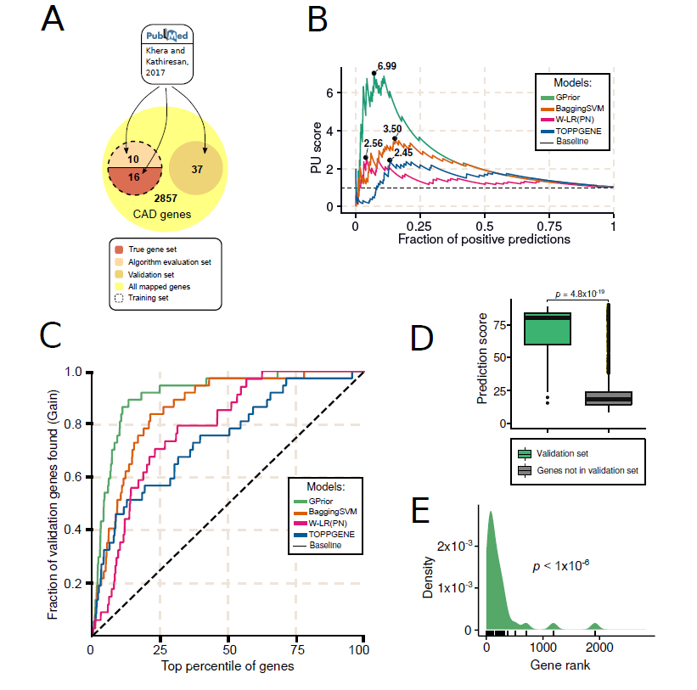
Gene prioritization for coronary artery disease GWAS.
(A) Scheme for selection of training, algorithm evaluation and validation gene sets; (B) Classification quality comparison for GPrior, Bagging SVM and conventional Pnlearning with weighted linear regression; (C) Cumulative gains curve shows better prioritization of true genes at the top of the candidate list using GPrior in comparison with other methods; (D) True genes from the independent validation gene set receive significantly higher scores than genes found within the same loci but not implicated in the disease; (E) Enrichment of true genes from independent validation gene set among
top predictions from GPrior.
Notes:
冠状动脉疾病

Slide 11
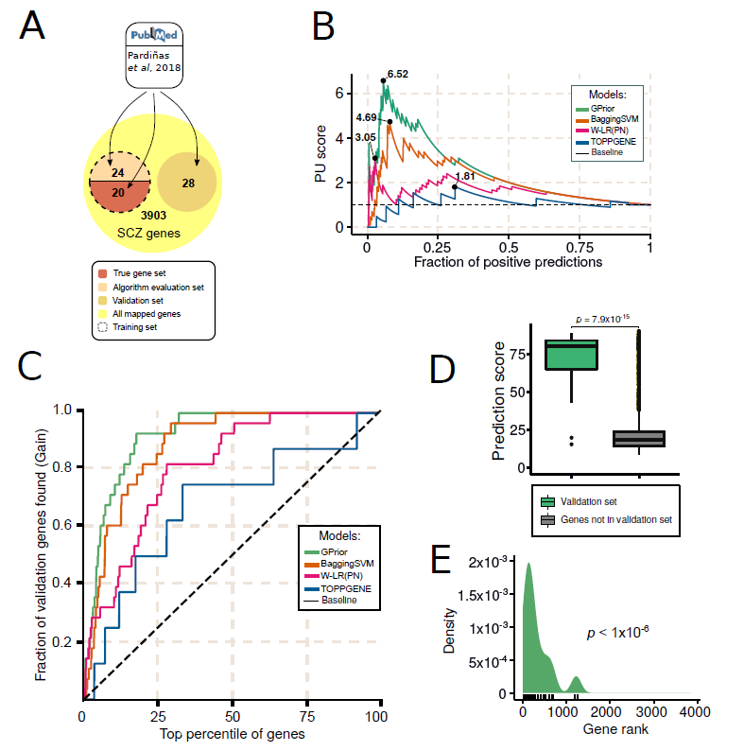
Gene prioritization for schizophrenia GWAS
(A) Scheme for selection of training, algorithm evaluation and validation gene sets; (B) Classification quality comparison for GPrior, Bagging SVM and conventional PNlearning
with weighted linear regression; (C) Cumulative gains curve shows better prioritization of true genes at the top of the candidate list using GPrior in comparison with other methods; (D) True genes from the independent validation gene set receive significantly higher scores than genes found within the same loci but not implicated in the disease; (E) Enrichment of true genes from independent validation gene set among top predictions from GPrior.
Notes:
精神分裂症

Slide 12
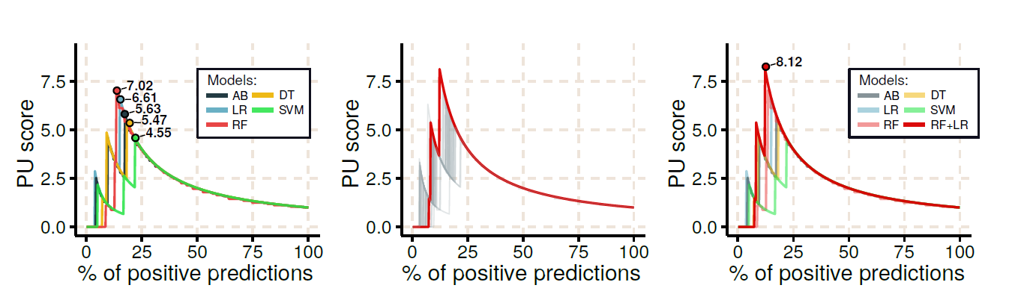
Optimal combination of the predictions
(A) Quality of each model is evaluated using PU-score metric; (B) All possible combinations of 5 models are evaluated and the one with the highest PU-score is selected for predictions. An independent set of genes – algorithm evaluation gene set is used to evaluate each combination; (C) Optimal combination of predictive models performs better than individual PU-models (Optimal combination - RF+LR).

Slide 13
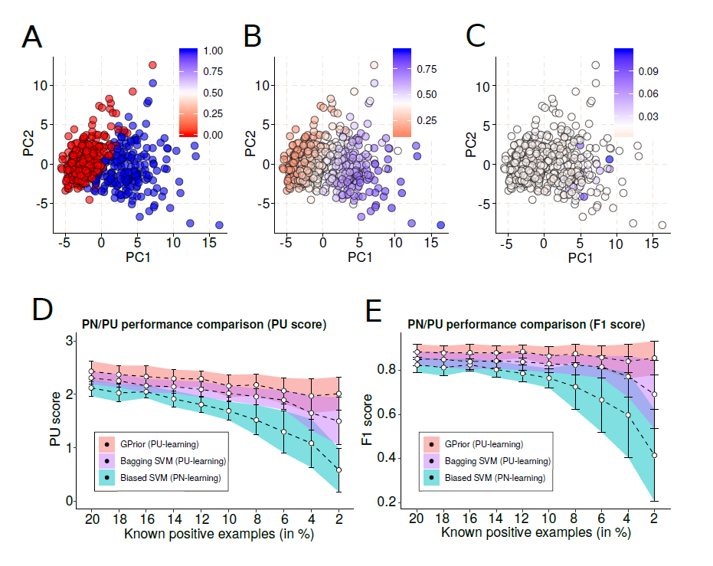
Evaluation of PN and PU learning methods performance using benchmark dataset.
(A) PCA of the original data, showing non-malignant (true negative, red) and malignant (true positive, blue) tumors in Wisconsin Breast Cancer data; (B) PCA of the original data colored with respect to the probability of an instance coming from true positive (blue) class. Probabilities estimated using GPrior; (C) PCA of the original data colored with respect to the probability of an instance coming from true positive (blue) class. Probabilities estimated using biased SVM (PN-learning); (D) Comparison of algorithm performances for different fraction of true positive instances used for training using PUscore; (E) Comparison of algorithm performances for different fraction of true positive instances used for training using F1-score.

Slide 14
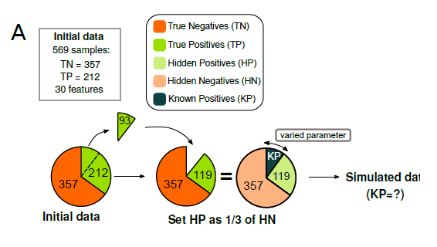
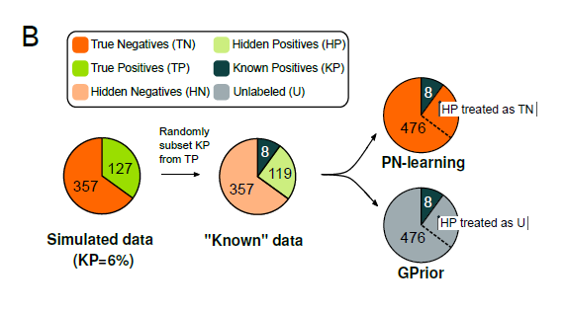
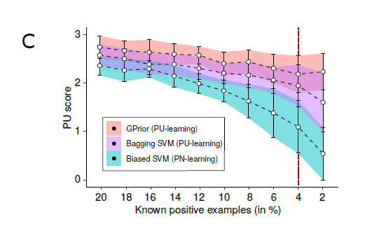
Benchmark dataset analysis with fixed fraction of hidden positive instances in the unlabeled set
(A) Scheme for construction of the benchmark data subset with fixed fraction of hidden positive instances in the unlabeled set; (B) Training scheme for PN and PU-learning; (C) PU-score based comparison of performance evaluation for biased SVM, bagging SVM and GPrior

Slide 15
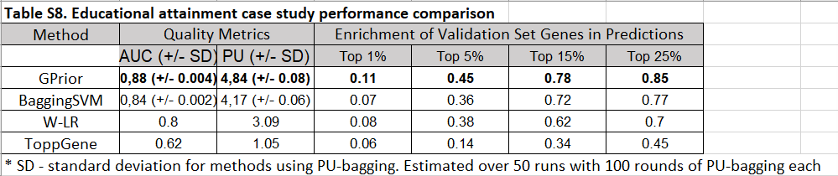
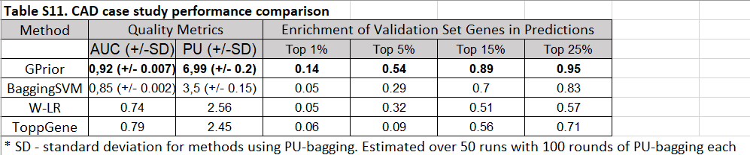

Slide 16
Thanks

