Slide 1


Variant to function mapping at single-cell
resolution through network propagation
Authors: Fulong Yu，Liam D. Cato
From: Nature Biotechnology, June 2022
DOI: https://doi.org/10.1038/s41587-022-01341-y
Reporter: Huang Wenkui

Slide 2
1 Motivation
contents
2 Overview of the SCAVENGE
3 Methods
4 Results

Slide 3
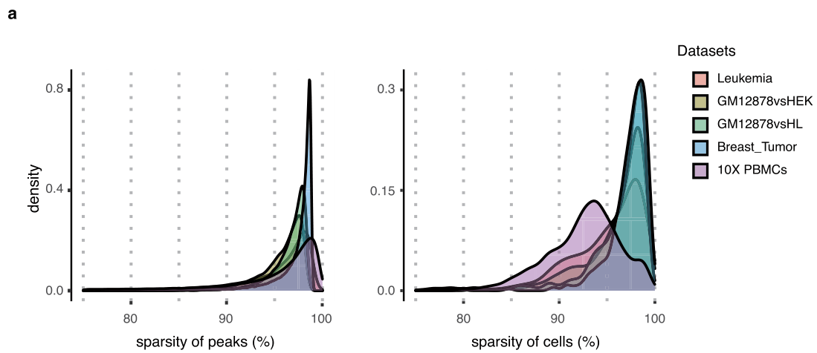
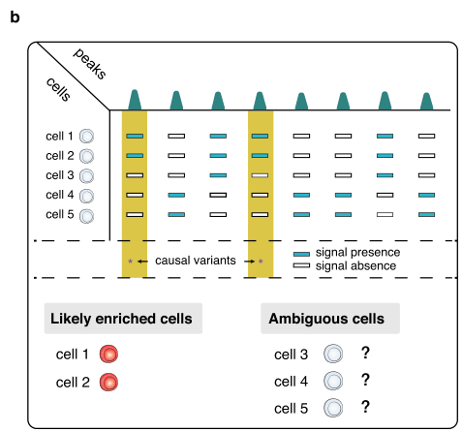
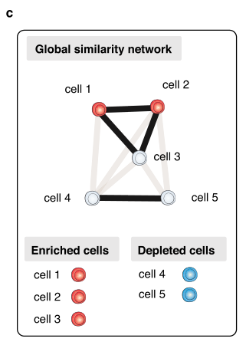
Motivation
Challenges for identification of trait/phenotype-relevant cells：
The extensive amount of sparsity and noise ( >95% of sparsity )
Most cells are uninformative at specific loci

Slide 4
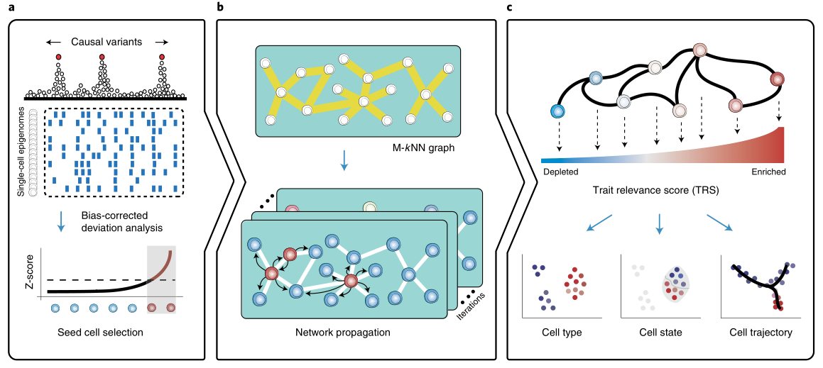
Overview of the SCAVENGE
Overview of the SCAVENGE approach and applications

Slide 5



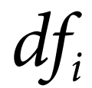

Methods
Cell-to-cell similarity network construction：
first convert binarized sparse matrix into a term frequency-inverse document frequency (TF-IDF) matrix：
where is the weight for the feature i in cell j；
indicates the term frequency that is the number of feature i in cell j；
is the document frequency of term i that is number of cells where the feature i appears；
is the total number of cells in the experiment

Slide 6

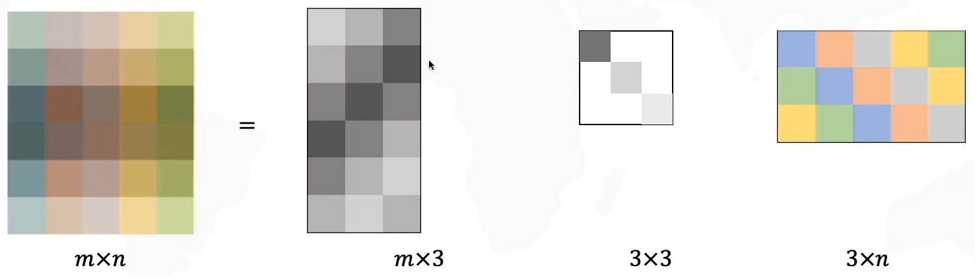
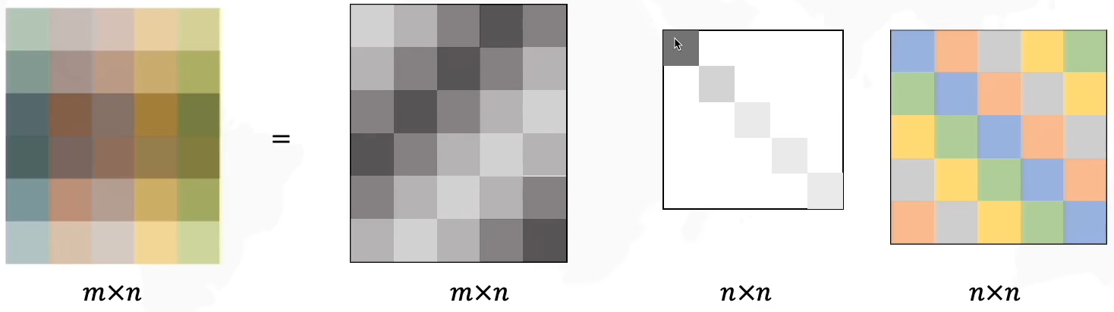
Methods
Cell-to-cell similarity network construction：
The singular value decomposition (SVD) is applied on the TF-IDF matrix：
where U and V are orthogonal matrices, and Σ is a diagonal matrix

Slide 7
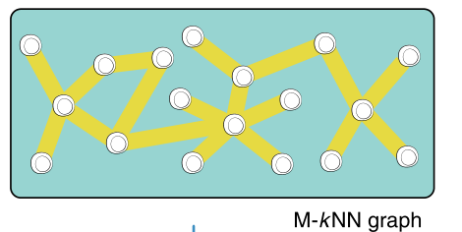
Methods
Cell-to-cell similarity network construction：
builds a nearest neighbor graph from the LSI matrix of N cells and d leading LSIs (d = 30)：
The Euclidean distance between any pair of cells is calculated based on the LSI matrix；
k nearest neighbors (k = 30) for each cell are identified；
construct an M-kNN graph by requiring the node (cell) pair that are mutually the k nearest neighbors to each other；
If a cell fails to find its mutually k nearest neighbors, connect this cell to its nearest neighbor；
allows each cell to have, at most, k neighbors

Slide 8
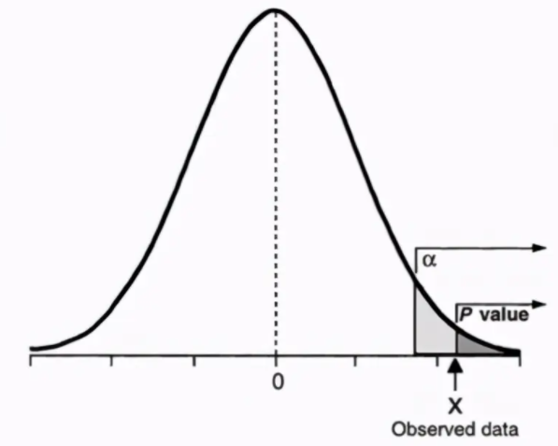
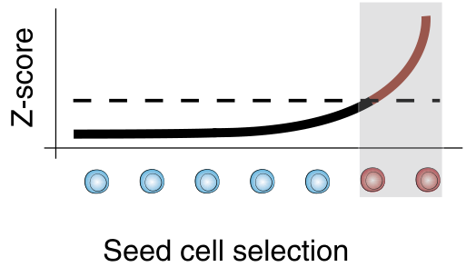
Methods
Definition of seed cells：
define the seed cells as a set of cells that are most likely to be relevant to the tested trait：
use g-chromVAR to calculate a bias-corrected Z-score for each cell
it is not suitable to pre-define a fixed number because number can vary among tested genetic traits and the single-cell dataset
convert Z-scores to P values using a one-tailed normal distribution
consider all the cells with P values less than 0.05 as seed cells

Slide 9
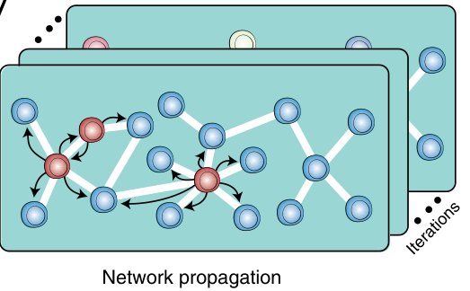




Methods
Network propagation with seed cells：
there is a set of seed nodes I ∈ V defining the initial states of an undirected M-kNN graph,
G = (V, E) , that is constructed as described above.
Two sparse matrices are created to represent graph structure :
where denotes adjacency matrix of G
is the transition probability matrix that is column normalization of
transition probability matrix describes the probability for one node jumping to another

Slide 10


Methods
Network propagation with seed cells：
random walk with restart (RWR), a network propagation-based algorithm for propagating the set of seed cells for a trait of interest
The random walk steps s is discrete and finite, s ∈ N
The information carried of node v at step s is
considered that the information is equally distributed across the seed nodes in the initial state of step 0
where n(I) is the number of seed nodes

Slide 11
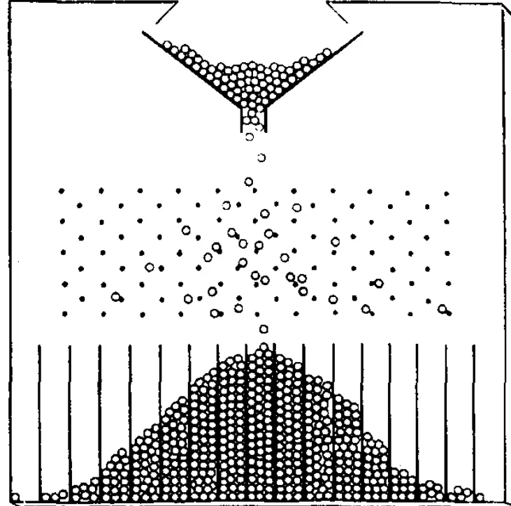




Methods
Network propagation with seed cells：
At each iteration, a node can transfer the information to one of its randomly selected neighbors
or restart at the node by transferring information back to itself
As G is undirected, highly connective and not a bipartite, the iterative update is guaranteed to converge to the stationary steady state
Stationary distribution or probability for each node can be obtained:
where γ is the restart probability
The random walk process is continued until steady state

Slide 12




Methods
TRS normalization and scale：
The total sum of information is kept constant and equals 1 throughout the graph
Therefore, the original network propagation scores are very small(for example, )
network propagation scores cannot be directly compared across different datasets
define the TRS by scaling and normalizing the network propagation score:
first calculate the 99th percentile of network propagation scores as the ceiling
TRS, a scaling factor representing the average levels of bias-corrected Z-score with the top 1% of cells is calculated:
where m is a cell with the top 1% bias-corrected Z-score

Slide 13


Methods
Cell state identification using the permutation test：
Here, focus on network propagation score rather than TRS
the sum of network propagation scores is constantly equal to 1 and independent of seed cell selection
network propagation scores with different sets of seed cells are directly comparable
randomly select a set of number-matched seed cells to repeat SCAVENGE analyses
if a seed cell has m neighbors in the cell-to-cell graph, the matched permuted one can be selected only from cells with m neighbors
The empirical P value is defined as
where B is the number of permutations (B = 1,000)
Trait-enriched cells are defined as cells with P less than 0.05

Slide 14
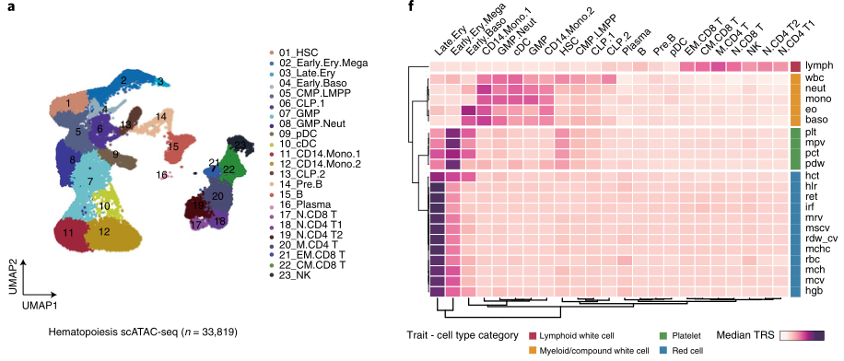
Results
Systematic discovery of blood cell trait enrichments:

Slide 15
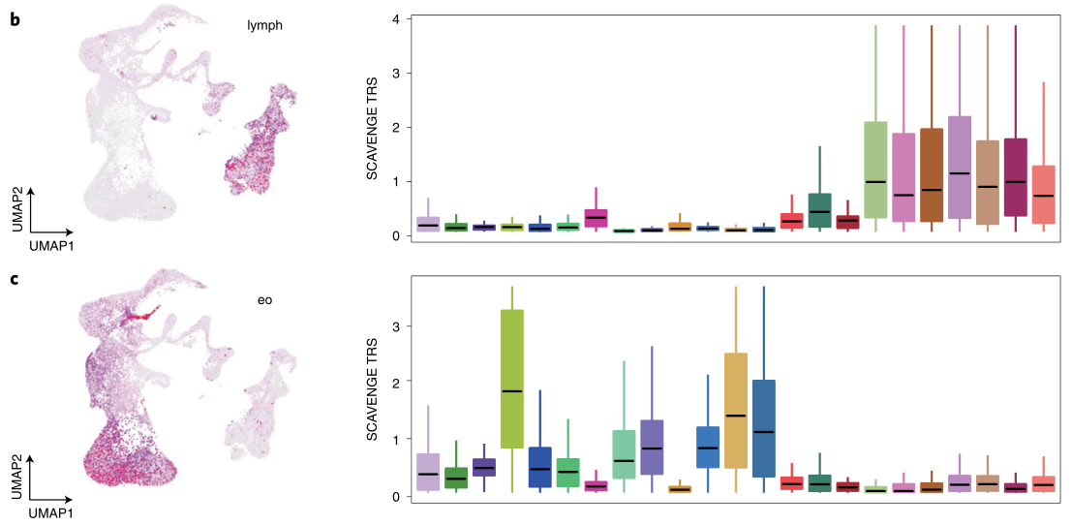
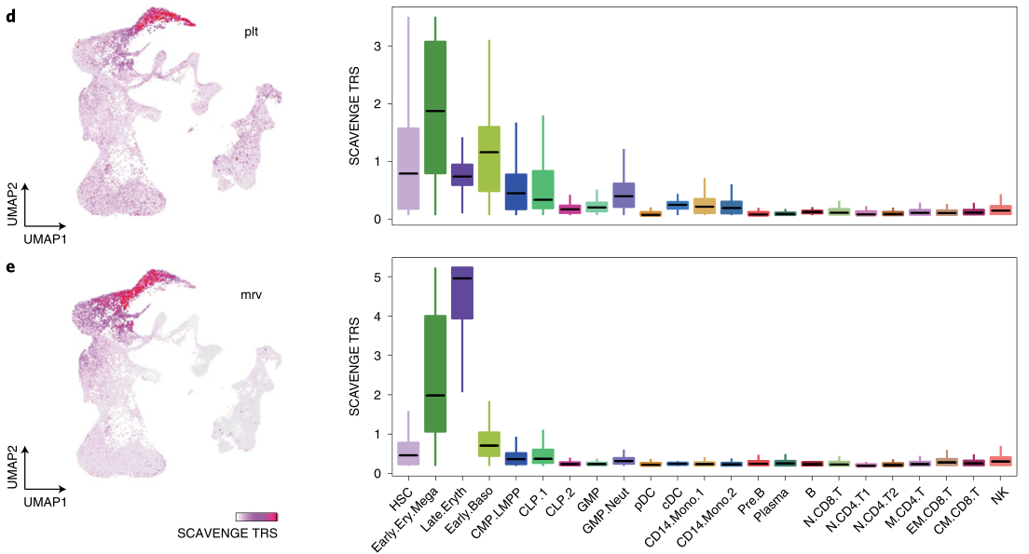
Results
Systematic discovery of blood cell trait enrichments:

Slide 16
Results
Systematic discovery of blood cell trait enrichments:

Slide 17
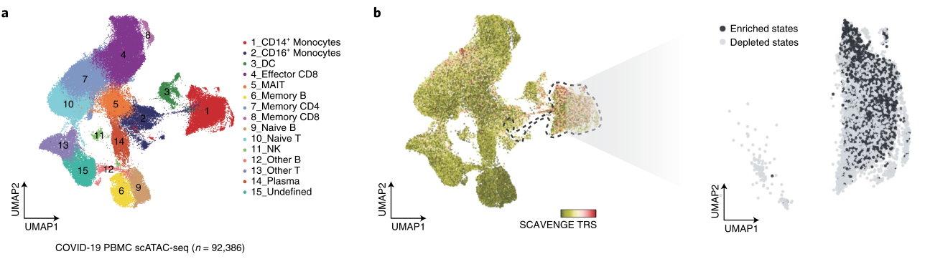
Results
SCAVENGE uncovers cell heterogeneity in COVID-19:

Slide 18
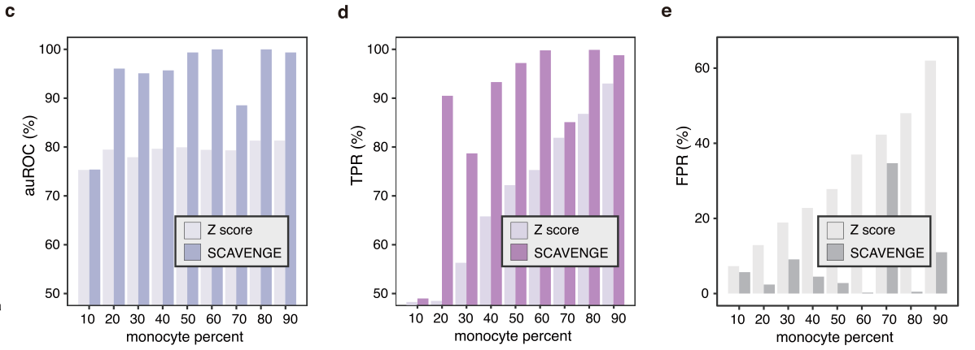
Results
Benchmarking assessments with simulated and real data:

Slide 19
Thank you for listening
Reporter: Huang Wenkui

