Slide 1
Chapter two
Divide-and-conquer

Slide 2
Divide-and-Conquer: General Method
In divide and conquer method, a given problem is,
  Divided into smaller sub problems
  These sub problems are solved independently
  Combining all the solutions of sub problems into a solution of the whole.
If the sub problems are large enough then divide and conquer is reapplied
The generated sub problems are usually of same type as the original problem. Hence recursive algorithms are used in divided and conquer strategy.

Slide 3
Divide-and-Conquer: General Method
Divide
  The problem into a number of sub problems
Conquer
  The sub problems by solving them recursively. If the sup problem sizes are small enough, however, just solve the sup problems in a straightforward manner.
Combine
  The solutions to the sub problems into the solution for the original problem.

Slide 4
Divide-and-Conquer: General Method
a problem of size n
sub problem 1
of size n/2
sub problem 2
of size n/2
a solution to
sub problem 1
a solution to
sub problem 2
a solution to
the original problem
It general leads to a recursive algorithm!

Slide 5
Divide-and-Conquer Examples
Sorting: merge sort and quick sort
Finding maximum and minimum
Binary tree traversals
Binary search
Multiplication of large integers
Matrix multiplication: Strassen’s algorithm
Closest-pair and convex-hull algorithms

Slide 6
An Example: Binary search
Binary Search is an efficient searching method and an example of divide and conquer approach.
While searching the elements using this method the most essential thing is that the elements in the array should be sorted one.
Strategy:
    Obtain the middle element
    If it equals searched value, algorithm stops.
    Other wise, two cases possible.
      If search value < middle element, repeat the procedure for sub array before the middle element.
      If search value > middle element, repeat the procedure for sub array after the middle element.

Slide 7
Iterative Code for Binary search
void binarysearch (int a[], int Find, int first, int last)
{
first = 0; last = n-1; middle = (first + last) / 2;
while (first <= last)
{
if(a[middle]==Find)
{
printf(“Search Element in location %d”, middle);
break;
}
else if(Find<a[middle])
last=middle-1;
else
first=middle+1;
middle=(first + last) / 2;
}
if(first>last) printf(“Element not found”);
}

Slide 8
Recursive Code for Binary search
int binarysearch (int a[], int Find, int first, int last)
{ int middle;
if(first>last)
return 0;
else
{ middle=( first + last) / 2;
if(a[middle] == Find) return middle;
else if(Find<a[middle]) return binarysearch(a,Find,first,middle-1);
else return binarysearch(a,Find,middle+1,last);
}
}

Slide 9
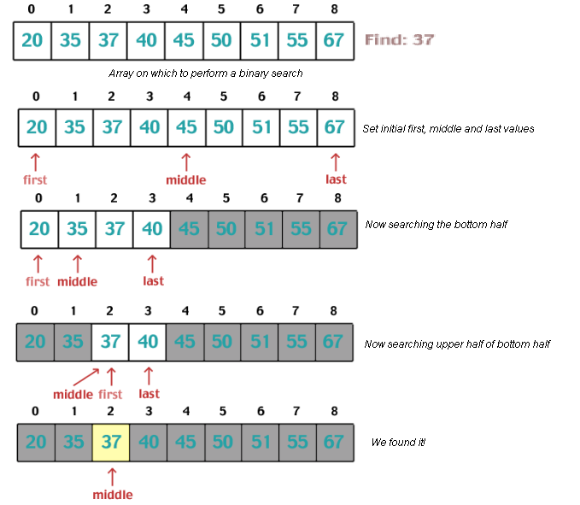
Binary search - example

Slide 10
An Example: Merge Sort
Sorting Problem: Sort a sequence of n elements into non-decreasing order.
Divide: Divide the n-element sequence to be sorted into two subsequences of n/2 elements each
Conquer: Sort the two subsequences recursively using merge sort.
Combine: Merge the two sorted subsequences to produce the sorted answer.

Slide 11
Merge sort Algorithm
Split array A[0..n-1] into about equal halves and make copies of each half in arrays B and C
Sort arrays B and C recursively
Merge sorted arrays B and C into array A as follows:
  Repeat the following until no elements remain in one of the arrays:
    compare the first elements in the remaining unprocessed portions of the arrays
    copy the smaller of the two into A, while incrementing the index indicating the unprocessed portion of that array
  Once all elements in one of the arrays are processed, copy the remaining unprocessed elements from the other array into A.

Slide 12
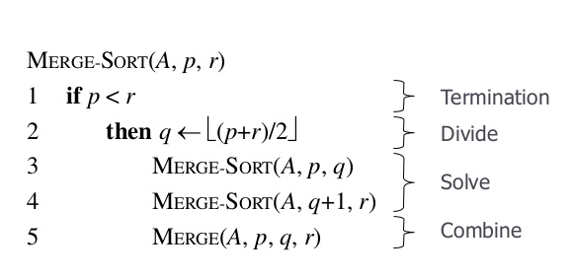
Merge Sort Algorithm

Slide 13
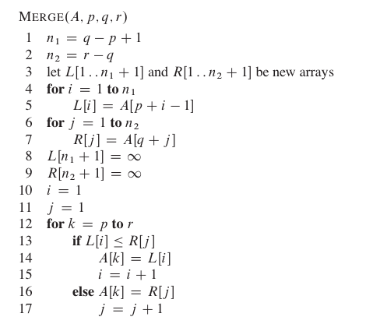
Merge Sort Algorithm

Slide 14
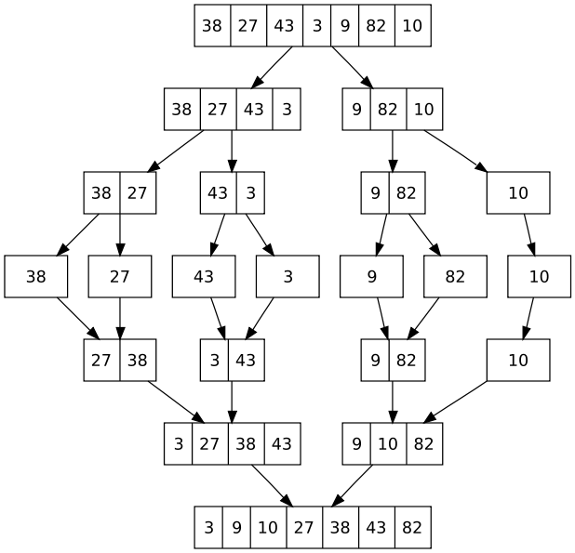
Merge Sort Example

Slide 15
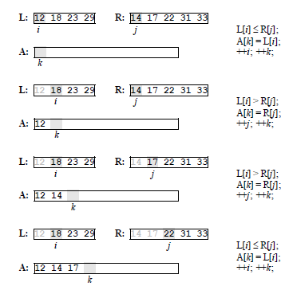
Merging – Example

Slide 16
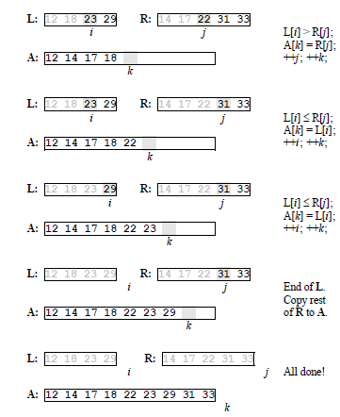
Merging – Example

Slide 17
Merge Sort Analysis (Worst Case)
In Merge sort algorithm the two recursive calls are made. Each recursive call focuses on n/2 elements of the list. After two recursive calls one call is made to combine two sub lists i.e to merge all n elements.
Recurrence Relation
  T(n) = T(n/2) + T (n/2) + (n)
  = 2T(n/2) + (n) Where n>1
  T(1) = 1 Where n=1

Slide 18
Merge Sort Analysis ( Worst Case)
  T(n) = T(n/2) + T (n/2) + (n)
  = 2T(n/2) + (n)
  Let n = 2^{k} i.e., k = log₂ n
T(2^{k} )= 2 T ( 2^{k} / 2 ) + ( 2^{k} )
= 2 T ( 2^{k-1} ) + 2^{k}
= 2 [2 T ( 2^{k-2} ) + 2^{k-1} ] + 2^{k}
= 2² T ( 2^{k-2} ) + 2^{k} + 2^{k}
= 2²[2 T ( 2^{k-3} ) + 2^{k-2} ]+ 2^{k} + 2k
= 2³ T ( 2^{k-3} ) + 2^{k} + 2^{k} + 2^{k}
= 2³ T ( 2^{k-3} ) + 3. ( 2^{k} )
and so on…
Let k=3
= 2^{k} T (2^{k-k} ) + k. (2^{k})
= 2^{k} T (1) + k. (2^{k})
= 2^{k} + k. (2^{k})
Substitute 2^{k} = n i.e., k = log₂ n
T(n)=n+ log₂ n .n
Therefore, T (n) = O (n log₂ n )

Slide 19
Merge Sort Analysis (Best Case)
When first element of one of the list is larger than the largest element in the other list, only (n/2) comparisons are needed to merge the two sorted list.
Recurrence Relation
  T(n) = T(n/2) + T (n/2) + (n/2)
  = 2T(n/2) + (n/2) Where n>1
  T(1) = 1 where n=1

Slide 20
Merge Sort Analysis ( Best Case)
  T(n) = T(n/2) + T (n/2) + (n/2)
  = 2T(n/2) + (n/2)
Let n = 2^{k} i.e., k = log₂ n
T(2^{k} )= 2 T ( 2^{k} / 2 ) + ( 2^{k} / 2 )
= 2 T ( 2^{k-1} ) + 2^{k-1}
= 2 [2 T ( 2^{k-2} ) + 2^{k-2} ] + 2^{k-1}
= 2² T ( 2^{k-2} ) + 2^{k-1} + 2^{k-1}
= 2² [2 T ( 2^{k-3} ) + 2^{k-3} ] + 2^{k-1} + 2^{k-1}
= 2³ T ( 2^{k-3} ) + 2^{k-1} + 2^{k-1} + 2^{k-1}
= 2³ T ( 2^{k-3} ) + 3. ( 2^{k-1} ) and so on…
Let k=3
= 2^{k} T ( 2^{k-k} ) + k. ( 2^{k-1} )
= 2^{k} T (1) + k. ( 2^{k-1} )
= 2^{k} + k. (2^{k} / 2 )
Substitute 2^{k} = n i.e., k = log₂ n
T( n) = n + n log₂ n / 2
T(n) = O(n log₂ n )

Slide 21
Merge Sort Analysis
Best Case : O(n log₂n)
Average Case : O(n log₂n)
Worst Case : O(n log₂n)

Slide 22
Finding Maximum and Minimum
Problem Description: Finding min, max elements recursively
Example: Consider a list of some elements from which maximum and minimum element can be found out.
We have divided the original list at mid and two sublists: sublist1 and sublist2 are created.
1 | 2 | 3 | 4 | 5 | 6 | 7 | 8 | 9
50 | 40 | -5 | -9 | 45 | 90 | 65 | 25 | 75
1 | 2 | 3 | 4 | 5
50 | 40 | -5 | -9 | 45
Sublist 1
6 | 7 | 8 | 9
90 | 65 | 25 | 75
Sublist 2

Slide 23
An Example: Finding Maximum and Minimum
Again divide each sublist and create further sublists. Then from each sublist obtain.
It is possible to divide the list (50,40,-5) further. Hence we have divided the list into sublists and min, max values are obtained.
1 | 2 | 3
4 | 5
50 | 40 | -5
-9 | 45
Sublists
6 | 7
8 | 9
90 | 65
25 | 75
Sublists
1 | 2
3
4 | 5
50 | 40
-5
-9 | 45
6 | 7
8 | 9
90 | 65
25 | 75

Slide 24
An Example: Finding Maximum and Minimum
Now further division of the list is not possible. Hence we start combining the solutions of min and max values from each sublist.
Combine (1,2) and (3) Min= -5, Max=50
Now we will combine (1,… 3) and (4,5) and the min and max values among them are obtained. Hence,
Min=-9 and Max=50
1 | 2
3
50 | 40
-5
1 | 2 | 3
4 | 5
50 | 40 | -5
-9 | 45

Slide 25
An Example: Finding Maximum and Minimum
Combine (6,7) and (8,9) Min=25, Max=90
Combine the sublists (1,… 5) and (6, … 9). Min=-9, Max=90
Thus the complete list is formed from which the min and max values are obtained. Hence final min and max values are
Min=-9 and Max=90
6 | 7
8 | 9
90 | 65
25 | 75
1 | 2 | 3 | 4 | 5
6 | 7 | 8 | 9
50 | 40 | -5 | -9 | 45
90 | 65 | 25 | 75

Slide 26
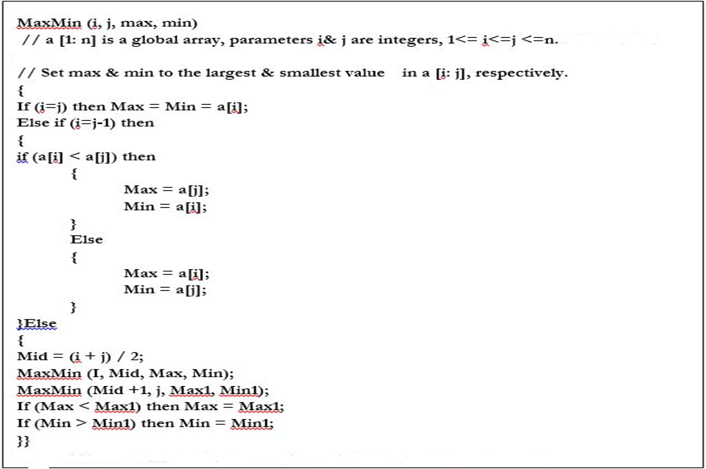
An Example: Finding Maximum and Minimum

Slide 27
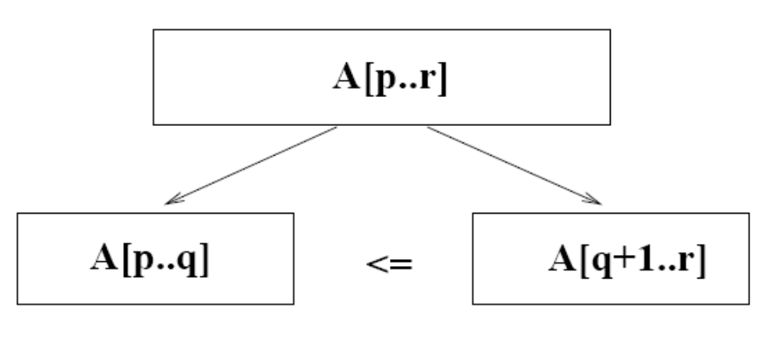
Quick Sort
Sorting Problem: Sort a sequence of n elements into non-decreasing order.
Divide: Partition the array A[p…r] into two sub arrays A[p…q-1] and A[q+1…r] such that each element of A[p…q-1] is less than or equal to A[q], which is, in turn, less than or equal to each element of A[q+1…r].
  Need to find index q to partition the array

Slide 28
An Example: Quick Sort
Conquer: Sort the two sub arrays A[p…q-1] and A[q+1…r] by recursive calls to quick sort.
Combine: Since the sup arrays are sorted in place, no work is needed to combine them: the entire array A[p…r] is now sorted.

Slide 29
Quick sort Algorithm
Given an array of n elements (e.g., integers):
If array only contains one element, return
Else
  pick one element to use as pivot.
  Partition elements into two sub-arrays:
    Elements less than or equal to pivot
    Elements greater than pivot
  Quick sort two sub-arrays
  Return results

Slide 30
Pick Pivot Element
There are a number of ways to pick the pivot element.
In this example, we will use the first element in the array:
40
20
10
80
60
50
7
30
100

Slide 31
Partitioning Array
Given a pivot, partition the elements of the array such that the resulting array consists of:
  One sub-array that contains elements >= pivot
  Another sub-array that contains elements < pivot
The sub-arrays are stored in the original data array.

Slide 32
pivot_index = 0
Pivot = 40
40
20
10
80
60
50
7
30
100
[0] [1] [2] [3] [4] [5] [6] [7] [8]
left
right

Slide 33
While data[left] <= data[pivot_index]
++left
pivot_index = 0
40
20
10
80
60
50
7
30
100
[0] [1] [2] [3] [4] [5] [6] [7] [8]
left
right

Slide 34
While data[left] <= data[pivot_index]
++left
pivot_index = 0
40
20
10
80
60
50
7
30
100
[0] [1] [2] [3] [4] [5] [6] [7] [8]
left
right

Slide 35
While data[left] <= data[pivot_index]
++left
pivot_index = 0
40
20
10
80
60
50
7
30
100
[0] [1] [2] [3] [4] [5] [6] [7] [8]
left
right

Slide 36
While data[left] <= data[pivot_index]
  ++left
While data[right] > data[pivot_index]
  --right
pivot_index = 0
40
20
10
80
60
50
7
30
100
[0] [1] [2] [3] [4] [5] [6] [7] [8]
left
right

Slide 37
While data[left] <= data[pivot_index]
  ++left
While data[right] > data[pivot_index]
  --right
pivot_index = 0
40
20
10
80
60
50
7
30
100
[0] [1] [2] [3] [4] [5] [6] [7] [8]
left
right

Slide 38
While data[left] <= data[pivot_index]
  ++left
While data[right] > data[pivot_index]
  --right
If left< right
  swap data[left] and data[right]
pivot_index = 0
40
20
10
80
60
50
7
30
100
[0] [1] [2] [3] [4] [5] [6] [7] [8]
left
right

Slide 39
While data[left] <= data[pivot_index]
  ++left
While data[right] > data[pivot_index]
  --right
If left< right
  swap data[left] and data[right]
pivot_index = 0
40
20
10
30
60
50
7
80
100
[0] [1] [2] [3] [4] [5] [6] [7] [8]
left
right

Slide 40
While data[left] <= data[pivot_index]
  ++left
While data[right] > data[pivot_index]
  --right
If left< right
  swap data[left] and data[right]
While right > left, go to 1.
pivot_index = 0
40
20
10
30
60
50
7
80
100
[0] [1] [2] [3] [4] [5] [6] [7] [8]
left
right

Slide 41
While data[left] <= data[pivot_index]
  ++left
While data[right] > data[pivot_index]
  --right
If left< right
  swap data[left] and data[right]
While right > left, go to 1.
pivot_index = 0
40
20
10
30
60
50
7
80
100
[0] [1] [2] [3] [4] [5] [6] [7] [8]
left
right

Slide 42
While data[left] <= data[pivot_index]
  ++left
While data[right] > data[pivot_index]
  --right
If left< right
  swap data[left] and data[right]
While right > left, go to 1.
pivot_index = 0
40
20
10
30
60
50
7
80
100
[0] [1] [2] [3] [4] [5] [6] [7] [8]
left
right

Slide 43
While data[left] <= data[pivot_index]
  ++left
While data[right] > data[pivot_index]
  --right
If left< right
  swap data[left] and data[right]
pivot_index = 0
40
20
10
30
60
50
7
80
100
[0] [1] [2] [3] [4] [5] [6] [7] [8]
left
right

Slide 44
While data[left] <= data[pivot_index]
  ++left
While data[right] > data[pivot_index]
  --right
If left< right
  swap data[left] and data[right]
While right > left, go to 1.
pivot_index = 0
40
20
10
30
7
50
60
80
100
[0] [1] [2] [3] [4] [5] [6] [7] [8]
left
right

Slide 45
While data[left] <= data[pivot_index]
  ++left
While data[right] > data[pivot_index]
  --right
If left< right
  swap data[left] and data[right]
While right > left, go to 1.
pivot_index = 0
40
20
10
30
7
50
60
80
100
[0] [1] [2] [3] [4] [5] [6] [7] [8]
left
right

Slide 46
While data[left] <= data[pivot_index]
  ++left
While data[right] > data[pivot_index]
  --right
If left< right
  swap data[left] and data[right]
While right > left, go to 1.
pivot_index = 0
40
20
10
30
7
50
60
80
100
[0] [1] [2] [3] [4] [5] [6] [7] [8]
left
right

Slide 47
While data[left] <= data[pivot_index]
  ++left
While data[right] > data[pivot_index]
  --right
If left< right
  swap data[left] and data[right]
While right > left, go to 1.
pivot_index = 0
40
20
10
30
7
50
60
80
100
[0] [1] [2] [3] [4] [5] [6] [7] [8]
left
right

Slide 48
While data[left] <= data[pivot_index]
  ++left
While data[right] > data[pivot_index]
  --right
If left< right
  swap data[left] and data[right]
While right > left, go to 1.
pivot_index = 0
40
20
10
30
7
50
60
80
100
[0] [1] [2] [3] [4] [5] [6] [7] [8]
left
right

Slide 49
While data[left] <= data[pivot_index]
  ++left
While data[right] > data[pivot_index]
  --right
If left< right
  swap data[left] and data[right]
While right > left, go to 1 otherwise go to 5
Swap data[right] and data[pivot_index]
pivot_index = 0
40
20
10
30
7
50
60
80
100
[0] [1] [2] [3] [4] [5] [6] [7] [8]
left
right

Slide 50
While data[left] <= data[pivot_index]
  ++left
While data[right] > data[pivot_index]
  --right
If left< right
  swap data[left] and data[right]
While right > left, go to 1 otherwise go to 5
Swap data[right] and data[pivot_index]
7
20
10
30
40
50
60
80
100
pivot_index = 4
[0] [1] [2] [3] [4] [5] [6] [7] [8]
left
right

Slide 51
Partition Result
7
20
10
30
40
50
60
80
100
pivot_index = 4
[0] [1] [2] [3] [4] [5] [6] [7] [8]
<= data[pivot]
> data[pivot]

Slide 52
Recursion: Quicksort Sub-arrays
7
20
10
30
40
50
60
80
100
[0] [1] [2] [3] [4] [5] [6] [7] [8]
<= data[pivot]
> data[pivot]

Slide 53
Quick Sort Routine
void quicksort(int a[],int l,int r)
{
int s;
if(l<r)
{
s=partition(a,l,r);
quicksort(a,l,s-1);
quicksort(a,s+1,r);
}
}

Slide 54
int partition(int a[],int left,int right)
{
int p,i,j,t;
i=left+1;
j=right;
p=a[left];
while(j>=i)// i and j interchange
{
while(a[i]<=p)
i++;
while(a[j]>p)
j--;
If(i<j)//i hold grater than pivot
{ //j hold less than pivot
t=a[i];
a[i]=a[j];
a[j]=t;
}
}
t=a[left];
a[left]=a[j];
a[j]=t;
return j;
}

