Slide 1
CHAPTER FOUR
GEOMETRY AND LINE GENERATION

Slide 2
Geometry and Line Generation
Point and Lines, Bresenham’s algorithm Generating Line, & Circle
Plotting General Curves
Line Thickness & Line Style
Polygons
Filling
Text and Characters
Colors

Slide 3
LINE GENERATION/DROWING ALGORITHM
A line connects two points.
It is a basic element in graphics.
To draw a line, you need two points between which you can draw a line.
we refer the one point of line as X0, Y0 and the second point of line as X1, Y1.

Slide 4
Cont..
Line drawing algorithm
Programmer specifies (x,y) values of end pixels
Need algorithm to figure out which intermediate pixels are on line path
Pixel (x,y) values constrained to integer values
Actual computed intermediate line values may be floats
Rounding may be required. E.g. computed point (10.48, 20.51) rounded to (10, 21)

Slide 5
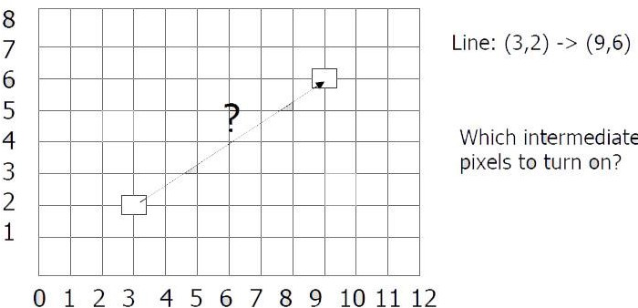
Cont..

Slide 6
Cont..
LINE EQUASION
Slope-intercept line equation (Cartesian equation) written as
𝑦 = 𝑓(𝑥) = 𝑚𝑥 + 𝑏
where m is the slope and b is the y-intercept. This is a function of only x and it would be useful to make this equation written as a function of both x and y. Using algebraic manipulation and recognition that the slope is the "rise over run" or dy/dx then

Slide 7
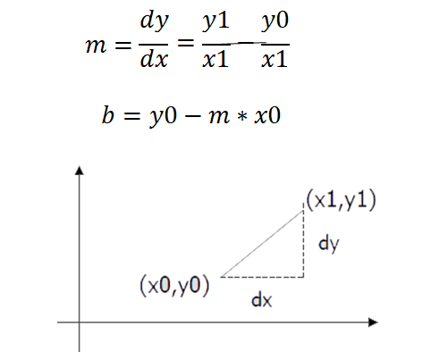
Cont..
Given two end points (x0,y0), (x1, y1), how to compute m and b?

Slide 8
Cont..
Numerical example of finding slope
m: (Ax, Ay) = (23, 41), (Bx, By) = (125,96)
M=𝐵𝑦−𝐴𝑦 = 96−41 = 55 = 0.5392
𝐵𝑥−𝐴x 125−23 102

Slide 9
DDA Algorithm
DDA algorithm is an incremental scan conversion method.
Here we perform calculations at each step using the results from the preceding step.
The characteristic of the DDA algorithm is to take unit steps along one coordinate and compute the corresponding values along the other coordinate.
The unit steps are always along the coordinate of greatest change

Slide 10
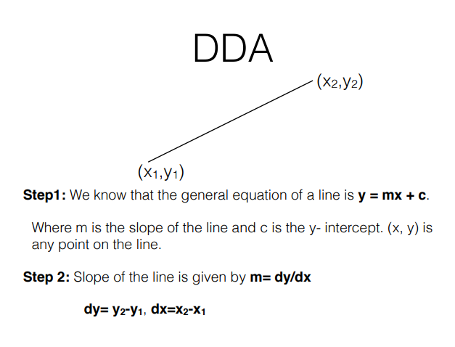

Slide 11
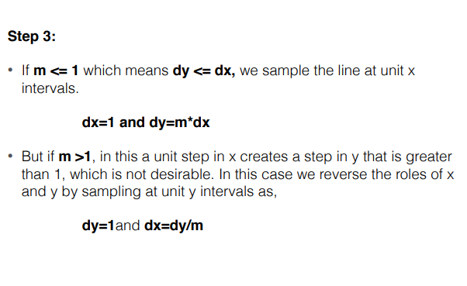
Cont..

Slide 12
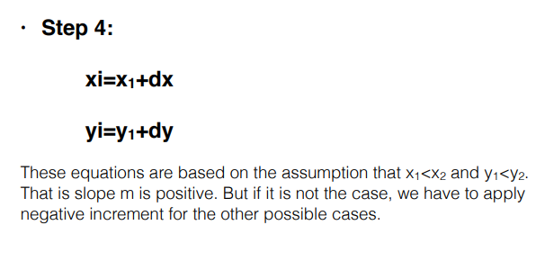
Cont..

Slide 13
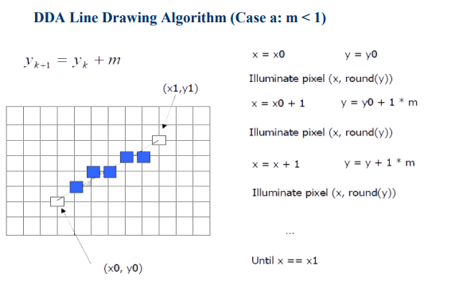

Slide 14
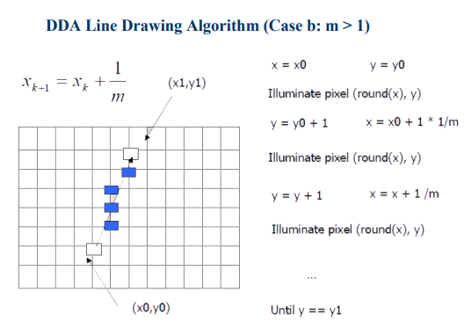

Slide 15
Cont..
DDA Line Drawing Algorithm Pseudocode
compute m;
if m < 1:
{
float y = y0; // initial value
for(int x = x0;x <= x1; x++, y += m)
setPixel(x, round(y));
}
else // m > 1
{
float x = x0; // initial value
for(int y = y0;y <= y1; y++, x += 1/m)
setPixel(round(x), y);
}

Slide 16
Bresenham’s LINE GENERATION
The Bresenham algorithm is another incremental scan conversion algorithm.
The big advantage of this algorithm is that, it uses only integer calculations.
Moving across the x axis in unit intervals and at each step choose between two different y coordinates.

Slide 17
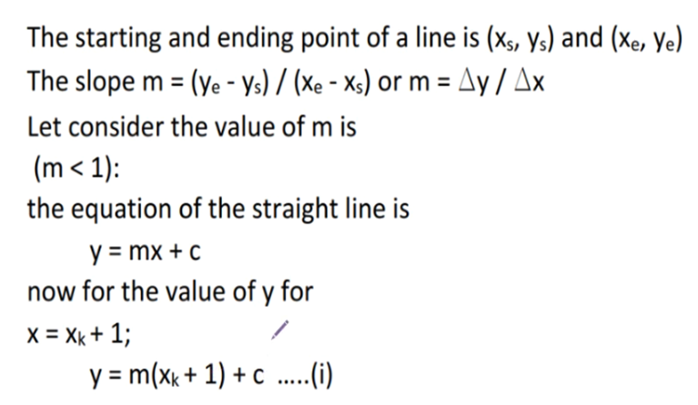
Cont..

Slide 18
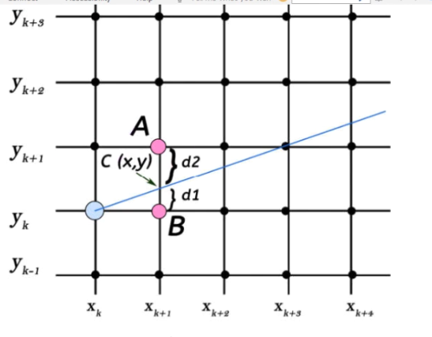
Cont..

Slide 19
Cont.…
In the diagram the starting point is blue dot(xk,yk).
There are two points A and B are there on the grid line
The line intersects the gird at point C (x,y).
The AC=d2 and BC= d1 with the values of d1 and d2 the next point will be selected.
Here a new term is introduced which is decision parameter(pk).
This parameter will take the decision which grid line will be selected yk or yk +1.

Slide 20
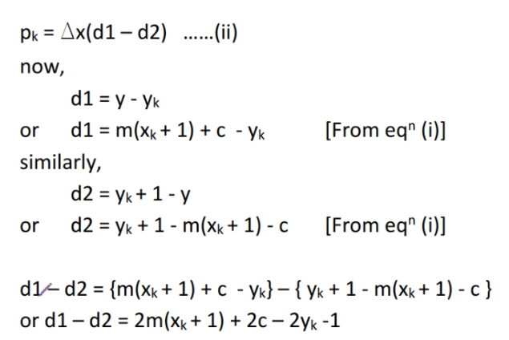
Cont..

Slide 21
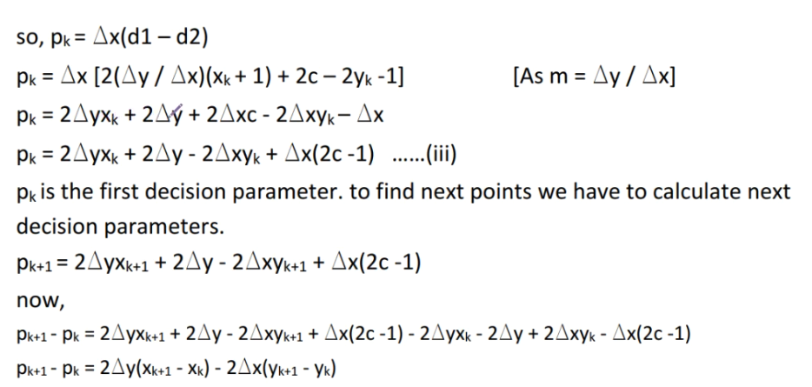
Cont..

Slide 22
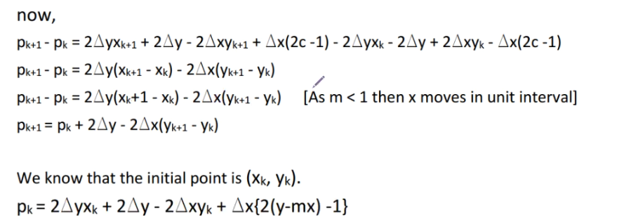
Cont..

Slide 23
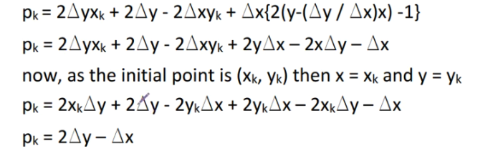
cont..

Slide 24
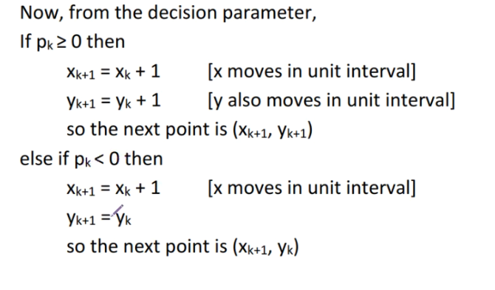
Cont..

Slide 25
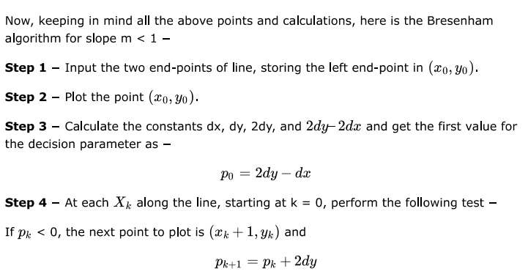
Cont..

Slide 26
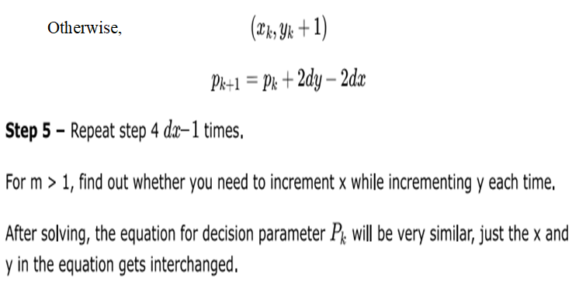
Cont.
Cont.

Slide 27
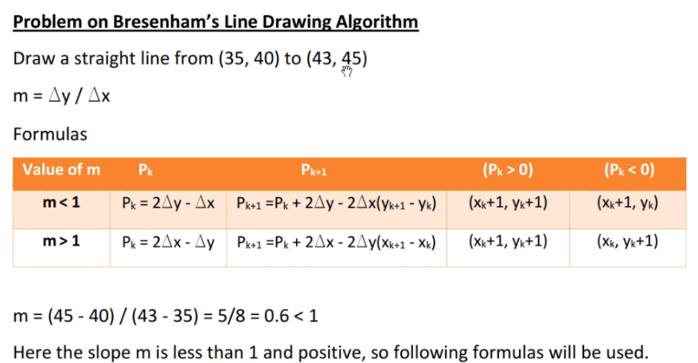

Slide 28
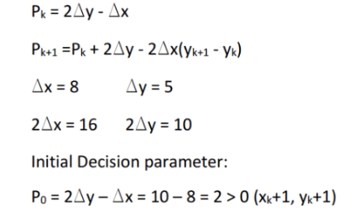
Cont..

Slide 29
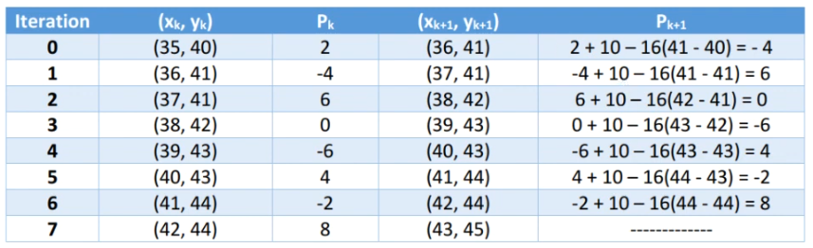
Cont..

Slide 30
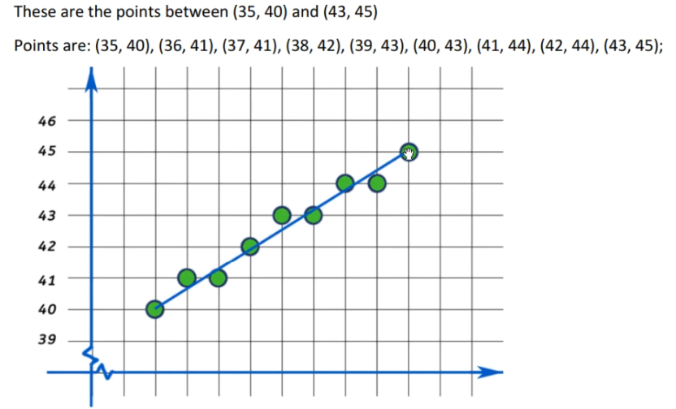
Cont..

Slide 31
Circle Generation Algorithm
A circle is a set of all points in a plane that are at a given distance from a given point, centre.
Drawing a circle on the screen is a little complex than drawing a line.
There are two popular algorithms for generating a circle:
Bresenham’s Algorithm and
Midpoint Circle Algorithm.
These algorithms are based on the idea of determining the subsequent points required to draw the circle.
Let us discuss the algorithms in detail: The equation of circle is X² + Y² = r² , where r is radius.

Slide 32

Cont..
So, we can write a simple circle drawing algorithm by solving the equation for y at unit x intervals using:
However, unsurprisingly this is not a brilliant solution!
Firstly, the resulting circle has large gaps where the slope approaches the vertical Secondly, the calculations are not very efficient
The square (multiply) operations
The square root operation

Slide 33
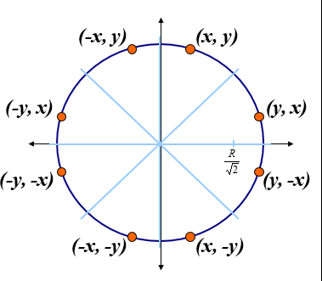
Cont..
We need a more efficient, more accurate solution
The first thing we can notice to make our circle drawing algorithm more efficient is that circles centred at (0, 0) have eight-way symmetry

Slide 34
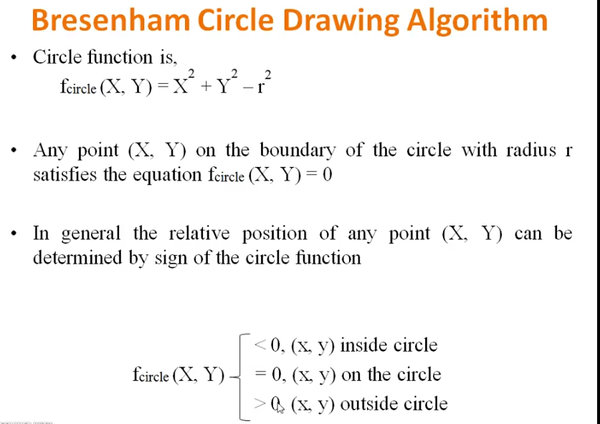

Slide 35
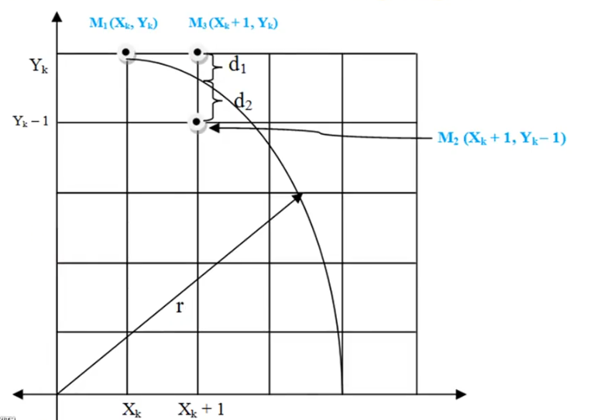
Cont..

Slide 36
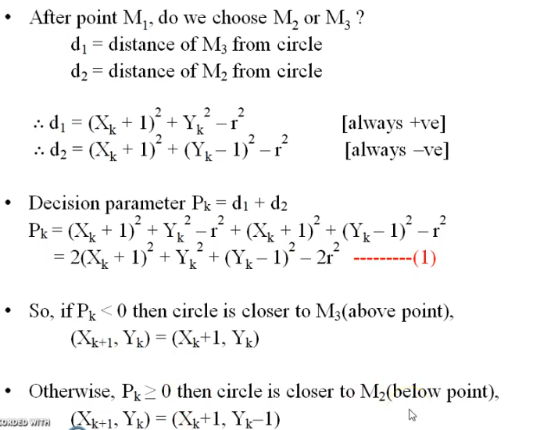
Cont..

Slide 37
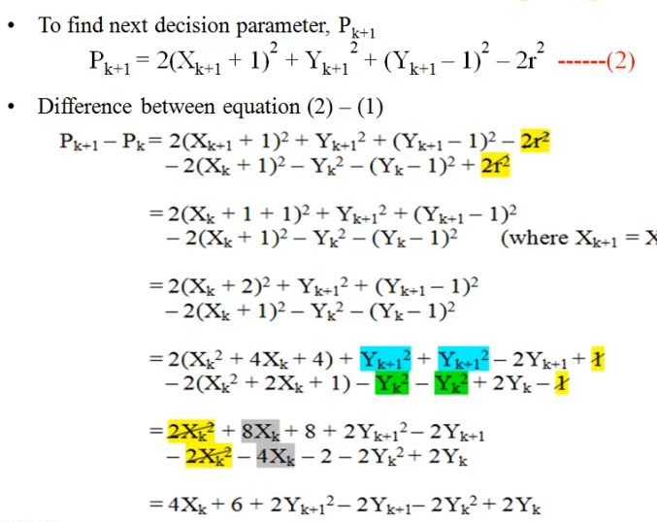
Cont..
=

Slide 38
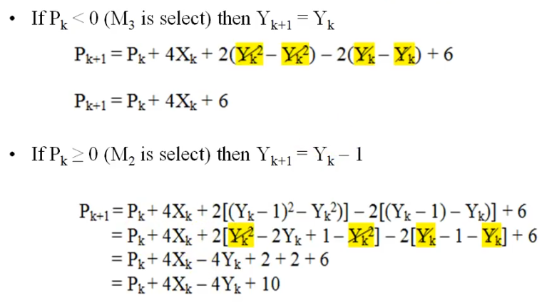

Cont..

Slide 39
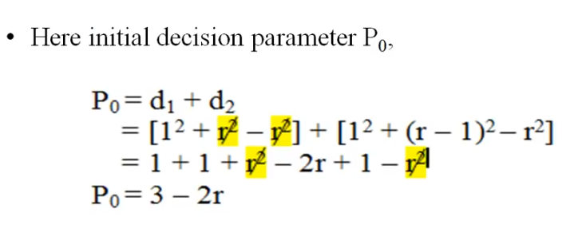
Cont.…

Slide 40
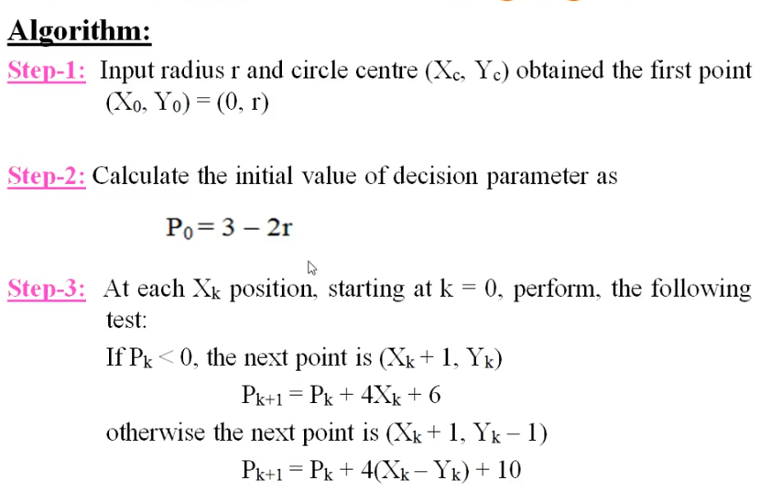
Cont.…

Slide 41
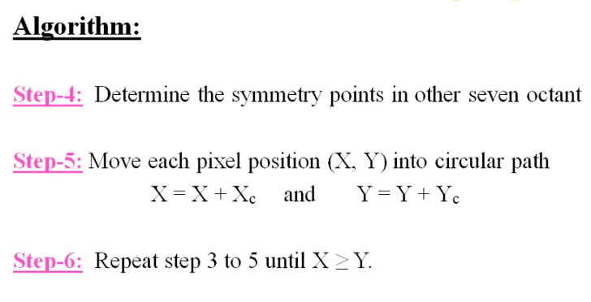
Cont.…

Slide 42
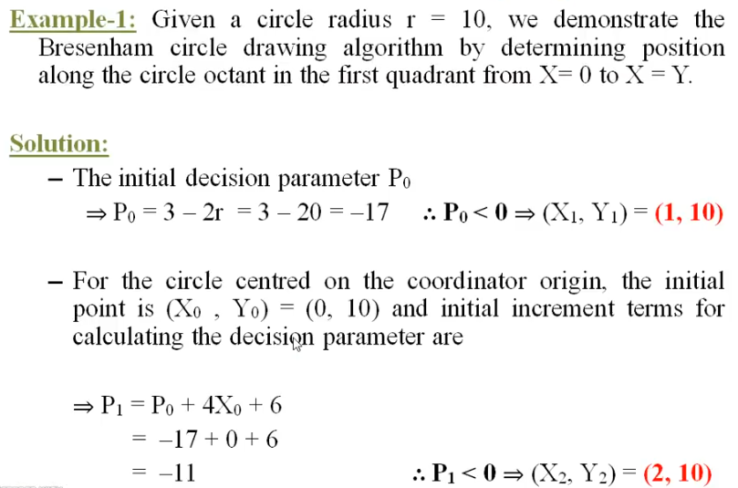

Slide 43
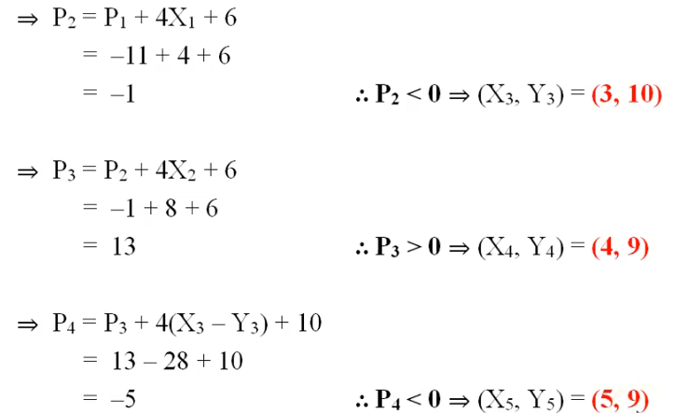

Slide 44
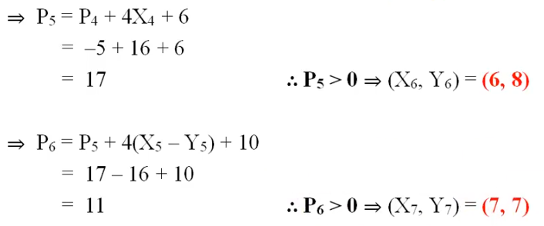

Slide 45
Point and Lines
Points
glBegin(GL_POINTS);
Vertex2i(100,50);
Lines
glBegin(GL_LINES);
Vertex2i(100,50);
Vertex2i(200,250);

Slide 46
Plotting curves
Plotting General Curves
Syntax
drawArc(Point Centre,
Float Radius,
Float Angle_a,
Float Angle_b)
a
b

Slide 47
Line thickness
Line Thickness (Width)
Syntax
void glLineWidth( GLfloat width);
width→ Specifies the width of rasterized lines. The initial value is 1.

Slide 48
Line style
Line Stipple
Syntax
void glLineStipple(Glint factor, Glushort pattern);
• sets the current stippling patten for lines
– the pattern argument is a 16 bit series of 0s and 1s, and it is repeated as necessary
– the pattern can be stretched out by using factor (factor is clamped between 1 and 256)
glLineStipple(1, 0x3F07);
glEnable(GL_LINE_STIPPLE);

Slide 49
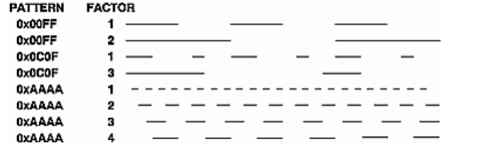
Con…

Slide 50
polygons
Polygon
Polygon refer to an object that has border that can be described by a line loop.
Types
GL_Polygon (more than four angles in an object)
GL_Quads (four different angles in an object)
GL_Triangles (three different angles in an object)

Slide 51
Polygons (contd…)
Attributes in Polygons
STRIP and FAN
GL_TRIANGLES_STRIP
GL_TRIANGLES_FAN
GL_QUAD_STRIP

Slide 52
filling
Filling Area
A basic fill-area attribute provided by a general graphics library is the display style of the interior.
void glShadeModel(GLenum mode);
mode →Accepted values are GL_FLAT and GL_SMOOTH. The initial value is GL_SMOOTH.

Slide 53
Text in graphics
Text
Combination or collection of characters which is meaningful called text(s).
There are two forms of text is available in Graphics,
Stoke Text (from predefined FONT)
glutStrokeCharacter(GLUT_STROKE_ROMAN, Char Text); (Roman Font)
Raster Text (creating with Vertices)
glutBitmapCharacter(GLUT_BITMAP_8_BY_13 , Char Text);
( 8 x 13 size)

Slide 54
Colors
Color
Color is one of the most interesting aspects of both human perception and computer graphics.
Subtractive -CMY Model
Additive - RGB Model

Slide 55
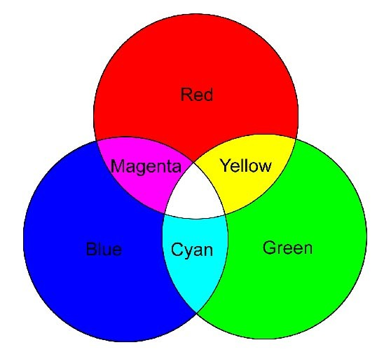
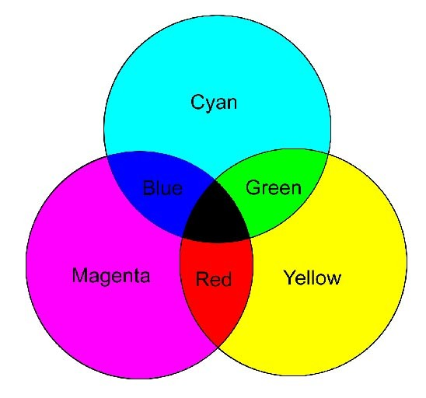
Cont..
Color combinations that result from combining primary colors available in the two situations additive color and subtractive color.
a): RGB is used to specify additive color.
(b): CMY is used to specify subtractive color

Slide 56
Color values
Red | Green | Blue | Color as Output
1.0 | 0.0 | 0.0 | Red
0.0 | 1.0 | 0.0 | Green
0.0 | 0.0 | 1.0 | Blue
1.0 | 1.0 | 0.0 | Yellow
0.0 | 1.0 | 1.0 | Cyan
1.0 | 0.0 | 1.0 | Magenta
1.0 | 1.0 | 1.0 | White
0.0 | 0.0 | 0.0 | Black

Slide 57
End of Chapter 4

