Slide 1
<Questionnaire for Business Strategy & Marketing>
Please describe for the below questions. Be specific.
COMPANY OVERVIEW
1. COMPANY OWNERSHIP : (founder 60%, co-owners 40%)
2. WHAT IS THE COMPANY'S VISION? our vision is to be the biggest sericulture farm in Ethiopia and to dominate the world market by our silk products
3. WHAT ARE THE COMPANY'S MAIN SERVICES?
Rearing of silkworm to produce silk and silk products
Processing fresh cocoon By using our processing machines, drying, boiling, reeling of silk cocoons, re-reeling, dyeing, twisting, weaving and finishing processing will be carried out. Different clothe types such as scarves, cultural female and male clothes made from silk and cotton will be prepared as the primary product.
COMPANY PERFORMANCE
4. WHAT ARE SOME OF THE COMPANY'S CURRENT GOALS?
- SALES: AVERAGE GROWTH %, INCREASE OR DECREASE ?
- SUMMARY OF OVERALL : sales, profit margin, projected future projects
Become the #1 silk producer in Ethiopia with 50% market share by 2025
Increase raw silk production capacity to 500 metric tons annually by 2027
Reduce defects in reeling and weaving to <1% by 2023
Expand distribution networks to export silk to 10 new global markets by 2026
5. WHAT WAS THE COMPANY'S REVENUE GROWTH IN THE PREVIOUS FINANCIAL YEARS? (3 years)

Slide 2
ENTREPRENEUR BACKGROUND
6. WHAT IS THE ENTREPRENEUR'S BACKGROUND AND EXPERIENCE IN THE INDUSTRY?
(number of years in the industry, affiliation to industry bodies, understanding of the industry and desire to grow in the industry ) I possess an educational background in purchasing and fashion design. I bring a fresh perspective to the industry with a desire to grow and excel. I also work with the international center of insect physiology and ecology(icipe) which has a big role on sericulture farm in Ethiopia.
7. WHAT DROVE THE ENTREPRENEUR TO START THE BUSINESS? The passion I have for the industry
8. WHAT ARE SOME OF THE CHALLENGES IN RUNNING THE BUSINESS? Financial and the limit to access some machineries.
9. WHAT ARE SOME OF THE HIGHLIGHTS IN RUNNING THE BUSINESS? I work with the international center of insect physiology and ecology(icipe) and through this company I have already built the market linkage with the smallholders who produce silk cocoon , yarn and also make the final products.
10.WHAT TITLE DOES THE OTHER DIRECTOR/S HAVE AND WHAT ROLE/S DO THEY PLAY IN THE BUSINESS? The co-owner is there for consultancy and some financial availability.
HUMAN RESOURCES
11. WHAT IS THE TOTAL NUMBER OF STAFF IN THE COMPANY? There are 6
12. DOES THE COMPANY HAVE ANY TEMPORARY STAFF? Yes I have some weavers who works me in there house
GROWTH IN THE MARKET
13. SALES: is there a dedicated sales resource, is there a sales pipeline, how does the company sell to potential clients? When we get some exhibitions or other events.
14. MARKETING: is there a dedicated marketing resource/plan/process followed, how does the company market its services to potential clients? The company markets its services to potential clients through social media engagement
15. CLIENT RETENTION: what is the business's repeat business like? We are working on the quality of our products to maintain our potential clients

Slide 3
16. PERFORMANCE MANAGEMENT : does the business conduct structured performance management for staff? Yes
STRUCTURAL CAPABILITY
17. DOES THE BUSINESS HAVE EXISTING SYSTEMS, POLICIES AND PROCESSES THAT IT UTILIZES? Not yet
18. DOES THE BUSINESS HAVE RELEVANT RESOURCES TO SUPPORT ITS FINANCIAL AND STRATEGIC GROWTH? We are short on that area
STRATEGIC OUTLOOK
19. DOES THE BUSINESS HAVE A STRATEGIC PLAN IN PLACE? yes it does
20. IS THE STRATEGIC PLAN REVIEWED REGULARLY? Yes
21. DOES THE BUSINESS HAVE SALES TARGETS FOR THE YEAR? Yes it does.
22. DOES THE BUSINESS HAVE SALES PROJECTIONS FOR THE YEAR? Yes it does
23. ARE THE BUSINESS'S STRATEGIC OBJECTIVES ALIGNED WITH ITS OPERATIONAL ACTIVITIES? Yes
24. DOES THE BUSINESS HAVE ALONG TERM PLAN IN PLACE? Yes of course
25. ARE THE BUSINESS'S STRATEGIC OBJECTIVES ALIGNED WITH ITS OPERATIONAL ACTIVITIES?
KEY GAPS IDENTIFIED
26. HIGH PRIORITY AREAS? The production and marketing areas are high priority
27. ANY KEY AREAS OF DEVELOPMENT IDENTIFIED? The management area
28. What are the key determinants for your customers to make a purchase?
– Product, Price, Promotion, quality, or delivery? Be specific. The products and quality
29. If you could change one thing about your business, what would it be? Be specific. The working area

Slide 4
30. MARKETING OUTLOOK
Company has a marketing strategy / plan and is implementing it
Alignment of business activities with sales targets
Customers have clearly identified and defined the business's unique selling point or competitive advantage
USP comes through strongly in all company marketing material
USP is something that, were it to be removed, would critically impact on the business
Branding of the business
Clear target market segment
Understanding of competitors
SUMMARY for the marketing question. Be specific.
We aim to make our Business activities closely aligned with sales targets, and the customer-perceived Unique Selling Point (USP) is evident in all marketing materials, underscoring its importance. The USP is integral to the business's success and removal would have a significant impact. The brand's identity is strong, targeting a specific market segment while maintaining a clear understanding of competitors.

Slide 5
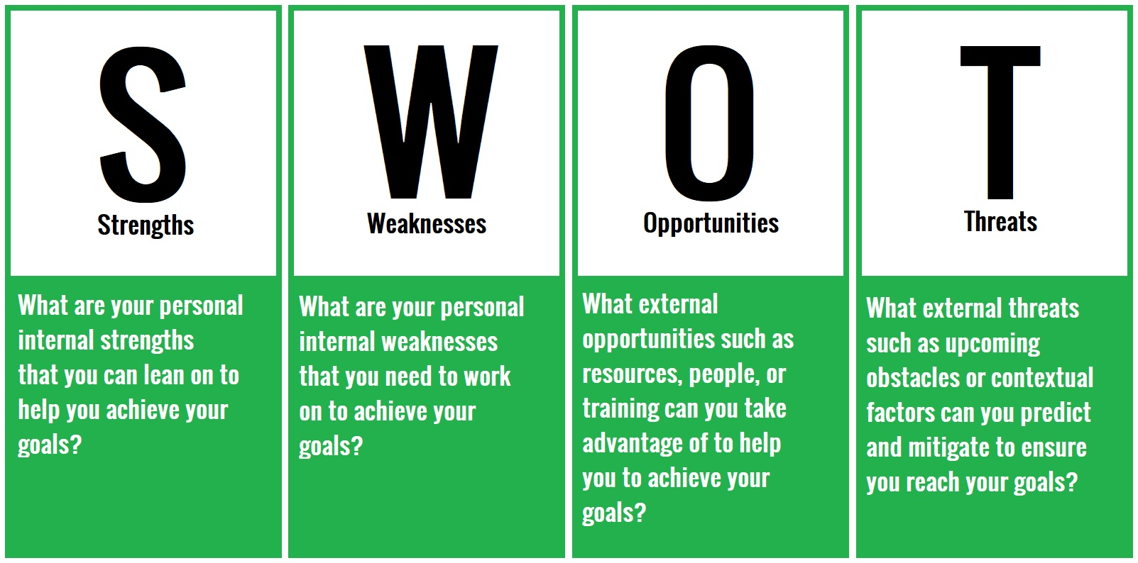

Slide 6
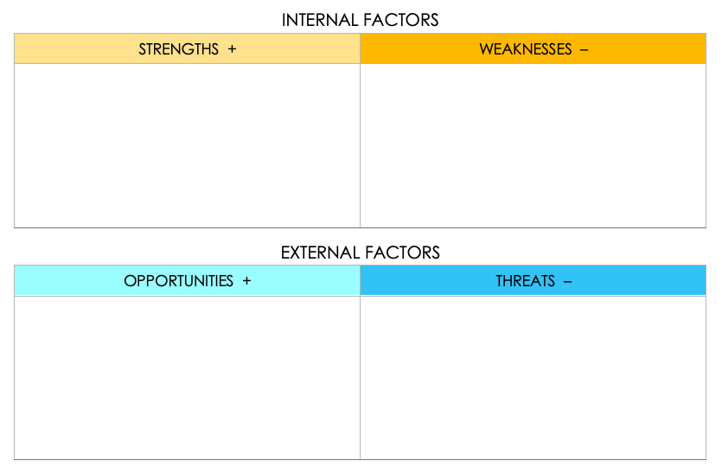
SIMPLE SWOT MATRIX TEMPLATE
I believe my strength lies in me being the CEO with the skills I have in fashion design I can design my products by myself
Lack of connection internationally to get market linkage
Working with ICIPE is a big opportunity for me also get some trainings on the field, sericulture field is on infant stage in Ethiopia so that I can work on it widely
Competition: Increased competition from similar businesses might impact market share and pricing strategies.

