Slide 1
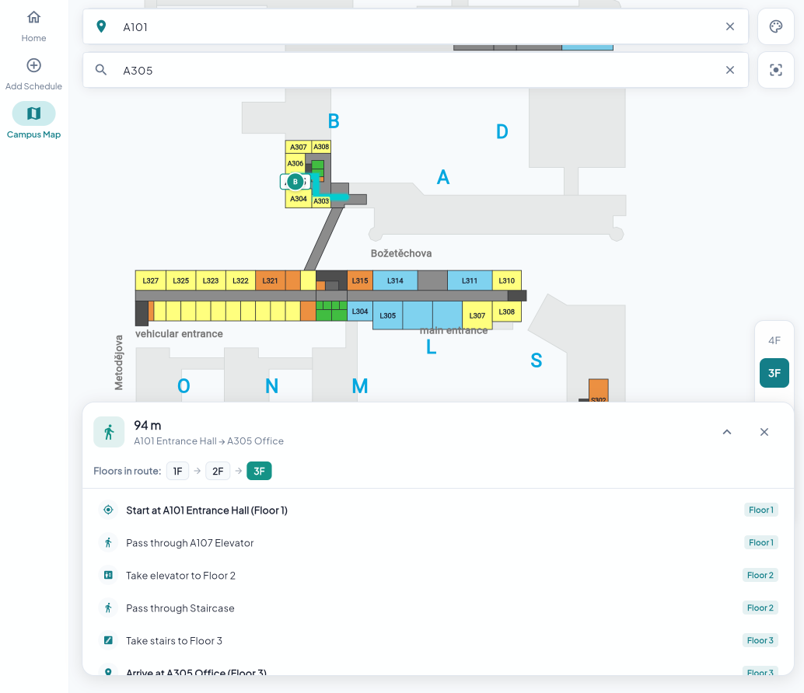
SYNCUP
Meet here.
Find it.
University appointment scheduling and indoor campus navigation
Adar Otieno · Eyobed Awel Nuri · Pengwei Jiang · Mengran Zhao
FIT VUT · September 2026
Notes:
Source: SyncUp technical report, September 2026.
Opening slide.

Slide 2
THE PROBLEM
02
One appointment involves two separate journeys
BOOK
LOCATE
CONNECT
Finding a free consultation slot often relies on email exchanges.
New students and visitors can struggle to find an office or lab.
Calendar tools and indoor maps do not share the meeting context.
Schedule the meeting
Reach the destination
Keep the context
SyncUp brings booking and campus navigation into one student-facing flow.
Notes:
Source: SyncUp technical report, September 2026.
Problem framing based on report sections Results and Practical Application.

Slide 3
THE SOLUTION
03
A single flow from availability to arrival
1
2
3
Choose a time
Meeting details
Open the route
Students browse staff availability and submit a consultation request.
The booking keeps the appointment’s location available at the right moment.
The map can focus on the destination and show an indoor path across floors.
Flutter application · PocketBase scheduling data · FIT indoor map data
Notes:
Source: SyncUp technical report, September 2026.
Solution overview based on report Results and Technical Details.

Slide 4
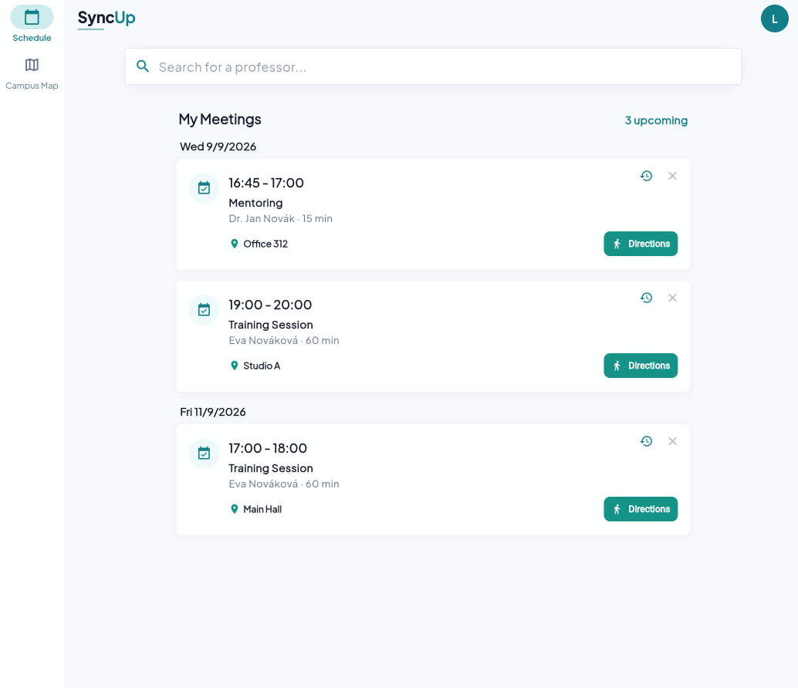
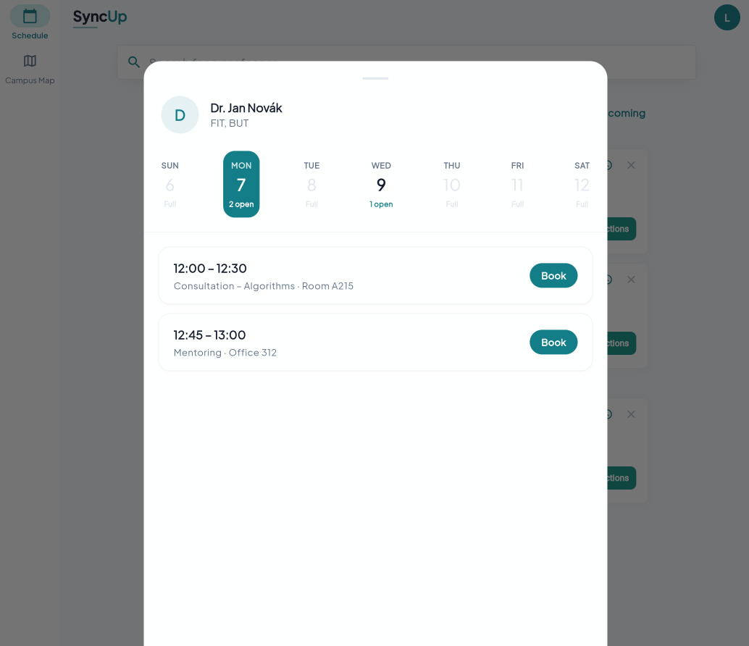
SCHEDULING
04
Student booking
Find
a professor
View availability by week
Pick an open slot and add a topic
The app replaces guesswork with visible times.
Notes:
Source: SyncUp technical report, September 2026.
Screens: report/assets/stud home.png and stud book.png. Features: report Results, Scheduling System, For Students.

Slide 5
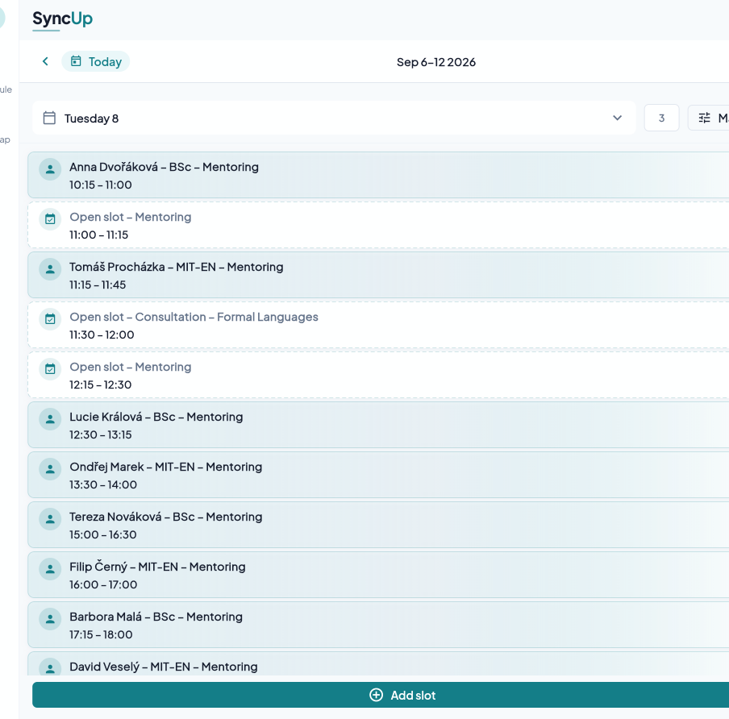
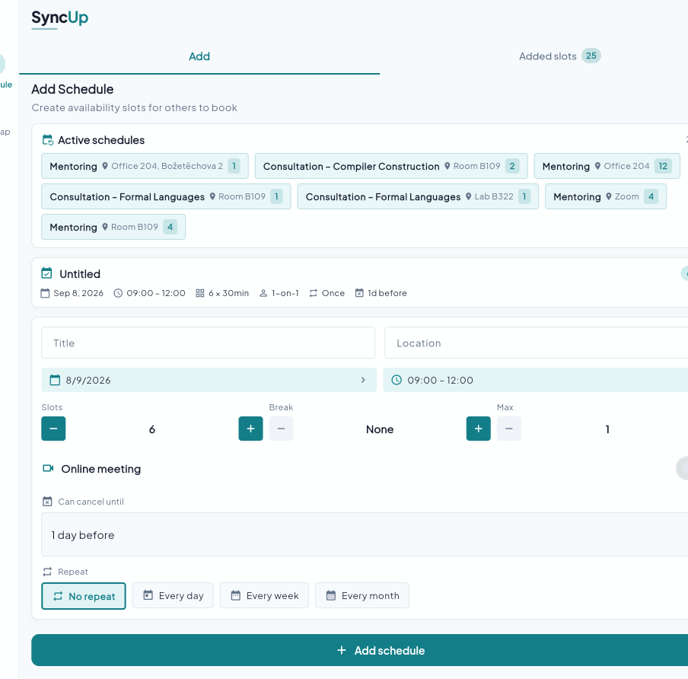
SCHEDULING
05
Availability management
For staff
Recurring availability fits a university timetable
Define a time range.
Review appointments.
Block exceptions such as holidays or conferences.
Weekly views keep incoming requests visible.
Notes:
Source: SyncUp technical report, September 2026.
Screens: report/assets/prof home.png and prof create slots.png. Features: report Results, Scheduling System, For Professors.

Slide 6
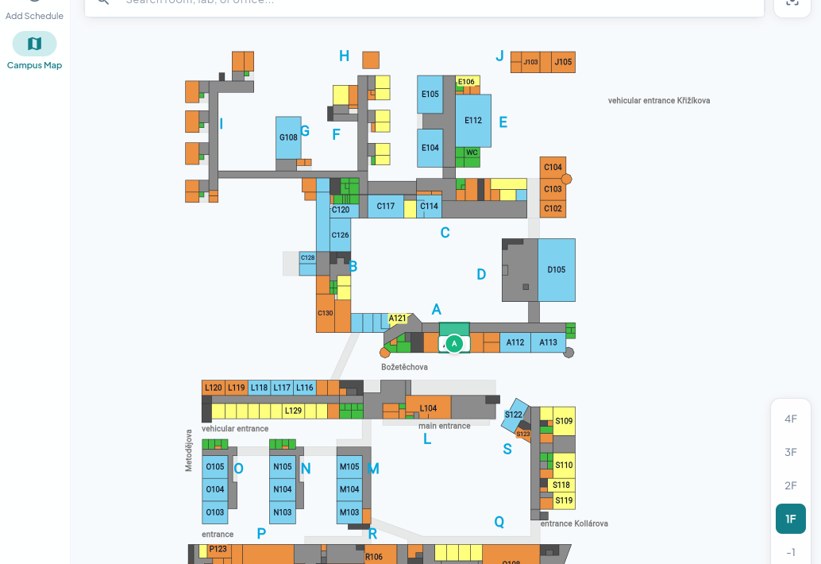
FITMAPS
06
Indoor map and room search
Campus layout
The interactive map supports panning, zooming, room selection, and search for labs or offices.
FIT campus data supports the project demonstration.
Notes:
Source: SyncUp technical report, September 2026.
Screen: report/assets/campus map.png. Features: report Results, Interactive Campus Layout.

Slide 7
NAVIGATION
07
Multi-floor route guidance
A101
Corridor and stair or elevator transition
Room destination
Dijkstra finds the lowest-weight path on the mapped campus graph; a floor-change penalty helps avoid unnecessary transitions.
Notes:
Source: SyncUp technical report, September 2026.
Screen: report/assets/campus routing multi floor.png. The graph uses Dijkstra; cross-floor edges receive a heuristic penalty.

Slide 8
INTEGRATION
08
The meeting location can become a route
01
02
03
Booking
Navigate
Route
A confirmed consultation includes its room.
The user opens navigation from meeting context.
The map targets the office and shows directions.
This connection helps users act on a booking without switching to a separate wayfinding tool.
Notes:
Source: SyncUp technical report, September 2026.
Integration described in report Multi-Floor Navigation.

Slide 9
TECHNICAL DETAILS
09
Prototype architecture and safeguards
Flutter client
Route engine
Scheduling service
Cross-platform scheduling and map UI
Custom-painted indoor geometry
Room search, floor selection, pan and zoom
Dijkstra on 1,004 nodes and 2,116 edges
Weighted floor changes add a 40 m-equivalent penalty
Mapped stairs and elevators guide transitions
Node.js Express API with PocketBase and SQLite
Recurring templates and date-specific slots
Unique slot key rejects duplicates with HTTP 409
Current scope: static indoor data and heuristic weighting. Live positioning, calendar integration, security/load testing, and campus validation belong to the next pilot.
Notes:
Source: SyncUp technical report, September 2026.
Flutter keeps scheduling and navigation in one client. The map renders bundled indoor geometry; Dijkstra runs on a pre-built campus graph. The booking API derives a stable key for each offered slot. The database rejects a second record for that key and the API returns HTTP 409. This is a prototype safeguard, not a claim of production-scale concurrency testing.

Slide 10
NEXT STEPS
10
Future development
Where the prototype can grow
SyncUp
1
BLE positioning
Use indoor beacons to estimate the user’s live location.
A practical foundation for easier campus meetings.
2
Campus coverage
Extend the map dataset beyond the primary FIT campus.
3
Wider adoption
Thank you
Adapt the scheduling and map model for other faculties or universities.
Notes:
Source: SyncUp technical report, September 2026.
Roadmap based on report Further Development and Practical Application/Deployment.

