Slide 1
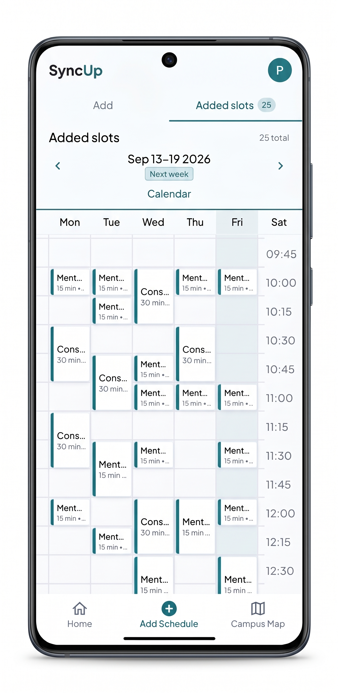

SyncUp
University appointment scheduling and indoor campus navigation
Adar Otieno · Eyobed Awel Nuri · Pengwei Jiang · Mengran Zhao
FIT VUT · September 2026
Notes:
Source: SyncUp technical report, September 2026.
Opening slide.

Slide 2
THE PROBLEM
02
One appointment involves multiple work
BOOK
LOCATE
CONNECT
Scheduling a consultation often relies on email exchanges and other fragmented methods
New students and visitors can struggle to find an office or class room.
Existing tools do not store the meeting context, history and aid with organisation
Scheduling the meeting
Reaching the destination
Keeping the context
SyncUp brings booking and campus navigation into one flow.
Notes:
Source: SyncUp technical report, September 2026.
Problem framing based on report sections Results and Practical Application.

Slide 3
OUR SOLUTION
03
One singular method from scheduling to arrival
1
2
3
Choose a time
Meeting details
Open the route
Students browse staff availability and submit a consultation request.
The booking keeps organisation of multiple consultations easy
The map can focus on the destination and show an indoor path across floors.

Slide 4
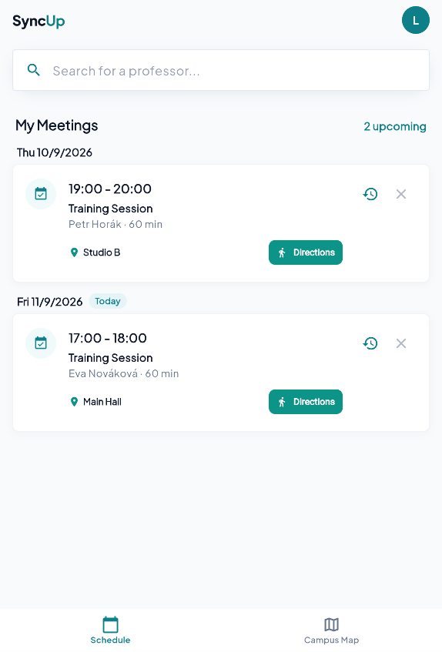
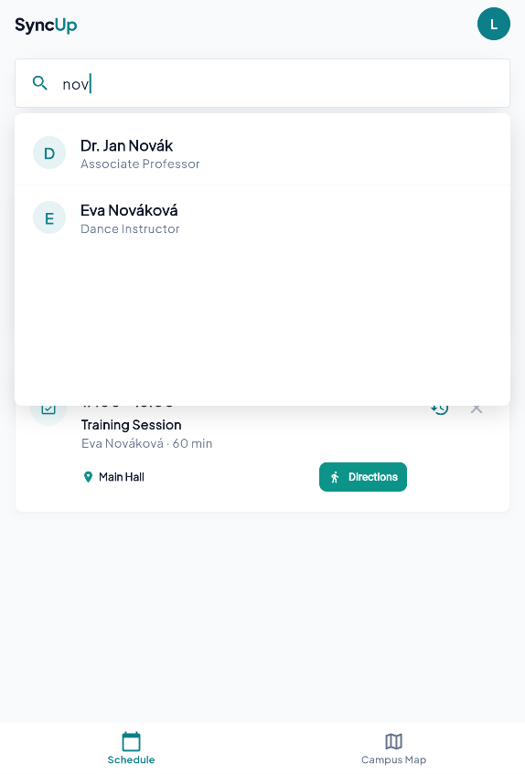
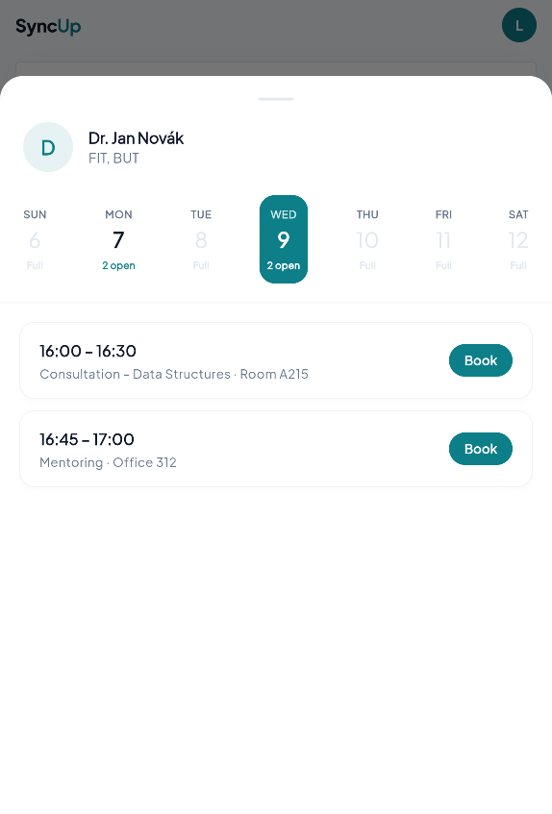
SCHEDULING
04
Student booking
home page
search
book
Notes:
Source: SyncUp technical report, September 2026.
Screens: report/assets/stud home.png and stud book.png. Features: report Results, Scheduling System, For Students.

Slide 5
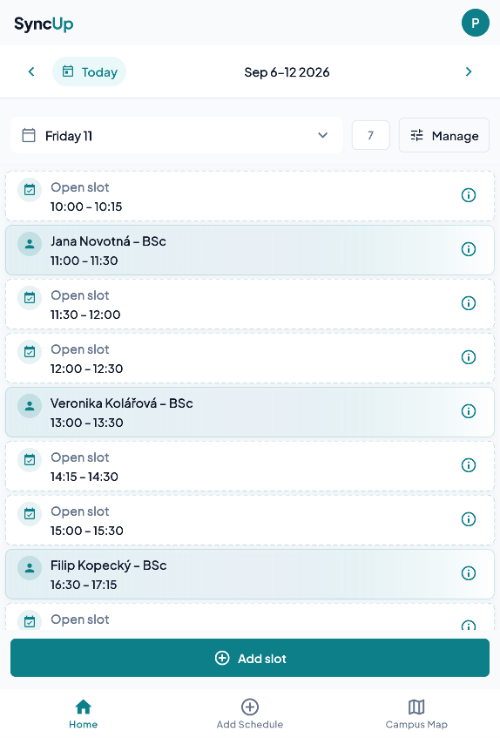
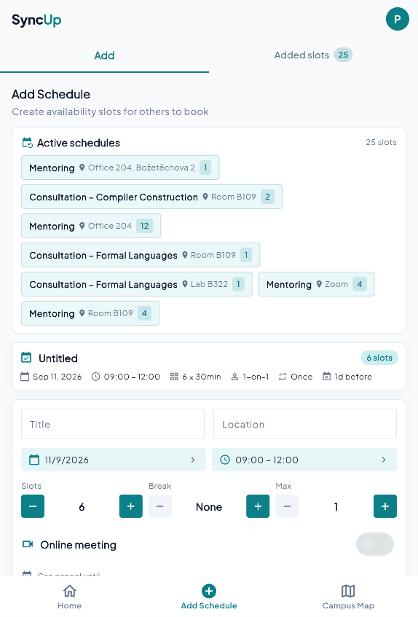
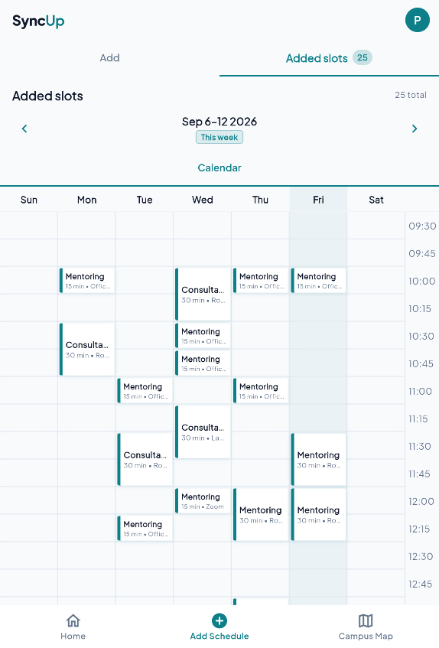
SCHEDULING
05
Availability management for staff
Schedule viewer
Setting up slots including recurring slots
Week viewer
Notes:
Source: SyncUp technical report, September 2026.
Screens: report/assets/prof home.png and prof create slots.png. Features: report Results, Scheduling System, For Professors.

Slide 6
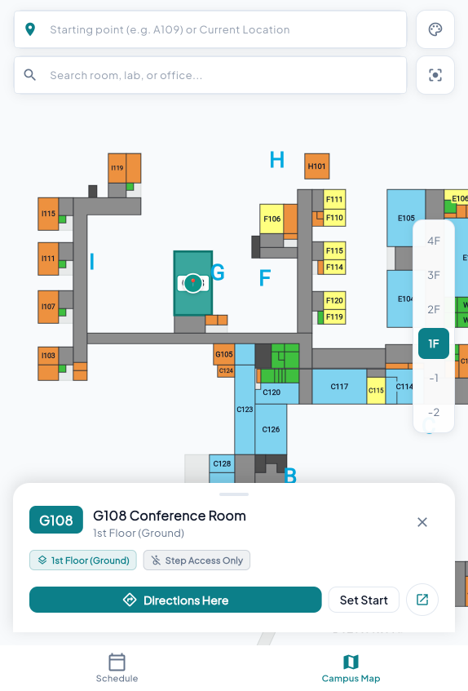
FITMAPS
06
Indoor mapping and room search
Demo on FIT campus
Information on all rooms and floors
Interactive floor selector
Detailed room cards
One-click route generation
Integrated fully with the scheduling system
Notes:
Source: SyncUp technical report, September 2026.
Screen: report/assets/campus map.png. Features: report Results, Interactive Campus Layout.

Slide 7
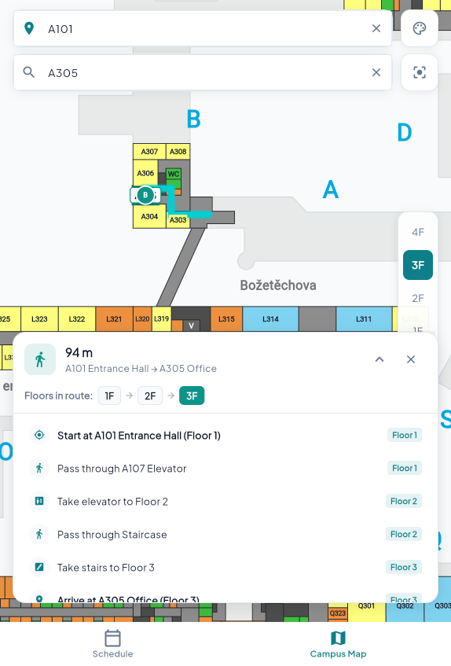
NAVIGATION
07
Routing
Finds the shortest path
multi-floor support
Notes:
Source: SyncUp technical report, September 2026.
Screen: report/assets/campus routing multi floor.png. The graph uses Dijkstra; cross-floor edges receive a heuristic penalty.

Slide 8
INTEGRATION
08
The meeting location can become a route
01
02
03
Booking
Navigate
Route
A confirmed consultation includes its room.
The user opens navigation from meeting context.
The map targets the office and shows directions.
Notes:
Source: SyncUp technical report, September 2026.
Integration described in report Multi-Floor Navigation.

Slide 9
TECHNICAL DETAILS
09
Prototype architecture
Flutter frontend
Route engine
Scheduling backend service
Cross-platform scheduling and map UI
Custom-painted indoor geometry
Room search, floor selection, pan and zoom
Dijkstra on 1,004 nodes and 2,116 edges
Weighted floor changes add a 40 m-equivalent penalty
Mapped stairs and elevators guide transitions
Node.js Express API with PocketBase and SQLite
Recurring templates and date-specific slots
Unique slot key rejects duplicates with HTTP 409
Current scope: static indoor data and heuristic weighting.
Live positioning, calendar integration, security/load testing, and campus validation belong to the next pilot.
Notes:
Source: SyncUp technical report, September 2026.
Flutter keeps scheduling and navigation in one client. The map renders bundled indoor geometry; Dijkstra runs on a pre-built campus graph. The booking API derives a stable key for each offered slot. The database rejects a second record for that key and the API returns HTTP 409. This is a prototype safeguard, not a claim of production-scale concurrency testing.

Slide 10
NEXT STEPS
10
Future development
Where the prototype can grow
SyncUp
1
WiFi triangulation real time navigation.
GPS does not work or is inaccurate indoors
2
Campus coverage
Extend the map dataset beyond the primary FIT campus.
3
Generalised solution
Thank you
Adapt the scheduling and map model for other faculties or universities.
Notes:
Source: SyncUp technical report, September 2026.
Roadmap based on report Further Development and Practical Application/Deployment.

Slide 11
11
Děkuju
SyncUp
SyncUp
Thank you
Online demo
Notes:
Source: SyncUp technical report, September 2026.
Roadmap based on report Further Development and Practical Application/Deployment.

