Slide 1

Final Presentation
VQueue
Adam Selmane, Eyobed Awel Nuri, Lucas Labhini, Kaung San, Krystof Michalek,

Slide 2
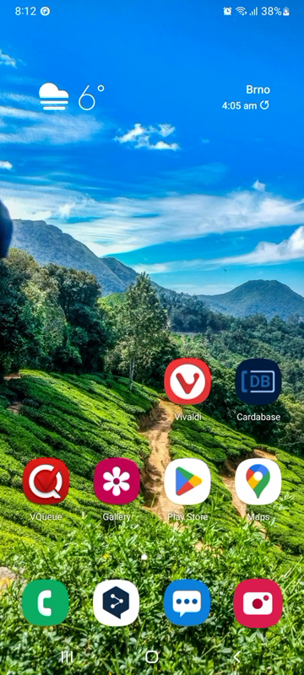
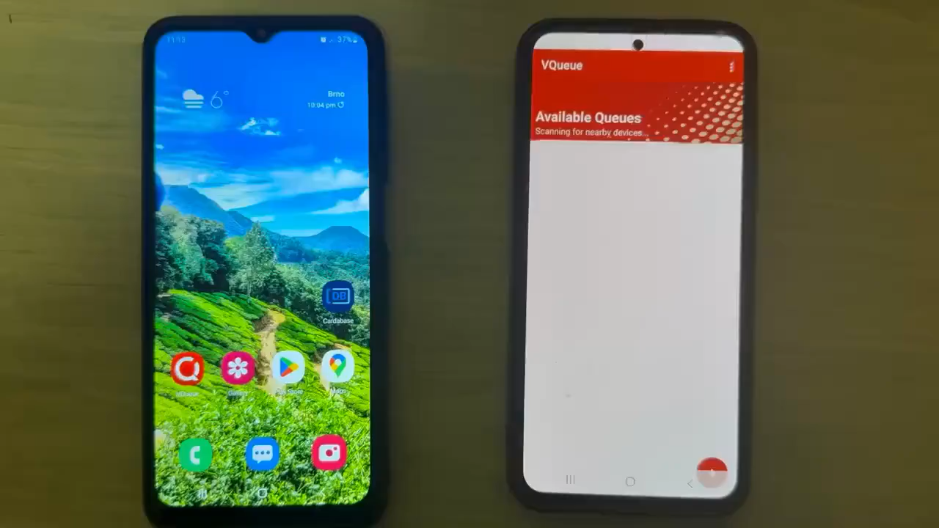
Result
Create flow
Join flow

Slide 3
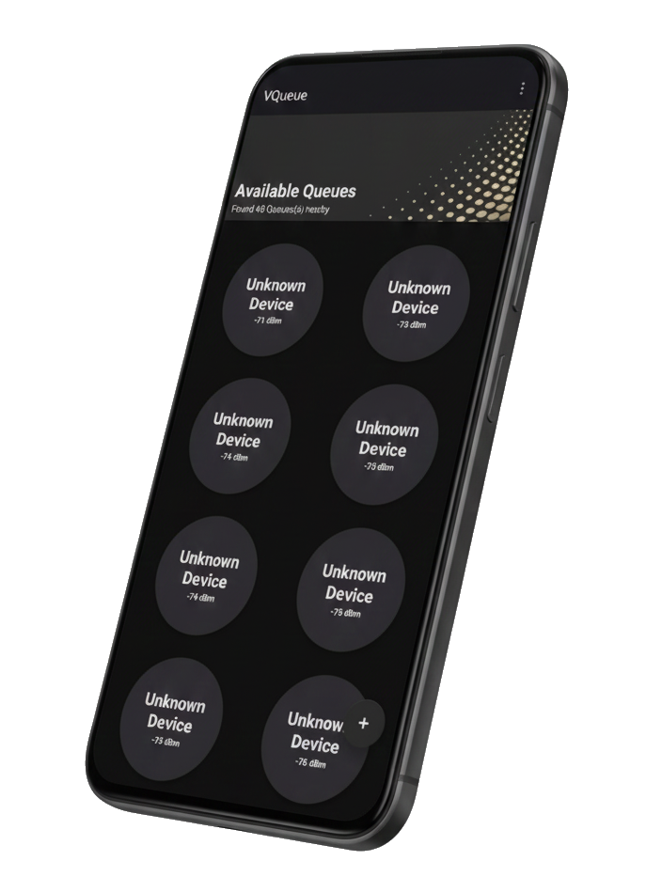
Dark mode
Thank You

