Slide 1


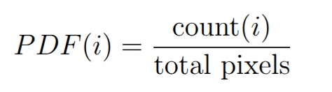
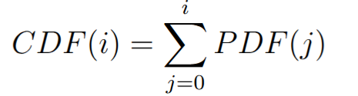
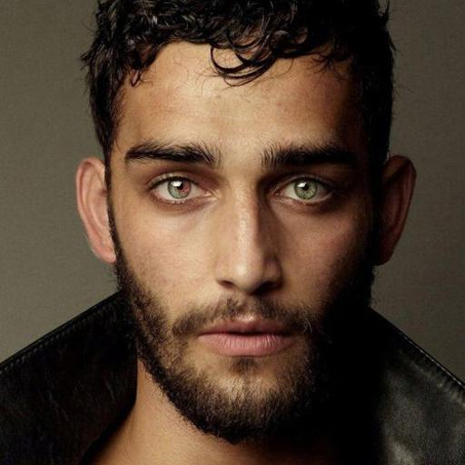
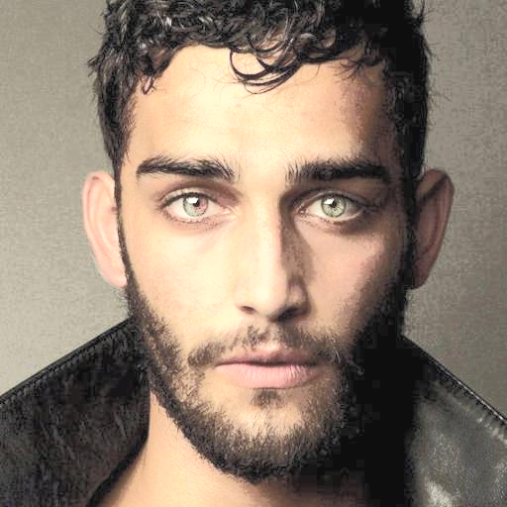
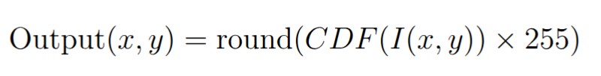
Histogram Equalization
Enhances image contrast by evenly redistributing pixel intensities.
Done in YCrCb color space on the luminance (Y) other wise color shifting happens for color images.
We calculate the PDF and CDF of pixel frequencies.
Then we scale CDF and remap to the pixels
and finally convert back to BGR.
Original Image
Histogram Equalized image

Slide 2
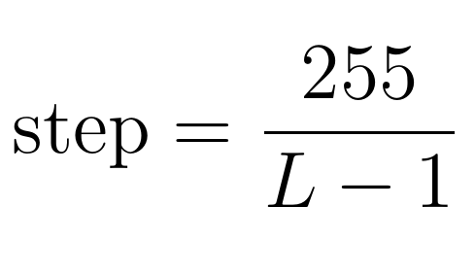
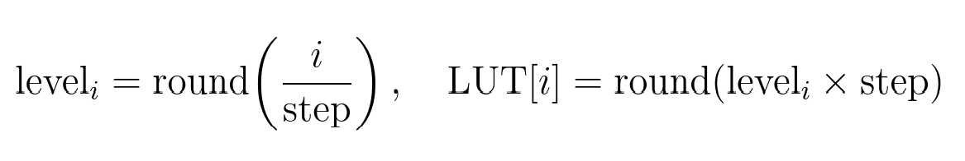
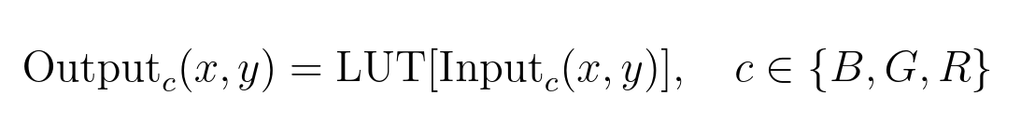
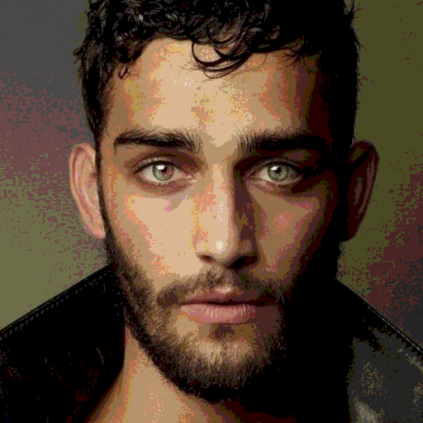
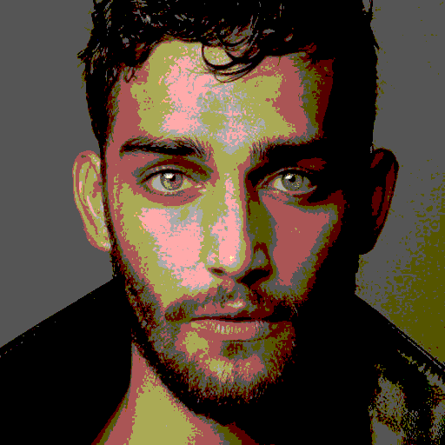
Posterize Filter
Reduces the number of distinct colors, creating a poster printer effect.
We first set color quantization levels (L).
Thenfor all intensity i, precomputed Look up Table (LUT) is made for performance reason
Finally Each BGR channel is independently mapped:
Original Image
Posterize L=8
Posterize L=4

Slide 3


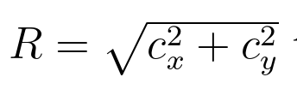


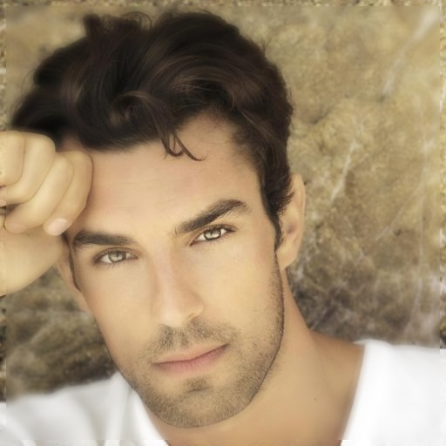
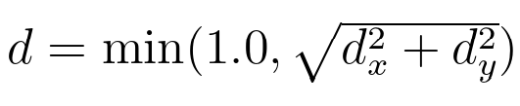
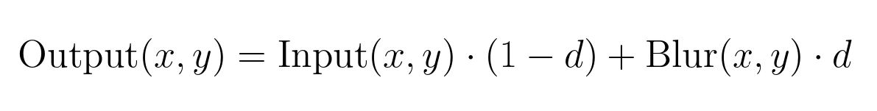
Vignette Blur Filter
Keeps the center sharp while gradually blurring towards the edges.
For each pixel, perform a 15x15 box-blur
Then we compute the normalized radial distance from the center of the image. C_{x} and C_{y} are center of the image
Finally we mix the original and the blurred image based on the radial distance.
Original Image
Vignette blurring

Slide 4
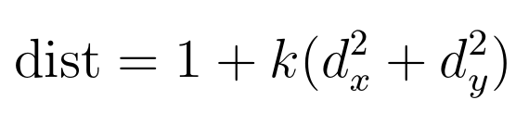
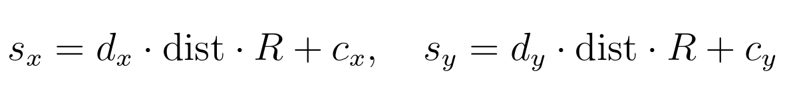
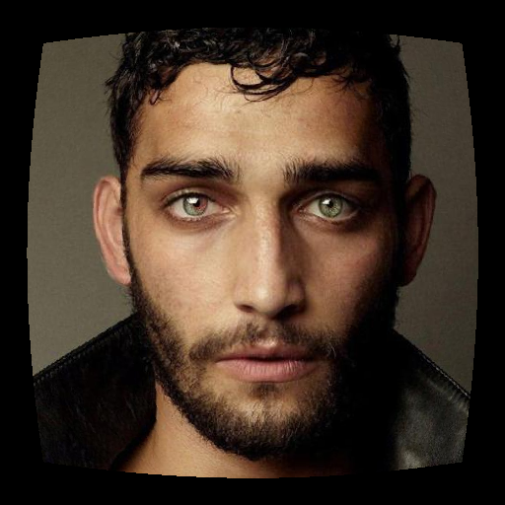
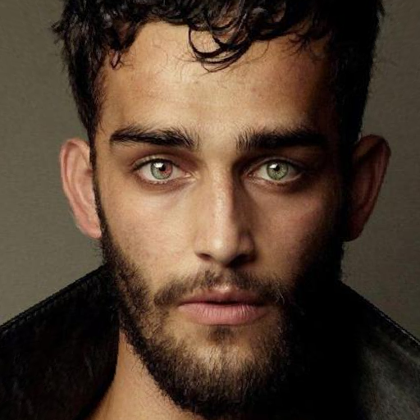
Lens Distortion Effect
Simulates optical lens distortion using inverse mapping.
For each pixel in dst image:
We get normalized distance again
                We calculate lens distortion. +ve k produces barrel, -ve k produces pincushion effect.
Finally we apply the distortion on d, then undo the normalization.
Nearest neighbor interpolation is used to get the src pixels s_{x} and s_{y}. For out of bound results pixel is set to black
Original Image
Lens distortion (barrel) k=0.2
Lens distortion (Pin cushion) k=-0.2

