Slide 1
Order Tracking System
Professor Obinna Kalu
Team members :
Elsabeth Melaku
Eyoubeil Fesseha
Semhar Weldegiorgis
Tomas Melake
November 2018

Slide 2
Contents
Introduction
Technologies Used
Main Use Cases
Class Diagram
Data Base Design Model (ER Diagram)
Sequence Diagram
Future Extension
Demo

Slide 3
Introduction
Currently online shopping/ordering products and services has been increasingly popular and more people are using the technology as a tool to do so.
Online order tracking system is one of the major contributors in the increase of the users in this paradigm shift of marketing system. (we can take USPS, UPS and Fedex tracking system as an example)
An order tracking system allows the customer to gain insight into where their order is at any given point in time.

Slide 4
Introduction cont’d
Customers need to follow their order from its initial placement right up until it arrives at their door.
Order tracking system is able to follow and provide insight into the status of the order to make the order process user problem.

Slide 5
Technologies Used
Eclipse and STS IDE
Spring Web/MVC
Hibernate
Spring Data
Spring Security
Hibernate Validation
Hibernate Transaction
DB: MySQL

Slide 6
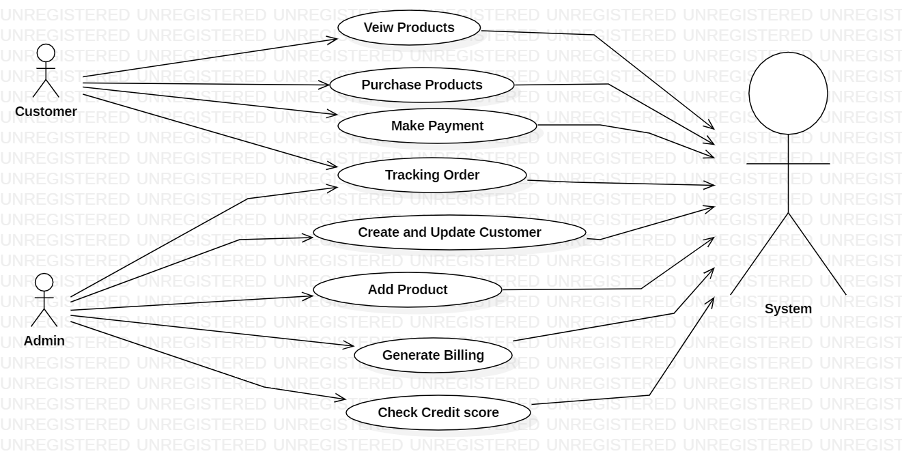
Main use case diagram
Admin and Customer domain use cases

Slide 7
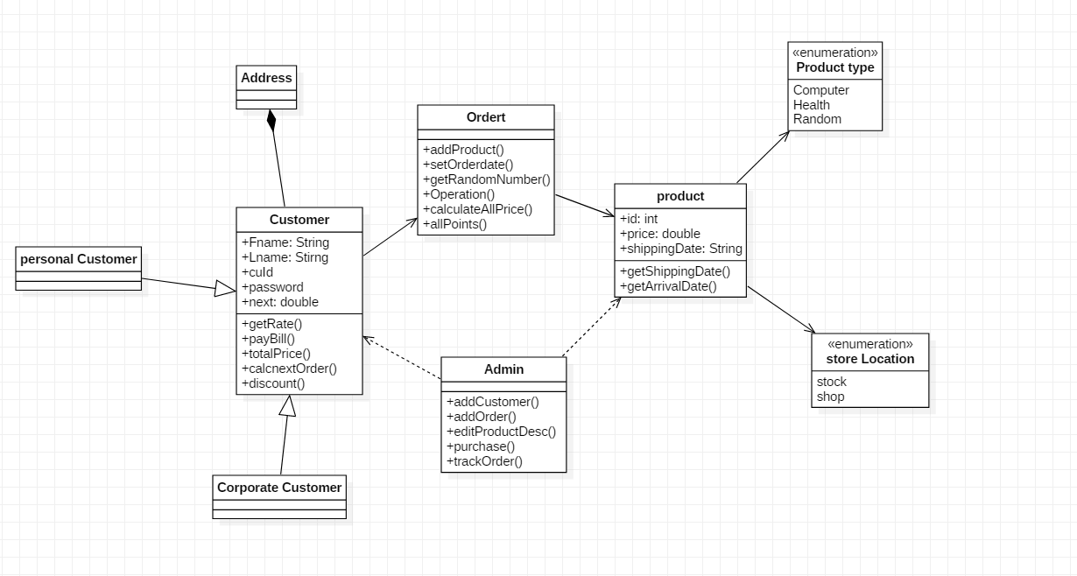
Class Diagram

Slide 8
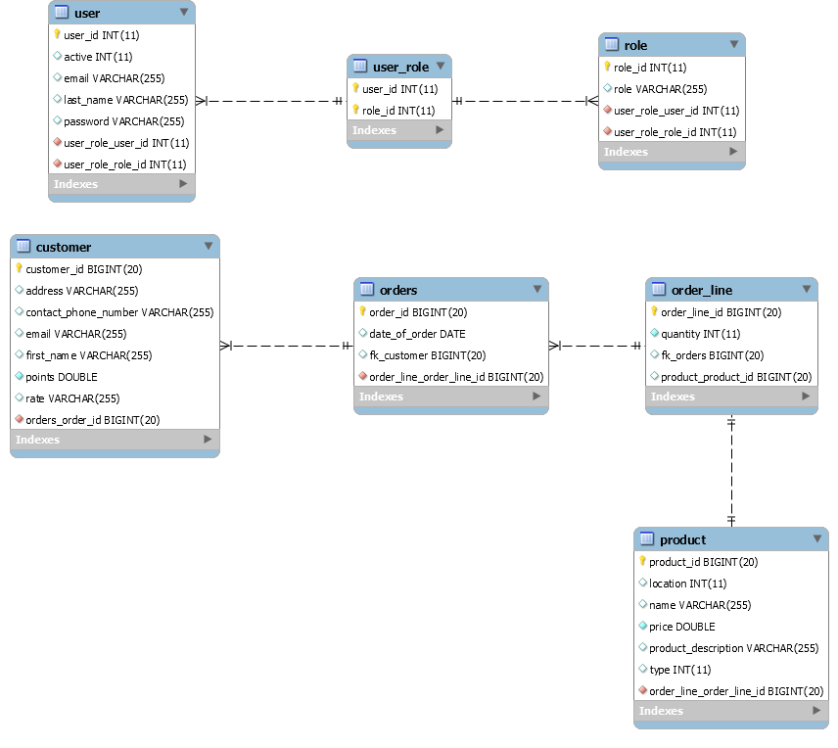
Data Base Design Model (ER Diagram)

Slide 9
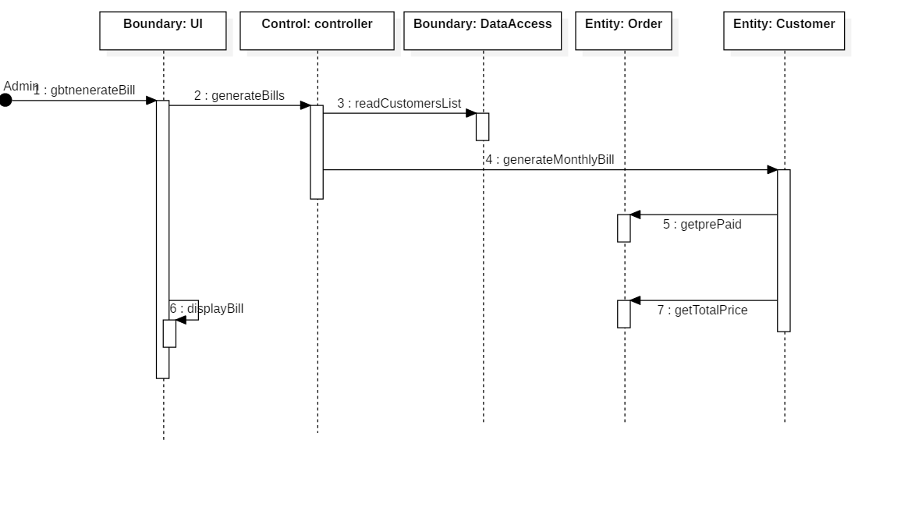
Sequence diagram– Generate Bill

Slide 10
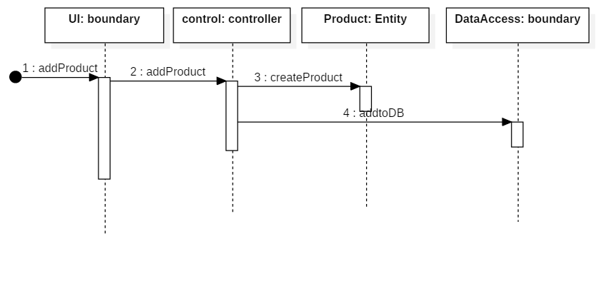
Sequence Diagram –
Adding a Product

Slide 11
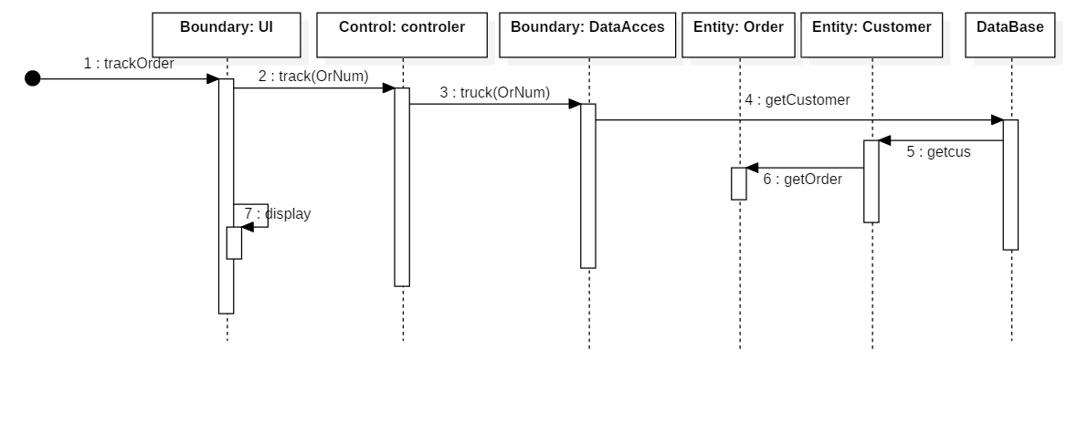
Sequence diagram –
Tracking an Order

Slide 12
Future Extension
Business Domain:
Implements reward system for customers
Implement payment system
Technologies
Mobile app
Use more reliable database system (eg: Amazon Cloud )
Implement better front end design using graphics

Slide 13
Reviewing codes and Demo will continue …..
Thank You!!

