Slide 1
THE BATTLE OF NEIGHBORHOOD
RECOMMENDING A SUITABLE LOCATION FOR a BUSINESS ENTITY TO BE ESTABLISHED IN THE CITY OF MINNEAPOLIS USA

Slide 2
PROBLEM STATEMENT
Xantan LLC" South-Korean Based company is seeking a suitable offices space and Wharehousing/manufacturing plant in the city of Minneapolis
Key Location Characteristics
Office size within 2000 - 7000 sq ft
At least one Asian restaurant with 2 mile radius, coffee shop and Grocery
Within 3 miles of densely populated Asian Community
within one mile from transit or bus station
Manufacturing plant be Within 5 miles of major Office and a major retail center
Manufacturing plant with 5 miles of a industrial employment district
Low crime rate

Slide 3
DATA SOURCES
Data will principally come from 'OPENDATAMINNEAPOLIS‘ and the Web Scrapping
Links to Key data to be used in the study
major retail centers:
https://opendata.arcgis.com/datasets/2c35bcea1a7c4a3ba48fa42b039e5aa6_0.geojson
industrial employment districts:
https://opendata.arcgis.com/datasets/4c768a5aa3154f85bd80dc9c5dd0ebf7_0.geojson
neighborhood commercial nodes:
https://opendata.arcgis.com/datasets/47a7b23ee906431eb646f863ad2cb2e5_0.geojson
neighborhoods:
https://opendata.arcgis.com/datasets/7f88316841ce471faa33c89035fb69e8_0.geojson

Slide 4
DATA SOURCES CONT
neighborhood crime stat:
https://opendata.arcgis.com/datasets/e251c3fe668243719001237d7ac74420_0.geojson
Transit stations:
https://opendata.arcgis.com/datasets/55a4601b78404583be59165006da9ad8_0.geojson
neighborhood and communities listing:
http://www.ci.minneapolis.mn.us/council/maps/index.htm
office lease site:
https://www.cityfeet.com/cont/minneapolis-mn/office-space-for-lease?sizeMin=1000&l=3-49492
communities:
https://opendata.arcgis.com/datasets/e0a3b6a4c23b4a03b988388553cb9638_0.geojson

Slide 5
KEY METHOD AND TOOLS FOR DATA PROCESSING
Four square API
Explore function to get the most common venue categories in each neighborhood
Geopy-distance and Nominatim or OPENCAGE API
Convert addresses into their equivalent latitude and longitude
k-means clustering algorithm
To group the neighborhoods into clusters
Folium, Matplot, seaborne library
to visualize the neighborhoods in Minneapolis and their emerging clusters
charts( horizontal bar charts and pie chart)
To visualize population distribution in the neighborhoods and their emerging clusters
Beautifulsoup4
Web scrapping

Slide 6
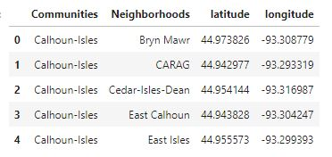
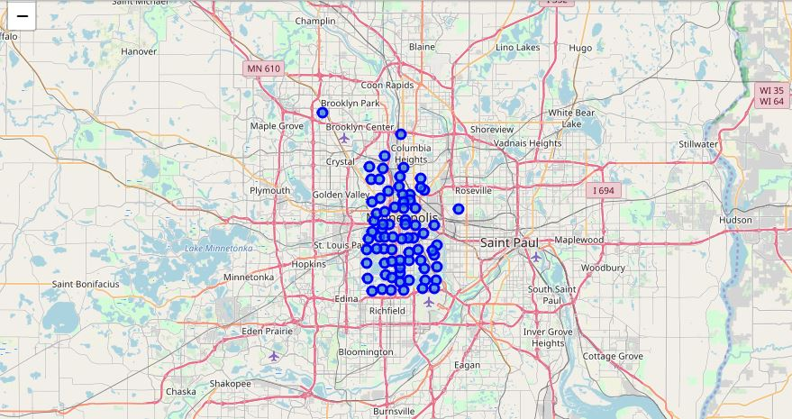
KEY EXTRACTED DATA AND DATA VISUALIZATION
Summary of data frame of neighborhoods of communities in Minneapolis with their geo location from OPENCAGE API
11 communities and their respective Neighborhoods for the city of Minneapolis displayed using folium
TOOLS AND METHODS USED
GEO CODER – NOMINATIN
OPENCAGE-GEOLOCATOR
FOLIUM

Slide 7
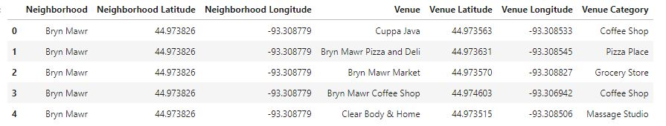
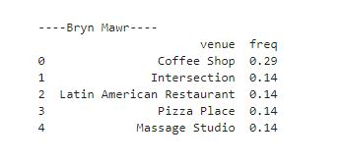
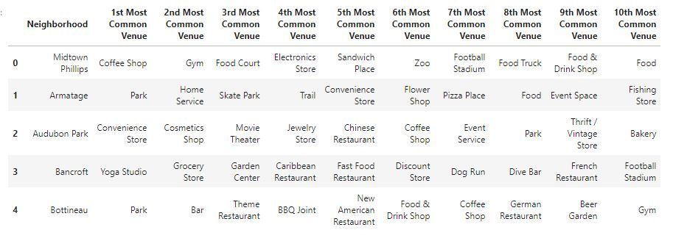
KEY EXTRACTED DATA AND DATA VISUALIZATION CONT’
Dataframe of neighborhoods in Minneapolis and their top 5 venues
Dataframe of top 10 venues of each neighborhoods in Minneapolis
TOOLS AND METHODS USED
FOUR SQUARE API

Slide 8
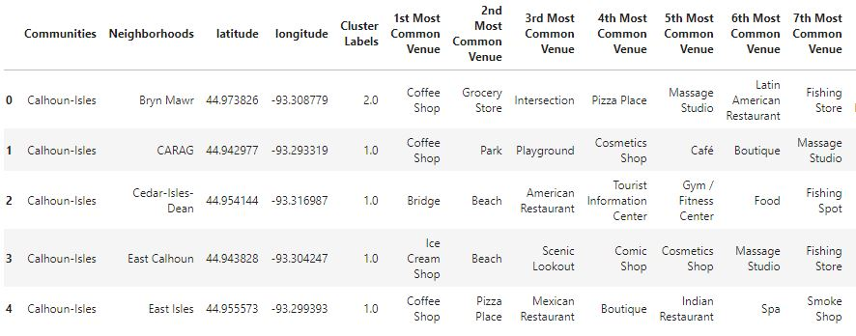
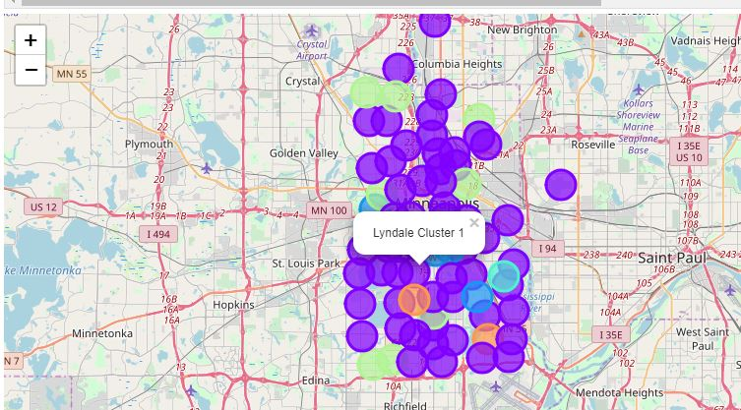
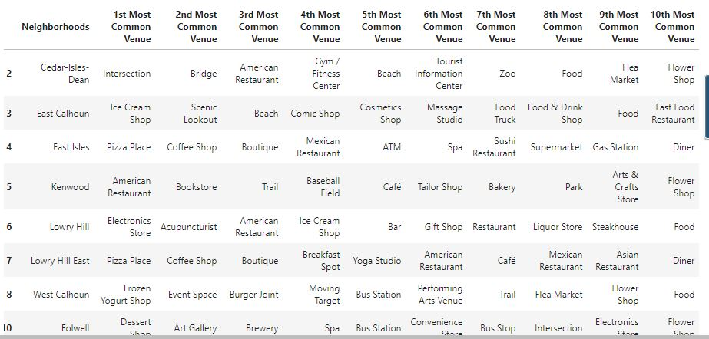
KEY EXTRACTED DATA AND DATA VISUALIZATION CONT’
Dataframe of merge clusters of venues and location of each neighborhoods
Map showing the various clusters as Bubbles
K = 6 in Kmeans clustering and we focused on clusters 2 and 3 as hold essential values to our project
TOOLS AND METHODS USED
K- MEANS CLUSTERING
FOLIUM
FOUR SQUARE API

Slide 9
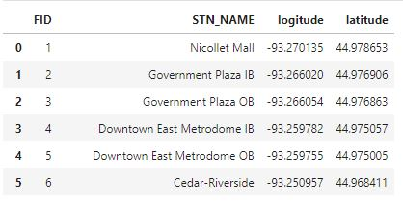
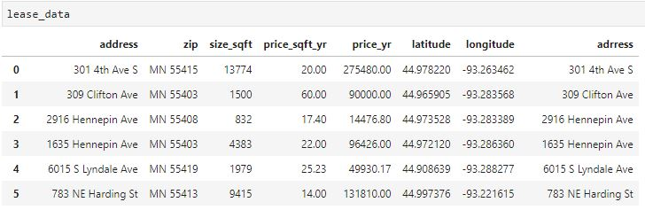
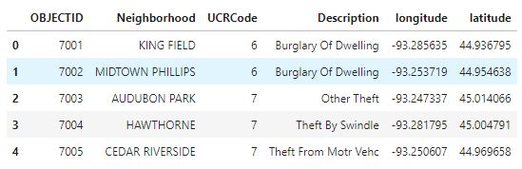
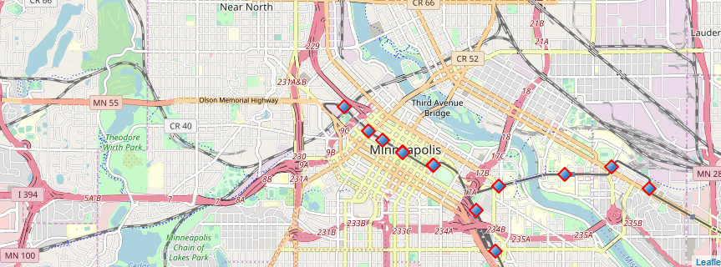
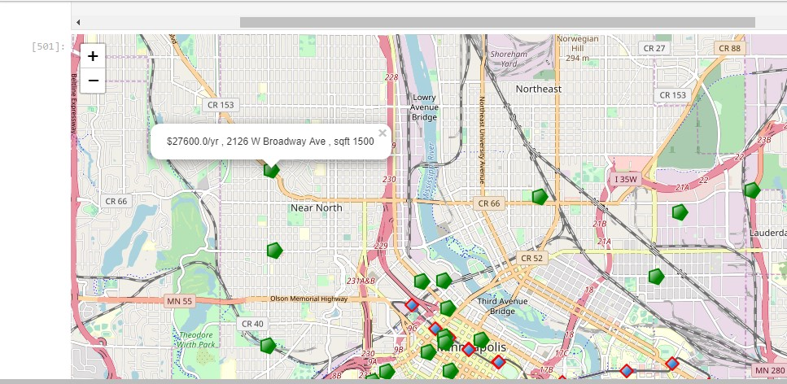
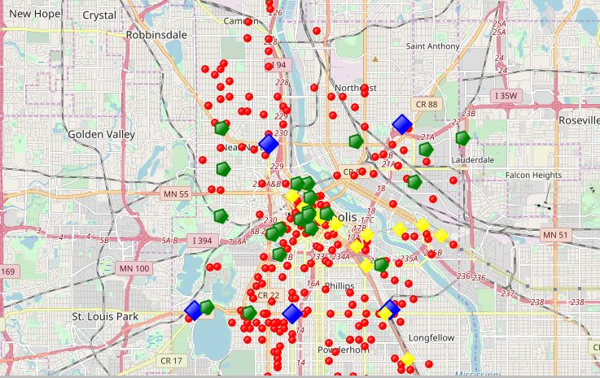
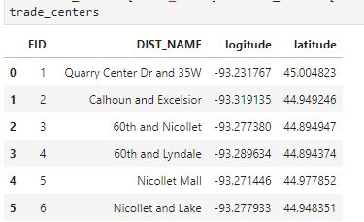
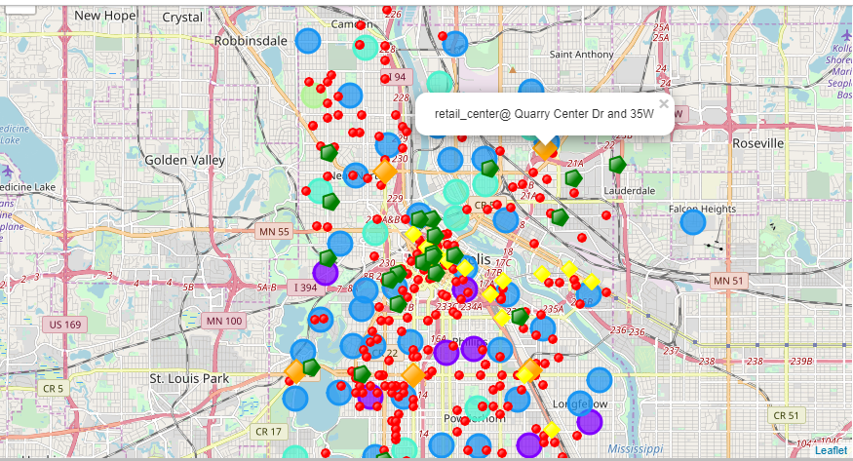
Dataframe of transit stations
KEY EXTRACTED DATA AND DATA VISUALIZATION CONT’
Dataframe of possible office locations
Dataframe of crime data in RED DOTS
TOOLS AND METHODS USED
FOLIUM
GEOCODER /LOCATOR
FOUR SQUARE API

Slide 10
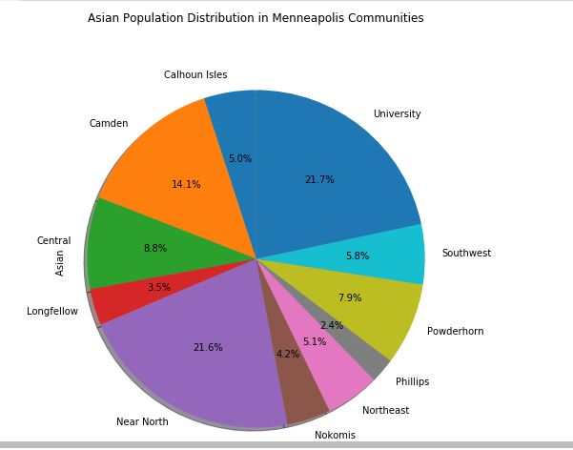
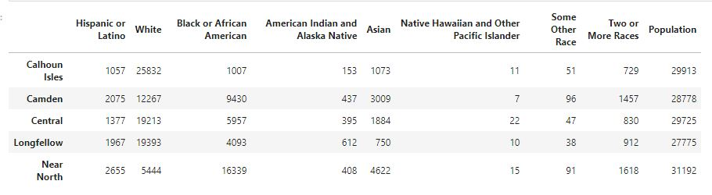
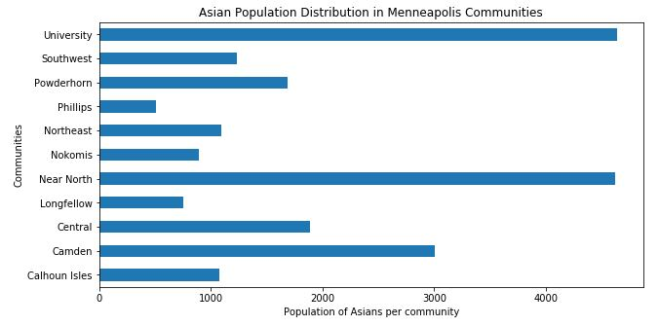
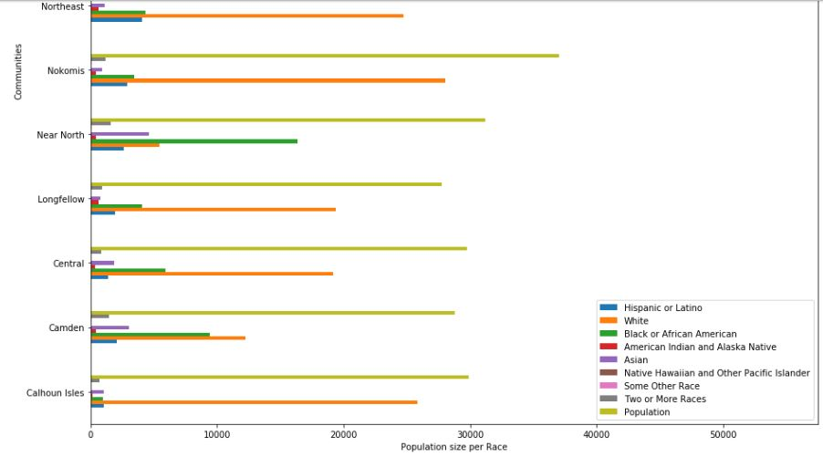
KEY EXTRACTED DATA AND DATA VISUALIZATION CONT’
Population distribution by race, with horizontal Bar charts capturing Asian population
TOOLS AND METHODS USED
Horizontal bar charts
Pie chart
Results:
University 21.7%
Near North 21.6%
Camden 14.1%

Slide 11
DATA INTERPRETATION
From the above bar and pie charts we can infere that communities with the most concentration of Asian poputlation are
University with a 21.7% of the total population, it belongs to cluster 2
Near North with a 21.6% of the total population, belonging to cluster 2
Candem with a 14.1% of the total population and in cluster 2 as well
this is logical as a greater proportions of ASIAN restaurants are also concentrated there
Overal whites are predominant in all neighborhoods, followed by Afrrican Amerians and then Asians
Crime rate is predominantly lower under 20% up North loop and Near North
From distance analysis and availalabilty of amenties clusters 2 and 3 are key in our search for a most suitable location

Slide 12
Data Analysis Cont’
From the superposition of clusters of venues, transit stations, industrial emploment district, lease space for offices, major retail centers and crime dustribution, we are able to narrow our choices to 5 key locations namely
N 1st street - Cluster 2 N-loop location
4th Ave s -Cluster 2 Down town East
6th street Cluster 1 Eliot park
9th Street Cluster 1 Eliot Park
Washington Ave N Cluster 3 Nicolet Island

Slide 13
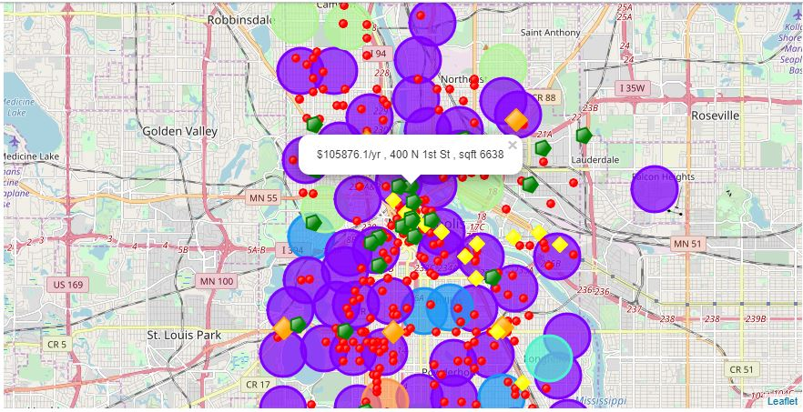
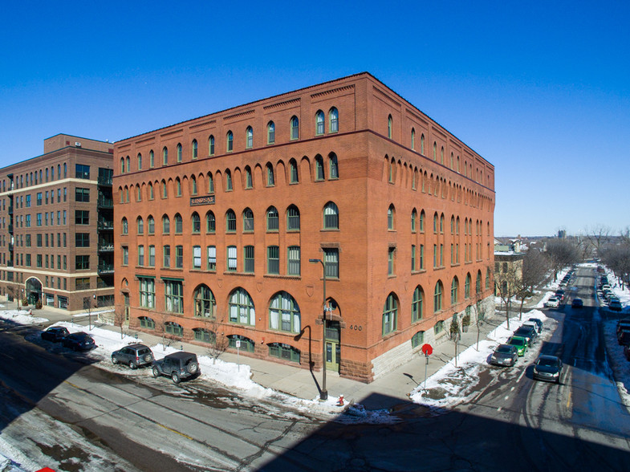
CONCLUSIONS
KEY TO MAP
Green pentagons are office space on lease
Orange diamonds represnt Major Retail Centers
bright Yellow Diamonds represents transit stations
Red small circles are Crime(police incidents)
Big bubbles are the clusters
Recommended location is 400 N 1st St , sqft 6638 priced at $105876.1/yr
This location practically meets all location criteria, its found in Cluster 2 North Loop, less than 2 miles away from the warehouse district and distribution center favorable for manufacturing and warehousing
0.5 miles away from major Asian (Chinese and Vietnamese) Restaurants, less than 2 miles away from the University and Near North which has the most densely populated settlements of Asians and very low in crime and accessible by bus from the employment district office space of 6638 sqft is suited for the business purpose.

Slide 14
QUESTIONS
-THANKS-

