Slide 1
Big Data Analysis: KDD-Cup99 on RHadoop
MSBIC: Zhiyue Liu
May 1st, 2015

Slide 2
Problem
Data mining in information security research: To detect network intrusions
Data Set: KDD-CUP99
41 features
24 attack types in train set, additional 14 types in test data only
Task description
http://archive.ics.uci.edu/ml/machine-learning-databases/kddcup99-mld/task.html

Slide 3
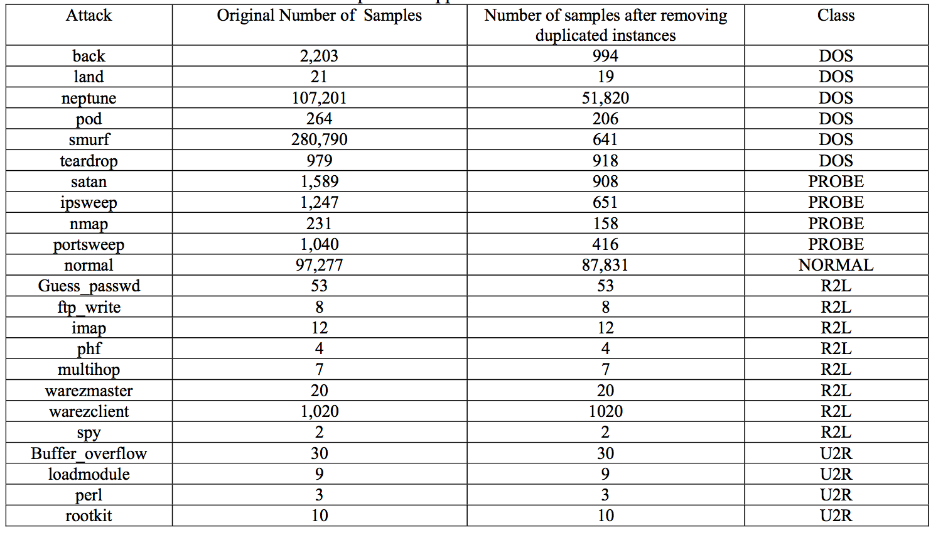
Class labels

Slide 4
Exp1: All class labels Dummy Perfect Result
 | Cross-validation(10-folder) | Test data
Naïve Bayes | 95.8% | 90.5%
Decision Tree (Best: leaf size=50) | 99.1% | 97.2%

Slide 5
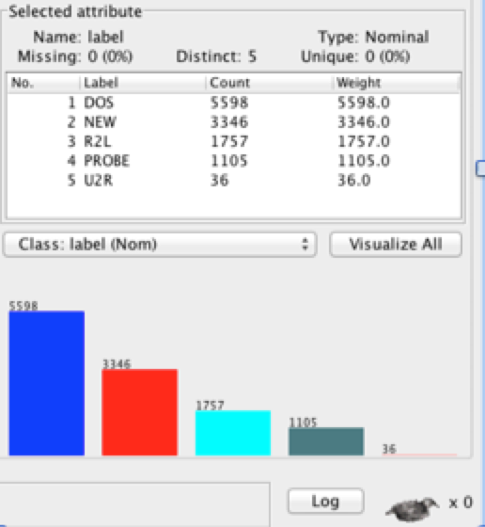
Exp1:Error Analysis
Why is the result so perfect?
Duplicate records (biased towards more frequent records)
After cleaning up duplicates:
Naïve Bayes | Decision Tree
61.2% | 80.1%
No matter which method, both confusion matrix showed lots of labels are misclassified into class ‘normal’, WHY?
Different distribution of train and test data
Not deal with additional new classes only in test data
(3365 records of test data come from new classes)

Slide 6
Exp2: Two main Categories Normal VS Anomaly
Why?
Additional types of test data are classified into known classes
Performance
 | Cross-validation(10-folder) | Test data
Random(Baseline) | - | 51.3%
Naïve Bayes | 90.0% | 76.3%
Decision Tree (Best: leaf size=50) | 99.1% | 82.4%
Random Forest(numTrees=100) | 99.9% | 80.1%

Slide 7
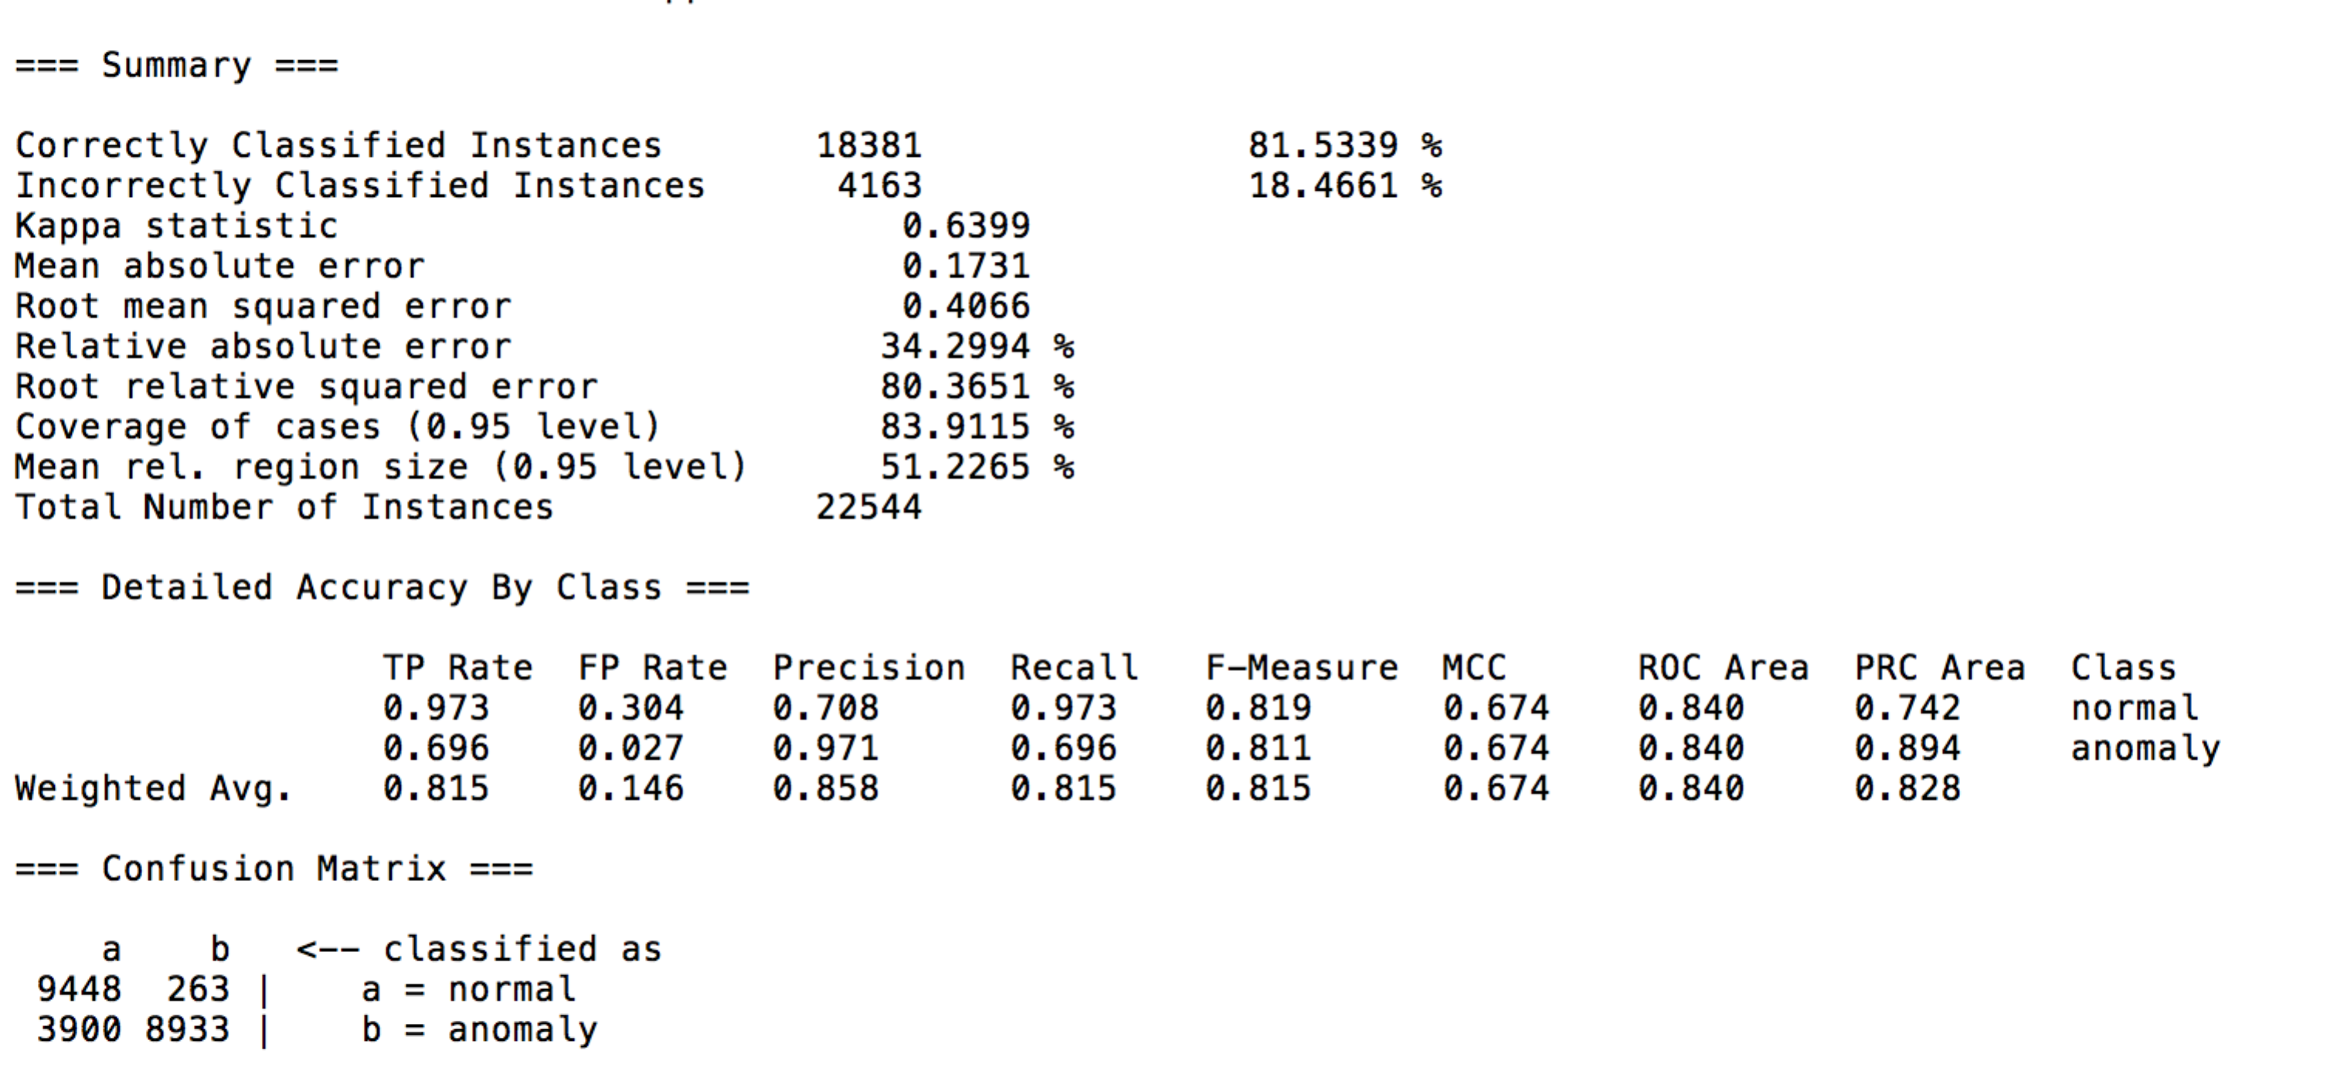
Exp2: Error Analysis
Given the confusion matrix,
Anomaly records are misclassified as normal
Anomaly has various subtypes, like smurf, land

Slide 8
Exp3: 5 categories
types | description | subtypes
Normal
DOS | Denial of service – e.g. syn flooding | Smurf, back, land, neptune, pod, teardrop Processtable, mailbomb, apache2, upstorm
Probing | Surveillance and other probing, e.g. port scanning | Satan, ipsweep, nmap, portsweep Saint, mscan
U2R | unauthorized access to local super user (root) privileges, e.g. buffer overflow attacks. | Buffer_overflow, loadmodule, perl, rootkit Sqlattack, ps, xterm
R2L | unauthorized access from a remote machine, e.g. password guessing | Guess_passwd, ftp_write, imap, phf, multihop, warezmaster, warezclient, spy Snmpgetattack, snmguess, named, sendemail, httptunnel, worm, xlock, xsnoop
http://cseweb.ucsd.edu/~elkan/tabulate.html

Slide 9
Exp3: Result & Sample Code
 | Cross-validation(10-folder) | Test data
Random(Baseline) | - | 20.2%
Naïve Bayes | 84.7% | 50.4%
Decision Tree(Best: leaf size=50) | 96.3% | 83.2%
Random Forest(num_tree=100) | 98.1% | 78.2%
xrange <- length(as.factor(uni_test[,42]))
x <- sample(c(1,2,3,4,5), xrange, replace = TRUE)
sum(x == as.numeric(points))/xrange
library(tree)
dt_tree_model=tree(as.factor(label_result)~.,num_train)
tree_pred=predict(dt_tree_model, testing_data, type="class”)
confusion_table=table(tree_pred, golden_answer)
DT_accuracy <- mean(golden_answer == tree_pred,na.rm = TRUE)
library(randomForest)
set.seed(415)
rf_model<- randomForest(as.factor(label_result)~.,num_train, importance=TRUE, ntree=100)
forest_pred=predict(rf_model, testing_data, type="class")
forest_pred = factor(forest_pred, levels =levels(golden_answer))
confusion_table=table(forest_pred, golden_answer)
F_accuracy <- mean(golden_answer == forest_pred,na.rm = TRUE)

Slide 10
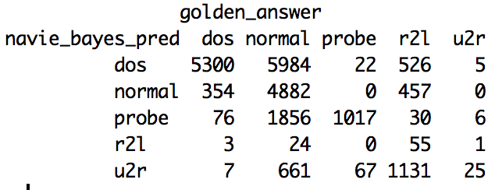
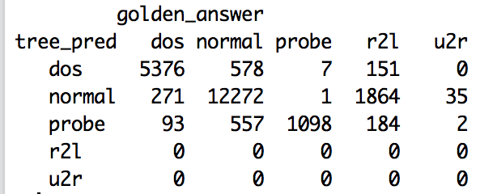
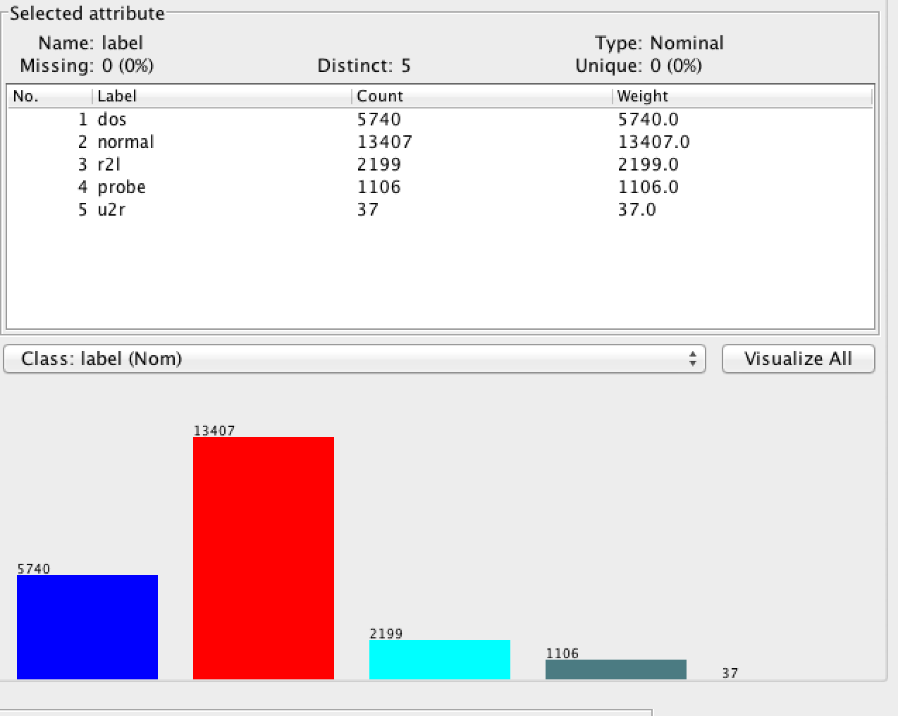
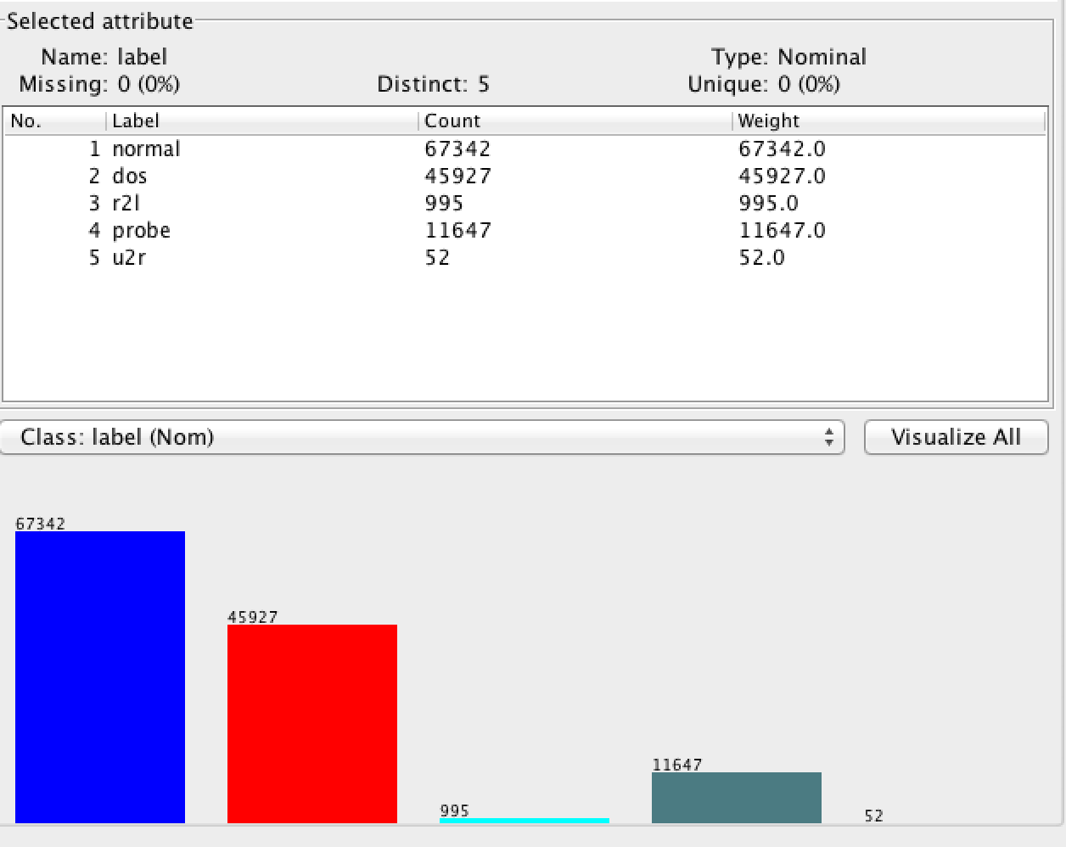
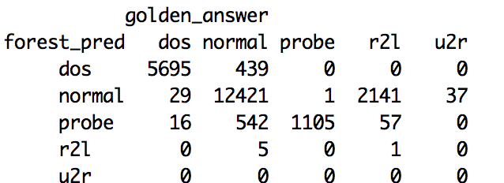
Exp3: Error analysis
Train data and test data have relatively different distribution(especially, normal, dos)
-Normalize
-Hope Random forest will have better performance with sampling data and smaller feature set
U2R counts for 0.01% of train data, hard to predict
Feature noise:
i.e. ‘num_outbound_cmds’ are all zero in both train and test set.
They have similar performance on predicting DOS, and PROBE.
Decision tree, Random Forest are better at predicting normal, while nb is more precise on U2L and U2R

Slide 11
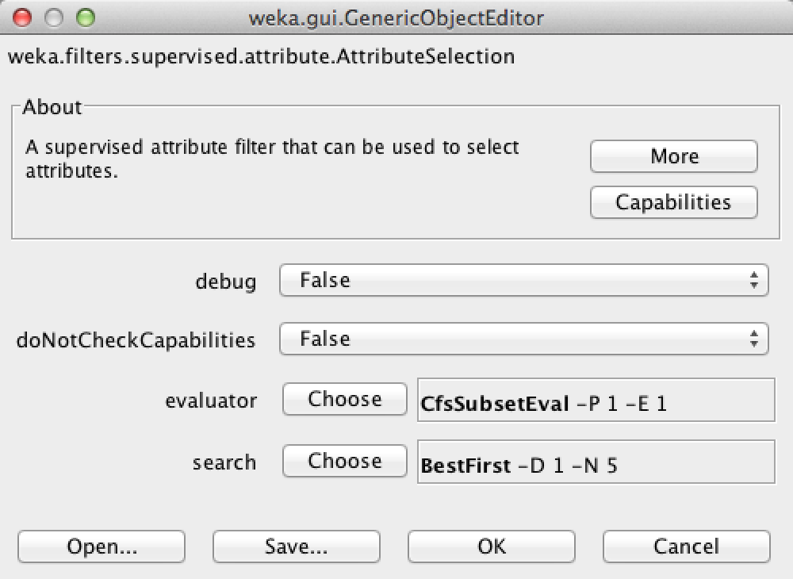
Feature Engineering Feature Selection
Why?
Reduces Overfitting: Less redundant data means less opportunity to make decisions based on noise.
Improves Accuracy: Less misleading data means modeling accuracy improves.
Reduces Training Time: Less data means that algorithms train faster.
How?
Rule Based feature selection: need domain knowledge
Feature selection alg: CfsSubsetEval
Weka support:
Evaluates the worth of a subset of attributes by considering the individual predictive ability of each feature along with the degree of redundancy between them.
Subsets of features that are highly correlated with the class while having low intercorrelation are preferred.

Slide 12
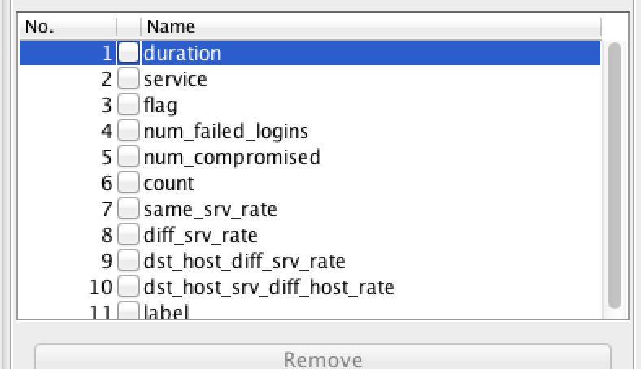
Exp4: Normalization & Feature Engineering
 | Cross-validation(10-folder) | Test data
Decision Tree (Best: leaf size=50) | 98.1% | 85.2%
Random Forest | 98.9% | 79.4%
Random Forest: random in row-data level; random in column-model level
Computational Complexity: Random Forest >> Decision Tree

Slide 13
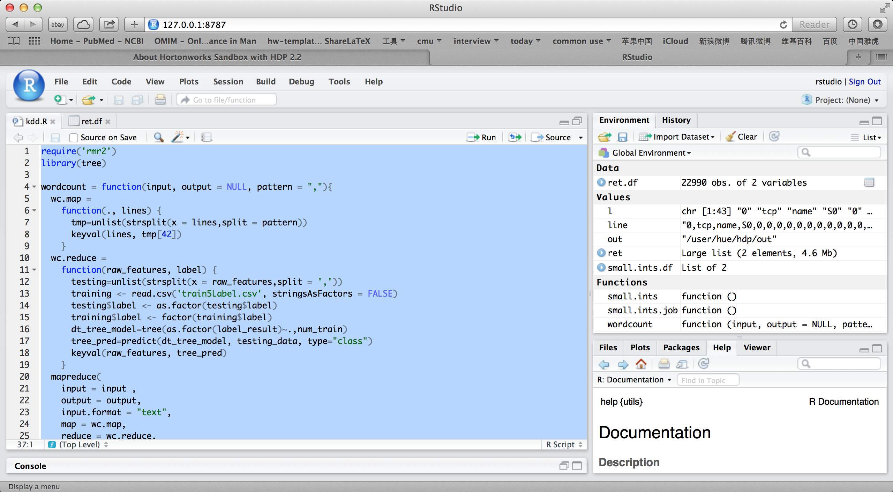
Feature Engineering Sample R Code

Slide 14
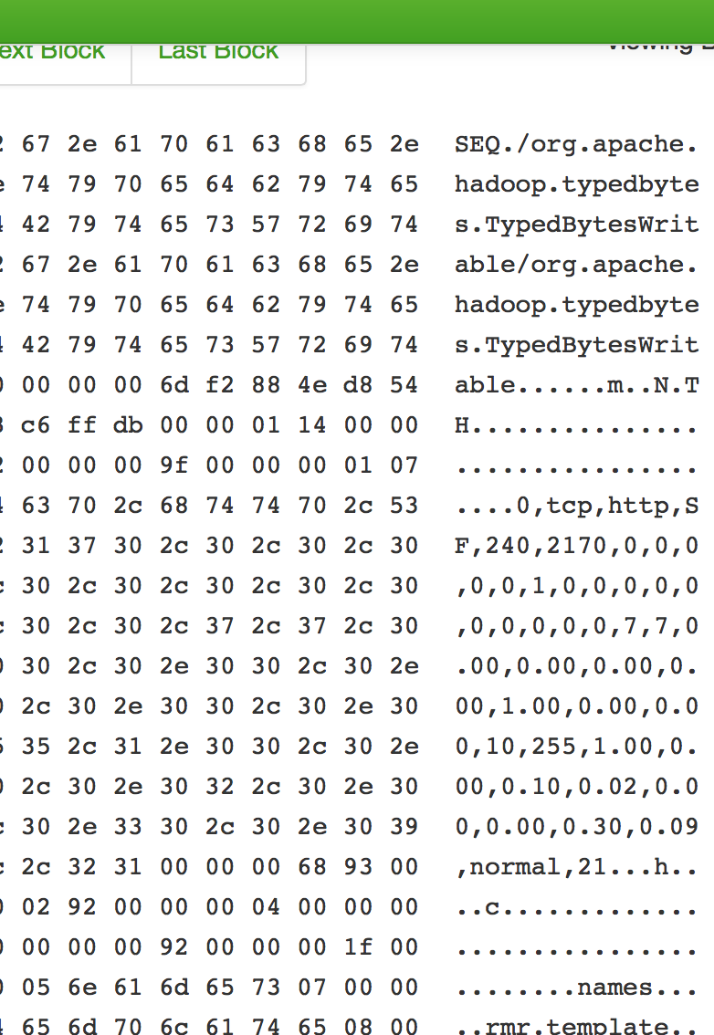
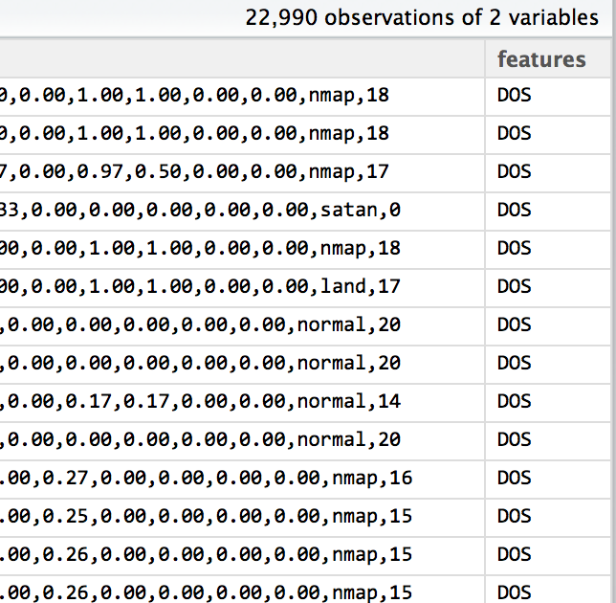
Feature Engineering Sample Result
For random forest implementation: see more on http://blog.cloudera.com/blog/2013/02/how-to-resample-from-a-large-data-set-in-parallel-with-r-on-hadoop/

Slide 15
Exp5:Detecting new label
#1: get centroids of all the classes, and avg distance from each node to its centroid
#2:compute the distance of the test case to every centroid, and find the smallest one
#3: if the distance from test node to nearest centroid is 3 times bigger than the avg distance of that centroid, we believe it’s a new node.

Slide 16
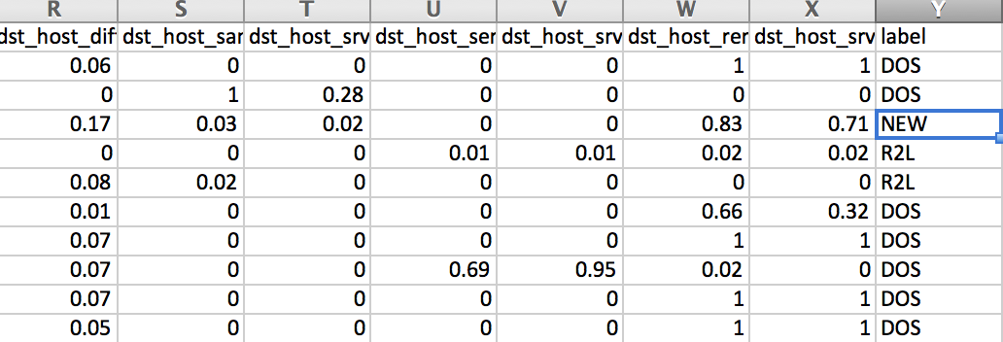
Exp5:Detecting new label
Problem:
Detect so few NEW, compared with the actual amount of NEW data(5000+ records)
Why?
The centroid information couldn’t represent the cluster, since its high dimension and nodes in cluster are not close. So, new type are more likely to be in one of them, could hardly detect it as a new attack type.
This might be convincible, since the new type are exactly classified to the existed classes.

Slide 17
Summary
Data Processing
Feature selection
Algorithm Selection
Implementing on Rhadoop
Error Analysis

Slide 18
Future work
Rule-Based:
Symbolic feature: like service, flag
domain knowledge for detecting U2R
Other feature selection Algorithm: i.e. PCA
Implement and compare other models: i.e. svm
Vote :
Combination of Naïve Bayes and Decision Tree
Do more work on detecting new attacked types

Slide 19
Reference
An Intrusion Detection System Based on KDD-99 Data using Data Mining Techniques and Feature Selection. Pratibha Soni, Prabhakar Sharma
A Detailed Analysis of the KDD CUP 99 Data Set. Mahbod Tavallaee, Ebrahim Bagheri, Wei Lu, and Ali A. Ghorbani
KDD-99 Classifier Learning Contest LLSoft’s Results Overview. Itzhak Levin LLSoft 6 Ha-Marganit Street Rishon-Le-Ziyyon, 75427, Israel
Selecting Features for Intrusion Detection: A Feature Relevance Analysis on KDD 99 Intrusion Detection Datasets. H. Günes Kayacık, A. Nur Zincir-Heywood, Malcolm I. Heywood Dalhousie University, Faculty of Computer Science, 6050 University Avenue, Halifax, Nova Scotia. B3H 1W5
Analysis of KDD ’99 Intrusion Detection Dataset for Selection of Relevance Features. Adetunmbi A.Olusola., Adeola S.Oladele. and Daramola O.Abosede

Slide 20
Q&A
Feel free to contact my email eyre.lzy@gmail.com for any question.
Thanks

