Slide 1
Hand prediction
Rule-based
Baseline: KNN
Decision Tree
Naïve bayes
Summary
MSBIC:
NAME: ZHIYUE LIU
ANDREW ID: ZHIYUEL

Slide 2
Rule-based
what_hand = function(hand)
{
ranks_acehigh = c(1:13)
rank_i_ah = sort( sapply(hand[,"rank"],function(x) which(x == ranks_acehigh)) )
is_straight = all( rank_i_ah-min(rank_i_ah)+1 == 1:5 )
is_flush = length(unique(hand[,"suit"])) == 1
if (is_straight && is_flush) {
if (all(c(13,1) %in% hand[,"rank"])) return( "Royal flush 9 " )
else return( "Straight flush 8" )
}
if (is_straight) return( "Straight 4" )
if (is_flush) return( "Flush 5" )
tab = sort( table(hand[,"rank"]) )
if (length(tab)==2) {
if (all(tab == c(1,4))) return( "Four of a kind 7" )
if (all(tab == c(2,3))) return( "Full house 6")
}
if (length(tab)==3) {
if (all(tab == c(1,1,3))) return( "Three of a kind 3")
if (all(tab == c(1,2,2))) return( "Two pairs 2" )
}
if (length(tab)==4) {
return( "One Pair 1" )
}
return( "Nothing in hand 0" )
}
Rule-based solution could have a accuracy of 100% on any test data set. It has a strong bias.

Slide 3
KNN-R codes
library(class)
trainfile='poker-hand-training-true.csv'
testfile='poker-hand-testing.csv'
traindata=read.csv(trainfile, header=TRUE, sep=",")
testdata=read.csv(testfile, header=TRUE, sep=",")
for( i in 1:ncol(traindata)){
traindata[i]=factor(traindata[[i]])
}
for( i in 1:ncol(testdata)){
testdata[i]=factor(testdata[[i]])
}
train<-rbind(traindata[, c(1:10)])
test <-rbind(testdata[, c(1:10)])
cl<-traindata[,11]
testcl=testdata[,11]
#testcl<-factor(testcl)
result=knn(train, test, cl, k = 1)
m<-table(testcl,result)
mean(testcl!=result)
KNN classify the result by considering k nearby instances, and get voting from them. However, it’s unreasonable in most cases that even if two instances are close, they are not necessarily the same label. For example,
Rank suit
1 1
1
1
1
1
Label 8
Rank suit
1
1
1
2
1
Label 4

Slide 4
KNN
Parameter k | Accuracy
1 | 0.513261
5 | 0.555167
10 | 0.56883
60 | 0.580243
100 | 0.577673
Even if we have seen the peak value when k=60, it makes no sense.
In the hand prediction problem, the distance between two hands has slightly small relation to the prediction.

Slide 5
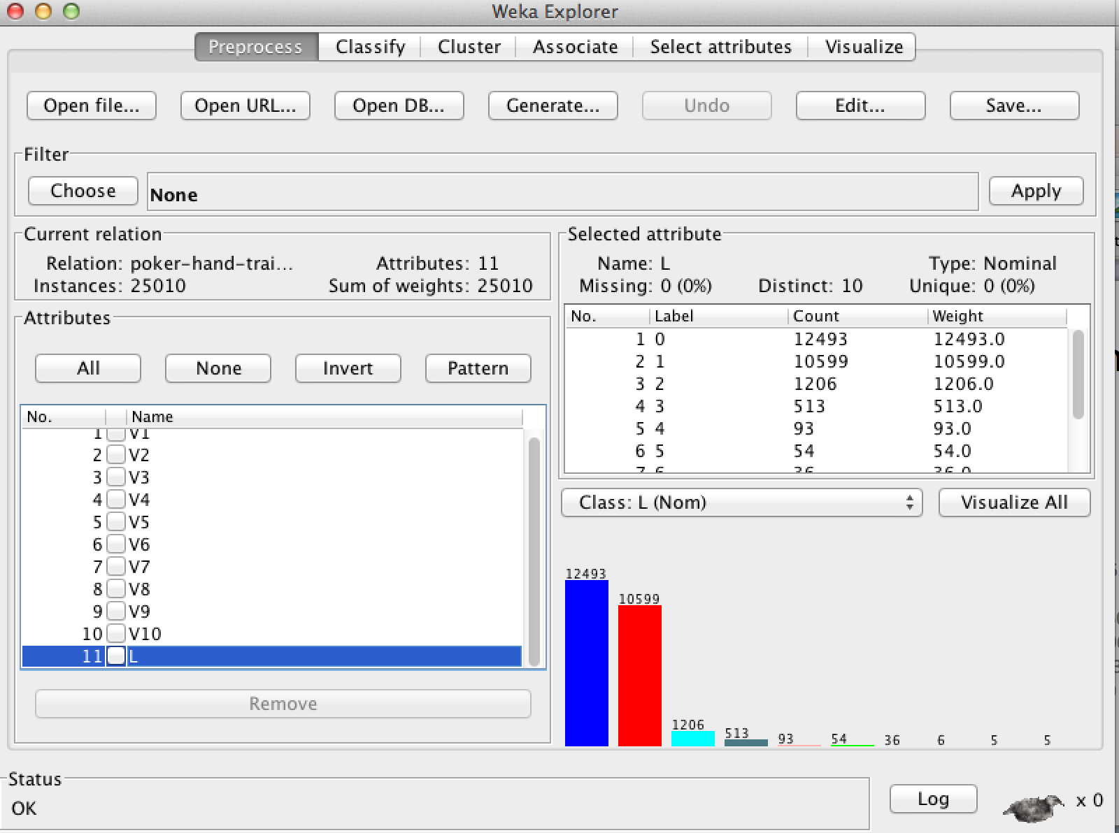
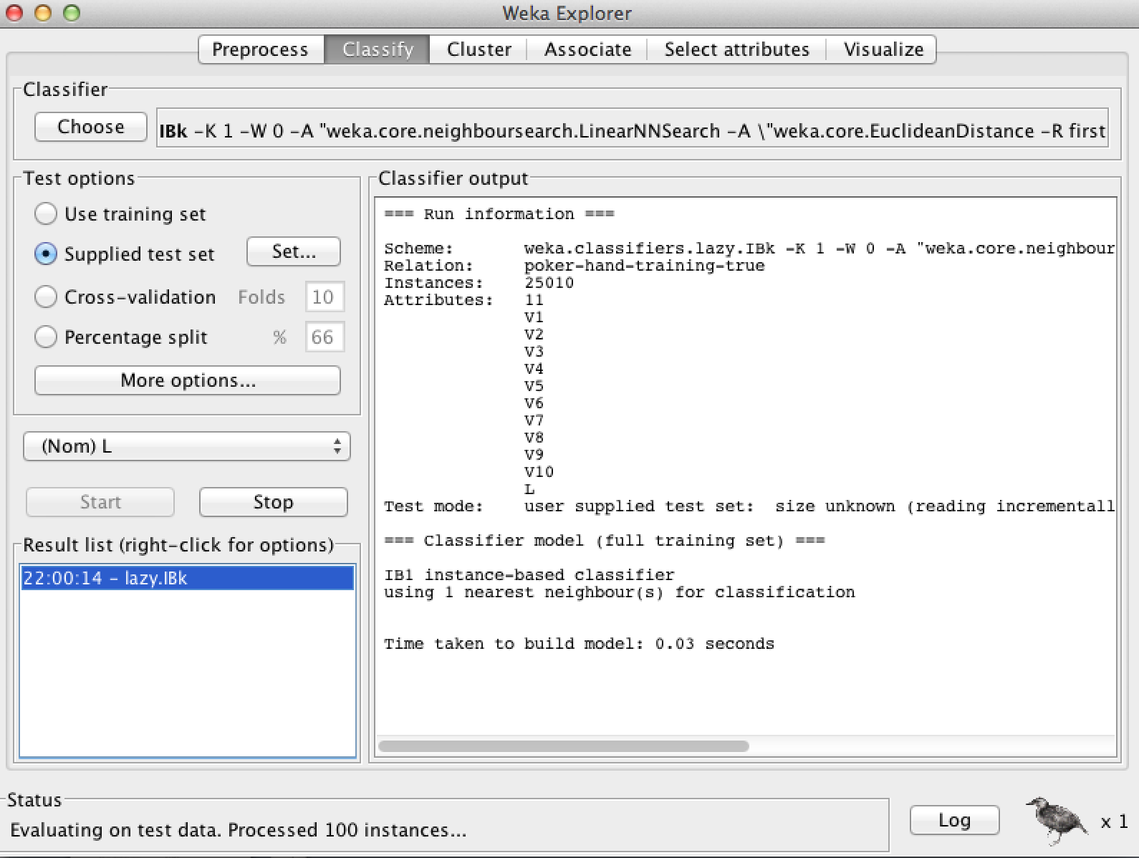
KNN-Results from Weka when k=2 with all attributes assigned to nominal type

Slide 6
KNN-Results from Weka
=== Summary ===
Correctly Classified Instances 467686 46.7686 %
Incorrectly Classified Instances 532314 53.2314 %
Kappa statistic 0.0613
Mean absolute error 0.1067
Root mean squared error 0.3255
Relative absolute error 93.9378 %
Root relative squared error 136.6508 %
Coverage of cases (0.95 level) 47.2066 %
Mean rel. region size (0.95 level) 10.1321 %
Total Number of Instances 1000000

Slide 7
KNN-Results from Weka
=== Detailed Accuracy By Class ===
TP Rate FP Rate Precision Recall F-Measure MCC ROC Area PRC Area Class
0.548 0.458 0.546 0.548 0.547 0.091 0.546 0.527 0
0.443 0.406 0.444 0.443 0.444 0.037 0.519 0.432 1
0.078 0.046 0.078 0.078 0.078 0.032 0.517 0.050 2
0.056 0.020 0.058 0.056 0.057 0.037 0.519 0.023 3
0.022 0.004 0.023 0.022 0.022 0.018 0.510 0.004 4
0.349 0.001 0.381 0.349 0.364 0.363 0.675 0.136 5
0.010 0.002 0.009 0.010 0.009 0.008 0.502 0.001 6
0.000 0.000 0.000 0.000 0.000 -0.000 0.492 0.000 7
0.000 0.000 0.000 0.000 0.000 -0.000 0.470 0.000 8
0.333 0.000 0.012 0.333 0.024 0.064 0.675 0.004 9
Weighted Avg. 0.468 0.403 0.467 0.468 0.467 0.064 0.533 0.450

Slide 8
KNN-Results from Weka
=== Confusion Matrix ===
a b c d e f g h i j <-- classified as
274735 197878 19345 6768 1052 817 513 53 26 22 | a = 0
199387 187263 22162 10463 1982 309 727 132 41 32 | b = 1
19364 22283 3719 1676 369 1 180 27 2 1 | c = 2
7115 10868 1642 1174 213 0 86 23 0 0 | d = 3
1089 2096 384 196 84 2 23 3 5 3 | e = 4
849 388 3 0 0 696 0 0 37 23 | f = 5
415 714 154 99 27 0 14 1 0 0 | g = 6
43 109 29 41 6 0 2 0 0 0 | h = 7
6 5 1 0 0 0 0 0 0 0 | i = 8
0 0 0 0 0 2 0 0 0 1 | j = 9

Slide 9
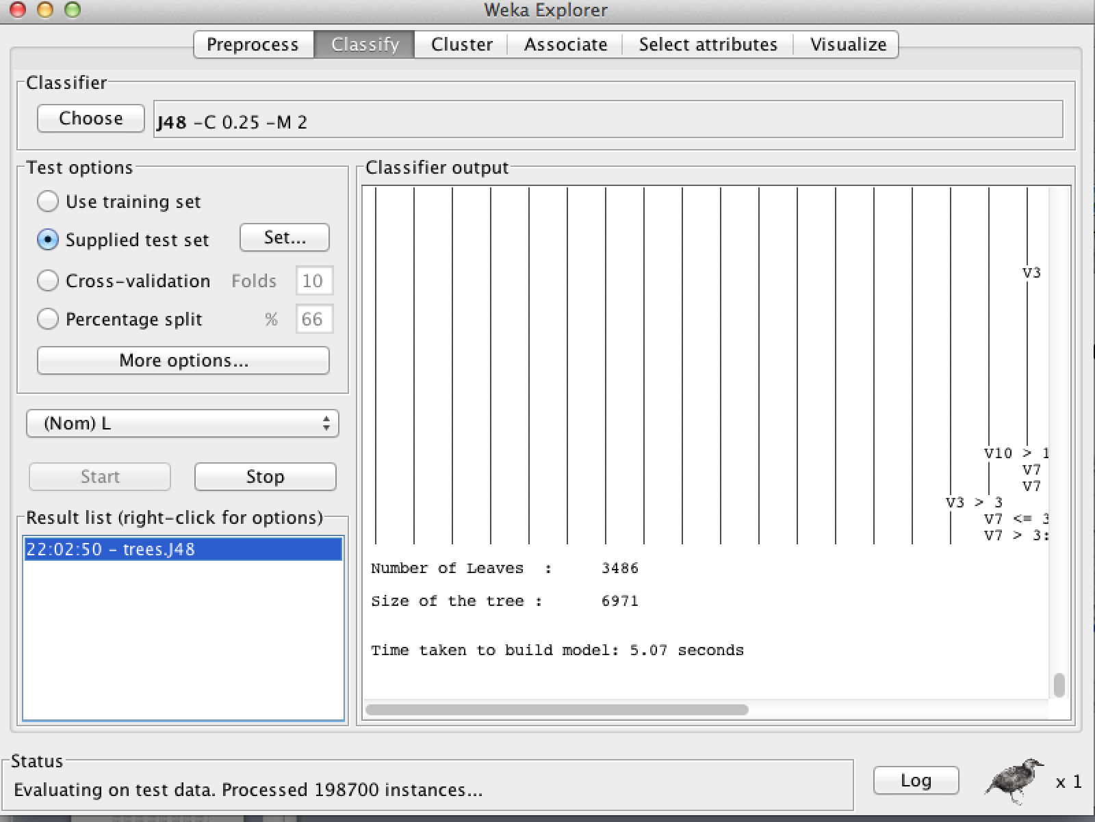
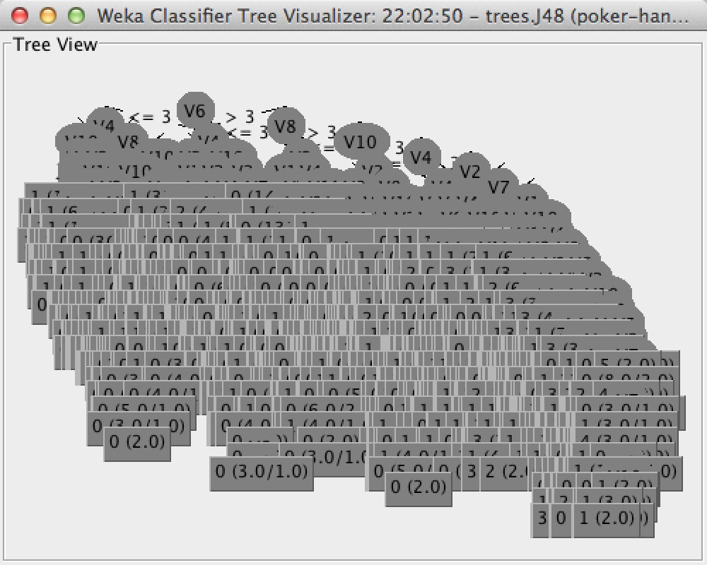
Rule-based Decision Tree Results from Weka

Slide 10
Decision Tree
=== Summary ===
Correctly Classified Instances 566619 56.6619 %
Incorrectly Classified Instances 433381 43.3381 %
Kappa statistic 0.2136
Mean absolute error 0.0944
Root mean squared error 0.2677
Relative absolute error 83.0638 %
Root relative squared error 112.3645 %
Coverage of cases (0.95 level) 79.4266 %
Mean rel. region size (0.95 level) 18.3387 %
Total Number of Instances 1000000

Slide 11
Decision Tree
=== Detailed Accuracy By Class ===
TP Rate FP Rate Precision Recall F-Measure MCC ROC Area PRC Area Class
0.694 0.413 0.628 0.694 0.659 0.282 0.663 0.606 0
0.503 0.327 0.529 0.503 0.516 0.177 0.584 0.492 1
0.090 0.028 0.137 0.090 0.108 0.075 0.639 0.086 2
0.094 0.009 0.185 0.094 0.125 0.118 0.610 0.056 3
0.025 0.002 0.048 0.025 0.033 0.032 0.556 0.007 4
0.014 0.000 0.052 0.014 0.021 0.026 0.542 0.004 5
0.008 0.000 0.092 0.008 0.014 0.026 0.528 0.002 6
0.000 0.000 0.000 0.000 0.000 0.000 0.514 0.000 7
0.000 0.000 0.000 0.000 0.000 0.000 0.499 0.000 8
0.000 0.000 0.000 0.000 0.000 0.000 0.499 0.000 9
Weighted Avg. 0.567 0.347 0.549 0.567 0.556 0.223 0.627 0.517

Slide 12
Decision Tree
=== Confusion Matrix ===
a b c d e f g h i j <-- classified as
347612 143778 6905 2100 510 304 0 0 0 0 | a = 0
185174 212613 18152 5312 1029 174 44 0 0 0 | b = 1
11820 30185 4275 1048 242 6 46 0 0 0 | c = 2
5771 11699 1522 1984 127 1 17 0 0 0 | d = 3
1524 1932 236 92 97 4 0 0 0 0 | e = 4
1419 508 32 8 2 27 0 0 0 0 | f = 5
215 859 157 173 9 0 11 0 0 0 | g = 6
26 139 30 31 3 0 1 0 0 0 | h = 7
4 6 0 0 0 2 0 0 0 0 | i = 8
1 0 1 1 0 0 0 0 0 0 | j = 9

Slide 13
Naïve Bayes Results from Weka
=== Summary ===
Correctly Classified Instances 501209 50.1209 %
Incorrectly Classified Instances 498791 49.8791 %
Kappa statistic 0
Mean absolute error 0.1136
Root mean squared error 0.2383
Relative absolute error 99.9816 %
Root relative squared error 100.0126 %
Coverage of cases (0.95 level) 97.1337 %
Mean rel. region size (0.95 level) 30.0276 %
Total Number of Instances 1000000

Slide 14
Naïve Bayes
=== Detailed Accuracy By Class ===
TP Rate FP Rate Precision Recall F-Measure MCC ROC Area PRC Area Class
1.000 1.000 0.501 1.000 0.668 0.000 0.509 0.514 0
0.000 0.000 0.000 0.000 0.000 0.000 0.496 0.415 1
0.000 0.000 0.000 0.000 0.000 0.000 0.495 0.047 2
0.000 0.000 0.000 0.000 0.000 0.000 0.485 0.030 3
0.000 0.000 0.000 0.000 0.000 0.000 0.645 0.012 4
0.000 0.000 0.000 0.000 0.000 0.000 0.462 0.132 5
0.000 0.000 0.000 0.000 0.000 0.000 0.499 0.001 6
0.000 0.000 0.000 0.000 0.000 0.000 0.480 0.000 7
0.000 0.000 0.000 0.000 0.000 0.000 0.499 0.000 8
0.000 0.000 0.000 0.000 0.000 0.000 0.492 0.000 9
Weighted Avg. 0.501 0.501 0.251 0.501 0.335 0.000 0.503 0.436

Slide 15
Naïve Bayes
=== Confusion Matrix ===
a b c d e f g h i j <-- classified as
501209 0 0 0 0 0 0 0 0 0 | a = 0
422498 0 0 0 0 0 0 0 0 0 | b = 1
47622 0 0 0 0 0 0 0 0 0 | c = 2
21121 0 0 0 0 0 0 0 0 0 | d = 3
3885 0 0 0 0 0 0 0 0 0 | e = 4
1996 0 0 0 0 0 0 0 0 0 | f = 5
1424 0 0 0 0 0 0 0 0 0 | g = 6
230 0 0 0 0 0 0 0 0 0 | h = 7
12 0 0 0 0 0 0 0 0 0 | i = 8
3 0 0 0 0 0 0 0 0 0 | j = 9

Slide 16
Summary
Best performance:
KNN(best k)>DT>NB
Time cost:
DT>NB>KNN
Memory cost:
NB>DT>KNN
 | KNN | DT | NB | Rule(100%)
K=60 | 59% | - | - | -
K=1 | 51% | - | - | -
K=5 | 56% | - | - | -
Pruned | - | 57% | - | -

