Slide 1
2026
CASE STUDY
create-intapp-app
CLI Scaffolding & AI-Ready Infrastructure
for Intapp Product Design
Aimee Maroney
aimee.maroney@gmail.com

Slide 2
THE SCOPE
My role on the project
TEAM
MAR 2026
2 contributors: Myself and one other engineer
Pre-1.0 groundwork
Core scaffold, template shared-plan, token replacement.
MY ROLE
Lead engineer
MAY 2026
v1.0 – v1.6
DUTIES
Guided interview flow, prototype starter templates, trusted-channel AI priming.
CLI construction: CLI flow & interview design. Template architecture and design across 4 frameworks. AI-context enforcement.
JUN 2026
v1.7 – v2.0
Pattern library, provenance tracking, 3-way-merge upgrades.

Slide 3
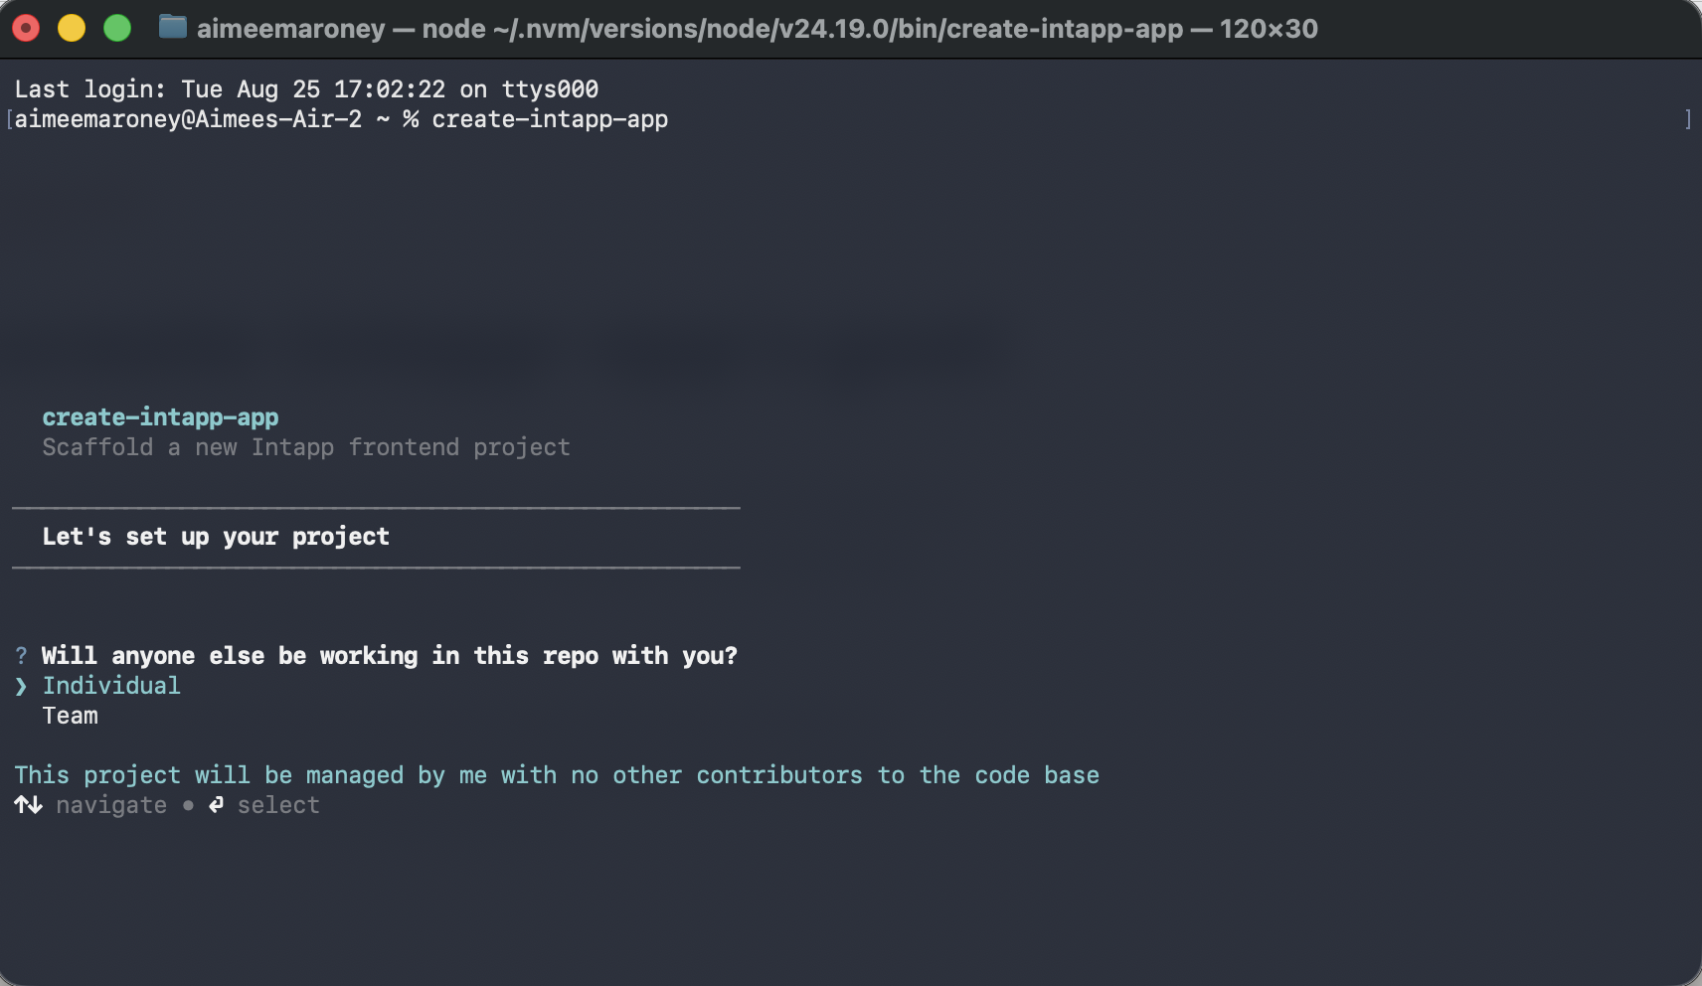
THE CASE
CLI goal
To give every Intapp designers, product managers, and AI agents a single, correctly configured starting point for delivering prototypes and feature designs.
Modeled on create-react-app and create-next-app, but built for Intapp's own infrastructure: the Uniform Design System, internal Artifactory registries, and Azure DevOps.

Slide 4
THE PROBLEM
Prototypes that didn't match the product
Designers and PMs reached for general-purpose AI prototyping tools that are fast, but blind to Intapp's design system.
Figma Make
Claude Design
Lovable
Generated screens with no concept of IDS components, tokens, or naming.
Fast, polished mockups — built entirely outside the codebase and component library.
Shipped working apps that looked plausible but used none of Uniform's components.
— Off-brand UI: Invented components, and spacing, color, and type that drifted from Uniform tokens.
— Nothing engineering could hand off as-is: Every prototype had to be rebuilt from scratch in code.
— No shared vocabulary between what design approved and what the codebase could actually ship.

Slide 5
THE RESEARCH
INTERVIEW THEMES
Interview.
Map.
Decide.
Designers default to Figma Make or Lovable. Fast iteration but no alignment with design system or access design system context
PMs want to test an idea without waiting on an engineering ticket.
Engineers have no connection to generated code. They have to recreate every design from scratch.
Lots of effort spent on prompting a way to a usable design. Tokens burned to get to a starting point.
Designers and PMs were interviewed first, about how they actually reached for a prototype today. Their answers became a user flow and a decision tree before a line of the CLI was written.

Slide 6
CASE STUDY
Scaffolding & Setup
The CLI flow, the four templates, and role-based recommendations
create-intapp-app · v1.0–2.0

Slide 7
HOW IT WORKS
Three phases, one scaffold
A guided interview replaces template-picker paralysis with a specific, reasoned recommendation.
01
Team & project
Solo or team, then a project name. If project already exists in Azure, it is flagged in the set-up and prompted for a new name
02
What you're building
Prototype or app, then which product (or Standalone) resolves to a recommended framework the prompt always lets you override.
03
Finishing touches
For apps: a layout template, optional Vitest, and — for a product repo — which Azure DevOps project it lives in.

Slide 8
THE WORKSHOP
Tested with the room, before it shipped
Before the flow was final, I walked the product design team through the CLI live in a workshop. Their feedback changed what it actually asks.
BEFORE — INITIAL DESIGN
AFTER — FROM WORKSHOP FEEDBACK
“What best describes
your role?”
“Will anyone else be
working in this repo
with you?”
Designer / UX · Product Manager
Engineer · Other / Exploring
Individual · Team
Cut after the workshop
Question 1 in src/interview.js today
Role didn't predict what the CLI needed to know. Solo vs. team does — it prefixes the project name for individual work and feeds the git and branching guidance later in the flow. Build type and product took over the recommendation itself.

Slide 9
THE DECISION TREE
What the CLI actually asks
The core recommendation logic from src/interview.js: Build type and product resolve to a default framework, which the prompt always lets you override.
React 18 (Vite) — recommended for Time, DealCloud prototypes
Prototype
Vanilla JS — recommended for prototypes, regardless of product.
What are you building?
Billstream · Compliance · Termsheet → Vanilla JS
App
Time · DealCloud · Standalone · Other Product → React 18
Celeste → Next.js (App Router)
Also asked, not pictured: solo vs. team, project name, layout template, Vitest, and (for product apps) the Azure DevOps project.

Slide 10
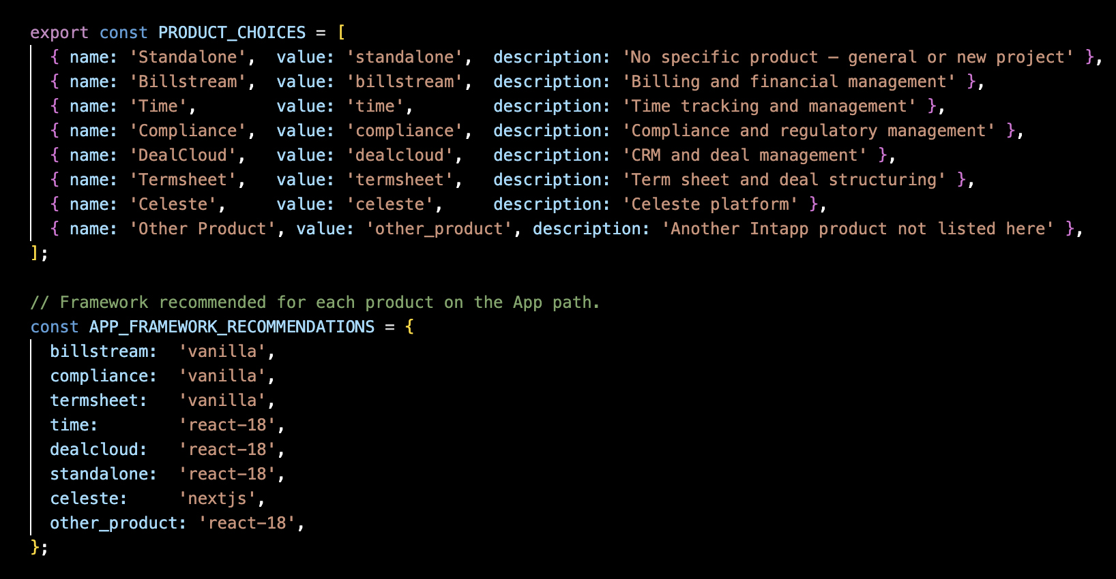
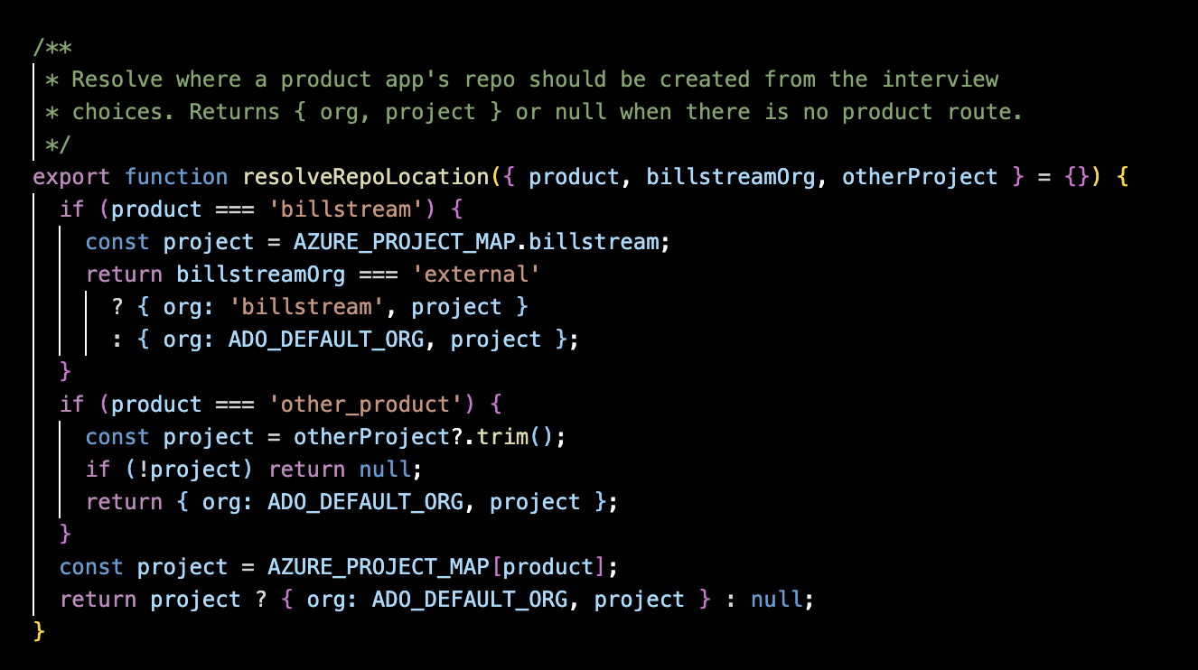
THE TEMPLATES
One CLI, four correct starting points
Every template ships with the design system, linting, pipeline creation, and AI context and skills

Slide 11
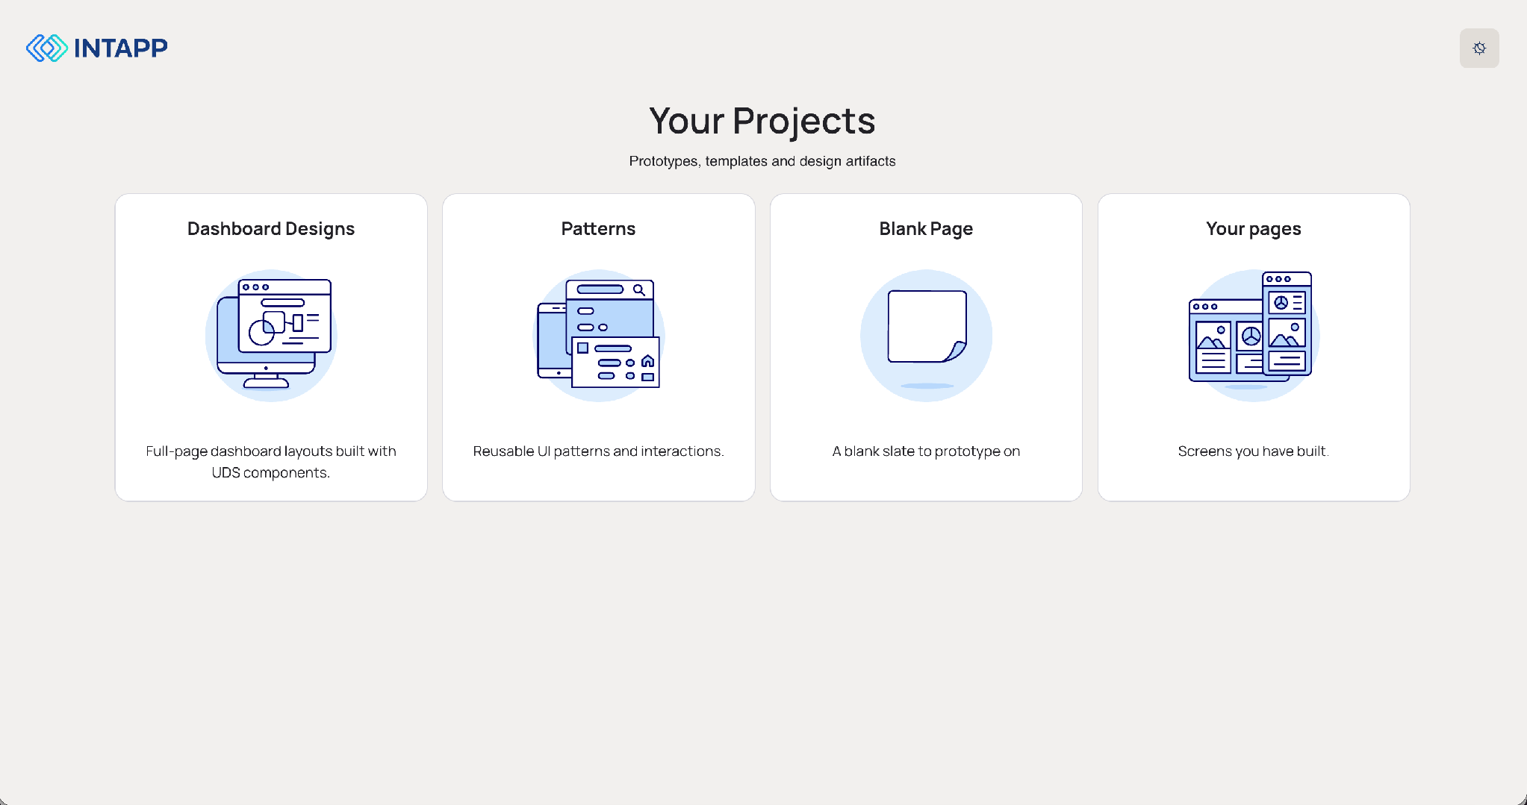
THE SCAFFOLD
Every project starts from the same home base each team
The landing page every scaffolded project ships with quick links into dashboard templates, the pattern library, a blank canvas, and a section for individuals can store their designs.

Slide 12
CASE STUDY
Architecture & AI Tooling
Enforcement, upgrades, and making the system legible to agents
create-intapp-app · v1.5–2.0

Slide 13
DESIGN-SYSTEM ENFORCEMENT
Four layers so agents can't invent UDS components
$ claude edit Button.jsx
✖ UDS violation blocked
Raw <button> element detected.
Use <UdsButton variant="primary">.
no-raw-interactive-elements
override: // ids-allow: <reason>
→ Agent self-corrects and retries
✔ UdsButton applied
— Priming: CLAUDE.md and .cursor/rules/ids.mdc instruct agents never to invent styles, components, or icons.
— PreToolUse hook: loads installed @uds/* manifests live, scans every Write/Edit, and blocks violations with structured remediation.
— Lint backstop: a custom ESLint plugin and Stylelint rules catch anything the hook misses: raw interactive elements, invalid icon names, hardcoded hex or px.
— Component-options skill: vague requests scaffold variants for review. Specific requests build directly.

Slide 14
KEEPING PROJECTS CURRENT
Updates that never clobber a user’s work
$ npx @ids/create-intapp-app upgrade
Comparing pristine → working copy
base: v1.9 pattern baseline
ours: v2.0 pattern (updated)
theirs: your edited copy
- import { Nav } from './old-nav'
+ import { Nav } from './nav-shell'
✔ 3 patterns merged, 0 conflicts
— Managed vs. owned: each template's shared.manifest.json declares which files are refreshed by upgrade and which stay untouched, always.
— Provenance + 3-way merge: patterns.lock.json tracks source, version, and a copy-time baseline, so updates merge into edited work instead of overwriting it.
— Opt-in restructuring: upgrade --adopt installs the newer nav harness into pre-2.0 prototypes without silently rewriting an entry file the designer customized.
— Dry runs: every upgrade path supports --dry-run to preview changes before anything is written.

Slide 15
2026
MAKING THE SYSTEM LEGIBLE TO AI
Not just documented for humans
AI coding tools started generating UI with zero knowledge of the system. The scaffold now primes every session before the first line of code is written.
— A trusted-channel steering doc (CLAUDE.md) carries behavioral guidance. The SessionStart hook emits facts only, so hardened agents never mistake project state for an injected instruction.
— A manage-patterns skill lets the agent adopt hand-built screens as nav pages, register reusable patterns, and review upstream updates always confirm-before-write.
$ npx @uds/create-intapp-app
✔ CLAUDE.md written
✔ .github/copilot-instructions.md written
✔ .cursor/rules/ids.mdc written
✔ PreToolUse UDS guard hook wired
SessionStart → facts only:
repo wired? pipeline registered?
git-email / Azure-CLI status
→ see CLAUDE.md for how to act

Slide 16
THE HANDOFF SKILL
Closing the loop, back to engineering
$ /handoff DES-1540
Fetching prototype via az … done
Scanning product repo … done
HANDOFF_PLAN.md
Already in product: UdsButton, UdsModal
To add: UdsTable, UdsTextArea
New token: --color-data-positive-default
Needs review: src/App.css:42 — non-UDS
✔ Plan written to product repo
Turns a designer's real, on-system prototype into a structured plan inside the engineer's own repo, no manual re-implementation.
— No clone needed: fetches the prototype straight from Azure DevOps using the engineer's existing az login, then scans the product repo for what's already there.
— Writes HANDOFF_PLAN.md: acceptance criteria from Jira, components already in product, components to add, new tokens introduced, and non-UDS code flagged for review.
— Same framework → a structured diff. Vanilla → React/Next.js → a mechanical translation, since both are generated from the same underlying components. React 18 ↔ 19 → adjusted imports and client boundaries.

Slide 17
IMPACT
Where create-intapp-app landed.
5
10
4 → 1
product teams building with it
product designers shipping features through it
setup paths unified into one CLI
— Shipping features to engineering faster, with less friction in the handoff.
— Fewer questions about design intention once work reaches engineering.
— 11 tagged releases, v1.0 → v2.0, in 3 months (Mar–Jun 2026).

Slide 18
ITERATION & NEXT STEPS
Where to take the CLI beyond v2
— Refine the hand-off skill and workshop with product managers, designers, engineers and leadership
— Expanding template and pattern offerings for each product
— Encourage cross-functional contribution to CLI
— Create an agent orchestration and documentation layer to understand at a glance what agents/skill/hooks exist and what their role is

Slide 19
Thank you
Aimee Maroney
Senior Design Engineer
aimee.maroney@gmail.com

