Slide 1
2026
PORTFOLIO
Aimee Maroney
Senior Design Engineer
aimee.maroney@gmail.com
aimeemaroney.work
Notes:
Open by naming the throughline: three years building a design system from zero to adopted-at-scale, spanning visual language, token architecture, framework-agnostic component infrastructure, and now AI tooling. Frame the talk as the shape of that work, not a tour of every slide.

Slide 2

ABOUT
I see every detail as part of a larger system. Making those connections visible and helping people understand them is what I enjoy most.
Interests: Drawing, photography, travel

Slide 3
BACKGROUND
My background
2013 – 2020
→
2020 – 2022
→
2022 – 2026
TCGPlayer (An Ebay Co)
Syracuse University
Intapp
Front End Developer
Full Stack Developer
UI Engineer → Engineering Lead
Consumer e-commerce & marketplace UI
Syracuse University design system and marketing platform tools
Uniform design system: visual language, tokens, component infrastructure, AI tooling
02

Slide 4
2026
Case Study
Uniform
Design Language & Foundations
Intapp 2022-2026

Slide 5
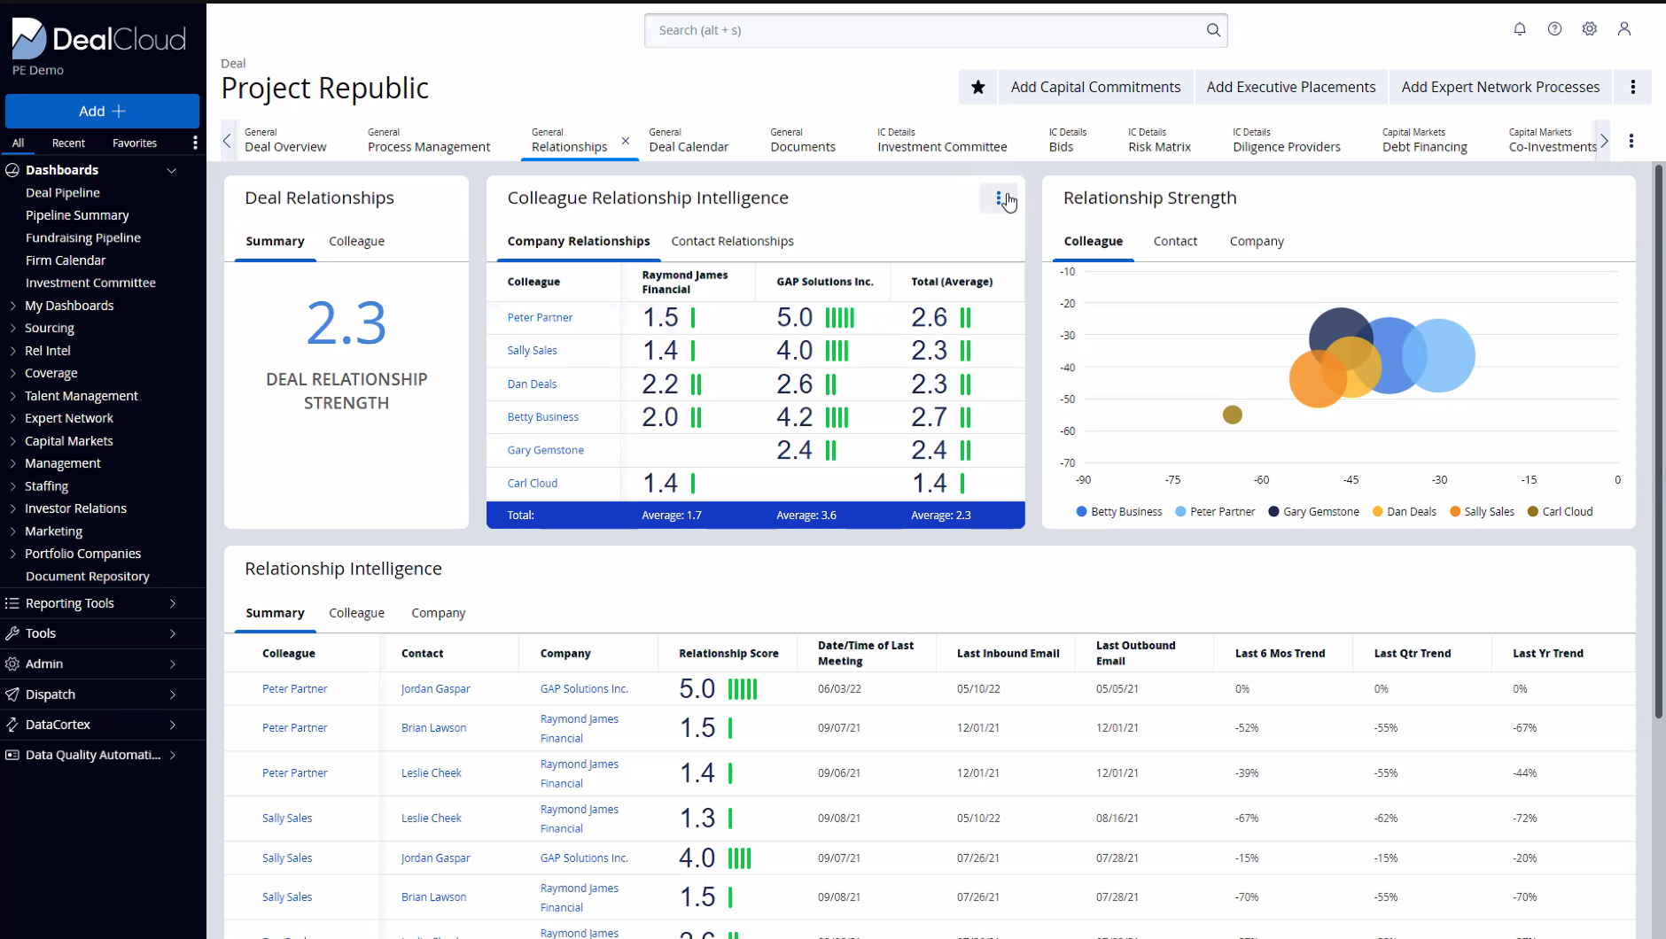
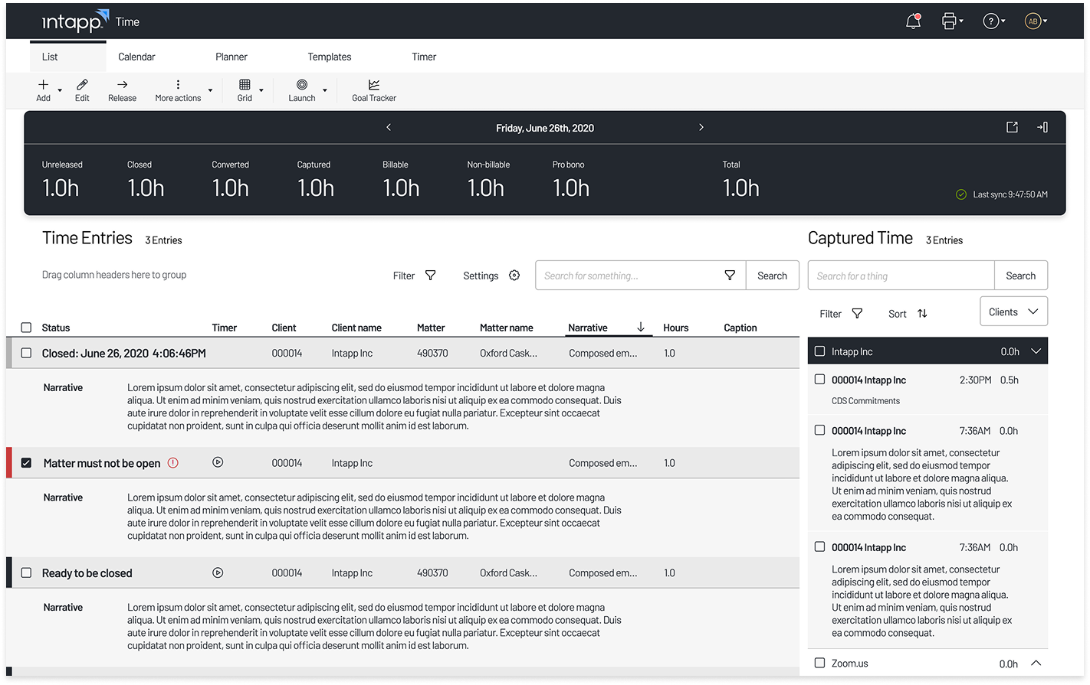
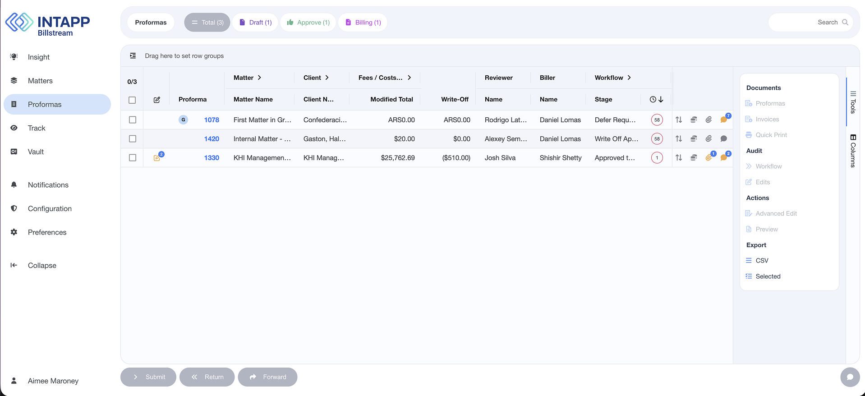
THE CASE
Intapp’s goal:
To unify Intapp’s product suite under one brand appearance and improve product experience.
03

Slide 6
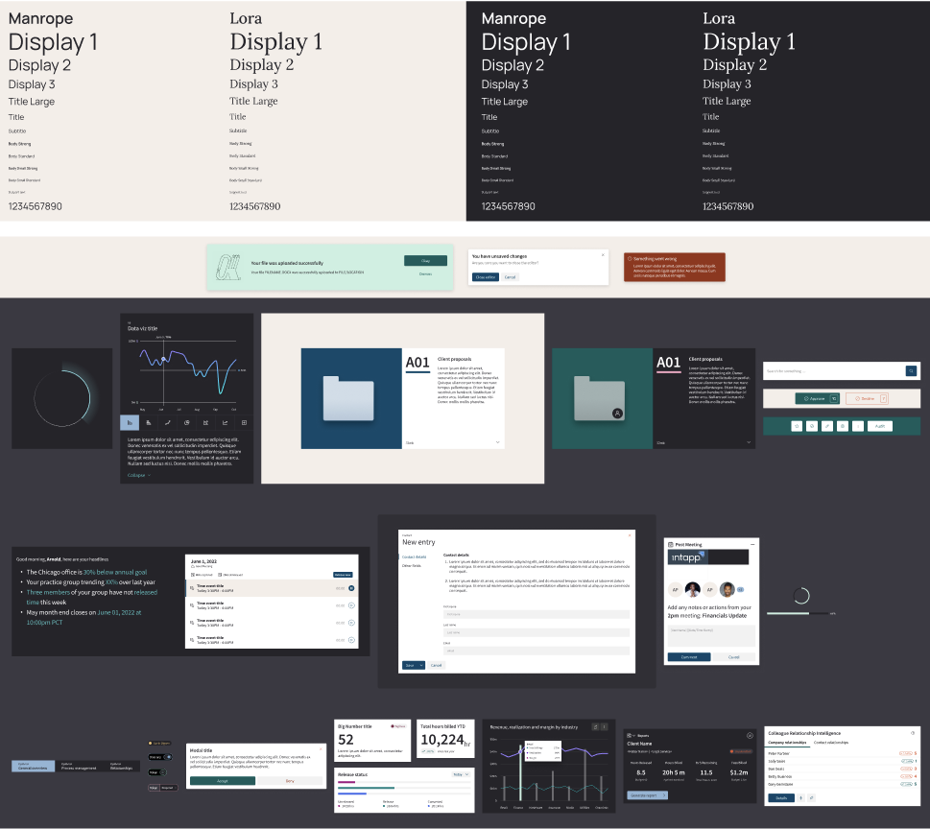
THE SCOPE
The Uniform team
TEAM
3 designers, 3 engineers, 1 director
MY ROLE
UI Engineering Lead, Design Systems
DUTIES
The bridge between design and engineering. Planning and scope of the design system. Design token architecture. AI tooling. Communicate strategic vision.
03

Slide 7
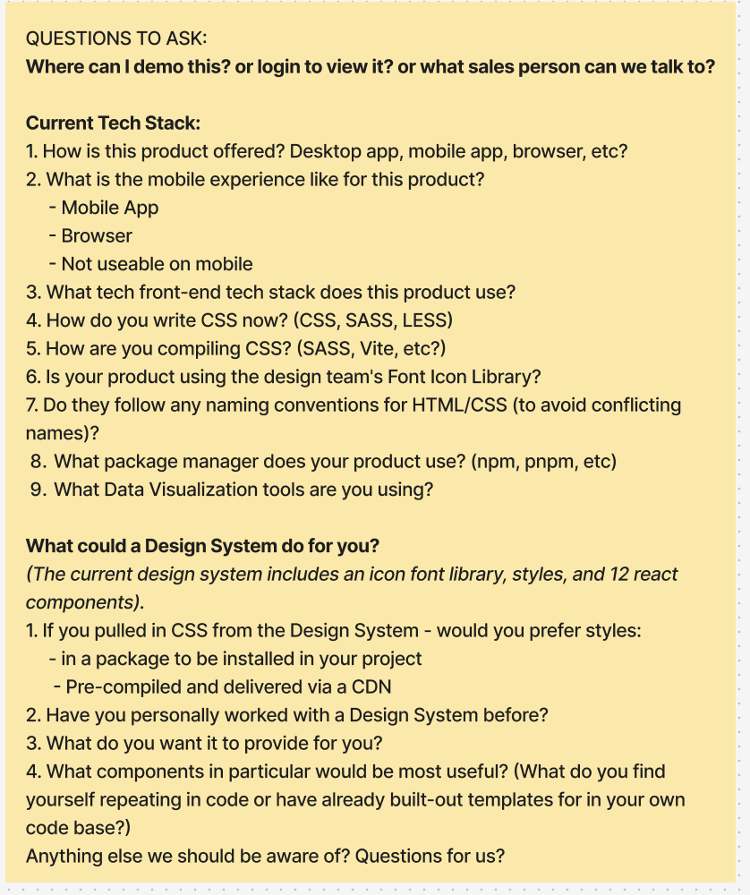
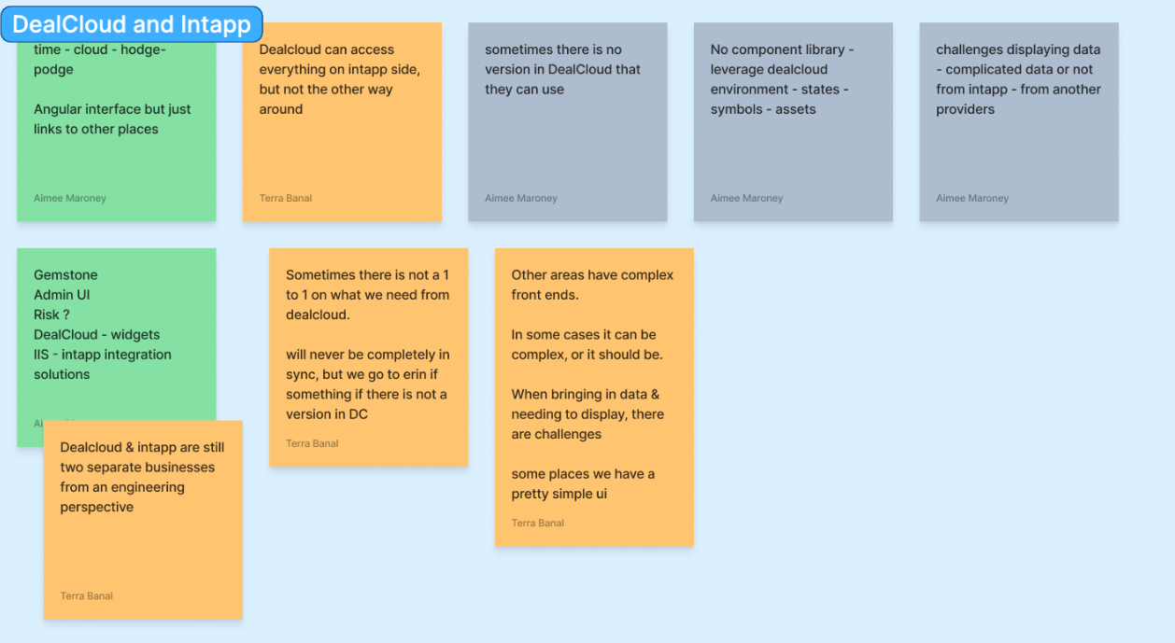
HOW I WORK
Understand.
Align.
Build.
03

Slide 8
THE PROBLEM
8 products. 6 stacks. No shared foundation
Every team inventing the same button. No shared governance or contribution model.
8
6
products
front-end frameworks — React, Angular, Next.js, React Native, .NET
15
0
button components, all slightly different
shared tokens or icon library
04

Slide 9
PRODUCT LANDSCAPE
One system, six front-end stacks
A framework-agnostic core was the only path to consistency that didn't ask every product team to rewrite their app.
01
DealCloud
React 17, custom CSS
05
Termsheet
Angular, Material UI
02
Time
React 18, Material UI
06
Celeste
Next.js, Tailwind
03
Billstream
Angular, PrimeNG
07
Mobile
React Native
04
Compliance
Angular, PrimeNG
08
Admin UIs
Mixed microservices
07

Slide 10
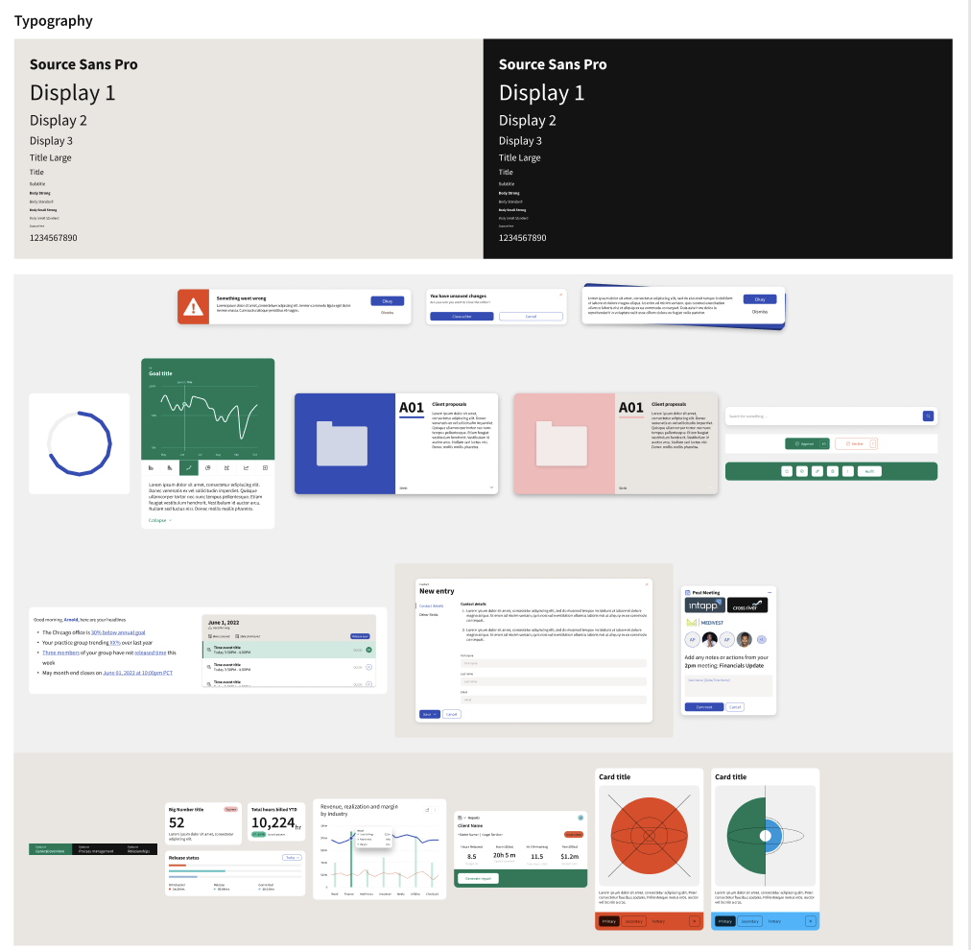
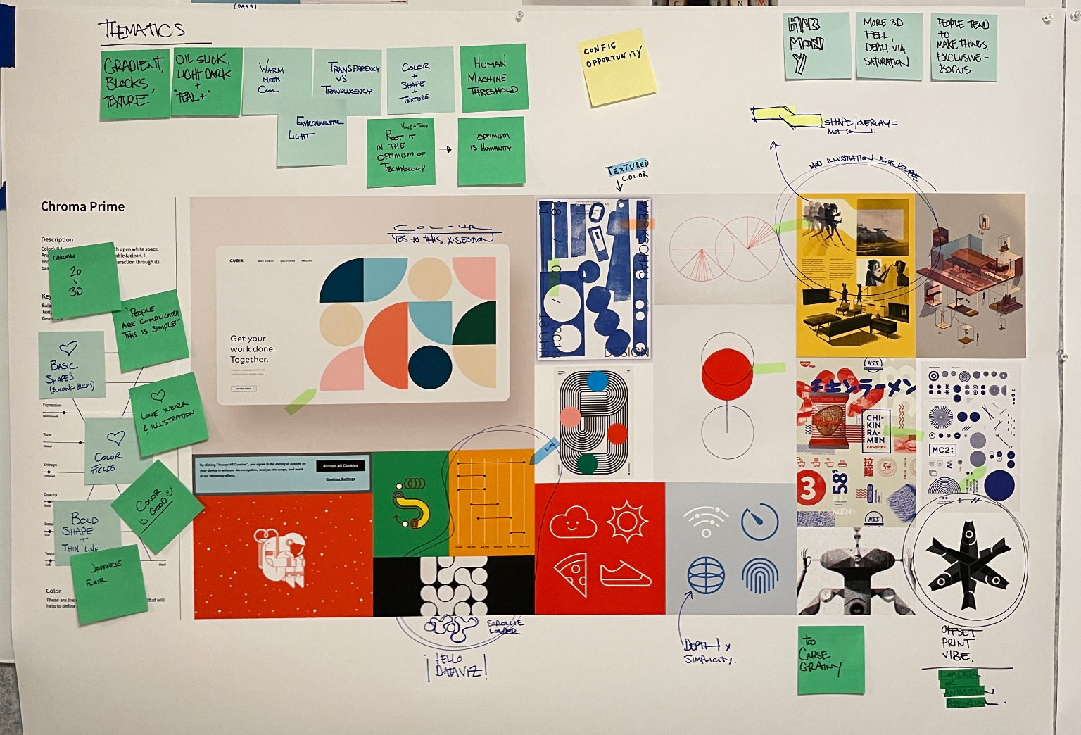
DESIGN EXPLORATION
Design Explorations
Explored three visual directions, presented to product and marketing, and user-tested with clients before committing.
05

Slide 11
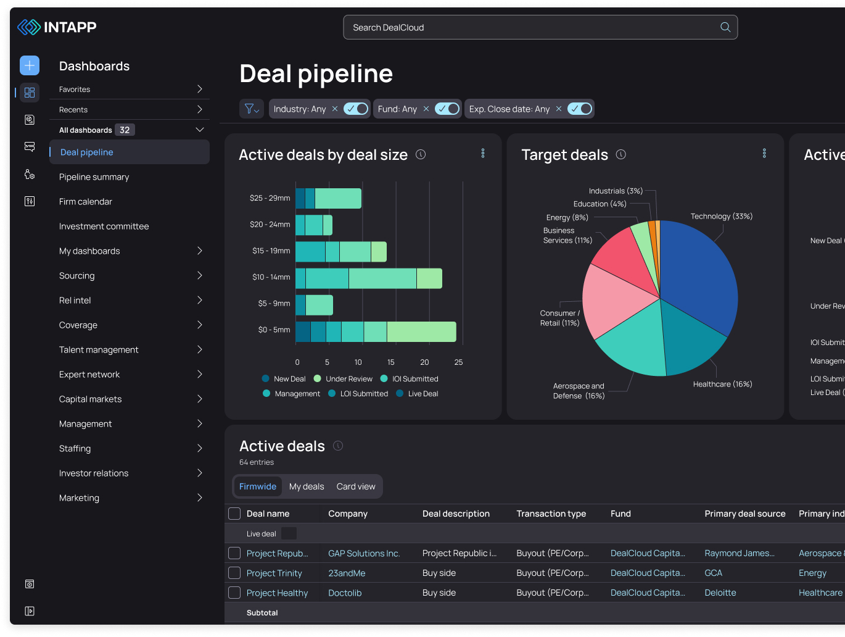
DESIGN LANGUAGE
One unified design language
The winner: “Uniform”, for uniformity, consistency, clarity.
05

Slide 12
Case Study
Uniform architecture
Tokens, components & AI
Intapp 2022-2026

Slide 13
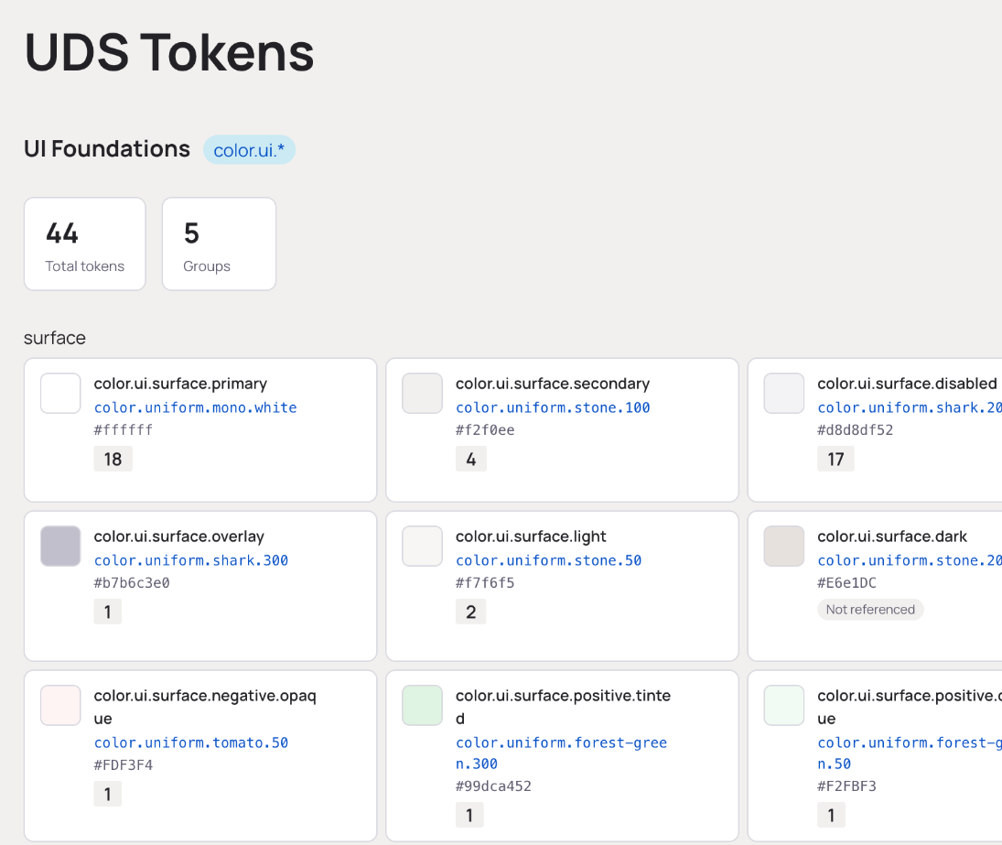
TOKEN ARCHITECTURE
Tokens as the single source of truth
— Three-layer architecture: Global (raw palette) → Theme (semantic decisions) → Mode (light/dark overrides). Mode files hold only the diff — no duplication.
— Managed in Figma via Token Studio, synced to a design branch, built through Style Dictionary into CSS, SCSS, and React Native outputs.
— Semantic naming keeps design and engineering in the same vocabulary — color-button-primary-surface-default, not blue-500.
— Dark mode is a data-attribute switch, not a rebuild: 1,783 tokens swap per mode, zero component code changes.
06
Notes:
This is the technical core of the talk — spend real time here. If they ask one follow-up question, it will likely be about this slide. Know the token pipeline cold: Token Studio -> Token Transformer -> Style Dictionary -> platform outputs.

Slide 14
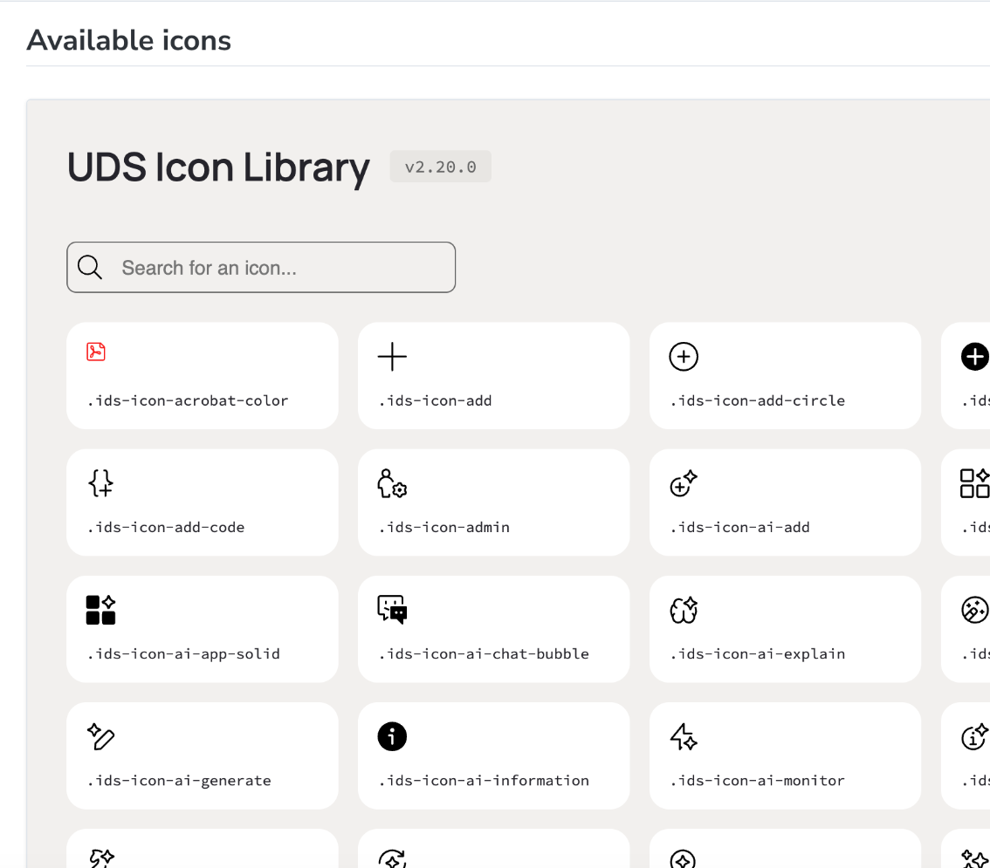
ICON LIBRARY
One icon library.
Every product.
A universal icon library distributed as a font, SVGs, and a React component library — the lowest-friction way for any team to start adopting Uniform.
06

Slide 15
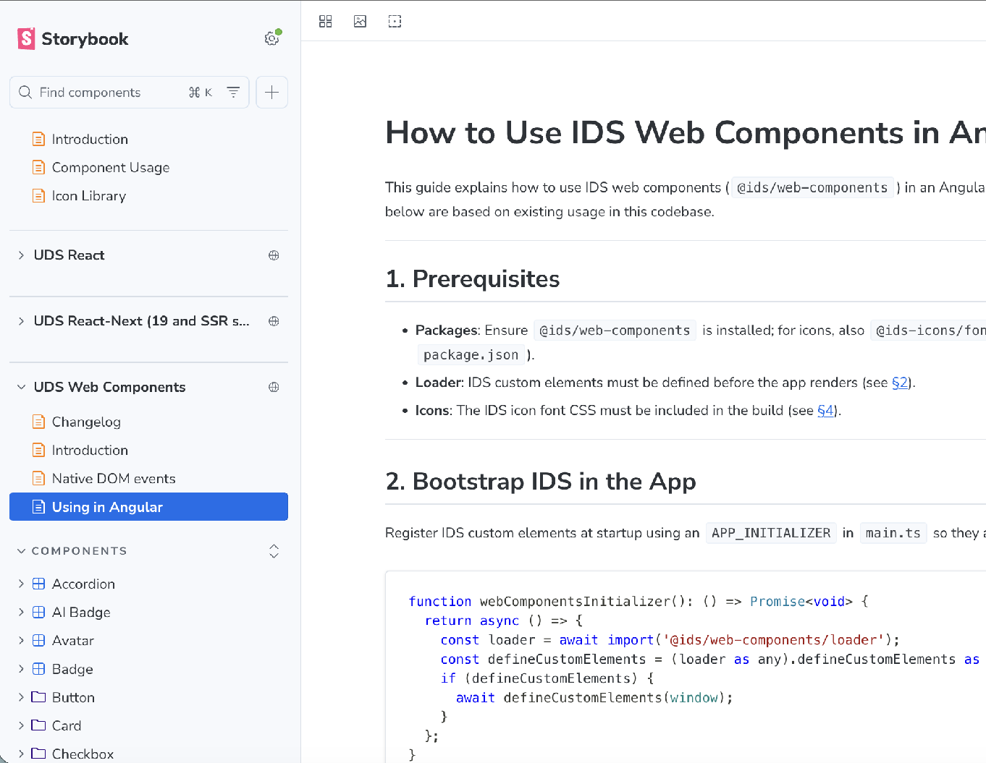
ARCHITECTURAL STRATEGY
Built once in Stencil, shipped everywhere
— Components authored once in Stencil, compiled to standards-based Web Components — the source of truth.
— Stencil auto-generates React, React 19/SSR, and framework-native wrappers from that single source, so consuming teams get their native format automatically.
— Five independently versioned npm packages in one monorepo: tokens, styles, web-components, react, react-next.
— Quality gates on every build: documented props, full unit + E2E suites, and Chromatic visual regression before anything ships.
08

Slide 16
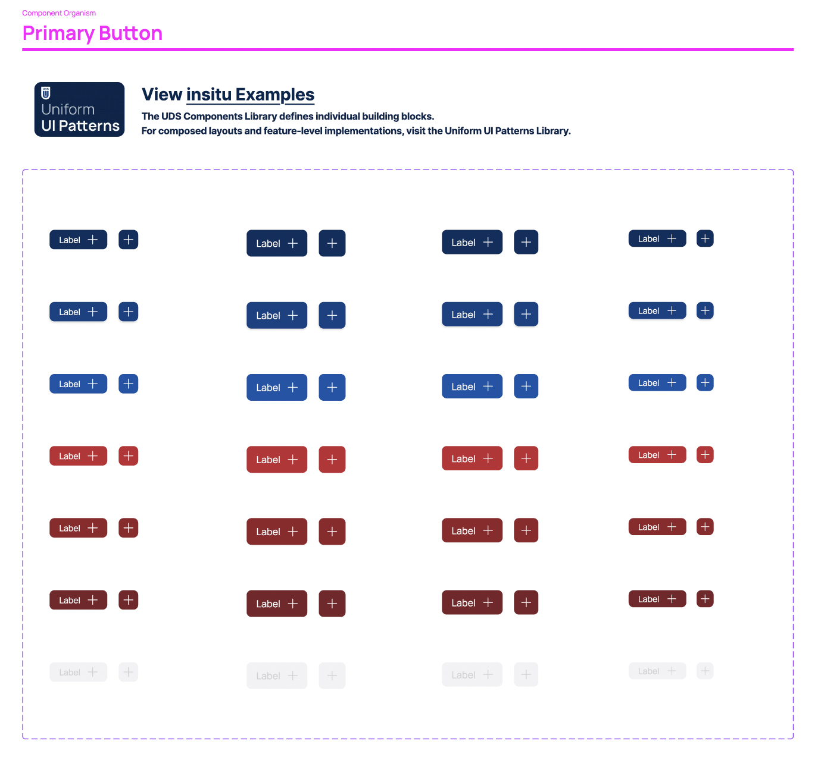
COMPONENT LIBRARY
32 components.
3 libraries.
All products served.
Every component ships from the same framework-agnostic source — no adapters, no duplicated logic, no version drift between a React team and an Angular team.
08

Slide 17
ADOPTION
Meet teams where they are.
No single migration path. We reviewed each team's codebase and roadmap and built a custom plan.
01
02
03
Icons first
Tokens & CSS
Components
Zero conflicting dependencies. Immediate, visible improvement.
Map existing variables to system tokens. Brand alignment at minimal migration cost.
Replace one component at a time as teams have capacity. No big-bang rewrite.
Weekly office hours · Dedicated Slack channel · Direct engineering embeds
09

Slide 18
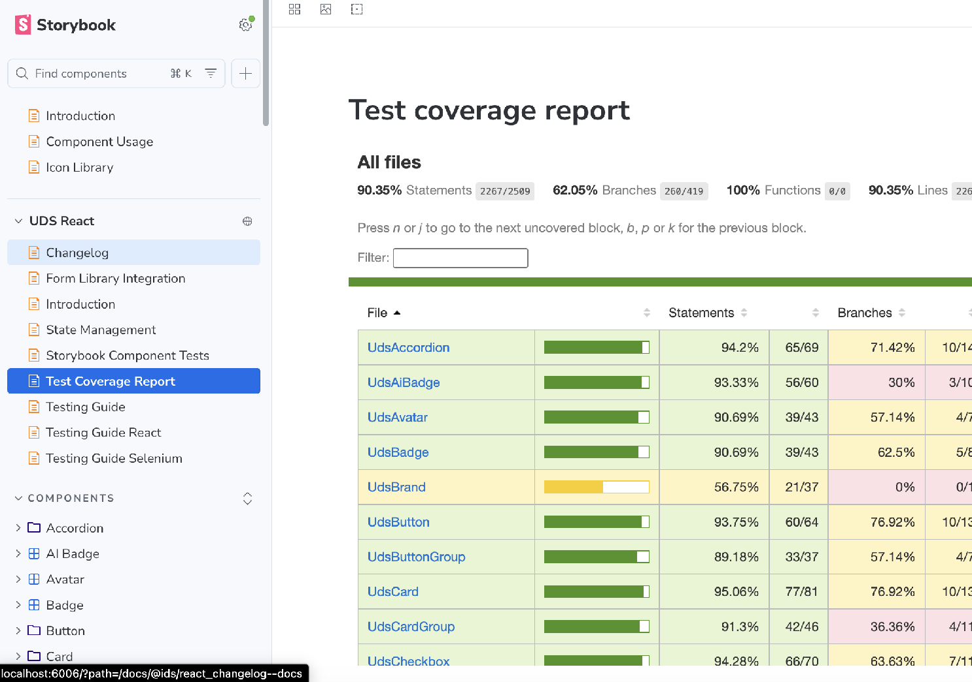
SYSTEM MATURITY
Maturity measured, not assumed
— Design documentation lives in Zeroheight, kept in sync with Storybook so guidance and live code always point to the same source of truth.
— Stencil generates component API docs directly from source — a build fails if a prop is undocumented, so docs can never drift from implementation.
— Chromatic runs visual regression testing on every push against approved baselines.
— Every build is gated on prop documentation, full unit and E2E suites, and changelog updates before it can ship.
10

Slide 19
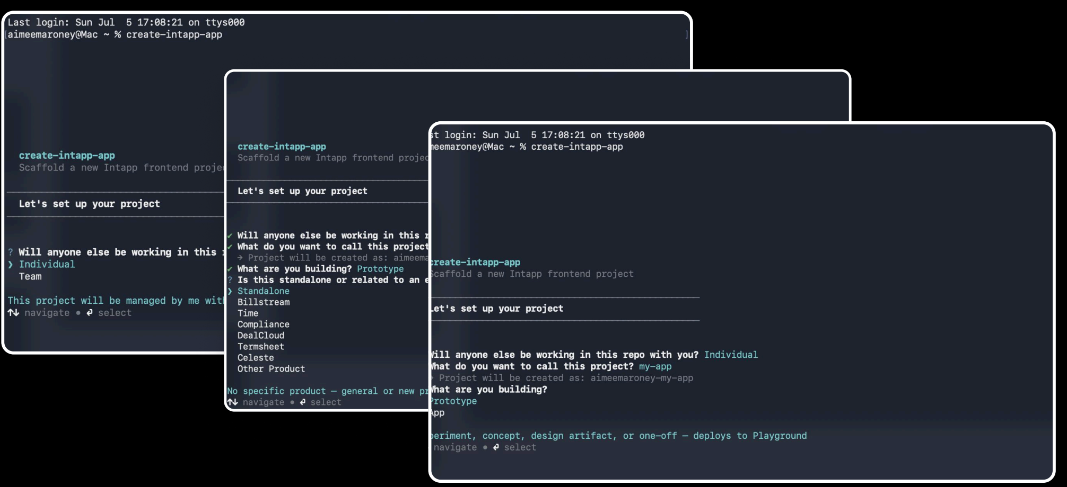
2026
Making the system legible to AI and humans
AI coding tools started generating UI with zero knowledge of the system and design drift accelerated because the system existed but AI couldn't see it.
— Claude Code usage primers shipped with every package, giving AI assistants accurate, system-specific context instead of generic web knowledge.
— A Figma MCP integration scopes AI-generated design suggestions to the system, keeping output on-brand automatically.
— A CLI scaffolds new projects with the system pre-wired — tokens, components, CI/CD, linting — so teams stop rebuilding the same infrastructure.
— A Slack assistant, trained on system docs, answers any designer, PM, or engineer's questions directly.
11

Slide 20
IMPACT
Where Uniform landed.
8 → 1
5
3 yrs
products unified
npm packages
sustained build
— 8 products sharing one unified visual language.
— 6 front-end frameworks unified behind one component API.
— Accessibility inherited by every adopting team.
— AI-ready infrastructure — documented for humans and agents alike.
12

Slide 21
Thank you
Aimee Maroney
Senior Design Technologist
aimee.maroney@gmail.com

